Slide 1
Fall 2021 AP CS A
Lesson 16.4
Dr. O’Brien
Herbert H. Lehman High School
13 January 2022

Slide 2
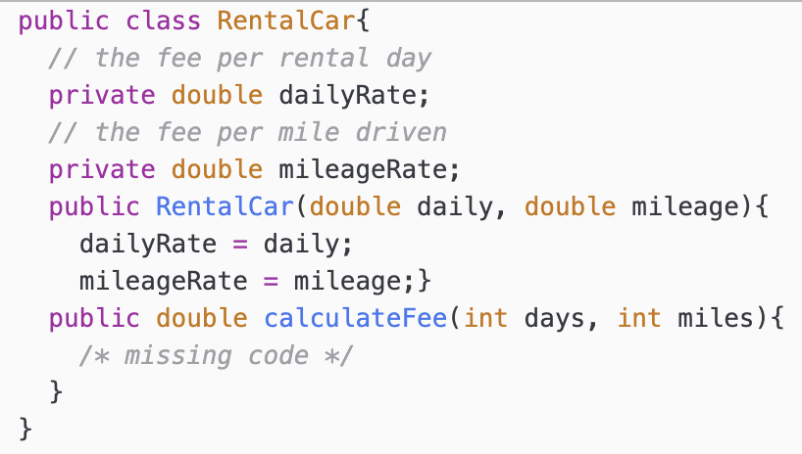
Do now
be sure to: Get out your binder. Copy goal and answer do now questions below. Then (i) select an answer for the problem below, and (ii) justify your answer in a complete sentence:
The calculateFee method is intended to calculate the total fee for renting a car. The total fee is equal to the number of days of the rental, days, times the daily rental rate plus the number of miles driven, miles, times the per mile rate.
Which of the following code segments should replace /* missing code */ so that the calculateFee method will work as intended?
return dailyRate + mileageRate;
return (daily * dailyRate) + (mileage * mileageRate);
return (daily * days) + (mileage * miles);
return (days * dailyRate) + (miles * mileageRate);
return (days + miles) * (dailyRate + mileageRate);
Notes:
Answer B.
The smallest possible value of n is 0, which will return the initial character. This rules out A, D, and E. If n = str.length(), where str = “ABCDE”, n will be 5. substring(5, 5+1) will return an array index out of bounds exception, because there is no character w/ an index of 5.
+how does substring(n,n+1) work? Look at your java quick reference!!!

Slide 3
framing
what: define behaviors of a class w/ static methods
why: Static methods allow us to define behaviors that are specific to an entire class, instead of one object.
where to: Scope and access in classes

Slide 4
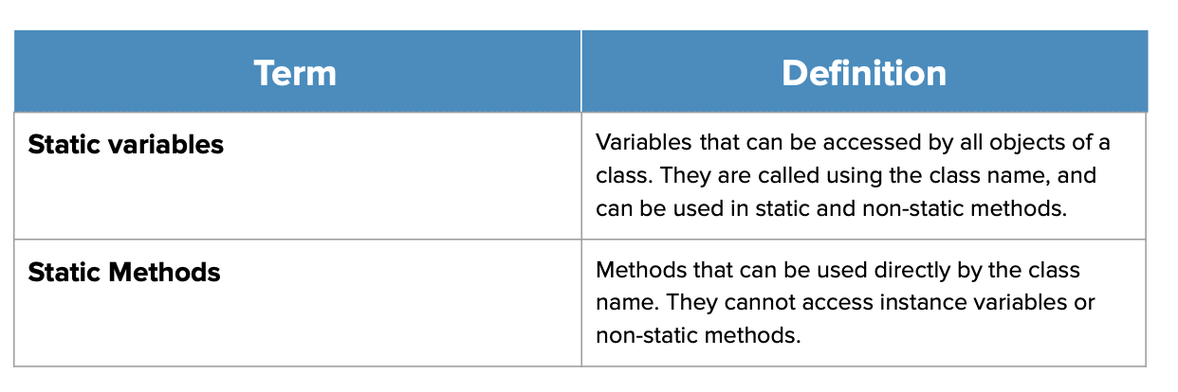
Vocab
be sure to: Keep your notebook open. These should be in your notes already! If not, copy the definition in your notebook.

Slide 5
Coding to learn: live coding
be sure to: Log in to Workstation. Open Counting LehmanStudents activity under In-class examples on CodeHS. Follow along, but try to stay one step ahead!
What do we expect getNumStudents() to return?
What goes wrong if we define a regular getter method for numStudents?
How are static methods different from other sorts of methods?
Where have we already seen some static methods?
Notes:
+What do we expect getNumStudents() to return? 2, because we have two student object.
+What goes wrong if we define a regular getter method for numStudents? It’s associated with one object, so it can only print out 1.
+How are static methods different from other sorts of methods? Static methods are associated with an entire class, so they return the same info
regardless of objects.
+ Where have we already seen some static methods? Math methods. This makes sense because, e.g. Math.sqrt() doesn’t depend on a specific number, the operation is always the same.
FULLY WORKED OUT CODE:
public class RentalCar{
// the fee per rental day
private double dailyRate;
// the fee per mile driven
private double mileageRate;
public RentalCar(double daily, double mileage){
dailyRate = daily;
mileageRate = mileage;}
public double calculateFee(int days, int miles){
/* missing code */
}
}
public class LehmanStudent {
//instance variables
private String firstName;
private String lastName;
private int grade;
private String osis;
private static int numStudents = 0;
//constructor
public LehmanStudent(String fname, String lname, int g, String o){
firstName = fname;
lastName = lname;
grade = g;
osis = o;
numStudents++;
}
//methods
public String getFirstName(){
return firstName;
}
public String getlastName(){
return lastName;
}
public int getGrade(){
return grade;
}
public String getOsis(){
return osis;
}
public void setFirstName(String newFn){
firstName = newFn;
}
public String getlastName(String newLn){
return lastName = newLn;
}
public int getGrade(int newGrade){
return grade = newGrade;
}
public String getOsis(String newOs){
return osis = newOs;
}
//remove before posting to CodeHS
public static int getNumStudents(){
return numStudents;
}
public String toString(){
String output = "Name: " + firstName + " " + lastName + "\n";
output += "Grade: " + grade + "\n";
output += "OSIS: " + osis + "\n";
return output;
}
}

Slide 6
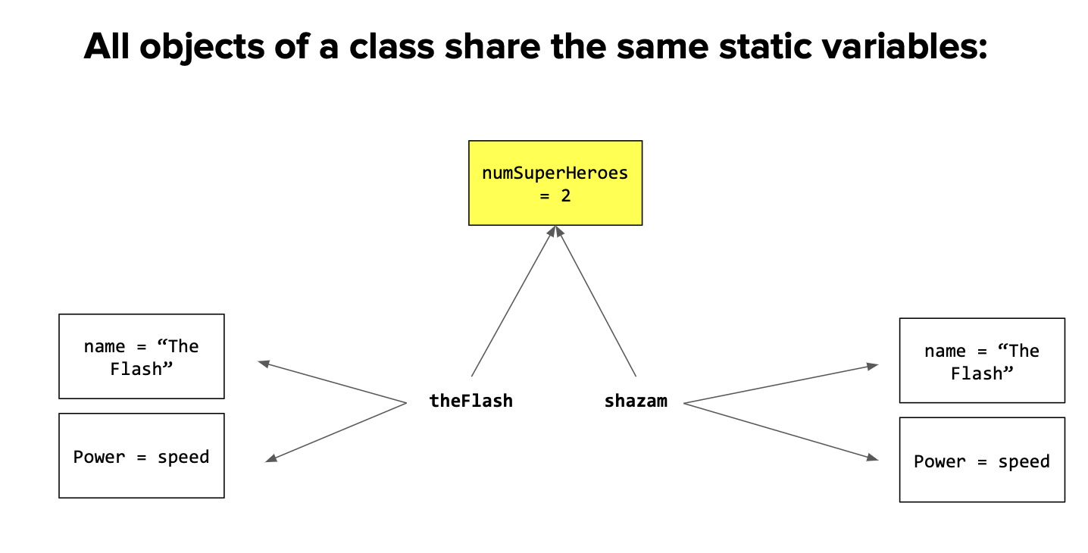
Notes:
As opposed to the instance variables, which are exclusive to the reference, static variables are shared across all objects. We can see here that while theFlash and shazam have their own name and Power values, they both share the static variable numSuperHeroes.

Slide 7
Coding to lean: Independent work
Remain your workstation. Read BSTs below.
be sure to:
Work on following problems in CodeHS:
5.375: Randomizer Class
5.7.6: Rock, Paper, Scissors
5.3.7 How many players in the game?
If you have a question, ask!
complete any remaining assignment for homework!
Notes:
See solution references at: https://codehs.com/lms/assignment/55325744/lesson_plan?section_id=256470
Pre-planned Qs for 5.7.5:
+how does the nextInt(min, max) method work? The formula for creating a random number is (Math.random() * range) + min. In order to get the correct numbers for this, students should find the range by subtracting the min range from the max. Then, use the min as the minimum value in the Math.Random formula to create the correct range.
Pre-planned Qs for 5.7.6:
+How can I tell who won? Students will have to create the getWinner method with a series of scenarios for who should win. Essentially, this method should test what the computer put compared to the user. Students should use .equals to compare the responses to determine which player has won.
Pre-planned Qs for 5.7.7:
+Where should I be using the instance variable? +When a new team is created, totalTeams should increase by one. Both variables will be needed to complete the comparison in tournamentReady.
+How do I implement tournamentReady? The tournament is ready to proceed if the total number of teams signed up is at least minTeams. Compare the two static variables and return the result of the comparison.

Slide 8
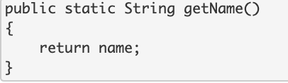
Reflection & wrapping up
be sure to:
Get out your notebook. Answer the questions below with a complete sentence for each:
What makes static methods and variables different from other sorts of constructs?
What will happen if the method below is run? Why?
Be prepared to share out!
Notes:
a. answer: Static variables belong to a class, and all objects of the class share a single static variable.
b. An error will be thrown because a static method cannot access instance variables.

