Slide 1
Fall 2021 Java
Lesson 9.1
Dr. O’Brien
Herbert H. Lehman High School
November 15, 2021
Notes:
VOCAB:

Slide 2
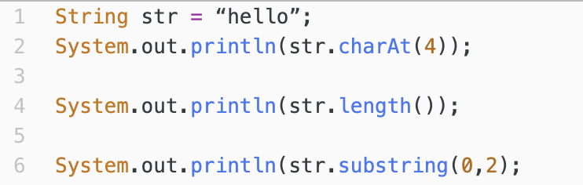
do now
be sure to: Get out your binder. Copy goal and answer do now questions below. Show all work or write a complete sentence for each answer:
Get out your Java Reference Sheet. Examine the code to the right.
Describe the output of lines 2, 4, and 6. Explain how you know.
How do you think it could be useful to be able to access substrings within a string?
Notes:
1. What will be printed as a result of this program? Why?
”o” will be printed since it is at the fourth index in the String.
What will be printed if we add the command System.out.println(str.length());? Why?
5 will be printed since there are five characters in the
String.
What will be printed if we add the command System.out.println(str.substring(0,2);? Why?
The characters from index 0 (inclusive) to index 2 (exclusive) will be printed: he?
2. Answers will vary. We might want to extract specific information. e.g. if we want to construct a student user name we’d want to extract the first letter of the first name, etc.

Slide 3
framing
what: use for loops to traverse a string?
why: This will provide us with a powerful set of tools to manipulate strings.
where to: Practice building algorithms that manipulate strings.

Slide 4
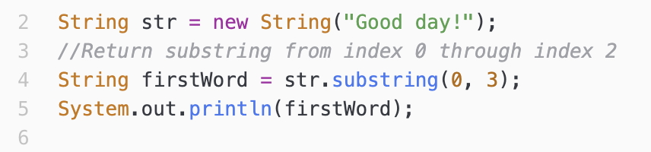
Warm up: Writing to learn
be sure to: Keep your notebook open. Answer each question below with a complete sentence.
What will this program print out? Explain how you know
Notes:
“Goo”. See next Slide for details

Slide 5
Warm up: Substring review
be sure to: Keep your notebook open. Answer each question below with a complete sentence.
Strings are sequence of characters
Each character in a string has an index.
0 | 1 | 2 | 3 | 4 | 5 | 6 | 7 | 8
G | o | o | d |  | d | a | y | !
⎨
Characters 0-2
Notes:
“Goo”. See next Slide for details

Slide 6
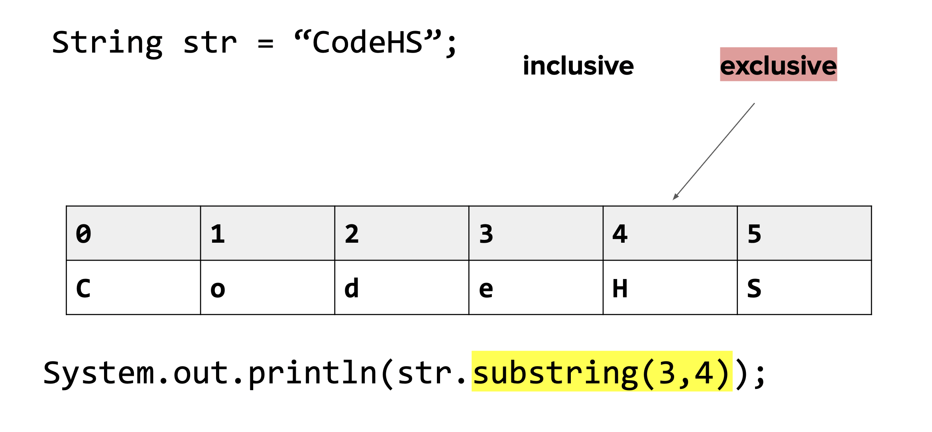
Warm up: Substring review
be sure to: Keep your notebook open. Answer each question below with a complete sentence.
Characters 0-2
Notes:
“Goo”. See next Slide for details

Slide 7
Vocab
be sure to: Keep your notebook open. Copy each definition, including the code sample, in your Java Glossary.
Traversal
The process of going through a string one character at a time, often using loops.
Notes:
copy in notes

Slide 8
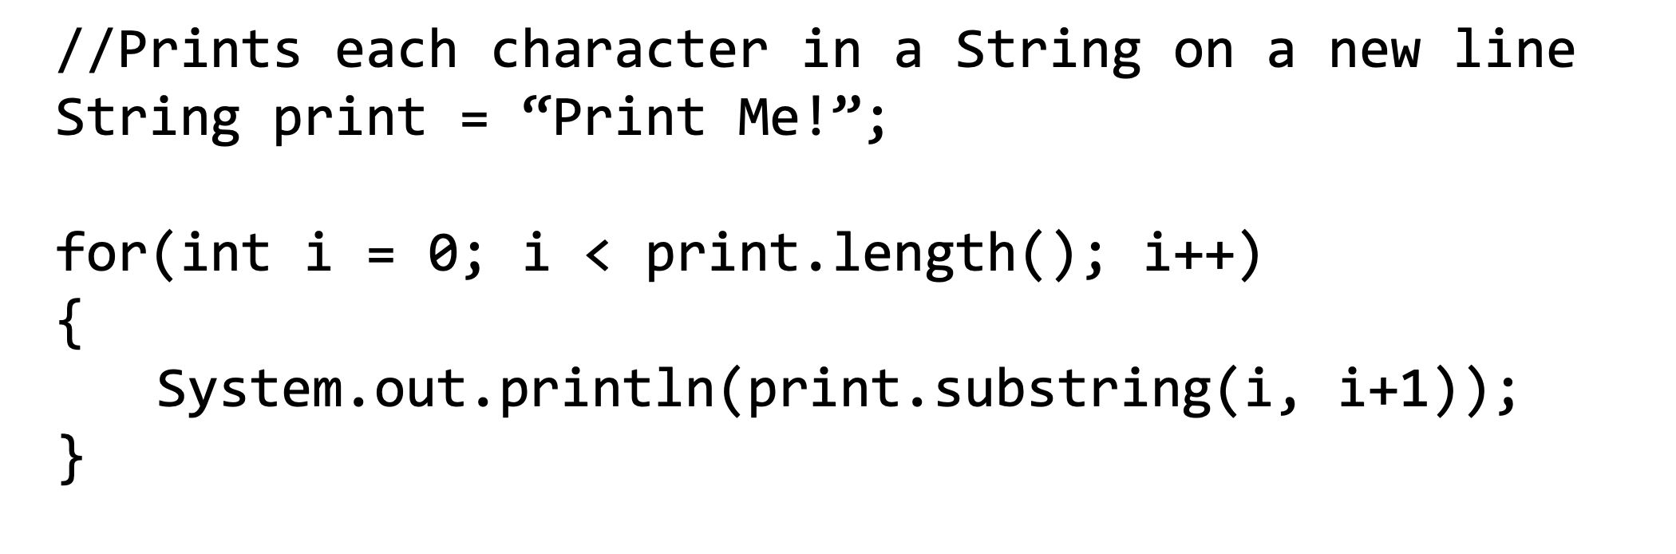
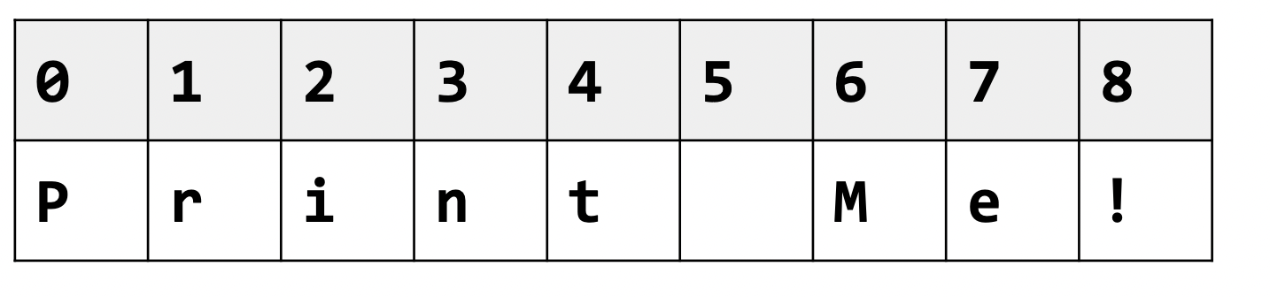
Writing to learn: Code Tracing
be sure to: Keep your notebook open. Make a column for code tracing.
Notes:
On board: What will this code print out?
make table on board: columns: i, i+1, print.substring(i,i+1)
print. length = 0;
+HDW know that print.length = 9 and not 8? Because it’s counting the number of characters not the max index value.
i=0 | i+1 = 1 | P
1 | 2 | r
…
i=8; i+1 = 9; !

Slide 9
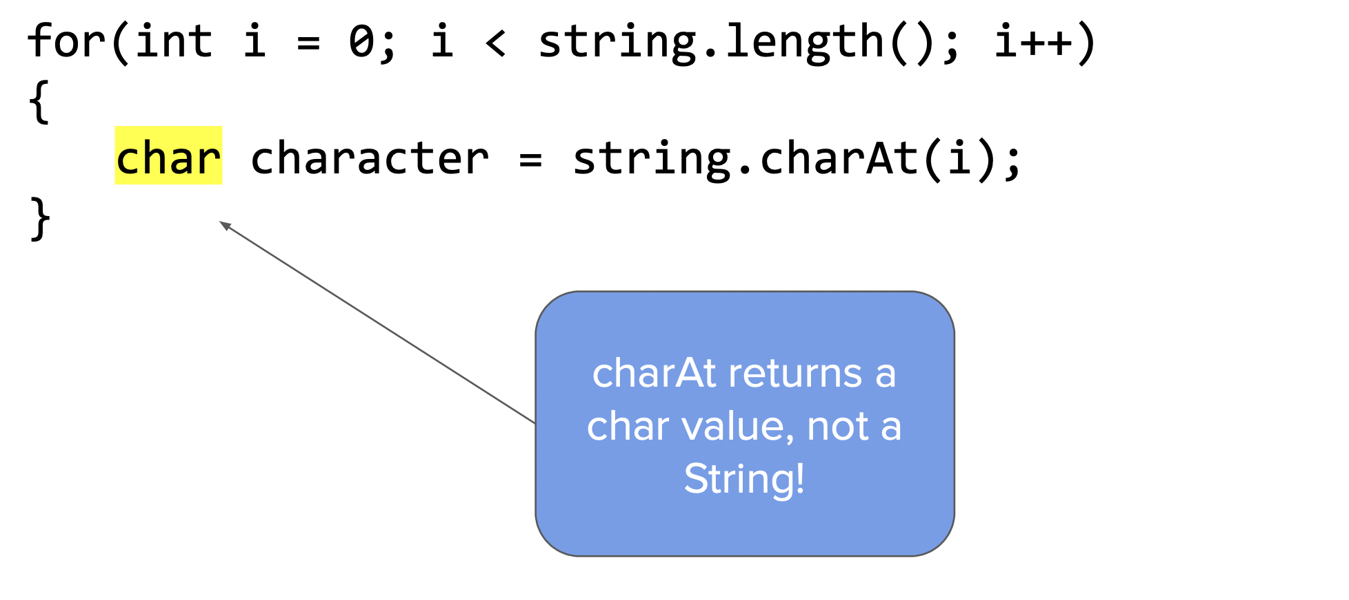
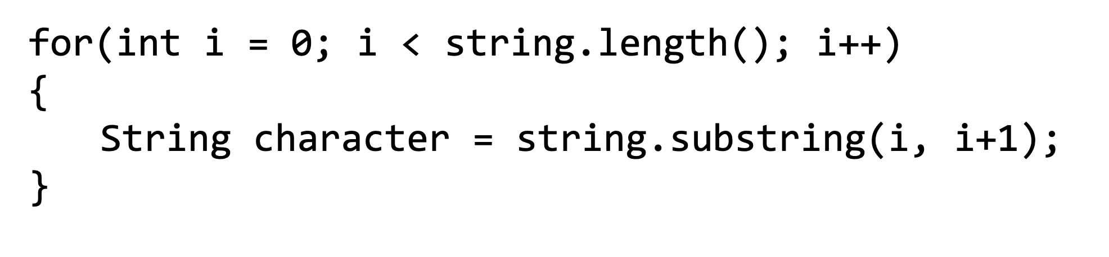
Vocab
be sure to: Keep your notebook open. Copy each definition, including the code sample, in your Java Glossary.
General formula for traversing a String string
The process of going through a string one character at a time, often using loops.
Traversal
The process of going through a string one character at a time, often using loops.
string.charAt(int index)
Another way to accessing individual characters in a string
Notes:
copy in notes

Slide 10
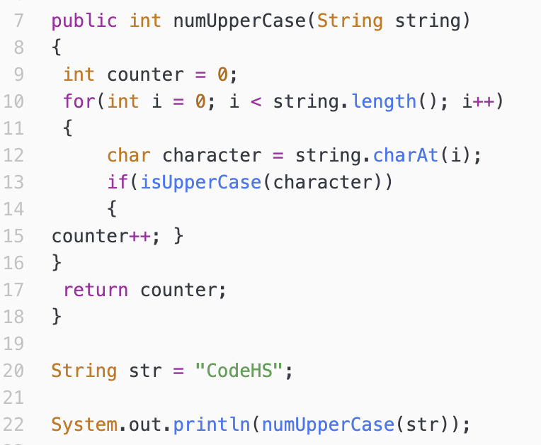
Writing to learn: Code Tracing
be sure to: Keep your notebook open. Make a column for code tracing.
Notes:
make table :
| i | character | isUpperCase | string.length | counter
|- | - | - | 6 | 0
|0| “C” | true | 6 | 1
|1| “o” | false | ‘’ | 1
|2| “d” | false | ‘’ | 1
|3| “e” | false | ‘’ | 1
|4| “H” | true | ‘’ | 2
|1| “S” | true | ‘’ | 3
return 3

Slide 11
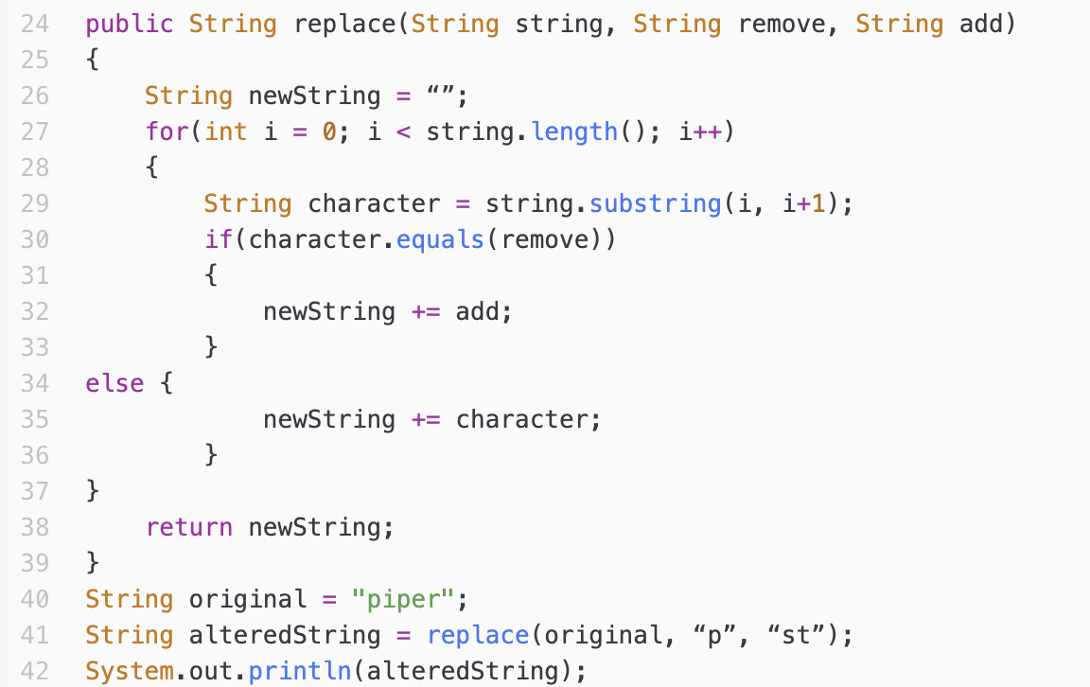
Writing to learn: Code Tracing
be sure to: Keep your notebook open. Make a column for code tracing.
Notes:
string. length = 5
original = piper
remove = “p”
add = “st”
| i | character | newString
| - | - | “”
| 0 | “p” | “st”
| 1 | “i” | “sti”
| 2 | “p” | “stist”
| 3 | “e” | “stiste”
| 4 | “r” | “stister”

Slide 12
Reflection: Thinking about thinking
be sure to: Answer each question below with a complete sentence.
Why is it useful to apply loops to strings?
Do you think the algorithms we’ve learned about today can only work in Java? Or are the applicable for other programming languages? Explain why or why not
Notes:
Strings are sequences of characters. This sequence can be traversed with a for loop. We can traverse a string and perform various operations on individual characters.
Loops strings and characters appear in most other languages, including python. so these algorithms are not Java specific.

