Slide 1
Fall 2021 Java
Lesson 9.5
Dr. O’Brien
Herbert H. Lehman High School
November 9, 2021
Notes:
VOCAB:
nested loop

Slide 2
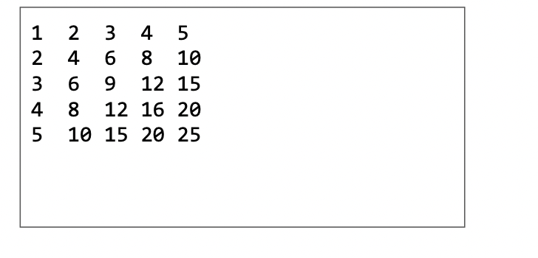
do now
be sure to: Get out your binder. Copy goal and answer do now questions below. Show all work or write a complete sentence for each answer:
Examine the table to the right.
What patterns do you notice in this table? Identify at least two. Be as explicit as possible.
How could you devise an algorithm to print out this table?
Notes:
DRAW TABLE BEFORE CLASS.
The first row increments by 1, the second row by 2, and so on. The first column increments by 1, and so on.
The “brute force solution” involves making a separate for loop for each row, changing the initial state of the counter, the increment and so on. But we can also observe that this table is equivalent to… (1 2 3 4 5) X 1 (1 2 3 4 5) X 2 (1 2 3 4 5) X 3 (1 2 3 4 5) X 4 (1 2 3 4 5) X 5 Believe it or not, this actually suggests a much simpler way to solve our problem.

Slide 3
do now
be sure to: Get out your binder. Copy goal and answer do now questions below. Show all work or write a complete sentence for each answer:
As we develop more sophisticated algorithms, and tackle more complex problems, you’ll find it very convenient to make a plan before you start coding!!!
Notes:
You could go through a string and check if each character is a number or a letter.
for char in string: if char is not letter and char is not number: return false return true

Slide 4
framing
what: implement nested string algorithms in Java
why: Nested algorithms add to our toolkit, but also make programs more complex.
where to: Informal computational analysis

Slide 5
Vocab
be sure to: Keep your notebook open. Copy each definition, in your Java Glossary.
nesting
Embedding one structure (e.g. a loop) inside of another one
Notes:
+Why do you think it’s called nesting? because one is placed inside of the other?

Slide 6
Coding to learn: preplanning
be sure to: Keep your notebook out. Write out your algorithm in pseudocode.
Describe the task in one sentence.
How do you print out the first line?
How do you print out the second line
How could you write your algorithm in pseudocode?
Notes:
Make a table of numbers with five columns where the numbers in each row are a multiple of the top row.
Make a string and add 1 + 2. + 3 +4 +5. A loop could be useful with this.
Multiple each number by 2.
for each number i in 1-5:
for each number j in 1-5:
add i*j to column

Slide 7
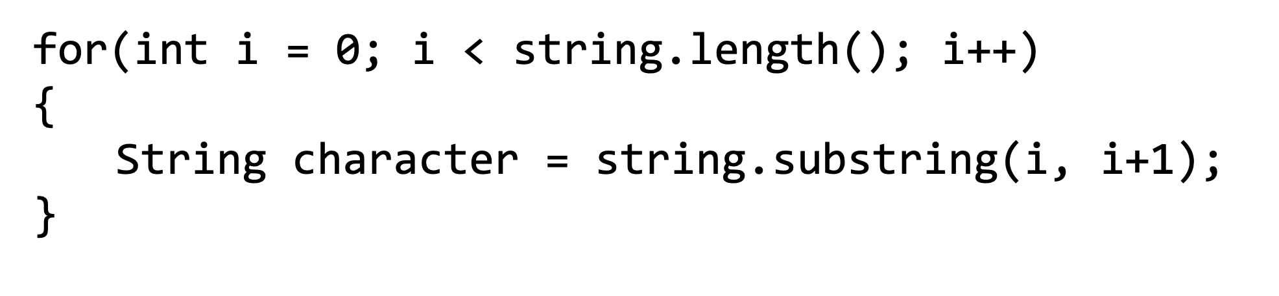
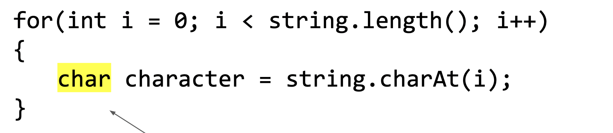
Coding to learn: live coding
be sure to: Log in to Workstation. In CodeHS, navigate to Nov. 19 Nested Loops under In class Examples. Follow along with Dr. O’Brien
General formula for traversing a String string
nesting
Embedding one structure (e.g. a loop) inside of another one
Notes:
Follow along in code HS
First make a for loop for making a single row
public static void main(String[] args){
String counter = "";
for (int num =1; num < 6; num++ ){
counter += row + " ";
}
Next we add an additional loop. build this loop from the inside out, the new row contains our row multiplier:
public static void main(String[] args){
String counter = “";
for (int row = 1; row <6; row++){
for (int num =1; num < 6; num++ ){
counter += row*num + " ";
}
}

Slide 8
Coding to learn
be sure to: Log in to Workstation. Work on CodeHS exercises below. Make sure to write out a plan before you start coding!
General formula for traversing a String string
Exercise 4.4.6:
Upright number triangle
Exercise4.4.8: Multiplication table
Notes:
BE SURE TO WRITE OUT A PLAN
+How could you use .indexOf() to solve the password checker assignment? You could make a string containing all lower case letters. and all digits 0-9. then you could check if a given character is in them because if not you’ll return -1.
+
+How is fixing grammar similar to the ‘remove’ method we discussed in the mini-lesson? It’s similar in that we want to make a new string with the corrected form of the input string.

Slide 9
Reflection: Thinking about thinking
be sure to: Answer each question below with a complete sentence.
Why is it useful to apply loops to strings?
Do you think the algorithms we’ve learned about today can only work in Java? Or are the applicable for other programming languages? Explain why or why not
Notes:
Strings are sequences of characters. This sequence can be traversed with a for loop. We can traverse a string and perform various operations on individual characters.
Loops strings and characters appear in most other languages, including python. so these algorithms are not Java specific.

