Slide 1
Fall 2021 AP CS A
Lesson 11.4
Dr. O’Brien
Herbert H. Lehman High School
2 December 2021
Notes:
VOCAB:
nested loop

Slide 2
Pre-test
Be sure to…
Navigate to AP Classroom.
Begin working on Iteration Pre-test AP CS A.
For each question, use your notebook to draw a code tracing table or some other appropriate means to make your thinking visible.

Slide 3
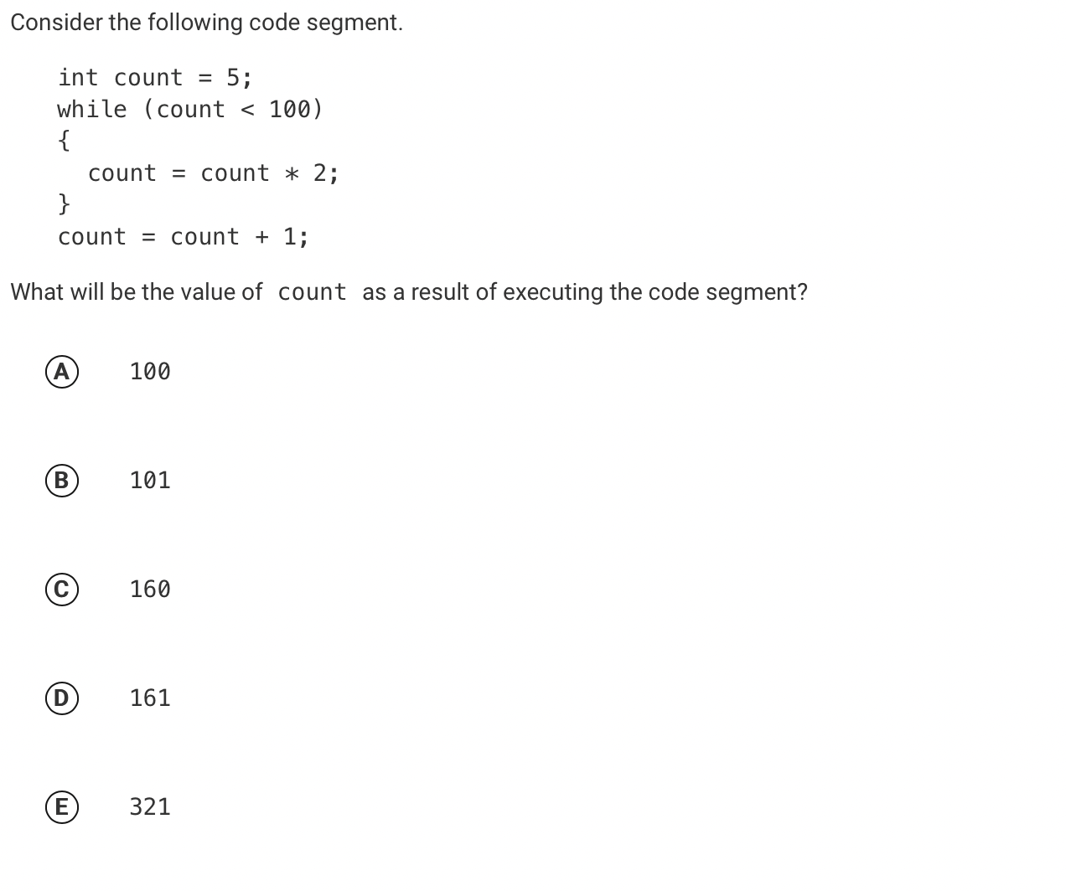
Review: Pre-test problem #1
be sure to: Check if your answer was correct. Explain how to get the right answer in your notebook. Be prepared to share out.
Notes:
D: 161.
See handwritten notes for details, including a code tracing table.

Slide 4
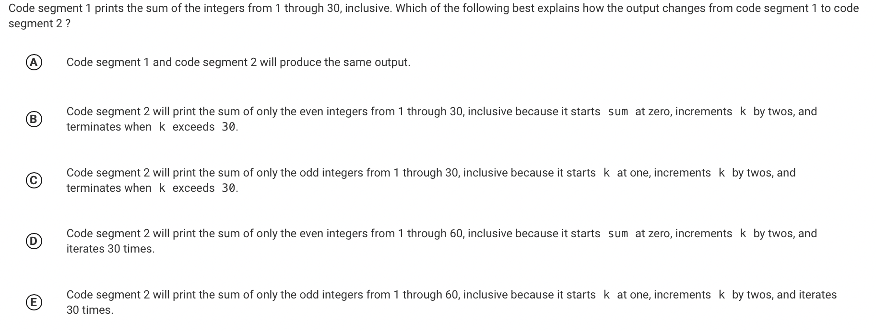
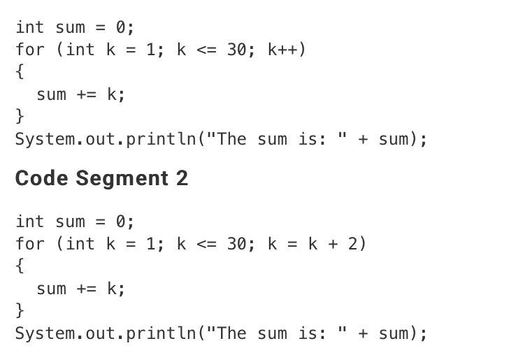
Review: Pre-test problem #2
be sure to: Check if your answer was correct. Explain how to get the right answer in your notebook. Be prepared to share out.
Notes:
C
See handwritten notes for details, including a code tracing table.

Slide 5
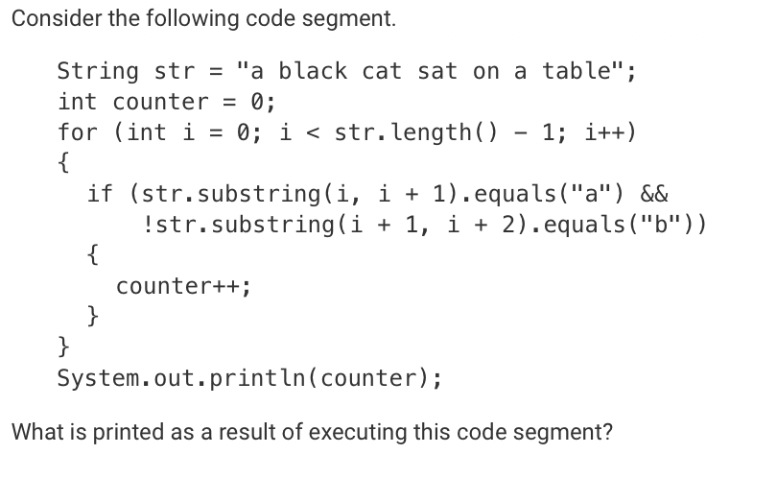
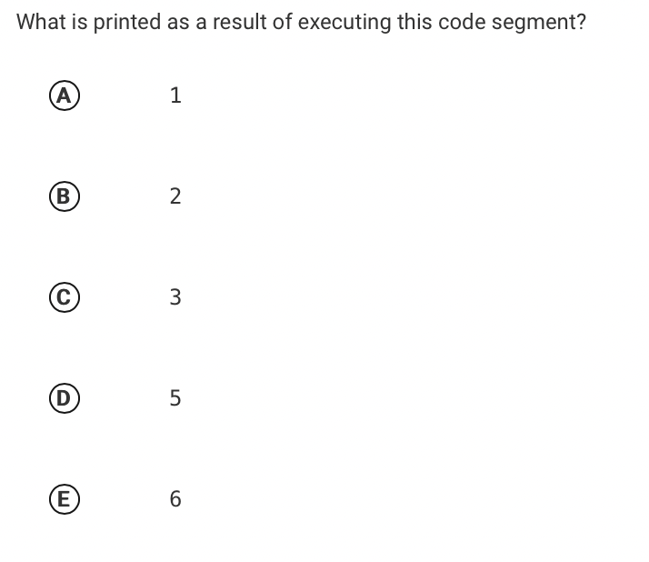
Review: Pre-test problem #3
be sure to: Check if your answer was correct. Explain how to get the right answer in your notebook. Be prepared to share out.
Notes:
5. All instanes of “a” except the last one. Note that a blank space. counts as a character

Slide 6
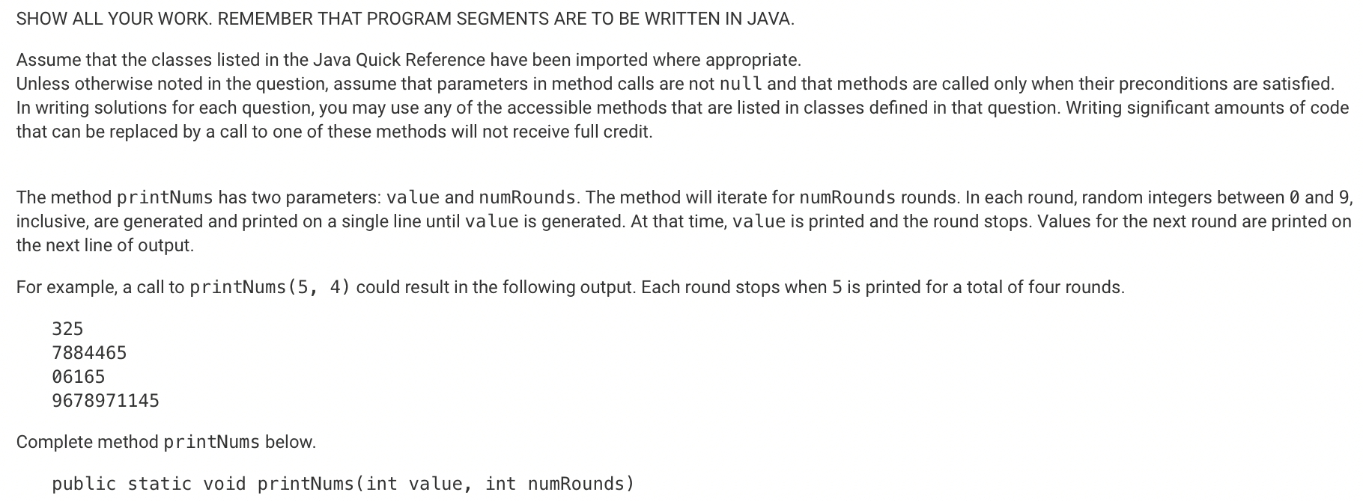
Review: Pre-test problem #4
be sure to: Check if your answer was correct. Explain how to get the right answer in your notebook. Be prepared to share out.
Notes:
for (int i = 0; i <. numRounds; i++){
String str = “”;
int rand_int = Random.randInt();
while (value != rand_int){
str += rand_int;
rand_int = Random.randInt();
}
System.out.print(str);
}

Slide 7
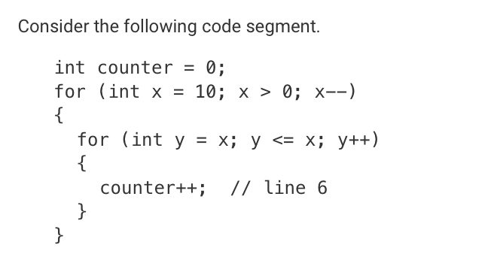
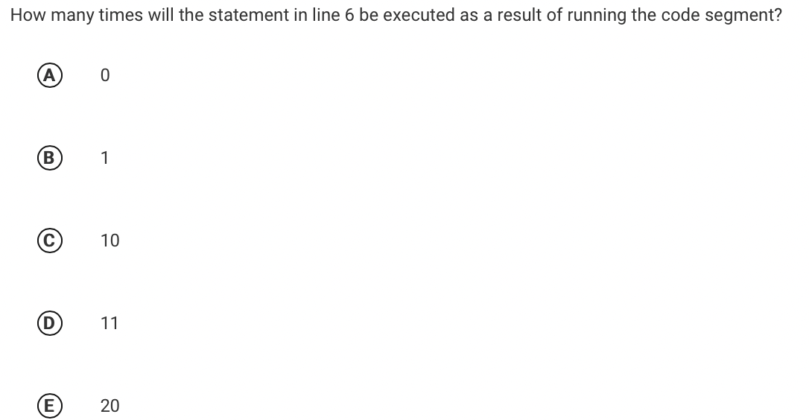
Review: Pre-test problem #5
be sure to: Check if your answer was correct. Explain how to get the right answer in your notebook. Be prepared to share out.
Notes:
10. If y is initialized as x in the inner loop, it will only be less than or equal to x on the first iteration, so it only runs once for each iteration in the outer loop, of which there are ten iterations in total.

