Slide 1
Fall 2021 Precalc
Lesson 9.5
Dr. O’Brien
Herbert H. Lehman High School
7 April 2022
Notes:
VOCAB
transpose
cofactor matrix

Slide 2
Do now…Get out your notebook/binder. Write down the date and goal.
Be sure to…
Get out your work for Pset #7. Review how much progress you’ve made so far.
Write down which problems you’ve completed (e.g. if you finished the first two but not the third, you can write down (1) and (2))
Write down any remaining questions you have. Write down at least two questions.
Write a sentence explaining, in general, how linear algebra is useful to solving real world problems.
Notes:
THIS PROBLEM CONTINUES ONE FROM PAST WEEKS HW.
Every batch has the same amount of peanuts (5 kg). The table contains info with new recipes.
7b + 6s + 2f = 380 5b + 5s + 5f = 500 2b + 5s + 8f = 620
You could try to find the inverse for the coefficient matrix, the multiply that by the solution matrix to find the value of [b s f].

Slide 3
framing
what: Use linear algebra strategies to solve real world problems
why: This formula is useful for solving problems in business, science, and engineering!
where to: What to do when you can’t find the inverse

Slide 4
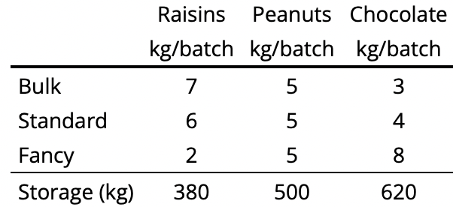
Today’s activity (continued)
Your goal today is to determine how much of each mix should be made, so that both the marketing department and the production manager are happy. You have to options when it comes to solving this problem. You’ll be using a worksheet to help guide your work.
Be sure to…
Do all work on notebook paper
Carefully follow the directions on the worksheet
Be prepared to turn in your work at the end of the period!
The marketing department at ${\text{Jada}}^{2}$Inc. has suggested that the company's trail mix products standardize with every mix being one-third peanuts. Adjusting the peanut portion of each recipe by also adjusting the chocolate portion leads to revised recipes, as given in the following table:
The production manager insists that enough of each mix should be made so that no ingredients are left over at the end of the day.
Notes:
See handwritten answer key for solutions
Pre-planned questions:
+What does it tell you if the matrix has no inverse? It means that there isn’t just one solution for this problem, so the quick formula won’t work
+How do determine if the system has no solutions or infinitely many? Apply gaussian elimination to [A | B]. You’ll get row echelon form [A’ | B’] if you get any rows where all the values of A’ are 0 then there isn’t one solution (but you already know this because the determinant is 0). If the value for B’ in that row is not 0, then there’s no solution, otherwise infinitely many.
How can I find a solution that works? Pick an arbitrary value for for f, then think about how you can use your row echelon form to figure out the amount of b and s to use.
Why doesn’t it make sense if the values you get for b, s, and f are negative? Because you can’t make negative batches!
CHALLENGE QUESTION (write on board):
+review your solution from (b). What values did you get for b,s, and f Suppose that the cost and sales price for each mix is given below:
COST. SALES PRICE
BULK: 3.69. 4.99
STND: 3.86. 5.50
FANCY: 4.45. 6.50
What’s the overall profit for your solution?
How could you make the profit bigger (try playing around with different solutions)?

Slide 5
Reflection: Thinking about thinking
be sure to: Answer each question below with a complete sentence. Be prepared to share out!
Why is it impossible to use up all the ingredients with the new recipes?
How does using linear algebra make this problem easier to solve than without it?
Notes:
last five minutes of class. share out.

Slide 6
wrapping up!
be sure to: read the directions below!
Make sure there isn’t any litter near your workstation.
If you borrowed headphones, sign them back in.
Make sure you are logged out of your computer!
Remain in your seat until the bell rings.

