Slide 1
Fall 2021 Pre-calculus
Lesson 7.5
Dr. O’Brien
Lehman High School
November 5, 2021
Notes:
Quadratic formula

Slide 2
Group work
be sure to: find seat. Get out your binder and carefully read the directions below.
You’ll work on the following assignments today. After you’ve looked over the answer key, move on to the next one:
Remote assignment review
How is it different?
Why is it useful to be able to do long division of polynomials?
Group work
Today we will be doing group work. Be sure to:
Work on each problem. Show all work and answer any questions in a complete sentence.
Stay together! Do not move on to the next problem until everyone in your group agrees on an answer.
After you finish a worksheet, ask for the worksheet answer key.
Fill out the Answer record (more on this next slide!).
Notes:
It’s basically the same algorithm, if you think about a number being broken up like 89 = 8*10^2 + 9*10^1 then it’s **exactly** the same
It’s different because you’re dealing with expressions that contain variables rather than just numbers
It’s useful because if we can figure out one factor of a polynomial we can use long division to help find the others!

Slide 3
framing
what: review and consolidate material from this unit
why: we have test coming up next week!
where to: more review, then unit test!

Slide 4
Exam next Wednesday Nov., 10th!
We’ll review tomorrow, Friday, and Monday
Topics to be covered:
Combining functions
arithmetic combinations
composition of functions
Polynomials:
Applying leading coefficient test,
finding roots,
and sketching quadratics and higher order polynomials
long division of polynomials
Notes:
Make sure this is in your notes from friday (if not check in w/ neighbor)

Slide 5
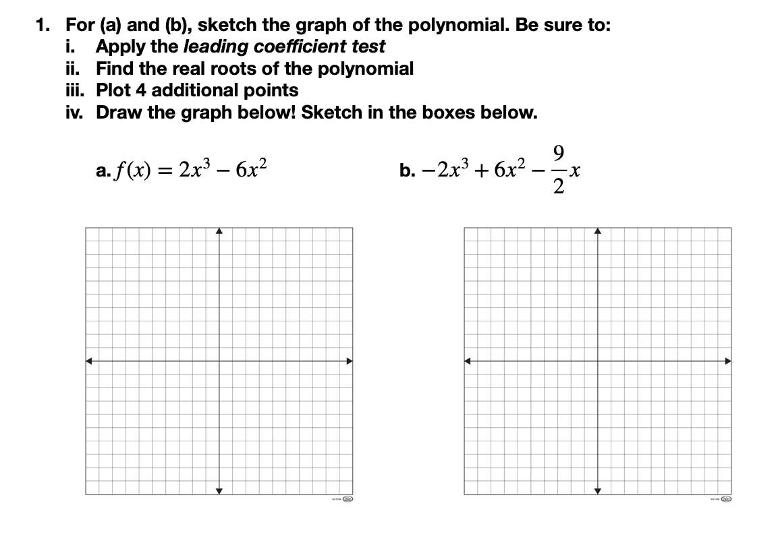
Worksheet 1: Remote assignment review
Notes:
See answer key.

Slide 6
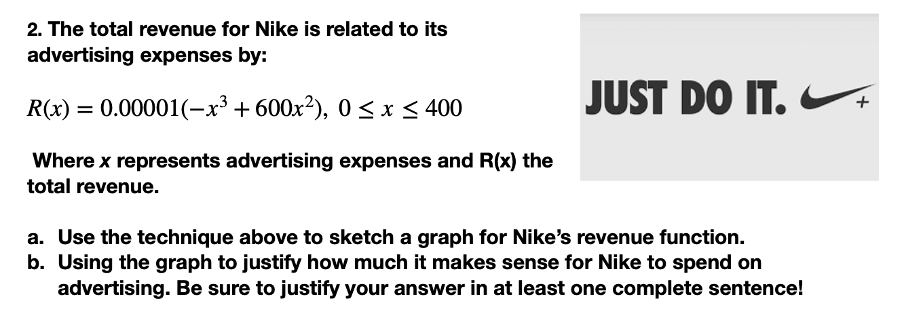
Worksheet 1: Remote assignment review
Notes:
See answer key.

Slide 7
Worksheet 2: Long division of polynomials
Use the long division of polynomials to calculate: $q(x)=\frac{6x^{3}-19x^{2}+16x-4}{x-2}$ Show all work!
Now that you’ve found $q(x)$, plug in the quadratic formula to find the other roots. Again, show all work!
Review your work. Do your answers make sense given the graph above? Explain why or why not!
Quadratic formula:
For any quadratic $ax^{2}+bx+c$ you can find the roots x using the quadratic formula:
$$x=\frac{-b±\sqrt{b^{2}-4ac}}{2a}$$
Notes:
See answer key.

Slide 8
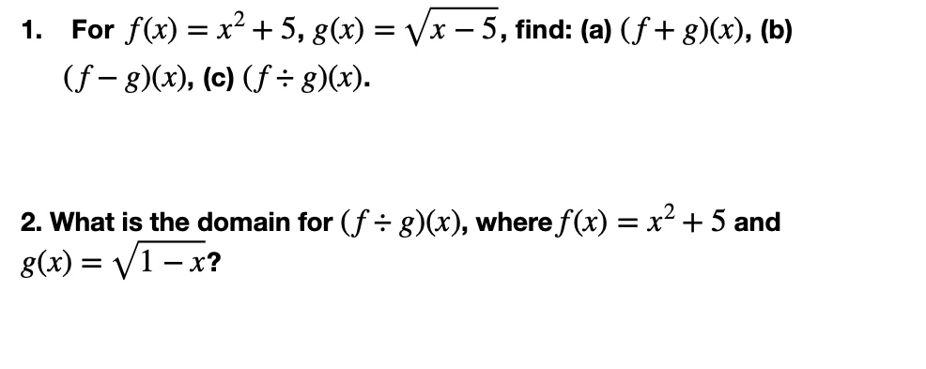
Worksheet 3: combinations of functions

Slide 9
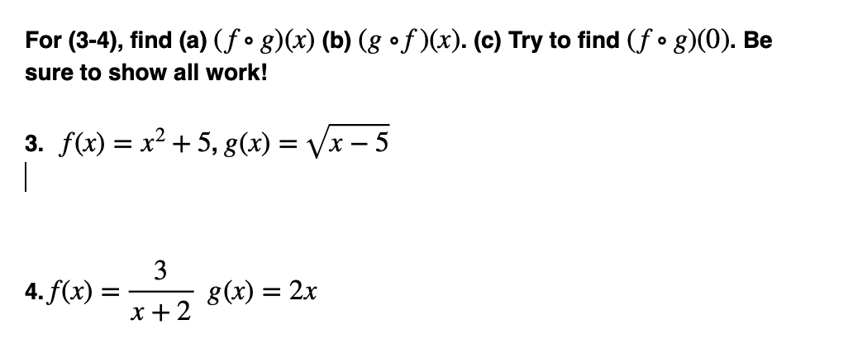
Worksheet 3: combinations of functions

Slide 10
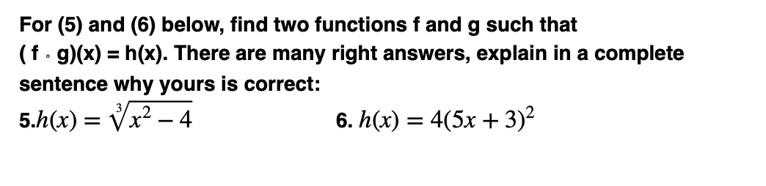
Worksheet 3: combinations of functions

Slide 11
d
exit ticket
be sure to: Answer on a sheet of loose leaf paper. Show all work or write a complete sentence for each answer:
Divide x³ −2x² −9 by x−3.

