Slide 1
Fall 2021 Pre-calculus
Lesson 5.4
Dr. O’Brien
Lehman High School
October 21, 2021
Notes:
students need calculator
Parabola
Vertex

Slide 2
do now
be sure to: Get out your binder. Copy goal and answer do now questions below. Show all work or write a complete sentence for each answer:
$$f(x)=x^{2}+6x+19$$
$$g(x)=x^{2}+3x+2$$
Convert (A) and (B) to standard (aka vertex) form.
Try to find factor (B)

Slide 3
framing
what: find x-intercepts for quadratic equations
why: This skill helps us to sketch quadratics. Quadratic equations can be used to model things in science, engineering, and more!
where to: Use quadratic functions to solve real world problems

Slide 4
Vocabulary
Vertex: Minimum or maximum point of a quadratic function
Parabola: The curve formed by the graph for a quadratic function.

Slide 5
How do we graph this?
Find the x intercepts
$$g(x)=x^{2}-4x+3$$
Yesterday we found that the k form is $(x-2)^{2}-1$
Notes:
hdw find the vertex? convert to standard form? try on own, followed by turn & talk.
(x^2 -4x + 4) - 4 + 3
(x - 2)^2 - 1.
vertex is (2,-1). Sketch
+how do we make our sketch more precise? Let’s find the the x-ints
+factor out the equation. find two numbers that multiply to +3 and add to -4
x^2 -4x + 3 = 0
(x - __)(x - __ )
(x-1)(x-3) ,
xints are 1 and 3

Slide 6

How to find x-intercepts
For any quadratic $x^{2}+bx+c$
Find two numbers m and n that add up to b and multiply to c:
$(x+m)(x+n)$ = $x^{2}+bx+c$
Why are m and n the x-intercepts

Slide 7
Convert to stand form. Find x-intercepts
$$y=x^{2}-2x-8$$
Notes:
SF: (x-1)^2 -9
Factors: (x+2)(x-4)

Slide 8
Problem set
Be sure to:
Work with your neighbors. Ask them for help before Dr. O’Brien
Help students who come in late to get caught up!
Do work in your notebook
Show all work

Slide 9
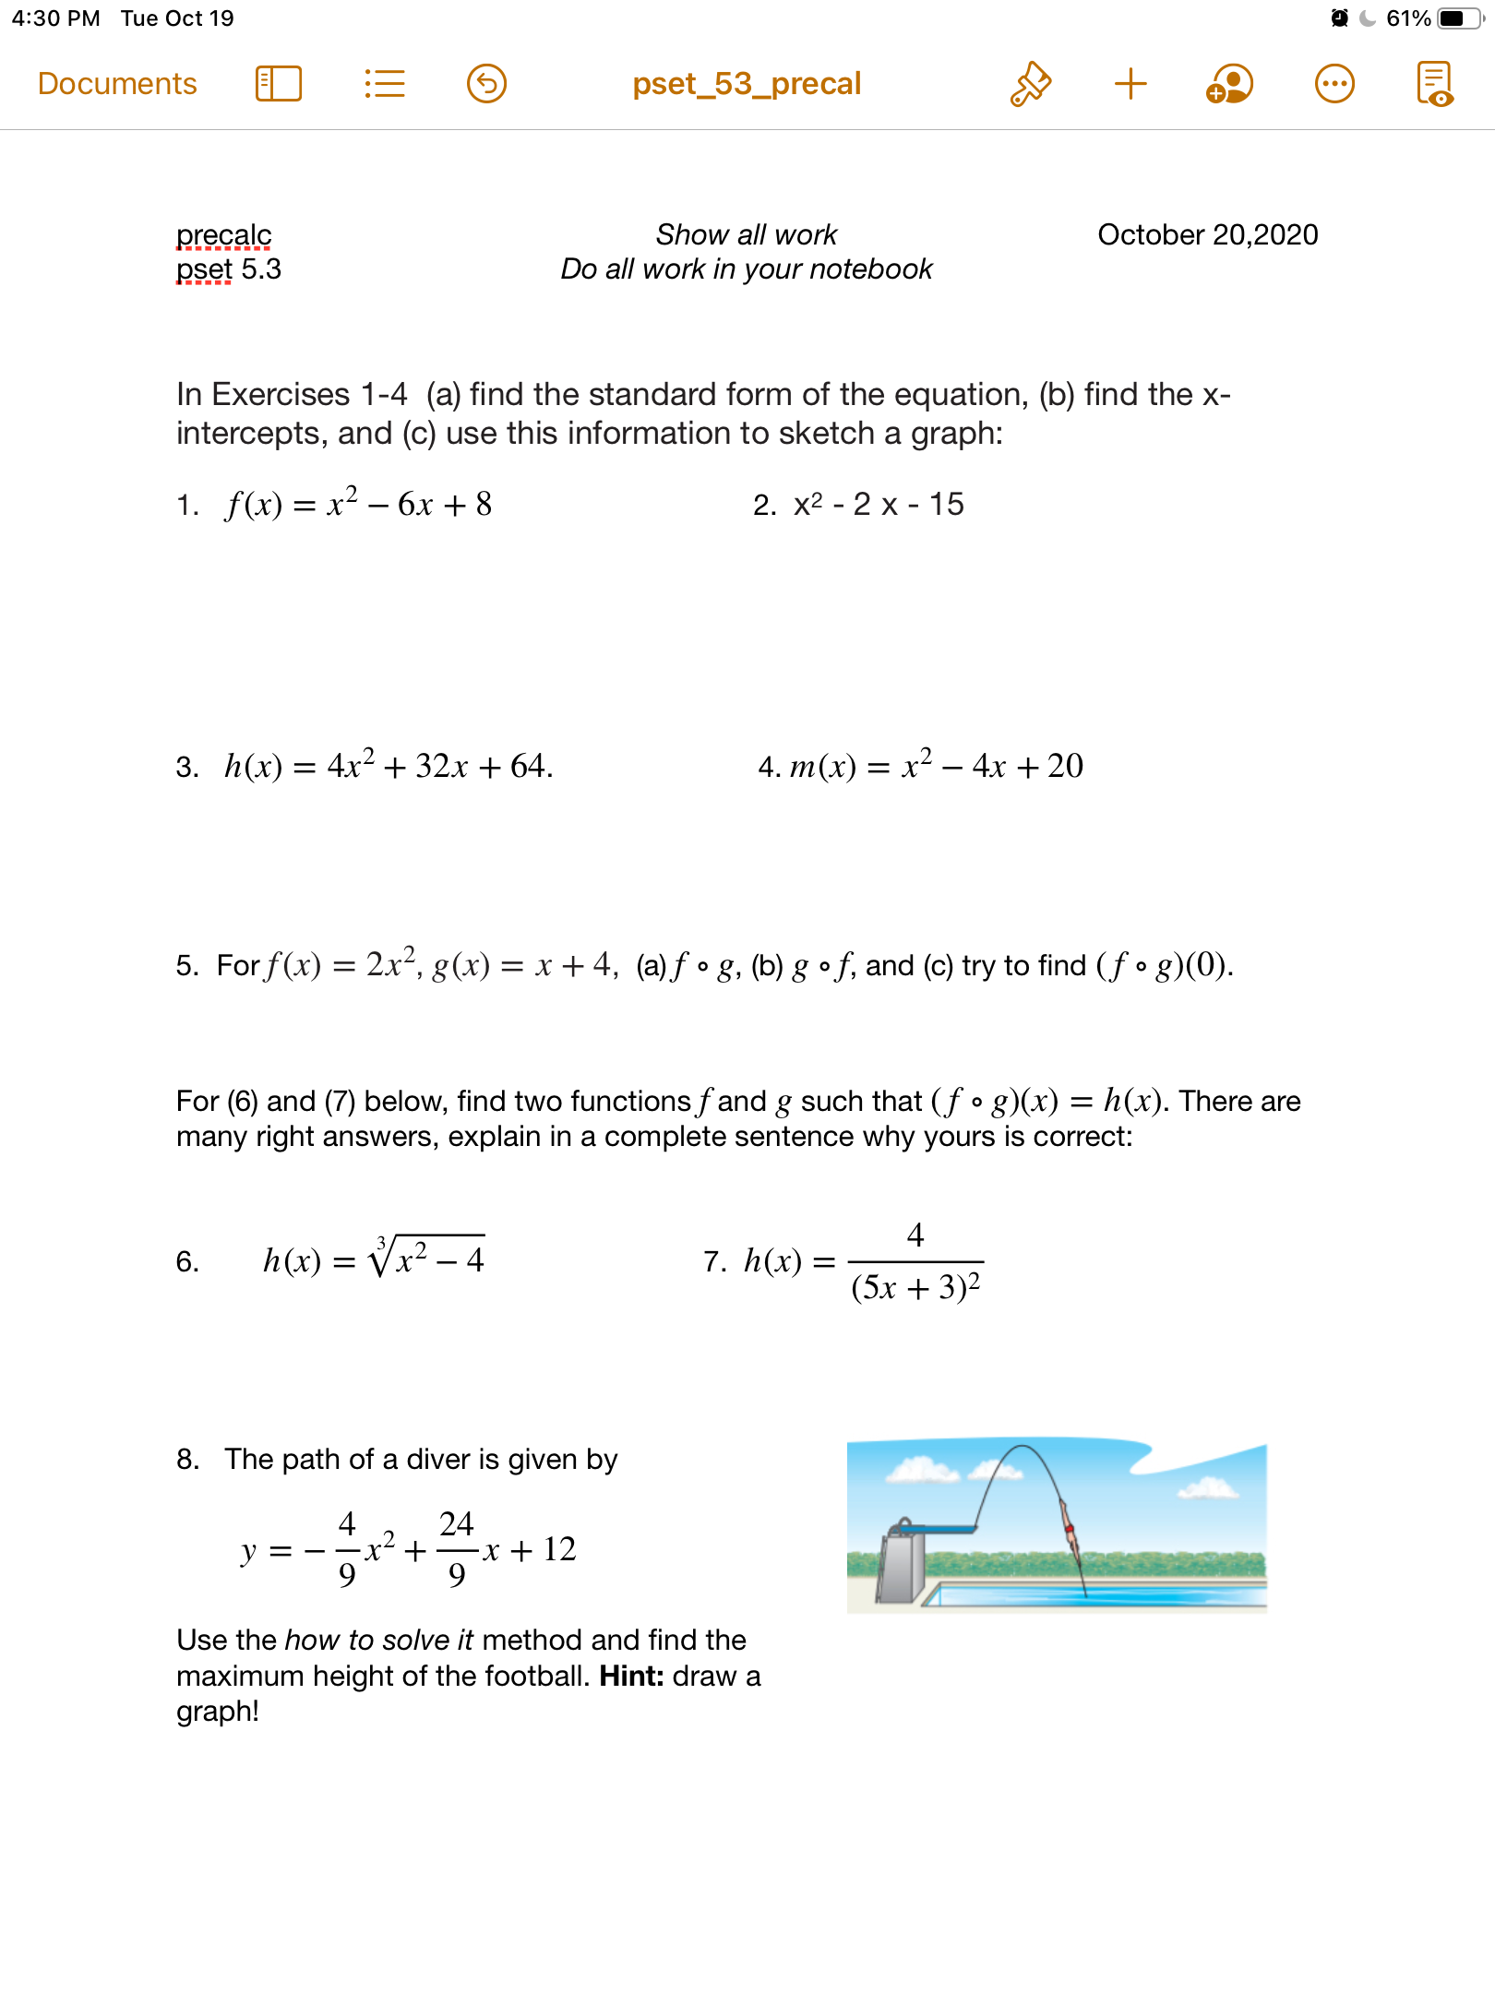
Notes:
See answer key

Slide 10
Notes:
+how rewrite in standard form?check notes!
How identify composite functions? Find a simpler function in the bigger one

Slide 11
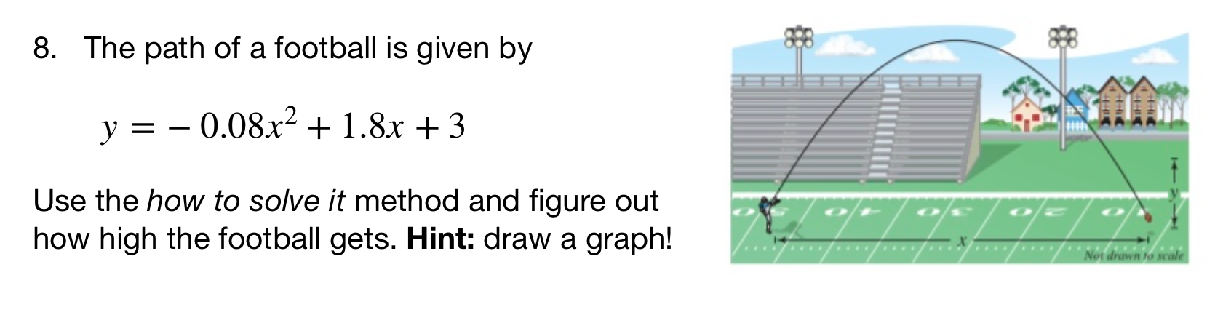
Notes:
See answer key
+hdw rewrite in standard form? Factor out-0.08, then it’s the same strategy as normal
+hdw know this graph will be a frowns face? It’s what the path of a football should look like. Also when we rewrite in standard form the coefficient is -.
+how do you tell from a sketch the highest point? It’s the vertex

Slide 12
d
exit ticket
be sure to: Answer on a sheet of loose leaf paper. Show all work or write a complete sentence for each answer:
Rewrite $h(x)=x^{2}-2x-12$ in standard form.
Find the x-intercepts then sketch a graph for the equation.
Notes:
(x^2 - 2x - 1) + 1 + 1
(x - 1)^2 + 2
vertex = (1,2)
2. sketch an upward facing quadratic with vertex at (1,2).

