Slide 1
Fall 2021 Java
Lesson 5.3
Dr. O’Brien
Lehman High School
October 20, 2021

Slide 2
do now
be sure to: Go to desk. Take out binder. Copy goal and read instructions below.
The plan
Read through each problem carefully write answers to the prompts below:.
Explain why the correct answer is correct (one sentence minimum).
Write down any questions you have.
Then we’ll go over as a group.
The framing
what: go over Unit assessment
why: In this unit, we learned about basics of Java classes. This will provide the groundwork for the rest of the course.
where to: Control structures tomorrow

Slide 3
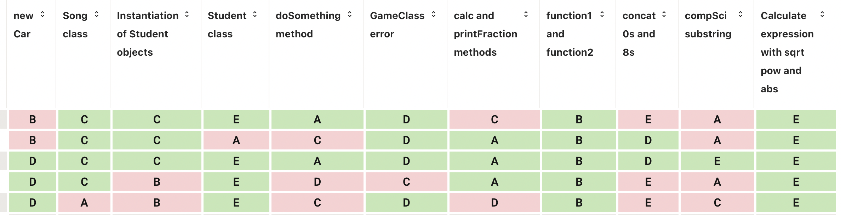

Slide 4
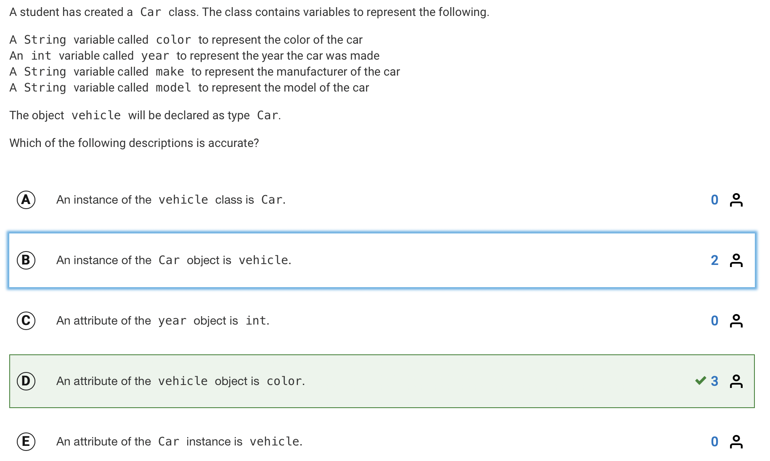
Notes:
This is actually tricky. Why is B not quite right?
Car is a class, not an object.

Slide 5
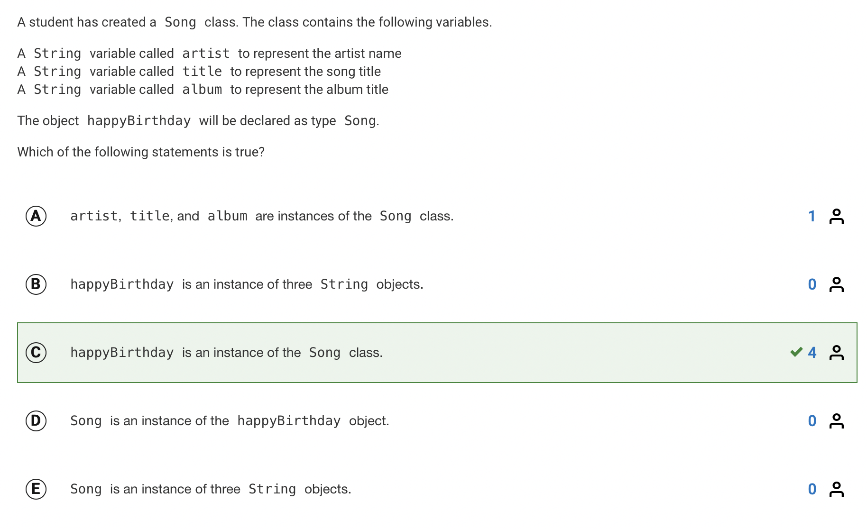
Notes:
Why is A not correct?

Slide 6
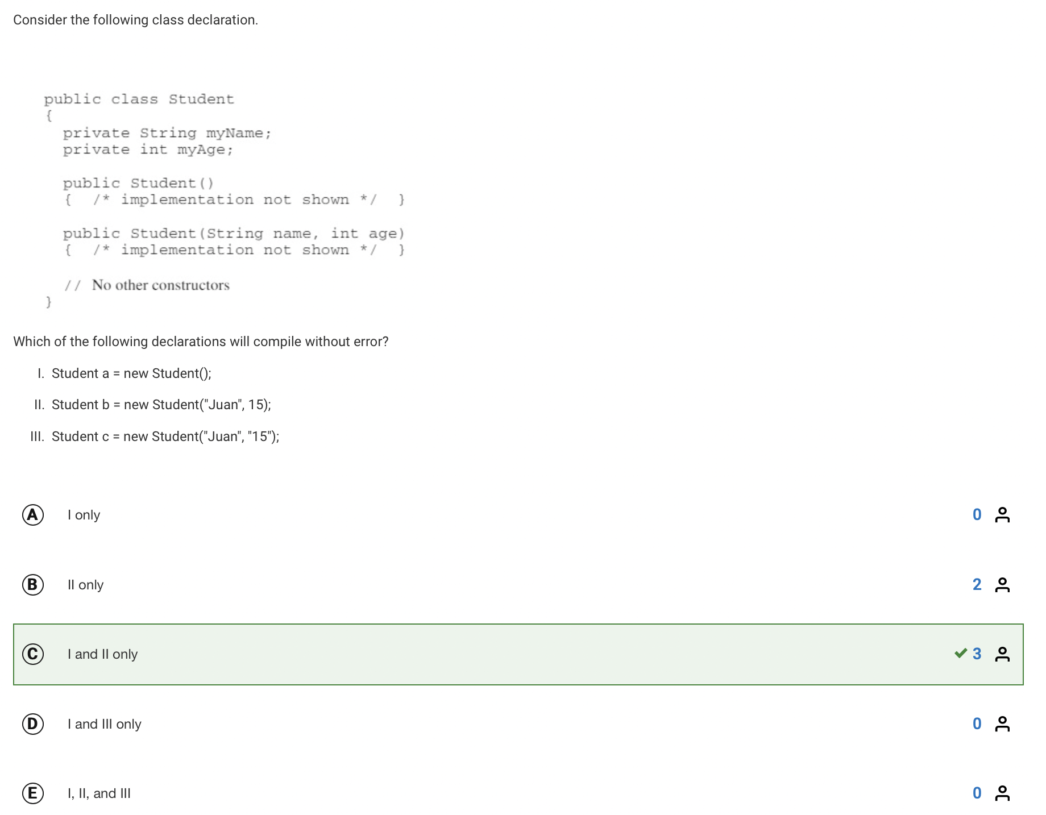
Notes:
Hdw describe the use of the student constructor here? It’s overloaded, meaning that the same name is applied to two separate constructor methods.
How does Java disambiguate? The parameters!

Slide 7
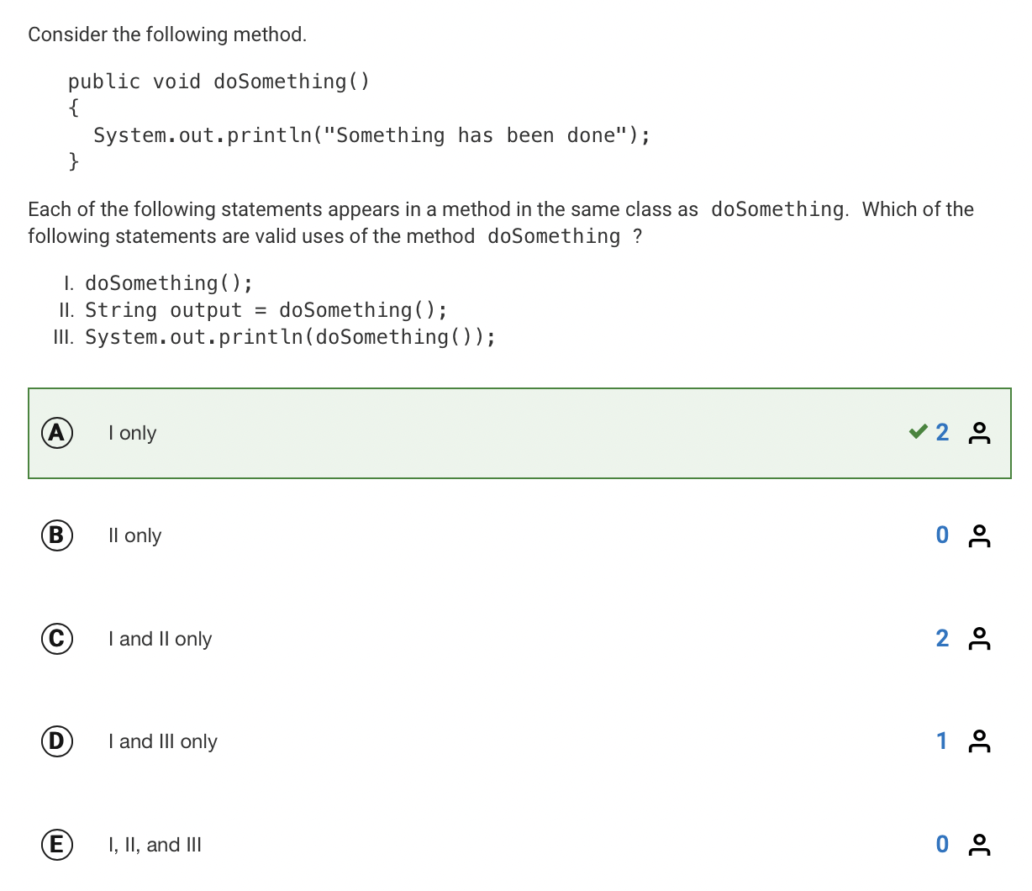

Slide 8
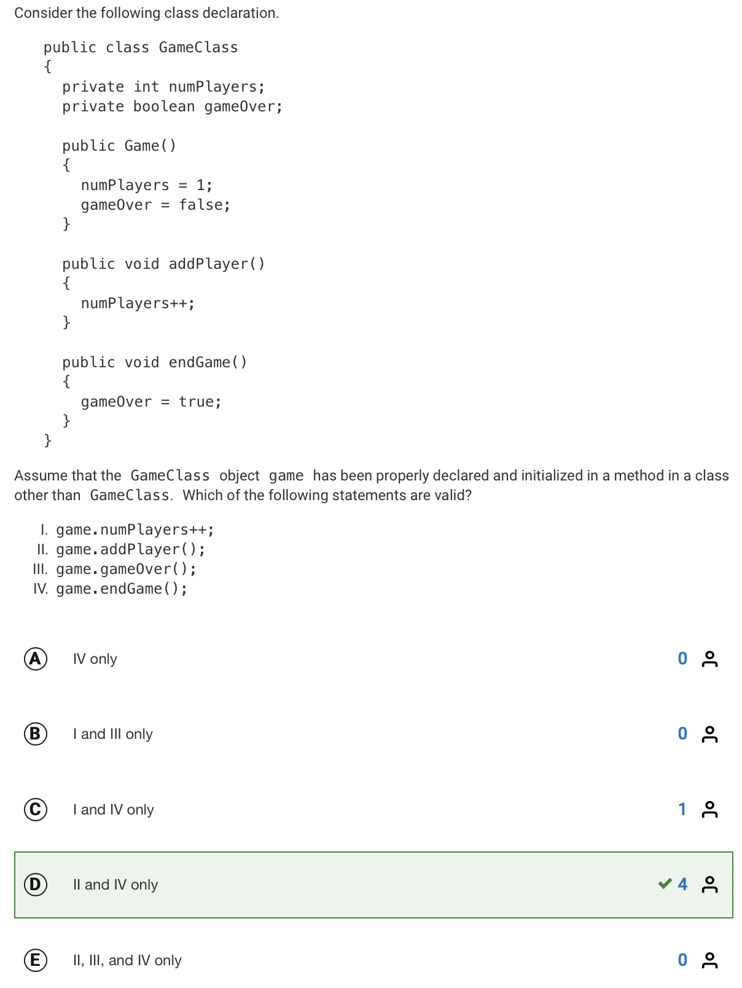

Slide 9
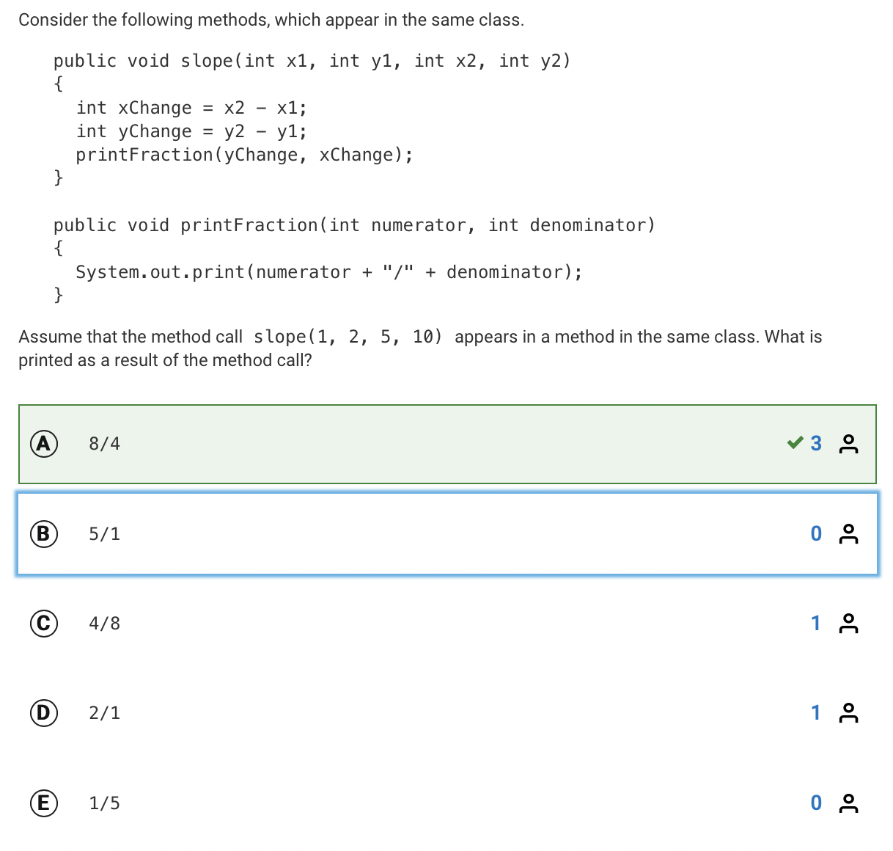

Slide 10
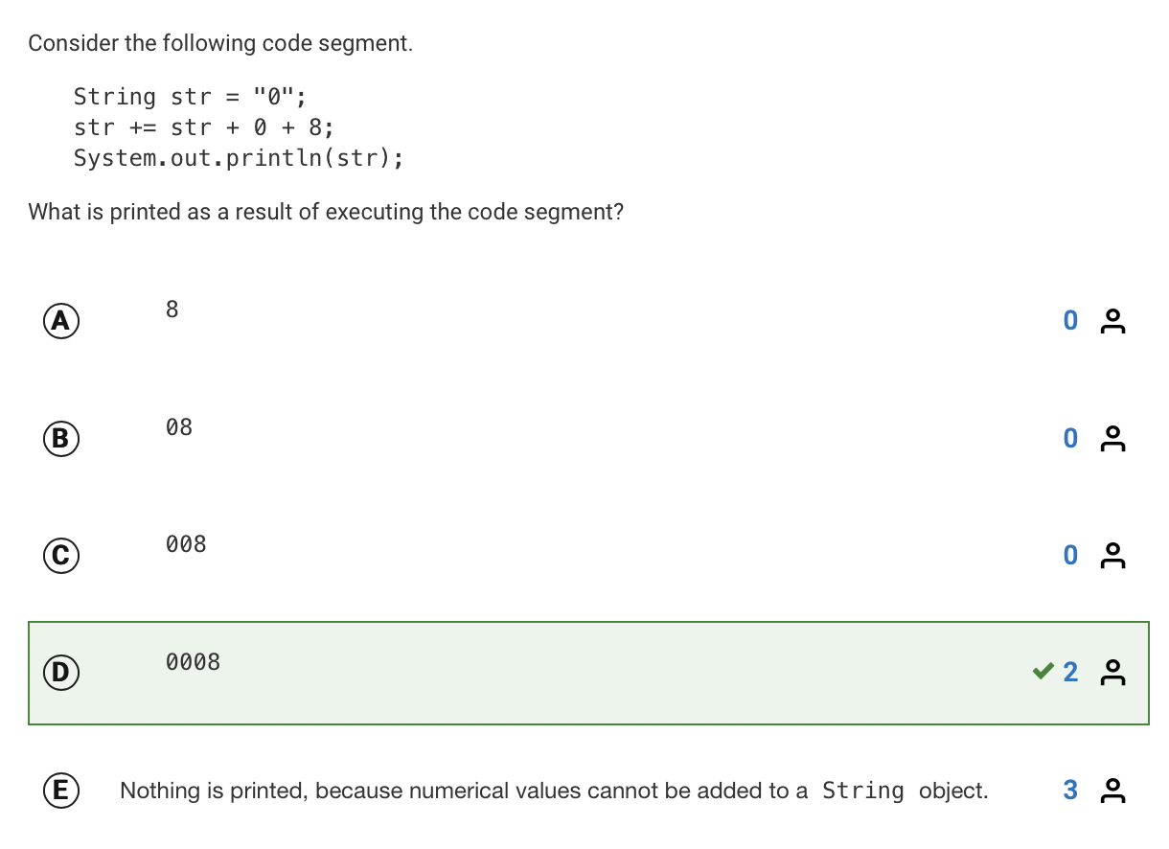

Slide 11
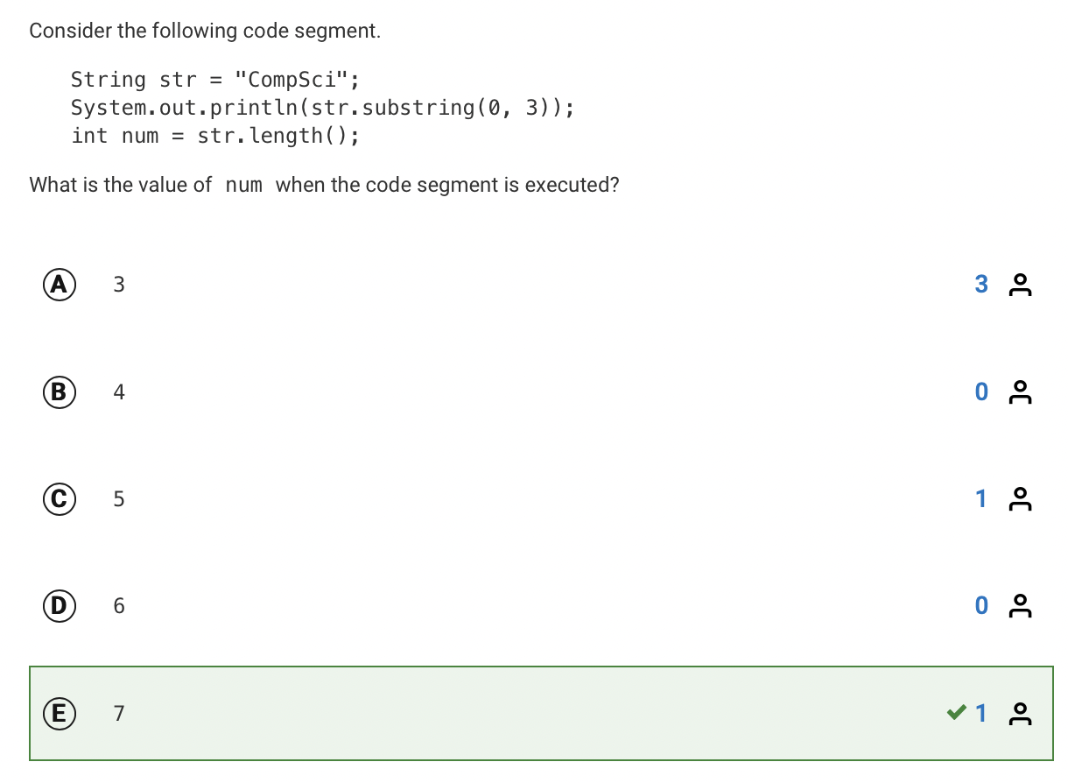

Slide 12
reflection
What’s one thing you understand better after today’s lesson?
What is one question you still have?
How prepared to you feel for the retake? What’s one thing you can do?

