Slide 1
Capstone development
(front end)

Slide 2
Project Requirements
The Administrator module should allow administrators perform:
Login and authentication.
Saving details of airports.
Viewing and deleting the details of airports.
Updating the airport details.
Search for airports.
New administrators to register.

Slide 3
Design and Frameworks
Design:
Client frontend
Observables/Promise for asynchronous calls to backend
Spring monolithic backend
Segregation of controller / services / data access layers
Database
Language and Frameworks:
Client: Typescript Angular + bootstrap
Backend: Java Spring boot
Database: SQL Hibernate / MySQL

Slide 4
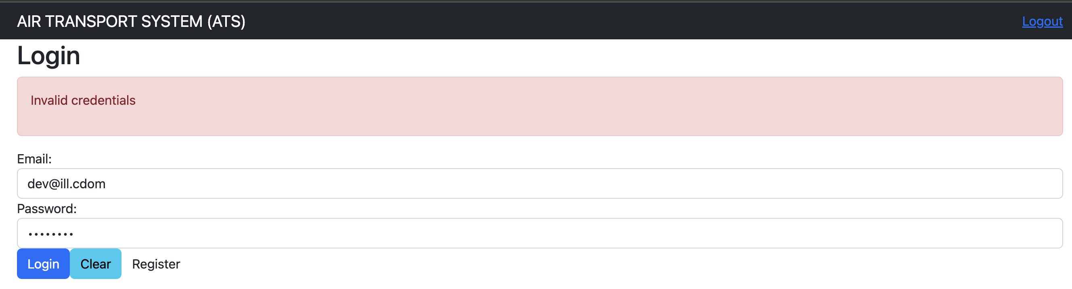
Login and Authentication
Form based authentication:
Login is stored in sessionStorage upon successful login. Failed login results in Invalid credentials error shown

Slide 5
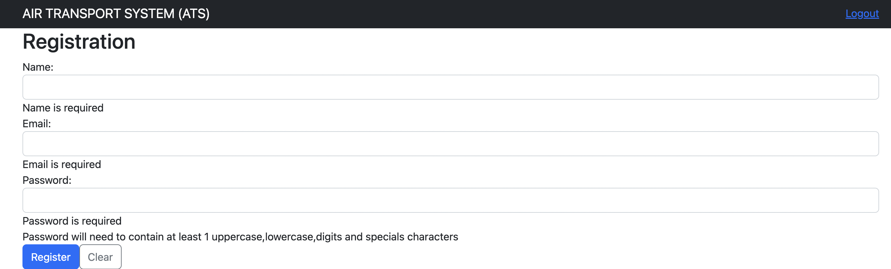
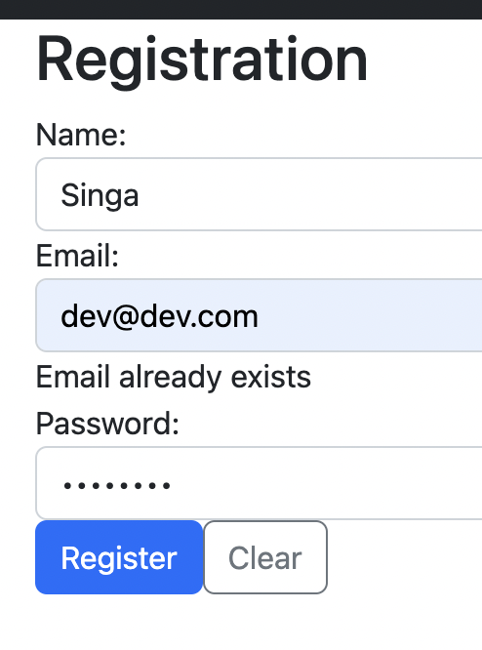
Registration
Errors to introduce for synchronous validation (errors that are checked immediately
Error to introduce for asynchronous validation (errors that are checked after synchronous)

Slide 6
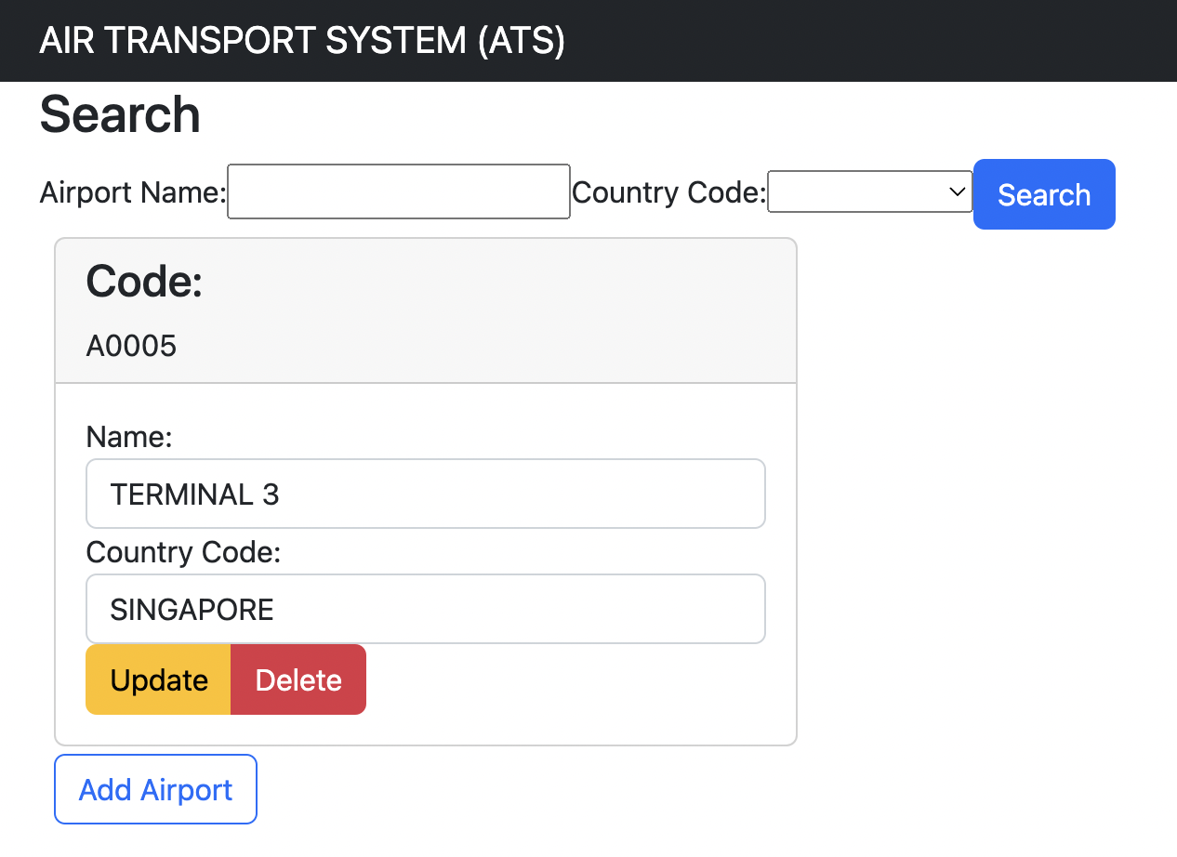
Search and listing

Slide 7
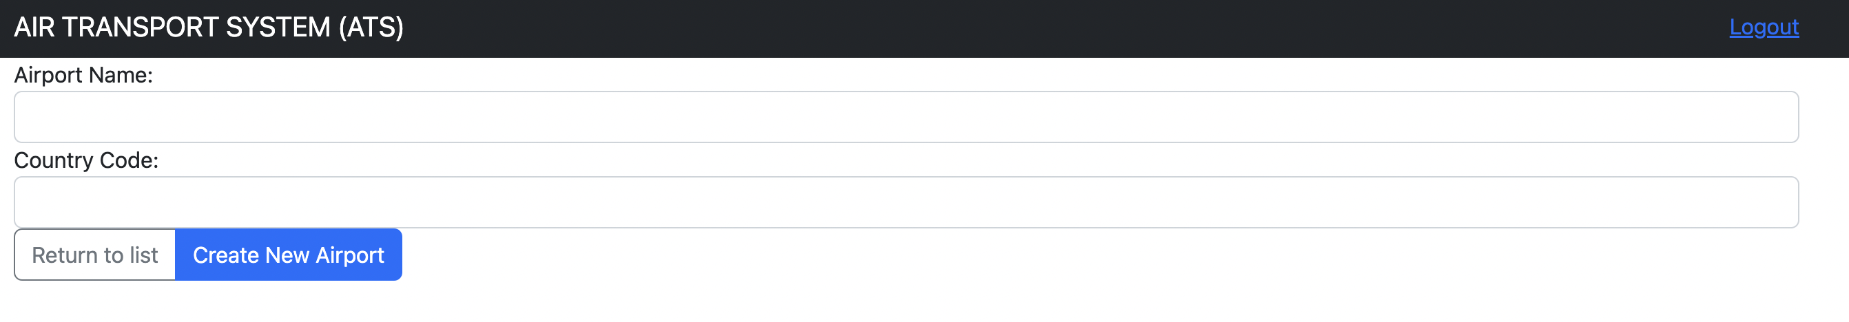
Registration of new Airport

