Slide 1

AWS User Groups
Customizing Your User Group Page

Slide 2
Guidelines
We’d like to create a stronger, more cohesive sense of community by creating a consistent visual identity across the logos used to represent official AWS User Groups worldwide. Please follow the below guidelines as you create a logo from the logo templates:
Pick the image and color scheme that best fits with your group.
Use ALL CAPS for your location.
Do not change location font size or style.
Do not change dimensions.
To customize the background on a Meetup.com page, use hex codes provided.
If you’d like to customize the Meetup.com header image, we recommend using flat colors of the hex codes provided, along with white (#FFFFFF) title text.
#FF9D00
#527FFF
#07C284
#FF5757
#A166FF

Slide 3
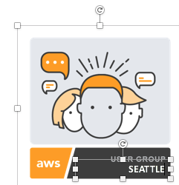
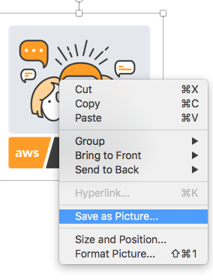

Getting Started
Choose a custom avatar for your User Group
2. Edit CITY NAME
(with caps lock on)
3. Right Click and Save As Picture…
CITY NAME

Slide 4


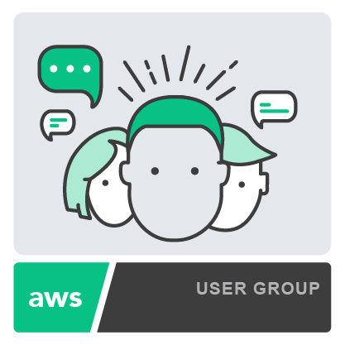

Option 1
CITY NAME
CITY NAME
CITY NAME
CITY NAME
CITY NAME

Slide 5





Option 2
CITY NAME
CITY NAME
CITY NAME
CITY NAME
CITY NAME

Slide 6





Option 3
CITY NAME
CITY NAME
CITY NAME
CITY NAME
CITY NAME

Slide 7





Option 4
CITY NAME
CITY NAME
CITY NAME
CITY NAME
CITY NAME

Slide 8
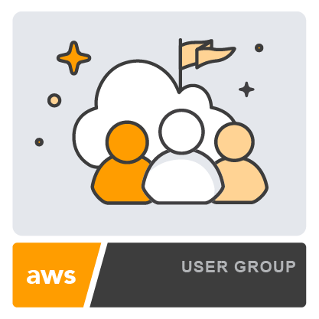
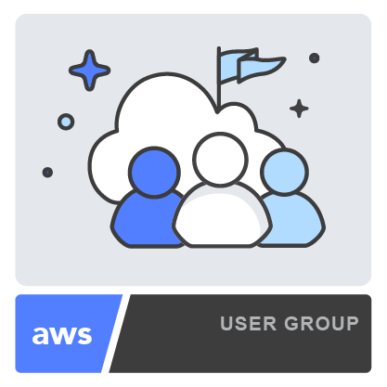
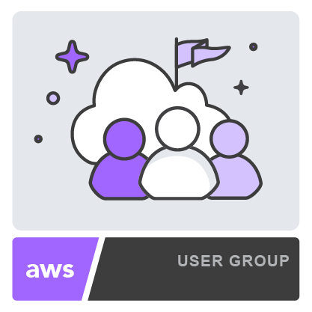
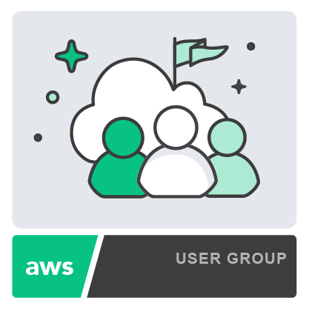
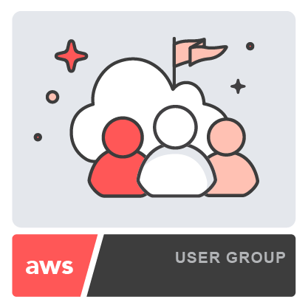
Option 5
CITY NAME
CITY NAME
CITY NAME
CITY NAME
CITY NAME

Slide 9



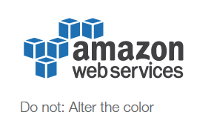

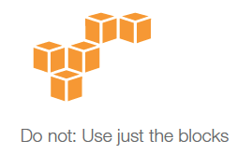
Additional Guidelines
We understand that your community deserves its own visual style. If you don’t think the official logo template fits with your group, that’s ok! Feel free to customize your own User Group design(s), keeping in mind the following:
Here are examples of custom User Group graphics, specific to a region, and within our recommended design guidelines.
AWS Miami Meetup
Japan JAWS User Group Tokyo
AWS Belfast User Group
San Francisco Advanced AWS Meetup
AWS User Group Shanghai
Feel free to use the “Powered by Amazon Web Services” logo, (without modifying), per trademark guidelines here.
However, The Amazon Web Services logo should not be used, nor should the AWS blocks on their own.

