Slide 1

AWS User Groups
Customizing Your User Group Page

Slide 2

Guidelines
We’d like to create a stronger, more cohesive sense of community by creating a consistent visual identity across the logos used to represent official AWS User Groups worldwide. Please follow the below guidelines as you create a logo from the logo templates:
Pick the image and color scheme that best fits with your group.
Use ALL CAPS for your location.
Do not change location font size or style.
Do not change dimensions.

Slide 3

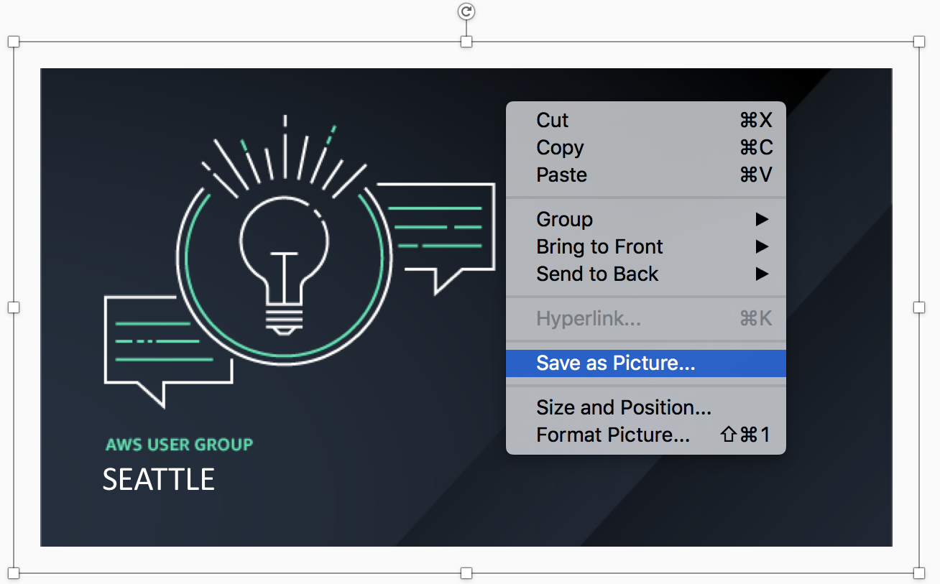

Getting Started
Choose a custom avatar for your User Group
2. Edit NAME OF LOCATION (with caps lock on)
3. Right Click and ”Save as Picture…”

Slide 4

Option 1: Community
NAME OF LOCATION

Slide 5

Option 1: Community
NAME OF LOCATION

Slide 6

Option 1: Community
NAME OF LOCATION

Slide 7

Option 1: Community
NAME OF LOCATION

Slide 8

Option 2: Global
NAME OF LOCATION

Slide 9

Option 2: Global
NAME OF LOCATION

Slide 10

Option 2: Global
NAME OF LOCATION

Slide 11

Option 2: Global
NAME OF LOCATION

Slide 12

Option 3: Innovation
NAME OF LOCATION

Slide 13

Option 3: Innovation
NAME OF LOCATION

Slide 14

Option 3: Innovation
NAME OF LOCATION

Slide 15

Option 3: Innovation
NAME OF LOCATION

Slide 16

Option 4: Technology
NAME OF LOCATION

Slide 17

Option 4: Technology
NAME OF LOCATION

Slide 18

Option 4: Technology
NAME OF LOCATION

Slide 19

Option 4: Technology
NAME OF LOCATION

Slide 20







Additional Guidelines
We understand that your community deserves its own visual style. If you don’t think the official logo template fits with your group, that’s ok! Feel free to customize your own User Group design(s), keeping in mind the following:
Feel free to use the “Powered by Amazon Web Services” logo, (without modifying), per trademark guidelines here.
However, the Amazon Web Services logo should not be used.
Do not: Use the old ‘Powered by AWS’ logo
Do: Use the full “Powered by AWS” color logo on a light background
Do not: Alter the color of the logo
Do: Use the reverse logo on a dark background
Do not: Remove the smile
Do not: Use only the smile

