Slide 1
Decoding Dreams: A Data Driven Dive Into Sleep Efficiency.
Prepared by
Coby Alvarez
Daniel Hernandez
Shivani Kotian
Elias Schablowski
Erick Jerson Vergara
Professor. Navid Amini
Department of Computer Science
California State University, Los Angeles

Slide 2
Introduction & Significance
Our project is a comprehensive data-driven investigation into sleep efficiency, leveraging the "Sleep Efficiency" dataset to explore and visualize how various factors such as lifestyle, diet, and habits influence sleep quality and patterns.
It is significant because the average person spends approximately one-third of their life sleeping, and poor sleep quality is linked to a multitude of health issues including dementia and mood shifts. Improving sleep can significantly enhance life quality and longevity.
The project aims to solve the problem of understanding what influences sleep quality and efficiency, identifying actionable changes people can make to improve their sleep, thereby enhancing overall health and productivity.

Slide 3

Target Audience
People with sleep difficulty
Health professionals who specialize in sleep
Somnologist
Psychologist
Average person who wants better sleep
Data analyst interested in sleep data

Slide 4
About Dataset
Sleep
Found on Kaggle
618 Records (452 in the original)
We will correlate multiple variables to show the effects of certain activities and externalities on sleep quality

Slide 5
Dataset Overview
ID
Age
Gender
Male
Female
Bedtime
Wakeup time
Sleep Duration
Sleep Efficiency
Sleep breakdown
Awakenings
Caffeine/Alcohol Consumption
Smoking Status
Exercise frequency

Slide 6
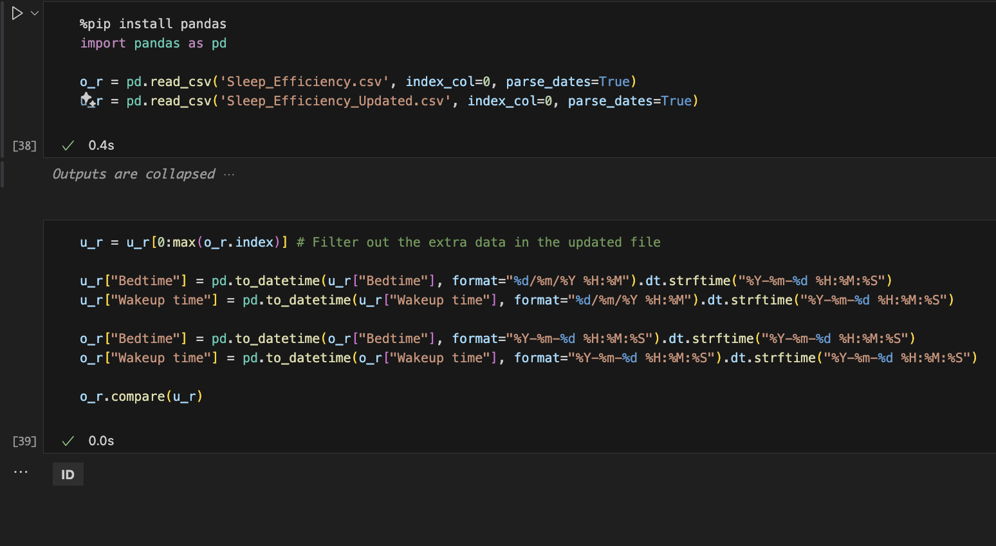
Data Cleaning and Preprocessing
2 Datasets
Original (popular)
Updated (less popular)
Verify the datasets match

Slide 7
Data Cleaning and Preprocessing

Slide 8
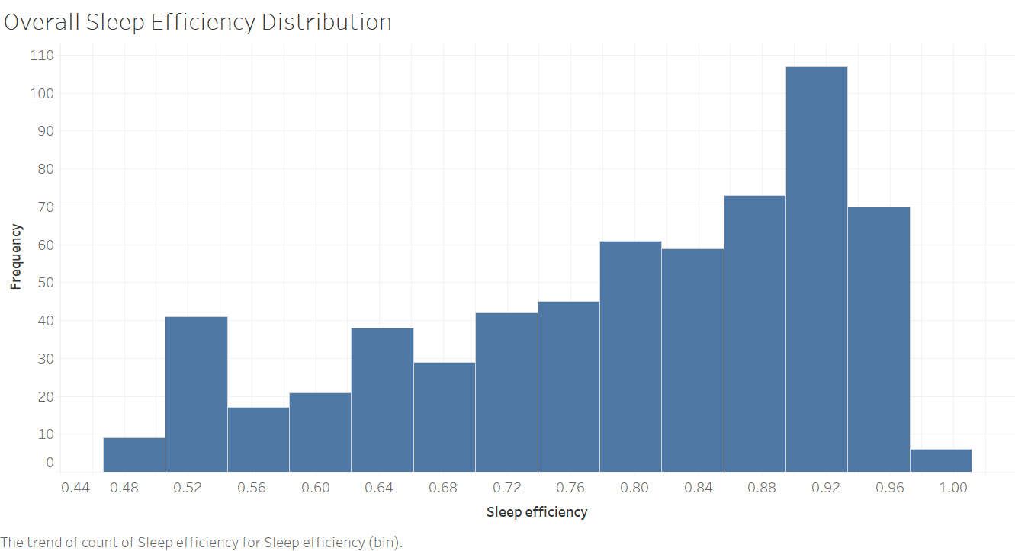
Viz 1: Sleep
Task / Goal:
To display the distribution of sleep efficiency across a population.
Encoding Scheme:
A histogram with sleep efficiency intervals on the x-axis and frequency counts on the y-axis, using color fill for bars.
Advantage:
Quickly identifies the most common efficiency ranges and outliers, facilitating the understanding of sleep quality trends within the dataset.

Slide 9
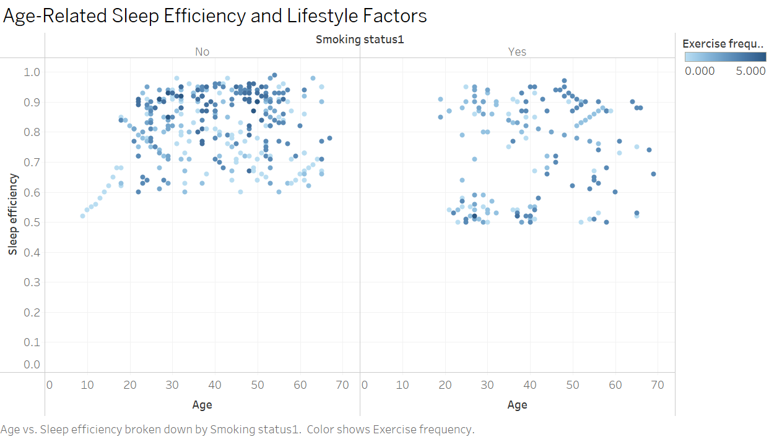
Viz 2: Factors to sleep Efficiency
Task / Goal:
To analyze the relationship between age, sleep efficiency, and lifestyle factors such as exercise frequency and smoking status.
Encoding Scheme:
Position: age (x-axis) and sleep efficiency (y-axis)
Color: exercise frequency
Split axes: differentiate non-smokers versus smokers.
Advantage:
Facilitates the comparison of sleep efficiency across different age groups while considering the impact of smoking and exercise habits.

Slide 10
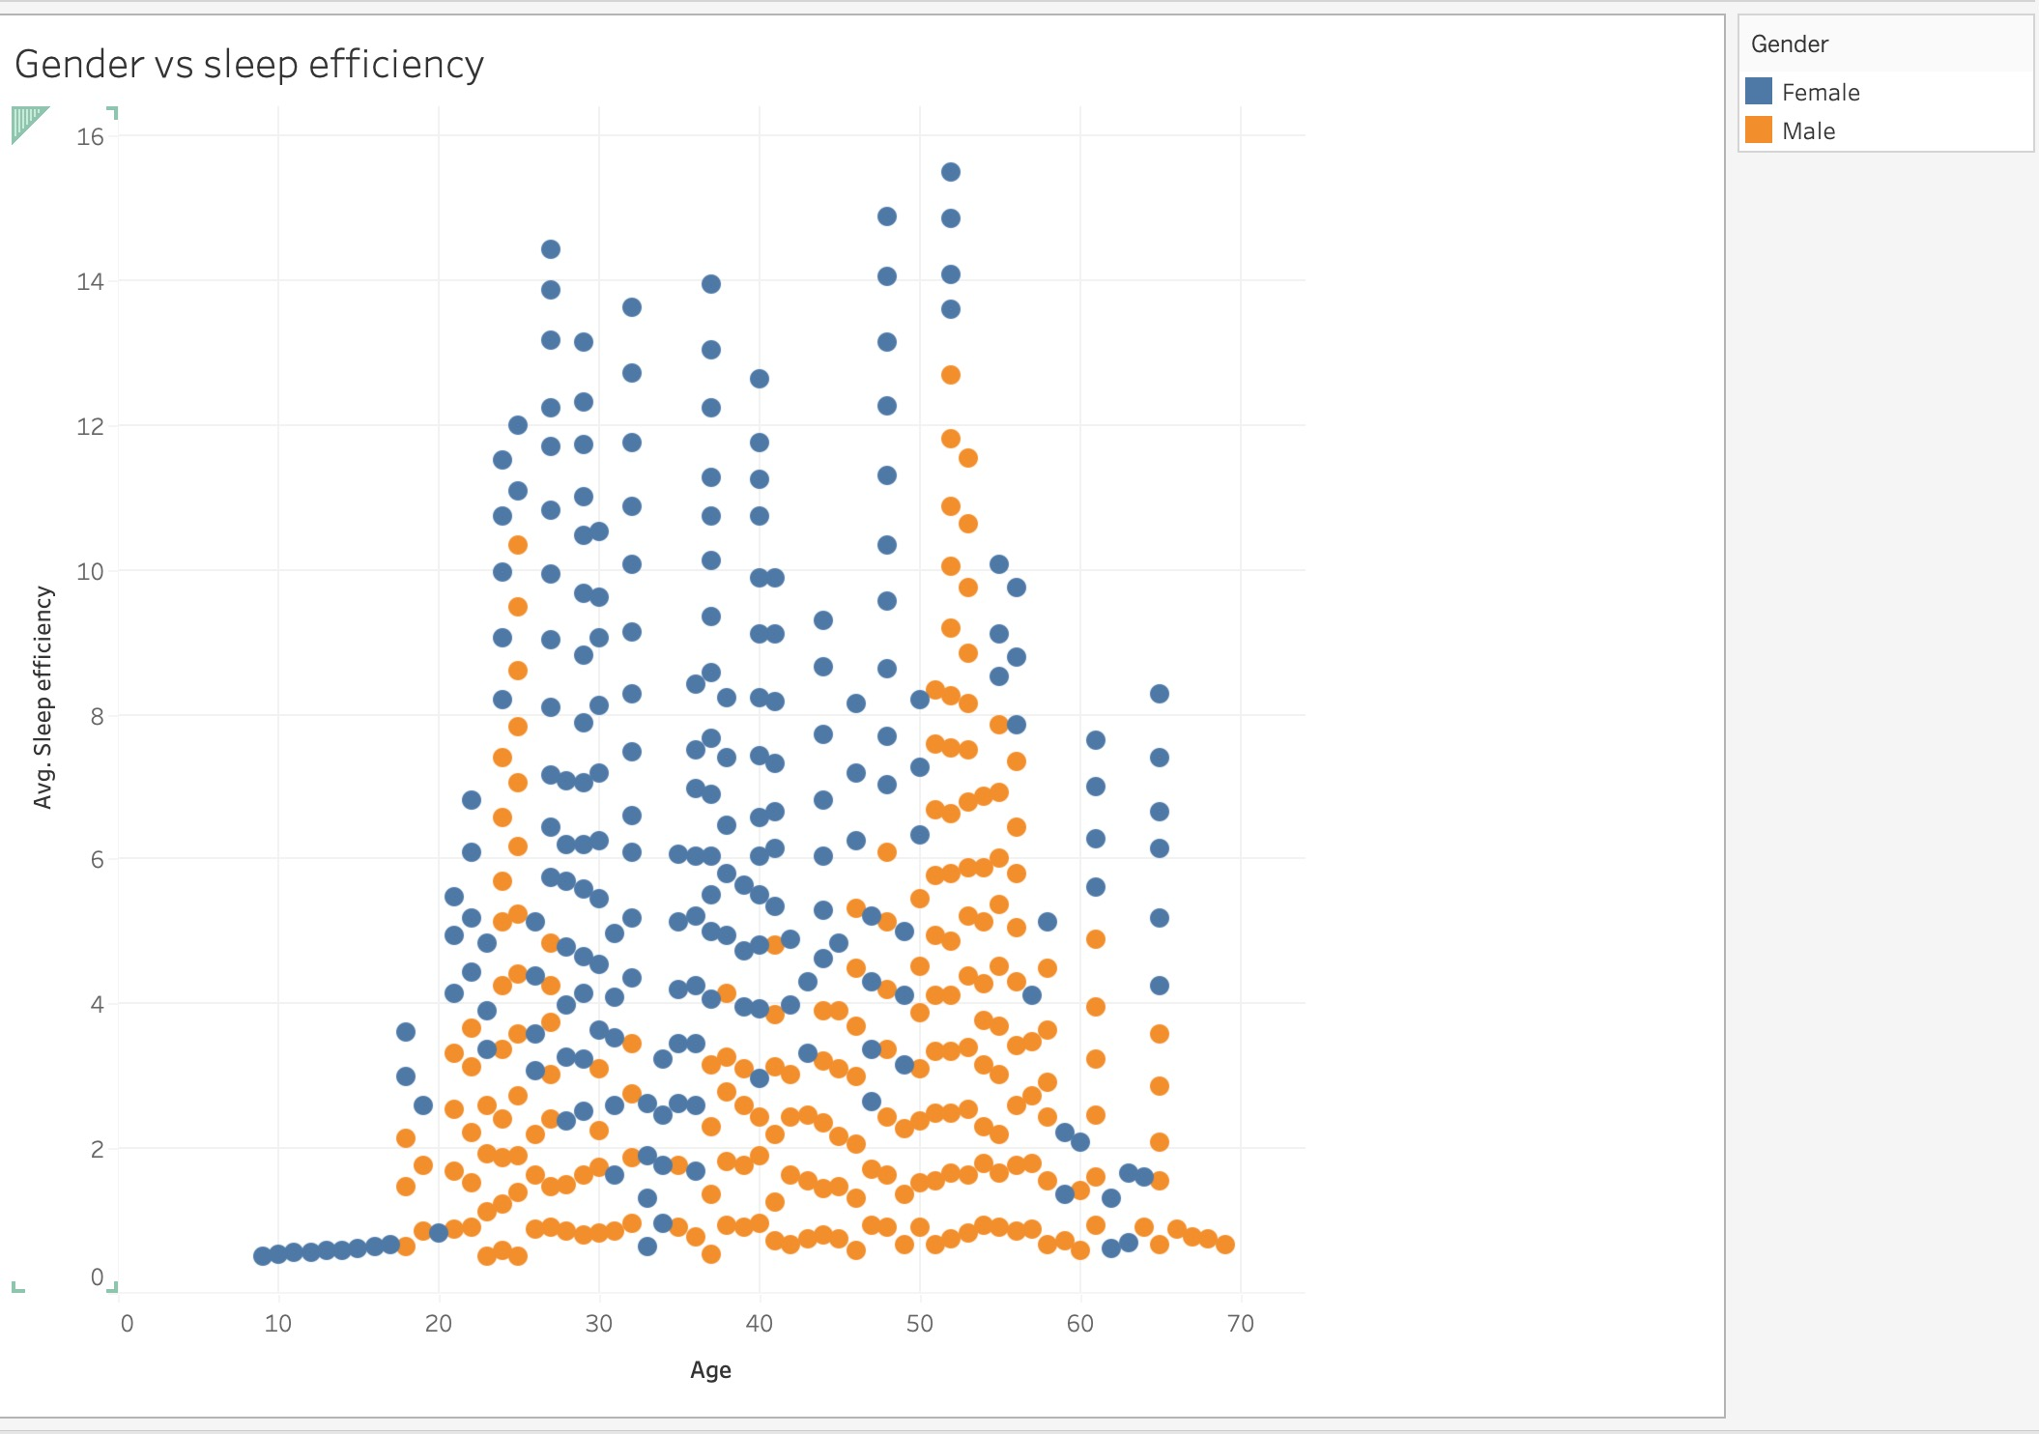
Viz 3: Gender vs Sleep Efficiency
Task / Goal
To demonstrate how gender affects sleep efficiency
Encoding Scheme
Color: Blue (female) and Orange (male)
Positions: Age (x-axis) and average sleep efficiency(y-axis)
Advantage
Demonstrates how gender impacts sleep and accounts different ages to show how sleep and gender differ results.

Slide 11
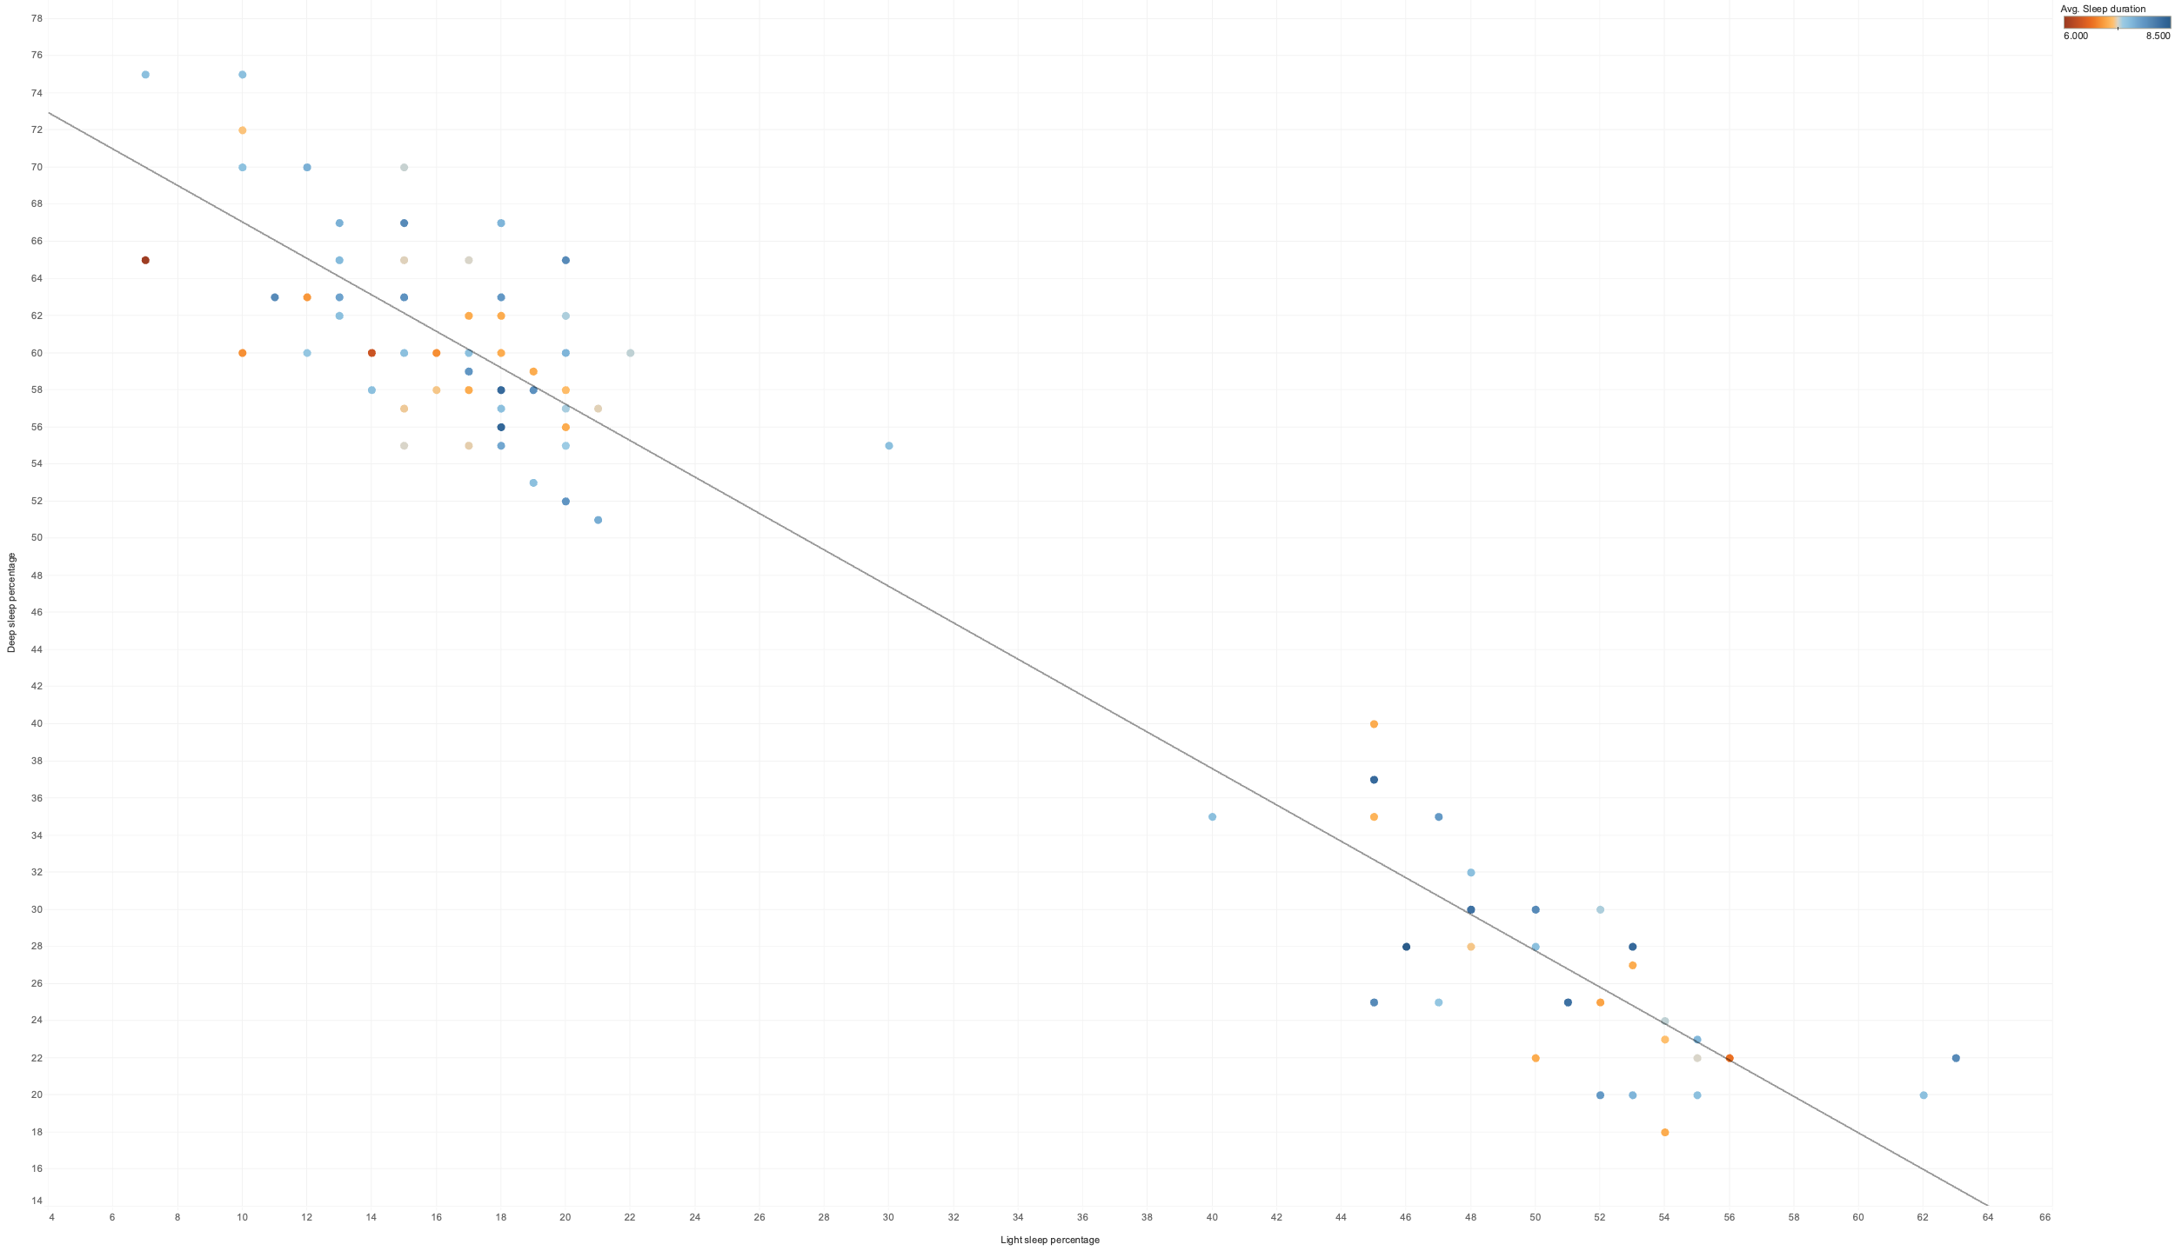
Viz 4: Deep and Light Sleep
Goal
Compare Deep and Light sleep
How does this affect sleep duration
Encoding
Position
Deep sleep percentage
Light Sleep Percentage
Color
Sleep Duration
Advantage
REM percentage encoded as well

Slide 12
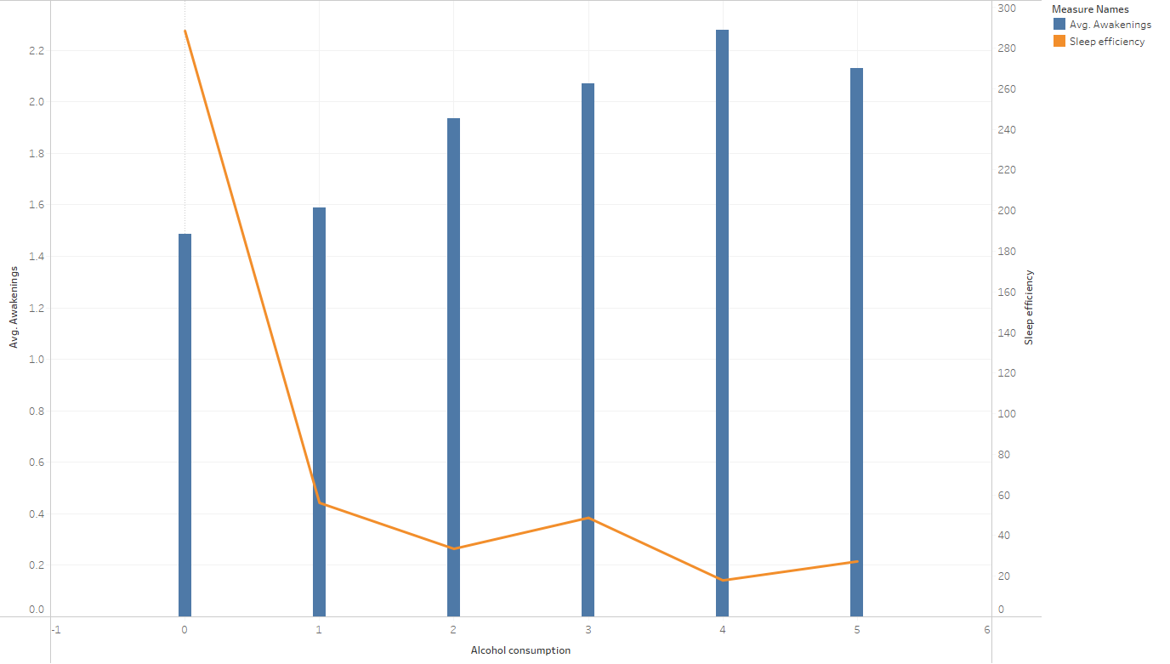
Viz 5: Alcohol vs Sleep
Goal
Analyze the effects that drinking has on sleep
Encoding
X-axis shows the amount of alcohol consumption and Y-axis shows the average awakenings
The line demonstrates sleep efficiency
Advantage
Demonstrate the impact of alcohol consumption on sleep efficiency and awakening

Slide 13
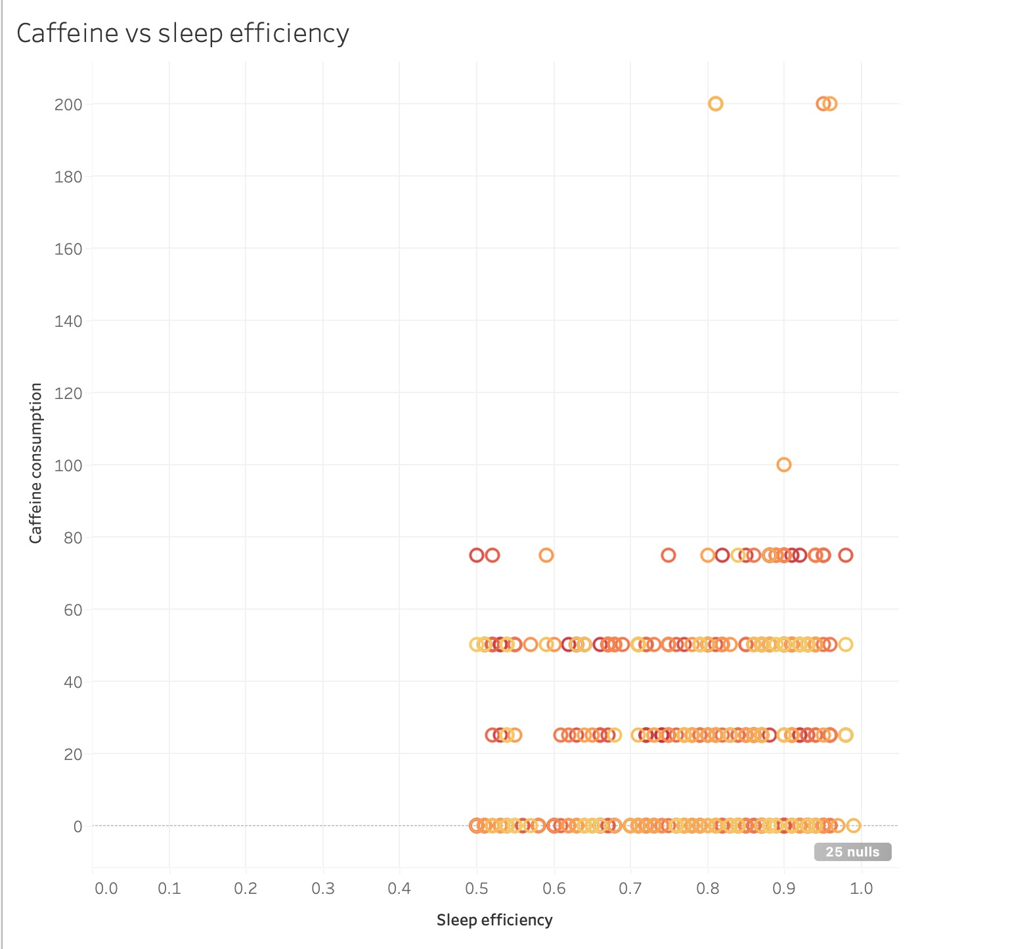
Viz 6: Caffeine vs Sleep
Goal
Show the effects that drinking caffeine during the day has on sleep
Encoding
X axis holds avg. Sleep efficiency and Y-axis holds caffeine intake
Advantage
There is no correlation between caffeine and sleep efficiency but with there needs to be more data to show better result

Slide 14
Live Demo
Tableau Desktop, Tableau Public or Python Demo

Slide 15
Summary of Findings and Insights
Data from the 618 records taken in 2021 show:
Light sleep and deep sleep ratios are proportional and tend to be higher or lower compared to each other
Deeper sleep yields better sleep
Data taken doesn't evenly include young and older groups due to difficulty gathering sleep information
Age has no correlation with sleep efficiency
Adult Males tend to have worse sleep than women
Longer sleep duration doesn't mean better sleep
Health issues cause awakenings reducing sleep quality

Slide 16
Extensions and Future Work
Create software on the dataset to provide users recommended adjustments to habits and sleep schedule for better sleep.
Analyze why health related factors like smoking aren't affecting sleep awakenings in expected ways. Gather more data to note if work & employment affects sleep.
More data can be collected regarding time of caffeine intake, alcohol, and different populations to show more correlations.
Find discrepancies of sleep reported by participants and sleep measured.
Notes:
Sleep apnea leading to poorer sleep cycles and sleep quality

Slide 17
Reference
Ishhjain. “Sleep Efficiency Updated Dataset.” Kaggle, 9 June 2023, www.kaggle.com/datasets/ishhjain/sleep-efficiency-updated-dataset/data.
EQUILIBRIUMM. “Sleep Efficiency Dataset.” Kaggle, 21 February 2023, https://www.kaggle.com/datasets/equilibriumm/sleep-efficiency

