Slide 1
S5BD Line Up Enhancement
2015.4 Pan Liu

Slide 2
Content
What & Why
Resolution
Implementation

Slide 3
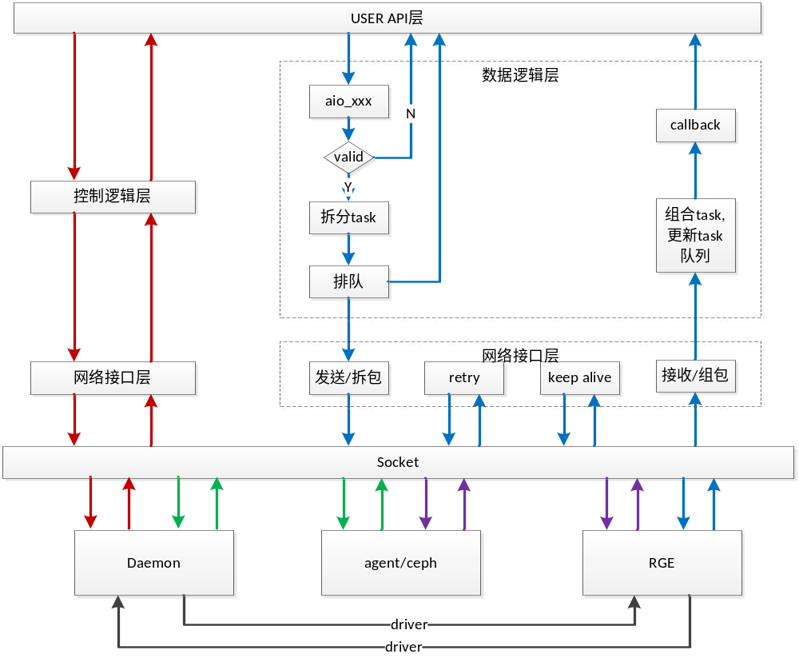
S5bd Flow Chart

Slide 4
Issue One - Mutual Exclusion

Slide 5
What & Why
Line-up machine inside S5BD:
4M block node
    Running unit node
    Ready unit node
Running Queue
Ready Queue
In the same 4M block:
  Read-write mutual exclusion
  Write-Write mutual exclusion
Performance loss.

Slide 6
What & Why
  Case One: Next read or write must wait in the ready queue, until last write finishes.
w
w
r
Ready Queue
Running Queue
r
r

Slide 7
What & Why
  Case Two: Next write must wait in the ready queue, until last read/write finishes.
r
r
r
w
Ready Queue
Running Queue

Slide 8
Resolution - One
No line up at all? Just send the requests to RGE as user asks…
  No. RGE will not make sure the operation sequence.
  When miss, session retry will also not make sure the operation sequence.

Slide 9
Resolution - Two
When the operation data of two requests have no overlap, don’t need to line up.
Read-Read requests don’t need to line up at all.

Slide 10
Implementation
Add two arrays for each BlockNode instance.
Both size = 1024(4M / 4K)
One array for write. Each array item represents a flag:
  True means write that 4k.
  False means no write for that 4k.
  Reset the flag when write replies.
The other array for read. Each array item represents
a counter:
  Increase it when one read on this 4k.
  Decrease it when one read replies.

Slide 11
Implementation
If one request is blocked(because of overlap with last one), the next requests in the same 4M will be blocked too.
Current issue: BlockNode will be created when use, but not deleted. (Jigui)
Memory use: (2B + 1B) * 1024 * 512 = 1.5MB

Slide 12
Implementation
Write1 – Read2: Speedup.
Read1 – Write2: Speedup.
Write1 – Write2: Speedup.
Read1 – Read2: Slow down.

Slide 13
Issue Two – Retry When Miss

Slide 14
What & Why
If one request needs retry, all the next requests will also need retry, until load finishes.
This will make burden to S5, and occupy many S5 resources.
w
r
r
r

Slide 15
Resolution
When “request A” is retrying, all the tasks in the same 4M queue will be held.
When “request A” replies, unlock the pending tasks.
Can not make sure all requests will be hold.

Slide 16
Implementation
Add a flag for each BlockNode instance.
  False: 4M miss the cache.
  True: 4M hit in the cache.
When retry happens, set the flag of the BlockNode to false.
When reply, reset the flag of the BlockNode to true, continue sending tasks.

