Slide 1
Undergraduate Project:
YOLO-based License Plate Recognition

Slide 2
Contents
Problem Statements
Backgrounds
Solution
Implementation
Evaluation

Slide 3
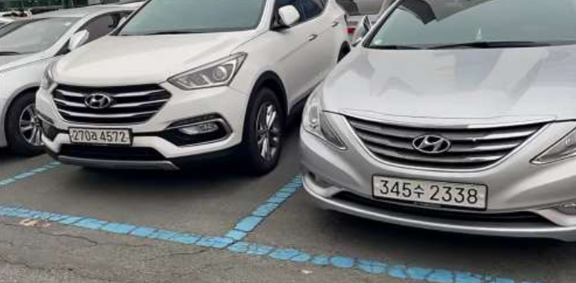
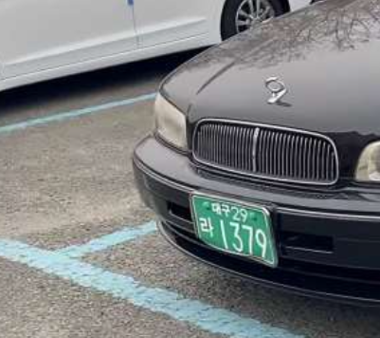
Problem Statement
Given
A set of video frames with license plates
A diverse type of license plates
License plate recognition
Detect license plates in the image and draw bounding boxes surrounding them
Extension of object detection problem
Utilized in various real-world applications including traffic management, parking lot management
Example image

Slide 4
Background
Deep-learning based object detection
YOLO (You-Only-Look-Once)
Partition the input image into SxS grids and find bounding box coordinates in each grid
SSD (Single Shot Detector)
Find bounding box coordinates in a number of image resolutions
YOLO-approach: Grid-based detection
SSD-approach: Multi-resolution detection

Slide 5
Solution
YOLO-based license plate recognition
Select YOLO for faster processing
Real-time processing of a video with license plates in its frames
Tuning hyperparameters and YOLO version for accuracy improvement
Batch size
Training dataset size : Test dataset size
YOLO v3, v4

Slide 6
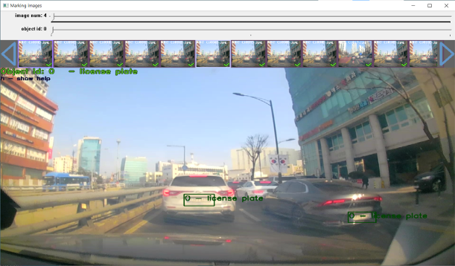
Implementation
Data labelling
Extracted 5,000 video frames from black-box videos with 5 fps settings and manually labelled each video frames
Training
Trained on NVIDIA RTX 3060 Ti with approximately 160K iterations
Labelling dataset

Slide 7
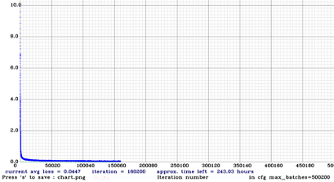
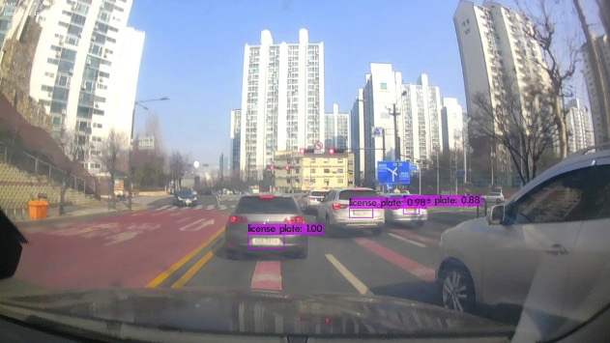
Evaluation
Achieved 82 % accuracy with 0.044 loss rate
Hyperparameter tuning and YOLO’s version replacement shows nearly no difference in accuracy
Batch size tuning (32 / 64 / 128)
Training : test dataset size ratio (9:1 / 8:2)
YOLO version (v3 / v4)
Loss rate convergence
Demo license plate recognition

