Slide 1
ITSM, AI agents, agentic workflows, and where analytics fits
ITSCM 451Z · MODULE 7 · CONCEPTUAL LECTURE
What changes when a goal-directed program is allowed to touch a service desk, who approves it, how it is undone, and why the answer is measurement as much as governance.
Notes:
Framing for the whole hour: two shifts landing at once, and the course premise that an agent that cannot measure its own effect on the desk cannot be trusted with the desk. Everything named today is something the student has built or will build.

Slide 2
By the end of the hour you can
OBJECTIVES
1 · Define
2 · Describe
An AI agent and an agentic workflow, told apart from a script and from a fixed workflow.
ITSM under ITIL 4: the value chain, the four dimensions, and the three practices that carry the rest of the course.
3 · Explain
4 · Place
Why change and release are the least mature places for an agent, and the three answers: deterministic gates, human checkpoints, incremental scope.
The four kinds of analytics inside the agent’s loop and inside the ITIL practices, with one example of each from this course.
5 · Sketch an agentic workflow for an ITSM scenario and mark its checkpoints, guardrails, data sources, and the analytics that feed it.
Objectives
Notes:
Five objectives. The fourth is the one the draft lecture lacked and the one this course is built on.

Slide 3
Sixty-five minutes, seven sections
OUTLINE
Minutes | Part | Topic
0 to 5 | I | Two things changing at once
5 to 15 | II | Agents and agentic workflows
15 to 27 | III | ITSM and ITIL 4
27 to 38 | IV | Change enablement, release management, deployment management
38 to 50 | V | Where analytics fits
50 to 58 | VI | Agents in ITSM today, and the governance problem
58 to 65 | VII | Synthesis, discussion, exercise
Outline
Notes:
Part V is highlighted because it is the addition. Each section comes back to one of the six figures on the next slide.

Slide 4
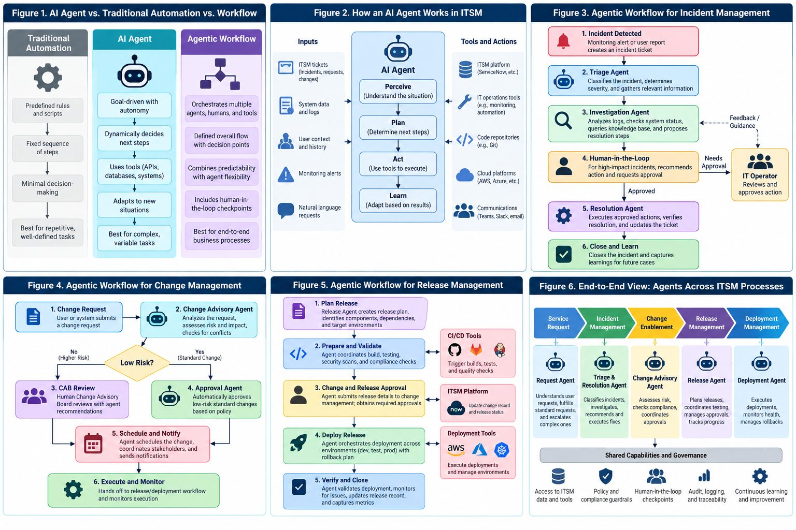
The map for today: six figures
THE MAP
Figure 1: agent vs automation vs workflow · 2: the loop · 3 to 5: incident, change, release · 6: end to end
Notes:
Leave this up for a minute. Each later section names the figure it returns to: Part II is figures 1 and 2, Part IV is 4 and 5, Part V reads 3 to 5 again with the analytics table beside them.

Slide 5
Two things changing at once
PART I
Service management loosened
Automation became goal-directed
ITIL 4 (2019) replaced the gatekeeping processes of ITIL v3 with practices meant to enable value. “Change management” became “change enablement” on purpose.
A script does what it is told, in order. An AI agent is given a goal and a set of tools and decides the steps itself.
The question the course is built around: who approves an agent’s decision to change a production system, how is the decision recorded, and how is it undone? That is the design of the registry, the approval queue, and the before-image in Module 7.
Part I · Two things changing at once
Notes:
The premise: the answer is not only governance, it is analytics. An agent that cannot measure its own effect on the desk cannot be trusted with the desk.

Slide 6
Three kinds of program, three rungs of this course
PART II · FIGURE 1
Traditional automation
AI agent
Agentic workflow
Predefined rules, a fixed sequence, minimal decision-making. Reliable, auditable, blind to anything the rules did not anticipate.
Here: the Rung 0 poller
Driven by a language model. Perceives, chooses among actions, uses tools, adapts. Autonomy within limits, goal orientation.
Here: the model in the loop, Rung 4
A defined overall flow with decision points; agents, people and systems act at set steps. The flow is fixed; a step may be dynamic.
Here: the whole repository
The distinction that matters for ITSM is predictability versus adaptability. You want both, and you want to know at every step which one you are using.
Part II · Agents and agentic workflows
Notes:
Nearly every real deployment is a deterministic skeleton that calls agents at well-defined points and puts a human at the points that matter.

Slide 7
The loop an agent runs
PART II · FIGURE 2
Perceive
Plan
Act
Learn
Tickets, system data, user context, alerts
Decide the next step
Call a tool: the ITSM platform, monitoring, a repository, a message
Adjust from the result
Three phases of every agentic workflow
The word to keep: escalate
Planning: interpret the goal, choose a strategy. Execution: act through tools. Iterative adaptation: evaluate, revise, escalate.
An agent that cannot say “I am not sure, a person should look” is not safe to run.
Part II · Agents and agentic workflows
Notes:
Part V comes back to these four boxes and puts one kind of analytics in each.

Slide 8
The registry is the skeleton; the model only chooses a door
PART II · IN THIS COURSE
Piece | What it is | Fixed or dynamic
One door, four tiers | Every tool call passes through dispatch; the tier comes from the schema file | Fixed: a caller cannot pick a branch
The tools behind the door | Read, propose, assign, resolve, comment; each checks its target | Fixed: deterministic Python
The model (Rung 4) | Given a ticket and the tool schemas, decides which tool to call | Dynamic: it chooses which door, never what is behind one
The two logs | Audit entries and proposals, append-only | Fixed: every branch writes one, refusals included
A workflow gives you an execution path you can audit before it runs. An agent gives you the ability to handle a ticket nobody wrote a rule for. The repository is the first wrapped around the second.
Part II · Agents and agentic workflows
Notes:
Figure 1 again: the three columns are, in order, Rung 0, Rung 4, and the whole repository.

Slide 9
ITIL 4’s service value chain, and where you have already met it
PART III
Activity | What it means | In this course
Plan | Strategy and direction | COURSE_CONTEXT’s capability ladder
Engage | Understand what stakeholders need | The SLA page (Module 3)
Design and transition | Create and change services | Every ADR; the model pin (Module 4)
Obtain and build | Acquire or build components | Training a classifier (Modules 3 and 4)
Deliver and support | Run the service, resolve incidents | The poller, the read tools, the write tools
Improve | Measure and improve | The eval harness; the KPIs (Module 8)
ITSM is the management of technology as a service, with customers, targets and costs. ITIL 4 is the current edition of the most widely used framework for it; the six activities are not a sequence.
Part III · ITSM and ITIL 4
Notes:
ITIL 4 dates from 2019. The point of the third column: the student has already done one thing in every activity without naming it.

Slide 10
Four dimensions, three practices
PART III
Any service, from four sides at once
The practices that carry the rest of the hour
Organizations and people
Information and technology
Partners and suppliers
Value streams and processes
An agent touches all four: it is technology, it changes who does what, it is usually supplied by a vendor, and it sits inside a value stream. Consider only the second and the deployment fails on the other three.
Practice | Purpose
Change enablement | Assess risk, authorize changes to proceed
Release management | Make new and changed services available
Deployment management | Move components into live environments
Related and distinct. Confusing them is a common source of unclear ownership.
Part III · ITSM and ITIL 4
Notes:
Practices replaced processes in ITIL 4’s vocabulary. The next section takes the three one at a time.

Slide 11
Three change types are the three write tiers
PART IV · FIGURE 4
Type | What it is | Who approves | In the agent
Standard | Pre-approved, repeatable, low risk: monthly patching, a standard laptop | Nobody each time; the type was approved once | autonomous: no tool has it; nothing has earned it
Normal | Needs assessment and approval; most of the pipeline | The CAB or a delegated authority | execute_with_approval: a named person approves this exact call, once
Emergency | Urgent, expedited; reviewed afterwards | Emergency CAB or named authority | Not granted: the audit log is the review, but nothing acts first
Change record | The written description before the change is made | — | propose: the agent drafts, a human makes it
Purpose of change enablement: maximize the number of successful changes by assessing risk, authorizing, and managing the schedule. The before-image is the back-out plan the CAB keeps asking for. The six rows in the desk’s change history are reviewed in Module 8: was “successful” true for all of them?
Part IV · Change enablement, release, deployment
Notes:
This is the mapping the student lives in Module 7. Granting the autonomous tier is an ADR plus a governance row; nothing has it yet.

Slide 12
The CAB problem, and the four habits that answer it
PART IV
Too many changes
Incomplete records
Manual reconciliation
Fatigue
The risky one slips through a cursory look.
No credible back-out plan, no test evidence.
Hours cross-referencing incidents, criticality, dependencies.
Decisions get worse as the meeting gets longer.
Modern guidance
Anchor every change to a business service, not only a configuration item.
Tiered risk rules by service criticality, with multipliers for concurrent changes.
Graduate proven procedures from normal to standard, on evidence.
Use AI to map raw text to services and correlate dependencies. A data task before it is an agent task.
Part IV · Change enablement, release, deployment
Notes:
The fourth habit is the hook for Part V: mapping text to services and correlating dependencies is analytics on the CMDB and the incident history.

Slide 13
A tag is a release; a pull is a deployment
PART IV · FIGURE 5
Release management
Deployment management
A release is one or more changes built, tested and deployed together. The practice plans, schedules and controls the whole, technical and non-technical, and protects what is already running. In DevOps settings: small, frequent, often staged with a pilot.
The narrower act of moving components into a live environment. One release may involve several deployments. Change enablement makes the go or no-go; release coordinates what follows; deployment moves the bits.
ITIL | In this course
Release | Tag v0.1: a trained model, its card, its ADR, a pin and an eval report, bundled
Release record | The GitHub release page with the report attached
Deployment | git pull on your laptop
Part IV · Change enablement, release, deployment
Notes:
Small, but the whole shape, and why the course insists on a tag per rung.

Slide 14
Analytics is not a feature of the agent. It is the loop the agent runs in.
PART V · WHERE ANALYTICS FITS
Descriptive before deployment, predictive inside planning, prescriptive at the tier boundary, diagnostic afterwards.
Notes:
This is the section the vendor material leaves out and the one the course is built on. Twelve minutes.

Slide 15
Four kinds of analytics, one loop, one course
PART V · FIGURE 2 AGAIN
Kind | Question | In the agent’s loop | In this course
Descriptive | What happened? | Perceive: the facts the agent and its operators see | KPIs: MTTR, SLA attainment, backlog aging, Pareto (Module 8); the Module 2 notebook
Diagnostic | Why did it happen? | Learn: explaining an outcome after the fact | Change impact: did a change cause incidents (Module 8); clustering into problem candidates (Module 13)
Predictive | What will happen? | Plan: a label or a score before acting | Category classifier (Modules 3 and 4); SLA breach-risk score (Module 10); volume forecast (Module 11)
Prescriptive | What should be done? | Act: a recommendation with a tier | Routing a ticket to a group; proposing an assignment or a resolution (Module 7); retraining policy (Module 14)
Part V · Where analytics fits
Notes:
Each cell is something the student builds. Walk the loop slide from Part II with this table beside it.

Slide 16
Two points about that table
PART V
The model is not the analytics
Prescriptive is where the tiers live
The classifier is one predictive cell. Most of the value, and most of the risk, sits in the descriptive and diagnostic rows, which are a groupby and a comparison against a baseline.
A desk that cannot say what its MTTR was last month cannot tell whether an agent made it better.
“Assign to Network Ops” is analytics until it is acted on. The tier decides whether the agent may act on its own recommendation.
Analytics produces the recommendation; change management decides who may execute it. That is the whole link between the two threads of this course.
Part V · Where analytics fits
Notes:
Pause on the right-hand card. It is the sentence to remember if nothing else from Part V survives.

Slide 17
Analytics inside each practice
PART V · FIGURES 3 TO 5
Incident management
Change enablement
Release management
Triage is prediction (category, priority, group). Investigation is retrieval, which is similarity analytics. Resolution is prescriptive. Close and learn is descriptive: the ticket joins the history that trains the next model.
The risk rating is predictive, built on descriptive inputs: incident history for this item, change failure rate, concurrent changes. The “low risk?” diamond is a threshold on a score; who sets it is governance. The post-implementation review is diagnostic: the Module 8 method, every time.
Readiness is a scorecard: tests, coverage, dependencies, security scans. Verify and close is descriptive again: metrics after against metrics before. For a model release, that is the bake-off table and the harness.
The fourth CAB habit, “use AI to map text to services and correlate dependencies”, is in this slide twice: once as retrieval, once as the change-impact review.
Part V · Where analytics fits
Notes:
Read figures 3, 4 and 5 again with the four-kinds table beside them; each box in those figures is one of the four kinds.

Slide 18
Agents are only as good as the data behind them. That is an analytics problem.
PART V
What every vendor says after a first deployment
The analytics reading
An agent rating change risk needs accurate configuration items, dependencies, vulnerability data and incident history. With a half-maintained CMDB it produces confident, wrong ratings, faster than the people it replaced.
Before an agent, run the descriptive analytics. If the KPIs cannot be computed cleanly, the agent inherits every defect. Module 2 found one: the PDI stamped every historical timestamp with the load time, so time-based analytics reads the CSV and joins on a correlation id. That finding shaped the whole course.
Part V · Where analytics fits
Notes:
The student lived this in Module 2. Name it as a data-foundation finding, which is what a business analyst would have written up.

Slide 19
Evaluation is analytics too, and so is the analyst’s job
PART V
The harness is a measurement program
What a business analyst does on an agent project
Four metrics are descriptive statistics of the agent’s behaviour on a fixed holdout set. harmful_action_count turns governance into a number. Module 14’s drift detection is diagnostic analytics on the agent itself. An agent program with no measurement program is a demo.
Define the KPIs the agent must move; measure them before deploying anything.
Find and fix the data defects the KPIs expose.
Build or evaluate the predictive pieces on a time-based holdout.
Design the recommendation and the threshold that turns it into an action.
Own the post-implementation review.
Every one of those five is a module of this course. The job is not “write the model”.
Part V · Where analytics fits
Notes:
End of Part V. Close with the list on the right: it is the student’s job description.

Slide 20
Not every ITSM task is equally ready for an agent
PART VI · FIGURE 6
Tier | Use case | Maturity
1 | Incident triage, knowledge retrieval, ticket deflection | Most mature
2 | Request fulfilment, automated incident creation | Emerging
3 | Change approval, autonomous release decisions | Least mature, highest risk
The principle underneath: the more consequential and the less reversible the action, the more caution it needs. A wrong triage is reassigned in a minute; a wrong production change may not be undoable.
The capability ladder of this course climbs this table from the bottom row of risk to the top: read first, then propose, then execute with approval, and nothing autonomous yet.
Part VI · Agents in ITSM today, and governance
Notes:
Industry assessments as of 2026. Change management remains the least proven use case; that is a reason for incremental deployment, not avoidance.

Slide 21
What vendors ship in 2026
PART VI
Change manager agents
Release agents
ReleaseOps
Lansweeper’s Change Manager, BMC Helix’s Change Risk Advisor, ServiceNow’s intelligent change management. Read the request, cross-reference incident history, asset criticality, vulnerabilities and collision rules, produce a risk rating: approve, approve with conditions, escalate. Some auto-approve low-risk normal changes against policy.
AWS DevOps Agent’s release manager tools; multi-agent release teams arranged as a directed graph of release manager, CI/CD, tester, docs, dependency and security agents. Readiness reviews on every pull request; human approval at defined gates.
An agent’s prompts, policies and model configuration are a versioned artifact promoted through gated environments. An agent is itself software that must be released.
You already do this: the model pin, the card, the tag.
Part VI · Agents in ITSM today, and governance
Notes:
Vendor claims as the draft stated them, dated 2026. The third card is the one to connect to the course: ADR-0008 in Module 8 writes it down.

Slide 22
Four governance patterns, each with a file in the repository
PART VI
Pattern | What it is | Here
Deterministic gating layer | Hard rules the agent cannot argue with, with its judgement inside them | Tiers in schema files; dispatch
Pre and post guardrails | Checks before the action and verification after it | Target-exists checks; before-image and after-image
Human-in-the-loop checkpoints | High-risk actions need a named approver even after the agent assessed them | The approval queue; --as NAME
Checkpointing and recovery | State is saved so an interrupted workflow resumes without acting twice | Idempotency keys; the Module 14 kill-mid-workflow scenario
Four questions traditional frameworks were not built to answer: who is accountable when an agent’s decision causes an outage; how its reasoning is reconstructed afterwards; which changes it may approve alone; when it hands off to a person. ITIL 4 already says what has to be managed when many semi-autonomous actors change a shared system. A working ITSM foundation governs agents better than none.
Part VI · Agents in ITSM today, and governance
Notes:
The third column is the point: none of these patterns is abstract for the student; each is a file they have opened.

Slide 23
Six things to keep
PART VII
1
2
Agentic workflows move automation from fixed sequences to goal-directed steps inside a defined flow. The flow is where the control lives.
ITIL 4’s three practices are the governance frame, and they map onto tiers, tags and pulls in this repository.
3
4
Agents are mature for triage and retrieval, emerging for requests, least proven for change and release. Climb in that order.
Analytics is not a feature of the agent; it is the loop the agent runs in. Descriptive before, predictive inside, prescriptive at the tier boundary, diagnostic after.
5
6
The data foundation is an analytics problem, found by computing the KPIs first.
An agent is software to be released: prompts, policies, models, versioned and gated.
Part VII · Synthesis
Notes:
Number four is highlighted on purpose.

Slide 24
Discussion
PART VII
Accountability
Data first
An agent auto-approves a standard change that causes a major outage. Who is accountable: the builders, the change manager who set the autonomy threshold, or the CAB that delegated the authority? Design the rule in three sentences.
A company with a half-accurate CMDB wants a change manager agent. What do you measure before deploying anything, and what guardrails hold for the first six months?
The review as a standing report
ReleaseOps
The Module 8 change-impact method run after every change: which of the four kinds is it, what threshold would you set on the ratio, and what do you do with a result that depends on the window length?
Prompts and model configurations as versioned artifacts. What belongs in the release notes of an agent behaviour change, and who should have to approve it?
Part VII · Discussion
Notes:
Pick two for a one-student class. The third one is the most useful follow-up to Module 8.

Slide 25
Design the pilot: a one-page memo
PART VII · EXERCISE, 10 MINUTES IF TIME ALLOWS
The situation
Answer, in order
You are the ITSM lead at a 2,000-person company. 400 to 500 normal changes a month. A weekly CAB that runs three hours. A 12 percent change failure rate. Leadership has approved a pilot of a change manager agent.
Which change types may it approve alone, and which always go to a person?
Which data sources must it have, and which KPI would you compute first to find out whether they are good enough?
Success metrics for a 90-day pilot: measured how, against what baseline?
What happens when the agent is unsure?
These are the same questions the governance document in Module 8 asks about your own program.
Part VII · Exercise · Readings and vocabulary are in the lecture notes
Notes:
Collect it as a page in the journal if time runs out. Readings: UK Government AI Insights on agentic workflow; Lansweeper on the change manager agent; Freshworks on change management best practices; AWS DevOps Agent release manager tools; Atomicwork on ITIL 4; and the repository’s COURSE_CONTEXT and governance document.

