Slide 1



Risk among smokers
$$(B+w_{N}Δ, B+w_{S}Δ)$$
$$B+w_{S}Δ$$
Risk among non-smokers
$$B+w_{N}Δ$$

Slide 2
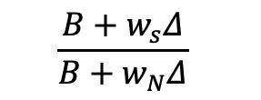
Risk among smokers
$$B+w_{S}Δ$$
$$\frac{{B+w}_{s}Δ}{{B+w}_{N}Δ}$$
$$B+w_{N}Δ$$

Slide 3



Risk among smokers
$$B+w_{S}Δ$$
$$(w_{N}Δ, w_{S}Δ)$$
$$w_{S}Δ$$
Risk among non-smokers
$$w_{N}Δ$$
$$B+w_{N}Δ$$

Slide 4
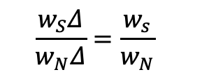
Risk among smokers
$$B+w_{S}Δ$$
$$w_{S}Δ$$
$$\frac{w_{S}Δ}{w_{N}Δ}=\frac{w_{s}}{w_{N}}$$
Risk among non-smokers
$$w_{N}Δ$$
$$B+w_{N}Δ$$

Slide 5
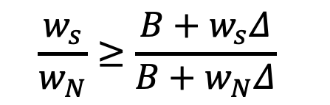
Risk among smokers
$$B+w_{S}Δ$$
$$w_{S}Δ$$
$$\frac{w_{s}}{w_{N}}≥\frac{{B+w}_{s}Δ}{{B+w}_{N}Δ}$$
Risk among non-smokers
$$w_{N}Δ$$
$$B+w_{N}Δ$$

