Slide 1



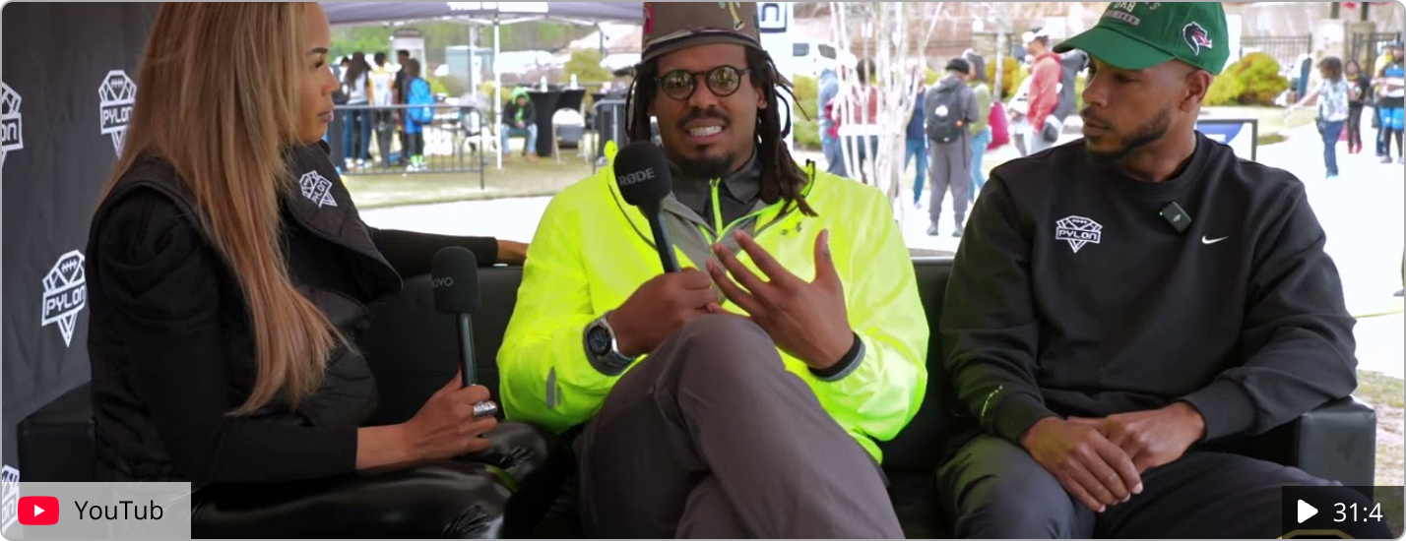
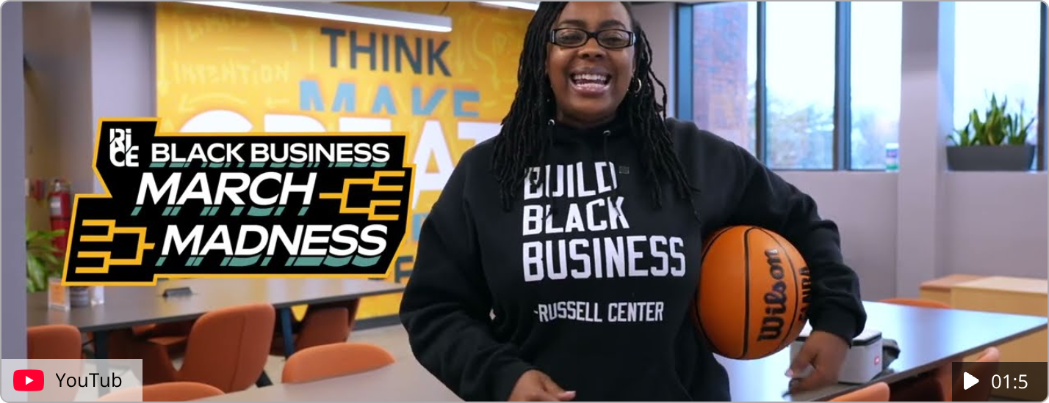
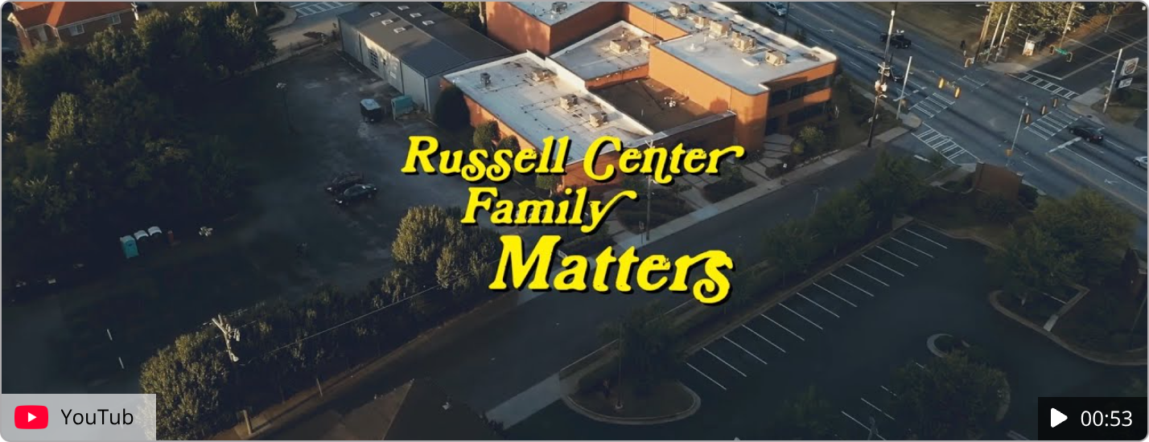
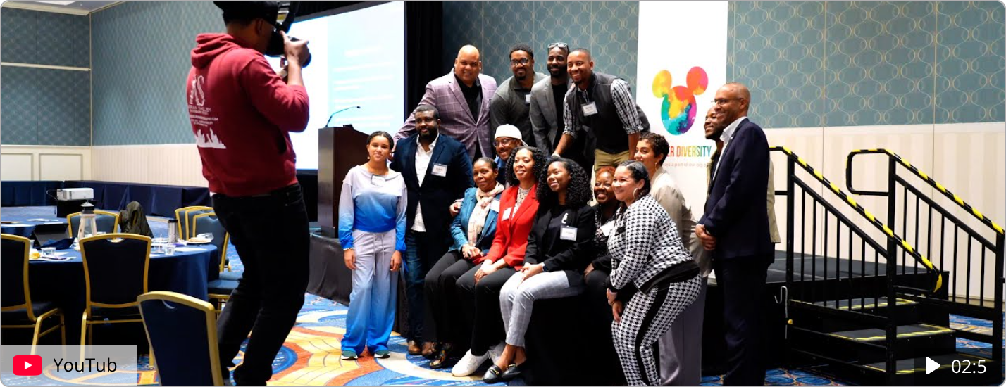
Portfolio Highlights
Witness the artistry behind impactful visuals. Our latest work, spanning compelling corporate narratives and electrifying live events, redefines production excellence and strategic engagement.
Our diverse portfolio spans short films, corporate videos, educational content, and event coverage. Each project is crafted with attention to detail and strategic alignment with client goals.

