Slide 1

R&D SOFTWARE REQUEST FOR TECHNICAL REACHBACK Benefits of the Python Based Scientific Analysis Suite: SciPy
23Jan2015
Requestor: Anthony Cochran, PhD

Slide 2
Request Summary
(U//FOUO) Request
Requestor: Anthony Cochran, PhD, Engility Corporation
Contact: 703-924-2543 or acochran.ctr@cnttr.dtra.mil
Request: Software installation for a DTRA Laptop. Field test data made available is not easily analyzed with present tools.
(U//FOUO) Provided
A Description to IT of the most relevant modules, a demonstration of analysis potential, long-term benefits and uses are provided
Copy of application is available on physical media for testing purposes, a download mirror links available at http://code.google.com/p/pythonxy/wiki/Downloads
Reachback: Anthony Cochran

Slide 3
Software Installation Request
Application | Description
SciPy (x,y) | Open Source modules designed to address all aspect of scientific data analysis
Python 2.7.9 | Flexible object oriented programming ideally designed for the scientific community
A physical copy of the Scipy (x,y) 2.7.9.0 Windows version is available, or it can be downloaded (~813 MB) at http://code.google.com/p/pythonxy/wiki/Downloads

Slide 4
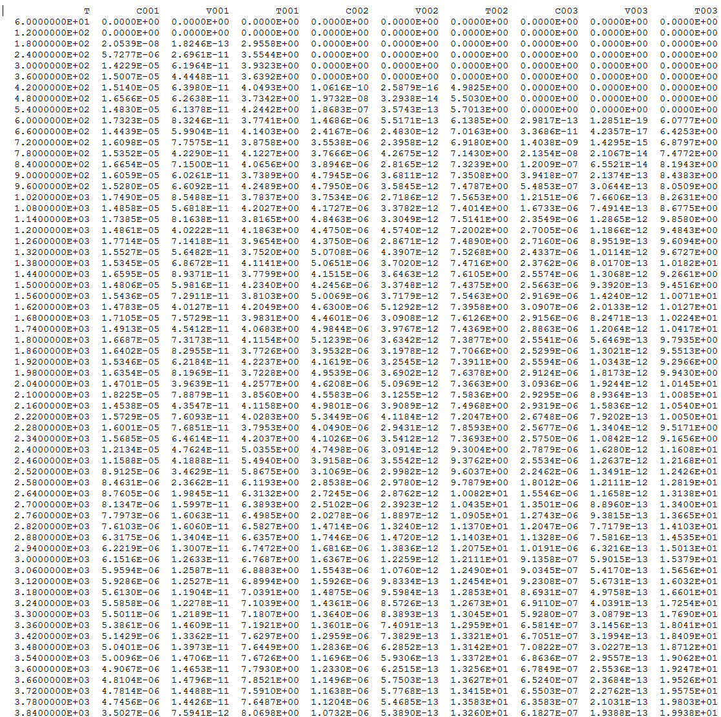
HPAC Data Demonstration
Snapshot of an HPAC sampler output file is limited and needs a lot of manipulation for effective interpretation. Typical hazard data are much more vast and complex

Slide 5
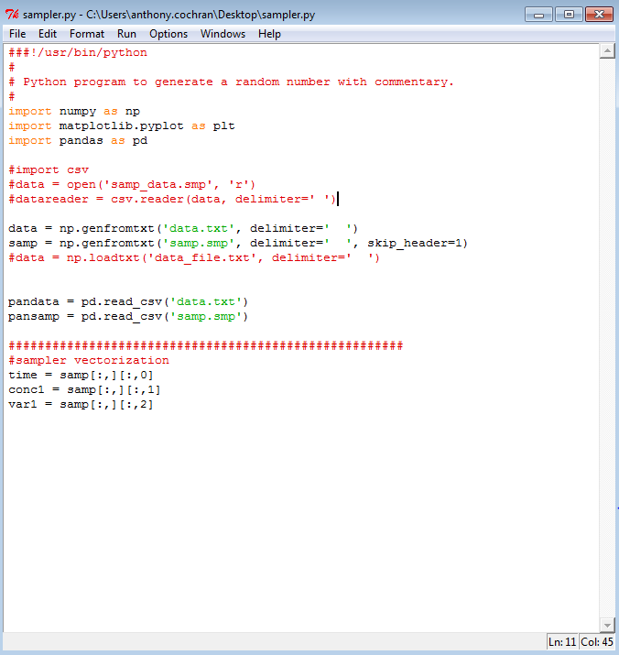
Python-SciPy Scripting
A simple code written in minutes vectorized the data: made it easy to manipulate, perform calculations, and apply matrix operations directly
Can be combined into multivariate-multidimensional arrays for optimization, regression analysis, and statistical analysis with existing modules.
Other data structures for large data sets such as SCIPUFF could possiblt be compressed into binary HD5 formats to make 3D time evolved contaminant modeling possible.

Slide 6
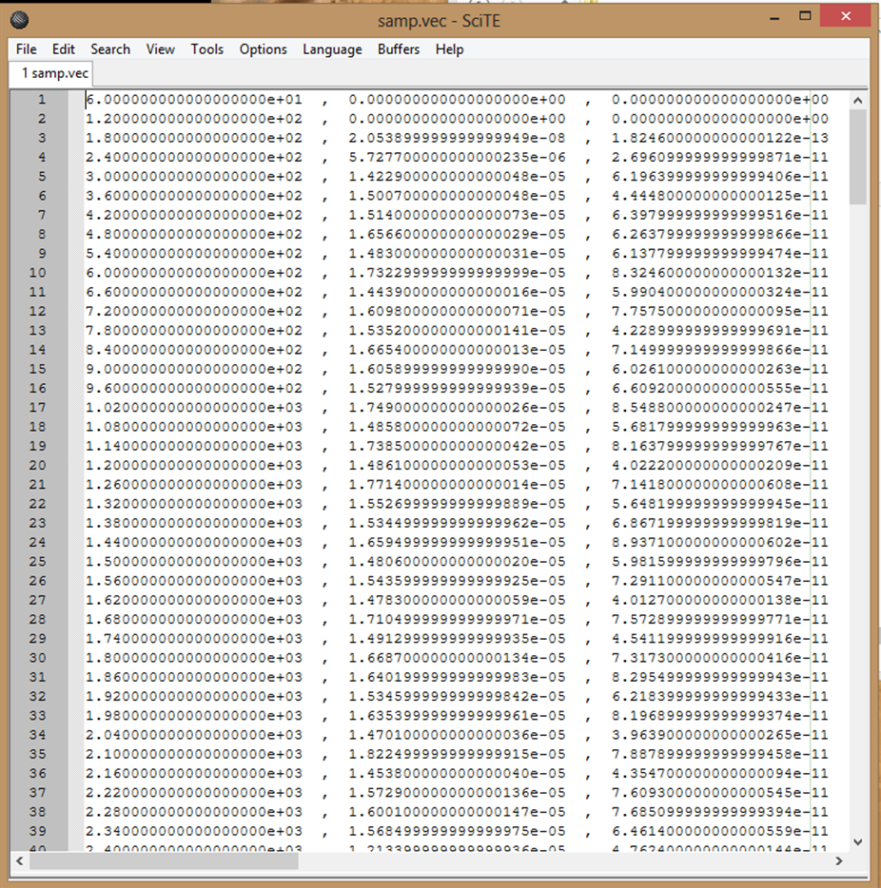
Restructured Data
Data sorted into vectors (time, concentration, variance) for more flexibility in calculations, optimization, interpolation, statistics, etc)

Slide 7
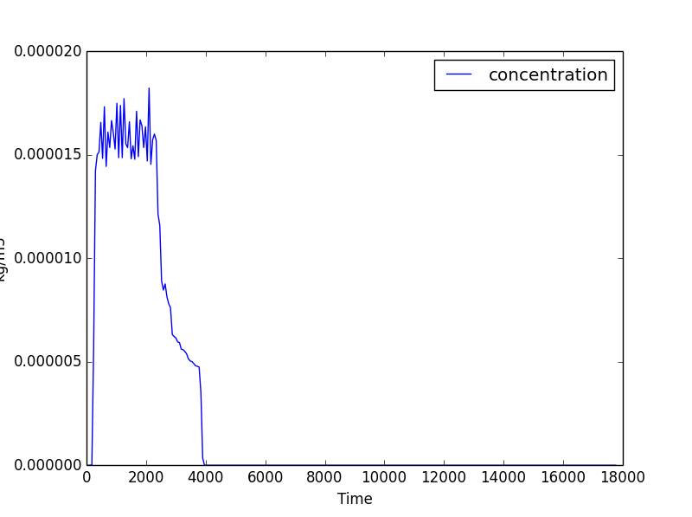
Individual Sampler information
Individual sampler concentration measurement is isolated from
the raw HPAC sampler data in seconds, just one of many uses of SciPy

Slide 8
Modules With Immediate Potential
Module | Potential Use
SciPy | Approximately 75 Open Source packages designed to deal with vast amounts of scientific data and large data sets
Matplotlib | MatLab equivalent, programmable plotting module (contours, 3D, etc).
NumPy | Matrix/Array based numerical structuring. Makes multivariate calculations and statistical analysis faster and easier. Numerous built in operations
H5Py | Binary data compression, faster processing and manipulation for handling larger file and time series data
QGIS | ArcGIS equivalent designed to integrate well with SciPy and the Python programming language. Will allow for eventual hazard mapping, potentially in 3-4 dimensions
Note: This mentions only 5 of over 75 modules available

Slide 9
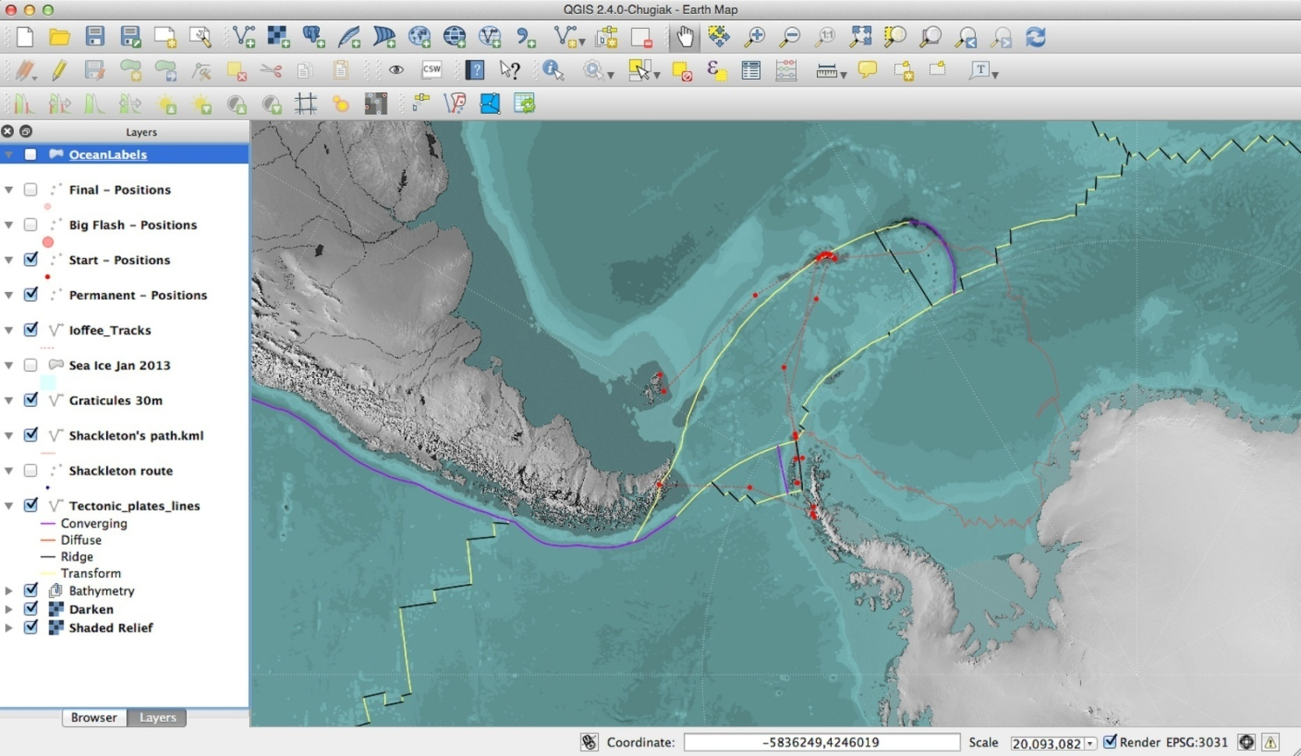
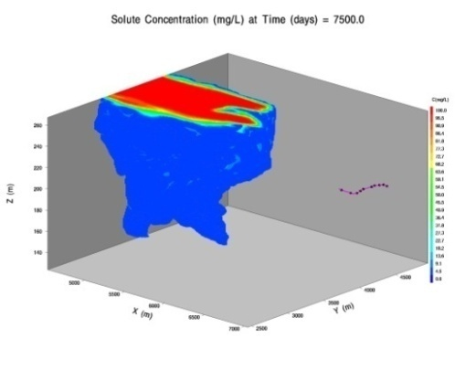
Long-Term Potential (demonstration only)
Easily Integrate moving 3D
hazard plumes with QGIS
Projected use: Hazard modeling in 3 dimensions with the ability to dynamically show smooth plume evolution

Slide 10
Conclusion
Unlimited potential with this application. All codes can be written with Reachback operations in mind so that they could potentially used to assist in adding information and capability to our end products.

