Slide 1
Analyze gene information from fly reference transcriptome GTF file
Jun Yin
05/01/18

Slide 2
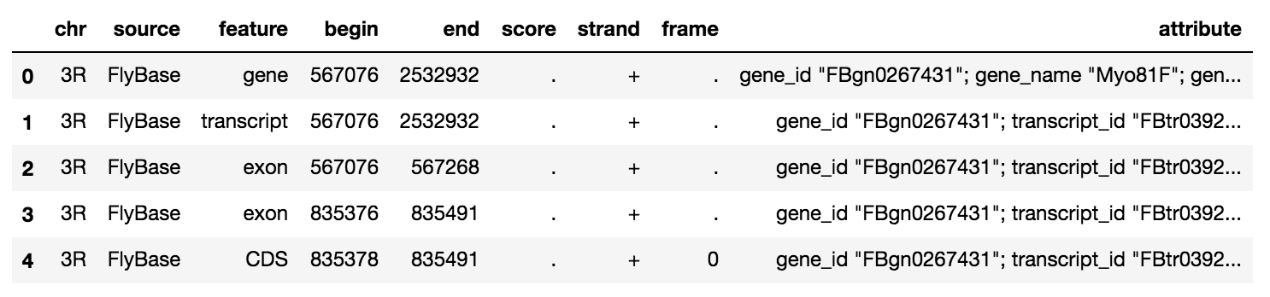
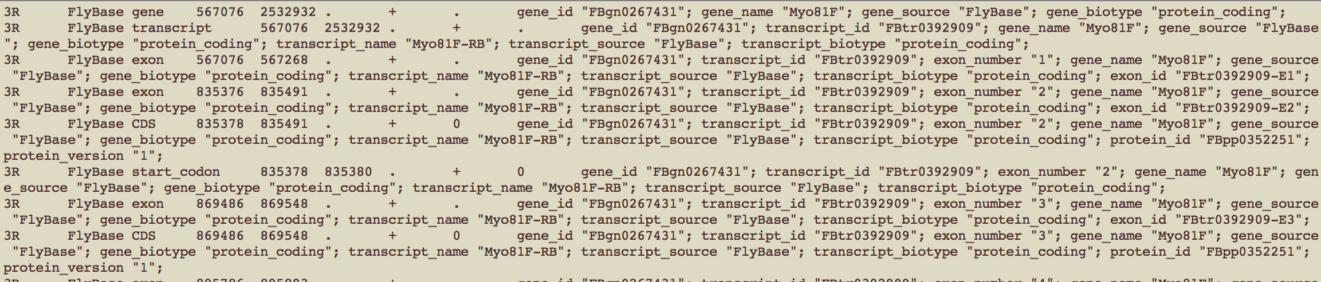
GTF file: tab-delimited text format
Reference transcriptome file is usually stored as GTF or GFF file
GTF/GFF file could reach to several Gb. Directly read it will use all of memory.

Slide 3
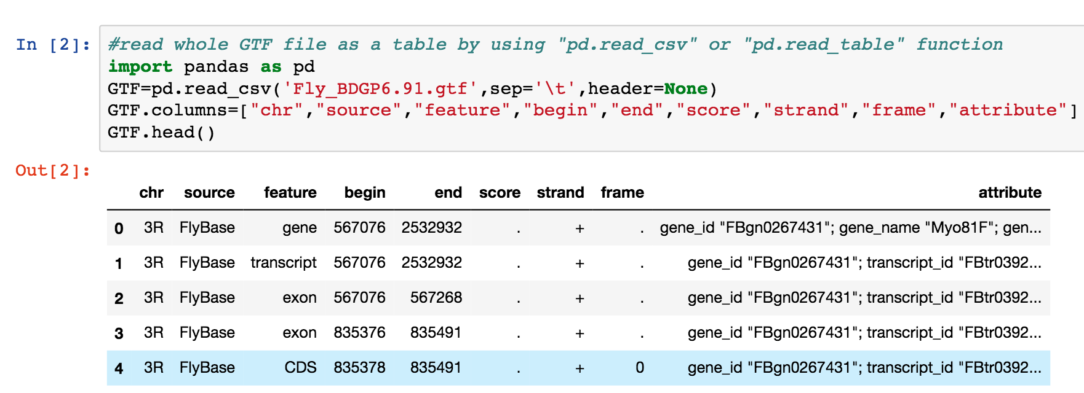
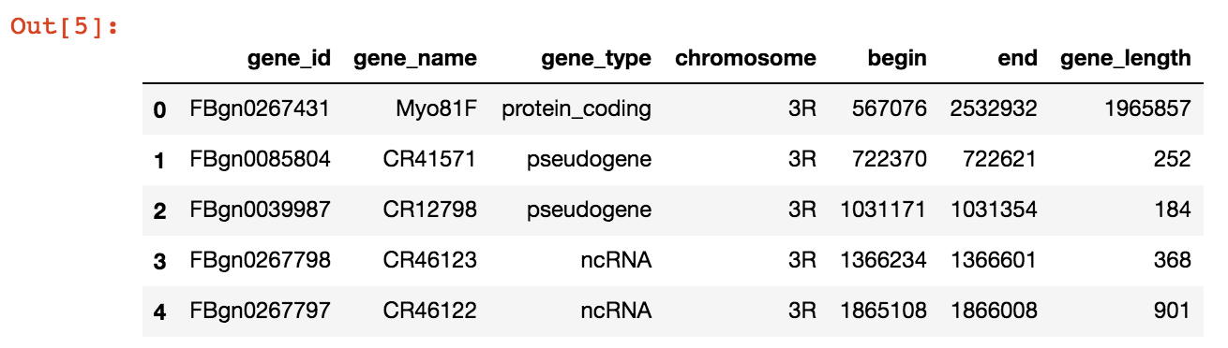
Desired output file
Input file
4
5
6
1
2
3
GTF
“Protein coding”
Output file

Slide 4
Workflow
Read GTF file
Unix/Pandas
Extract gene information from GTF file
1) For loop
2) Delimiter
3) write csv
Plotting
gene numbers in each chromosome
Gene numbers in each RNA type
Gene length frequency
Pandas
Pyplot

Slide 5
Use pandas to read whole GTF file

Slide 6
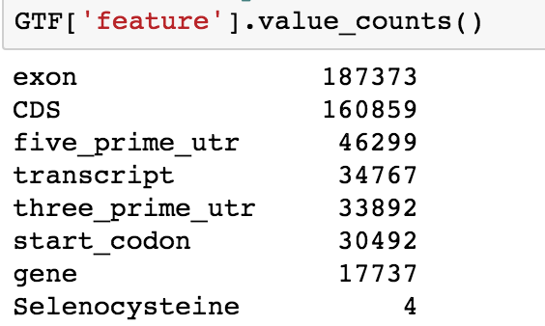
How many features in GTF file

Slide 7
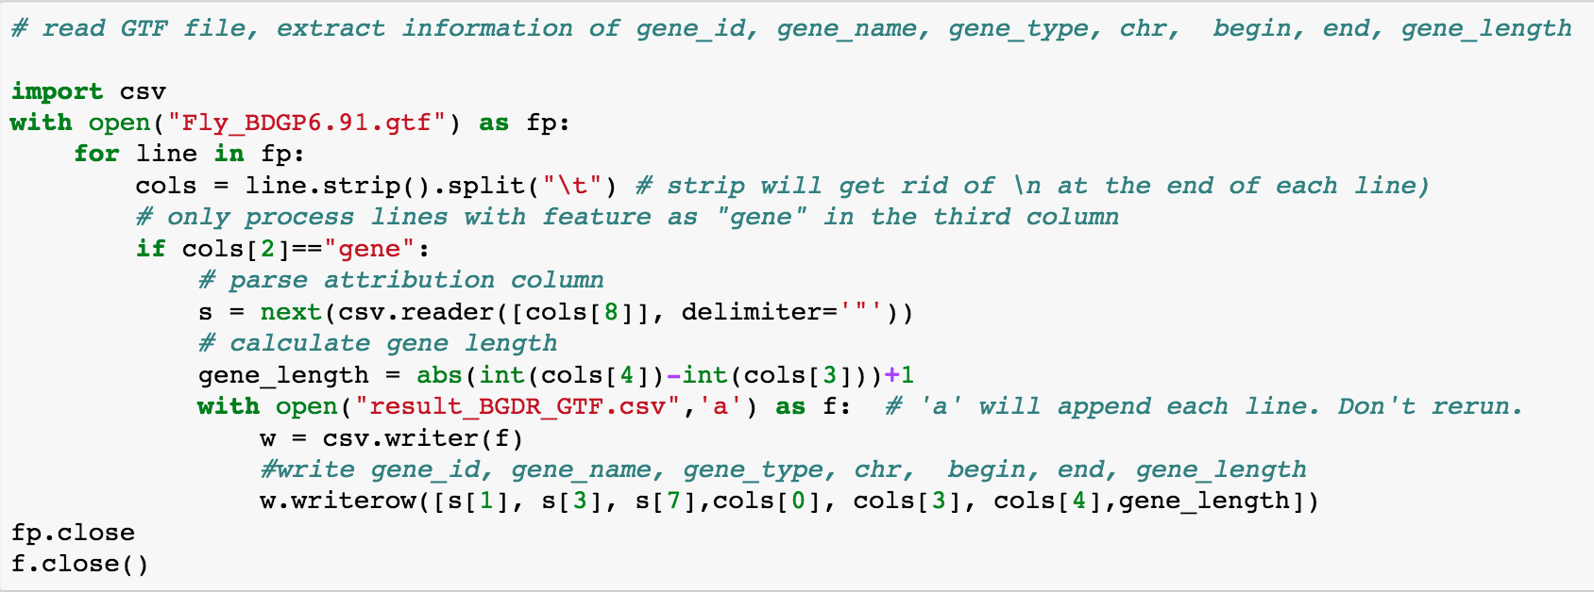
Python script to extract desired information
4
5
6
1
2
3
“Protein coding”

Slide 8
Work csv file with data frame in pandas

Slide 9
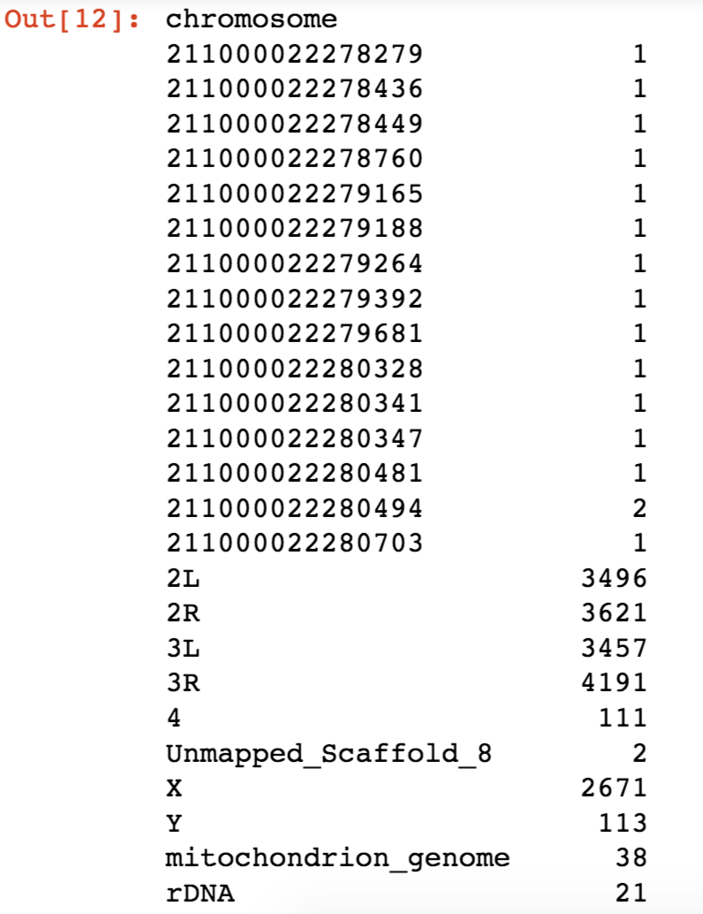
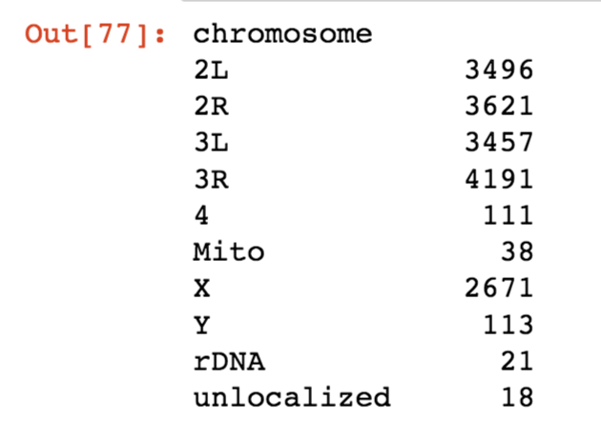
Replace all numerical chromosome to unlocalized chromosome

Slide 10
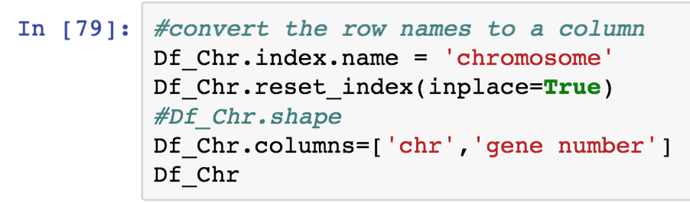
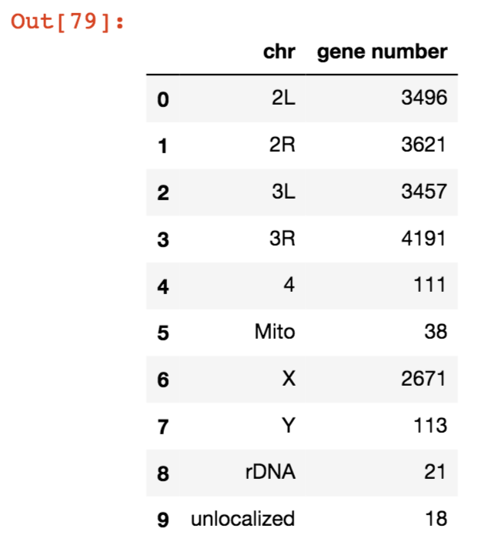
Convert row names to a new column

Slide 11
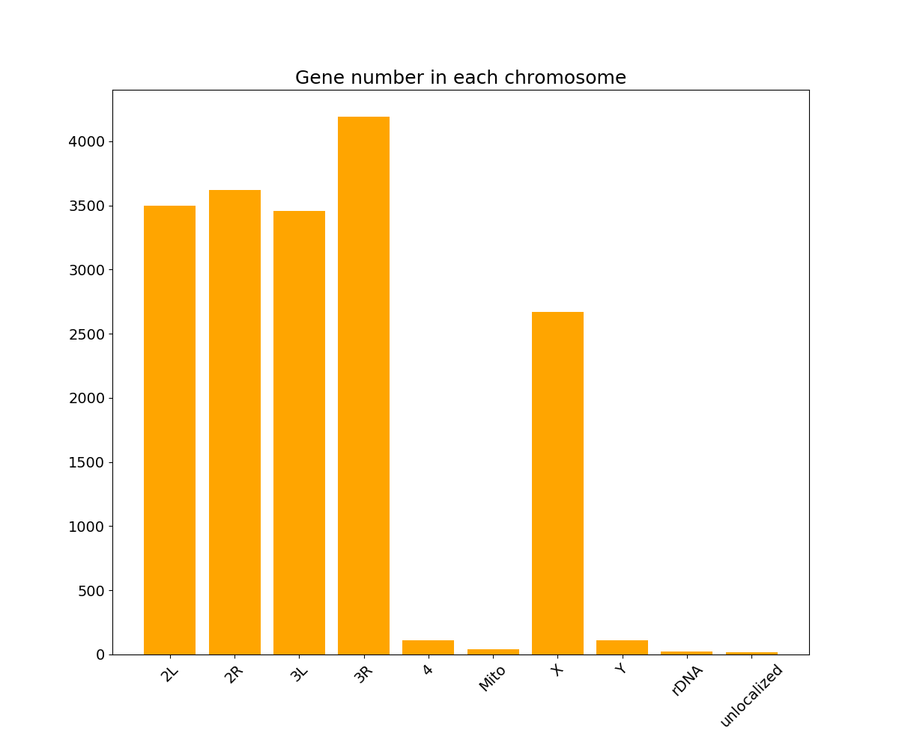
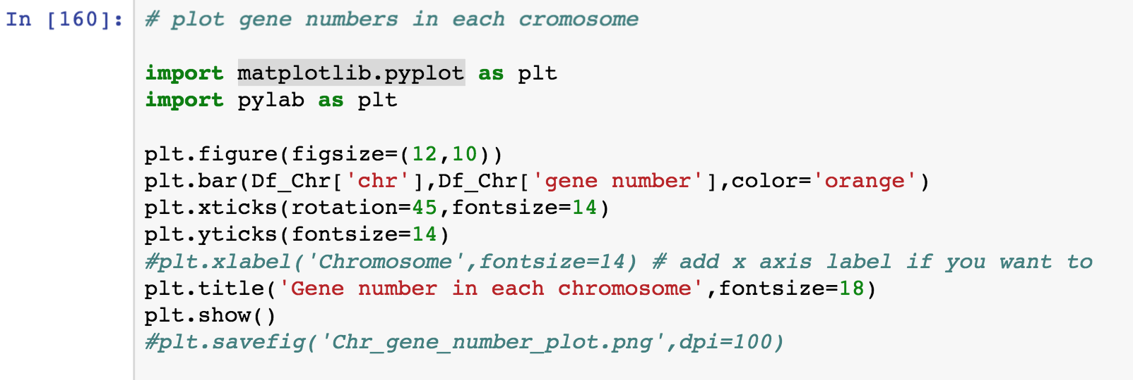
Plot gene numbers as plt with matplotlib.pyplot

Slide 12
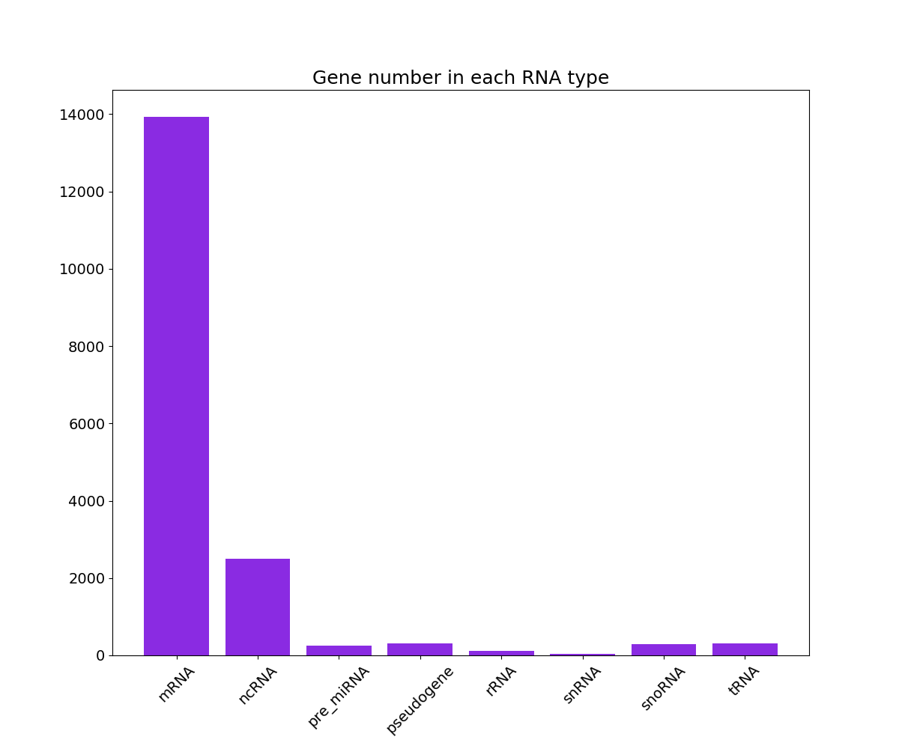
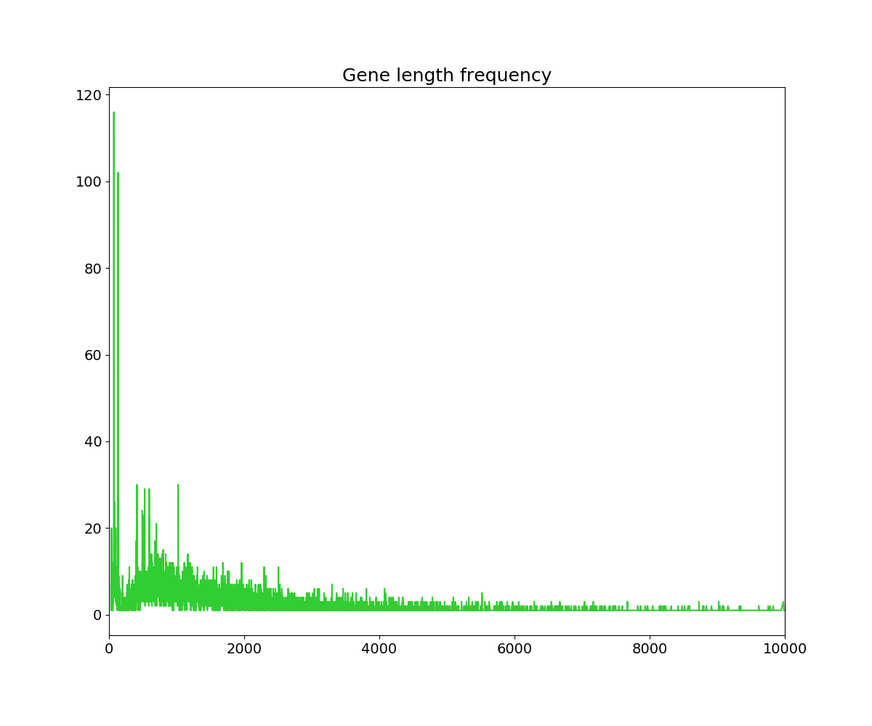
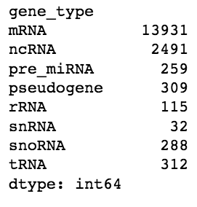
Plot gene number in each RNA type and gene length frequency

Slide 13
Thank you !

