Slide 1
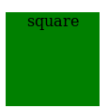
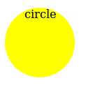
Active Learning (1)
Modify “mouse_timer.html” to add the text “square” to the green square and “circle” to the yellow circle when the mouse is on/off the square

Slide 2
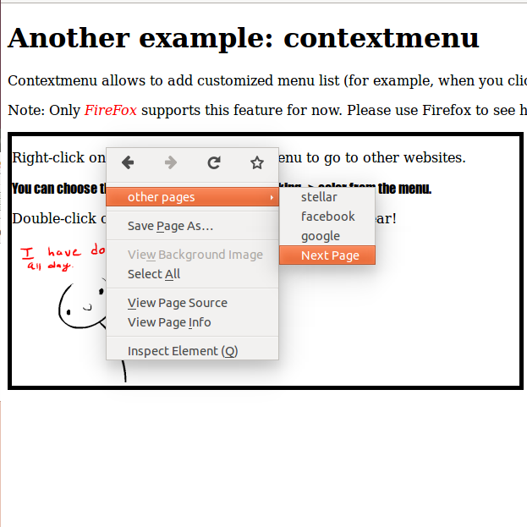
Active Learning (2)
Remember to use Firefox to open “contextmenu_demo.html”
Add another option to the container's menu that allows to jump to “mouse_timer.html” upon a click
Hint:
See the element with id=”pages-menu” in html

