Slide 1
Basic Data Analysis with Python: Hands-on Workshop
Roppon Picha

Slide 2
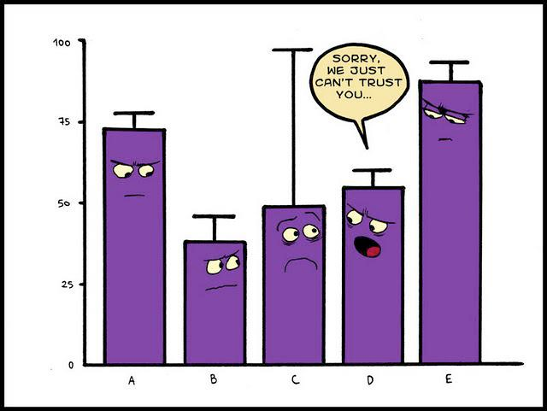
Notes:
Science is about collecting data, and extract information from them and test hypotheses.
<number>

Slide 3

“If we have data, let’s look at the data.
If all we have are opinions, let’s go with mine.”
Jim Barksdale
Former Netscape CEO

Slide 4
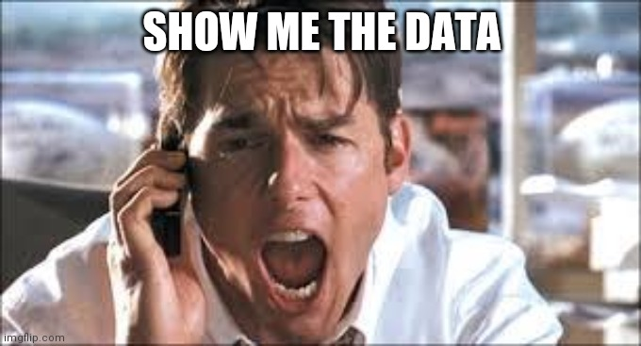

Slide 5
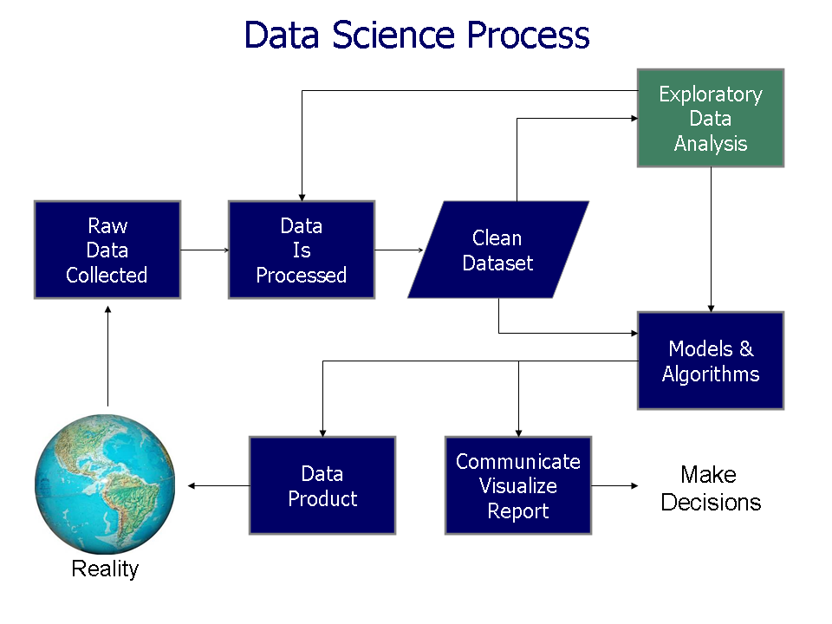
Doing Data Science, by Schutt & O'Neil (2013)

Slide 6
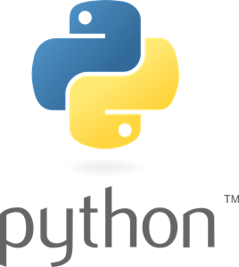

Goals:
An easy and intuitive language just as powerful as major competitors
Open source, so anyone can contribute to its development
Code that is as understandable as plain English
Suitability for everyday tasks, allowing for short development times
Created in 1989 by Guido van Rossum

Slide 7
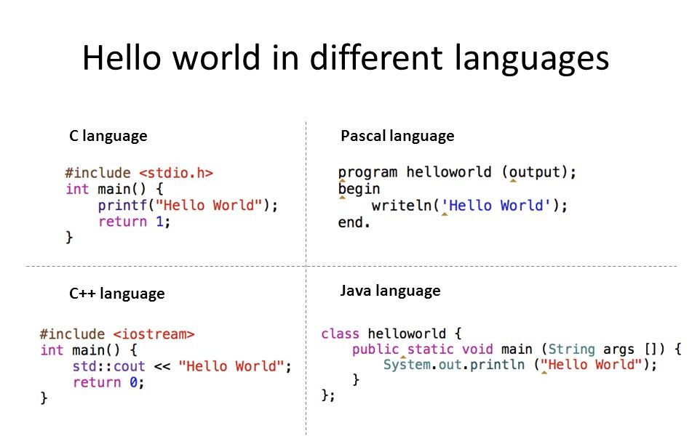
Python language:
print(“Hello World”)
cppsecrets.com

Slide 8
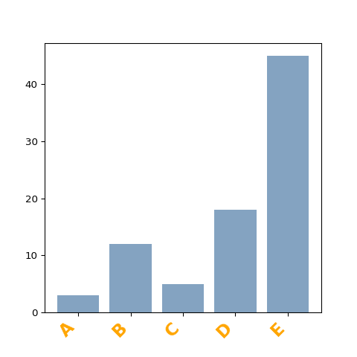
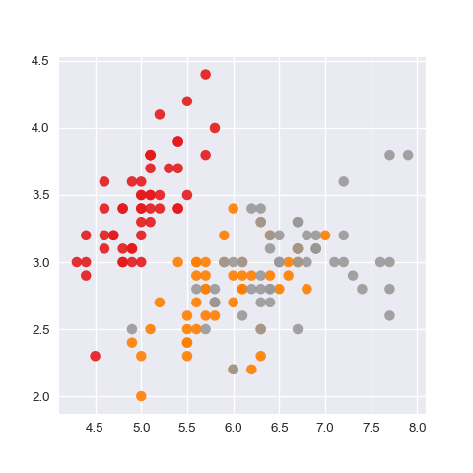
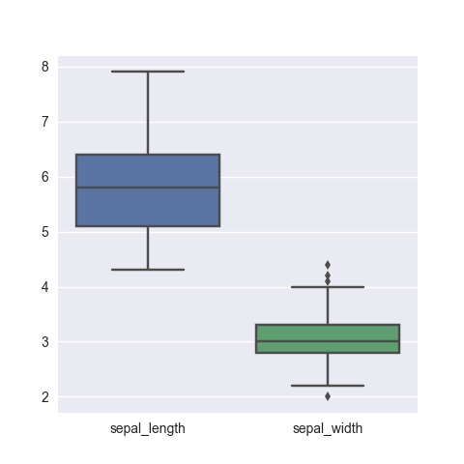
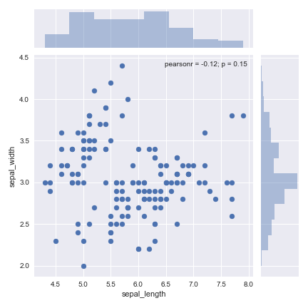
Notes:
<number>

Slide 9
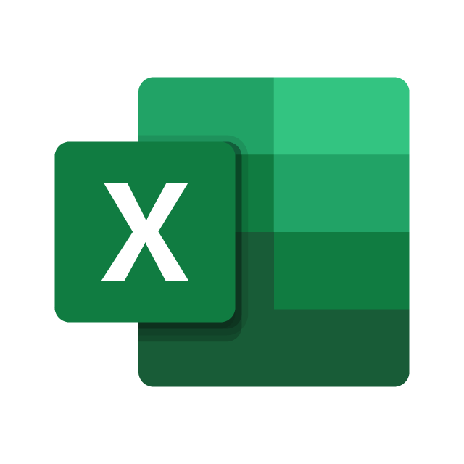
Python advantages:
Reproducibility
Performance
Cost
Flexibility
Readability
Excel advantages:
Familiarity
Simple problems
Notes:
Python advantages:
Reproducibility: Scripts can be reused with new, or changed datasets
Performance: Python is faster for loading, tidying, calculation, especially for huge datasets
Cost: Python is free, Excel is expensive
Flexibility: complex calculations are easier in Python and special-purpose libraries
Readability: Python is easier than Excel VBA
Excel advantages:
Familiarity: Excel is familiar by more people
Simple problems: Excel is faster for simple calculations and plotting
<number>

Slide 10

Notes:
<number>

