Slide 1
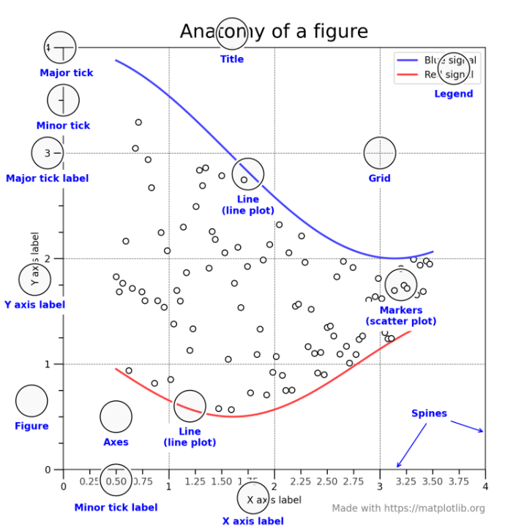
Grid
Figure
Axes
Spine
Major tick
Title
Major tick label
Legend
Line(line plot)
3
Minor tick
Y axis label
Markers
(scatter plot)
X axis label

Slide 2
Grid
Figure
Axes
Spine
Major tick
Title
Major tick label
Legend
Line(line plot)
3
Minor tick
Y axis label
Markers
(scatter plot)
X axis label

Slide 3
Grid
Figure
Axes
Spine
Major tick
Title
Major tick label
Legend
Line(line plot)
3
Minor tick
Y axis label
Markers
(scatter plot)
X axis label

Slide 4
Grid
Figure
Axes
Spine
Major tick
Title
Major tick label
Legend
Line(line plot)
3
Minor tick
Y axis label
Markers
(scatter plot)
X axis label

Slide 5
OO style | Pyploy style
객체의 method 호출 처럼 사용, Setter 사용 | plt module에서 바로 호출하여 사용
import matplotlib as mpl import matplotlib.pyplot as plt import numpy as np x = np.linspace(0, 2, 100) fig, ax = plt.subplots(figsize=(5, 2.7), layout='constrained') ax.plot(x, x, label='y=x') ax.plot(x, x**2, label='y=x^2') ax.plot(x, x**3, label='y=x^3') ax.set_xlabel('x-label') ax.set_ylabel('y-label') ax.set_title("plot test") ax.legend(); plt.show() | import matplotlib as mpl import matplotlib.pyplot as plt import numpy as np x = np.linspace(0, 2, 100) plt.figure(figsize=(5, 2.7), layout='constrained') #layout='constrained' 로 세 Axes가 한 plt.plot(x, x, label='y=x') plt.plot(x, x**2, label='y=x^2') plt.plot(x, x**3, label='y=x^3') plt.xlabel('x-label') plt.ylabel('y-label') plt.title("plot test") plt.legend(); plt.show()

