Slide 1
ME Payment Gateway
Author: Toannq
Date:8/10/2010

Slide 2
Change History
Nov 30 2010 move ZK fire event to PG

Slide 3
Index
Sample
Business Requirements
Important Requirements
Selected Technologies
System Architecture
Process
Failure Case
Solving Problem

Slide 4
Sample
Convert ZingXu to game money, and push it into game via web service. Using for most of game
ZingXu will be used for all game via GTX, Game will request transaction if need. Defined transaction:
  Purchase
  Balance Inquiry
  Gift
  Cancel Purchase
  6 game used

Slide 5
Business Requirement
Transfer ZingXu:
  Push: using web service to push ZingXu from Payletter
  MePayment Request convert ZingXu to MeXU from Payletter to MePayment via GTX
Bill: Game purchases items
  Authenticating follow VISA 3D
  Making order from game
  Sending order to MePayment
Reversal: rollBack transaction if there is error outside MePayment:
  Interface with Payletter: no response from payletter. Reversal to Payletter
  Game interface: Game did not receive response. Receive reversal from Game
  Zookeeper rollback transaction. Reversal to Payletter
Settlement/Clearing file: Game and Payletter
Update order to Payletter (Payletter did not apply now)
Administrator: configure or set up parameters
Report
  User report: latest transactions and report transactions in period
  Administrator report
  Accountant Report

Slide 6
Importance Requirement
Low Cost: using free technologies: Mysql, Zookeeper, ...
Data Reliability
High Performance
  Caching Account in Memory
  Caching Latest Transaction
Scalability
Security: using 3D(3 domain) Secure Standard
Stateless mode for browser and Web server

Slide 7
Selected Technologies
PHP: for UI
Java: for all back end processing
Zookeeper:
  Managing Transaction
  Logging transaction at processing time
  Configuring parameters
Memcache:
  Caching user's account
  Caching latest transactions
MySql:
  Persistent data
  Reporting and statistic

Slide 8
System Overview
Front End – UI: interface to User
Back End:
  PG : Me Payment
    Receive and validate tranx
    Proccess and send tranx to payletter
  Billing:
    Validate Transaction
    Proccessing
  Zookeeper Frontend
    Tranx Management
    Processing
  Report: persist data from Zookeeper to MySql
  Storage: persistent data
  Zookeeper Backend: Listen event from zookeeper, and process back end
Third Party
  Zookeeper : manage transaction, caching data
  Mysql : persist data, report, statistic
  ActiveMQ: Queuing before access MySql
  Balancer: balancing workload

Slide 9
Architecture
G1-FW
Payletter
GTX
UI
G2-PG
Zookeeper
Server
Latest
Transaction
Caching
Thrift
PG
Zookeeper
FronEnd
ZKCmd
Reports
TXCaching
Zookeeper
BackEnd
Mysql
Billing
T
T
Administrator
JDBC
T
Storage
AccountCaching
G2-GAME
Game
GameAPI
Logging
HD

Slide 10
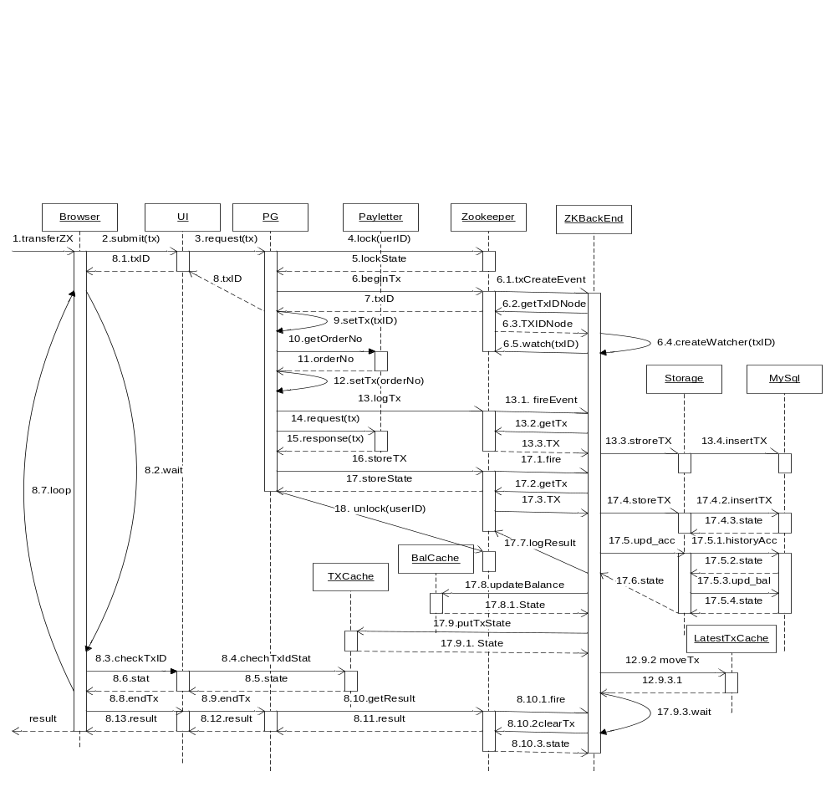
Transfer ZingXu - Pull ZingXu

Slide 11
Abbreviations
TX: transaction
UI: User Interface (Web Server)
PG: Payment Gateway
ZK: Zookeeper
ZKBE: Zookeeper Back End
TXCache: Transaction Caching
LatestTXCache: Latest Transaction Caching
Tti: transaction type indicator
UserID: ZingMe account name
UserNo: Passport UINT

Slide 12
Transaction Structure
Transaction ID
Tti: Transaction Type Indicator
UserID: ZingMe account name
UserNo: passport UINT
Amount : ZingXu transfer amount
MAC: Signature
PIN (Personal Identifier Number) - option
OrderNo: ID transaction using for rollback from Payletter
ChargeNo: return from Payletter
ZingXu Balance: return from Payletter
Response Code: return from Payletter

Slide 13
Pull ZingXu - Descriptions
1.User login, selected transfer ZingXU, enter amount and submit
2. SubmitTx: browser submit tx to UI
3. Request: UI create tx and send it to PG
4&5. Lock (userDI): PG request ZK to lock the userID to avoid the same userID do concurrent transaction and send this lock state to PG
6. BeginTx: PG request the ZK to create atomic transation ID and create the node for this tx ID
  6.1.ZK fire create txID event to ZKBE
  6.2 & 6.3 ZKBE get tx and receive tx from ZK
  6.4 & 6.5 ZKBE create the Watcher and register to watch the txID node in ZK
7.ZK return the begun txID to PG
8. PG return txID to UI
  8.1. UI return txID to browser
  8.2. Browser wait until defined timeout
  8.3, 8.4, 8.5 & 8.6 check tx status in TXCache
  8.7. loop if still has interval and tx is not finished
  8.8, 8.9, 8.10 end tx and get result
  8.10.1, 8.10.2, 8.10.3 ZKBE end and clean tx
  8.11, 8.12, 8.13 the tx’s result

Slide 14
Pull ZingXu - Descriptions
9. set txID to tx
10&11. request and receive orderNo from payletter
12. setOrderNo: set orderNo to transaction
13. Log tx into ZK
  13.1 ZK notify to ZKBE
  13.2 & 13.3 ZKBE get and receive tx from ZK
  13.4 ZKBE send tx to storage
  13.5 Storage insert tx to TransactionLogs table in Mysql
14 & 15 PG request and receive response from payletter
16 validate tx and update tx
17. store tx to ZK
18 Receive store state

Slide 15
Pull ZingXU - Descriptions
17.1 fire event to request ZKBE to store tx
17.2 & 17.3 ZKBE get tx
17.4 request storage to store tx
17.4.1 & 17.4.2 insert tx into Mysql and receive inserted status
17.5 request storage to update balance of user account
17.5.1 & 17.5.2 insert history account into MySql and receive inserted status
17.5.3 & 17.5.4 update balance of account and receive updated status
17.5 & 17.6 ZKBE receive updated status and log the result into ZK
17.8 update BalanceCaching and receive state
17.9 put tx’s state into TXCache
17.10 wait and check if tx is not ended by Browser, it will to end the tx

Slide 16
Pull ZingXU – Failure Case
No Response from Payletter: Do reversal transaction to request Payletter rollback previous transaction
Can not update account in database: Do Reversal and update status of transaction is “Revasal” status
At step 17.6 – Storage commit transaction but the state is not reach ZKBE (maybe network is boken): ZKBE will check account history by txID:
  If there is not exist account history: Do the same 2
  If there is existed history : ???

Slide 17
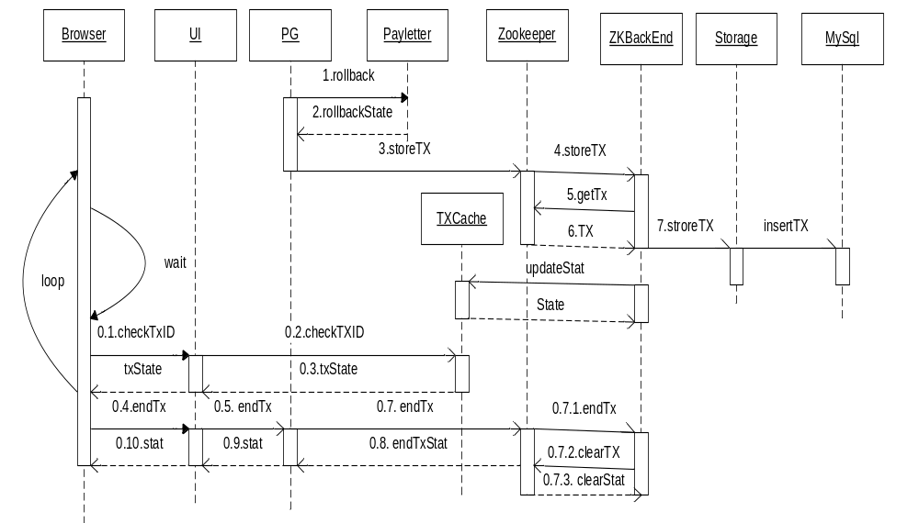
Pull ZingXu – Reversal

Slide 18
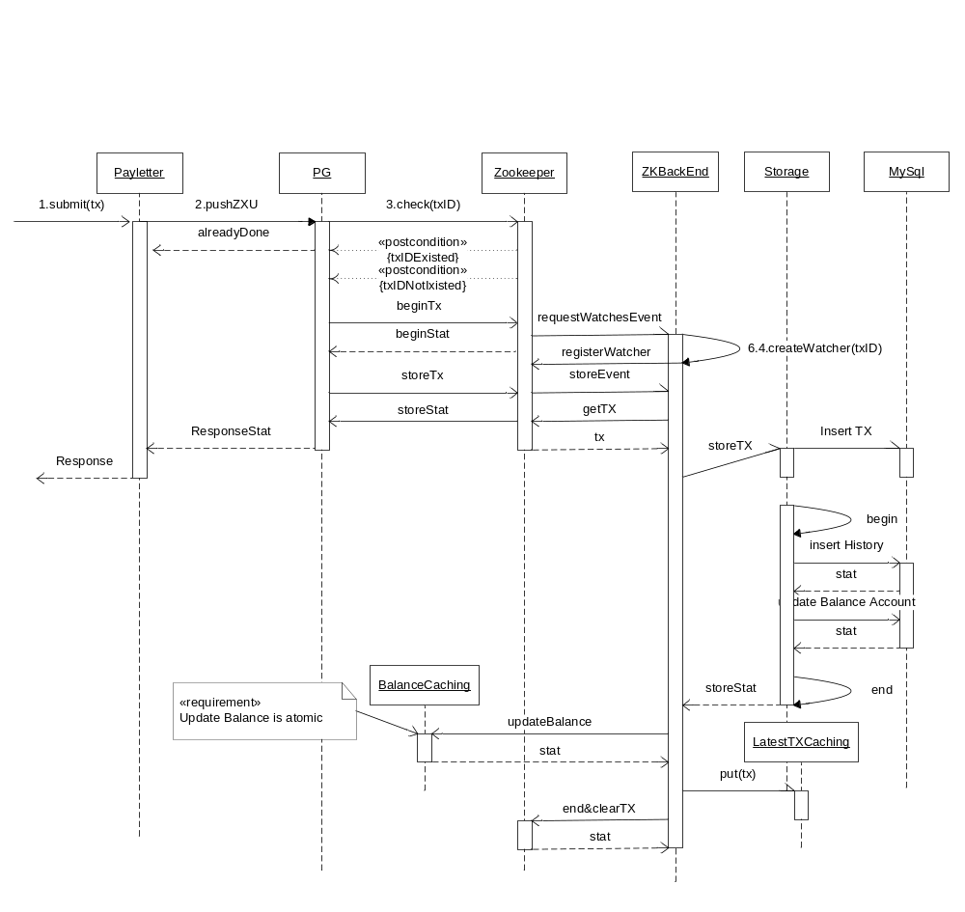
Transfer – Push ZingXu

Slide 19
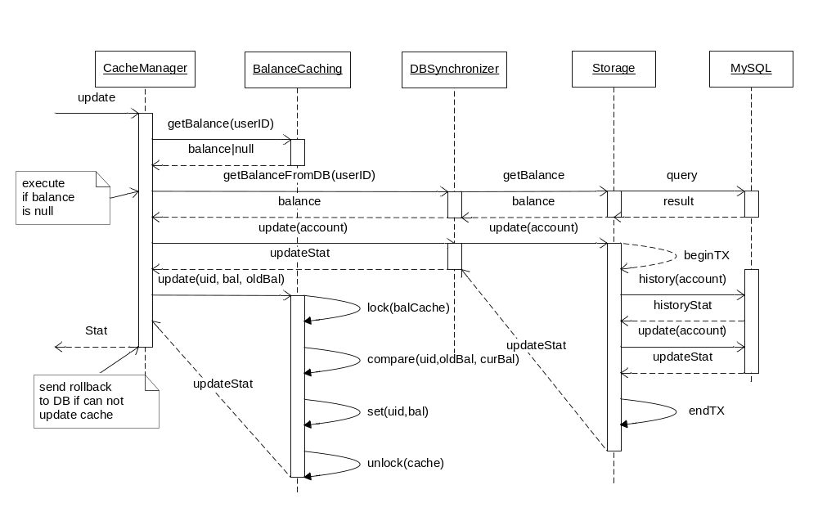
Balance Caching – Add/Plus Balance

Slide 20
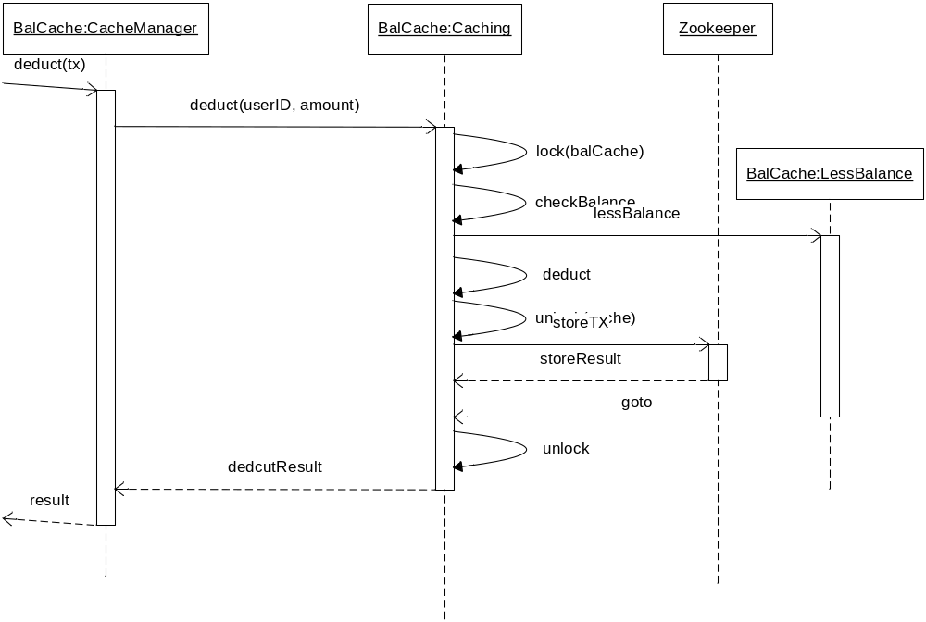
Balance Caching – Deduct Balance

Slide 21
Push ZingXU – End Transaction
End with success: Clear transaction in ZK
End With update balance Error:
  TxID duplication: stop update balance and keep transaction in ZK, Transaction will be remove out ZK if Payletter stop request and timeout
  Other Error: Retry update balance until success or back up if time out

Slide 22
Push ZingXu – Demo
Correct case
ZKBE down:
  All data will be kept in ZK
  All Data will be stored in DB when ZKBE up
Balance Cache down : ZKBE will retry with defined time and do not remove data out ZK
Payletter did not receive response and retry, balance cache will return duplicate key when history account and ZKBE do not end this transaction

Slide 23
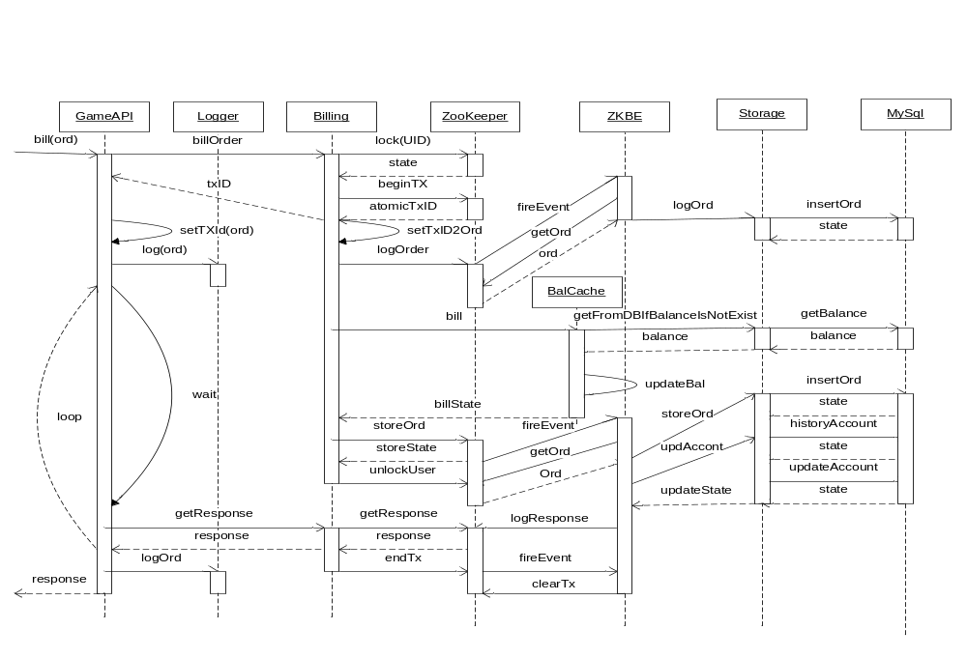
Process Bill – Pull From Game

Slide 24
Bill Push - Index
Business Definition
Processing Flow
Transaction Structure
Exchanged Data
  Front End
  Back End
Prototype FE

Slide 25
Bill Push – Business Definition
User Purchase Item in game
Game will pop up PG page via HTTPS Request
User click confirm button in PG page (option fill some securities information)
PG will check and deduct MeXu, and store transaction.
PG calls API of Game to response the result, and wait for ACK
PG will retry step 5 until received ACK

Slide 26
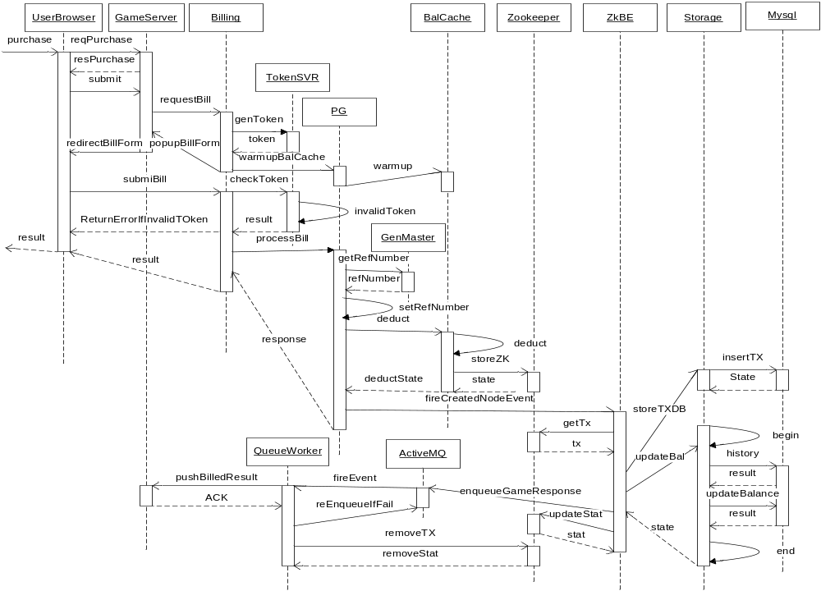
Bill Push– Processing Flow

Slide 27
Bill Push -Transaction Structure
Field | Description | Request | Response
UserID | ZingMe UserID | M(mandate) | M
AppID | App ID | M | M
BillNo | Bill No | M | M
ItemIDs | List purchased itemID | M
ItemQties | List of quantity for each itemID | M
ItemPrices | List of prices for each itemID | M
Amount | Total amount for all items | M | M
TxTime | Transaction time | M | M
MAC | Message Authentication Code (apply formular later) | M | M
PIN | Personal Identifier Umber | Reserve
TxID | Reference Number |  | M
Balance | Remain Balance |  | M

Slide 28
Bill Push - Exchanged Data - FE
requestBill: Transaction
getToken : none
Token: token, timestamp
popupFormBill: transaction, token
submitBill: transation, token
checkToken: token
Result – check token: true or false
processBill: transaction
Respose – return result to BillingFE after precessed bill : bill state and balance
Result-return to userBrowser: bill state and balance

Slide 29
Bill Push - Exchanged Data - BE
TransactionBE = transaction – mac - PIN + txID
Deduct : transactionBE, return true or false
StoreZK : transactionBE, and return true or false
FireCreatedNodeEvent: transation ID
GetTx : return transactionBE
StoreTXDB: transactionBE
UpdateBalance: userID, appid, transaction ID,amount, type of update (plus/minus), and return error code
Response to game server: Transaction follow indication transaction structure

Slide 30
Prototype FE – Request Bill Form
UserID : zingme userID
AppID : ID of game
BillNo :
ItemIds
ItemsQties
ItemPrices
Amount
txTime
MAC

Slide 31
Prototye FE – Pop up Bill Form
UserID : zingme userID
AppID : ID of game
BillNo :
ItemIds
ItemsQties
ItemPrices
Amount
txTime
MAC
Token

Slide 32
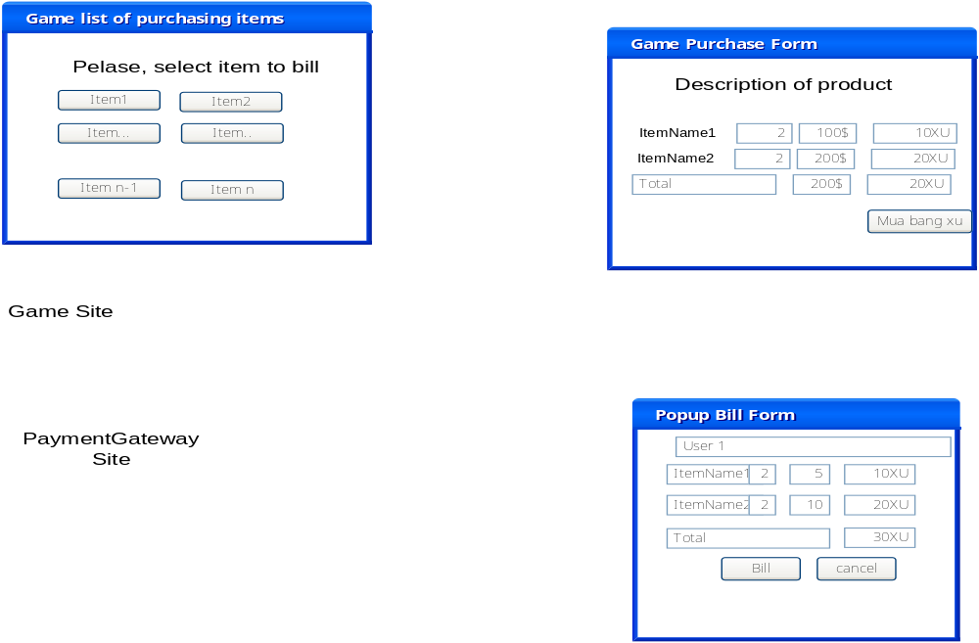
Prototype FE – Screen Flow
1
3
2

Slide 33
Screen Data Exchange
userID, appID, itemID, price
UserID, appID, ItemID, price, quantity, transaction time, billNo, Signature, response URL
State, amount, remain balance
Back End to push response via REST: UserID, appID, ItemID, price, quantity, transaction time, billNo, txID, remain balance

Slide 34
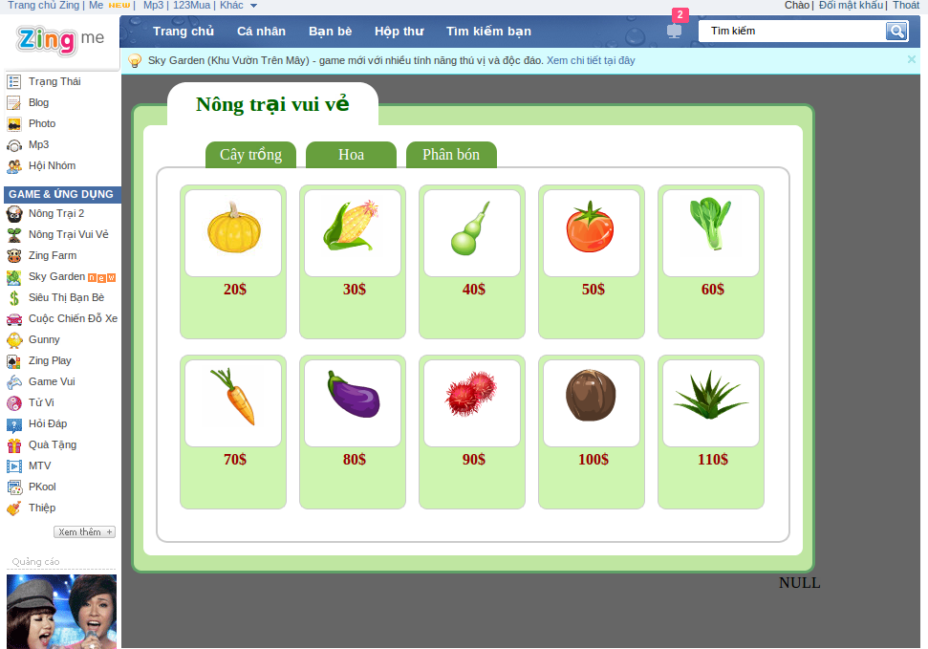
Game List Purchasing Item Screen

Slide 35
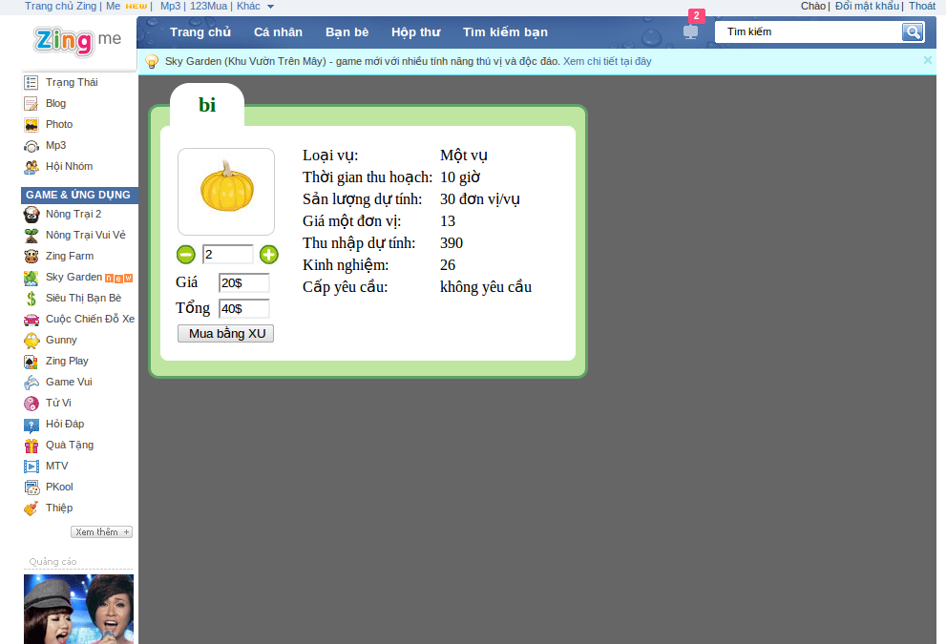
Game Purchased Item Screen

Slide 36
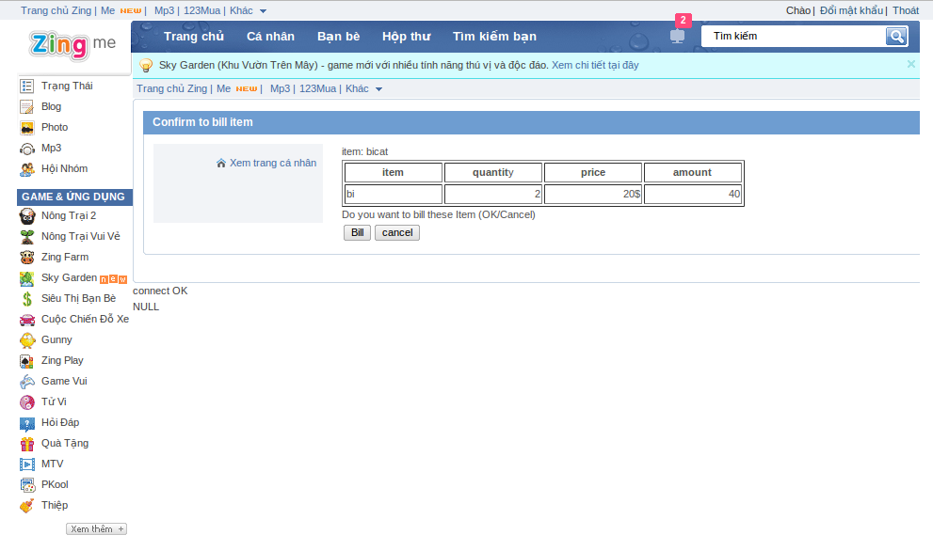
Payment Gateway Billing Confirm

Slide 37
Failure Cases
Did not receive response from Payletter in case request transfer ZingXu from Mepayment
Payletter do not receive response from Mepayment in case convert ZingXu from Payletter
If there is any operation in transaction fail
Time out bettwen brownser anh web server

Slide 38
Solving Problem
Rollback and reversal if any operation failed
Reversal if there is no response from Payletter
Send Settlement/Clearing file to Payletter to check at the end of day
Send order to Payletter for each bill transaction if Payletter support this transaction
Using stateless transaction for brownser to make sure transaction is success

