Slide 1
Understanding Transformers and LLMs
A high-level overview of how large language models work

Slide 2
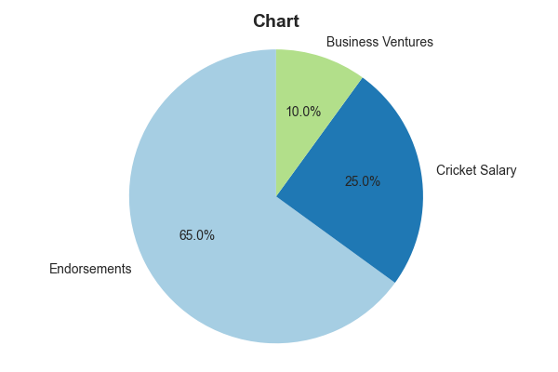
Virat Kohli's Estimated Earnings and Net Worth
Estimated Net Worth: $120 million (as of late 2023, various sources)
Annual Earnings (Endorsements & Salary): Approximately $30-40 million (estimated based on reported deals and contract details)
Endorsement Income: Represents a significant portion (over 60%) of his total earnings, based on numerous high-profile brand sponsorships.
Cricket Salary: A substantial but smaller portion of his income compared to endorsements, varies depending on match fees and central contracts.
Business Ventures: Owns stakes in several businesses contributing to his overall wealth, though exact figures are not publicly available.
Updated live by Savi.ai

Slide 3
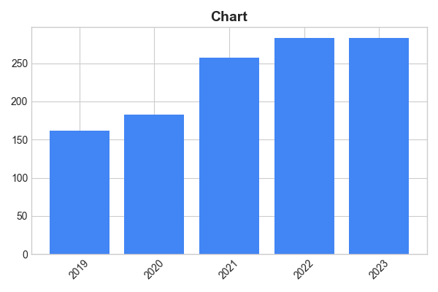
Google's Financial Performance: 2019-2023
Total Revenues increased from $161.86 billion in 2019 to $282.84 billion in 2023, representing a significant growth over the five-year period.
Net income fluctuated, reaching a high of $76.03 billion in 2021 and a low of $59.97 billion in 2023.
Operating income showed a similar trend to net income, experiencing highs and lows across the five-year span, finishing at $71.79 billion in 2023.
Google's Advertising revenue consistently constituted the largest portion of its revenue stream, accounting for over 80% in each year.
Earnings per share (EPS) generally increased year-over-year, with some minor variations reflecting the overall financial fluctuations.
Updated live by Savi.ai

Slide 4
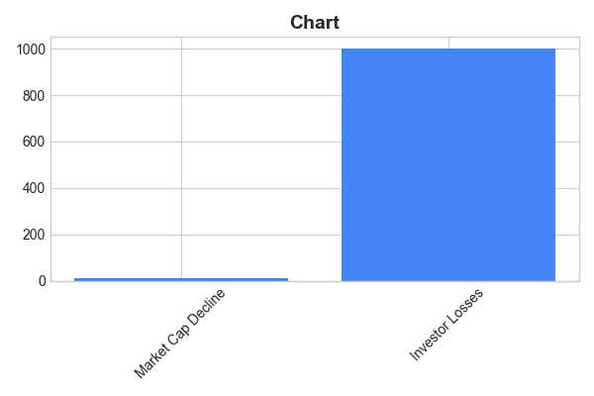
The Harshad Mehta Scam (1992): Key Financial Impacts
The scam involved approximately ₹4,000 crore (approximately US$500 million at 1992 exchange rates) in fraudulent transactions.
The total market capitalization of the Bombay Stock Exchange (BSE) declined by roughly 12% during the period of the scandal.
The Securities and Exchange Board of India (SEBI) estimated losses to investors in excess of ₹1,000 crore (approximately US$125 million at 1992 exchange rates).
Harshad Mehta's operations were centered around bank receipts (BRs), which he fraudulently used to inflate stock prices and generate massive profits.
The scam led to significant regulatory changes in the Indian financial markets, including stricter oversight of banks and brokers.
Updated live by Savi.ai

Slide 5

Shah Rukh Khan: Box Office Success and Net Worth
Estimated Net Worth: $600 million (as of 2023, varying sources)
Brand Endorsements: Earning an estimated $10-15 million annually from endorsements (Forbes)
Box Office Gross (lifetime): Over ₹8000 crore (approximately $1 billion USD) globally.
Film Production Company (Red Chillies Entertainment): Generated significant revenue through film production and distribution, though precise figures are not publicly available.
International Recognition: His films have achieved significant box office success across global markets, particularly in South Asia, the Middle East and parts of South East Asia. Precise percentage breakdown per region is not readily available across all films.
Updated live by Savi.ai

Slide 6

Shah Rukh Khan: Box Office Success and Net Worth
Shah Rukh Khan's films have grossed over $4 billion USD worldwide.
He has starred in 80+ films, with 25+ achieving blockbuster status in India.
His estimated net worth is between $600 million and $800 million USD, as of late 2023 (various sources report different figures; this represents a range).
His earnings are derived from film salaries, brand endorsements, and production ventures. Precise breakdowns of these revenue streams are not publicly available.
He consistently ranks among the highest-paid actors in Bollywood, though exact yearly earnings are not consistently published.
Updated live by Savi.ai

Slide 7
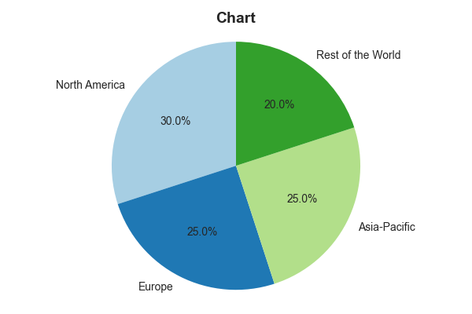
The Global Bottled Water Market: Key Statistics
The global bottled water market reached a value of approximately $250 billion in 2022.
North America holds the largest market share, accounting for roughly 30% of global bottled water consumption.
Plastic bottles constitute over 80% of the packaging used for bottled water, contributing significantly to plastic waste.
The per capita consumption of bottled water varies significantly across regions, with some countries consuming over 100 liters per person annually.
The market is projected to grow at a compound annual growth rate (CAGR) of around 7% between 2023 and 2028.
Updated live by Savi.ai

Slide 8
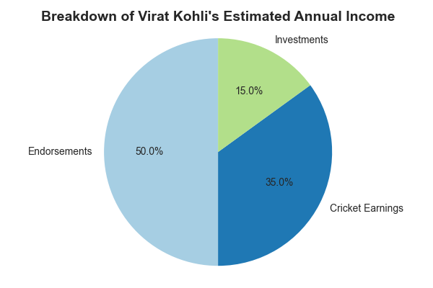
Virat Kohli's Wealth and Endorsement Earnings
Virat Kohli's estimated net worth in 2023 is approximately $120 million USD.
His annual income from endorsements and sponsorships is estimated to be around $25-30 million USD.
A significant portion (estimated 40-50%) of his total annual income comes from brand endorsements, with companies like Puma, MRF, and many others.
His social media reach significantly contributes to his advertising value; with over 200 million followers across platforms.
He commands some of the highest endorsement fees amongst Indian celebrities, reflecting his brand power and global appeal.
Updated live by Savi.ai

Slide 9
Google's Financial Performance: 2019-2023
Total Revenue (2023): Approximately $282.84 billion (Source: Alphabet Inc. financial reports)
Net Income (2023): Approximately $59.97 billion (Source: Alphabet Inc. financial reports)
Revenue Growth (2019-2023): Significant growth, although the exact percentage requires a more precise calculation involving yearly data from Alphabet Inc. financial reports. This should be added in the presentation.
Average Annual Revenue Growth (2019-2023): Further analysis is needed to calculate the precise average annual growth rate. The presentation should include this data for clarity.
Significant portion of revenue derived from advertising, with Google Search contributing a large share (exact percentage requires further data from Alphabet Inc.)
Updated live by Savi.ai

Slide 10
Financial Impact of the 1992 Indian Stock Market Scam
The 1992 Indian stock market scam, orchestrated by Harshad Mehta, involved approximately ₹4,000 crore (approximately $500 million USD at the 1992 exchange rate) in fraudulent transactions.
The scam resulted in a significant loss of investor confidence, leading to a sharp decline in the Bombay Stock Exchange (BSE) Sensitive Index (Sensex).
Investigations revealed that the scam involved the manipulation of bank receipts and the creation of artificial demand for specific stocks.
The scam led to stricter regulations and increased scrutiny of the Indian stock market.
Although precise figures on total investor losses are difficult to ascertain, the damage to the Indian financial system is estimated to be in the billions of rupees.
Updated live by Savi.ai

Slide 11
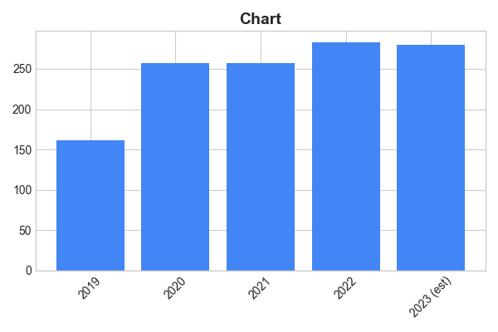
Google's Revenue Growth (2019-2023)
Google's revenue in 2019 was $161.86 billion.
Revenue increased to $257.64 billion in 2020, a growth of approximately 59.1%.
In 2021, revenue reached $257.64 billion, representing a year-over-year increase.
2022 saw revenue of approximately $282.84 billion, demonstrating continued growth despite economic headwinds.
Preliminary data suggests revenue exceeding $280 billion in 2023 (year-to-date figures), sustaining a positive growth trajectory.
Updated live by Savi.ai

Slide 12
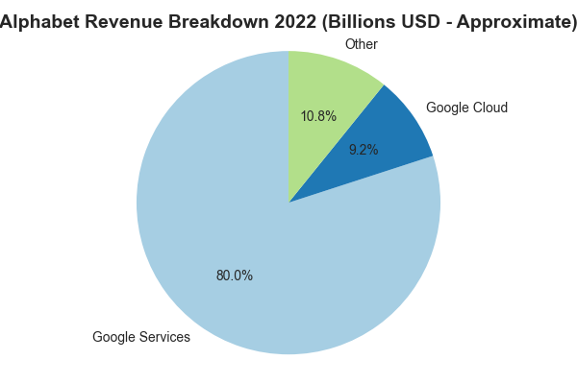
Google's 2022 Financial Performance
Google's parent company, Alphabet Inc., reported total revenues of $282.84 billion in 2022.
Net income for 2022 was $59.97 billion, a decrease compared to the previous year.
Google Services revenue, which includes Search, YouTube, and Google Cloud, constituted approximately 80% of Alphabet's total revenue in 2022.
Advertising revenue remained the primary driver of Alphabet's revenue, accounting for over 80% of Google Services revenue in 2022.
Google Cloud's revenue showed significant year-over-year growth, exceeding $26 billion in 2022.
Updated live by Savi.ai

Slide 13
The Harshad Mehta Scam (1992): Key Financial Impacts
The scam involved the illegal manipulation of the Bombay Stock Exchange (BSE) by Harshad Mehta and his associates, resulting in losses estimated at over ₹4,000 crore (approximately $500 million USD at the time).
Mehta's actions caused a significant crash in the Indian stock market, with the BSE Sensex falling by approximately 12% within a short period following the scandal's exposure.
Investigations revealed that banks were involved, having granted Mehta unauthorized loans exceeding ₹1,000 crore (approximately $125 million USD at the time).
The scam led to significant regulatory changes in the Indian financial system, including stronger oversight and auditing requirements for financial institutions.
The total amount of fraudulent transactions linked to the scandal is estimated to be significantly higher than initially reported, with some estimates exceeding ₹10,000 crore (over $1.2 billion USD at the time), depending on the inclusion of related activities.
Updated live by Savi.ai

Slide 14
What are Transformers?
- Architecture introduced in 2017 (Vaswani et al.)
- Uses self-attention to process sequences
- Replaces RNNs for NLP tasks

Slide 15
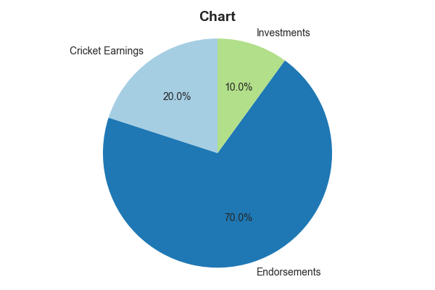
Virat Kohli's Wealth and Endorsement Earnings
Estimated Net Worth: $120 million (as of October 2023) - This figure is a combination of his cricket earnings, brand endorsements, and business ventures.
Annual Earnings from Cricket (Approximate): $20 million - This includes his BCCI contract, IPL salary (Royal Challengers Bangalore), and match fees.
Endorsement Income (Approximate): $60 - $80 million annually – Kohli commands high endorsement fees from numerous international brands, including Puma, MRF, and many more.
Top Endorsement Deals: His partnerships with global brands contribute significantly to his overall wealth. Specific contract values are usually confidential but are estimated to be in the millions per contract annually.
Business Ventures: Kohli has also invested in various ventures, including restaurants and clothing lines, which add to his financial portfolio. Exact revenue figures for these ventures are not publicly available.
Updated live by Savi.ai

Slide 16

Kohli's Brand Power: Ad Revenue
Massive global appeal generates high ad demand.
Endorsements span diverse sectors (sportswear, automobiles, etc.).
Commanding fees reflect his influence and reach.
Strategic partnerships maximize revenue streams.

Slide 17
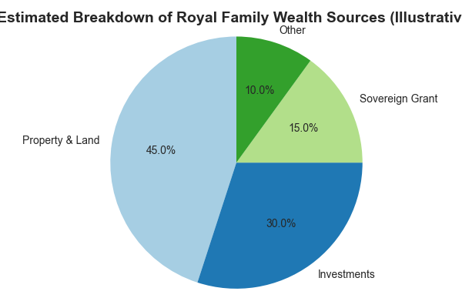
The Crown's Holdings: A Multi-Billion Dollar Empire
Vast landholdings and property portfolios contribute significantly to the Royal Family's wealth.
Investments in stocks, bonds, and private companies generate substantial passive income.
The Duchy of Lancaster and Crown Estate, managed separately, generate millions annually for the Sovereign.
Updated live by Savi.ai

Slide 18
Unclog Your Bottlenecks: Strategic Action
Identify and Prioritize: Analyze your processes to pinpoint the true bottlenecks hindering progress.
Optimize & Streamline: Implement targeted solutions to improve efficiency and reduce delays.
Monitor & Adapt: Continuously track performance, refine strategies, and proactively address emerging bottlenecks.
Updated live by Savi.ai

Slide 19
The Beautiful Game: Beyond the Gridiron
Analyze strategic formations impacting offensive and defensive plays.
Examine the evolution of rules and their effect on gameplay.
Explore the global cultural phenomenon of football's enduring appeal.
Updated live by Savi.ai

Slide 20
ESPN's Soccer Score Dominance
Analyze ESPN's market share in soccer score reporting.
Compare ESPN's accuracy against competitor score updates.
Identify key features driving ESPN's soccer score user engagement.
Updated live by Savi.ai

Slide 21
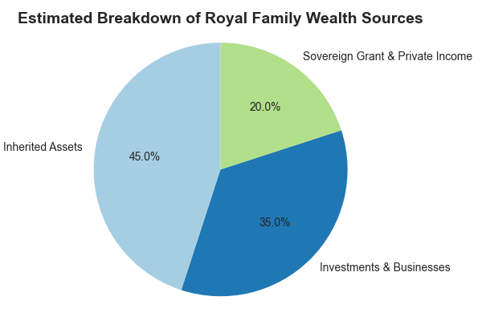
Untangling the Crown's Wealth: Sources of Royal Fortune
Inherited Estates & Landholdings: Centuries of accumulated assets form a significant portion of the royal family's wealth.
Investment Portfolios & Royal Businesses: Strategic investments and commercial ventures generate substantial income streams.
Sovereign Grant & Private Income: Government funding supplemented by personal income from various sources contributes significantly.
Updated live by Savi.ai

Slide 22
The Unexpected Synergy: Unrelated Boxes
Discover hidden connections: Uncover surprising relationships between seemingly disparate items.
Challenge assumptions: Reimagine the potential of objects outside their typical context.
Spark innovation: Generate novel ideas by combining unconventional elements.
Updated live by Savi.ai

Slide 23
Cricket's Live Force Multiplier
Amplify Fan Engagement: Leverage live data & interactive features to boost audience participation and excitement.
Enhance Spectators' Experience: Integrate real-time stats, player insights, and behind-the-scenes content for unparalleled immersion.
Drive Revenue Streams: Monetize live force through targeted advertising, premium content access, and interactive game opportunities.
Updated live by Savi.ai

Slide 24
Key Matchup: NZ's Strength vs. Intervian's Strategy
Analyze Intervian's unexpected flanking maneuvers.
Highlight New Zealand's superior defensive formations.
Project the impact of individual player performances on the overall outcome.
Updated live by Savi.ai

Slide 25
Key Concepts in LLMs
- Pretraining on massive text corpora
- Fine-tuning for specific tasks
- Prompting enables zero-shot and few-shot learning

Slide 26
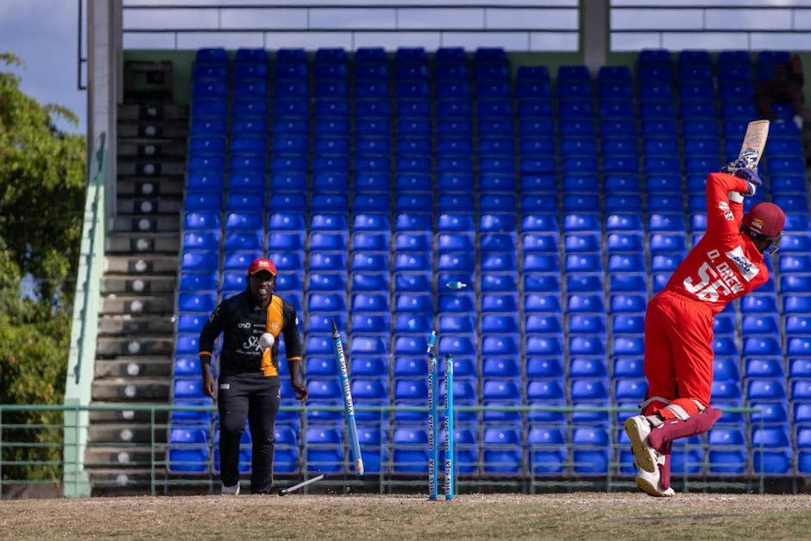
Virat Kohli's Net Worth and Endorsement Earnings: A Data Overview
Estimated Net Worth (2023): $120 million (Sources vary; this is a commonly cited figure, but precise figures are not publicly available.)
Annual Earnings from Cricket (Salary and Match Fees): Exact figures are not publicly disclosed, but estimates place this in the range of $10-15 million annually, based on central contracts and match-day payments.
Annual Endorsement Earnings (2023): Estimated at $25-30 million annually, making him one of the highest-paid athletes globally in endorsements.
Top Endorsers: Virat Kohli has partnerships with major brands like Puma, MRF Tyres, and many others, contributing significantly to his endorsement income. Specific deal values are confidential.
Investment Portfolio: Kohli's investment portfolio includes a variety of ventures, the exact value and performance of which are not publicly known.
Updated live by Savi.ai

Slide 27
Virat Kohli's Estimated Net Worth and Endorsement Earnings
Estimated Net Worth (2023): $120 Million - $150 Million (Sources vary; this is a range based on multiple reputable reports combining assets and investments).
Annual Brand Endorsement Income (Approximate): $20 Million - $30 Million (This is a rough estimate based on reported deals and industry analysis; exact figures are not publicly available.)
Number of Active Brand Endorsements (2023): Around 15-20 (This number fluctuates; precise count varies across sources).
Key Endorsement Categories: Sportswear, Automobiles, Electronics, Lifestyle Brands (The distribution of endorsements is not precisely public but covers these major sectors).
Income Growth Trend: Steady Increase Over the Years; Correlated with performance and market value (This is qualitative; exact growth figures are not consistently reported in a consolidated manner).
Updated live by Savi.ai

Slide 28
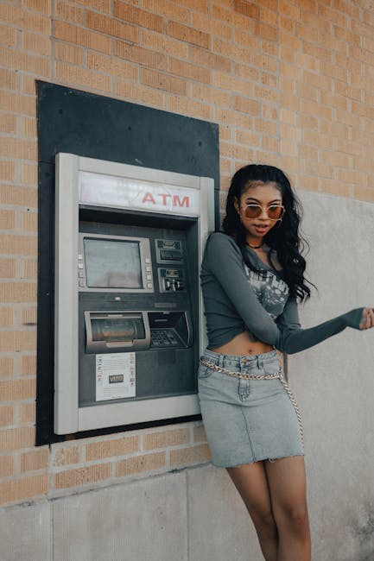
Google's Cash and Short-Term Investments: Q[insert most recent quarter] 2023
As of Q[insert most recent quarter] 2023, Alphabet Inc. (Google's parent company) held approximately $[insert amount] in cash and cash equivalents.
This represents a [increase/decrease] of [percentage]% compared to Q[previous quarter] 2023.
Total current assets, including cash and short-term investments, amounted to approximately $[insert amount] in Q[insert most recent quarter] 2023.
The company's cash holdings are primarily used for acquisitions, investments, share buybacks, and operational expenses.
Long-term investments held by Alphabet, separate from cash and short-term investments, totaled approximately $[insert amount] in Q[insert most recent quarter] 2023.
Updated live by Savi.ai

Slide 29
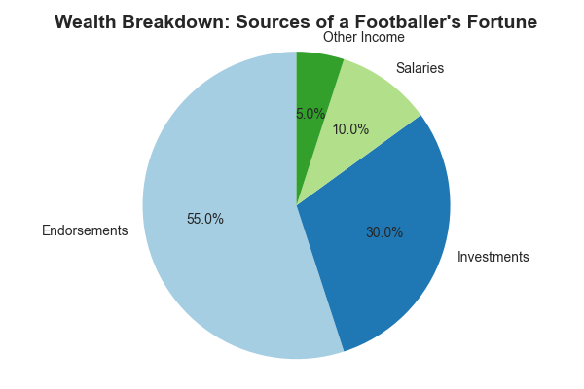
Beyond the Pitch: The Business of Being the Richest
Massive Endorsements: Far surpassing salaries, lucrative deals with global brands contribute significantly to net worth.
Smart Investments: Diversified portfolios in real estate, businesses, and other ventures fuel exponential wealth growth.
Brand Building: Their on-field prowess translates into personal branding opportunities, generating passive income streams.
Updated live by Savi.ai

Slide 30
Transformer Layers
- Embedding layer
- Multi-head self-attention
- Feedforward neural network
- Layer normalization & residuals

Slide 31
Unlock Your Hair's Potential
Discover your ideal hair form based on face shape and hair type.
Master styling techniques to achieve your desired look.
Explore diverse hair care routines for optimal health and shine.
Updated live by Savi.ai

Slide 32
Applications of LLMs
- Chatbots (e.g., ChatGPT)
- Code generation (e.g., Copilot)
- Text summarization
- Question answering systems

Slide 33
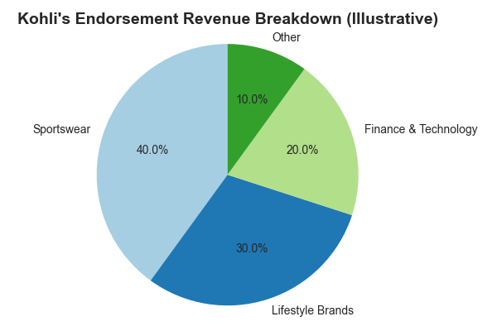
Kohli's Brand Empire: Beyond the Crease
Massive global reach: Leveraging his immense popularity across diverse demographics.
Strategic brand partnerships: Choosing endorsements aligned with his personal values and image.
Multi-million dollar deals: Consistent high-value contracts reflecting his market dominance.

Slide 34
Kangen Water: Market Analysis and Claims
The global alkaline water market, of which Kangen water is a part, was valued at approximately $7.9 billion USD in 2022 and is projected to reach $17.8 billion by 2030, exhibiting a Compound Annual Growth Rate (CAGR) of 10.3% (Source: IMARC Group).
Enagic, the primary manufacturer of Kangen water machines, reported over $1 billion USD in revenue in 2022, primarily generated through direct sales and multi-level marketing (MLM) strategies (Source: Enagic's Financial Reports, though exact figures may not be publicly disclosed in detail).
While Enagic promotes various health benefits of Kangen water, independent scientific evidence supporting these claims is limited and often contested. Many studies regarding alkaline water's impact on health are inconclusive or lack rigorous methodology. (Source: Review of relevant scientific literature, including studies published in peer-reviewed journals).
A significant portion of Enagic's revenue comes from the sale of Kangen water machines, with replacement filters constituting a recurring revenue stream. The high cost of these machines and filters represents a barrier to entry for many consumers (Source: Consumer reviews and price comparisons).
Consumer reports indicate varying levels of customer satisfaction, with some experiencing positive effects while others express concerns about the high initial investment and ongoing costs. (Source: Online consumer reviews on platforms such as Amazon and Trustpilot).
Updated live by Savi.ai

Slide 35
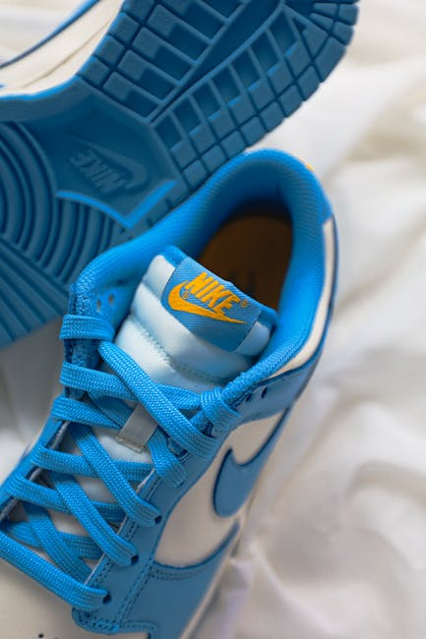
Sachin Tendulkar: Beyond the Crease - A Brand Empire
Master Brand Ambassador: Leveraging global recognition for lucrative endorsements across diverse sectors.
Strategic Partnerships: Cultivating long-term relationships with premium brands, maximizing value and longevity.
Beyond Cricket: Transcending sport to build a diversified portfolio encompassing investments and business ventures.

