Slide 1
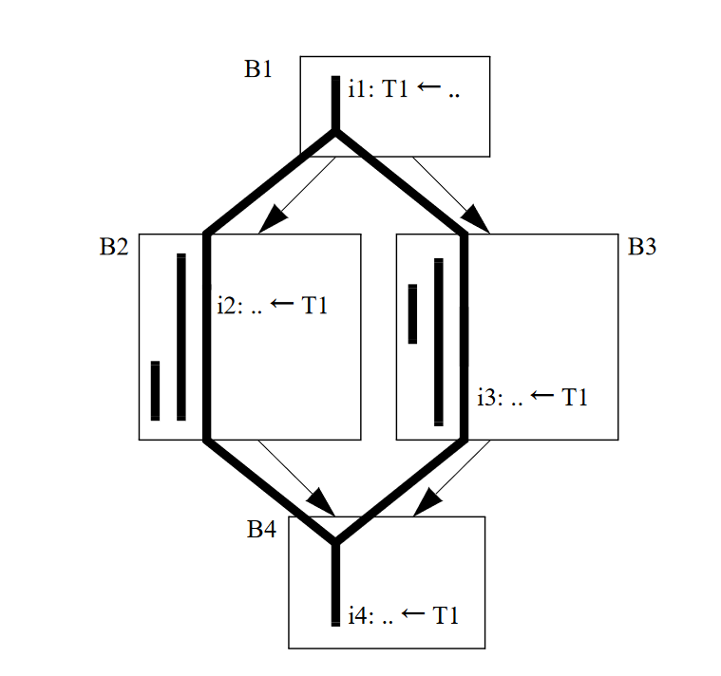
T1 not live
R1
T1 in R1
st R1, T1
T1 in R1
T1 in mem
R1
ld R2, T1
st R1, T1
R2
T1 in mem
T1 in R2
ld R2, T1
T1 in R2
R2

