Slide 1
GPU Performance Analysis and Optimization
Paulius Micikevicius
Developer Technology, NVIDIA
2017.04.06
Jinsu Lee
Notes:
Thank you, Mr. Chairman.
Good morning. I’m Gyeonghoon Kim from KAIST in Korea.
Today I’d like to talk about “A Low-energy Hybrid Radix-4/-8 Multiplier for Portable Multimedia Applications”.

Slide 2
Contents
Exposing Sufficient Parallelism
Global Memory Access
Shared Memory
Arithmetic Optimizations

Slide 3
Parallelism Needed
Exposing Sufficient Parallelism
GPU is a parallel machine
Lots of arithmetic pipelines
Multiple memory banks
To get good performance, your code must expose sufficient parallelism for 2 reasons:
To actually give work to all the pipelines
To hide latency of the pipelines
Rough rule of thumb for K20x:
You want to have 14K or more threads running concurrently

Slide 4
Exposing Sufficient Parallelism
Exposing Sufficient Parallelism
What hardware ultimately needs:
Arithmetic pipes:
sufficient number of independent instructions
accommodates multi-issue and latency hiding
Memory system:
sufficient requests in flight to saturate bandwidth
Two ways to increase parallelism:
More independent work within a thread
ILP for math, independent accesses for memory
More concurrent threads

Slide 5
Occupancy and Performance
Exposing Sufficient Parallelism
Occupancy: number of concurrent threads per SM
Note that 100% occupancy isn’t needed to reach maximum performance
Once the “needed” occupancy is reached, further increases won’t improve performance
Needed occupancy depends on the code
More independent work per thread -> less occupancy is needed
Memory-bound codes tend to need more occupancy
Higher latency than for arithmetic, need more work to hide it

Slide 6
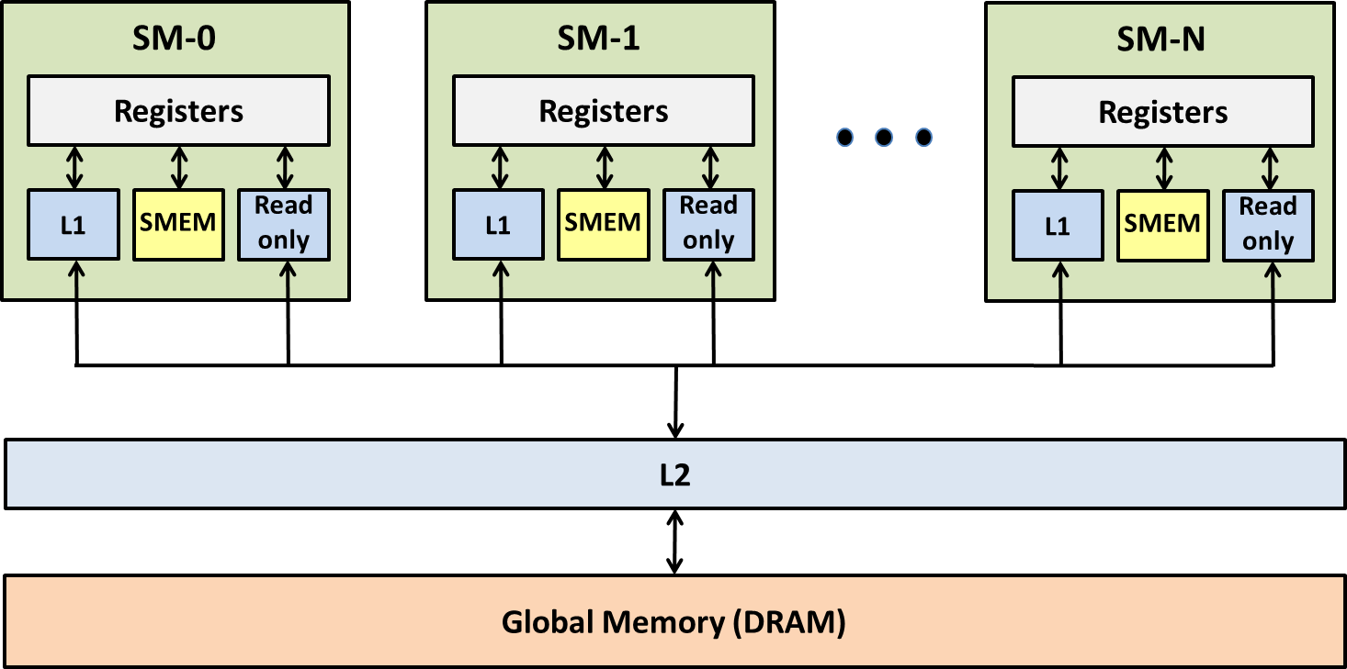
Kepler Memory Hierarchy
Global memory access

Slide 7
Global Memory Operation
Global memory access
Memory operations are executed per warp
32 threads in a warp provide memory addresses
Hardware determines into which lines those addresses fall
Memory transaction size is 32 bytes
There are benefits to a warp accessing a contiguous aligned region of 128 or 256 bytes
Access word size
Natively supported sizes (per thread): 1, 2, 4, 8, 16 bytes

Slide 8
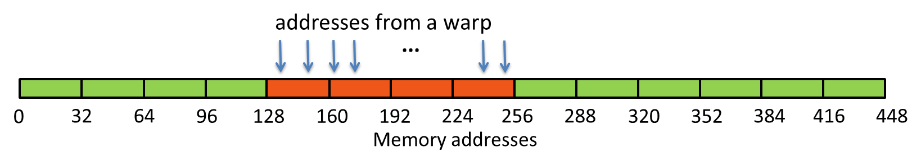
Scenario
Global memory access
Scenario:
Warp requests 32 aligned, consecutive 4-byte words
Addresses fall within 4 segments
Warp needs 128 bytes
128 bytes move across the bus
Bus utilization: 100%

Slide 9
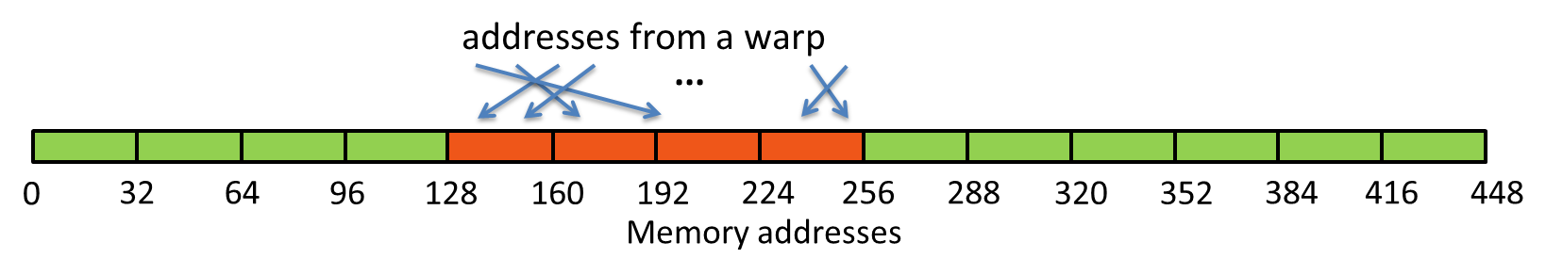
Scenario
Global memory access
Scenario:
Warp requests 32 aligned, permuted 4-byte words
Addresses fall within 4 segments
Warp needs 128 bytes
128 bytes move across the bus
Bus utilization: 100%

Slide 10
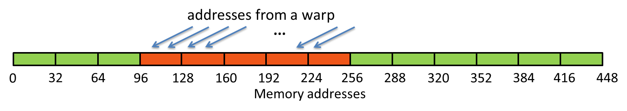
Scenario
Global memory access
Scenario:
Warp requests 32 misaligned, consecutive 4-byte words
Addresses fall within at most 5 segments
Warp needs 128 bytes
At most 160 bytes move across the bus
Bus utilization: at least 80%
Some misaligned patterns will fall within 4 segments, so 100% utilization

Slide 11
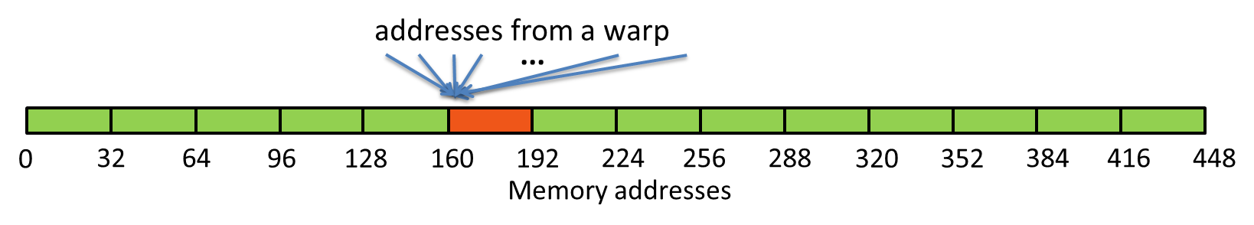
Scenario
Global memory access
Scenario:
All threads in a warp request the same 4-byte word
Addresses fall within a single segment
Warp needs 4 bytes
32 bytes move across the bus
Bus utilization: 12.5%

Slide 12
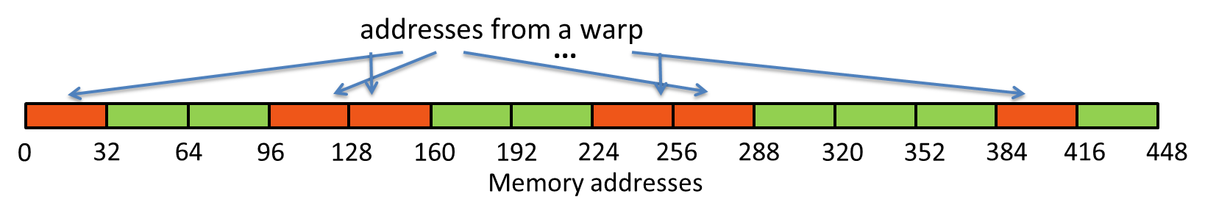
Scenario
Global memory access
Scenario:
Warp requests 32 scattered 4-byte words
Addresses fall within N segments
Warp needs 128 bytes
N*32 bytes move across the bus
Bus utilization: 128 / (N*32)

Slide 13
Structure of Non-Native Size
Global memory access
Say we are reading a 12-byte structure per thread
struct Position
{
float x, y, z;
};
...
__global__ void kernel( Position *data, ... )
{
int idx = blockIdx.x * blockDim.x + threadIdx.x;
Position temp = data[idx];
...
}

Slide 14
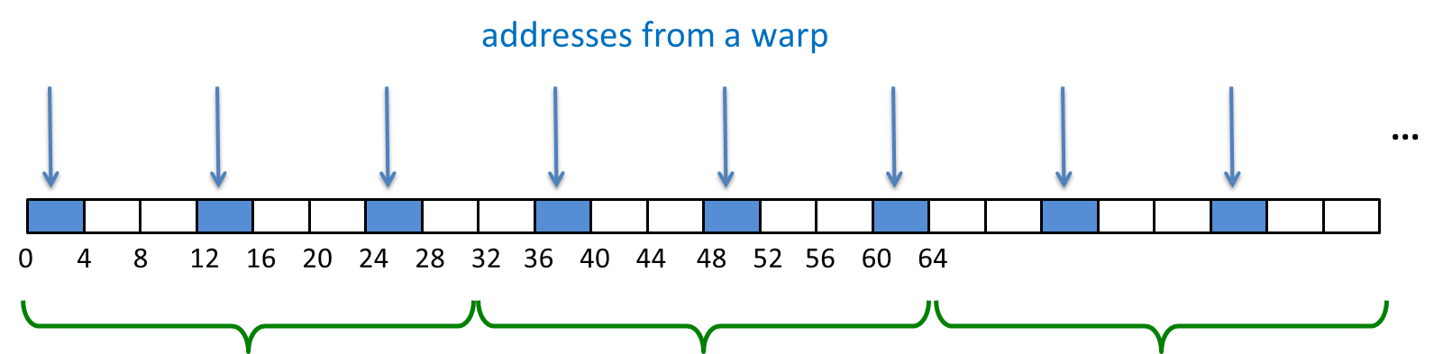
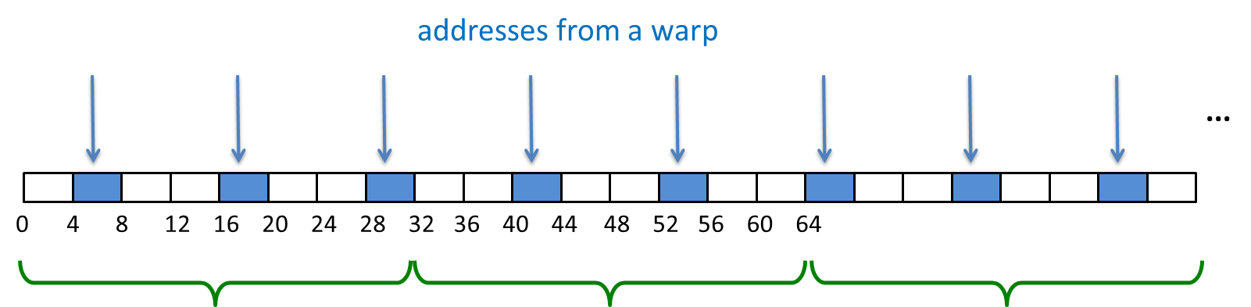
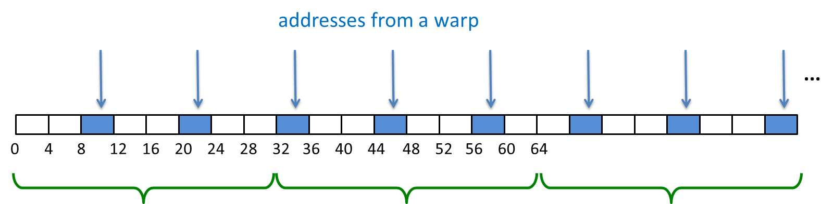
Structure of Non-Native Size
Global memory access
First Load Instruction
Second Load Instruction
Third Load Instruction

Slide 15
Solutions
Global memory access
➔Moving 3x more bytes than application requests
Change data layout from array of structures to structure of arrays
In this case: 3 separate arrays of floats
The most reliable approach (also ideal for both CPUs and GPUs)
Use loads via read-only cache
As long as lines survive in the cache, performance will be nearly optimal
Stage loads via shared memory

Slide 16
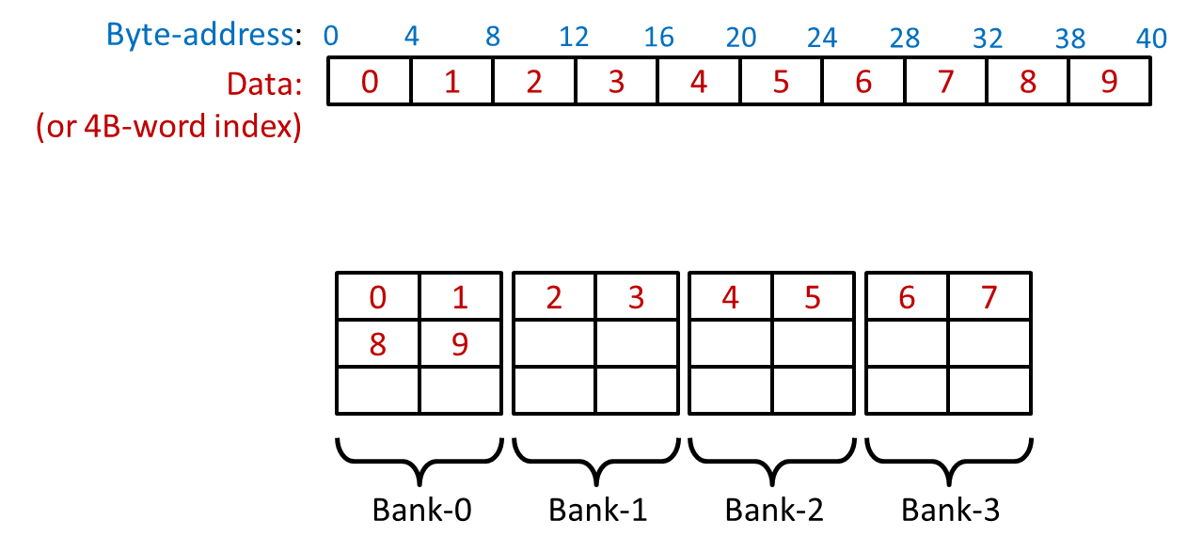
Shared Memory
Shared memory
On-chip (on each SM) memory
Comparing SMEM to GMEM:
Order of magnitude (20-30x) lower latency
Order of magnitude (~10x) higher bandwidth
Accessed at bank-width granularity

Slide 17
Shared Memory Bank Conflicts
Shared memory
A bank conflict occurs when:
2 or more threads in a warp access different words in the same bank
N-way bank conflict: N threads in a warp conflict
Note there is no bank conflict if:
Several threads access the same word
Several threads access different bytes of the same word

Slide 18
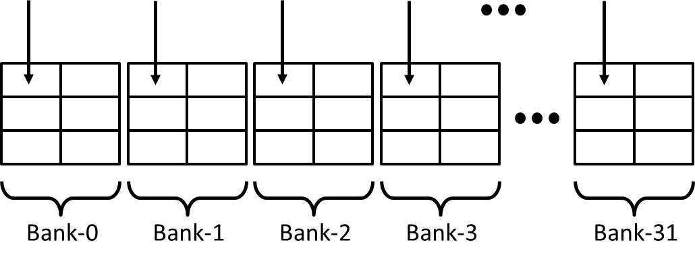
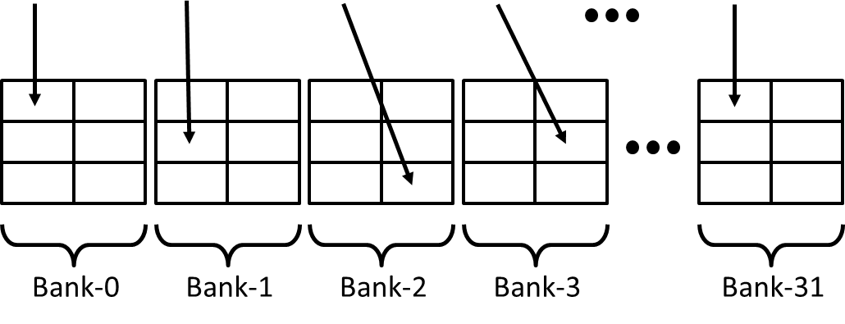
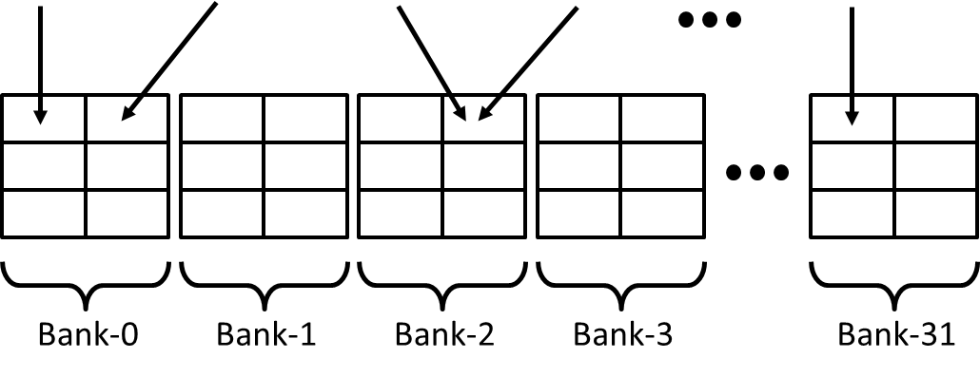
SMEM Access Examples
Shared memory
No Bank Conflicts Cases

Slide 19
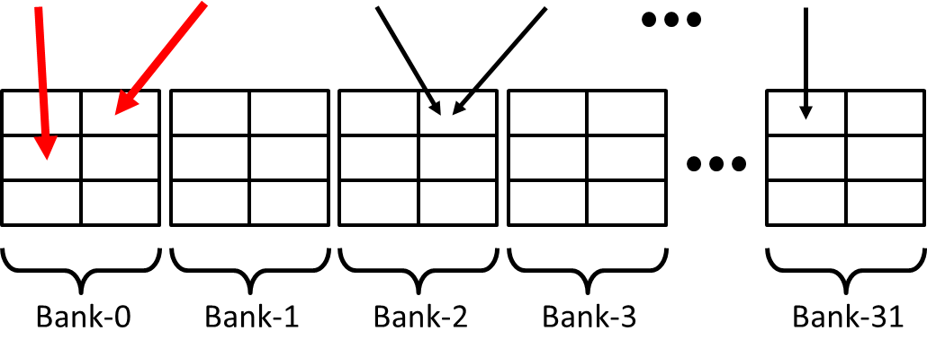
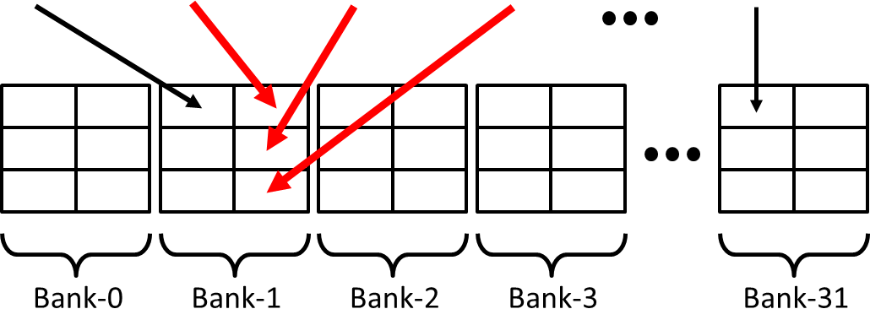
SMEM Access Examples
Shared memory
Bank Conflicts Cases

Slide 20
SMEM Access Examples
Shared memory
Shared memory is a tremendous resource
Very high bandwidth (terabytes per second)
20-30x lower latency than accessing GMEM
Performance issues to look out for:
Bank conflicts add latency and reduce throughput
Many-way bank conflicts can be very expensive
Replay latency adds up
However, few code patterns have high conflicts, padding is a very simple and effective solution

Slide 21
Execution
Arithmetic optimizations
Instructions are issued/executed per warp
Warp = 32 consecutive threads
Think of it as a “vector” of 32 threads
The same instruction is issued to the entire warp
Scheduling
Warps are scheduled at run-time
Hardware picks from warps that have an instruction ready to execute
Ready = all arguments are ready
Instruction latency is hidden by executing other warps

Slide 22
Conditional Control Flow
Arithmetic optimizations
If at least one thread in a warp needs take a particular path:
All threads in a warp take that path
Threads that aren’t on that path:
Don’t fetch arguments, don’t write outputs: guarantees correctness
Still spend time, instead of executing their path: potential performance impact

Slide 23
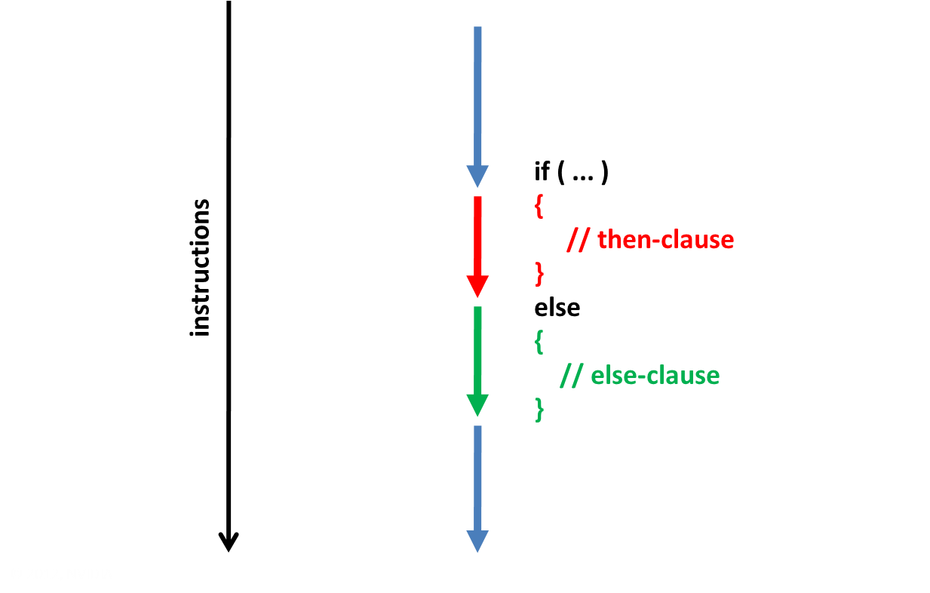
Control Flow
Arithmetic optimizations

Slide 24
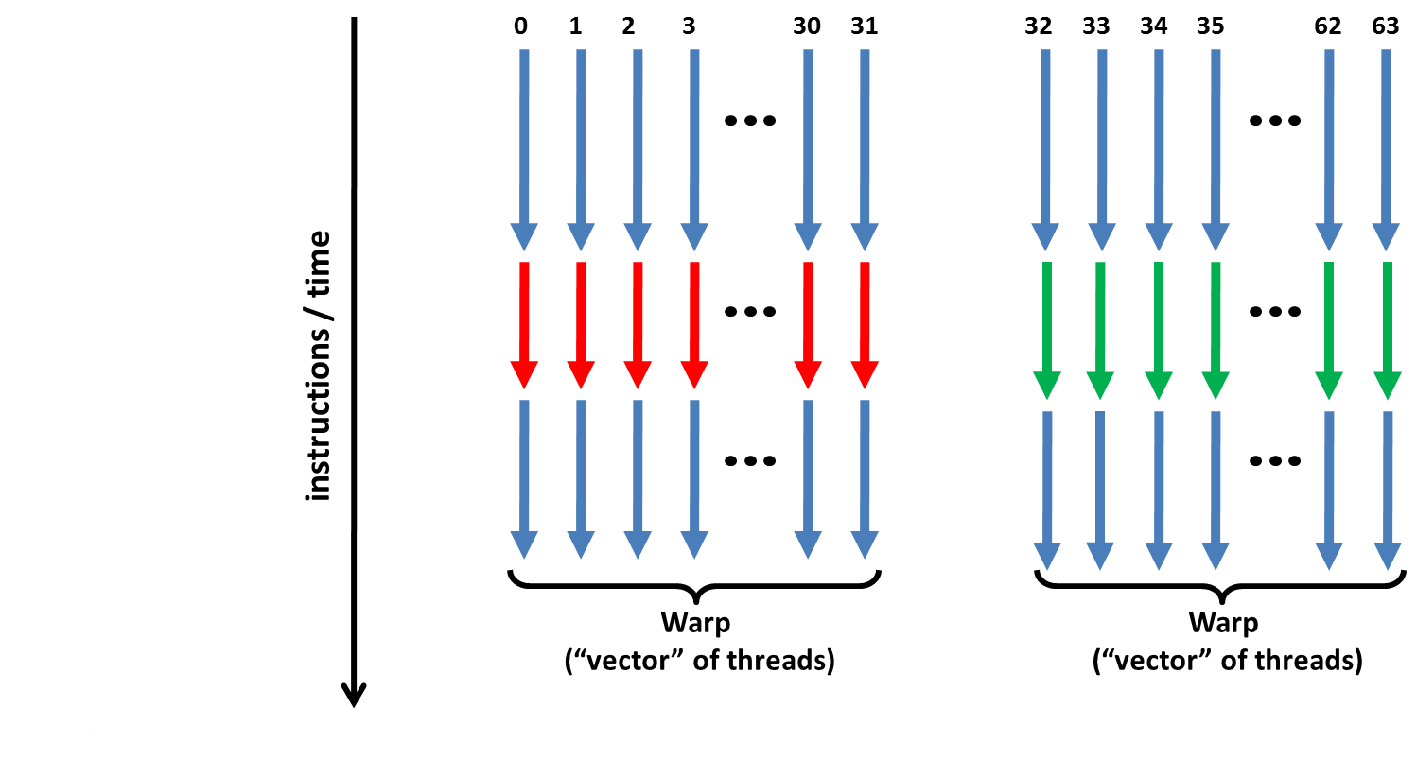
Execution within warps is coherent
Arithmetic optimizations

Slide 25
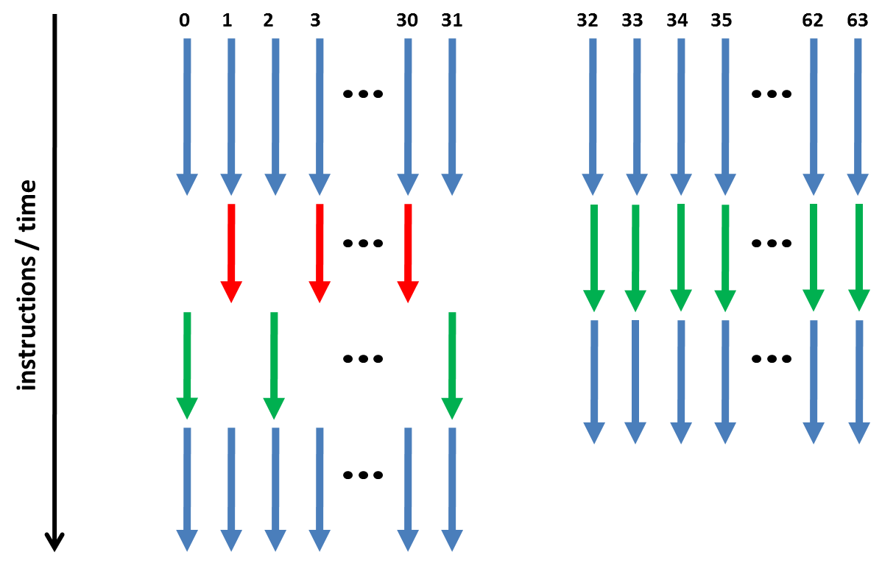
Execution diverges within a warp
Arithmetic optimizations

Slide 26
Instruction Throughput: Summary
Arithmetic optimizations
Analyze:
Check achieved instruction throughput
Compare to HW peak
Check percentage of instructions due to serialization
Optimizations:
Intrinsics, compiler options for expensive operations
Group threads that are likely to follow same execution path (minimize warp divergence)
Minimize memory access replays (SMEM and GMEM)

