Slide 1
USE OF NVIDIA CUDA FOR NUMERICAL SOLUTION OF
PARTIAL
DIFFERENTIAL
EQUATIONS
USE OF NVIDIA CUDA FOR NUMERICAL SOLUTION OF PARTIAL DIFFERENTIAL EQUATIONS
TOMÁŠ
OBERHUBER, ATSUSHI SUZUKI,
JAN VACATA,
VÍTE^{ˇ} ZSLAV ŽABKA
WHY WE SHOULD BE INTERESTED IN GPU?
HISTORY OF GPU
Tomáš Oberhuber, Atsushi Suzuki, Jan Vacata, V í t e zslav Žabka
WHAT IS A
GPGPU?
Faculty of Nuclear Sciences and Physical Engineering Czech Technical University in Prague
NVIDIA CUDA
METHOD OF LINES FOR PARABOLIC PDES IN CUDA
Mini workshop on advanced numerical methods for parallel computers
IMPLEMENTATION OF GMRES
METHOD IN CUDA
CONCLUSION
Notes:
Hello, my name is Seungyul Han and I will introduce about ‘use of nvidia cuda for numerical solution of partial differential equations which is presented at mini workshop in Czech technical university.

Slide 2
OVERVIEW
USE OF NVIDIA CUDA FOR NUMERICAL SOLUTION OF
PARTIAL
DIFFERENTIAL
EQUATIONS
WHY WE SHOULD BE INTERESTED IN GPU?
TOMÁŠ
OBERHUBER, ATSUSHI SUZUKI,
JAN VACATA,
VÍTE^{ˇ} ZSLAV ŽABKA
HISTORY OF GPU
WHAT IS A GPGPU?
WHY WE SHOULD BE INTERESTED IN GPU?
HISTORY OF GPU
NVIDIA CUDA
WHAT IS A
GPGPU?
METHOD OF LINES FOR PARABOLIC PDES IN CUDA
NVIDIA CUDA
METHOD OF LINES FOR PARABOLIC PDES IN CUDA
IMPLEMENTATION OF GMRES METHOD IN CUDA
IMPLEMENTATION OF GMRES
METHOD IN CUDA
CONCLUSION
CONCLUSION
Notes:
I will talk about following : interest in GPU, history of GPU, and what is GPU. Then, nvidia CUDA for solving partial differential equation numerically to detect cancer, or the generalized minimal residual method which solves linear system by using CUDA, and I will conclude.

Slide 3
NEED FOR MORE COMPUTATIONAL POWER
USE OF NVIDIA CUDA FOR NUMERICAL SOLUTION OF
PARTIAL
DIFFERENTIAL
EQUATIONS
TOMÁŠ
OBERHUBER, ATSUSHI SUZUKI,
JAN VACATA,
VÍTE^{ˇ} ZSLAV ŽABKA
we want to do more and more complex computations
they require more powerful CPUs
we cannot increase the power of CPU by increasing the clock frequency anymore
we may search for more efficient architectures ...
... or for parallel computing using multicore CPUs
WHY WE SHOULD BE INTERESTED IN GPU?
HISTORY OF GPU
WHAT IS A
GPGPU?
NVIDIA CUDA
METHOD OF LINES FOR PARABOLIC PDES IN CUDA
IMPLEMENTATION
OF GMRES
METHOD IN CUDA
CONCLUSION
Notes:
In these days, we need more computational power to solve complex computations, but we cannot increase the power of CPU any more, so we parallel computed by multicore CPU before,

Slide 4
IS MULTICORE ENOUGH?
USE OF NVIDIA CUDA FOR NUMERICAL SOLUTION OF
PARTIAL
DIFFERENTIAL
EQUATIONS
However
adding more cores is not so simple because of shared memory architecture
it is very difficult to build parallel system with shared memory and more then 100 cores
for more then 100 cores we usually have to switch to distributed systems
the latest mainframe z10 supports up to 64 cores
September 26, 2006 - Intel: 80 cores by 2011
TOMÁŠ
OBERHUBER, ATSUSHI SUZUKI,
JAN VACATA,
VÍTE^{ˇ} ZSLAV ŽABKA
WHY WE SHOULD BE INTERESTED IN GPU?
HISTORY OF GPU
WHAT IS A
GPGPU?
NVIDIA CUDA
METHOD OF LINES FOR PARABOLIC PDES IN CUDA
http://techfreep.com/intel-80-cores-by-2011.htm
IMPLEMENTATION
OF GMRES
METHOD IN CUDA
CONCLUSION
Notes:
but, adding cores is hard to build parallel system because it use same shared memory. If there are more than one hundred cores, then we switched to distributed systems and the latest z ten supports only sixty four cores.

Slide 5
DISADVANTAGES OF CPU
USE OF NVIDIA CUDA FOR NUMERICAL SOLUTION OF
PARTIAL
DIFFERENTIAL
EQUATIONS
CPU is designed to process general code
the main parts of CPU design are pipeline and cache
pipeline allows
more efficient processing of instructions
it needs to predict conditions in code - speculative execution
in average there is 1 condition instruction per 6 instructions
cache allows
to hide big latency of common RAM
both require complicated algorithms
majority of transistors is spent on cache and speculative execution and not for main computing
CPU is not well designed for numerical computing.
TOMÁŠ
OBERHUBER, ATSUSHI SUZUKI,
JAN VACATA,
VÍTE^{ˇ} ZSLAV ŽABKA
WHY WE SHOULD BE INTERESTED IN GPU?
HISTORY OF GPU
WHAT IS A
GPGPU?
NVIDIA CUDA
METHOD OF LINES FOR PARABOLIC PDES IN CUDA
IMPLEMENTATION OF GMRES
METHOD IN CUDA
CONCLUSION
Notes:
In addition, CPU is designed to process general code, and it use pipeline and cache which requires complicated algorithms like prediction of condition or hiding latency, so CPU is not well designed for numerical computing.

Slide 6
ADVANTAGES OF GPU
USE OF NVIDIA CUDA FOR NUMERICAL SOLUTION OF
PARTIAL
DIFFERENTIAL
EQUATIONS
GPU - graphics processing unit
GPU is designed to run simultaneously up to 240 threads - virtually up to 30 000 threads ¹
threads must be independent - it is not known in what order the are going to be scheduled
intensive computing and only few conditions is assumed
there is no speculative execution
there is no cache
GPU is optimised for sequential memory access - 112 GB/s
TOMÁŠ
OBERHUBER, ATSUSHI SUZUKI,
JAN VACATA,
VÍTE^{ˇ} ZSLAV ŽABKA
WHY WE SHOULD BE INTERESTED IN GPU?
HISTORY OF GPU
WHAT IS A
GPGPU?
NVIDIA CUDA
METHOD OF LINES FOR PARABOLIC PDES IN CUDA
IMPLEMENTATION OF GMRES
METHOD IN CUDA
CONCLUSION
¹nVidia Tesla
Notes:
Therefore GPU has been emerged, GPU has so many threads and they are independent, and there is no complicate work, so GPU has advantage for numerical computation.

Slide 7
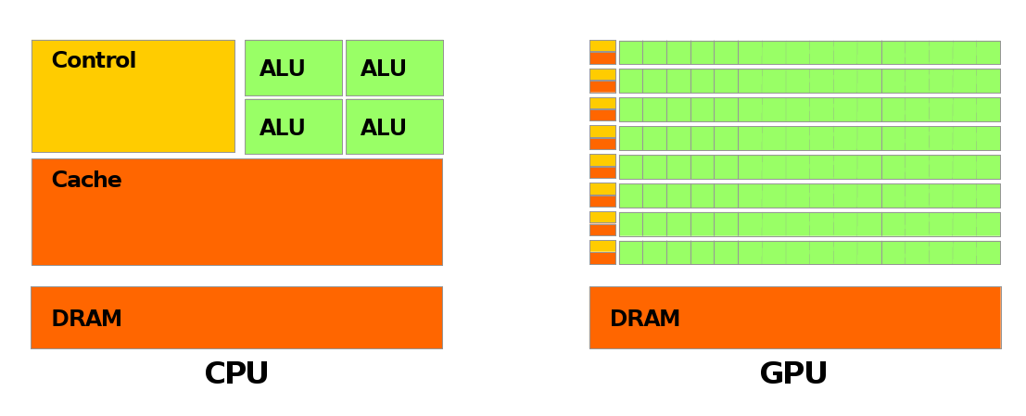
ADVANTAGES OF GPU
USE OF NVIDIA CUDA FOR NUMERICAL SOLUTION OF
PARTIAL
DIFFERENTIAL
EQUATIONS
TOMÁŠ
OBERHUBER, ATSUSHI SUZUKI,
JAN VACATA,
VÍTE^{ˇ} ZSLAV ŽABKA
WHY WE SHOULD BE INTERESTED IN GPU?
HISTORY OF GPU WHAT IS A
GPGPU?
NVIDIA CUDA
METHOD OF LINES FOR PARABOLIC PDES IN CUDA
FIGURE: Source nVidia Programming Guide
IMPLEMENTATION OF GMRES
METHOD IN CUDA
CONCLUSION
Notes:
As explained, GPU has many thread to computing and there is no big cache like CPU. -> History of GPU

Slide 8
COMPARISON CPU VS. GPU
USE OF NVIDIA CUDA FOR NUMERICAL SOLUTION OF
PARTIAL
DIFFERENTIAL
EQUATIONS
For approx. 1000 EUR one can buy
TOMÁŠ
OBERHUBER, ATSUSHI SUZUKI,
JAN VACATA,
VÍTE^{ˇ} ZSLAV ŽABKA
 | nVidia TESLA S1060 | Intel Core i7-975 Extreme Quad-Core
Transistors | 1 400 millions | 731 millions
Clock | 1.3 GHz | 3.3 GHz
Threads Num. | 240 | 8
Peak. Perf. Bandwidth | 936 GFlops 102 GB/s | ≈ 50 GFlops 25.6 GB/s
RAM | 4 GB | ≈ 48 GB
WHY WE SHOULD BE INTERESTED IN GPU?
HISTORY OF GPU WHAT IS A
GPGPU?
NVIDIA CUDA
METHOD OF LINES FOR PARABOLIC PDES IN CUDA
IMPLEMENTATION OF GMRES
METHOD IN CUDA
nVidia predicts 570 times faster GPUs until 2015
CONCLUSION
Notes:
This table shows comparison between CPU and GPU. We can see that GPU has more transistors and threads to compute parallel, so it is much faster than CPU. Because of there advantages,

Slide 9
HISTORY OF GPU
USE OF NVIDIA CUDA FOR NUMERICAL SOLUTION OF
PARTIAL
DIFFERENTIAL
EQUATIONS
GPU = graphics processing unit
accelerators of algorithms in 3D graphics and visualisation
originally aimed for computer games
psychological disadvantage of GPU even today
typical run
transformation of thousands of triangles
applying textures
projection to frame buffer
no data dependency
TOMÁŠ
OBERHUBER, ATSUSHI SUZUKI,
JAN VACATA,
VÍTE^{ˇ} ZSLAV ŽABKA
WHY WE SHOULD BE INTERESTED IN GPU?
HISTORY OF GPU
WHAT IS A
GPGPU?
NVIDIA CUDA
METHOD OF LINES FOR PARABOLIC PDES IN CUDA
IMPLEMENTATION
OF GMRES
METHOD IN CUDA
CONCLUSION
Notes:
Then I will explain about history of GPU. We used GPU for algorithms in 3D graphics, computer games or typical image processing and they has no data dependency, so they can be parallelized.

Slide 10

WHAT IS A GPGPU?
USE OF NVIDIA CUDA FOR NUMERICAL SOLUTION OF
PARTIAL
DIFFERENTIAL
EQUATIONS
assume having a rectangle and apply gray scale texture with 800x600 pixels
project it one-to-one to framebuffer/screen with resolution 800x600 pixels
we can apply two textures and mix them
TOMÁŠ
OBERHUBER, ATSUSHI SUZUKI,
JAN VACATA,
VÍTE^{ˇ} ZSLAV ŽABKA
WHY WE SHOULD BE INTERESTED IN GPU?
HISTORY OF GPU
it equals weighted sum of two matrices from
result of which is stored in framebuffer/screen
GPGPU = General-purpose computing on graphics
WHAT IS A
GPGPU?
NVIDIA CUDA
METHOD OF LINES FOR PARABOLIC PDES IN CUDA
IMPLEMENTATION
processing units (2003)
OF GMRES
METHOD IN CUDA
CONCLUSION
Notes:
For example, assume gray scaling of rectangle images, then it requires weighted sum of three R, G, B matrices from image and it has no dependency. Therefore, GPGPU is emerged in 2003,

Slide 11
ESSENCE OF GPGPU
USE OF NVIDIA CUDA FOR NUMERICAL SOLUTION OF
PARTIAL
DIFFERENTIAL
EQUATIONS
TOMÁŠ
OBERHUBER, ATSUSHI SUZUKI,
JAN VACATA,
VÍTE^{ˇ} ZSLAV ŽABKA
at the beginnings we had to use OpenGL for GPGPU
problems were reformulated in terms of textures and operations on pixels
WHY WE SHOULD BE INTERESTED IN GPU?
HISTORY OF GPU
game developers needed more flexible hardware ⇒
pixel shaders
simple programmable processors for operations with pixels
support for single precision arithmetic
limited number of instructions
WHAT IS A
GPGPU?
NVIDIA CUDA
METHOD OF LINES FOR PARABOLIC PDES IN CUDA
IMPLEMENTATION
OF GMRES
METHOD IN CUDA
CONCLUSION
Notes:
At the beginnings, we had to use OpenGL and it reformulates problems in terms of textures and operations on pixels. But game developers need some flexible and simple hardware.

Slide 12
NVIDIA CUDA
USE OF NVIDIA CUDA FOR NUMERICAL SOLUTION OF
PARTIAL
DIFFERENTIAL
EQUATIONS
CUDA = Compute Unified Device Architecture - nVidia 15 February 2007
significantly simplifies GPGPU programming
based on simple extension of C-language
completely avoids use of OpenGL and texture-like formulations of problems
support only for nVidia graphic cards (or TESLA cards)
It is very easy to write code for CUDA but one must have
TOMÁŠ
OBERHUBER, ATSUSHI SUZUKI,
JAN VACATA,
VÍTE^{ˇ} ZSLAV ŽABKA
WHY WE SHOULD BE INTERESTED IN GPU?
HISTORY OF GPU
WHAT IS A
GPGPU?
NVIDIA CUDA
METHOD OF LINES FOR PARABOLIC PDES IN CUDA
good knowledge of hardware to get efficient code.
IMPLEMENTATION
OF GMRES
METHOD IN CUDA
CONCLUSION
Notes:
In 2007, NVIDIA CUDA is developed which simplifies GPGPU programming and avoid use of OpenGL. It is based on simple extension of C so easy to write code and supports NVIDIA GPU.

Slide 13
CUDA ARCHITECTURE I.
USE OF NVIDIA CUDA FOR NUMERICAL SOLUTION OF
PARTIAL
DIFFERENTIAL
EQUATIONS
CUDA device = device for simultaneous processing of thousands of independent threads
CUDA thread is lightweight structure - easy and efficient to create
we cannot hope to be able to synchronise 240 resp.
30 000 threads efficiently
CUDA architecture introduces small groups of threads with shared memory which can be synchronized
communication between processing units is the main difficulty in parallel computing.
TOMÁŠ
OBERHUBER, ATSUSHI SUZUKI,
JAN VACATA,
VÍTE^{ˇ} ZSLAV ŽABKA
WHY WE SHOULD BE INTERESTED IN GPU?
HISTORY OF GPU
WHAT IS A
GPGPU?
NVIDIA CUDA
METHOD OF LINES FOR PARABOLIC PDES IN CUDA
IMPLEMENTATION
OF GMRES
METHOD IN CUDA
CONCLUSION
Notes:
CUDA use simultaneous programming by using many independent threads, and CUDA thread is easy and efficient to use, but there is overhead to communicate between CPU and GPU. CUDA makes small group of threads with shared memory and they can be synchronized.

Slide 14
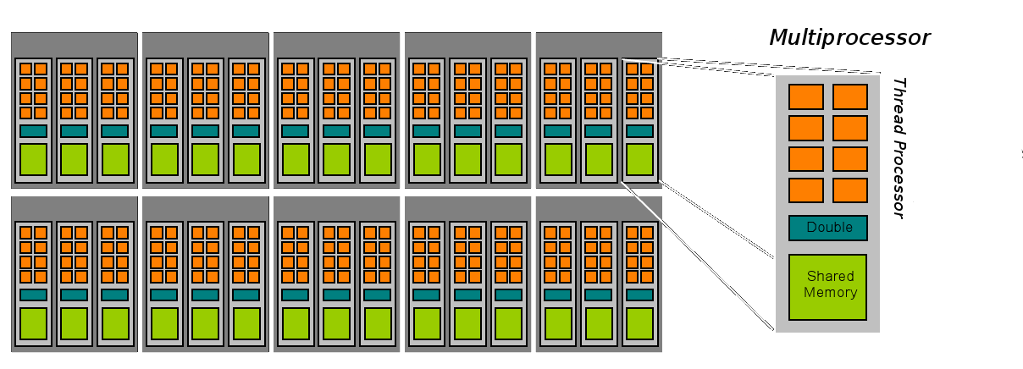
CUDA ARCHITECTURE II.
USE OF NVIDIA CUDA FOR NUMERICAL SOLUTION OF
PARTIAL
DIFFERENTIAL
EQUATIONS
10-Series architecture (GeForce 2xx, TESLA) consists of 30 multiprocessors
each has 8 thread processors
TOMÁŠ
OBERHUBER, ATSUSHI SUZUKI,
JAN VACATA,
VÍTE^{ˇ} ZSLAV ŽABKA
WHY WE SHOULD BE INTERESTED IN GPU?
HISTORY OF GPU WHAT IS A
GPGPU?
NVIDIA CUDA
METHOD OF LINES FOR PARABOLIC PDES IN CUDA
IMPLEMENTATION OF GMRES
METHOD IN CUDA
CONCLUSION
FIGURE: Source nVidia Programming Guide
From the hardware architecture thread hierarchy follows:
Notes:
GPU architecture is like this, each streaming multiprocessor has multiple thread and they have same shared memory. GPU has multiple SMs. From this, thread hierarchy is,

Slide 15
THREAD HIERARCHY
USE OF NVIDIA CUDA FOR NUMERICAL SOLUTION OF
PARTIAL
DIFFERENTIAL
EQUATIONS
TOMÁŠ
OBERHUBER, ATSUSHI SUZUKI,
JAN VACATA,
VÍTE^{ˇ} ZSLAV ŽABKA
threads are grouped into blocks
there can be up to 512 threads in one block
multiprocessor must switch between them
blocks of threads are grouped into grids
WHY WE SHOULD BE INTERESTED IN GPU?
HISTORY OF GPU
WHAT IS A
GPGPU?
NVIDIA CUDA
METHOD OF LINES FOR PARABOLIC PDES IN CUDA
IMPLEMENTATION OF GMRES
METHOD IN CUDA
CONCLUSION
Notes:
Threads are grouped into blocks, each block has five hundred twelve threads, but not thousand twenty four tand block is grouped into grid.

Slide 16
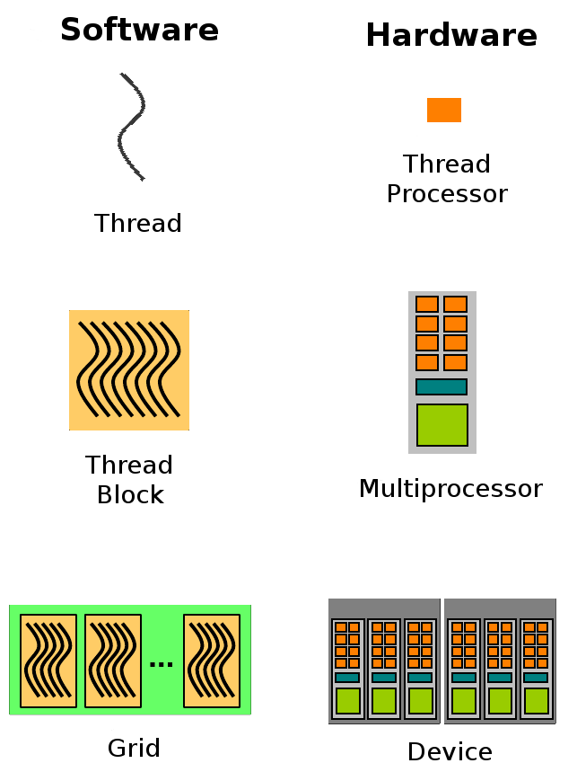
EXECUTION MODEL
USE OF NVIDIA CUDA FOR NUMERICAL SOLUTION OF
PARTIAL
DIFFERENTIAL
EQUATIONS
TOMÁŠ
OBERHUBER, ATSUSHI SUZUKI,
JAN VACATA,
VÍTE^{ˇ} ZSLAV ŽABKA
WHY WE SHOULD BE INTERESTED IN GPU?
HISTORY OF GPU WHAT IS A
GPGPU?
NVIDIA CUDA
METHOD OF LINES FOR PARABOLIC PDES IN CUDA
IMPLEMENTATION OF GMRES
METHOD IN CUDA
CONCLUSION
FIGURE: Source nVidia: Getting Started with CUDA
Notes:
Here, core executes thread, and SM executes block, and device executes grid. -> Memory Layout

Slide 17
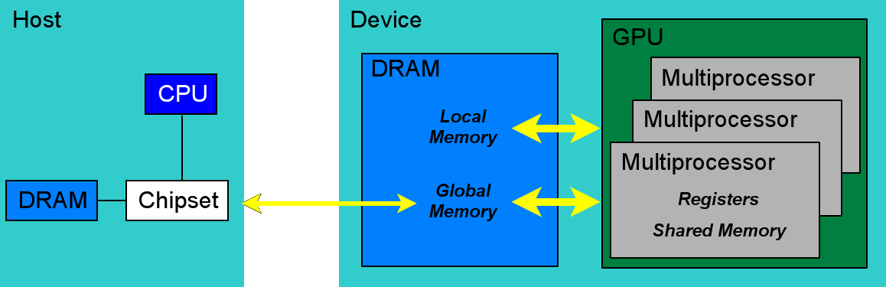
MEMORY LAYOUT
USE OF NVIDIA CUDA FOR NUMERICAL SOLUTION OF
PARTIAL
DIFFERENTIAL
EQUATIONS
TOMÁŠ
OBERHUBER, ATSUSHI SUZUKI,
JAN VACATA,
VÍTE^{ˇ} ZSLAV ŽABKA
WHY WE SHOULD BE INTERESTED IN GPU?
HISTORY OF GPU WHAT IS A
GPGPU?
FIGURE: Source nVidia: Getting Started with CUDA
NVIDIA CUDA
METHOD OF LINES FOR PARABOLIC PDES IN CUDA
IMPLEMENTATION OF GMRES
METHOD IN CUDA
CONCLUSION
Notes:
Host and Device communicates by PCIe bus and device has local memory and global memory, and each SM has shared memory and registers.

Slide 18
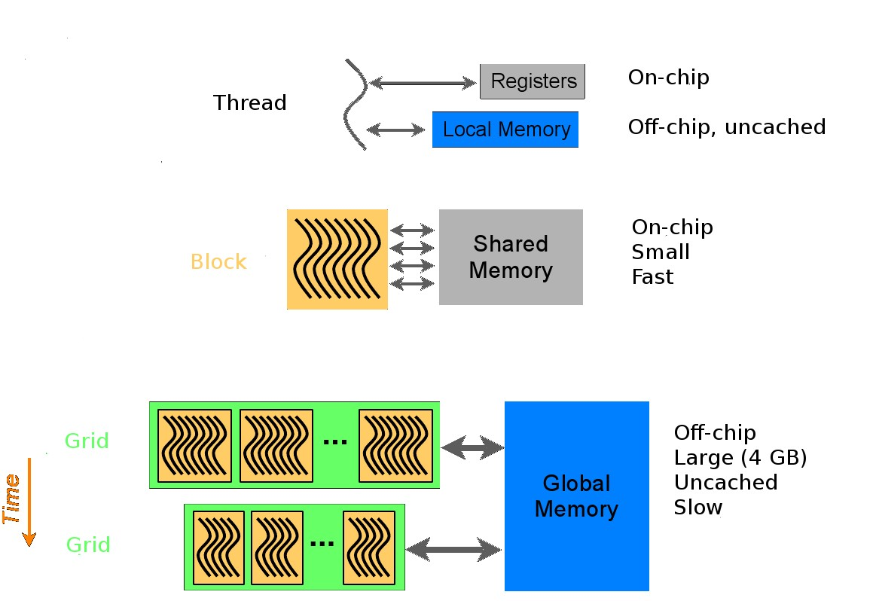
MEMORY HIERARCHY
USE OF NVIDIA CUDA FOR NUMERICAL SOLUTION OF
PARTIAL
DIFFERENTIAL
EQUATIONS
TOMÁŠ
OBERHUBER, ATSUSHI SUZUKI,
JAN VACATA,
VÍTE^{ˇ} ZSLAV ŽABKA
WHY WE SHOULD BE INTERESTED IN GPU?
HISTORY OF GPU WHAT IS A
GPGPU?
NVIDIA CUDA
METHOD OF LINES FOR PARABOLIC PDES IN CUDA
IMPLEMENTATION OF GMRES
METHOD IN CUDA
CONCLUSION
FIGURE: Source nVidia: Getting Started with CUDA
Notes:
Each thread has register and local memory, and each block has shared memory, and device has global memory as explained.

Slide 19
COALESCED ACCES
USE OF NVIDIA CUDA FOR NUMERICAL SOLUTION OF
PARTIAL
DIFFERENTIAL
EQUATIONS
TOMÁŠ
OBERHUBER, ATSUSHI SUZUKI,
JAN VACATA,
VÍTE^{ˇ} ZSLAV ŽABKA
majority of GPU global memory acces consists of texture acces
GPU is strongly optimised for sequential global memory acces
one should avoid random acces to global memory
coalesced memory acces can significantly reduce (up to 16x) number of memory transactions
WHY WE SHOULD BE INTERESTED IN GPU?
HISTORY OF GPU
WHAT IS A
GPGPU?
NVIDIA CUDA
METHOD OF LINES FOR PARABOLIC PDES IN CUDA
IMPLEMENTATION OF GMRES
METHOD IN CUDA
CONCLUSION
Notes:
I will skip memory access since it is explained many times before.

Slide 20
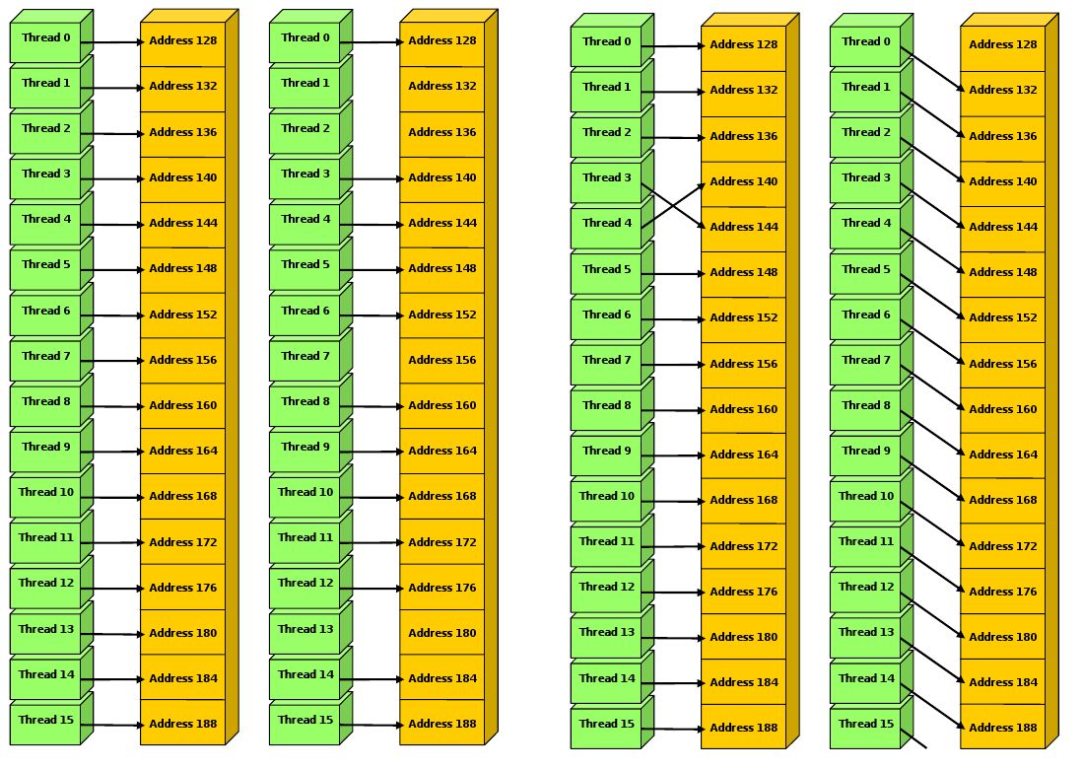
COALESCED ACCES
USE OF NVIDIA CUDA FOR NUMERICAL SOLUTION OF
PARTIAL
DIFFERENTIAL
EQUATIONS
TOMÁŠ
OBERHUBER, ATSUSHI SUZUKI,
JAN VACATA,
VÍTE^{ˇ} ZSLAV ŽABKA
WHY WE SHOULD BE INTERESTED IN GPU?
HISTORY OF GPU WHAT IS A
GPGPU?
NVIDIA CUDA
METHOD OF LINES FOR PARABOLIC PDES IN CUDA
IMPLEMENTATION OF GMRES
METHOD IN CUDA
CONCLUSION
FIGURE: Source nVidia: nVidia CUDA programming guide

Slide 21
PROGRAMMING IN CUDA I.
USE OF NVIDIA CUDA FOR NUMERICAL SOLUTION OF
PARTIAL
DIFFERENTIAL
EQUATIONS
programming for CUDA consists of writing of kernels
= code processed by one thread
kernels do not support recursion
they support branching - it can reduce efficiency
The following code in C
intmain()
{
floatA[ N ], B[ N ], C[ N ];
...
for(inti = 0; i <= N-1, i ++ ) C[ i ] = A[ i ] + B[ i ];
}
TOMÁŠ
OBERHUBER, ATSUSHI SUZUKI,
JAN VACATA,
VÍTE^{ˇ} ZSLAV ŽABKA
WHY WE SHOULD BE INTERESTED IN GPU?
HISTORY OF GPU
WHAT IS A
GPGPU?
NVIDIA CUDA
METHOD OF LINES FOR PARABOLIC PDES IN CUDA
IMPLEMENTATION OF GMRES
METHOD IN CUDA
CONCLUSION
Notes:
Then programming for CUDA use kernels by each thread, and each thread do same instruction in parallel. For example, this simple addition and write code in C is changed to

Slide 22
PROGRAMMING IN CUDA II.
USE OF NVIDIA CUDA FOR NUMERICAL SOLUTION OF
PARTIAL
DIFFERENTIAL
EQUATIONS
can be replaced by
global voidvecAdd(float float* C )
{
inti =threadIdx.x;
C[ i ] = A[ i ] + B[ i ];
}
intmain()
{
// allocate A, B, C on the CUDA device
...
vecAdd<<< 0,N-1 >>>( A, B, C );
}
TOMÁŠ
OBERHUBER, ATSUSHI SUZUKI,
JAN VACATA,
VÍTE^{ˇ} ZSLAV ŽABKA
* A,float * B,
WHY WE SHOULD BE INTERESTED IN GPU?
HISTORY OF GPU
WHAT IS A
GPGPU?
NVIDIA CUDA
METHOD OF LINES FOR PARABOLIC PDES IN CUDA
IMPLEMENTATION OF GMRES
METHOD IN CUDA
CONCLUSION
Notes:
Like this code. Kernel vecAdd do addition and writing in device which is executed at each thread in parallel.

Slide 23
ALLOCATING MEMORY ON THE CUDA DEVICE
USE OF NVIDIA CUDA FOR NUMERICAL SOLUTION OF
PARTIAL
DIFFERENTIAL
EQUATIONS
TOMÁŠ
OBERHUBER, ATSUSHI SUZUKI,
JAN VACATA,
VÍTE^{ˇ} ZSLAV ŽABKA
WHY WE SHOULD BE INTERESTED IN GPU?
HISTORY OF GPU WHAT IS A
GPGPU?
NVIDIA CUDA
METHOD OF LINES FOR PARABOLIC PDES IN CUDA
IMPLEMENTATION OF GMRES
METHOD IN CUDA
CONCLUSION
// Allocate input vectors h_A and h_B in host memory float* h_A = malloc(size);
float* h_B = malloc(size);
// Allocate vectors in device memory float* d_A; cudaMalloc((void**)&d_A, size); float* d_B; cudaMalloc((void**)&d_B, size); float* d_C; cudaMalloc((void**)&d_C, size);
// Copy vectors from host memory to device memory cudaMemcpy(d_A, h_A, size,cudaMemcpyHostToDevice); cudaMemcpy(d_B, h_B, size,cudaMemcpyHostToDevice);
// Invoke kernel
VecAdd<<< 0, N-1 >>>(d_A, d_B, d_C);
// Copy result from device memory to host memory
// h_C contains the result in host memory cudaMemcpy(h_C, d_C, size,cudaMemcpyDeviceToHost);
// Free device memory cudaFree(d_A); cudaFree(d_B); cudaFree(d_C);
Compile with nvcc
Notes:
Full code for vector addition is like this, which is same for our homework 1 problem : allocate memory copy memory kernel execution, then free memory. -> PDE

Slide 24
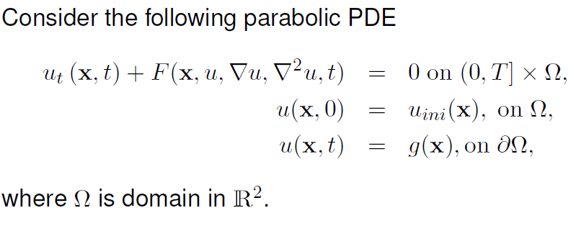
METHOD OF LINES FOR PARABOLIC PDES IN
CUDA I.
USE OF NVIDIA CUDA FOR NUMERICAL SOLUTION OF
PARTIAL
DIFFERENTIAL
EQUATIONS
TOMÁŠ
OBERHUBER, ATSUSHI SUZUKI,
JAN VACATA,
VÍTE^{ˇ} ZSLAV ŽABKA
WHY WE SHOULD BE INTERESTED IN GPU?
HISTORY OF GPU WHAT IS A
GPGPU?
NVIDIA CUDA
METHOD OF LINES FOR PARABOLIC PDES IN CUDA
IMPLEMENTATION OF GMRES
METHOD IN CUDA
CONCLUSION
Notes:
Then I will explain about numerical computing on partial differential equation. First, PDE is given like this, partial differential equation, initial condition, and boundary condition in continuous domain.

Slide 25
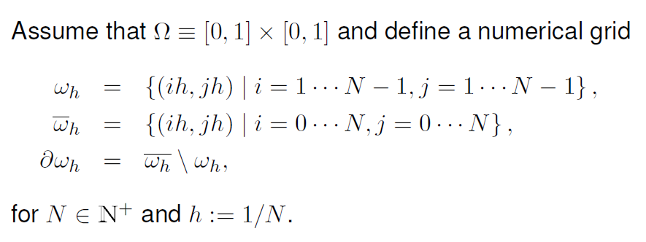
METHOD OF LINES FOR PARABOLIC PDES IN
CUDA II.
USE OF NVIDIA CUDA FOR NUMERICAL SOLUTION OF
PARTIAL
DIFFERENTIAL
EQUATIONS
TOMÁŠ
OBERHUBER, ATSUSHI SUZUKI,
JAN VACATA,
VÍTE^{ˇ} ZSLAV ŽABKA
WHY WE SHOULD BE INTERESTED IN GPU?
HISTORY OF GPU
WHAT IS A
GPGPU?
NVIDIA CUDA
METHOD OF LINES FOR PARABOLIC PDES IN CUDA
IMPLEMENTATION OF GMRES
METHOD IN CUDA
CONCLUSION
Notes:
Assume domain is defined as numerical grid and define grid whose blocks is size 1/N times 1/N.

Slide 26
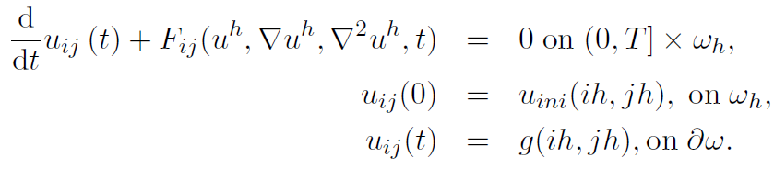
METHOD OF LINES FOR PARABOLIC PDES IN
CUDA III.
USE OF NVIDIA CUDA FOR NUMERICAL SOLUTION OF
PARTIAL
DIFFERENTIAL
EQUATIONS
TOMÁŠ
OBERHUBER, ATSUSHI SUZUKI,
JAN VACATA,
VÍTE^{ˇ} ZSLAV ŽABKA
After discretisation in space (using e.g. the finite difference method) we obtain the following system of ODEs
WHY WE SHOULD BE INTERESTED IN GPU?
HISTORY OF GPU
WHAT IS A
GPGPU?
NVIDIA CUDA
METHOD OF LINES FOR PARABOLIC PDES IN CUDA
IMPLEMENTATION
OF GMRES
METHOD IN CUDA
CONCLUSION
Notes:
If PDE is separable, then we can divide x in R square into numerical grid so it disappears and there is simple ordinary differential equation on each block of grid.

Slide 27
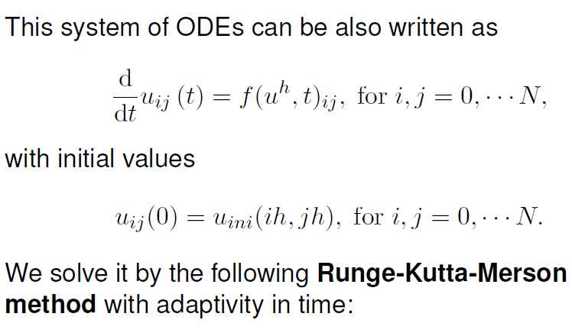
METHOD OF LINES FOR PARABOLIC PDES IN
CUDA IV.
USE OF NVIDIA CUDA FOR NUMERICAL SOLUTION OF
PARTIAL
DIFFERENTIAL
EQUATIONS
TOMÁŠ
OBERHUBER, ATSUSHI SUZUKI,
JAN VACATA,
VÍTE^{ˇ} ZSLAV ŽABKA
WHY WE SHOULD BE INTERESTED IN GPU?
HISTORY OF GPU
WHAT IS A
GPGPU?
NVIDIA CUDA
METHOD OF LINES FOR PARABOLIC PDES IN CUDA
IMPLEMENTATION
OF GMRES
METHOD IN CUDA
CONCLUSION
Notes:
For simple first order case with initial condition only, the equation is followings : du dt equals to f and u zero equals to u initial, then it can be solved numerically by using Runge-Kutta-Merson method at each time step which is generalization of Euler or taylor method.

Slide 28
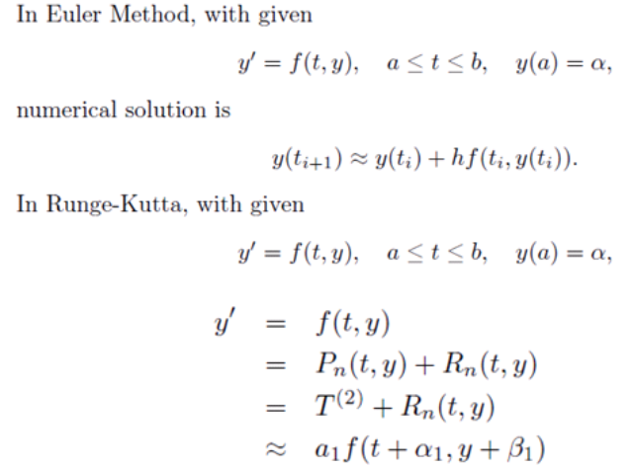
METHOD OF LINES FOR PARABOLIC PDES IN
CUDA V.
USE OF NVIDIA CUDA FOR NUMERICAL SOLUTION OF
PARTIAL
DIFFERENTIAL
EQUATIONS
TOMÁŠ
OBERHUBER, ATSUSHI SUZUKI,
JAN VACATA,
VÍTE^{ˇ} ZSLAV ŽABKA
WHY WE SHOULD BE INTERESTED IN GPU?
HISTORY OF GPU
WHAT IS A
GPGPU?
NVIDIA CUDA
METHOD OF LINES FOR PARABOLIC PDES IN CUDA
IMPLEMENTATION
OF GMRES
METHOD IN CUDA
CONCLUSION
Notes:
In Euler method, PDE is solved by first order Taylor series approximation for variable t only, but it has large error since it considers update over variable t only Runge-Kutta-Merson method divide f by two part P and R which is n-th order Taylor series for variable t and y, and we find appropriate constant a1 alpha1 beta1 to fit y prime and optimal constant is known value. Then we update y.

Slide 29
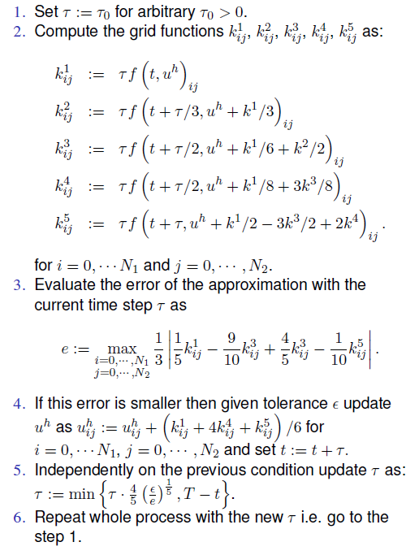
METHOD OF LINES FOR PARABOLIC PDES IN
CUDA VI.
USE OF NVIDIA CUDA FOR NUMERICAL SOLUTION OF
PARTIAL
DIFFERENTIAL
EQUATIONS
TOMÁŠ
OBERHUBER, ATSUSHI SUZUKI,
JAN VACATA,
VÍTE^{ˇ} ZSLAV ŽABKA
WHY WE SHOULD BE INTERESTED IN GPU?
HISTORY OF GPU WHAT IS A
GPGPU?
NVIDIA CUDA
METHOD OF LINES FOR PARABOLIC PDES IN CUDA
IMPLEMENTATION OF GMRES
METHOD IN CUDA
CONCLUSION
Notes:
Previous example is first order approximation, but Runge-Kutta-Merson method can do nth order approximation, and this shows the algorithm of higher order Runge-Kutta-Merson Method. If we use high order, we must compute more combination of alpha and beta. Here, we set tau as time step which is equal to h in previous slide, and there are 5 kernel functions to compute. Then, we evaluate maximum theoretical error from approximation like this, and if the error is smaller than tolerance, then update function u and tau and repeat whole process.

Slide 30
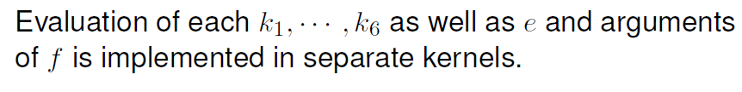
METHOD OF LINES FOR PARABOLIC PDES IN
CUDA VI.
USE OF NVIDIA CUDA FOR NUMERICAL SOLUTION OF
PARTIAL
DIFFERENTIAL
EQUATIONS
TOMÁŠ
OBERHUBER, ATSUSHI SUZUKI,
JAN VACATA,
VÍTE^{ˇ} ZSLAV ŽABKA
WHY WE SHOULD BE INTERESTED IN GPU?
HISTORY OF GPU WHAT IS A
GPGPU?
NVIDIA CUDA
METHOD OF LINES FOR PARABOLIC PDES IN CUDA
IMPLEMENTATION OF GMRES
METHOD IN CUDA
CONCLUSION
Notes:
In method, kernels k1 to k6 and error e are independently computed for every I, j so GPU can parallelize these kernel execution.

Slide 31
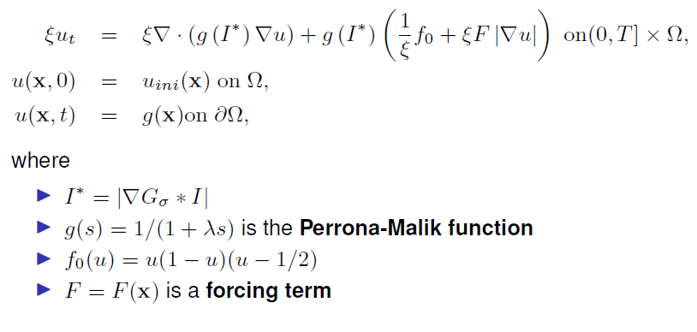

APPLICATION TO MEDICAL IMAGE SEGMENTATION BY MODIFIED ALLEN-CAHN EQUATION
USE OF NVIDIA CUDA FOR NUMERICAL SOLUTION OF
PARTIAL
DIFFERENTIAL
EQUATIONS
TOMÁŠ
OBERHUBER, ATSUSHI SUZUKI,
JAN VACATA,
VÍTE^{ˇ} ZSLAV ŽABKA
WHY WE SHOULD BE INTERESTED IN GPU?
HISTORY OF GPU
WHAT IS A
GPGPU?
NVIDIA CUDA
METHOD OF LINES FOR PARABOLIC PDES IN CUDA
Notes:
This example shows that MRI uses Allen-Chan equation to detect cancer. And here, function u is a characteristic function meaning existence of cancer in time t at location x.

Slide 32
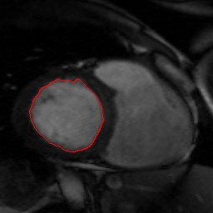
MRI SEGMENTATION
USE OF NVIDIA CUDA FOR NUMERICAL SOLUTION OF
PARTIAL
DIFFERENTIAL
EQUATIONS
TOMÁŠ
OBERHUBER, ATSUSHI SUZUKI,
JAN VACATA,
VÍTE^{ˇ} ZSLAV ŽABKA
WHY WE SHOULD BE INTERESTED IN GPU?
HISTORY OF GPU WHAT IS A
GPGPU?
NVIDIA CUDA
METHOD OF LINES FOR PARABOLIC PDES IN CUDA
IMPLEMENTATION OF GMRES
METHOD IN CUDA
CONCLUSION
FIGURE: Segmentation of MRI data by the Allen-Cahn equation
Notes:
By solving PDE, we can detect image segments which is cancer.

Slide 33
SPEEDUP OF THE METHOD IN LINES IN CUDA
USE OF NVIDIA CUDA FOR NUMERICAL SOLUTION OF
PARTIAL
DIFFERENTIAL
EQUATIONS
Comparison of CPU time vs GPU time on
Intel Core 2 Duo E6550 - 2 cores at 2.33 GHz, 4 MB L2 cache 12.8 GB/s
GPU time (nVidia GeForce 8800 GT - 112 cores at
1.62 GHz, 512 MB RAM 60.8 GB/s
TOMÁŠ
OBERHUBER, ATSUSHI SUZUKI,
JAN VACATA,
VÍTE^{ˇ} ZSLAV ŽABKA
WHY WE SHOULD BE INTERESTED IN GPU?
HISTORY OF GPU
Resolution | CPU (s) | GPU (s) | Speedup
256 × 256 512 × 512 1024 × 1024 | 16.2 341 6054 | 1.056 11.92 183.52 | 15.34 28.61 32.99
WHAT IS A
GPGPU?
NVIDIA CUDA
METHOD OF LINES FOR PARABOLIC PDES IN CUDA
IMPLEMENTATION
OF GMRES
METHOD IN CUDA
CONCLUSION
Notes:
And this table shows that GPU can executes PDE faster than CPU up to thirty three times.

Slide 34
IMPLEMENTATION OF GMRES METHOD IN
CUDA
USE OF NVIDIA CUDA FOR NUMERICAL SOLUTION OF
PARTIAL
DIFFERENTIAL
EQUATIONS
TOMÁŠ
OBERHUBER, ATSUSHI SUZUKI,
JAN VACATA,
VÍTE^{ˇ} ZSLAV ŽABKA
we implemented GMRES method for solving linear system Ax = b - J. Vacata, 2008
by Google, in March 2009 we were the only one having GMRES for sparse matrices in CUDA
implementing GMRES in CUDA is straightforward
we need format for storing sparse matrices fulfilling coalesced memory acces when computing
matrix-vector product
WHY WE SHOULD BE INTERESTED IN GPU?
HISTORY OF GPU
WHAT IS A
GPGPU?
NVIDIA CUDA
METHOD OF LINES FOR PARABOLIC PDES IN CUDA
IMPLEMENTATION
OF GMRES
METHOD IN CUDA
CONCLUSION
Notes:
For using Generalized minimal residual method to solve linear system with sparse matrix A, we need to some algorithm for storing matrix when matrix size is very large to store all matrix.

Slide 35
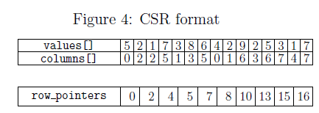
CSR FORMAT FOR SPARSE MATRICES
USE OF NVIDIA CUDA FOR NUMERICAL SOLUTION OF
PARTIAL
DIFFERENTIAL
EQUATIONS
TOMÁŠ
OBERHUBER, ATSUSHI SUZUKI,
JAN VACATA,
VÍTE^{ˇ} ZSLAV ŽABKA
5 |  | 2
 |  | 1 |  |  | 7
 | 3
 |  |  |  | 8 |  | 6
4
 | 2 |  |  |  |  | 9
 |  | 2 |  |  | 5 |  | 3
 |  |  |  | 1 |  |  | 7
WHY WE SHOULD BE INTERESTED IN GPU?
HISTORY OF GPU
WHAT IS A
GPGPU?
NVIDIA CUDA
METHOD OF LINES FOR PARABOLIC
PDES IN CUDA
IMPLEMENTATION
OF GMRES
METHOD IN CUDA
CONCLUSION
Notes:
This is Compressed Sparse Row storing operation. We read row based order for coalesced memory access. For first row, we first read 5, then we store value 5 and its column index and row pointer which represent location of first row points zero column index, then we read 2, and we store value 2 and column index again. Then for second row, we first read 1, store 1 and column index and second row pointer which represent location of second row point second column index since first row has two elements, then repeat this serially in CPU. Then we can find the location of every elements by using this table. This operation can be parallelized.

Slide 36
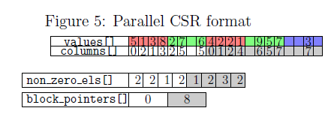
PCSR FORMAT FOR SPARSE MATRICES
USE OF NVIDIA CUDA FOR NUMERICAL SOLUTION OF
PARTIAL
DIFFERENTIAL
EQUATIONS
TOMÁŠ
OBERHUBER, ATSUSHI SUZUKI,
JAN VACATA,
VÍTE^{ˇ} ZSLAV ŽABKA
WHY WE SHOULD BE INTERESTED IN GPU?
HISTORY OF GPU
5 |  | 2
 |  | 1 |  |  | 7
 | 3
 |  |  |  | 8 |  | 6
4
 | 2 |  |  |  |  | 9
 |  | 2 |  |  | 5 |  | 3
 |  |  |  | 1 |  |  | 7
WHAT IS A
GPGPU?
NVIDIA CUDA
METHOD OF LINES FOR PARABOLIC PDES IN CUDA
IMPLEMENTATION OF GMRES
METHOD IN CUDA
CONCLUSION
Notes:
In Parallel CSR operation, the matrix is divided into several blocks. Here, we divide into 2 blocks and first block has this 4 rows of matrix and other block has 4 rows of matrix. Then 4 threads in a warp reads 5, 3, 1, 8, simultaneously and store the value and column index at its thread index and first block pointer which represents the location of first block points zero column index. Then same 4 threads read 2, 7, 6. If first block operation ended, then again 4 threads in a warp reads 4, 2, 2, 1 and store them here, and second block pointers which represent the location of second block points index 8 because first block has 8 nonzero elements and so on. By using this operation, we can parallelize CSR operation but it has some redundancy memory. When each block computation is ended each thread count the number of non zero element at their row and store counted value at here. Therefore, the matrix can be stored in parallel by GPU.

Slide 37
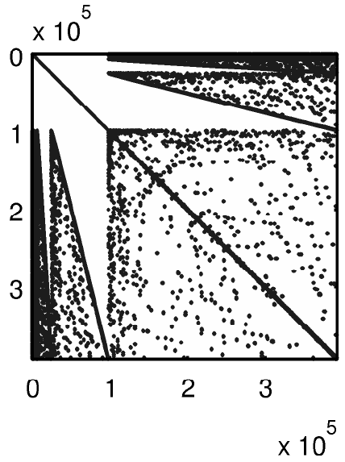
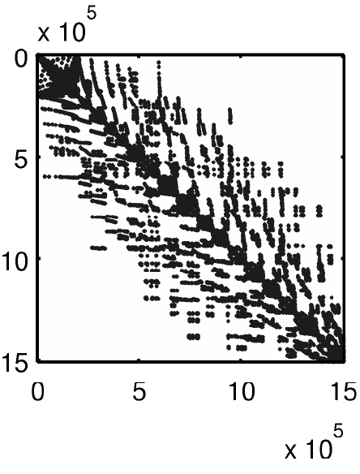
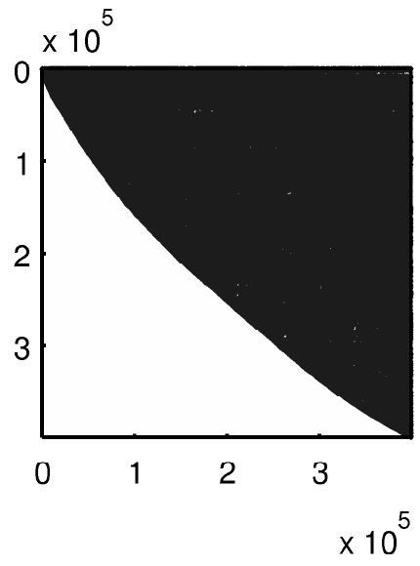
USE OF NVIDIA CUDA FOR NUMERICAL SOLUTION OF
PARTIAL
DIFFERENTIAL
EQUATIONS
We tested CUDA GMRES solver on the following matrices - helm2d03, language and cage14.
TOMÁŠ
OBERHUBER, ATSUSHI SUZUKI,
JAN VACATA,
VÍTE^{ˇ} ZSLAV ŽABKA
WHY WE SHOULD BE INTERESTED IN GPU?
HISTORY OF GPU WHAT IS A
GPGPU?
NVIDIA CUDA
METHOD OF LINES FOR PARABOLIC PDES IN CUDA
IMPLEMENTATION OF GMRES
METHOD IN CUDA
CONCLUSION
Notes:
This is some solved result of these problems and we can see that they are large sparse matrix, so we need parallelization by GPU.

Slide 38
CUDA GMRES SPEEDUP
USE OF NVIDIA CUDA FOR NUMERICAL SOLUTION OF
PARTIAL
DIFFERENTIAL
EQUATIONS
Results obtained in the single-precision arithmetic on
TOMÁŠ
OBERHUBER, ATSUSHI SUZUKI,
JAN VACATA,
VÍTE^{ˇ} ZSLAV ŽABKA
Intel Core 2 Duo E6550 - 2 cores at 2.33 GHz, 4 MB L2 cache 12.8 GB/s
nVidia GeForce 8800 GT - 112 cores at 1.62 GHz, 512 MB RAM 60.8 GB/s
WHY WE SHOULD BE INTERESTED IN GPU?
HISTORY OF GPU
Matrix | Non-zero els. | CPU (s) | GPU (s) | Speedup
helm2d03 | 2,741,935 | 40.5 | 4 | 10.1
language | 1,216,334 | 66.5 | 10.6 | 6.27
cage14 | 27,130,349 | 96.5 | 4.4 | 21.9
WHAT IS A
GPGPU?
NVIDIA CUDA
METHOD OF LINES FOR PARABOLIC PDES IN CUDA
IMPLEMENTATION OF GMRES
METHOD IN CUDA
CONCLUSION
Notes:
This is result of storing matrix, and we can see that GPU is faster than CPU up to twenty times.

Slide 39
FUTURE OF GPGPU?
USE OF NVIDIA CUDA FOR NUMERICAL SOLUTION OF
PARTIAL
DIFFERENTIAL
EQUATIONS
GPU is much better designed for numerical computations
However
it is still understood as a computer games device
even with CUDA, the code development takes a lot of time
libraries only by nVidia
weak support of double precision
limited memory 4GB
almost no experience with GPU clusters
GPU is still quickly developing therefore it is changing a lot
possible fusion with CPU
it would avoid necesity of CPU ↔ GPU data transfer
but common RAM is not sequentialy optimised !!!
TOMÁŠ
OBERHUBER, ATSUSHI SUZUKI,
JAN VACATA,
VÍTE^{ˇ} ZSLAV ŽABKA
WHY WE SHOULD BE INTERESTED IN GPU?
HISTORY OF GPU
WHAT IS A
GPGPU?
NVIDIA CUDA
METHOD OF LINES FOR PARABOLIC PDES IN CUDA
IMPLEMENTATION OF GMRES
METHOD IN CUDA
CONCLUSION
Notes:
And this is future of GPGPU, but these are already solved in present, so I will skip this.

Slide 40
FUTURE OF CUDA?
USE OF NVIDIA CUDA FOR NUMERICAL SOLUTION OF
PARTIAL
DIFFERENTIAL
EQUATIONS
TOMÁŠ
OBERHUBER, ATSUSHI SUZUKI,
JAN VACATA,
VÍTE^{ˇ} ZSLAV ŽABKA
nVidia is now leader in GPGPU thanks to CUDA
CUDA does not support GPU by AMD
new standard OpenCL
CUDA still does not have good support for computation on more cards
WHY WE SHOULD BE INTERESTED IN GPU?
HISTORY OF GPU
WHAT IS A
GPGPU?
NVIDIA CUDA
METHOD OF LINES FOR PARABOLIC PDES IN CUDA
IMPLEMENTATION OF GMRES
METHOD IN CUDA
CONCLUSION

Slide 41
THANK YOU
USE OF NVIDIA CUDA FOR NUMERICAL SOLUTION OF
PARTIAL
DIFFERENTIAL
EQUATIONS
TOMÁŠ
OBERHUBER, ATSUSHI SUZUKI,
JAN VACATA,
VÍTE^{ˇ} ZSLAV ŽABKA
To start with CUDA visit
WHY WE SHOULD BE INTERESTED IN GPU?
HISTORY OF GPU
http://www.nvidia.com/object/cuda_home.html#
or
WHAT IS A
GPGPU?
NVIDIA CUDA
METHOD OF LINES FOR PARABOLIC PDES IN CUDA
just type "CUDA" into Google.
IMPLEMENTATION OF GMRES
METHOD IN CUDA
CONCLUSION
Notes:
Thank you.

