Slide 1
GPU Performance Analysis and Optimization
Paulius Micikevicius
Developer Technology, NVIDIA

Slide 2
Main Requirements for GPU Performance
Expose sufficient parallelism
Use memory efficiently
Coalesce global memory access
Use shared memory where possible
Have coherent execution within warps

Slide 3
Exposing sufficient parallelism

Slide 4
Parallelism Needed
GPU is a parallel machine
Lots of arithmetic pipelines
Multiple memory banks
To get good performance, your code must expose sufficient parallelism for 2 reasons:
To actually give work to all the pipelines
To hide latency of the pipelines
Rough rule of thumb for K20x:
You want to have 14K or more threads running concurrently

Slide 5
Exposing Sufficient Parallelism
What hardware ultimately needs:
Arithmetic pipes:
sufficient number of independent instructions
accommodates multi-issue and latency hiding
Memory system:
sufficient requests in flight to saturate bandwidth
Two ways to increase parallelism:
More independent work within a thread (warp)
ILP for math, independent accesses for memory
More concurrent threads (warps)

Slide 6
Kepler: Level of Parallelism Needed
To saturate instruction bandwidth:
Fp32 math: ~1.7K independent instructions per SM
Lower for other, lower-throughput instructions
Keep in mind that Kepler SM can track up to 2048 threads
To saturate memory bandwidth:
100+ independent 128-byte lines per SM

Slide 7
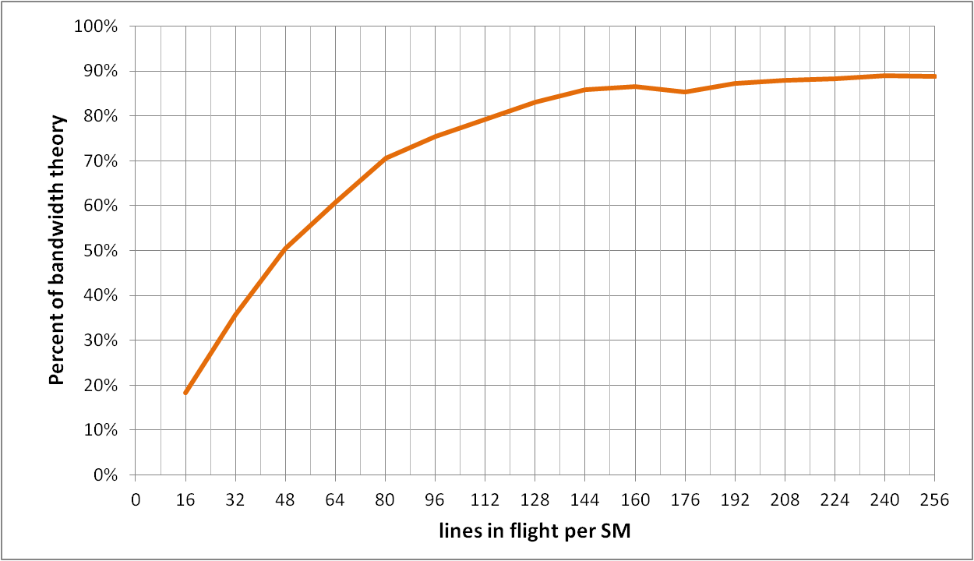
Memory Parallelism
Achieved Kepler memory thoughput
As a function of the number of independent requests per SM
Request: 128-byte line

Slide 8
Occupancy
Occupancy: number of concurrent threads per SM
Expressed as either:
the number of threads (or warps),
percentage of maximum threads
Determined by several factors
(refer to Occupancy Calculator, CUDA Programming Guide for full details)
Registers per thread
SM registers are partitioned among the threads
Shared memory per threadblock
SM shared memory is partitioned among the blocks
Threads per threadblock
Threads are allocated at threadblock granularity
Kepler SM resources
64K 32-bit registers
Up to 48 KB of shared memory
Up to 2048 concurrent threads
Up to 16 concurrent threadblocks

Slide 9
Occupancy and Performance
Note that 100% occupancy isn’t needed to reach maximum performance
Once the “needed” occupancy is reached, further increases won’t improve performance
Needed occupancy depends on the code
More independent work per thread -> less occupancy is needed
Memory-bound codes tend to need more occupancy
Higher latency than for arithmetic, need more work to hide it

Slide 10
Threadblock Size and Occupancy
Threadblock size is a multiple of warp size (32)
Even if you request fewer threads, HW rounds up
Threadblocks can be too small
Kepler SM can run up to 16 threadblocks concurrently
SM may reach the block limit before reaching good occupancy
Example: 1-warp blocks -> 16 warps per Kepler SM (probably not enough)
Threadblocks can be too big
Quantization effect:
Enough SM resources for more threads, not enough for another large block
A threadblock isn’t started until resources are available for all of its threads

Slide 11
Threadblock Sizing
Too few threads per block
Number of warps allowed by SM resources
SM resources:
Registers
Shared memory
Too many threads per block

Slide 12
General Guidelines
Threadblock size choice:
Start with 128-256 threads per block
Adjust up/down by what best matches your function
Example: stencil codes prefer larger blocks to minimize halos
Multiple of warp size (32 threads)
If occupancy is critical to performance:
Check that block size isn’t precluding occupancy allowed by register and SMEM resources
Grid size:
1,000 or more threadblocks
10s of waves of threadblocks: no need to think about tail effect
See GTC12 talk on optimization for more details on tails
Makes your code ready for several generations of future GPUs

Slide 13
General Guidelines
Concurrent grids
Useful if any one given function doesn’t expose enough parallelism to saturate the GPU
Math pipes and memory system don’t really care where the work is coming from, as long as there’s enough of it
Two cases:
Concurrent grids from the same CPU process
Launch different functions into different streams
Several CPU processes sharing the GPU
HyperQ feature, available on Titan

Slide 14
Global memory access

Slide 15
Kepler Memory Hierarchy
SM-0
SM-1
SM-N
Registers
Registers
Registers
L1
SMEM
Read
only
L1
SMEM
Read
only
L1
SMEM
Read
only
L2
Global Memory (DRAM)

Slide 16
Memory Hierarchy Review
Registers
Storage local to each threads
Compiler-managed
Shared memory / L1
64 KB, program-configurable into shared:L1
Program-managed
Accessible by all threads in the same threadblock
Low latency, high bandwidth: ~2.5 TB/s
Read-only cache
Up to 48 KB per Kepler SM
Hardware-managed (also used by texture units)
Used for read-only GMEM accesses (not coherent with writes)
L2
1.5 MB
Hardware-managed: all accesses to global memory go through L2, including CPU and peer GPU
Global memory
6 GB, accessible by all threads, host (CPU), other GPUs in the same system
Higher latency (400-800 cycles)
250 GB/s

Slide 17
Blocking for L1, Read-only, L2 Caches
Short answer: DON’T
GPU caches are not intended for the same use as CPU caches
Smaller size (especially per thread), so not aimed at temporal reuse
Intended to smooth out some access patterns, help with spilled registers, etc.
Usually not worth trying to cache-block like you would on CPU
100s to 1,000s of run-time scheduled threads competing for the cache
If it is possible to block for L1 then it’s possible block for SMEM
Same size
Same or higher bandwidth
Guaranteed locality: hw will not evict behind your back

Slide 18
Memory Throughput Analysis
Two perspectives on the throughput:
Application’s point of view:
count only bytes requested by application
HW point of view:
count all bytes moved by hardware
The two views can be different:
Memory is accessed at 32 byte granularity
Scattered/offset pattern: application doesn’t use all the hw transaction bytes
Broadcast: the same small transaction serves many threads in a warp
Two aspects to inspect for performance impact:
Address pattern
Number of concurrent accesses in flight

Slide 19
Global Memory Operation
Memory operations are executed per warp
32 threads in a warp provide memory addresses
Hardware determines into which lines those addresses fall
Memory transaction granularity is 32 bytes
There are benefits to a warp accessing a contiguous aligned region of 128 or 256 bytes
Access word size
Natively supported sizes (per thread): 1, 2, 4, 8, 16 bytes
Assumes that each thread’s address is aligned on the word size boundary
If you are accessing a data type that’s of non-native size, compiler will generate several load or store instructions with native sizes

Slide 20
Scenario:
Warp requests 32 aligned, consecutive 4-byte words
Addresses fall within 4 segments
Warp needs 128 bytes
128 bytes move across the bus
Bus utilization: 100%
addresses from a warp
...
0
32
64
96
128
160
192
224
256
288
320
352
384
416
448
Memory addresses

Slide 21
Scenario:
Warp requests 32 aligned, permuted 4-byte words
Addresses fall within 4 segments
Warp needs 128 bytes
128 bytes move across the bus
Bus utilization: 100%
addresses from a warp
...
0
32
64
96
128
160
192
224
256
288
320
352
384
416
448
Memory addresses

Slide 22
Scenario:
Warp requests 32 misaligned, consecutive 4-byte words
Addresses fall within at most 5 segments
Warp needs 128 bytes
At most 160 bytes move across the bus
Bus utilization: at least 80%
Some misaligned patterns will fall within 4 segments, so 100% utilization
addresses from a warp
...
0
32
64
96
128
160
192
224
256
288
320
352
384
416
448
Memory addresses

Slide 23
Scenario:
All threads in a warp request the same 4-byte word
Addresses fall within a single segment
Warp needs 4 bytes
32 bytes move across the bus
Bus utilization: 12.5%
addresses from a warp
...
0
32
64
96
128
160
192
224
256
288
320
352
384
416
448
Memory addresses

Slide 24
Scenario:
Warp requests 32 scattered 4-byte words
Addresses fall within N segments
Warp needs 128 bytes
N*32 bytes move across the bus
Bus utilization: 128 / (N*32)
addresses from a warp
...
0
32
64
96
128
160
192
224
256
288
320
352
384
416
448
Memory addresses

Slide 25
Structure of Non-Native Size
Say we are reading a 12-byte structure per thread
struct Position
{
float x, y, z;
};
...
__global__ void kernel( Position *data, ... )
{
int idx = blockIdx.x * blockDim.x + threadIdx.x;
Position temp = data[idx];
...
}

Slide 26
Structure of Non-Native Size
Compiler converts temp = data[idx] into 3 loads:
Each loads 4 bytes
Can’t do an 8 and a 4 byte load: 12 bytes per element means that every other element wouldn’t align the 8-byte load on 8-byte boundary
Addresses per warp for each of the loads:
Successive threads read 4 bytes at 12-byte stride

Slide 27
First Load Instruction
addresses from a warp
...
0
4
8
12
16
20
24
28
32
36
40
44
48
52
56
60
64

Slide 28
Second Load Instruction
addresses from a warp
...
0
4
8
12
16
20
24
28
32
36
40
44
48
52
56
60
64

Slide 29
Third Load Instruction
addresses from a warp
...
0
4
8
12
16
20
24
28
32
36
40
44
48
52
56
60
64

Slide 30
Performance and Solutions
Because of the address pattern, we end up moving 3x more bytes than application requests
We waste a lot of bandwidth, leaving performance on the table
Potential solutions:
Change data layout from array of structures to structure of arrays
In this case: 3 separate arrays of floats
The most reliable approach (also ideal for both CPUs and GPUs)
Use loads via read-only cache
As long as lines survive in the cache, performance will be nearly optimal
Stage loads via shared memory

Slide 31
Read-only Loads
Go through the read-only cache
Not coherent with writes
Thus, addresses must not be written by the same kernel
Two ways to enable:
Decorating pointer arguments as hints to compiler:
Pointer of interest: const __restrict__
All other pointer arguments: __restrict__
Conveys to compiler that no aliasing will occur
Using __ldg() intrinsic
Requires no pointer decoration

Slide 32
Read-only Loads
Go through the read-only cache
Not coherent with writes
Thus, addresses must not be written by the same kernel
Two ways to enable:
Decorating pointer arguments as hints to compiler:
Pointer of interest: __restrict__ const
All other pointer arguments: __restrict__
Conveys to compiler that no aliasing will occur
Using __ldg() intrinsic
Requires no pointer decoration
__global__ void kernel( int*__restrict__ output,
const int* __restrict__ input )
{
...
output[idx] = ... + input[idx];
}

Slide 33
Read-only Loads
Go through the read-only cache
Not coherent with writes
Thus, addresses must not be written by the same kernel
Two ways to enable:
Decorating pointer arguments as hints to compiler:
Pointer of interest: __restrict__ const
All other pointer arguments: __restrict__
Conveys to compiler that no aliasing will occur
Using __ldg() intrinsic
Requires no pointer decoration
__global__ void kernel( int *output,
int *input )
{
...
output[idx] = ... + __ldg( &input[idx] );
}

Slide 34
Having Sufficient Concurrent Accesses
In order to saturate memory bandwidth, SM must issue enough independent memory requests

Slide 35
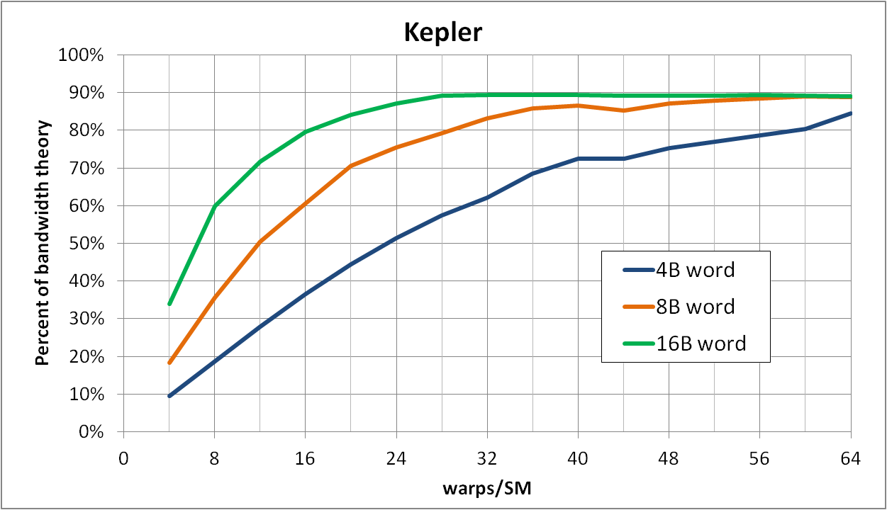
Elements per Thread and Performance
Experiment: each warp has 2 concurrent requests (memcopy, one word per thread)
4B word request: 1 line
8B word request: 2 lines
16B word request: 4 lines
To achieve the same throughput at lower occupancy:
Need more independent requests per warp
To achieve the same throughput with smaller words:
Need more independent requests per warp

Slide 36
Optimizing Access Concurrency
Have enough concurrent accesses to saturate the bus
Little’s law: need (mem_latency)x(bandwidth) bytes
Ways to increase concurrent accesses:
Increase occupancy (run more warps concurrently)
Adjust threadblock dimensions
To maximize occupancy at given register and smem requirements
If occupancy is limited by registers per thread:
Reduce register count (-maxrregcount option, or __launch_bounds__)
Modify code to process several elements per thread
Doubling elements per thread doubles independent accesses per thread

Slide 37
Optimizations When Addresses Are Coalesced
When looking for more performance and code:
Is memory bandwidth limited
Achieves high percentage of bandwidth theory
Addresses are coalesced
Consider compression
GPUs provide instructions for converting between fp16, fp32, and fp64 representations:
A single instruction, implemented in hw (__float2half(), ...)
If data has few distinct values, consider lookup tables
Store indices into the table
Small enough tables will likely survive in caches if used often enough

Slide 38
L1 Sizing
Shared memory and L1 use the same 64KB
Program-configurable split:
Fermi: 48:16, 16:48
Kepler: 48:16, 16:48, 32:32
CUDA API: cudaDeviceSetCacheConfig(), cudaFuncSetCacheConfig()
Large L1 can improve performance when:
Spilling registers (more lines in the cache -> fewer evictions)
Large SMEM can improve performance when:
Occupancy is limited by SMEM

Slide 39
Summary: GMEM Optimization
Strive for perfect address coalescing per warp
Align starting address (may require padding)
A warp will ideally access within a contiguous region
Avoid scattered address patterns or patterns with large strides between threads
Analyze and optimize address patterns:
Use profiling tools (included with CUDA toolkit download)
Compare the transactions per request to the ideal ratio
Choose appropriate data layout (prefer SoA)
If needed, try read-only loads, staging accesses via SMEM
Have enough concurrent accesses to saturate the bus
Launch enough threads to maximize throughput
Latency is hidden by switching threads (warps)
If needed, process several elements per thread
More concurrent loads/stores

Slide 40
Shared memory

Slide 41
Shared Memory
On-chip (on each SM) memory
Comparing SMEM to GMEM:
Order of magnitude (20-30x) lower latency
Order of magnitude (~10x) higher bandwidth
Accessed at bank-width granularity
Kepler: 8 bytes
For comparison: GMEM access granularity is either 32 or 128 bytes
SMEM instruction operation:
32 threads in a warp provide addresses
Determine into which 8-byte words addresses fall
Fetch the words, distribute the requested bytes among the threads
Multi-cast capable
Bank conflicts cause serialization

Slide 42
Kepler Shared Memory Banking
32 banks, 8 bytes wide
Bandwidth: 8 bytes per bank per clock per SM (256 bytes per clk per SM)
2x the bandwidth compared to Fermi
Two modes:
4-byte access (default):
Maintains Fermi bank-conflict behavior exactly
Provides 8-byte bandwidth for certain access patterns
8-byte access:
Some access patterns with Fermi-specific padding may incur bank conflicts
Provides 8-byte bandwidth for all patterns (assuming 8-byte words)
Selected with cudaDeviceSetSharedMemConfig() function arguments:
cudaSharedMemBankSizeFourByte
cudaSharedMemBankSizeEightByte

Slide 43
Kepler 8-byte Bank Mode
Mapping addresses to banks:
Successive 8-byte words go to successive banks
Bank index:
(8B word index) mod 32
(4B word index) mod (32*2)
(byte address) mod (32*8)
Given the 8 least-significant address bits: ...BBBBBxxx
xxx selects the byte within an 8-byte word
BBBBB selects the bank
Higher bits select a “column” within a bank

Slide 44
Kepler 8-byte Bank Mode
To visualize, let’s pretend we have 4 banks, not 32 (easier to draw)
Byte-address:
0
4
8
12
16
20
24
28
32
38
40
Data:
(or 4B-word index)
0
1
2
3
4
5
6
7
8
9
0
1
2
3
4
5
6
7
8
9
Bank-0
Bank-1
Bank-2
Bank-3

Slide 45
Shared Memory Bank Conflicts
A bank conflict occurs when:
2 or more threads in a warp access different words in the same bank
Think: 2 or more threads access different “rows” in the same bank
N-way bank conflict: N threads in a warp conflict
Instruction gets issued N times: increases latency
Note there is no bank conflict if:
Several threads access the same word
Several threads access different bytes of the same word

Slide 46
SMEM Access Examples
Addresses from a warp: no bank conflicts
One address access per bank
Bank-0
Bank-1
Bank-2
Bank-3
Bank-31

Slide 47
SMEM Access Examples
Addresses from a warp: no bank conflicts
One address access per bank
Bank-0
Bank-1
Bank-2
Bank-3
Bank-31

Slide 48
SMEM Access Examples
Addresses from a warp: no bank conflicts
Multiple addresses per bank, but within the same word
Bank-0
Bank-1
Bank-2
Bank-3
Bank-31

Slide 49
SMEM Access Examples
Addresses from a warp: 2-way bank conflict
2 accesses per bank, fall in two different words
Bank-0
Bank-1
Bank-2
Bank-3
Bank-31

Slide 50
SMEM Access Examples
Addresses from a warp: 3-way bank conflict
4 accesses per bank, fall in 3 different words
Bank-0
Bank-1
Bank-2
Bank-3
Bank-31

Slide 51
Diagnosing Bank Conflicts
Profiler counters:
Number of instructions executed, does not include replays:
shared_load, shared_store
Number of replays (number of instruction issues due to bank conflicts)
l1_shared_bank_conflict
Analysis:
Number of replays per instruction
l1_shared_bank_conflict / (shared_load + shared_store)
Replays are potentially a concern because:
Replays add latency
Compete for issue cycles with other SMEM and GMEM operations
Except for read-only loads, which go to different hardware
Remedy:
Usually padding SMEM data structures resolves/reduces bank conflicts

Slide 52
Summary: Shared Memory
Shared memory is a tremendous resource
Very high bandwidth (terabytes per second)
20-30x lower latency than accessing GMEM
Data is programmer-managed, no evictions by hardware
Performance issues to look out for:
Bank conflicts add latency and reduce throughput
Many-way bank conflicts can be very expensive
Replay latency adds up
However, few code patterns have high conflicts, padding is a very simple and effective solution

Slide 53
Arithmetic optimizations

Slide 54
Execution
Instructions are issued/executed per warp
Warp = 32 consecutive threads
Think of it as a “vector” of 32 threads
The same instruction is issued to the entire warp
Scheduling
Warps are scheduled at run-time
Hardware picks from warps that have an instruction ready to execute
Ready = all arguments are ready
Instruction latency is hidden by executing other warps

Slide 55
Conditional Control Flow
If at least one thread in a warp needs take a particular path:
All threads in a warp take that path
Threads that aren’t on that path:
Don’t fetch arguments, don’t write outputs: guarantees correctness
Still spend time, instead of executing their path: potential performance impact

Slide 56
Control Flow
if ( ... )
{
// then-clause
}
else
{
// else-clause
}
instructions

Slide 57
Execution within warps is coherent
0
1
2
3
30
31
32
33
34
35
62
63
instructions / time
Warp
(“vector” of threads)
Warp
(“vector” of threads)

Slide 58
Execution diverges within a warp
0
1
2
3
30
31
32
33
34
35
62
63
instructions / time

Slide 59
Possible Performance Limiting Factors
Raw instruction throughput
Know the kernel instruction mix
fp32, fp64, int, mem, transcendentals, etc. have different throughputs
Refer to the CUDA Programming Guide / Best Practices Guide
Can examine assembly: use cuobjdump tool provided with CUDA toolkit
A lot of divergence can “waste” instructions
Instruction serialization
Occurs when threads in a warp issue the same instruction in sequence
As opposed to the entire warp issuing the instruction at once
Think of it as “replaying” the same instruction for different threads in a warp
Mostly:
Shared memory bank conflicts
Memory accesses that result in multiple transactions (scattered address patterns)

Slide 60
Instruction Throughput: Analysis
Compare achieved instruction throughput to HW capabilities
Profiler reports achieved throughput as IPC (instructions per clock)
Peak instruction throughput is documented in the Programming Guide
Profiler also provides peak fp32 throughput for reference (doesn’t take your instruction mix into consideration)
Check for serialization
Number of replays due to serialization: instructions_issued - instructions_executed
Profiler reports:
% of serialization metric (ratio or replays to instructions issued)
Kepler: counts replays due to various memory access instructions
A concern if: code is instruction or latency-limited, replay percentage is high
Warp divergence
Profiler counters: divergent_branch, branch
Compare the two to see what percentage diverges
However, this only counts the branches, not the rest of serialized instructions

Slide 61
Instruction Throughput: Optimization
Use intrinsics where possible ( __sin(), __sincos(), __exp(), etc.)
Available for a number of math.h functions
2-3 bits lower precision, much higher throughput
Refer to the CUDA Programming Guide for details
Often a single HW instruction, whereas a non-intrinsic is a SW sequence
Additional compiler flags that also help performance:
-ftz=true : flush denormals to 0
-prec-div=false : faster fp division instruction sequence (some precision loss)
-prec-sqrt=false : faster fp sqrt instruction sequence (some precision loss)
Make sure you do fp64 arithmetic only where you mean it:
fp64 throughput is lower than fp32
fp literals without an “f” suffix ( 34.7 ) are interpreted as fp64 per C standard

Slide 62
Instruction Throughput: Summary
Analyze:
Check achieved instruction throughput
Compare to HW peak (but keep instruction mix in mind)
Check percentage of instructions due to serialization
Optimizations:
Intrinsics, compiler options for expensive operations
Group threads that are likely to follow same execution path (minimize warp divergence)
Minimize memory access replays (SMEM and GMEM)

Slide 63
In Conclusion
When programming and optimizing think about:
Exposing sufficient parallelism
Coalescing memory accesses
Having coherent control flow within warps
Use profiling tools when analyzing performance
Determine performance limiters first
Diagnose memory access patterns

Slide 64
Additional Resources
Extended version of the optimization talk:
GTC12 Session S0514: GPU Performance Analysis and Optimization
Kepler architecture:
GTC12 Session S0642: Inside Kepler
Kepler whitepapers (http://www.nvidia.com/object/nvidia-kepler.html)
Assessing performance limiters:
GTC10 Session 2012: Analysis-driven Optimization (slides 5-19):
http://www.nvidia.com/content/GTC-2010/pdfs/2012_GTC2010v2.pdf
Profiling tools:
GTC12 sessions:
S0419: Optimizing Application Performance with CUDA Performance Tools
S0420: Nsight IDE for Linux and Mac
...
CUPTI documentation (describes all the profiler counters)
Included in every CUDA toolkit (/cuda/extras/cupti/doc/Cupti_Users_Guide.pdf
Register spilling:
Webinar:
Slides: http://developer.download.nvidia.com/CUDA/training/register_spilling.pdf
Video: http://developer.download.nvidia.com/CUDA/training/CUDA_LocalMemoryOptimization.mp4
GPU computing webinars in general:
http://developer.nvidia.com/gpu-computing-webinars

