Slide 1

Mass Storage Structure

Slide 2
Physical Disk Structure
ReadWrite heads
Disk are made of thin metallic platters with a read/write head flying over it.
To read from disk, we must specify:
  cylinder #
  surface #
  sector #
  transfer size
  memory address
Transfer time includes: seek, latency, and transfer time
Platters
Spindle
Track
Sector
Rot
Delay
Seek Time
Hanyang University
Data-Centric Systems Lab.

Slide 3

Disk Structure
Disk drives are addressed as large
1-dimensional arrays of logical blocks,
where the logical block is the smallest unit of transfer.
The 1-dimensional array of logical blocks is mapped
into the sectors of the disk sequentially.
  Sector 0 is the 1st sector of the 1st track on the outermost cylinder.
  Mapping generally proceeds in order through that track, then the rest of the tracks in that cylinder, and then through the rest of the cylinders from outermost to innermost.
Hanyang University
Data-Centric Systems Lab.

Slide 4
Disk Scheduling
Access time has two major components
  Seek time is the time for the disk are to move the heads to the cylinder containing the desired sector.
  Rotational latency is the additional time waiting for the disk to rotate the desired sector to the disk head.
Minimize seek time
Seek time ≈ seek distance
Disk bandwidth is
(the total number of bytes transferred / the total time)
time between the request and the completion.
Hanyang University
Data-Centric Systems Lab.

Slide 5
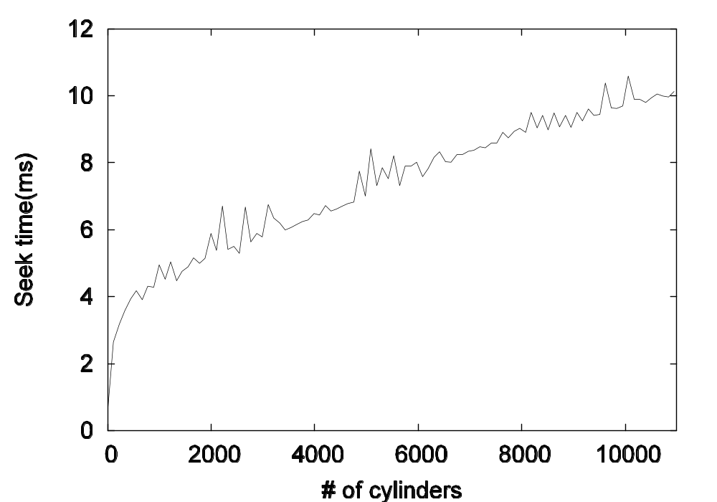
Seek Time Benchmark
Hanyang University
Data-Centric Systems Lab.

Slide 6
Disk Scheduling (Cont.)
Several algorithms exist to schedule the servicing of disk I/O requests.
We illustrate them with a request queue (0-199).
98, 183, 37, 122, 14, 124, 65, 67
Current head position: 53
Hanyang University
Data-Centric Systems Lab.

Slide 7

FCFS
Illustration shows total head movement of 640 cylinders.
Hanyang University
Data-Centric Systems Lab.

Slide 8
SSTF
Shortest Seek Time First
Selects the request with the minimum seek time from the current head position.
SSTF scheduling is a form of SJF scheduling; may cause starvation of some requests.
unpredictable performance
Illustration shows total head movement of 236 cylinders.
Hanyang University
Data-Centric Systems Lab.

Slide 9

SSTF (Cont.)
Hanyang University
Data-Centric Systems Lab.

Slide 10
SCAN
The disk arm starts at one end of the disk,
and moves toward the other end, servicing requests
until it gets to the other end of the disk,
where the head movement is reversed and servicing continues.
Sometimes called the elevator algorithm.
  First, service all requests while going up
  Then service all requests while going down
Illustration shows total head movement of 208 cylinders.
문제: 가장자리 1회 때마다 - 한가운데는 2회의 기회 --- unfair wait time
Hanyang University
Data-Centric Systems Lab.

Slide 11
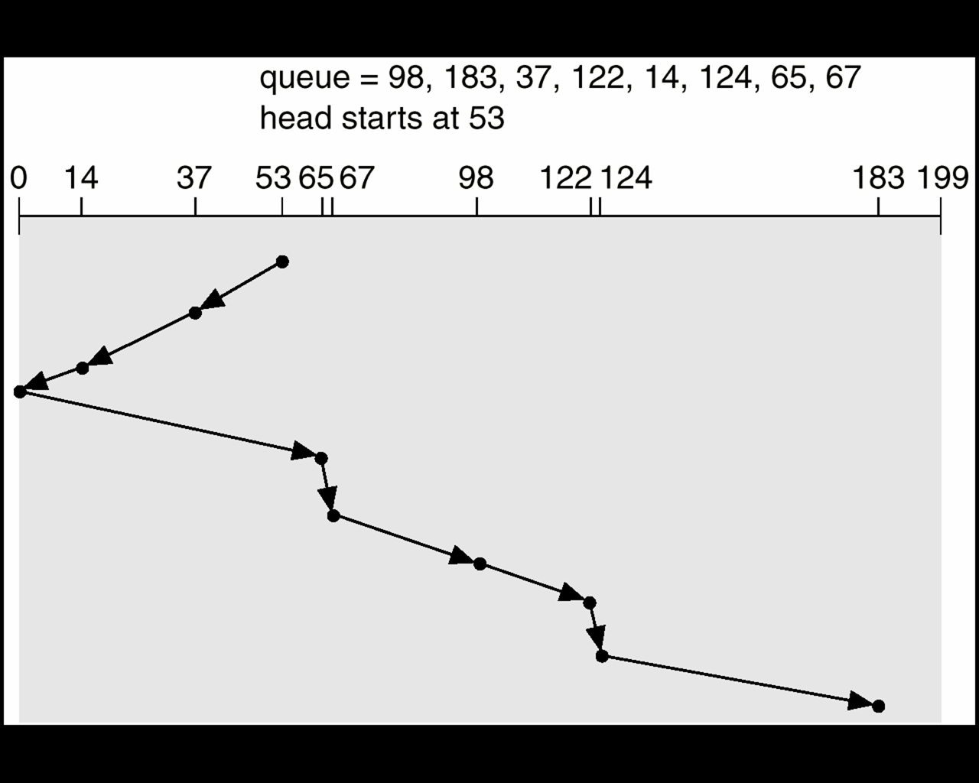
SCAN (Cont.)
Hanyang University
Data-Centric Systems Lab.

Slide 12
C-SCAN
Provides a more uniform wait time than SCAN.
The head moves from one end of the disk to the other
servicing requests as it goes.
When it reaches the other end, however,
it immediately returns to the beginning of the disk,
without servicing any requests on the return trip.
Treats the cylinders as a circular list that wraps around from the last cylinder to the first one.
문제: 가고 있는 방향 전방에 아무런 pending request 들이 없는데도 계속 전진?
Hanyang University
Data-Centric Systems Lab.

Slide 13

C-SCAN (Cont.)
Hanyang University
Data-Centric Systems Lab.

Slide 14
C-LOOK
Version of C-SCAN
  Look-for-Request before continuing
  Arm only goes as far as the last request in each direction,
  then reverses direction immediately,
  without first going all the way to the end of the disk.
Hanyang University
Data-Centric Systems Lab.

Slide 15

C-LOOK (Cont.)
Hanyang University
Data-Centric Systems Lab.

Slide 16
Selecting a Disk-Scheduling Algorithm
SSTF is common and has a natural appeal
SCAN and C-SCAN perform better for systems that place a heavy load on the disk.
Performance depends on the number and types of requests.
Requests for disk service can be influenced by the file-allocation method.
The disk-scheduling algorithm should be written as a separate module of the operating system, allowing it to be replaced with a different algorithm if necessary.
Either SSTF or LOOK is a reasonable choice for the default algorithm.
Hanyang University
Data-Centric Systems Lab.

Slide 17
Disk Management
physical formatting or Low-level formatting
Dividing a disk into sectors that the disk controller can R/W.
Each sector = [head + data(보통 512 B) + trailer]
header/trailer contain sector number, ECC (used by controller)
spare sectors/cylinder are reserved for bad blocks
To use a disk to hold files, the operating system still needs to record its own data structures on the disk.
  Partition the disk into one or more groups of cylinders
  OS는 이것을 독립적 disk로 취급
  Logical formatting or “making a file system”.
  data structure for file system, used by OS
  space management : map for
  free space
  busy space – 일반 파일, directory 파일
Power-up
  The “small bootstrap loader” runs from ROM
  Which is very small, only duty is to load sector 0 (boot block) of boot disk
  Sector 0 has “full Bootstrap loader program” which loads OS from disk.
Hanyang University
Data-Centric Systems Lab.

Slide 18
Bad Blocks
Scenario
  OS reads block 87
  Disk controller finds block 87 is bad (by checking ECC)
  Controller reports it to OS.
  Controller replaces bad block 87 with a spare sector
  (several spare blocks are reserved in each cylinder during formatting)
  After that, whenever block 87 is requested again,
  Controller translates that to the new spare sector
Hanyang University
Data-Centric Systems Lab.

Slide 19
Swap-Space Management
Swap-space — Virtual memory uses disk space as an extension of main memory.
Swap-space can be carved out of the normal file system,
or, more commonly, it can be in a separate disk partition.
May use different allocation policy etc than regular file system.
Hanyang University
Data-Centric Systems Lab.

Slide 20
RAID
RAID: Redundant Array of Inexpensive (Independent) Disks
  disk organization techniques that manage a large numbers of disks, providing a view of a single disk of
    high capacity and high speed by using multiple disks in parallel, and
    high reliability by storing data redundantly, so that data can be recovered even if a disk fails
The chance that some disk out of a set of N disks will fail is much higher than the chance that a specific single disk will fail.
  E.g., a system with 100 disks, each with MTTF of 100,000 hours (approx. 11 years), will have a system MTTF of 1000 hours (approx. 41 days)
  Techniques for using redundancy to avoid data loss are critical with large numbers of disks
Hanyang University
Data-Centric Systems Lab.

Slide 21
Improvement of Reliability via Redundancy
Redundancy – store extra information that can be used to rebuild information lost in a disk failure
E.g., Mirroring (or shadowing)
  Duplicate every disk. Logical disk consists of two physical disks.
  Every write is carried out on both disks
    Reads can take place from either disk
  If one disk in a pair fails, data still available in the other
    Data loss would occur only if a disk fails, and its mirror disk also fails before the system is repaired
      Probability of combined event is very small, except for dependent failure modes such as fire or building collapse or electrical power surges
Mean time to data loss depends on mean time to failure,
and mean time to repair
  E.g. MTTF of 100,000 hours, mean time to repair of 10 hours gives mean time to data loss of 500*10⁶ hours (or 57,000 years) for a mirrored pair of disks (ignoring dependent failure modes)
Hanyang University
Data-Centric Systems Lab.

Slide 22
Improvement in Performance via Parallelism
Two main goals of parallelism in a disk system:
  1. Load balance multiple small accesses to increase throughput
  2. Parallelize large accesses to reduce response time: Improve transfer rate by striping data across multiple disks
Bit-level striping – split the bits of each byte across multiple disks
  In an array of eight disks, write bit i of each byte to disk i
  Each access can read data at eight times the rate of a single disk
  But seek/access time worse than for a single disk
    Bit level striping is not used much any more
Block-level striping – with n disks, block i of a file goes to disk (i mod n) + 1
  Requests for different blocks can run in parallel if the blocks reside on different disks
  A request for a long sequence of blocks can utilize all disks in parallel
Hanyang University
Data-Centric Systems Lab.

Slide 23

RAID Levels
Schemes to provide redundancy at lower cost by using disk striping combined with parity bits
  Different RAID organizations, or RAID levels, have differing cost, performance and reliability characteristics
RAID Level 0: Block striping; non-redundant
  Used in high-performance applications where data loss is not critical.
RAID Level 1: Mirrored disks with block striping
  Offers best write performance
  Popular for applications such as storing log files in a database system
Hanyang University
Data-Centric Systems Lab.

Slide 24
RAID Levels (Cont.)
RAID Level 4: Block-Interleaved Parity; uses block-level striping, and keeps a parity block on a separate disk for corresponding blocks from N other disks
  When writing data block, corresponding block of parity bits must also be computed and written to parity disk
  To find value of a damaged block, compute XOR of bits from corresponding blocks (including parity block) from other disks
  Parity block becomes a bottleneck for independent block writes since every block write also writes to parity disk
Hanyang University
Data-Centric Systems Lab.

Slide 25
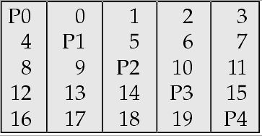
RAID Levels (Cont.)
RAID Level 5: Block-Interleaved Distributed Parity
  partitions data and parity among all N + 1 disks
  E.g., with 5 disks, parity block for nth set of blocks is stored on disk (n mod 5) + 1, with the data blocks stored on the other 4 disks.
Hanyang University
Data-Centric Systems Lab.

Slide 26
RAID Levels (Cont.)
RAID Level 5 (Cont.)
  Higher I/O rates than Level 4
    Block writes occur in parallel if the blocks and their parity blocks are on different disks
  Subsumes Level 4: provides same benefits, but avoids bottleneck of parity disk
Hanyang University
Data-Centric Systems Lab.

Slide 27
Choice of RAID Level
Factors in choosing RAID level
  Monetary cost
  Performance: Number of I/O operations per second, and bandwidth during normal operation
  Performance during failure
  Performance during rebuild of failed disk
RAID 0 is used only when data safety is not important
  E.g. data can be recovered quickly from other sources
Level 2 and 4 never used since they are subsumed by 3 and 5
Level 3 is not used anymore since bit-striping forces single block reads to access all disks, wasting disk arm movement, which block striping (level 5) avoids
So competition is between 1 and 5 only
Hanyang University
Data-Centric Systems Lab.

Slide 28
Choice of RAID Level (Cont.)
Level 1 provides much better write performance than level 5
  Level 5 requires at least 2 block reads and 2 block writes to write a single block, whereas Level 1 only requires 2 block writes
  Level 1 preferred for high update environments such as log disks
Level 1 had higher storage cost than level 5
  disk drive capacities increasing rapidly (50%/year) whereas disk access times have decreased much less (x 3 in 10 years)
  I/O requirements have increased greatly, e.g. for Web servers
  When enough disks have been bought to satisfy required rate of I/O, they often have spare storage capacity
    so there is often no extra monetary cost for Level 1!
Level 5 is preferred for applications with low update rate,
and large amounts of data
Level 1 is preferred for all other applications
Hanyang University
Data-Centric Systems Lab.

