Slide 1

Data Analysis Tool: R
Ph.D. Kichun Lee
Industrial Engineering, Hanyang University

Slide 2

R related article
New York Times:
Data Analysts Captivated by R’s Power
6 Jan 2009
To some people R is just the 18th letter of the alphabet. R is also the name of a popular programming language used by a growing number of data analysts inside corporations and academia.
Companies as diverse as Google, Pfizer, Merck, Bank of America, the InterContinental Hotels Group and Shell use it.
The popularity of R at universities could threaten SAS Institute, the privately held business software company that specializes in data analysis software.

Slide 3
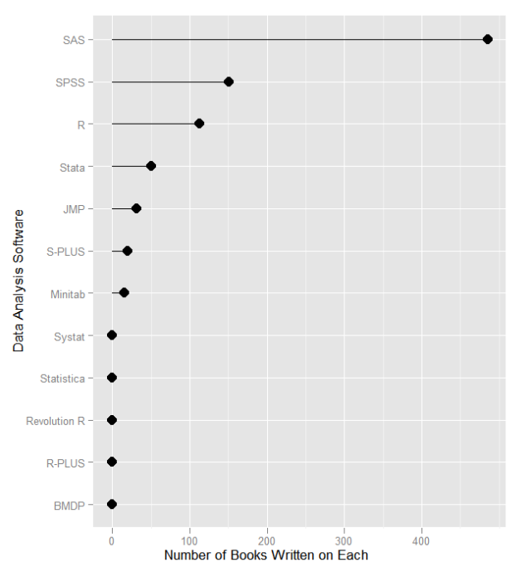
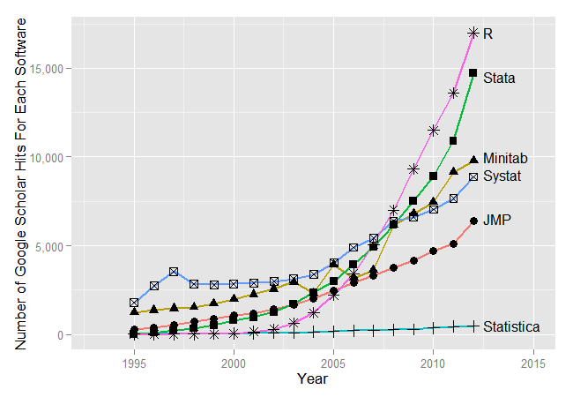
Growth of interest in R
Growth of users and packages lead R to be one standard of high-level education
☞ Revolution Analytics 소개자료(소스 : http://r4stats.com/articles/popularity/)

Slide 4
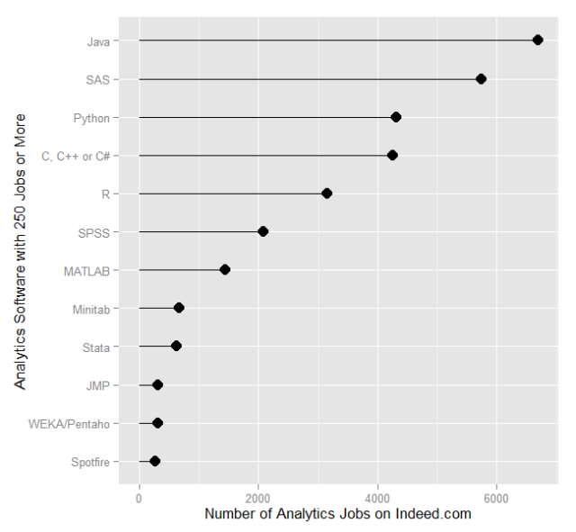
Growth of interest in R
☞ Revolution Analytics 소개자료(소스 : http://r4stats.com/articles/popularity/)

Slide 5









Service Providers use R
R is used as an underlying analysis engine in many service providers

Slide 6

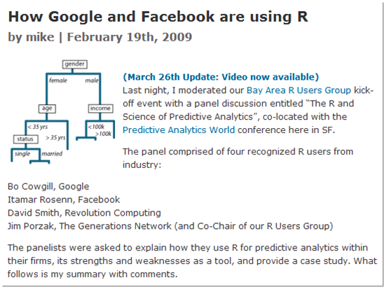
Service Providers use R
In particular, Google and Facebook extensively use R
Google's R Style Guide
Google uses R for data exploration and model prototyping, it is not typically used in production: in Bo’s group, R is typically run in a desktop environment.
- Bo Cowgill, Google
Itamar conveyed how Facebook’s Data Team used R in 2007 to answer two questions about new users: (i) which data points predict whether a user will stay? and (ii) if they stay, which data points predict how active they’ll be after three months?
- Itamar Rosenn, Facebook
http://www.dataspora.com/2009/02/predictive-analytics-using-r/

Slide 7
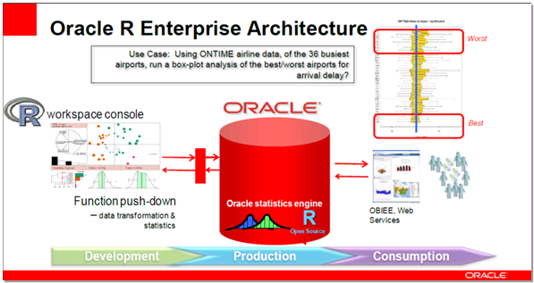
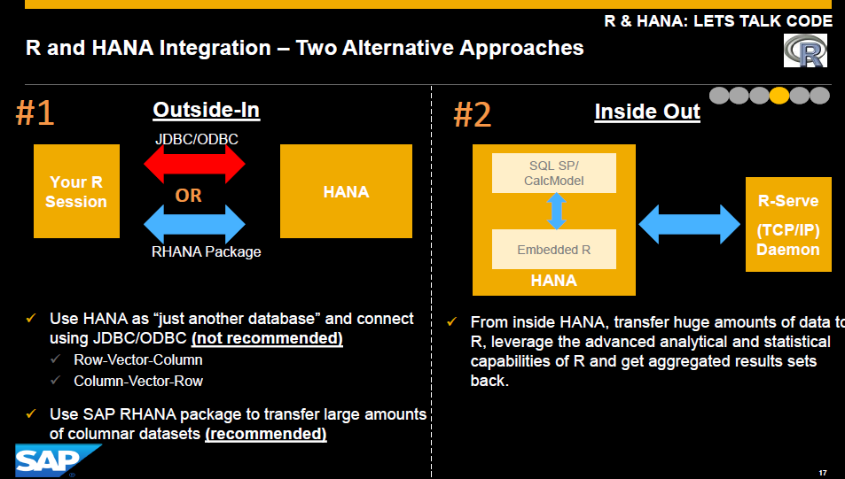
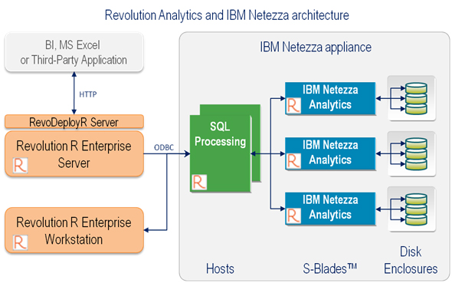
SW Vendors use R
Oracle, IBM’s Netezza, SAP’s HANA, Teradata also use R inside

Slide 8
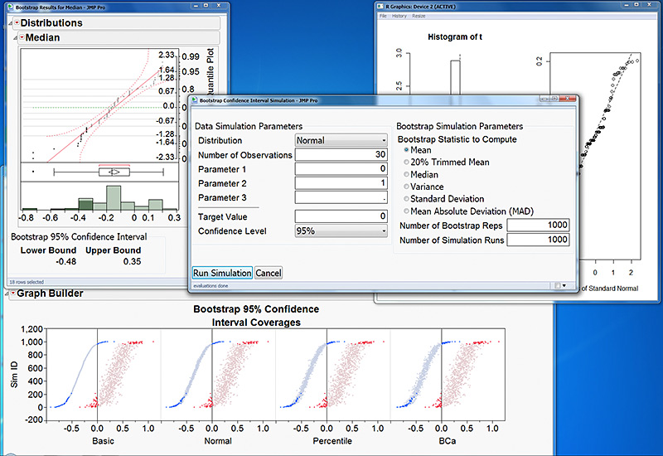
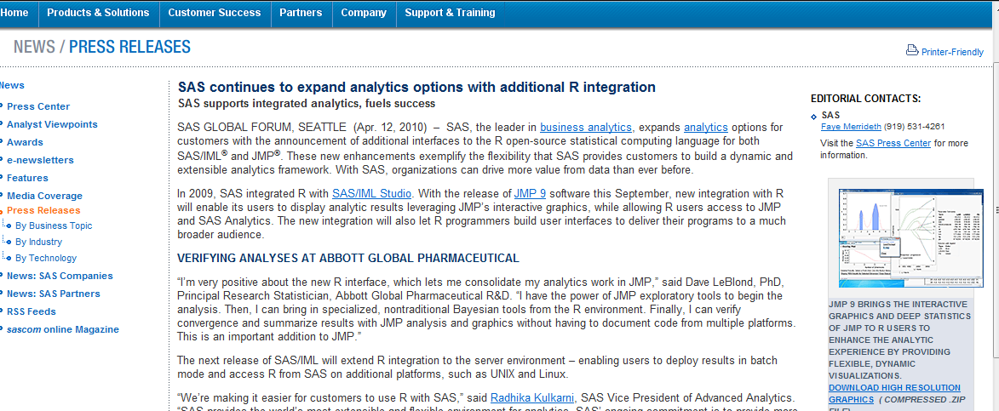
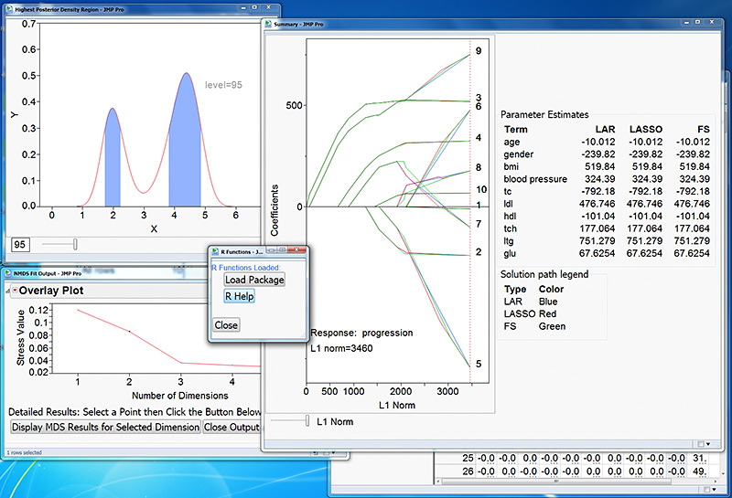
Stat Packages use R
SAS/JMP and SPSS also utilize R
SAS/JMP

Slide 9
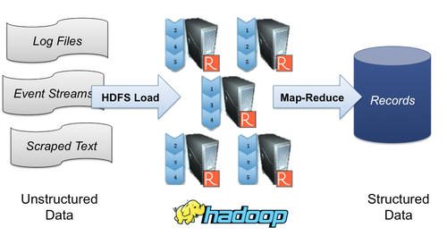
R/Hadoop
R is easily associated with Hadoop by Rhive and other packages.
☞ Revolution Analytics 소개자료

Slide 10
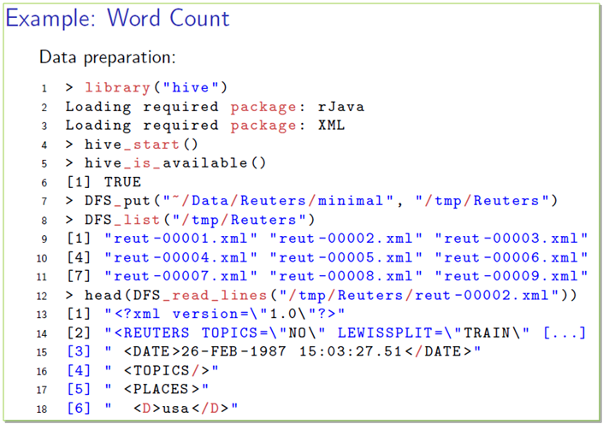
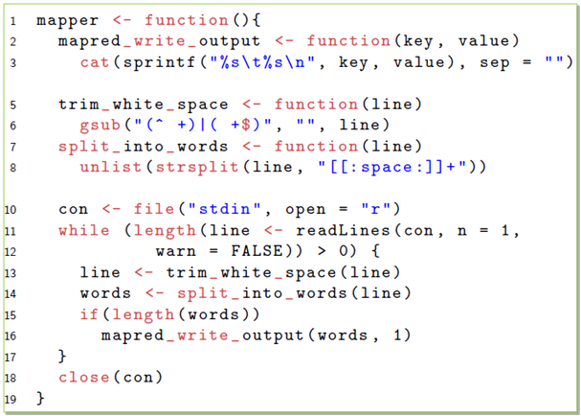
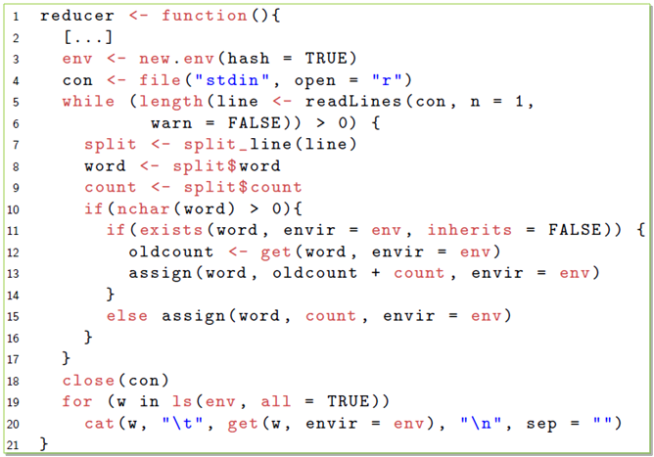
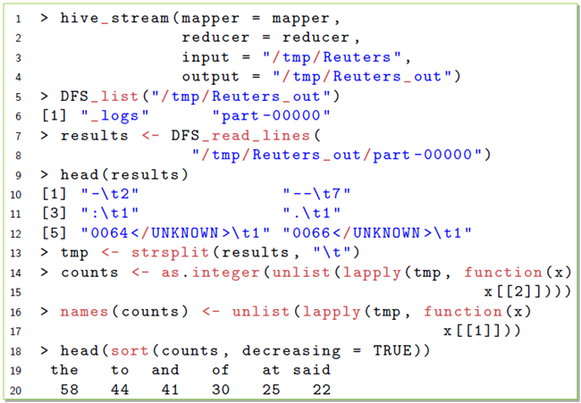
R/Hadoop (Word Count Example)
☞ Revolution Analytics 소개자료

Slide 11












Enterprise systems use R
R is an analysis platform in enterprise systems
Data Sources & Creation of Analytics
Consumption of Analytics & Results
Data Analysis
DeployR
R / Statistical Modeling Expert
Deployment Expert
Business Intelligence
Interactive Web Apps
Cloud / SaaS
☞ Revolution Analytics 소개자료

Slide 12
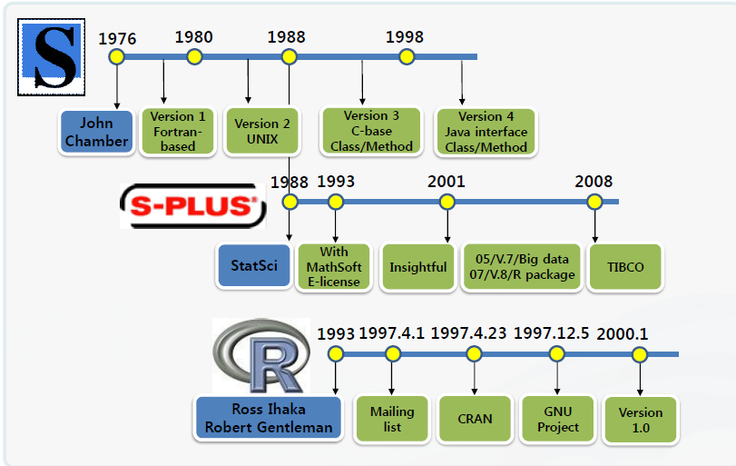
History of R
☞ 유충현 (넥스알, 빅데이터 애널리틱스 인사이드 2011)
In 1993, R was developed by two statisticians (Ross Ihaka, Robert Gentleman), Auckland University, New Zealand
It is based on S language developed by Bell Lab in 1976

Slide 13
Characteristics of R
I
R is a language and environment for statistical computing and graphics.
통계분석과 그래픽 작성을 위한 프로그래밍 언어
통계학자에 의한, 그리고 통계학자를 위한
분석 소프트웨어
데이터 입출력, 데이터 처리, 데이터 분석, 그래프 작성 등을 위한 수많은 알고리즘 및 방법론 제공

Slide 14
Characteristics of R
II
R is available as Free Software under the terms of the Free Software Foundation's GNU General Public License in source code form.
“GNU”라는 이름은 “GNU's Not Unix!”라는 문장의 재귀적 약어
GNU는 자유 소프트웨어를 뜻함
프로그램을 어떠한 목적으로도 실행할 수 있는 자유
자신의 필요에 맞게 개작할 수 있는 자유
복제물을 재배포할 수 있는 자유
프로그램을 개선시킬 수 있는 자유와 개선된 이점을 공동체 전체가 누릴 수 있게 그것을 발표할 자유

Slide 15
Characteristics of R
III
R is Free.
사용자의 입장에서 Free 라는 것이 단지 무료임을 뜻하는 것은 아님
언제 어디서든 다운로드 및 설치가 가능
Windows, Linux, Unix, Mac 등 다양한 운영체제에서 동작
누구나 패키지를 만들어 다른 사람과 공유 가능
Java, Python, .Net, Visual Studio 등 다양한 개발 언어 및 플랫폼과 연동

Slide 16
Characteristics of R
In-Memory Computing
빠른 처리 속도, H/W 메모리 크기에 영향을 받음
Object-oriented programming
데이터, 함수가 object로 관리되어 짐
클래스(class) & 메소드(method)
Package
최신의 알고리즘 및 방법론을 적용
다양한 함수 및 데이터 내장, Help의 Examples 바로 사용 가능

Slide 17
Issues of R
Memory Issue
데이터 메모리 로딩 처리
32비트 중심
TB급 빅데이터 처리가 어려움
Concurrent processing Issue
멀티 코어 CPU에서 1코어만 사용
단일 쓰래드 기반 처리
parallel 등의 패키지 등으로 보완

Slide 18
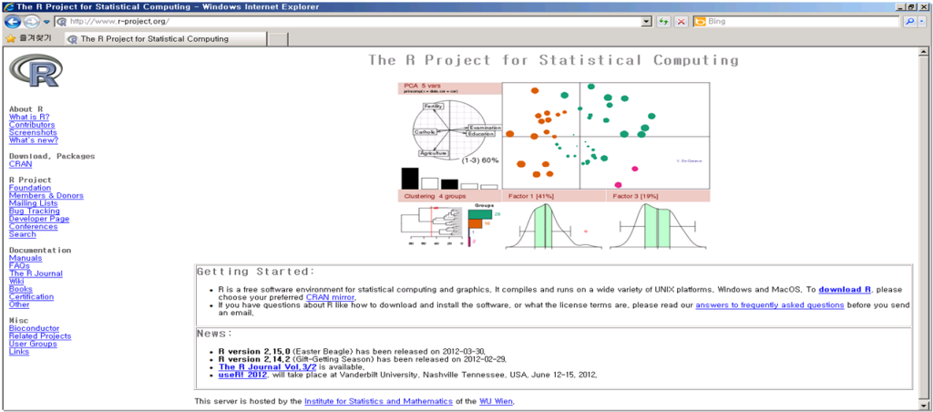
The R Foundation (http://www.r-project.org)
A non-profit organization by R Development Core Team members
Distribution of packages are done by R Development Core Team and other contributers

Slide 19
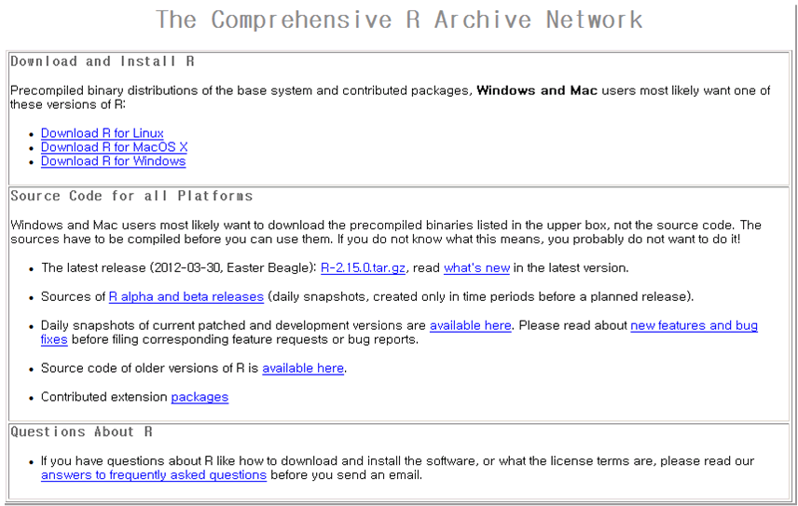
CRAN (The Comprehensive R Archive Network)
http://cran.r-project.org/
Korea :
http://cran.nexr.com/
http://biostat.cau.ac.kr/CRAN/
Now 87 Mirror sites in operation

Slide 20
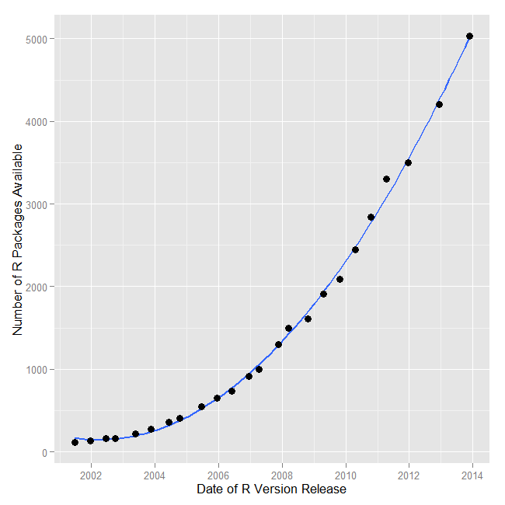
R Package (http://cran.r-project.org/web/packages/)
R 패키지 수
CRAN Site에 5,764개 등록됨 (2014년 7월 21일 기준)
이러한 패키지들은 새로운 통계분석 알고리즘이나 새로운 IT 기술의 응용에 관한 것을 포함
Software Vendor에 의하여 Version Up이 되지 않는다는 것이 다른 통계분석 소프트웨어와의 차이임

Slide 21
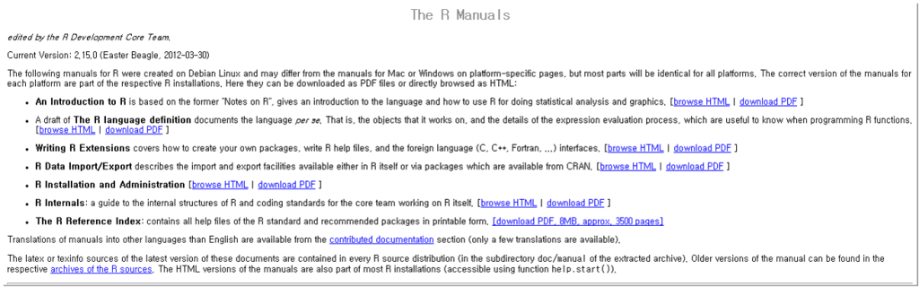
R Manual (http://cran.r-project.org/manuals.html)
R related PDF and documentations (An Introduction to R, R Data Import/Export, etc.)

Slide 22
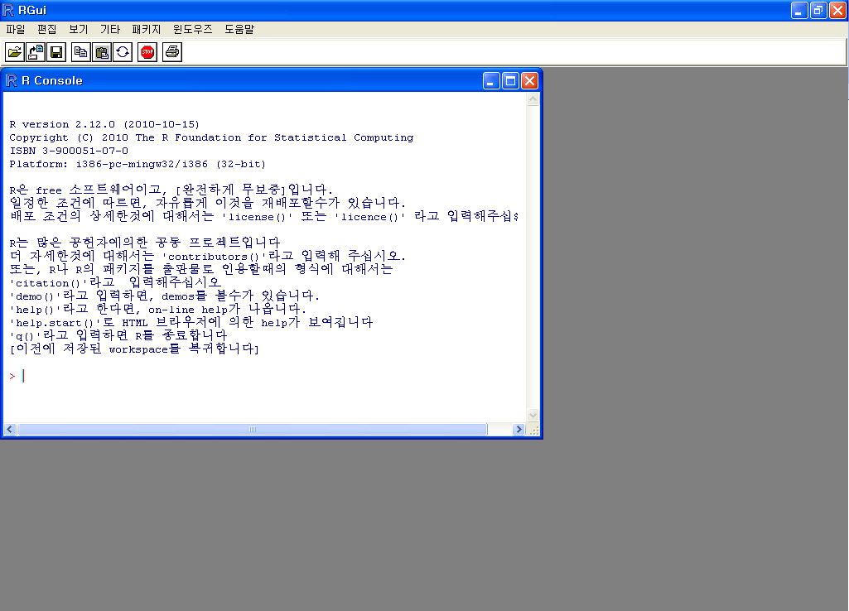
RGUI
RGui : menu, toolbar, console
①
메뉴
②
툴바
R Console
③

Slide 23
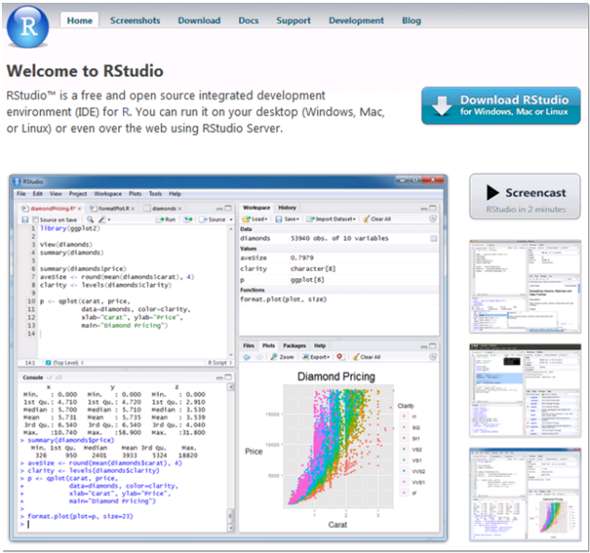
R Studio (http://www.rstudio.org/)
User editor: http://sourceforge.net/projects/tinn-r/

Slide 24
R related websites
http://www.r-project.org
http://www.r-project.kr (한국 R 사용자 모임 - KRUG)
http://www.r-bloggers.com
http://stackoverflow.com
http://stats.stackexchange.com
http://www.inside-r.org/
http://www.r-statistics.com/

Slide 25
Data Analysis Steps
Data Processing
Visualization
Modeling

Slide 26
Getting Started
Basic assignment and operations.
Arithmetic Operations:
+, -, *, /, ^ are the standard arithmetic operators.
Matrix Arithmetic.
* is element wise multiplication
%*% is matrix multiplication
Assignment
To assign a value to a variable use “<-”

Slide 27
An example
> # An example
> x <- c(1:10)
> x[(x>8) | (x<5)]
> # yields 1 2 3 4 9 10
> # How it works
> x <- c(1:10)
> X
>1 2 3 4 5 6 7 8 9 10
> x > 8
> F F F F F F F F T T
> x < 5
> T T T T F F F F F F
> x > 8 | x < 5
> T T T T F F F F T T
> x[c(T,T,T,T,F,F,F,F,T,T)]
> 1 2 3 4 9 10

Slide 28
R Introduction
To list the objects that you have in your current R session use the function ls or the function objects.
> ls()
[1] "x" "y"
So to run the function ls we need to enter the name followed by an opening ( and and aclosing ). Entering only ls will just print the object, you will see the underlying R code of the the function ls. Most functions in R accept certain arguments. For example, one of the arguments of the function ls is pattern. To list all objects starting with the letter x:
> x2 = 9
> y2 = 10
> ls(pattern="x")
[1] "x" "x2"

Slide 29
R Introduction
If you assign a value to an object that already exists then the contents of the object will be overwritten with the new value (without a warning!). Use the function rm to remove one or more objects from your session.
> rm(x, x2)
Lets create two small vectors with data and a scatterplot.
z2 <- c(1,2,3,4,5,6)
z3 <- c(6,8,3,5,7,1)
plot(z2,z3)
title("My first scatterplot")

Slide 30
R Introduction
> x = sin(9)/75
> y = log(x) + x^2
> x
[1] 0.005494913
> y
[1] -5.203902
> m <- matrix(c(1,2,4,1), ncol=2)
> m
> [,1] [,2]
[1,] 1 4
[2,] 2 1
> solve(m)
[,1] [,2]
[1,] -0.1428571 0.5714286
[2,] 0.2857143 -0.1428571
> solve(m) %*% m

Slide 31
R Workspace
getwd() # print the current working directory
ls() # list the objects in the current workspace
setwd(mydirectory) # change to mydirectory
setwd("c:/docs/mydir")

Slide 32
R Help
help.start() # general help
help(foo) # help about function foo
?foo # same thing
apropos("foo") # list all function containing string foo
example(foo) # show an example of function foo

Slide 33
R Datasets
R comes with a number of sample datasets that you can experiment with. Type
> data( )
to see the available datasets. The results will depend on which packages you have loaded. Type
help(datasetname)
for details on a sample dataset.

Slide 34
R Packages
To Install ”MyLibrary“
> install.packages("MyLibrary")
To use “MyLibrary”
> require(MyLibrary)

Slide 35
Data Types
R has a wide variety of data types including scalars, vectors (numerical, character, logical), matrices, dataframes, and lists.

Slide 36
Vectors
a <- c(1,2,5.3,6,-2,4) # numeric vector
b <- c("one","two","three") # character vector
c <- c(TRUE,TRUE,TRUE,FALSE,TRUE,FALSE)
#logical vector
Refer to elements of a vector using subscripts.
a[c(2,4)] # 2nd and 4th elements of vector

Slide 37
Matrices
All columns in a matrix must have the same mode(numeric, character, etc.) and the same length.
The general format is
mymatrix <- matrix(vector, nrow=r, ncol=c, byrow=FALSE,dimnames=list(char_vector_rownames, char_vector_colnames))
byrow=TRUE indicates that the matrix should be filled by rows. byrow=FALSE indicates that the matrix should be filled by columns (the default). dimnames provides optional labels for the columns and rows.

Slide 38
Data frames
A data frame is more general than a matrix, in that different columns can have different modes (numeric, character, factor, etc.).
d <- c(1,2,3,4)
e <- c("red", "white", "red", NA)
f <- c(TRUE,TRUE,TRUE,FALSE)
mydata <- data.frame(d,e,f)
names(mydata) <- c("ID","Color","Passed") #variable names

Slide 39
Data frames
There are a variety of ways to identify the elements of a dataframe .
myframe[3:5] # columns 3,4,5 of dataframe
myframe[c("ID","Age")] # columns ID and Age from dataframe
myframe$X1 # variable x1 in the dataframe

Slide 40
Useful Functions
length(object) # number of elements or components
str(object) # structure of an object
class(object) # class or type of an object
names(object) # names
c(object,object,...) # combine objects into a vector
cbind(object, object, ...) # combine objects as columns
rbind(object, object, ...) # combine objects as rows
ls() # list current objects
rm(object) # delete an object
newobject <- edit(object) # edit copy and save a
newobject
fix(object) # edit in place

Slide 41
From A Comma Delimited Text File
# first row contains variable names, comma is separator
# assign the variable id to row names
# note the / instead of \ on mswindows systems mydata <- read.table("c:/mydata.csv", header=TRUE, sep=",", row.names="id")

Slide 42
Exporting Data
To A Tab Delimited Text File
write.table(mydata, "c:/mydata.txt", sep="\t")
To an Excel Spreadsheet
library(xlsReadWrite) write.xls(mydata, "c:/mydata.xls")
To SAS
library(foreign) write.foreign(mydata, "c:/mydata.txt", "c:/mydata.sas", package="SAS")

Slide 43
Viewing Data
There are a number of functions for listing the contents of an object or dataset.
# list objects in the working environment ls()
# list the variables in mydata names(mydata)
# list the structure of mydata str(mydata)
# list levels of factor v1 in mydata levels(mydata$v1)
# dimensions of an object dim(object)

Slide 44
Viewing Data
There are a number of functions for listing the contents of an object or dataset.
# class of an object (numeric, matrix, dataframe, etc) class(object)
# print mydata mydata
# print first 10 rows of mydata head(mydata, n=10)
# print last 5 rows of mydata tail(mydata, n=5)

Slide 45
Missing Data
In R, missing values are represented by the symbol NA (not available) . Impossible values (e.g., dividing by zero) are represented by the symbol NaN (not a number). Unlike SAS, R uses the same symbol for character and numeric data.
Testing for Missing Values
is.na(x) # returns TRUE of x is missing
y <- c(1,2,3,NA)
is.na(y) # returns a vector (F F F T)

Slide 46
Missing Data
Recoding Values to Missing
# recode 99 to missing for variable v1
# select rows where v1 is 99 and recode column v1
mydata[mydata$v1==99,"v1"] <- NA
Excluding Missing Values from Analyses
Arithmetic functions on missing values yield missing values.
x <- c(1,2,NA,3)
mean(x) # returns NA
mean(x, na.rm=TRUE) # returns 2

Slide 47
Arithmetic Operators
Operator | Description
+ | addition
- | subtraction
* | multiplication
/ | division
^ or ** | exponentiation
x %% y | modulus (x mod y) 5%%2 is 1
x %/% y | integer division 5%/%2 is 2

Slide 48
Logical Operators
Operator | Description
< | less than
<= | less than or equal to
> | greater than
>= | greater than or equal to
== | exactly equal to
!= | not equal to
!x | Not x
x | y | x OR y
x & y | x AND y
isTRUE(x) | test if x is TRUE

Slide 49
Control Structures
if-else
if (cond) expr if (cond) expr1 else expr2
for
for (var in seq) expr
while
while (cond) expr
switch
switch(expr, ...)
ifelse
ifelse(test,yes,no)

Slide 50
Control Structures
# transpose of a matrix # a poor alternative to built-in t() function mytrans <- function(x) { if (!is.matrix(x)) { warning("argument is not a matrix: returning NA") return(NA_real_) } y <- matrix(1, nrow=ncol(x), ncol=nrow(x)) for (i in 1:nrow(x)) { for (j in 1:ncol(x)) { y[j,i] <- x[i,j] } } return(y) }

Slide 51
Control Structures
# try it z <- matrix(1:10, nrow=5, ncol=2) tz <- mytrans(z)

Slide 52
Numeric Functions
Function | Description
abs(x) | absolute value
sqrt(x) | square root
ceiling(x) | ceiling(3.475) is 4
floor(x) | floor(3.475) is 3
trunc(x) | trunc(5.99) is 5
round(x, digits=n) | round(3.475, digits=2) is 3.48
signif(x, digits=n) | signif(3.475, digits=2) is 3.5
cos(x), sin(x), tan(x) | also acos(x), cosh(x), acosh(x), etc.
log(x) | natural logarithm
log10(x) | common logarithm
exp(x) | e^x

Slide 53
Character Functions
Function | Description
substr(x, start=n1, stop=n2) | Extract or replace substrings in a character vector. x <- "abcdef" substr(x, 2, 4) is "bcd" substr(x, 2, 4) <- "22222" is "a222ef"
grep(pattern, x , ignore.case=FALSE, fixed=FALSE) | Search for pattern in x. If fixed =FALSE then pattern is a regular expression. If fixed=TRUE then pattern is a text string. Returns matching indices. grep("A", c("b","A","c"), fixed=TRUE) returns 2
sub(pattern, replacement, x, ignore.case =FALSE, fixed=FALSE) | Find pattern in x and replace with replacement text. If fixed=FALSE then pattern is a regular expression. If fixed = T then pattern is a text string. sub("\\s",".","Hello There") returns "Hello.There"
strsplit(x, split) | Split the elements of character vector x at split. strsplit("abc", "") returns 3 element vector "a","b","c"
paste(..., sep="") | Concatenate strings after using sep string to seperate them. paste("x",1:3,sep="") returns c("x1","x2" "x3") paste("x",1:3,sep="M") returns c("xM1","xM2" "xM3") paste("Today is", date())
toupper(x) | Uppercase
tolower(x) | Lowercase

Slide 54
Function | Description
dnorm(x) | normal density function (by default m=0 sd=1) # plot standard normal curve x <- pretty(c(-3,3), 30) y <- dnorm(x) plot(x, y, type='l', xlab="Normal Deviate", ylab="Density", yaxs="i")
pnorm(q) | cumulative normal probability for q (area under the normal curve to the right of q) pnorm(1.96) is 0.975
qnorm(p) | normal quantile. value at the p percentile of normal distribution qnorm(.9) is 1.28 # 90th percentile
rnorm(n, m=0,sd=1) | n random normal deviates with mean m and standard deviation sd. #50 random normal variates with mean=50, sd=10 x <- rnorm(50, m=50, sd=10)
dbinom(x, size, prob) pbinom(q, size, prob) qbinom(p, size, prob) rbinom(n, size, prob) | binomial distribution where size is the sample size and prob is the probability of a heads (pi) # prob of 0 to 5 heads of fair coin out of 10 flips dbinom(0:5, 10, .5) # prob of 5 or less heads of fair coin out of 10 flips pbinom(5, 10, .5)
dpois(x, lamda) ppois(q, lamda) qpois(p, lamda) rpois(n, lamda) | poisson distribution with m=std=lamda #probability of 0,1, or 2 events with lamda=4 dpois(0:2, 4) # probability of at least 3 events with lamda=4 1- ppois(2,4)
dunif(x, min=0, max=1) punif(q, min=0, max=1) qunif(p, min=0, max=1) runif(n, min=0, max=1) | uniform distribution, follows the same pattern as the normal distribution above. #10 uniform random variates x <- runif(10)

Slide 55
Other Useful Functions
Function | Description
seq(from , to, by) | generate a sequence indices <- seq(1,10,2) #indices is c(1, 3, 5, 7, 9)
rep(x, ntimes) | repeat x n times y <- rep(1:3, 2) # y is c(1, 2, 3, 1, 2, 3)
cut(x, n) | divide continuous variable in factor with n levels y <- cut(x, 5)

Slide 56
Creating a Graph
In R, graphs are typically created interactively.
# Creating a Graph attach(mtcars) plot(wt, mpg) abline(lm(mpg~wt)) title("Regression of MPG on Weight")
The plot( ) function opens a graph window and plots weight vs. miles per gallon. The next line of code adds a regression line to this graph. The final line adds a title.

Slide 57
Graphical Parameters
A second way to specify graphical parameters is by providing the optionname=value pairs directly to a high level plotting function. In this case, the options are only in effect for that specific graph.
# Set a graphical parameter within the plotting function hist(mtcars$mpg, col.lab="red")
See the help for a specific high level plotting function (e.g. plot, hist, boxplot) to determine which graphical parameters can be set this way.
The remainder of this section describes some of the more important graphical parameters that you can set.

Slide 58
Graphical Parameters
# A Simple Axis Example # specify the data x <- c(1:10); y <- x; z <- 10/x # create extra margin room on the right for an axis par(mar=c(5, 4, 4, 8) + 0.1) # plot x vs. y plot(x, y,type="b", pch=21, col="red", yaxt="n", lty=3, xlab="", ylab="") # add x vs. 1/x lines(x, z, type="b", pch=22, col="blue", lty=2) # draw an axis on the left axis(2, at=x,labels=x, col.axis="red", las=2) # draw an axis on the right, with smaller text and ticks axis(4, at=z,labels=round(z,digits=2), col.axis="blue", las=2, cex.axis=0.7, tck=-.01) # add a title for the right axis mtext("y=1/x", side=4, line=3, cex.lab=1,las=2, col="blue") # add a main title and bottom and left axis labels title("An Example of Creative Axes", xlab="X values", ylab="Y=X")

Slide 59
Graphical Parameters
# Legend Example attach(mtcars) boxplot(mpg~cyl, main="Milage by Car Weight", yaxt="n", xlab="Milage", horizontal=TRUE, col=terrain.colors(3)) legend("topright", inset=.05, title="Number of Cylinders", c("4","6","8"), fill=terrain.colors(3), horiz=TRUE)

Slide 60
Graphical Parameters
Combining Plots
R makes it easy to combine multiple plots into one overall graph, using either the par( ) or layout( ) function.
With the par( ) function, you can include the option mfrow=c(nrows, ncols) to create a matrix of nrows x ncols plots that are filled in by row. mfcol=c(nrows, ncols) fills in the matrix by columns.
# 4 figures arranged in 2 rows and 2 columns attach(mtcars) par(mfrow=c(2,2)) plot(wt,mpg, main="Scatterplot of wt vs. mpg") plot(wt,disp, main="Scatterplot of wt vs disp") hist(wt, main="Histogram of wt") boxplot(wt, main="Boxplot of wt")

Slide 61
Graphical Parameters
3 figures arranged in 3 rows and 1 column attach(mtcars) par(mfrow=c(3,1)) hist(wt) hist(mpg) hist(disp)

Slide 62
Scatterplot Matrices
There are at least 4 useful functions for creating scatterplot matrices.
# Basic Scatterplot Matrix pairs(~mpg+disp+drat+wt,data=mtcars, main="Simple Scatterplot Matrix")
#advanced version
library(car)
scatterplotMatrix(~mpg+disp+drat+wt|cyl, data=mtcars, main="Three Cylinder Options")

Slide 63
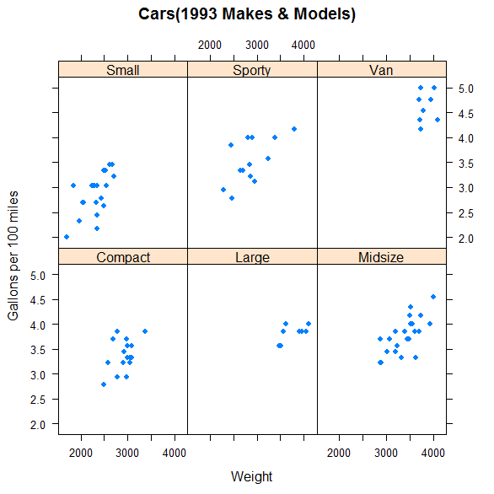
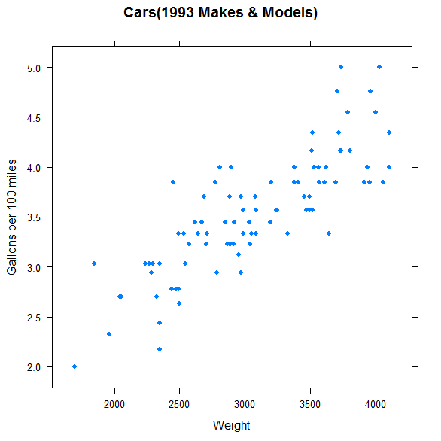
Visualization – basic statistics
Car data: CarData.csv
> Cars93[1:3,]
Notes:
R_visual_3_car_1993_InUse.txt

Slide 64
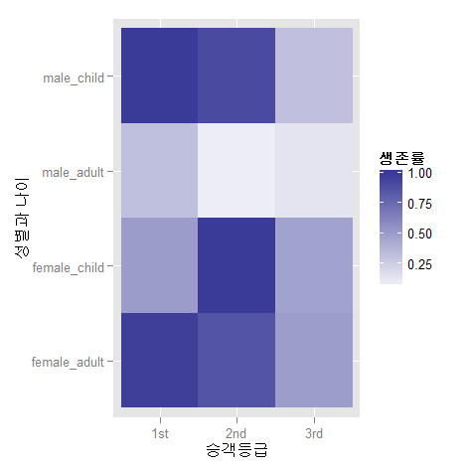

Visualization – survival rate
Titanic survival info: titanic.csv
Survival by seat rank
Survival by gender
1: 1st 0.62
2: 2nd 0.43
3: 3rd 0.26
1: female 0.73
2: male 0.19
Notes:
D:\HY\project\presentations\HyundaiNGV\Presentation\UseRModules\categoryAnalysis\Rscript1.txt

Slide 65
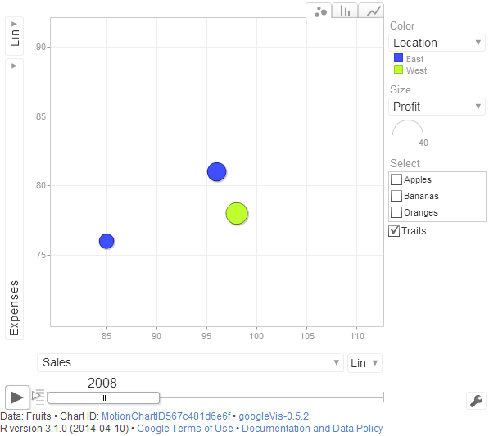
Visualization – googleVis
googleVis 패키지
Fruit 데이터에 대해

Slide 66
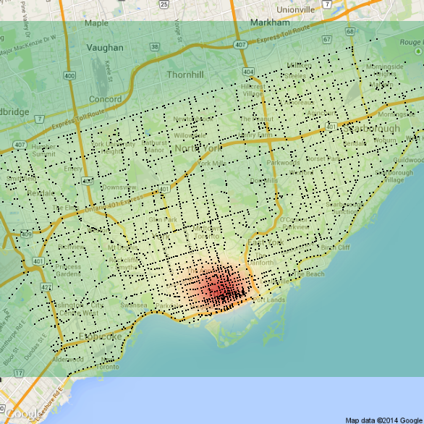
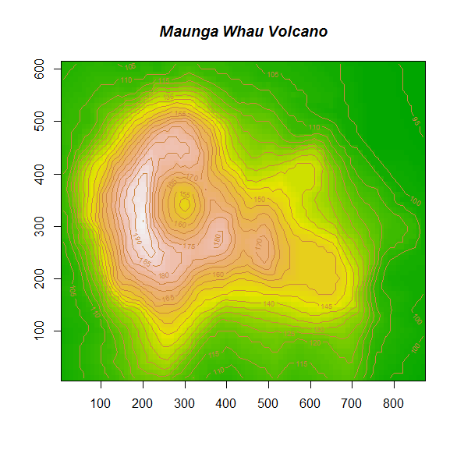
Visualization – map data
2-by-2 matrix in a contour plot
Traffic intensity overlapped by maps by RgoogleMaps
Notes:
R_visual_4.txt, R_visual_5.txt

Slide 67
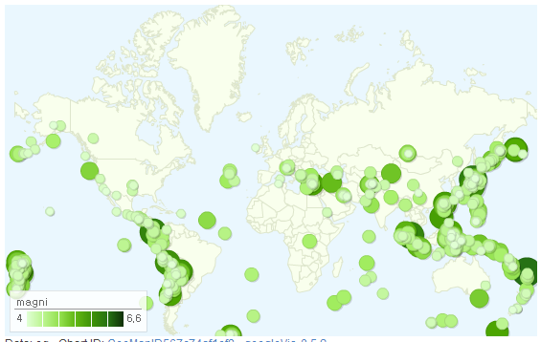
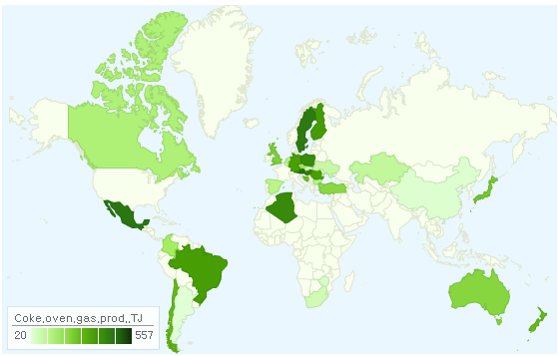
Visualization - maps
Earthquake epicenter
Use of coke oven gas
출처: http://freesearch.pe.kr/
Notes:
R_visual_8.txt

Slide 68
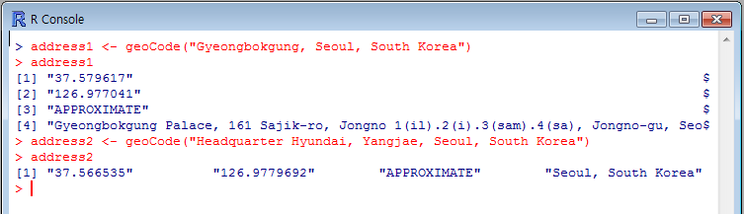
Visualization - maps
url <- function(address, return.call = "json", sensor = "false") {
root <- "http://maps.google.com/maps/api/geocode/"
u <- paste(root, return.call, "?address=", address, "&sensor=", sensor, sep = "")
return(URLencode(u))
}
geoCode <- function(address,verbose=FALSE) {
u <- url(address)
doc <- getURL(u)
x <- fromJSON(doc,simplify = FALSE)
lat <- x$results[[1]]$geometry$location$lat
lng <- x$results[[1]]$geometry$location$lng
…
http://maps.google.com/maps/api/geocode/
Latitude (위도), Longitude(경도)

