Slide 1
Data Mining for Business Intelligence
Chapter 5: Evaluating Classification &
Predictive Performance
Kichun Lee, Ph.D.
Department of Industrial Engineering
Hanyang University, Seoul, Korea

Slide 2
Why Evaluate?
Multiple methods are available to classify or predict
For each method, multiple choices are available for settings
To choose best model, need to assess each model’s performance

Slide 3
Accuracy Measures (Classification)

Slide 4
Misclassification error
Error = classifying a record as belonging to one class when it belongs to another class.
Error rate = percent of misclassified records out of the total records in the validation data

Slide 5
Confusion Matrix
201 1’s correctly classified as “1”
85 1’s incorrectly classified as “0”
25 0’s incorrectly classified as “1”
2689 0’s correctly classified as “0”

Slide 6
Error Rate
Overall error rate = (25+85)/3000 = 3.67%
Accuracy = 1 – err = (201+2689) = 96.33%
If multiple classes, error rate is:
(sum of misclassified records)/(total records)

Slide 7
Cutoff for classification
Most DM algorithms classify via a 2-step process:
For each record,
Compute probability of belonging to class “1”
Compare to cutoff value, and classify accordingly
Default cutoff value is 0.50
If >= 0.50, classify as “1”
If < 0.50, classify as “0”
Can use different cutoff values
Typically, error rate is lowest for cutoff = 0.50

Slide 8
Cutoff Table
If cutoff is 0.50: eleven records are classified as “1”
If cutoff is 0.80: seven records are classified as “1”

Slide 9
Confusion Matrix for Different Cutoffs

Slide 10
When One Class is More Important
In many cases it is more important to identify members of one class
Tax fraud
Credit default
Response to promotional offer
Detecting electronic network intrusion
Predicting delayed flights
In such cases, we are willing to tolerate greater overall error, in return for better identifying the important class for further attention

Slide 11
Alternate Accuracy Measures
If “C₁” is the important class,
Sensitivity = % of “C₁” class correctly classified
Specificity = % of “C₀” class correctly classified
False positive rate = % of predicted “C₁’s” that were not “C₁’s”
False negative rate = % of predicted “C₀’s” that were not “C₀’s”

Slide 12
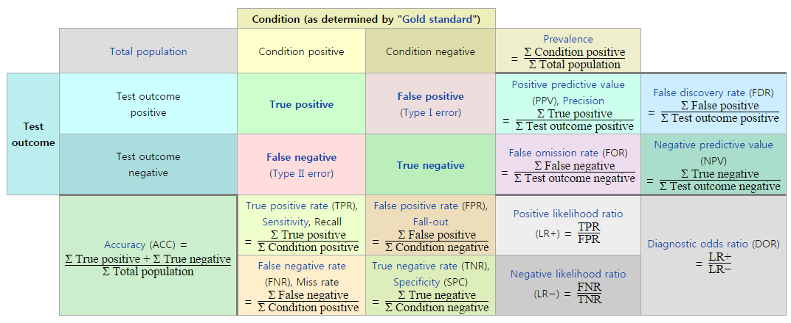
Alternate Accuracy Measures

Slide 13
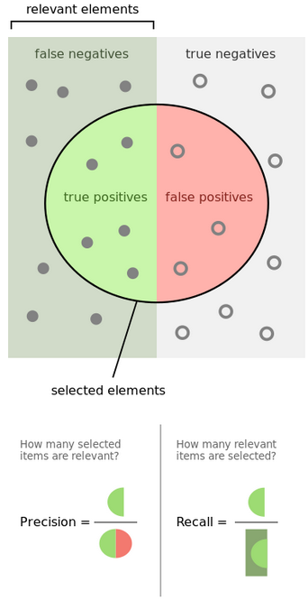

Slide 14
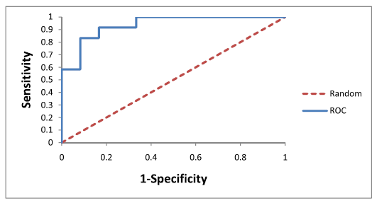
ROC Curve

Slide 15
Lift Charts
Goal: Useful for assessing performance in terms of identifying the most important class
Helps evaluate, e.g.,
How many tax records to examine
How many loans to grant
How many customers to mail offer to
Compare performance of DM model to “no model, pick randomly”

Slide 16
Lift Chart – cumulative performance
Compare lift to “no model” baseline
Compute lift: Accumulate the correctly classified “important class” records (Y axis) and compare to number of total records (X axis)
After examining (e.g.,) 10 cases (x-axis), 9 owners (y-axis) have been correctly identified

Slide 17
Asymmetric Costs

Slide 18
Misclassification Costs May Differ
The cost of making a misclassification error may be higher for one class than the other(s)
Looked at another way, the benefit of making a correct classification may be higher for one class than the other(s)

Slide 19
Example – Response to Promotional Offer
Suppose we send an offer to 1000 people, with 1% average response rate (“1” = response, “0” = nonresponse)
“Naïve rule” (classify everyone as “0”) has error rate of 1% (seems good)
Using DM we can correctly classify eight 1’s as 1’s
It comes at the cost of misclassifying twenty 0’s as 1’s and two 0’s as 1’s.

Slide 20
The Confusion Matrix
Error rate = (2+20) = 2.2% (higher than naïve rate)

Slide 21
Introducing Costs & Benefits
Suppose:
Profit from a “1” is $10
Cost of sending offer is $1
Then:
Under naïve rule, all are classified as “0”, so no offers are sent: no cost, no profit
Under DM predictions, 28 offers are sent.
8 respond with profit of $10 each
20 fail to respond, cost $1 each
972 receive nothing (no cost, no profit)
Net profit = $60

Slide 22
Profit Matrix, Opportunity cost
Recall original confusion matrix (profit from a “1” = $10, cost of sending offer = $1):
Profit Matrix
We can also include opportunity costs
E.g., instead of “benefit from sale” refer to “opportunity cost of lost sale”
Profit Matrix
80

Slide 23
Generalize to Cost Ratio
Sometimes actual costs and benefits are hard to estimate
Need to express everything in terms of costs (i.e., cost of misclassification per record)
Goal is to minimize the average cost per record
A good practical substitute for individual costs is the ratio of misclassification costs (e,g,, “misclassifying fraudulent firms is 5 times worse than misclassifying solvent firms”)

Slide 24
Oversampling and Asymmetric Costs

Slide 25
Rare Cases
Asymmetric costs/benefits typically go hand in hand with presence of rare but important class
Responder to mailing
Someone who commits fraud
Debt defaulter
Often we oversample rare cases to give model more information to work with
Typically use 50% “1” and 50% “0” for training

Slide 26
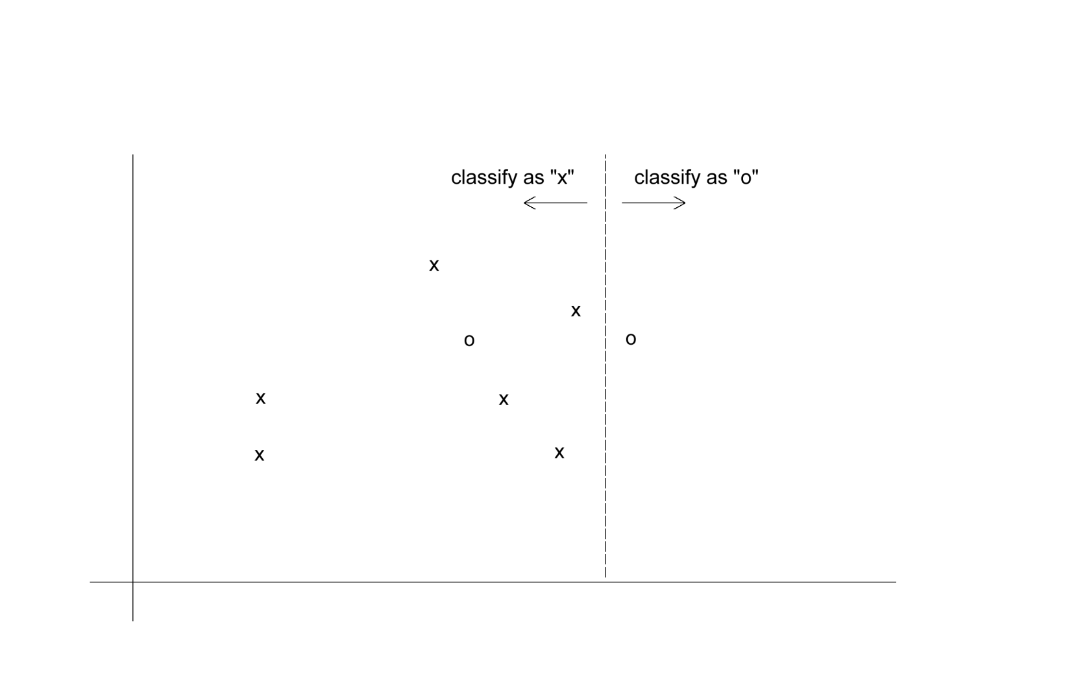
Classification: equal costs

Slide 27
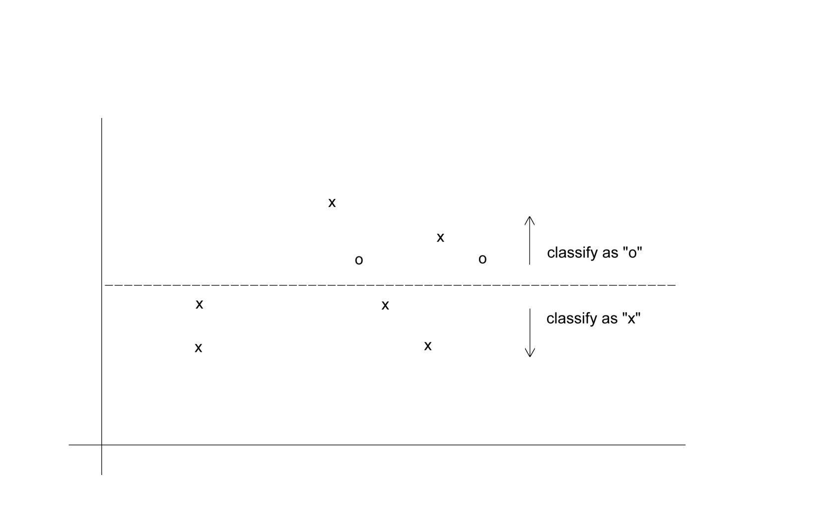
Classification: Unequal costs

Slide 28
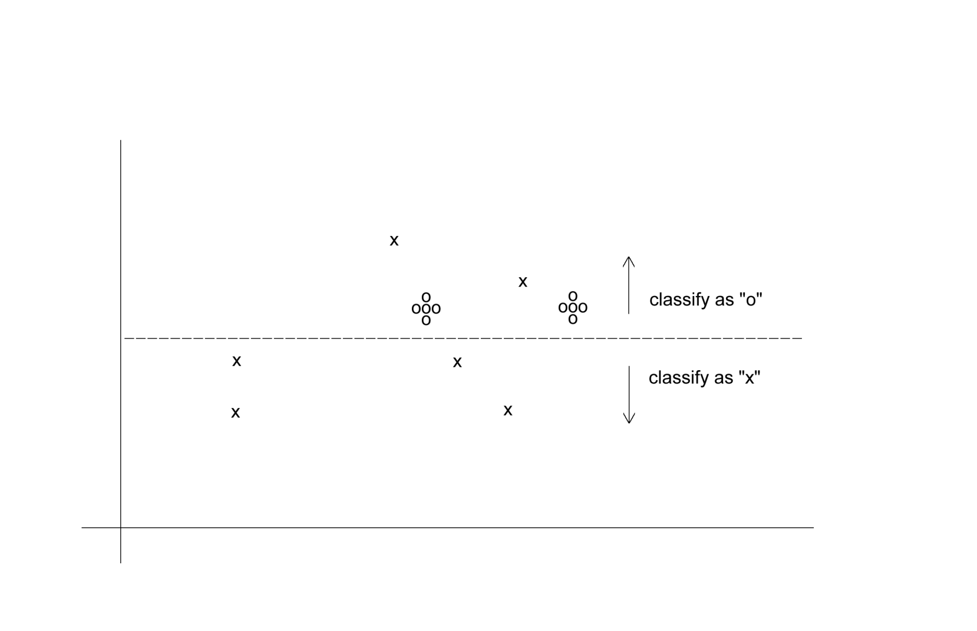
Oversampling Scheme
Oversample “o” to appropriately weight misclassification costs

Slide 29
Evaluating Predictive Performance

Slide 30
Measuring Predictive error
Not the same as “goodness-of-fit”
We want to know how well the model predicts new data, not how well it fits the data it was trained with
Key component of most measures is difference between actual y and predicted y (“error”)

Slide 31
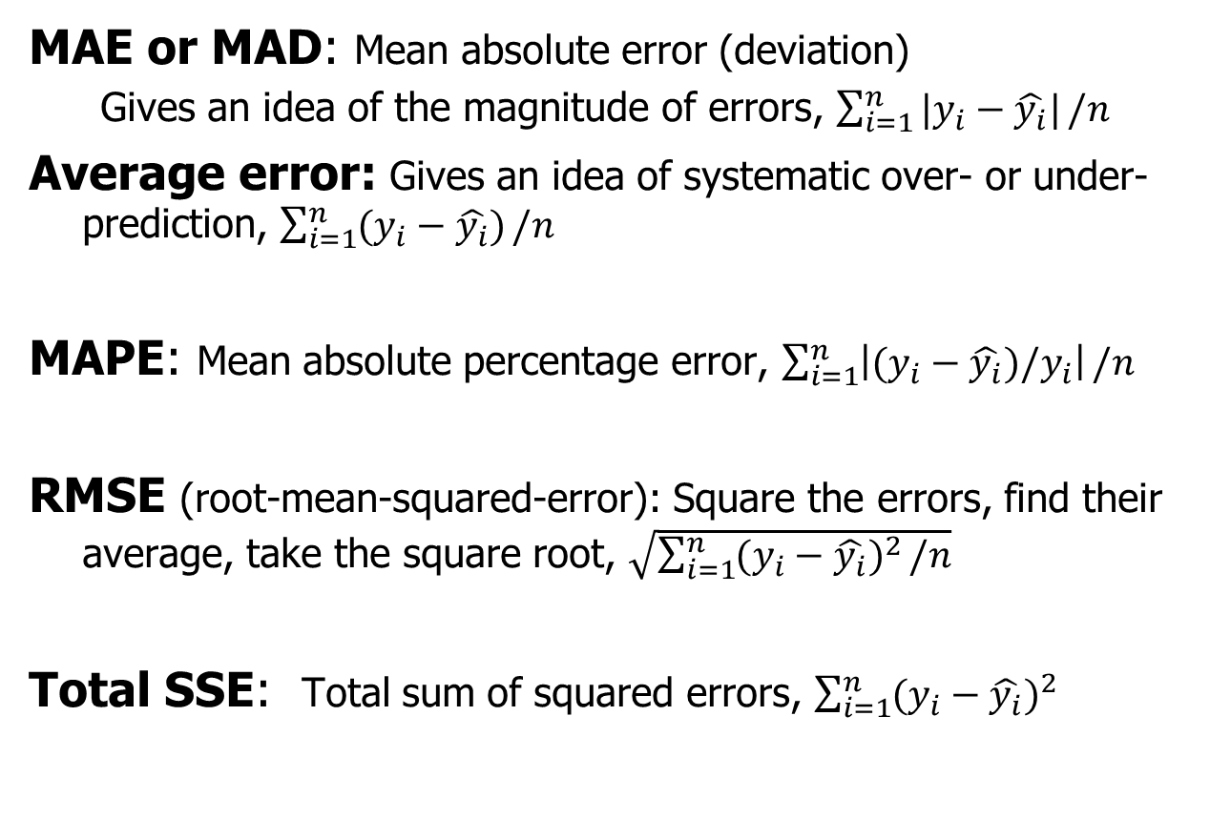
Some measures of error
MAE or MAD: Mean absolute error (deviation)
Gives an idea of the magnitude of errors, $\sum_{i=1}^{n}{|y_{i}−\hat{y_{i}}|}/n$
Average error: Gives an idea of systematic over- or under-prediction, $\sum_{i=1}^{n}{(y_{i}−\hat{y_{i}})}/n$
MAPE: Mean absolute percentage error, $\sum_{i=1}^{n}{\left|(y_{i}−\hat{y_{i}})/y_{i}\right|}/n$
RMSE (root-mean-squared-error): Square the errors, find their average, take the square root, $\sqrt{\sum_{i=1}^{n}{{(y_{i}−\hat{y_{i}})}^{2}}/n}$
Total SSE: Total sum of squared errors, $\sum_{i=1}^{n}{{(y_{i}−\hat{y_{i}})}^{2}}$

Slide 32
Summary
Evaluation metrics are important for comparing across DM models, for choosing the right configuration of a specific DM model, and for comparing to the baseline
Major metrics: confusion matrix, error rate, predictive error
Other metrics when
one class is more important
asymmetric costs
When important class is rare, use oversampling
In all cases, metrics computed from validation data

