Slide 1

I/O Systems

Slide 2

I/O Hardware
Variety of I/O devices
Common concepts
  Port (ex. Serial port)
  Bus (daisy chain or shared direct access)
  Controller (simple chip or separate circuit board called host adapter)
I/O instructions control devices
  Controller has one or more registers for data and control signals
Processor give commands and data to a controller via
  Special I/O instructions to an I/O port address
  Memory-mapped I/O
    device control registers are mapped into the address space of the processor
    CPU executes I/O requests using the standard data-transfer instructions
Hanyang University
Data-Centric Systems Lab.

Slide 3
I/O Hardware
I/O port consists of four registers
  Status register
    Contains bits that can be read by the host
    Busy bit, error bit
  Control register
    Can be written by the host to start a command or to change the mode of a device
  Data-in register
    Read by the host to get input
  Data-out register
    Written by the host to send output
Hanyang University
Data-Centric Systems Lab.

Slide 4
Polling
Determines state of device
  Busy bit in the status register
Busy-wait cycle to wait for I/O from device
  If the controller and device are fast, polling is a reasonable one
Polling becomes inefficient when it is attempted repeatedly, yet rarely finds a device to be ready for service, while other useful CPU processing remains undone
In such instances, It is better to arrange for the hardware controller to notify the CPU when the device becomes ready for service : interrupt
Hanyang University
Data-Centric Systems Lab.

Slide 5
Interrupts
CPU hardware has a wire called the Interrupt-request line
  triggered by I/O device
  CPU senses after executing every instruction
Detecting a signal, CPU saves state and jumps to the interrupt-handler routine at a fixed address in memory
Interrupt handler determines the cause of the interrupt, performs the necessary processing, and executes a return from interrupt instruction to return the CPU to the prior state
Two interrupt-request lines
  Nonmaskable : reserved for events such as unrecoverable memory errors
  Maskable : used by device controllers and can be turned off by CPU before critical instruction sequences
Interrupt vector to dispatch interrupt to correct handler
Interrupt mechanism also used for exceptions
  Divide by zero, accessing a protected memory address, etc
Hanyang University
Data-Centric Systems Lab.

Slide 6
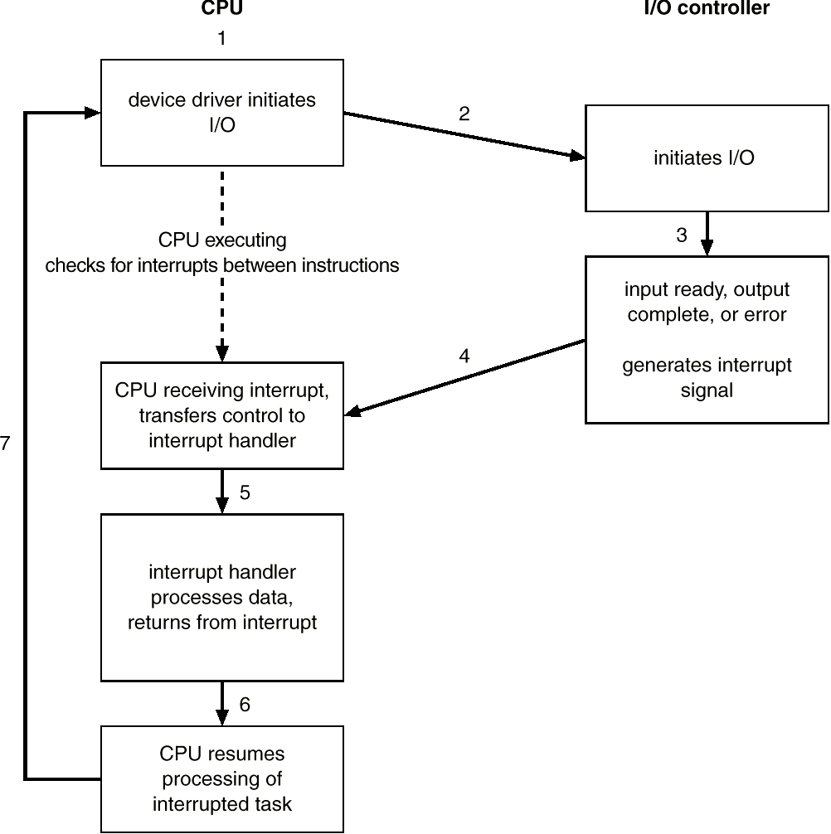
Interrupt-driven I/O Cycle
Hanyang University
Data-Centric Systems Lab.

Slide 7
Direct Memory Access
Used to avoid programmed I/O (PIO) for large data movement
  In PIO, CPU watches status bits and feed data into a controller register 1 byte at a time
Requires DMA controller
Bypasses CPU to transfer data directly between I/O device and memory
Hanyang University
Data-Centric Systems Lab.

Slide 8

Six step process to perform DMA transfer
Hanyang University
Data-Centric Systems Lab.

Slide 9
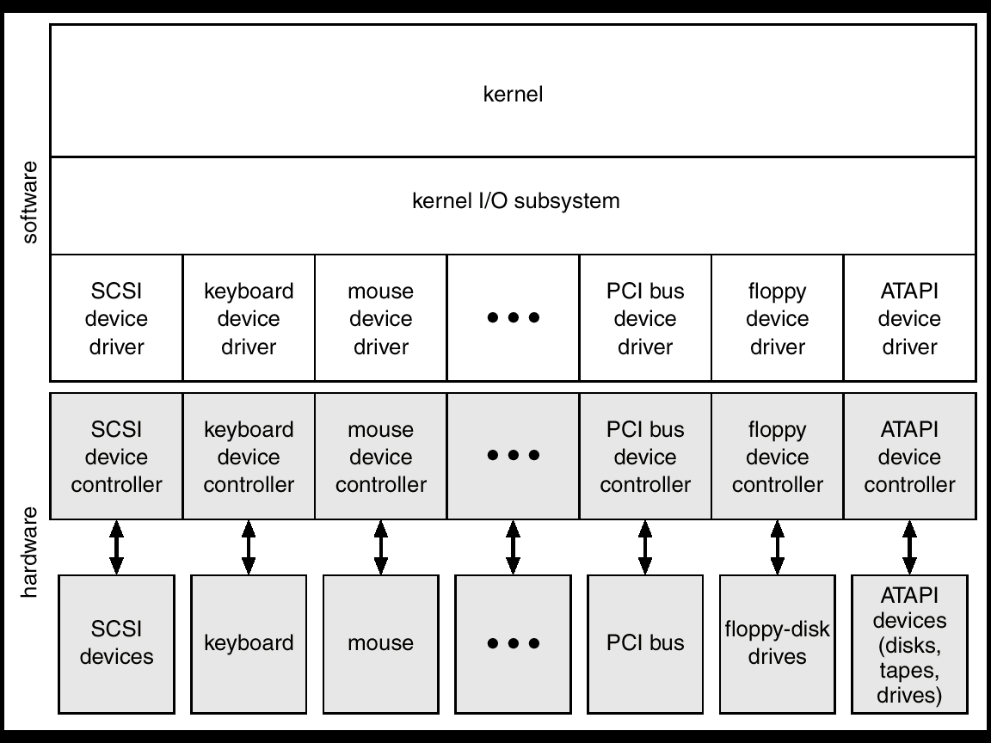
A Kernel I/O Structure
Hanyang University
Data-Centric Systems Lab.

Slide 10
Application I/O Interface
I/O system calls encapsulate device behaviors in generic classes to make I/O devices treated in a standard, uniform way
Device-driver layer hides differences among I/O controllers from kernel
Devices vary in many dimensions
  Character-stream or block
  Sequential or random-access
  Sharable or dedicated
  Speed of operation
  read-write, read only, or write only
Hanyang University
Data-Centric Systems Lab.

Slide 11
Block and Character Devices
Block devices include disk drives
  Commands include read, write, seek
  Raw I/O (ex. Database system) or file-system access
  Memory-mapped file access possible
    Data transfers are handled by the same mechanism as that used for demand-paged virtual-memory access
Character devices include keyboards, mice, serial ports
  Commands include get, put
  Libraries layered on top of this interface allow line editing
  Convenient for input devices which produce data for input spontaneously
  Good for output devices such as printers or audio boards, which naturally fit the concept of a linear stream of bytes
Hanyang University
Data-Centric Systems Lab.

Slide 12
Clocks and Timers
Provide current time, elapsed time, timer
Programmable interval timer
  Hardware to measure elapsed time and to trigger operations
  Can be set to wait a certain amount of time and generate an interrupt
  used for timings, periodic interrupts
Hanyang University
Data-Centric Systems Lab.

Slide 13
Blocking and Nonblocking I/O
Blocking - process suspended until I/O completed
  Application is moved from run queue to wait queue
  Easy to use and understand
  Insufficient for some needs
Nonblocking - I/O call returns as much as available
  Returns quickly with a return value that indicates how many bytes were transferred (read or written)
Asynchronous - process runs while I/O executes
  Requests a transfer that will be performed in its entirety, but that will complete at some future
    Nonblocking I/O returns immediately with whatever data are available – the full number of bytes requested, fewer, or none at all
  Difficult to use
  I/O subsystem signals process when I/O completed
Hanyang University
Data-Centric Systems Lab.

Slide 14
Kernel I/O Subsystem
Scheduling
  I/O request ordering via per-device queue
  try to be fair
Buffering - store data in memory while transferring between devices
  To cope with device speed mismatch
  To cope with device transfer size mismatch
  To maintain “copy semantics”
    “The version of the data written to disk is guaranteed to be the version of at the time of the application system call, independent of any subsequent changes in the application’s buffer”
    Copy the application data into a kernel buffer before returning control to the application. Disk write is performed from the kernel buffer – not the application buffer.
Hanyang University
Data-Centric Systems Lab.

Slide 15
Kernel I/O Subsystem
Caching – a region of fast memory that holds copies of data
  Always just a copy of an item that resides elsewhere
    Buffer holds the only copy of a data item
  Key to performance
Spooling - hold output for a device
  If device can serve only one request at a time
  i.e., Printing
Device reservation - provides exclusive access to a device
  System calls for allocation and deallocation
  Watch out for deadlock
Hanyang University
Data-Centric Systems Lab.

Slide 16
Kernel I/O Subsystem
Error Handling
  OS can recover from disk read failure, device unavailable, transient write failures so that a complete system failure is not the usual result of each minor problem
  Return an error number or code when I/O request fails
  System error logs hold problem reports
Kernel Data Structures
  Kernel keeps state info for I/O components, including open file tables, network connections, character device state
  Many, many complex data structures to track buffers, memory allocation, “dirty” blocks
Hanyang University
Data-Centric Systems Lab.

Slide 17
Performance
I/O is a major factor in system performance
  Places heavy demands on CPU to execute device driver, kernel I/O code
  Context switches due to interrupts
  Data copying
  Network traffic especially stressful
Hanyang University
Data-Centric Systems Lab.

Slide 18
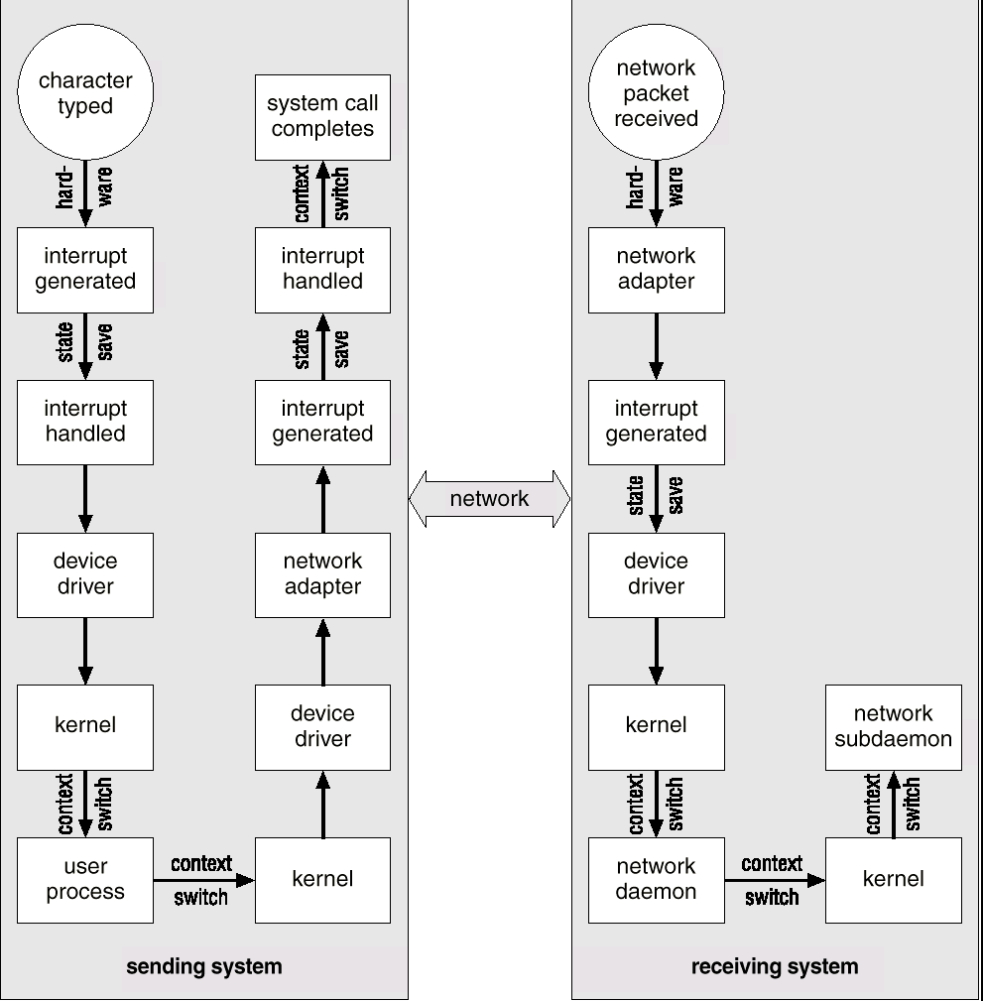
Intercomputer communications
Hanyang University
Data-Centric Systems Lab.

Slide 19
Improving Performance
Reduce number of context switches
Reduce data copying
Reduce interrupts by using large transfers, smart controllers, polling
Use DMA
Balance CPU, memory, bus, and I/O performance for highest throughput
Hanyang University
Data-Centric Systems Lab.

