Slide 1
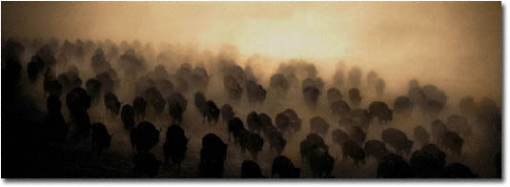
Virtual Memory

Slide 2

Background
Virtual memory – separation of user logical memory from physical memory
  Only part of the program needs to be in memory for execution
  Logical address space can therefore be much larger than physical address space
  Allows address spaces to be shared by several processes
  Allows for more efficient process creation
  Need to allow pages to be swapped in and out
Virtual memory can be implemented via:
  Demand paging
  Demand segmentation
Hanyang University
Data-Centric Systems Lab.

Slide 3
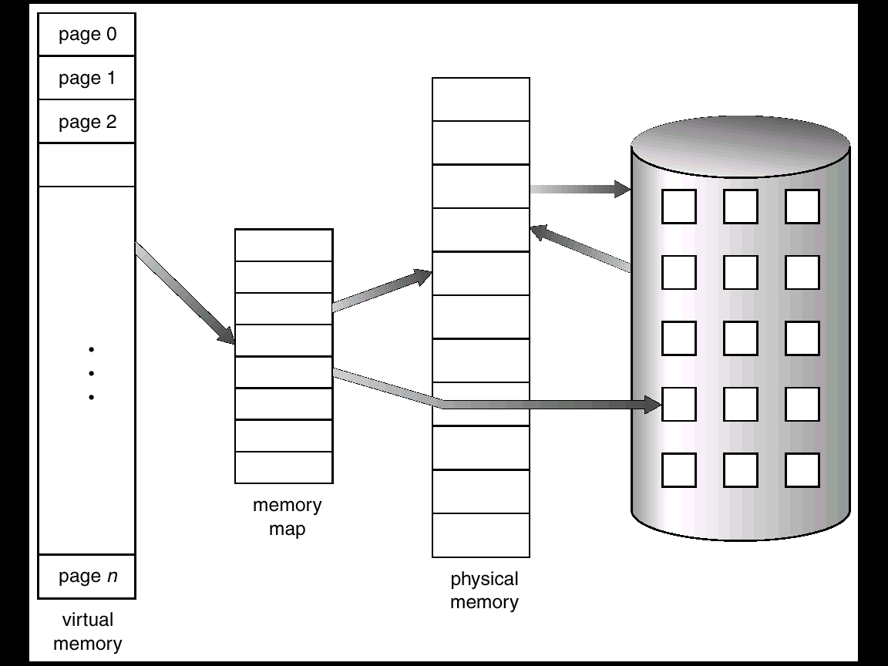
Virtual Memory Larger than Physical Memory
Hanyang University
Data-Centric Systems Lab.

Slide 4

Virtual-address Space
Hanyang University
Data-Centric Systems Lab.

Slide 5
Demand Paging
Bring a page into memory only when it is needed
  Less I/O needed
  Less memory needed
  Faster response – 초기 시작 시간이 짧다. (필요한 page만 옮기기 때문에)
  More users
Page is needed ⇒ reference to it
  invalid reference ⇒ abort
  not-in-memory ⇒ bring to memory
Lazy swapper – never swaps a page into memory unless page will be needed
  Swapper that deals with pages is a pager
Hanyang University
Data-Centric Systems Lab.

Slide 6
Valid-Invalid Bit
With each page table entry a valid-invalid bit is associated
  Valid (v) : in-memory
  “Invalid” means both:
    not-in-memory: this page has never been loaded from disk before
    not legal: it is from disk, but disk copy (original) has been updated
  eg: KAL reservation system:
  one global disk (headquater) – N computers / branch
Initially all entries are set to invalid
During address translation, if valid-invalid bit is `invalid’ ⇒ “page fault”
Hanyang University
Data-Centric Systems Lab.

Slide 7
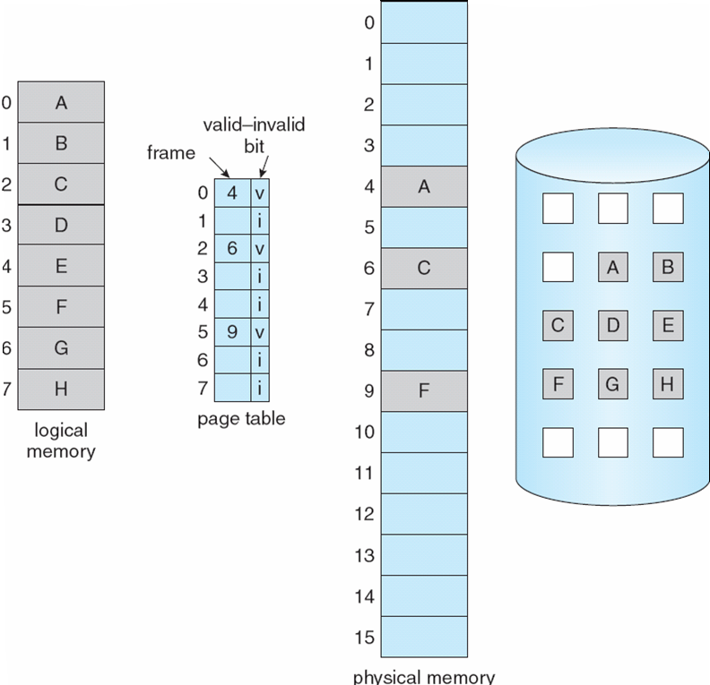
Page Table When Some Pages are Not in Main Memory
Hanyang University
Data-Centric Systems Lab.

Slide 8
Page Fault
Access to invalid page causes HW (MMU) trap – page fault trap
Trap handler is within OS address space : page fault handler is invoked
OS handles the page fault as follows:
  OS looks at another table to decide
    Invalid reference? eg. bad address, protection violation …? ⇒ abort process
    Just not in memory? Then continue.
  Get an empty page frame (If no free frame, replace)
  Read the page into the frame from disk
    The process remains in ‘wait’ state until this disk I/O finishes
    After disk I/O finishes, page table entries are updated (frame #, valid/invalid bit = “valid”)
    Move the process to the Ready queue – dispatch later
  Page fault trap finishes when CPU is assigned to the process, again
  Restart the instruction that caused the page fault
Hanyang University
Data-Centric Systems Lab.

Slide 9

Steps in Handling a Page Fault
Hanyang University
Data-Centric Systems Lab.

Slide 10
Difficulties in actual HW design
When does Page Fault occur?
on instruction fetch: okay
on operand fetch:
  restart needed → (instruction fetch, decode, operand-fetch)
Worst case: when an instruction updates multiple locations
  Ex: Block copy instruction:
      copy count from_address to_address
    <op-code> <bytes> source destination
  If page fault occurs while trying to write to the second block? (Integrity 깨짐 반 최신/반 과거)
    Undo
    Needs additional H/W that stores temporary addresses and values
spans two blocks
Hanyang University
Data-Centric Systems Lab.

Slide 11
Performance of Demand Paging
Page Fault Rate 0 ≤ p ≤ 1.0
  if p = 0 no page faults
  if p = 1, every reference is a fault
Effective Access Time (EAT)
EAT = (1 – p) x memory access
+ p (page fault overhead
+ [swap page out if needed]
+ swap page in
+ restart overhead)
Hanyang University
Data-Centric Systems Lab.

Slide 12
Demand Paging Example
Memory access time = 200 nanoseconds
Average page-fault service time = 8 milliseconds
EAT = (1 – p) x 200 + p x 8 milliseconds
= (1 – p) x 200 + p x 8,000,000
= 200 + p x 7,999,800
If one access out of 1,000 causes a page fault, then
EAT = 8.2 microseconds.
This is a slowdown by a factor of 40!!
Hanyang University
Data-Centric Systems Lab.

Slide 13
Performance of Demand Paging
Pure demand paging
  Never swap-in until referenced – start program with no page in memory
Locality of reference
  Occurs in almost all workloads
  Page references occur to very small set of pages in a certain time interval
  Makes Paging system feasible
처음 프로그램 시작시 page fault 많이 발생 (locality와 상관 없다.)
Hanyang University
Data-Centric Systems Lab.

Slide 14
Process Creation
Virtual memory allows other benefits during process creation:
- Copy-on-Write – fork overhead 줄인다.
- Memory-Mapped Files (later)
Hanyang University
Data-Centric Systems Lab.

Slide 15
Copy-on-Write
Copy-on-Write (COW) allows both parent and child processes to initially share the same pages in memory
If either process modifies a shared page, only then is the page copied
COW allows more efficient process creation as only modified pages are copied
평소에 복사하지 않았다가 (공유 상태 유지) write 할때 copy 해준다.
Virtual memory에는 따로 존재한다고 표시
Hanyang University
Data-Centric Systems Lab.

Slide 16
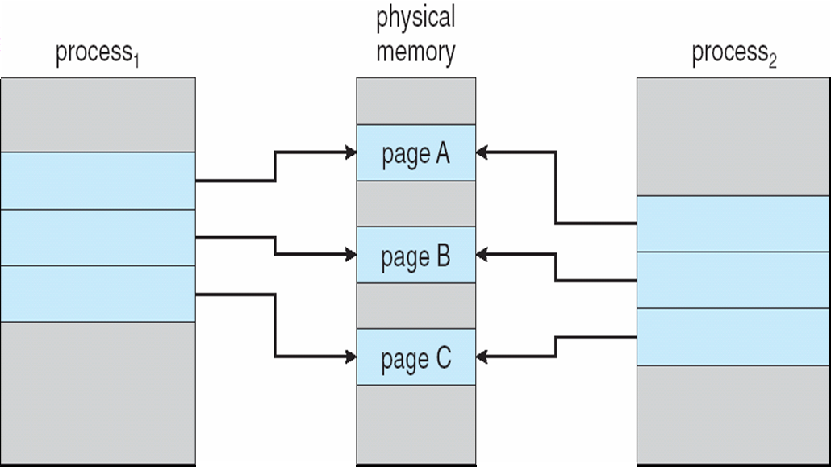
Before Process 1 Modifies Page C
Hanyang University
Data-Centric Systems Lab.

Slide 17

After Process 1 Modifies Page C
Hanyang University
Data-Centric Systems Lab.

Slide 18
What happens if there is no free frame?
Page replacement – determine a victim page in memory
  Will not be used soon?
  Swap it out if necessary (if modified)
  Algorithm for choosing victim page for replacement
  Goal – minimum number of page faults
Same page may be brought into memory several times during run
Hanyang University
Data-Centric Systems Lab.

Slide 19
Page Replacement
Prevent over-allocation of memory by modifying page-fault service routine to include page replacement
Use modify (dirty) bit to reduce overhead of page transfers – only modified pages are written to disk
Page replacement completes separation between logical memory and physical memory – large virtual memory can be provided on a smaller physical memory
Hanyang University
Data-Centric Systems Lab.

Slide 20
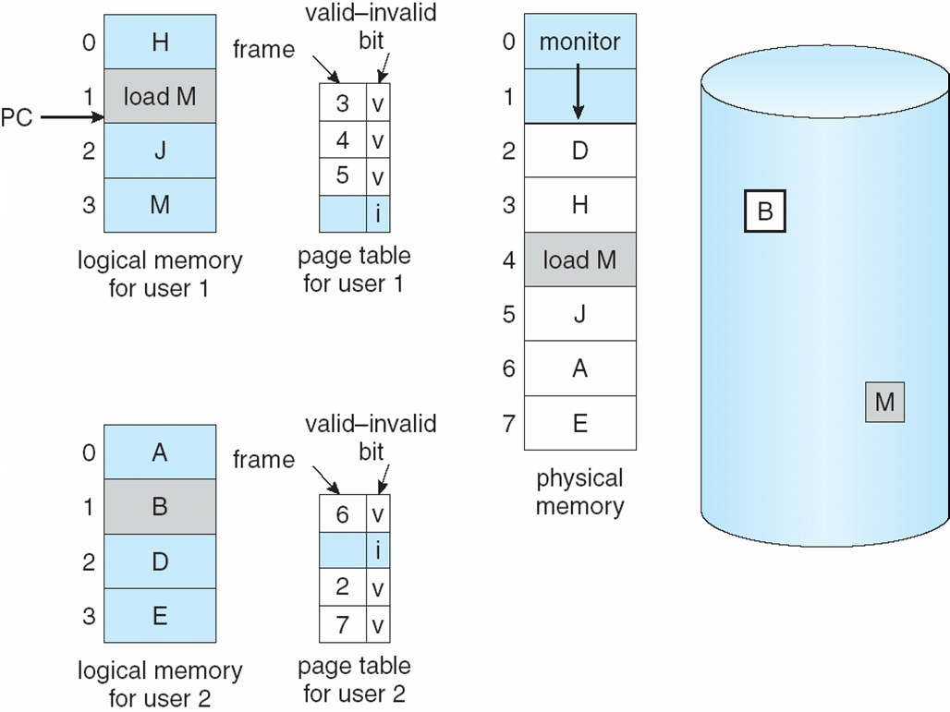
Need for Page Replacement
Hanyang University
Data-Centric Systems Lab.

Slide 21
Basic Page Replacement
Find the location of the desired page on disk
Find a free frame:
- If there is a free frame, use it
- If there is no free frame, use a page replacement algorithm to select a victim frame
Bring the desired page into the (newly) free frame; update the page and free frame tables
Restart the process
Hanyang University
Data-Centric Systems Lab.

Slide 22

Page Replacement
Hanyang University
Data-Centric Systems Lab.

Slide 23
Page-Replacement Algorithms
Want lowest page-fault rate
Evaluate algorithm by running it on a particular string of memory references (reference string) and computing the number of page faults on that string
In all our examples, the reference string is
1, 2, 3, 4, 1, 2, 5, 1, 2, 3, 4, 5
Hanyang University
Data-Centric Systems Lab.

Slide 24

Graph of Page Faults v.s. the Number of Frames
Hanyang University
Data-Centric Systems Lab.

Slide 25
First-In-First-Out (FIFO) Algorithm
Reference string: 1, 2, 3, 4, 1, 2, 5, 1, 2, 3, 4, 5
3 frames (3 pages can be in memory at a time per process)
4 frames
FIFO Replacement – Belady’s Anomaly
  more frames ⇒ more page faults
1
1
4
5
2
2
1
3
9 page faults
3
3
2
4
More page faults?
1
1
5
4
2
2
1
5
10 page faults
3
3
2
4
4
3
Hanyang University
Data-Centric Systems Lab.

Slide 26
Optimal Algorithm
Replace page that will not be used for longest period of time
4 frames example
1, 2, 3, 4, 1, 2, 5, 1, 2, 3, 4, 5
How do you know this?
Used for measuring how well your algorithm performs
1
4
2
6 page faults
3
4
5
Hanyang University
Data-Centric Systems Lab.

Slide 27

Least Recently Used (LRU) Algorithm
Temporal locality와 관련
Reference string: 1, 2, 3, 4, 1, 2, 5, 1, 2, 3, 4, 5
Problem: How to implement LRU ?
  If we implement LRU as it is,
    Timestamp needed for every page: extra memory (page table) traffic
    Need to find the page whose timestamp is the smallest
  Too large space/time overhead to be incorporated into the Kernel
  Approximation model for implementation needed
1
1
1
1
5
2
2
2
2
2
3
5
5
4
4
4
4
3
3
3
Hanyang University
Data-Centric Systems Lab.

Slide 28
LRU Implementation Algorithms
Counter implementation – timestamp은 overhead가 크기 때문에, 단순한 count를 이용
  Every page entry has a counter;
  CPU counter is incremented at every memory reference (logical clock)
  CPU counter = Number of total memory references
  When page A is accessed, copy the CPU counter into the A’s counter
  Overhead = 4byte (counter 저장용) + search time (n)
  At replacement, search page table for minimum counter
    Extra memory access (counter write time) – in each memory access
    Search (time) overhead – in each replacement
    Counter (space) overhead, ….
Stack implementation – keep a stack of page numbers in a double link form:
  Page A referenced:
    move page A to the top
    requires 6 pointers to be changed (including pointer to stack top)
  No search for replacement
  Overhead = 평상시 stack 유지 + stack 데이터 값
Hanyang University
Data-Centric Systems Lab.

Slide 29
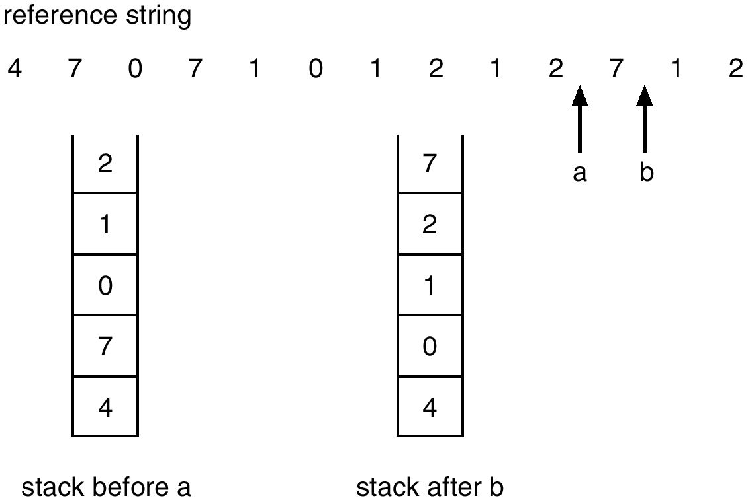
Use of a Stack to Record the Most Recent Page References
Hanyang University
Data-Centric Systems Lab.

Slide 30
LRU Approximation Algorithms
성능은 떨어지지만 overhead 감소
Reference bit
  With each page associate a bit, Initially = 0
  When page is referenced, bit set to 1
  Replace the one whose reference bit is 0 (if one exists)
    We do not know the order, however
Additional-Reference-Bits Algorithm (page history 저장)
  8 bits for additional reference bits
  Reference bit is shifted to the highest order bit of the additional reference bits, periodically
  Shift the other bits right 1 bit, discarding the low-order bit
  MSB가 최근 자료가 되도록 – 제일 작은 값이 LRU
  Overhead = 8bit+ search time
  Ex: 00000000 – never referenced page
  10101010 – accessed in every two periods
.
Hanyang University
Data-Centric Systems Lab.

Slide 31
LRU Approximation Algorithms
Second chance (clock) algorithm
  Need reference bit
  Circular queue of pages
  Advance pointer until it finds reference bit 0 (never referenced)
  If page to be replaced (in clock order) has reference bit = 1 then:
    Set reference bit to 0 and leave the page in memory
    Replace next page (in clock order), subject to same rules
  Characteristics:
    포인터 이동하는 중에 reference bit 1 은 모두 0 으로 바꿈
    한 바퀴 되돌아와서도 (second chance) 0이면 그때에는 replace 당함
    자주 사용되는 페이지라면 second chance 가 올때 1
    최악의 경우 모든 bit 이 1 이면 FIFO 가 됨
  FIFO로 동작할 경우 : 1. 모두가 인기 있을 경우 2. 모두가 인기 없을 경우
Enhanced Second chance algorithm
Reference bit Modify bit
  Not-Referenced not-modified 첫번째로 replace
  Referenced modified 가장 나중 replace
Hanyang University
Data-Centric Systems Lab.

Slide 32

Second-Chance (clock) Page-Replacement Algorithm
Hanyang University
Data-Centric Systems Lab.

Slide 33
Counting Algorithms
Keep a counter of the number of references that have been made to each page
LFU (Least Frequently Used) Algorithm:
  replaces page with smallest count
MFU (Most Frequently Used) Algorithm:
  based on the argument that the page with the smallest count was probably just brought in and has yet to be used
Hanyang University
Data-Centric Systems Lab.

Slide 34
Allocation of Frames
How to allocate page frames to multiple processes?
Each process needs minimum number of pages
  HW 측면: IBM 370 – 6 pages to handle SS MOVE instruction:
    instruction is 6 bytes, might span 2 pages
    2 pages to handle from
    2 pages to handle to
  SW 측면:
    Loop 내의 page 는 한꺼번에 allocate 되는 것이 유리함
    그렇지 않으면 매 loop 마다 page fault – CPU/disk load 심한 불균형
Two major allocation schemes
  fixed allocation
  priority allocation
Hanyang University
Data-Centric Systems Lab.

Slide 35
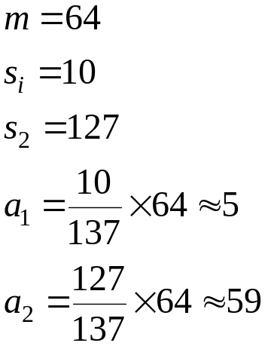
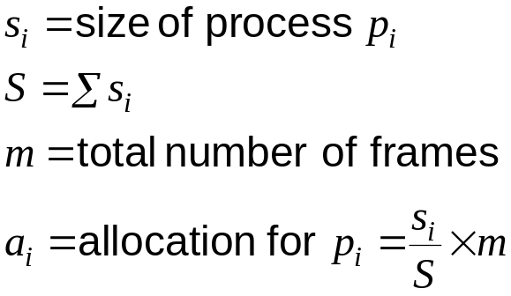
Fixed Allocation
Equal allocation – e.g., (100 frames, 5 processes) 20 pages each.
Proportional allocation – Allocate according to the size of process.
Hanyang University
Data-Centric Systems Lab.

Slide 36
Priority Allocation
Use a proportional allocation scheme using priorities rather than size.
High priority process – give more memory – finish early (decreased I/O ➔ decreased time in ‘waiting’ state ➔ early finish)
If process P_{i} generates a page fault,
  select a victim from one of its frames
  select a victim from lower priority processes’ frames
Global vs. Local Replacement
Global replacement – process selects a replacement frame from the set of all frames; one process can take a frame from another.
Local replacement – each process selects from only its own set of allocated frames.
Hanyang University
Data-Centric Systems Lab.

Slide 37
Thrashing
If a process does not have “enough” pages, the page-fault rate is very high. This leads to:
  low CPU utilization
  operating system thinks that it needs to increase the degree of multiprogramming
  another process added to the system (higher MPD)
  Page fault rate ↑ (Page fault I/O 발생 ↑ ) low cpu utilization
  Degree of multiprogramming 증가
  (long term scheduler는 cpu utilization을 기준으로 삼는다.)
Thrashing ≡ a process is busy swapping pages in and out.
CPU is idle most of the time – low throughput
A
main() main()
{ for (I=1, 100000) { A = B + X }} X
B
Hanyang University
Data-Centric Systems Lab.

Slide 38

Thrashing Diagram
Why does paging work?
Locality model
  Process migrates from one locality to another
  Localities may overlap
Why does thrashing occur?
(Σ size of locality) > (total allocated memory size)
Hanyang University
Data-Centric Systems Lab.

Slide 39
Locality
프로그램의 메모리 참조는 고도의 지역성을 가짐
Locality 때문에 thrashing,page fault 발생 가능성 적다.
자주 접근 되는 page가 올라가야 thrashing 발생하지 않는다.
Locality 성질 1. 참조되는 놈이 계속 참조
2. 시간에 따라 변화(대응 필요)
임의시간 Δ t 내에 프로그램의 일부분만을 집중적으로 참조
  시간 지역성 (Temporal Locality) : 현재 참조된 메모리가 가까운 미래에도 참조될 가능성이 높음
  ex) loop, subroutine, stack
  공간지역성 (Spatial Locality) : 하나의 메모리가 참조되면 주변의 메모리가 계속 참조될 가능성이 높음
  ex) Array Traversal, 명령의 순차실행
Hanyang University
Data-Centric Systems Lab.

Slide 40
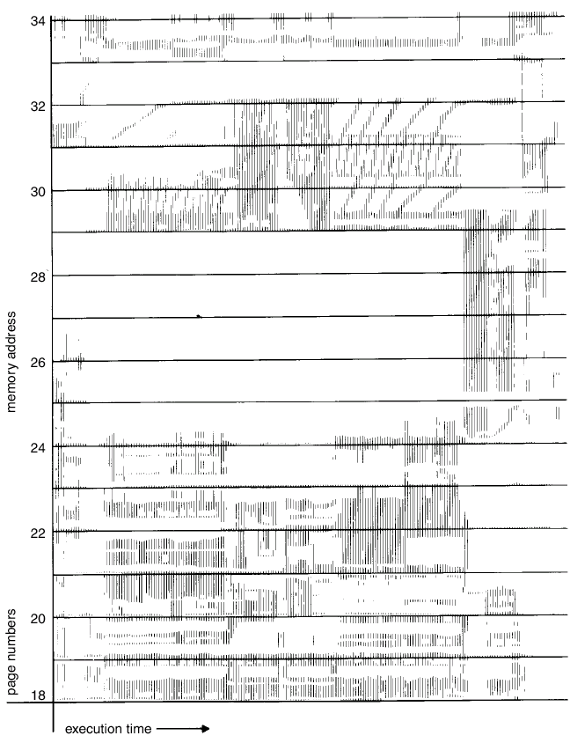
Locality In a Memory-Reference Pattern
Hanyang University
Data-Centric Systems Lab.

Slide 41
Working-Set Model
Δ ≡ working-set window ≡ a fixed number of page references
Example: 10,000 instruction
WS(t_{i} ) = { pages referenced in [ t_{i,} , t_{i} - Δ ] }
  if Δ too small, will not encompass entire locality.
  if Δ too large, will encompass several localities.
  if Δ = ∞ ⇒ will encompass entire program.
    123123123248024802480248033666666336666666336666633666
WSS_{i} = Working set size for process P_{i}
D = Σ WSS_{i} ≡ total demand frames
if D > m ⇒ Thrashing (m is total number of available frames)
Policy if D > m, then suspend one of the processes.
Working set model - If a process is not allocated memory greater than its WSS, choose a process to be suspended ➔ MPD 를 결정 함
즉 (WSS 전체) or (suspended) 중 택일
Hanyang University
Data-Centric Systems Lab.

Slide 42

Working-set model
Hanyang University
Data-Centric Systems Lab.

Slide 43
Working-Set Model
WS(t_{i} ) = { pages referenced in [ t_{i,} , t_{i} - Δ ] }
만일 페이지 P 가 t_{i}에 WS(t_{i} )에 속하였으면 keep in memory
안 속하였으면 out of memory
이 원칙에 따라 replace, allocate 를 결정
따라서 working set model은 allocate/replace 를 같이 결정함
시간에 따라 allocation size 가 달라질 수 있음
WS(t_{i} ) 가 모두 보장되어야만 run, 아니면 suspend.
Hanyang University
Data-Centric Systems Lab.

Slide 44
Keeping Track of the Working Set
구현: 매 ref 마다 각 page 들의 최근 reference time 을 Δ 와 비교?
→ too expensive (space for ref-time field + time for comparison)
Approximate with interval timer + a reference bit
Example: Δ = 10K,
  Timer interrupts: every 5K time units.
  Keep in memory 2 bits for each page.
  timer interrupts → copy and resets all reference bits
  If one of the bits in memory = 1 ⇒ page belongs to the working set.
Why is this not completely accurate?
Improvement = 10 bits and interrupt every 1000 time units.
정확도 & bit 수 overhea의 trade off 존재
정확도가 높을 수록 bit 수 차지 많다. (overhead)
Q: How do you decide window size?
R-bit
0
copy
copy
Hanyang University
Data-Centric Systems Lab.

Slide 45

Page-Fault Frequency Scheme
Establish “acceptable” page-fault rate
  If actual rate too low, process loses frame
  모든 프로세스 rate low – 메모리 넘침
  If actual rate too high, process gains frame
  모든 프로세스 rate high – 메모리 부족 -> 프로세스 종료 현상
Working set 기법은 참조시마다 페이지 집합을 수정
PFF 기법은 폴트시에만 페이지 집합을 수정 – 너무 늦은 상황 (사후 치료)
Hanyang University
Data-Centric Systems Lab.

Slide 46
Memory-Mapped Files
Memory-mapped file I/O allows file I/O to be treated as routine memory access by mapping a disk block to a page in memory
A file is initially read using demand paging. A page-sized portion of the file is read from the file system into a physical page. Subsequent reads/writes to/from the file are treated as ordinary memory accesses.
메모리에 올라와 있지 않으면 page fault 발생 후 메모리에 올림
File system – overhea가 엄청 크다. (hard disk 다루기 때문에)
Hard disk 다루는 것들은 느리기 떄문에 overhead가 크다.
Simplifies file access by treating file I/O through memory rather than read() write() system calls
Also allows several processes to map the same file allowing the pages in memory to be shared
File system – hard disk – hard disk의 속도가 빨라져서 file syste이 bottle neck으로 작용 (애초에 hard disk가 느리다는 가정하에 만들어진 것 이기 때문에)
Hanyang University
Data-Centric Systems Lab.

Slide 47
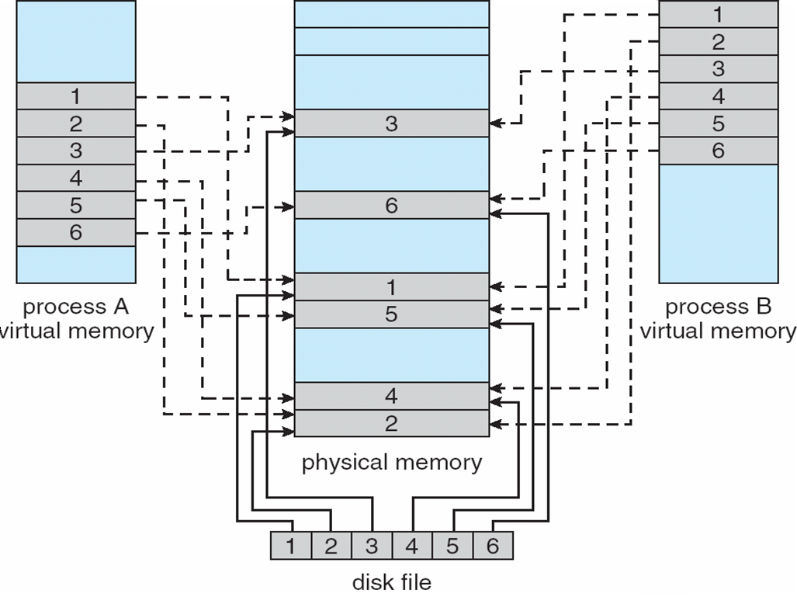
Memory Mapped Files
Hanyang University
Data-Centric Systems Lab.

Slide 48
Allocating Kernel Memory
Treated differently from user memory
Often allocated from a free-memory pool
  Kernel requests memory for structures of varying sizes
  Some kernel memory needs to be contiguous
Hanyang University
Data-Centric Systems Lab.

Slide 49
Buddy System
Allocates memory from fixed-size segment consisting of physically-contiguous pages
Memory allocated using power-of-2 allocator
  Satisfies requests in units sized as power of 2
  Request rounded up to next highest power of 2
  When smaller allocation needed than is available, current chunk split into two buddies of next-lower power of 2
    Continue until appropriate sized chunk available
Hanyang University
Data-Centric Systems Lab.

Slide 50
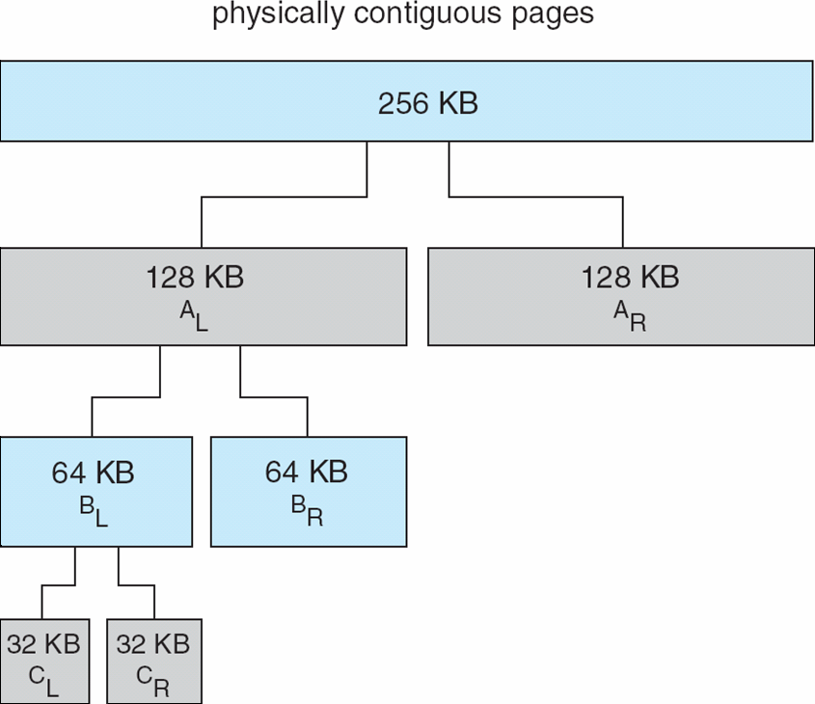
Buddy System Allocator
Hanyang University
Data-Centric Systems Lab.

Slide 51
Other Issues – Prepaging
Prepaging
  To reduce the large number of page faults that occurs at process startup
  Prepage all or some of the pages a process will need, before they are referenced
  But if prepaged pages are unused, I/O and memory was wasted
  Assume s pages are prepaged and α of the pages is used
    Is cost of s * α save pages faults > or < than the cost of prepaging
    s * (1- α) unnecessary pages?
    α near zero ⇒ prepaging loses
Hanyang University
Data-Centric Systems Lab.

Slide 52
Other Issues – Page size
Considerations for page size selection
  Internal fragmentation page size 작을수록
  Page table size page size 클수록
  Disk transfer efficiency – seek/rotation vs. transfer page size 클수록
  I/O 횟수 ( hard disk 느리기 때문에 고려 1순위) page size 클수록
  Improved Locality page size 클수록
    Smaller page size isolate only needed info within page
  Trend
    Larger page size
    CPU speed, memory capacity – improves faster than disk speed.
    Page fault (relative) penalty is becoming more costly these days.
Hanyang University
Data-Centric Systems Lab.

Slide 53
Other Issues – TLB Reach
TLB Reach
  The amount of memory accessible from the TLB
  TLB Reach = (TLB Size) X (Page Size)
  TLB Size - 비용 때문에 늘리기에 부담
  Page Size – 정할 수 없다. (TLB 입장에서) <- TLB 입장에서는 page size가 클수록 좋다.
  Ideally, the working set of each process is stored in the TLB
    Otherwise there is a high degree of TLB misses
  Increase the Page Size
    This may lead to an increase in fragmentation as not all applications require a large page size
    Locality 떨어지는 것들도 포함된다.
  Provide Multiple Page Sizes
    This allows applications that require larger page sizes the opportunity to use them without an increase in fragmentation
Hanyang University
Data-Centric Systems Lab.

Slide 54
Other Issues – Program Structure
Program structure
  int data[128][128];
  Each row is stored in one page
  Program 1
for (j = 0; j <128; j++)
for (i = 0; i < 128; i++)
data[i][j] = 0;
  128 x 128 = 16,384 page faults
  Program 2
  for (i = 0; i < 128; i++)
  for (j = 0; j < 128; j++)
  data[i][j] = 0;
  128 page faults
Hanyang University
Data-Centric Systems Lab.

Slide 55

Other Issues – I/O interlock
I/O Interlock – Pages must sometimes be locked into memory
Consider I/O - Pages that are used for copying a file from a device must be locked from being selected for eviction by a page replacement algorithm
Hanyang University
Data-Centric Systems Lab.

