Slide 1

Introduction
Companion slides for
The Art of Multiprocessor Programming
by Maurice Herlihy & Nir Shavit
TexPoint fonts used in EMF.
Read the TexPoint manual before you delete this box.: AAAA
Notes:
1

Slide 2
Hardware Development Trend
Processor cores
Network bandwidth
Storage medium (HDD & SSD)

Slide 3
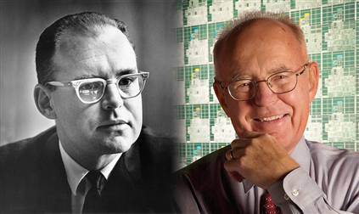
Moore’s Law (processor cores)
“The number of transistors incorporated in a chip will approximately double every 24 months.”
--Gordon Moore, Intel co-founder

Slide 4
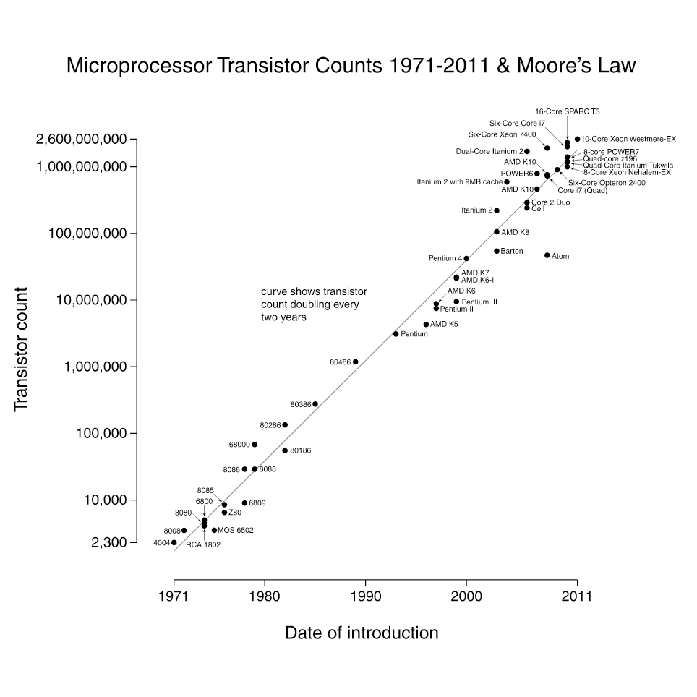
Moore’s Law (processor cores)
2014: IBM’s System z processor
5.7GHz and with 2.75B transistors.
Hz -> 간접적 온도에 연관,
트랜지스터 물리적인 거리에 의해 결정됨
2014

Slide 5

Nielsens’ Law (network bandwidth)
“Users' bandwidth grows by 50% per year (10% less than Moore's Law for computer speed).”
--Jakob Nielsen, Nielsen Norman Group

Slide 6
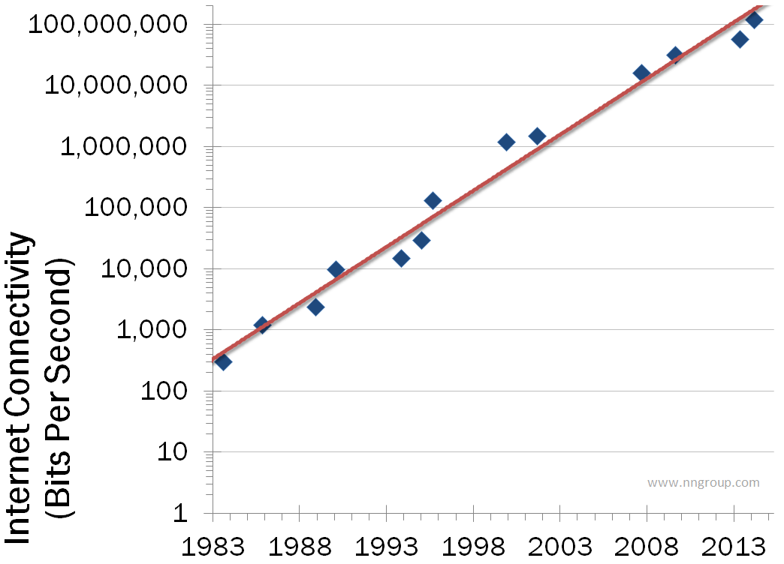
Nielsens’ Law (network bandwidth)

Slide 7
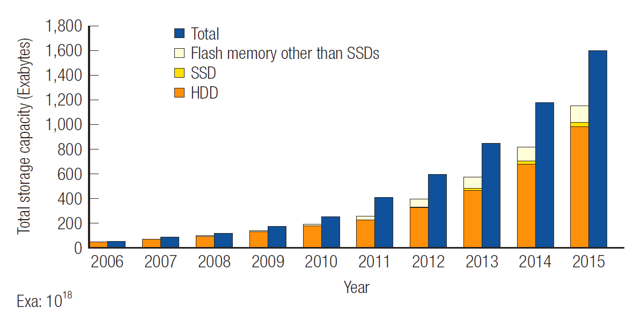
Storage medium (HDD & SSD)
하드디스크 – 내부 진공 (관리 X), 기체가 있어야 안정적으로 헤드 고정된다.
Head와 platter의 거리가 작으면 작을수록 platter 밀도가 높아진다.(즉, 큰 용량을 가진다.)
현재 15nm 정도이며 10nm정도가 되면 간섭이 심해진다. (트랜지스터 집적도랑 비슷)

Slide 8
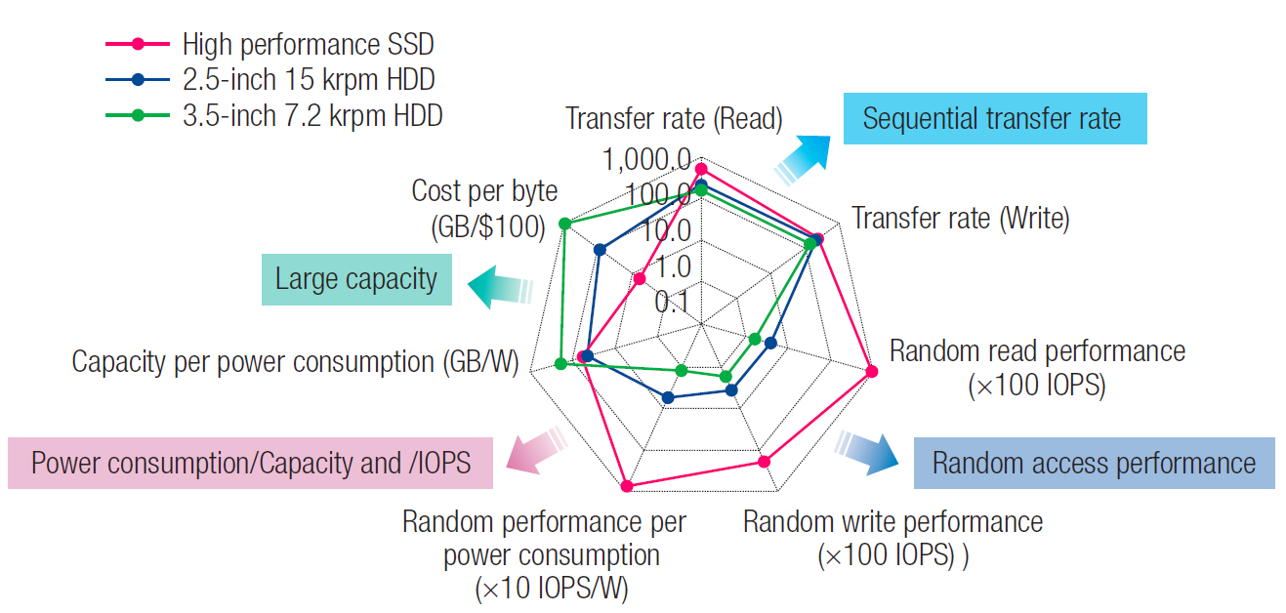
Storage medium (HDD & SSD)
Many legacy system software designs are based on the characteristics of HDD.

Slide 9
Trend Summary
 |  | Annualized Growth Rate | Compound Growth Over 10 Years
Nielsen's Law | Internet bandwidth | 50% | 57×
Moore's Law | Computer power | 60% | 100×

Slide 10
Problems in System Software

Slide 11
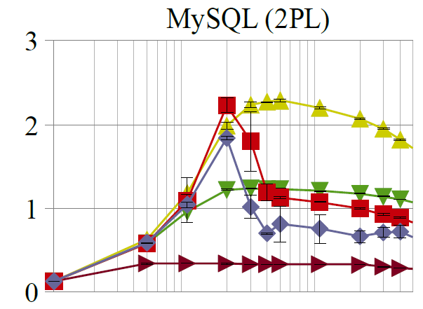






How bad is the performance collapse?
Throughput goes as we expected !!
1 Socket

Slide 12



How bad is the performance collapse?
Performance collapses !!!
2 and 4 Sockets

Slide 13

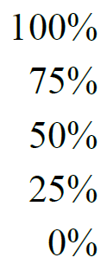






What causes this collapse ?
Latch contention is the cause !!!
Let’s profile databases to peek a little bit deeper inside the system.
Profiling:
read-only queries under “SERIALIZABLE” isolation on 32 cores on 4 sockets

Slide 14

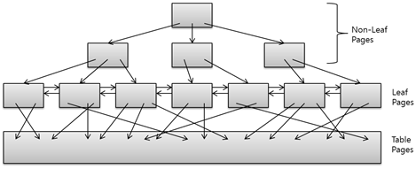
Mutex (latch)
Threads
Duration is usually very short
Access
Spin-waiting on contention
This works fine as long as
the duration is really short.
Concurrency control by latches
Data base lock
Db의 logical record를 보호하는 장치
Duration 길다
Latch
운영체제의 mutex
Shared memory 보호
Duration 짧다.
Sched_yield()
- Run queue 마지막에 넣는다.(양보)
e.g., B+tree
In-memory Data Structures

Slide 15
Mutex (Latch)
More threads
In high contention :
Access
(1) latch duration gets longer
(2) spin-waiting incurs the cache invalidation storm on multicores!!!
Concurrency control by latches
(3) This causes performance collapse !!!!
B+tree
In-memory Data Structures

Slide 16
Goal
Design software (especially core data structures and algorithms) to make it multicore scalability !!!
Mode switch – 커널 <-> 유저 , tlb flush X , 100단위 cycle
Contex switch – 프로세스 문맥 바꾸기, tlb flush O , 3000단위 cycle
Spining 하다가 yield()하는 프로그램의 경우 spinning duratio을 보통 3000으로 잡는다.
Convoy problem
- A lock convoy occurs when multiple threads of equal priority contend repeatedly for the same lock
# thread > # core 일 경우 convoy problem 발생할 확률 증가
L1 L2 – per codr
L3 – per chip
Invalidiant – 알고리즘에서 만족해야하는 성질들 ex) linked list에서 link 유지
16
Notes:
16
Here is our course overview. (at the end, we aim to give you a basic understanding of the issues, not to make you experts)
In this course, we will study a variety of synchronization algorithms,
with an emphasis on informal reasoning about correctness.
Reasoning about multiprocessor programs is different in many ways from the more
familiar style of reasoning about sequential programs.
Sequential correctness is mostly concerned with safety properties,
that is, ensuing that a program transforms each before-state to the correct
after-state.
Naturally, concurrent correctness is also concerned with safety,
but the problem is much, much harder,
because safety must be ensured despite the vast number of ways steps of
concurrent threads can be be interleaved.
Equally important, concurrent correctness encompasses a variety of
\emph{liveness} properties that have no counterparts in the sequential world.
The second part of the book concerns performance.
Analyzing the performance of synchronization algorithms is also different
in flavor from analyzing the performance of sequential programs.
Sequential programming is based on a collection of well-established and
well-understood abstractions.
When you write a sequential program,
you usually do not need to be aware that underneath it all,
pages are being swapped from disk to memory,
and smaller units of memory are being moved in and out of a hierarchy of
processor caches.
This complex memory hierarchy is essentially invisible,
hiding behind a simple programming abstraction.
In the multiprocessor context, this abstraction breaks down,
at least from a performance perspective.
To achieve adequate performance,
the programmer must sometimes ``outwit'' the underlying memory system,
writing programs that would seem bizarre to someone unfamiliar with
multiprocessor architectures.
Someday, perhaps, concurrent architectures will provide the same degree of
efficient abstraction now provided by sequential architectures,
but in the meantime, programmers should beware.
We start then with fundamentals, trying to understand what is and is not computable before we try and write programs. This is similar to the process you have probably gone through with sequential computation of learning computability and complexity theory so that you will not try and solve unsolvable problems. There are many such computational pitfals when programming multiprocessors.

Slide 17
Multicore Programming: Course Overview
Fundamentals
Models, algorithms, impossibility
Real-World programming
Architectures
Techniques
17
Notes:
17
Here is our course overview. (at the end, we aim to give you a basic understanding of the issues, not to make you experts)
In this course, we will study a variety of synchronization algorithms,
with an emphasis on informal reasoning about correctness.
Reasoning about multiprocessor programs is different in many ways from the more
familiar style of reasoning about sequential programs.
Sequential correctness is mostly concerned with safety properties,
that is, ensuing that a program transforms each before-state to the correct
after-state.
Naturally, concurrent correctness is also concerned with safety,
but the problem is much, much harder,
because safety must be ensured despite the vast number of ways steps of
concurrent threads can be be interleaved.
Equally important, concurrent correctness encompasses a variety of
\emph{liveness} properties that have no counterparts in the sequential world.
The second part of the book concerns performance.
Analyzing the performance of synchronization algorithms is also different
in flavor from analyzing the performance of sequential programs.
Sequential programming is based on a collection of well-established and
well-understood abstractions.
When you write a sequential program,
you usually do not need to be aware that underneath it all,
pages are being swapped from disk to memory,
and smaller units of memory are being moved in and out of a hierarchy of
processor caches.
This complex memory hierarchy is essentially invisible,
hiding behind a simple programming abstraction.
In the multiprocessor context, this abstraction breaks down,
at least from a performance perspective.
To achieve adequate performance,
the programmer must sometimes ``outwit'' the underlying memory system,
writing programs that would seem bizarre to someone unfamiliar with
multiprocessor architectures.
Someday, perhaps, concurrent architectures will provide the same degree of
efficient abstraction now provided by sequential architectures,
but in the meantime, programmers should beware.
We start then with fundamentals, trying to understand what is and is not computable before we try and write programs. This is similar to the process you have probably gone through with sequential computation of learning computability and complexity theory so that you will not try and solve unsolvable problems. There are many such computational pitfals when programming multiprocessors.

Slide 18
Sequential Computation
thread
memory
object
object
18
Notes:
18

Slide 19
Concurrent Computation
threads
memory
object
object
19
Notes:
19

Slide 20
Asynchrony
Sudden unpredictable delays
Cache misses (short)
Page faults (long)
Scheduling quantum used up (really long)
20
Notes:
20

Slide 21
Model Summary
21
Multiple threads
Sometimes called processes
Single shared memory
Objects live in memory
Unpredictable asynchronous delays
Notes:
21

Slide 22
Road Map
22
We are going to focus on principles first, then practice
Start with idealized models
Look at simplistic problems
Emphasize correctness over pragmatism
“Correctness may be theoretical, but incorrectness has practical impact”
Notes:
22
We want to understand what we can and cannot compute before we try and write code. In fact, as we will see there are problems that are Turing computable but not asynchronously computable.

Slide 23
Concurrency Jargon
23
Hardware
Processors
Software
Threads, processes
Sometimes OK to confuse them, sometimes not.
Notes:
23
We will use the terms above, even though there are also terms like strands, CPUs, chips etc also…

Slide 24
Parallel Primality Testing
24
Challenge
Print primes from 1 to 10¹⁰
Given
Ten-processor multiprocessor
One thread per processor
Goal
Get ten-fold speedup (or close)
Notes:
24
We want to look at the problem of printing the primes from 1 to 10^10 in some arbitrary order.

Slide 25
Load Balancing
1
10⁹
2·10⁹
…
10¹⁰
P₀
P₁
…
P₉
Split the work evenly
Each thread tests range of 10⁹
25
Notes:
25
Split the range ahead of time

Slide 26
Procedure for Thread i
void primePrint {
int i = ThreadID.get(); // IDs in {0..9}
for (j = i*10⁹+1, j<(i+1)*10⁹; j++) {
if (isPrime(j))
print(j);
}
}
26
Notes:
26
Code matches code in Chapter 1 of book.

Slide 27
Issues
27
Higher ranges have fewer primes
Yet larger numbers harder to test
Thread workloads
Uneven
Hard to predict
Notes:
27
You can mention that the use of prime() is a bit artificial since it makes sense to use earlier numbers detected as prime in testing whether a later number is prime.
Jean-Paul Rigault of the University of Nice Sophia Antipolis in France tells us that there are
Overall 454 millions Primes between 1 and 10¹⁰, 51 million of them between 0x10⁹ and 1x10⁹ and 43 million of them between 9x10⁹ and 10x10⁹. The primes seem rather uniformly distributed in the given range, although there are indeed fewer between 9x10⁹ and 10¹⁰ than between 1 and 10⁹ (about 20% less).
He obtained these numbers using a Python program implementing Legendre's approximation for pi(n), the number of primes less than n: pi(n) = n/(log n - 1).

Slide 28
Issues
rejected
28
Higher ranges have fewer primes
Yet larger numbers harder to test
Thread workloads
Uneven
Hard to predict
Need dynamic load balancing
Notes:
28
You can mention that the use of prime() is a bit artificial since it makes sense to use earlier numbers detected as prime in testing whether a later number is prime.
Jean-Paul Rigault of the University of Nice Sophia Antipolis in France tells us that there are
Overall 454 millions Primes between 1 and 10¹⁰, 51 million of them between 0x10⁹ and 1x10⁹ and 43 million of them between 9x10⁹ and 10x10⁹. The primes seem rather uniformly distributed in the given range, although there are indeed fewer between 9x10⁹ and 10¹⁰ than between 1 and 10⁹ (about 20% less).
He obtained these numbers using a Python program implementing Legendre's approximation for pi(n), the number of primes less than n: pi(n) = n/(log n - 1).

Slide 29
Shared Counter
19
each thread takes a number
18
17
29
Notes:
29

Slide 30
Procedure for Thread i
int counter = new Counter(1);
void primePrint {
long j = 0;
while (j < 10¹⁰) {
j = counter.getAndIncrement();
if (isPrime(j))
print(j);
}
}
30
Notes:
30

Slide 31
Procedure for Thread i
Counter counter = new Counter(1);
void primePrint {
long j = 0;
while (j < 10¹⁰) {
j = counter.getAndIncrement();
if (isPrime(j))
print(j);
}
}
Shared counter
object
31
Notes:
31

Slide 32
Where Things Reside
void primePrint {
int i = ThreadID.get(); // IDs in {0..9}
for (j = i*10⁹+1, j<(i+1)*10⁹; j++) {
if (isPrime(j))
print(j);
}
}
Local
variables
code
cache
cache
cache
Bus
Bus
shared
memory
1
shared counter
32
Notes:
32
Need this slide since some students do not understand where the counter resides, where the shared variables reside, and where the code resides etc. This is our opportunity to explain.

Slide 33
Procedure for Thread i
Counter counter = new Counter(1);
void primePrint {
long j = 0;
while (j < 10¹⁰) {
j = counter.getAndIncrement();
if (isPrime(j))
print(j);
}
}
Stop when every value taken
33
Notes:
33

Slide 34
Procedure for Thread i
Counter counter = new Counter(1);
void primePrint {
long j = 0;
while (j < 10¹⁰) {
j = counter.getAndIncrement();
if (isPrime(j))
print(j);
}
}
Increment & return each new value
34
Notes:
34

Slide 35
Counter Implementation
public class Counter {
private long value;
public long getAndIncrement() {
return value++;
}
}
35
Notes:
35

Slide 36
Counter Implementation
public class Counter {
private long value;
public long getAndIncrement() {
return value++;
}
}
OK for single thread,
not for concurrent threads
36
Notes:
36

Slide 37
What It Means
public class Counter {
private long value;
public long getAndIncrement() {
return value++;
}
}
37
Notes:
37

Slide 38
What It Means
public class Counter {
private long value;
public long getAndIncrement() {
return value++;
}
}
temp = value;
value = temp + 1;
return temp;
38
Notes:
38

Slide 39
Not so good…
Value… 1
2
3
2
read
1
write
2
read
2
write
3
read
1
write
2
time
39
Notes:
39
Time goes from left to right. The Blue thread might read 1 from \fValue{}, but before
it sets \fValue{} to 2, the Red thread would go through the
increment loop several times, reading 1 and setting to 2, reading
2 and setting to 3. When the Blue thread finally completes its
operation and sets \fValue{} to 2, it will actually be setting
the counter back from 3 to 2.

Slide 40
Is this problem inherent?
!!
!!
write
read
read
write
If we could only glue reads and writes together…
40
Notes:
40
Is this phenomena inherent or is there a better implementation we are missing?
To understand why such bad interleavings can always happen, consider
the following situation that all of us run into every once in a while.
You are walking down the street, and
suddenly someone is coming straight at you. You move to the right, and they
move to the right, so you move to the left, and they happen to do the
same, now you try and make a final break to either left or right, many
times you manage not to bump, but sometimes you do. Are these
collisions avoidable? Can we think of a protocol to follow in order to
prevent people from ever colliding?
The answer is NO! \footnote{One might think that you
can agree to always move to the right, to which you can answer ``but
what if the other person is British?'' Alternately,
think of Atlantis and Mir flying one towards the other in space, where
the is no predefined ``right side.''} It can be mathematically shown
that there is always a sequence of moves that will result in people
bumping (this is the famous result of Fischer, Lynch, and Paterson we will
Study later in the course).
The problem arises from the fact that ``looking'' at the other person
and ``moving'' aside to avoid him are two separate operations. If one
could ``look-and-jump'' instantaneously the problem could be avoided.
In the same way that people compete for the right to pass, computers
compete to gain access to shared locations in memory. In the case of
our {\tt shared-counter}, processors are in a competition where the
winner gets the lower counter value and the looser gets the higher
one. The moral of the ``people in the street'' example is that we need
to ``glue together'' the {\tt get} and {\tt increment} operations to
get an ``instantaneous'' {\tt get-and-increment}. This operation
would execute the {\tt get} and the {\tt increment} instructions
like one indivisible operation with no other operation taking place
between the start of the {\tt get} and the end of the {\tt
increment}. If we have such an operation then the following is a
correct and efficient solution to the prime printing problem.

Slide 41
Challenge
public class Counter {
private long value;
public long getAndIncrement() {
temp = value;
value = temp + 1;
return temp;
}
}
41
Notes:
41

Slide 42
Challenge
public class Counter {
private long value;
public long getAndIncrement() {
temp = value;
value = temp + 1;
return temp;
}
}
Make these steps atomic (indivisible)
42
Notes:
42

Slide 43
Hardware Solution
public class Counter {
private long value;
public long getAndIncrement() {
temp = value;
value = temp + 1;
return temp;
}
}
ReadModifyWrite()
instruction
43
Notes:
43
We will see later that modern multiprcessors provide special types of readModiftWrite() instructions to allow us to overcome the
problem at hand. But how do we solve this problem in software?

Slide 44
An Aside: Java™
public class Counter {
private long value;
public long getAndIncrement() {
synchronized {
temp = value;
value = temp + 1;
}
return temp;
}
}
44
Notes:
44

Slide 45
An Aside: Java™
public class Counter {
private long value;
public long getAndIncrement() {
synchronized {
temp = value;
value = temp + 1;
}
return temp;
}
}
Synchronized block
45
Notes:
45

Slide 46
An Aside: Java™
public class Counter {
private long value;
public long getAndIncrement() {
synchronized {
temp = value;
value = temp + 1;
}
return temp;
}
}
Mutual Exclusion
46
Notes:
46
Java provides us with a solution: mutual exclusion in software…lets try and understand how this is done

Slide 47
Mutual Exclusion or “Alice & Bob share a pond”
A
B
47
Notes:
47
We now present a sequence of fables, illustrating some of the basic problems.
Like most authors of fables, we retell stories mostly invented by others. The following story was told by a famous
Multiprocessing pioneer, Leslie Lamport.
See story outline in the Introduction Chapter of the Book.

Slide 48
Alice has a pet
A
B
48
Notes:
48

Slide 49
Bob has a pet
A
B
49
Notes:
49

Slide 50
The Problem
A
B
The pets don’t
get along
50
Notes:
50

Slide 51
Formalizing the Problem
51
Two types of formal properties in asynchronous computation:
Safety Properties
Nothing bad happens ever
Liveness Properties
Something good happens eventually
Notes:
51

Slide 52
Formalizing our Problem
52
Mutual Exclusion
Both pets never in pond simultaneously
This is a safety property
No Deadlock
if only one wants in, it gets in
if both want in, one gets in.
This is a liveness property
Notes:
52
Notice that we use the term deadlock and not livelock though some people would use both to describe the
Requirement. They are not the same thing. Deadlock is used to denote that Alice and Bob are stuck and no amount of retry (backoff) will help, while livelock means backoff can help. In any case both are different from “no starvation” which is the stronger requirement that means that every request always succeeds.

Slide 53
Simple Protocol
53
Idea
Just look at the pond
Gotcha
Not atomic
Trees obscure the view
Notes:
53
In the following versions of the protocol, we try and show the students which solutions will not work.
Can ask students for help in the solution by showing the first part of the slide (the Idea part) and then show the
Gotcha part once they have suggested solutions. This is true for all the next set of suggested solutions.

Slide 54
Interpretation
54
Threads can’t “see” what other threads are doing
Explicit communication required for coordination
Notes:
54

Slide 55
Cell Phone Protocol
55
Idea
Bob calls Alice (or vice-versa)
Gotcha
Bob takes shower
Alice recharges battery
Bob out shopping for pet food …
Notes:
55

Slide 56
Interpretation
56
Message-passing doesn’t work
Recipient might not be
Listening
There at all
Communication must be
Persistent (like writing)
Not transient (like speaking)
Notes:
56

Slide 57
Flag Protocol
A
B
57
Notes:
57
Here is a solution that does not suffer from the problems of the former ones…

Slide 58
Alice’s Protocol (sort of)
A
B
58
Notes:
58

Slide 59
Bob’s Protocol (sort of)
A
B
59
Notes:
59

Slide 60
Alice’s Protocol
60
Raise flag
Wait until Bob’s flag is down
Unleash pet
Lower flag when pet returns
Notes:
60

Slide 61
Bob’s Protocol
danger!
61
Raise flag
Wait until Alice’s flag is down
Unleash pet
Lower flag when pet returns
Notes:
61
Does not meet our requirement of no deadlock. Need to improve the protocol. Can ask students for help.

Slide 62
Bob’s Protocol (2nd try)
62
Raise flag
While Alice’s flag is up
Lower flag
Wait for Alice’s flag to go down
Raise flag
Unleash pet
Lower flag when pet returns
Notes:
62

Slide 63
Bob’s Protocol
Bob defers to Alice
63
Raise flag
While Alice’s flag is up
Lower flag
Wait for Alice’s flag to go down
Raise flag
Unleash pet
Lower flag when pet returns
Notes:
63

Slide 64
The Flag Principle
64
Raise the flag
Look at other’s flag
Flag Principle:
If each raises and looks, then
Last to look must see both flags up
Notes:
64
This intuitively explains implies why at least one of them will not
enter the critical section if both are trying at the same time. Many coordination protocols use falg raising and
The flag principle to guarantee that threads notice each other.
The following proof of mutual exclusion will not be
presented in class, but we provide it just to give you some intuition
about how one reasons about concurrent programs. Lets prove that if
they follow the algorithm the dogs will never be together in the yard.
Assume by way contradiction that this is not the case. We are assuming
that both dogs are in the yard. Therefore both Alice and Bob had a
last ``looking'' action before they let their dog enter the yard. Lets
take a look at the one who finished this looking action first. When he
(she) looked, he (she) saw that the other one's flag was down. Without
loss of generality let's assume it was Bob, so he had {\tt (=
Alice-flag 'down)} as true, otherwise he couldn't have entered the
critical section. So it follows that Alice's flag was up {\em after}
Bob finished his looking action. Therefore, Alice's looking was {\em
completely after} the end of Bob's raising of his flag, so Alice must
have seen this flag up and could not have entered the critical
section, a contradiction.

Slide 65
Proof of Mutual Exclusion
65
Assume both pets in pond
Derive a contradiction
By reasoning backwards
Consider the last time Alice and Bob each looked before letting the pets in
Without loss of generality assume Alice was the last to look…
Notes:
65
If both look at the same time, then its OK to assume that Alice looked last. They both have different protocols but the part of the protocols that raises the flag for the last time and looks if the other’s flag is raised is the same.

Slide 66
Proof
Bob last raised flag
Alice last raised her flag
Alice’s last look
Bob’s last look
QED
time
Alice must have seen Bob’s Flag. A Contradiction
66
Notes:
66
Explanation: assume without loss of generality that Alice was the last to look in the last look each performed before they both let their animals in the pond concurrently. Then Bob’s last look must have been
before Alice’s last flag raising since Bob let his pet into the pond. But since Bob raised his flag before he looked, it follows that Alice must have seen Bob’s flag raised, a contradiction.

Slide 67
Proof of No Deadlock
67
If only one pet wants in, it gets in.
Notes:
67

Slide 68
Proof of No Deadlock
68
If only one pet wants in, it gets in.
Deadlock requires both continually trying to get in.
Notes:
68

Slide 69
Proof of No Deadlock
QED
69
If only one pet wants in, it gets in.
Deadlock requires both continually trying to get in.
If Bob sees Alice’s flag, he gives her priority (a gentleman…)
Notes:
69

Slide 70
Remarks
70
Protocol is unfair
Bob’s pet might never get in
Protocol uses waiting
If Bob is eaten by his pet, Alice’s pet might never get in
Notes:
70
The protocol is unfair. Another property of compelling interest above no-deadlock is no-starvation:
if a pet wants to enter the yard, will it eventually succeed?
Here, Alice and Bob's protocol performs poorly. Whenever Alice and
Bob conflict, Bob defers to Alice, so it is possible that Alice's
pet can use the pond over and over again, while Bob's pet becomes
increasing uncomfortable. Later on, we will see how to make
protocols prevent starvation.
Waiting is problematic in terms of performance as we will explain in more detail later in the lecture

Slide 71
Moral of Story
Mutual Exclusion cannot be solved by
transient communication (cell phones)
interrupts (cans)
It can be solved by
one-bit shared variables
that can be read or written
71
Notes:
71
During the course we will devote quite a bit of effort to understanding the tradeoffs that have to do with the use of mutual exclusion.

Slide 72
The Fable Continues
72
Alice and Bob fall in love & marry
Notes:
72

Slide 73
The Fable Continues
73
Alice and Bob fall in love & marry
Then they fall out of love & divorce
She gets the pets
He has to feed them
Notes:
73
Joke: say that with a probability of 50% they divorce.

Slide 74
The Fable Continues
74
Alice and Bob fall in love & marry
Then they fall out of love & divorce
She gets the pets
He has to feed them
Leading to a new coordination problem: Producer-Consumer
Notes:
74
Joke: say that with a probability of 50% they divorce.

Slide 75
Bob Puts Food in the Pond
A
75
Notes:
75

Slide 76
Alice releases her pets to Feed
mmm…
B
mmm…
76
Notes:
76

Slide 77
Producer/Consumer
77
Alice and Bob can’t meet
Each has restraining order on other
So he puts food in the pond
And later, she releases the pets
Avoid
Releasing pets when there’s no food
Putting out food if uneaten food remains
Notes:
77
Many coordination problems are producer consumer problems, in fact, whenever an algorith involves the word “buffer” chances are high that we are talking about a producer consumer algorithm.

Slide 78
Producer/Consumer
78
Need a mechanism so that
Bob lets Alice know when food has been put out
Alice lets Bob know when to put out more food
Notes:
78

Slide 79
Surprise Solution
A
B
cola
79
Notes:
79

Slide 80
Bob puts food in Pond
A
B
cola
80
Notes:
80

Slide 81
Bob knocks over Can
A
B
cola
81
Notes:
81

Slide 82
Alice Releases Pets
yum…
A
B
B
yum…
cola
82
Notes:
82

Slide 83
Alice Resets Can when Pets are Fed
A
B
cola
83
Notes:
83

Slide 84
Pseudocode
while (true) {
while (can.isUp()){};
pet.release();
pet.recapture();
can.reset();
}
Alice’s code
84
Notes:
84

Slide 85
Pseudocode
while (true) {
while (can.isUp()){};
pet.release();
pet.recapture();
can.reset();
}
Bob’s code
while (true) {
while (can.isDown()){};
pond.stockWithFood();
can.knockOver();
}
Alice’s code
85
Notes:
85

Slide 86
Correctness
Mutual Exclusion
Pets and Bob never together in pond
86
Notes:
86
Mutual Exclusion: Bob and the pets are never in the yard together.

Slide 87
Correctness
Mutual Exclusion
Pets and Bob never together in pond
No Starvation
if Bob always willing to feed, and pets always famished, then pets eat infinitely often.
87
Notes:
87
No-Starvation: if Bob is always willing to feed, and
the pets are always famished, then the pets will eat infinitely
often.

Slide 88
Correctness
safety
Mutual Exclusion
Pets and Bob never together in pond
No Starvation
if Bob always willing to feed, and pets always famished, then pets eat infinitely often.
Producer/Consumer
The pets never enter pond unless there is food, and Bob never provides food if there is unconsumed food.
liveness
safety
88
Notes:
88
Producer/Consumer:
The pets will not enter the yard unless there is food, and Bob
will never provide more food if there is unconsumed food.
Let the students guess which property is a safety property and which is a liveness property.

Slide 89
Could Also Solve Using Flags
A
B
89
Notes:
89

Slide 90
Waiting
90
Both solutions use waiting
while(mumble){}
In some cases waiting is problematic
If one participant is delayed
So is everyone else
But delays are common & unpredictable
Notes:
90
Again, waiting si problematic as one delays all causing the computation to proceed in a sequential manner.

Slide 91
The Fable drags on …
91
Bob and Alice still have issues
Notes:
91

Slide 92
The Fable drags on …
92
Bob and Alice still have issues
So they need to communicate
Notes:
92

Slide 93
The Fable drags on …
93
Bob and Alice still have issues
So they need to communicate
They agree to use billboards …
Notes:
93

Slide 94
Billboards are Large
B
D
Letter
Tiles
From Scrabble™ box
A
C
2
3
E
1
3
1
94
Notes:
94
One tile at a time.

Slide 95
Write One Letter at a Time …
W
A
S
4
1
1
H
4
B
D
A
C
2
3
E
1
3
1
95
Notes:
95

Slide 96
To post a message
W
A
S
H
T
H
E
C
A
R
4
1
1
4
1
4
1
3
1
1
whew
96
Notes:
96

Slide 97
Let’s send another message
L
A
S
E
L
L
L
A
V
A
1
1
S
1
1
1
1
1
1
4
1
M
P
3
3
1
97
Notes:
97

Slide 98
Uh-Oh
S
E
L
L
T
H
E
C
A
R
1
1
1
1
1
4
1
3
1
1
L
1
OK
98
Notes:
98

Slide 99
Amdahl’s Law
1-thread execution time
Speedup=
n-thread execution time
99
Notes:
99
This kind of analysis is very important for concurrent computation.
The formula we need is called \emph{Amdahl's Law}.
It captures the notion that the extent to
which we can speed up any complex job (not just painting)
is limited by how much of the job must be executed sequentially.
Define the \emph{speedup} $S$ of a job to be the ratio between the
time it takes one processor to complete the job (as measured by a wall clock)
versus the time it takes $n$ concurrent processors to complete the same job.
\emph{Amdahl's Law} characterizes the maximum speedup $S$ that can be achieved by $n$
processors collaborating on an application where $p$ is the fraction of
the job that can be executed in parallel.
Assume, for simplicity,
that it takes (normalized) time 1 for a single processor to complete the job.
With $n$ concurrent processors, the parallel part takes time $p/n$ and the sequential part takes time $1-p$.
Overall, the parallelized computation takes time:
$$
1 - p + \frac{p}{n}
$$
Amdahl's Law says that the speedup, that is,
the ratio between the sequential (single-processor) time and the parallel time,
is:
$$
S = \frac{1}{1 - p + \frac{p}{n}}
$$
We show this in the next set of slides

Slide 100
Amdahl’s Law
Speedup=
100
Notes:
100
AVOID USING THE WORD “CODE”, P is not a fraction of the code but if the execution time of the solution algorithm. It could be that 5% of the code are executed in a loop and account for 90% of the execution time.

Slide 101
Amdahl’s Law
Parallel fraction
Speedup=
101
Notes:
101

Slide 102
Amdahl’s Law
Sequential fraction
Parallel fraction
Speedup=
102
Notes:
102

Slide 103
Amdahl’s Law
Sequential fraction
Parallel fraction
Speedup=
Number of threads
103
Notes:
103

Slide 104
Example
Ten processors
60% concurrent, 40% sequential
How close to 10-fold speedup?
104
Notes:
104

Slide 105
Example
Ten processors
60% concurrent, 40% sequential
How close to 10-fold speedup?
Speedup = 2.17=
105
Notes:
105
Explain to students that you work really hard and parallelize 60% of the applications execution (NOT ITS CODE, its EXECUTION)
and get little for your money

Slide 106
Example
Ten processors
80% concurrent, 20% sequential
How close to 10-fold speedup?
106
Notes:
106

Slide 107
Example
Ten processors
80% concurrent, 20% sequential
How close to 10-fold speedup?
Speedup = 3.57=
107
Notes:
107
Even with 80% we are only 2/5 utilization, we paid for 10 CPUs and got 4…

Slide 108
Example
Ten processors
90% concurrent, 10% sequential
How close to 10-fold speedup?
108
Notes:
108
With 90% parallelized we are using only half our computing capacity…

Slide 109
Example
Ten processors
90% concurrent, 10% sequential
How close to 10-fold speedup?
Speedup = 5.26=
109
Notes:
109
With 99% parallelized we are now utilizing 9 out of 10. What does this say to us?

Slide 110
Example
Ten processors
99% concurrent, 01% sequential
How close to 10-fold speedup?
110
Notes:
110

Slide 111
Example
Ten processors
99% concurrent, 01% sequential
How close to 10-fold speedup?
Speedup = 9.17=
111
Notes:
111

Slide 112
Back to Real-World Multicore Scaling
Speedup
2x
2.9x
1.8x
User code
Multicore
Not reducing sequential % of code
Notes:
112
A saying that is in todays jargon something like “It’s the parallel part, stupid” is attributed to Amdahl.

Slide 113
Why?
Amdahl’s Law:
Speedup = 1/(ParallelPart/N + SequentialPart)
Pay for N = 8 cores
SequentialPart = 25%
Speedup = only 2.9 times!
As num cores grows the effect of 25% becomes more accute
2.3/4, 2.9/8, 3.4/16, 3.7/32….

Slide 114
Shared Data Structures
c
c
Fine grained parallelism
has significant performance
benefit
c
c
The reason
we get
only 2.9 speedup
c
c
Coarse
Grained
c
Fine
Grained
c
c
c
c
25%
Shared
c
c
25%
Shared
c
c
c
c
c
c
c
c
c
75%
Unshared
c
c
75%
Unshared
c
c
c
c
c
c
c
c

