Slide 1

Computer System Overview

Slide 2
Computer-system operation
when computer is powered up or rebooted—it needs to have an initial program to run. This initial program, or bootstrap program, tends to be simple. Typically, it is stored within the computer hardware in read-only memory (ROM) or electrically erasable programmable read-only memory (EEPROM), known by the general term firmware. It initializes all aspects of the system, from CPU registers to device controllers to memory contents. The bootstrap program must know how to load the operating system and how to start executing that system. To accomplish this goal, the bootstrap program must locate the operating-system kernel and load it into memory. Once the kernel is loaded and executing, it can start providing services to the system and its users. Some services are provided outside of the kernel, by system programs that are loaded into memory at boot time to become system processes, or system daemons that run the entire time the kernel is running. On UNIX, the first system process is “init,” and it starts many other daemons. Once this phase is complete, the system is fully booted, and the system waits for some event to occur. The occurrence of an event is usually signaled by an interrupt from either the hardware or the software. Hardware may trigger an interrupt at any time by sending a signal to the CPU, usually by way of the system bus. Software may trigger an interrupt by executing a special operation called a system call (also called a monitor call).
The CPU and the device controllers can execute concurrently, competing for memory cycles. To ensure orderly access to the shared memory, a memory controller is provided whose function is to synchronize access to the memory.
Hanyang University
Data-Centric Systems Lab.

Slide 3
I/O structure
A large portion of operating system code is dedicated to managing I/O, both because of its importance to the reliability and performance of a system and because of the varying nature of the devices.
A device controller maintains some local buffer storage and a set of special-purpose registers. The device controller is responsible for moving the data between the peripheral devices that it controls and its local buffer storage. Typically, operating systems have a device driver for each device controller. This device driver understands the device controller and provides the rest of the operating system with a uniform interface to the device.
This form of interrupt-driven I/O - moving small amounts of data but can produce high overhead when used for bulk data movement such as disk I/O.
direct memory access (DMA) - After setting up buffers, pointers, and counters for the I/O device, the device controller transfers an entire block of data directly to or from its own buffer storage to memory, with no intervention by the CPU. Only one interrupt is generated per block, to tell the device driver that the operation has completed, rather than the one interrupt per byte generated for low-speed devices
Hanyang University
Data-Centric Systems Lab.

Slide 4
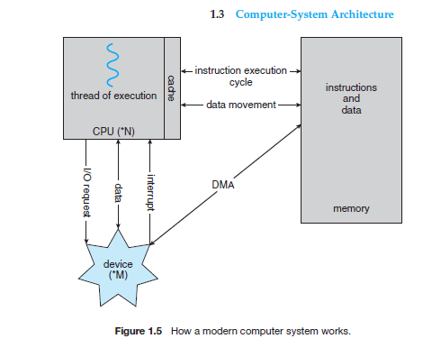
Hanyang University
Data-Centric Systems Lab.

Slide 5
Basic Elements
Processor
Main Memory
  volatile
  referred to as real memory or primary memory
I/O modules
  secondary memory devices
  communications equipment
  terminals
System bus
  communication among processors, memory, and I/O modules
Hanyang University
Data-Centric Systems Lab.

Slide 6

Processor
Internal registers for data I/O
  Memory address register (MAR)
    Specifies the address for the next read or write
  Memory buffer register (MBR)
    Contains data written into memory or receives data read from memory
  I/O address register
  I/O buffer register
Hanyang University
Data-Centric Systems Lab.

Slide 7
Processor Registers
User-visible registers
  Enable programmer to minimize main-memory references by optimizing register use
Control and status registers
  Used by processor to control operating of the processor
  Used by privileged operating-system routines to control the execution of programs
Hanyang University
Data-Centric Systems Lab.

Slide 8
User-Visible Registers
May be referenced by machine language
Available to all programs - application programs and system programs
Types of registers
  Data
  Address
    Index
    Segment pointer
    Stack pointer
Hanyang University
Data-Centric Systems Lab.

Slide 9

Control and Status Registers
Program Counter (PC)
  Contains the address of an instruction to be fetched
Instruction Register (IR)
  Contains the instruction most recently fetched
Program Status Word (PSW)
  Condition codes
    Bits set by the processor hardware as a result of operations
    Examples
      Positive result
      Negative result
      Zero
      Overflow
  Interrupt enable/disable
  Supervisor/user mode
Hanyang University
Data-Centric Systems Lab.

Slide 10
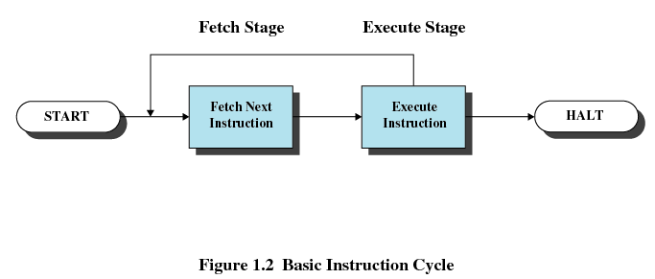
Instruction Execution
Two steps
  Processor reads instructions from memory: Fetch
  Processor executes each instruction
PC register holds address of the instruction to be fetched next
PC register is incremented after each fetch
Hanyang University
Data-Centric Systems Lab.

Slide 11
Instruction Register
Fetched instruction is placed in the instruction register
Instruction categories
  Processor-memory
    Transfer data between processor and memory
  Processor-I/O
    Data transferred to or from a peripheral device
  Data processing
    Arithmetic or logic operation on data
  Control
    Alter sequence of execution
Hanyang University
Data-Centric Systems Lab.

Slide 12
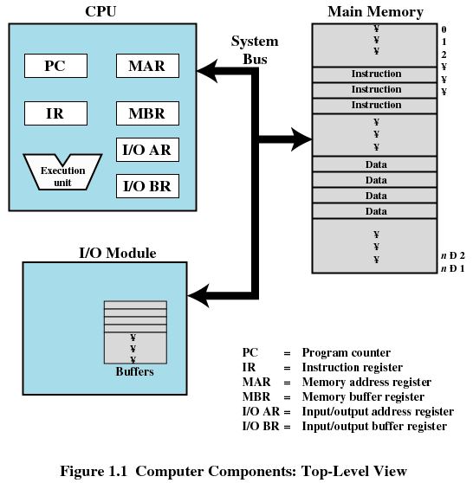
Top-Level Components
Hanyang University
Data-Centric Systems Lab.

Slide 13
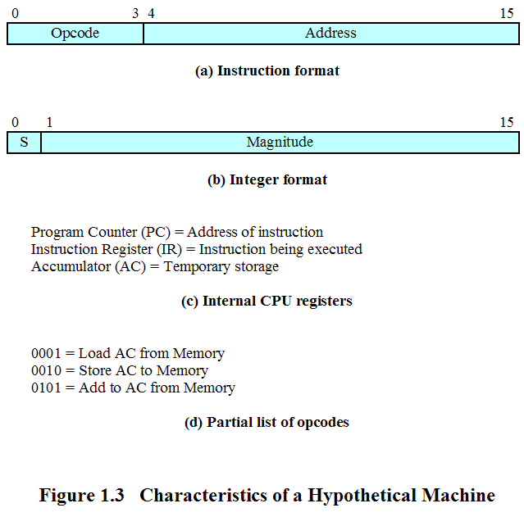
Characteristics of a Hypothetical Machine
Hanyang University
Data-Centric Systems Lab.

Slide 14
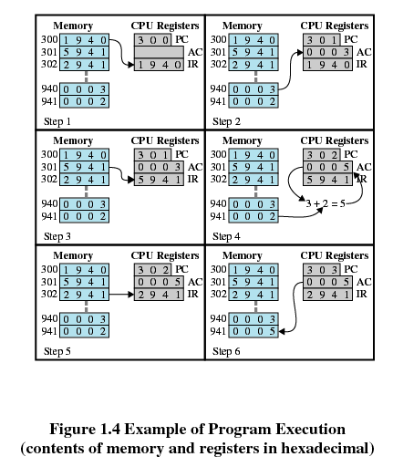
Example of Program Execution
Fetch
Execution
Hanyang University
Data-Centric Systems Lab.

Slide 15
Interrupt & Interrupt handler
Interrupt
  Interrupt the normal sequencing of the processor
  Most I/O devices are slower than the processor
    Processor must pause to wait for device
Interrupt handler
  Program to service a particular I/O device
  Generally part of the operating system
Hanyang University
Data-Centric Systems Lab.

Slide 16
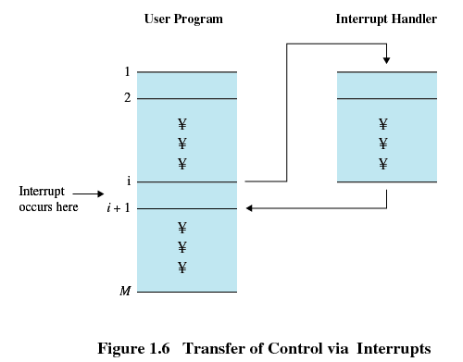
Interrupt
Suspends the normal sequence of execution
Hanyang University
Data-Centric Systems Lab.

Slide 17
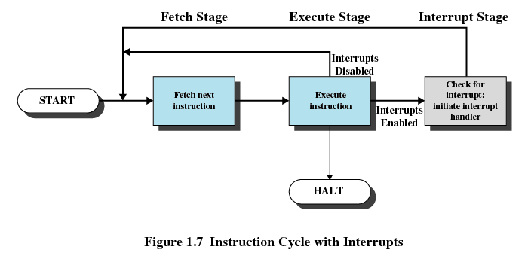
Interrupt Cycle
Hanyang University
Data-Centric Systems Lab.

Slide 18
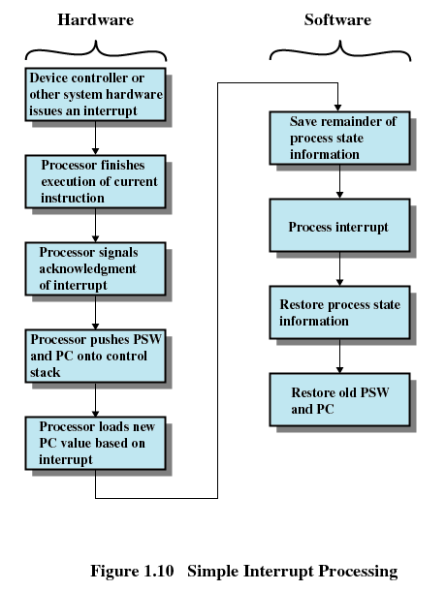
Simple Interrupt Processing
Hanyang University
Data-Centric Systems Lab.

Slide 19
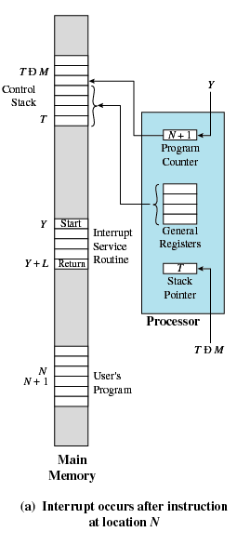
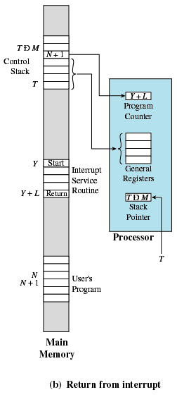
Changes in Memory and Registers for an Interrupt
Hanyang University
Data-Centric Systems Lab.

Slide 20
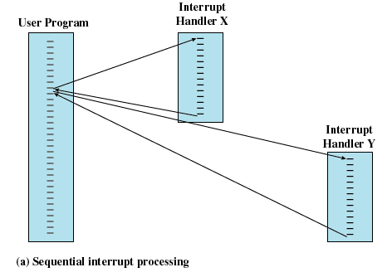
Multiple Interrupts
Disable interrupts while an interrupt is being processed
Hanyang University
Data-Centric Systems Lab.

Slide 21
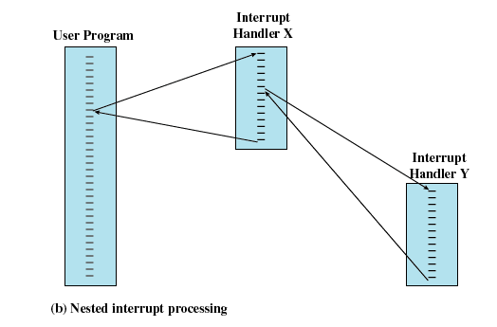
Multiple Interrupts
Define priorities for interrupts
Hanyang University
Data-Centric Systems Lab.

Slide 22
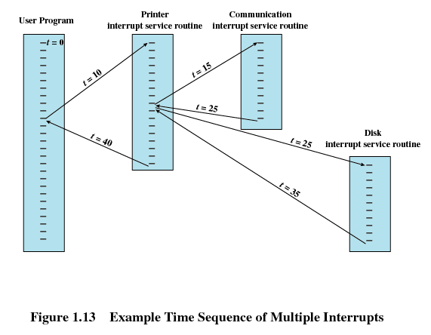
Multiple Interrupts
Hanyang University
Data-Centric Systems Lab.

Slide 23
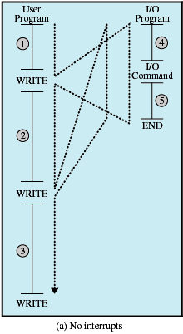
Program Flow of Control Without Interrupts
Hanyang University
Data-Centric Systems Lab.

Slide 24
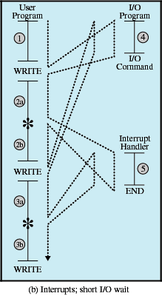
Program Flow of Control with Interrupts: Short I/O Wait
Hanyang University
Data-Centric Systems Lab.

Slide 25
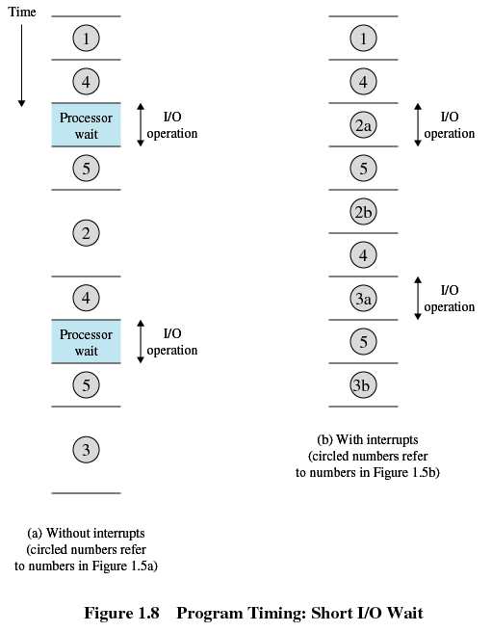
Timing Diagram Based on Short I/O Wait
Hanyang University
Data-Centric Systems Lab.

Slide 26
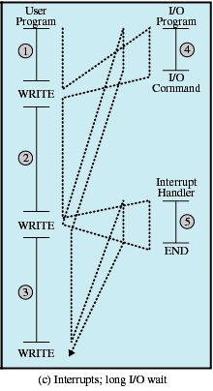
Program Flow of Control With Interrupts; Long I/O Wait
Hanyang University
Data-Centric Systems Lab.

Slide 27
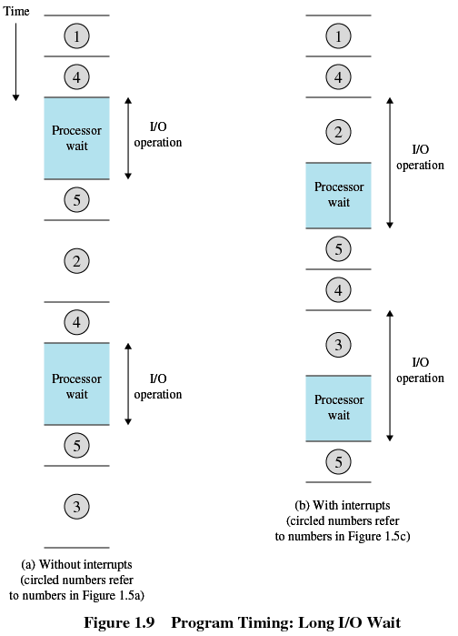
Timing Diagram Based on Long I/O Wait
Hanyang University
Data-Centric Systems Lab.

Slide 28
Multiprogramming
Even using interrupts, processor may not be used efficiently : A solution is multiprogramming
Processor has more than one program to execute
The sequence the programs are executed depends on their relative priority and whether they are waiting for I/O
After an interrupt handler completes, control may not return to the program that was executing at the time of the interrupt
Hanyang University
Data-Centric Systems Lab.

Slide 29
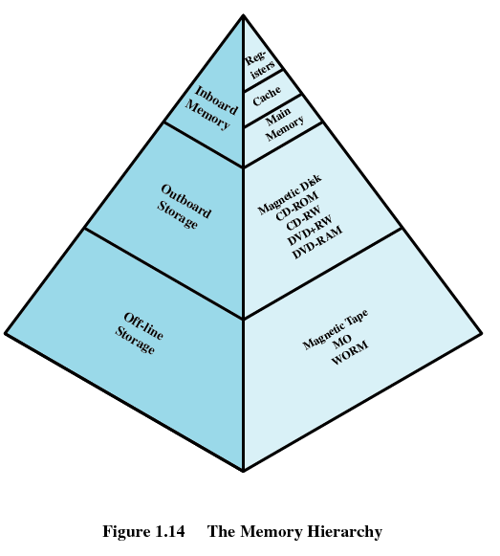
Memory Hierarchy
Going up the hierarchy
  Faster access time
  Decreasing capacity
  Greater cost per bit
Going down the hierarchy
  Decreasing cost per bit
  Increasing capacity
  Increasing access time
  Decreasing frequency of access of the memory by the processor
    Locality of reference
Hanyang University
Data-Centric Systems Lab.

Slide 30
Secondary Memory
Nonvolatile
Auxiliary memory
Used to store program and data files
Hanyang University
Data-Centric Systems Lab.

Slide 31
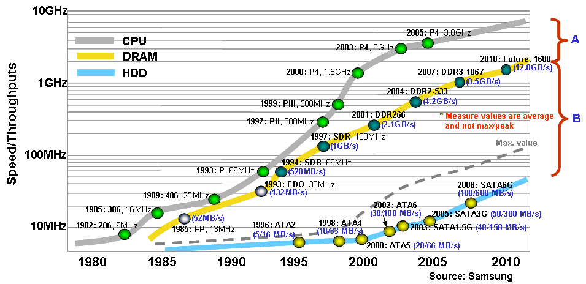
H/W Speed-up Trends
Hanyang University
Data-Centric Systems Lab.

Slide 32
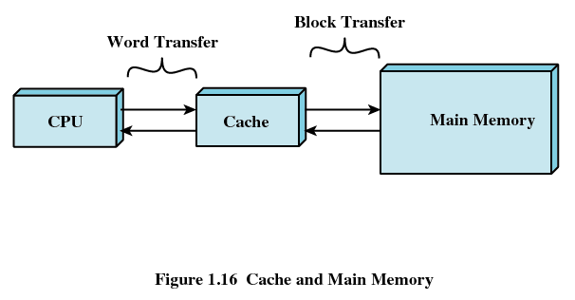
Cache Memory
Cache – a large access-time for transfer-rate disparity exists between two components.
The rate at which the processor can execute instructions is limited by the memory cycle time:
  The solution is to exploit the principle of locality by providing a small, fast memory between the processor and main memory, namely the cache
Hanyang University
Data-Centric Systems Lab.

Slide 33
Cache Memory
Contains a copy of a portion of main memory
Processor first checks cache
If not found in cache, the block of memory containing the needed information is moved to the cache and delivered to the processor
Hanyang University
Data-Centric Systems Lab.

Slide 34
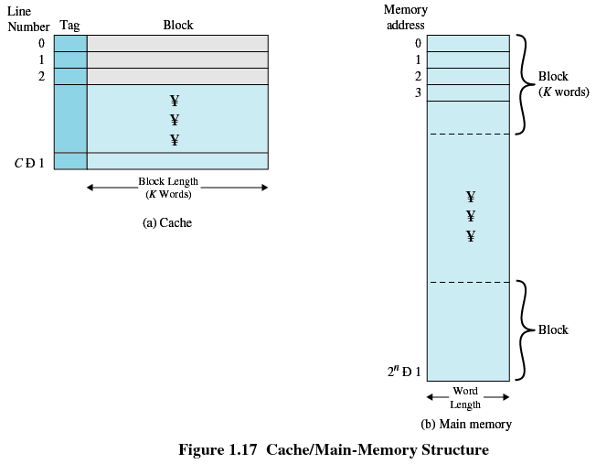
Cache/Main Memory System
Hanyang University
Data-Centric Systems Lab.

Slide 35
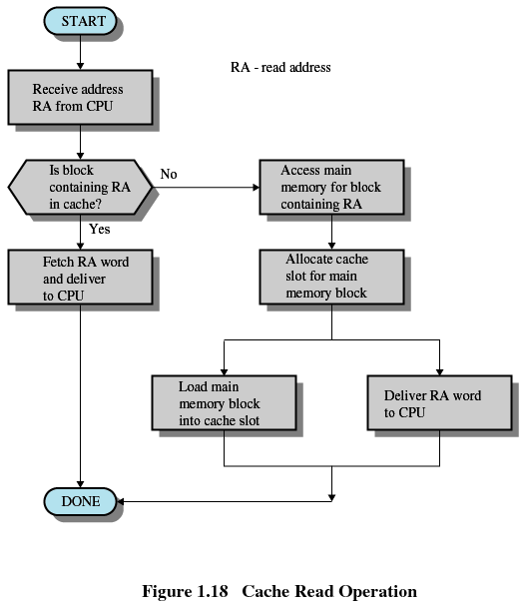
Cache Read Operation
Hanyang University
Data-Centric Systems Lab.

Slide 36
Cache Design
Cache size: Small caches have a significant impact on performance
Block size
  The unit of data exchanged between cache and main memory
  Larger block size increases hit ratio until probability of using newly fetched data becomes less than that of reusing data that have to be moved out of cache
Mapping function: Determines which cache location the block will occupy
Replacement algorithm
  Determines which block to replace
  Least-Recently-Used (LRU) algorithm
Write policy: When the memory write operation takes place
  Can occur every time block is updated
  Can occur only when block is replaced
    Minimizes memory write operations
    Leaves main memory in an obsolete state
    cache coherence problem in multicore or multiprocessor system
Hanyang University
Data-Centric Systems Lab.

Slide 37
Disk Cache
A portion of main memory used as a buffer to temporarily hold data for the disk
Disk writes are clustered
Some data written out may be referenced again. The data are retrieved rapidly from the software cache instead of slowly from disk
Hanyang University
Data-Centric Systems Lab.

Slide 38
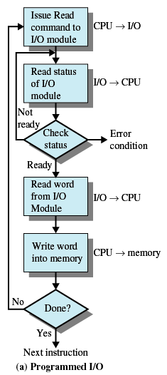
Programmed I/O
I/O module performs the action, not the processor
Sets appropriate bits in the I/O status register
No interrupts occur
Processor checks status until operation is complete
Hanyang University
Data-Centric Systems Lab.

Slide 39
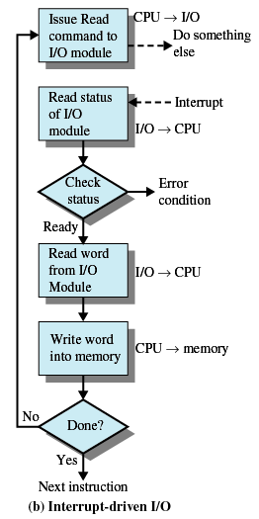
Interrupt-Driven I/O
Processor is interrupted when I/O module ready to exchange data
Processor saves context of program executing and begins executing interrupt-handler
No needless waiting
Still consumes a lot of processor time because every word read or written passes through the processor
Hanyang University
Data-Centric Systems Lab.

Slide 40
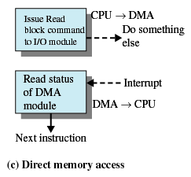
Direct Memory Access
I/O exchanges occur directly with memory
Processor grants I/O module authority to read from or write to memory
Relieves the processor responsibility for the exchange
Transfers a block of data directly to or from memory
An interrupt is sent when the transfer is complete
Processor continues with other work
Hanyang University
Data-Centric Systems Lab.

Slide 41
Computer System Structure
Computer system can be divided into four components
  Hardware – provides basic computing resources
    CPU, memory, I/O devices
  Operating system
    Controls and coordinates use of hardware among various applications and users
  Application programs – define the ways in which the system resources are used to solve the computing problems of the users
    Word processors, compilers, web browsers, database systems, video games
  Users
    People, machines, other computers
Hanyang University
Data-Centric Systems Lab.

Slide 42

Four Components of a Computer System
Hanyang University
Data-Centric Systems Lab.

Slide 43

Computer System Organization
Computer-system operation
  One or more CPUs, device controllers connect through common bus providing access to shared memory
  Concurrent execution of CPUs and devices competing for memory cycles
Hanyang University
Data-Centric Systems Lab.

Slide 44
Computer-System Operation
I/O devices and the CPU can execute concurrently
Each device controller is in charge of a particular device type
Each device controller has a local buffer
CPU moves data from/to main memory to/from local buffers
I/O is from the device to local buffer of controller
Device controller informs CPU that it has finished its operation by causing an interrupt
Hanyang University
Data-Centric Systems Lab.

Slide 45
Computer-System Architecture
Legacy systems use a single general-purpose processor (Smart phones through mainframes)
  Most systems have special-purpose processors as well
  Ex)a disk-controller microprocessor receives a sequence of requests from the main CPU and implements its own disk queue and scheduling algorithm. PCs contain a microprocessor in the keyboard to convert the keystrokes into codes to be sent to the
Multiprocessors systems growing in use and importance
  Also known as parallel systems, tightly-coupled systems
  Advantages include
    Increased throughput
    Economy of scale
Increased reliability – graceful degradation (The ability to continue providing service proportional to the level of surviving hardware ) or fault tolerance (they can suffer a failure of
any single component and still continue operation. Fault tolerance requires)
<Two types>
1.Asymmetric Multiprocessing (This scheme defines a boss–worker relationship. The boss processor schedules and allocates work to the worker processors.)
2. Symmetric Multiprocessing (load balancing 문제가 발생하기 때문에, 적절하게 load balancing을 시켜주기 위해서는 share data structure가 요구된다.)
Hanyang University
Data-Centric Systems Lab.

Slide 46
memory access model
1. UMA(uniform memory access)
2. NUMA(non-uniform memory access)- 자기의 로컬 메모리에 접근할 때가 원격 메모리에 접근할 때보다 더 빠르다. 원격 메모리는 다른 프로세서에 연결되어 있는 메모리를 말하고 로컬 메모리는 자기 프로세서에 연결되어 있는 메모리를 말한다
On-chip with multiple cores - on-chip communication is faster than between-chip communication. In addition, one chip with multiple cores uses significantly less power than multiple single-core chips.
Hanyang University
Data-Centric Systems Lab.

Slide 47

Symmetric Multiprocessing Architecture
Hanyang University
Data-Centric Systems Lab.

Slide 48

A Dual-Core Design
Hanyang University
Data-Centric Systems Lab.

Slide 49
Clustered Systems
Like multiprocessor systems, but multiple systems working together
  Usually sharing storage via a storage-area network (SAN)
  Provides a high-availability service which survives failures
    Asymmetric clustering has one machine in hot-standby mode
    Symmetric clustering has multiple nodes running applications, monitoring each other
  Some clusters are for high-performance computing (HPC)
    Applications must be written to use parallelization
Hanyang University
Data-Centric Systems Lab.

Slide 50
Operating System Definition
OS is a resource allocator
  Manages all resources
  Decides between conflicting requests for efficient and fair resource use
OS is a control program
  Controls execution of programs to prevent errors and improper use of the computer
Hanyang University
Data-Centric Systems Lab.

Slide 51
Operating System Definition (Cont)
No universally accepted definition
“Everything a vendor ships when you order an operating system” is good approximation
  But varies wildly
“The one program running at all times on the computer” is the kernel. Everything else is either a system program (ships with the operating system) or an application program
Hanyang University
Data-Centric Systems Lab.

Slide 52
Computer Startup
bootstrap program is loaded at power-up or reboot
  Typically stored in ROM or EPROM, generally known as firmware
  Initializes all aspects of system
  Loads operating system kernel and starts execution
Hanyang University
Data-Centric Systems Lab.

