Slide 1
pycuda
Jin Kwon Kim
JUNE 1, 2017
Notes:
Hi my name is jin kwon kim.
I will going to tell you about the pycuda.

Slide 2
Outline
Introduction to python
What is python
Introduction to pycuda
What is pycuda & characteristic
Installation
Tutorial
Compare pycuda & cuda in c
Conclusions
Notes:
This is my outline.
I will going to tell you what the python is. And then tell you pycuda and characteristic and installation and pycuda tutorial and compare pycuda and cuda in c and finaly conclusion.

Slide 3
Introduction to python
Notes:
First I will going to tell you about python.

Slide 4
What is python
Python
Interpreter : directly executes instructions written in a programming language
Advantage
Can learn easily
Can include a program written by another language
Automatic memory management.
disadvantage
slow
Notes:
Python is a one of the programming language.
most important feature in python is python is a interpreter that directly executes instructions written in a programming language. While c ,c++ and java have a compiler that change from programming language to other object file.
Python can learn easily cause their grammer is easier than other language.
Python can include a programming written by another language. For example you program python for the structure. Just import another program written by another language for the function.
Python has automatic memory management. So it has a garbage collection. So you don’t need call the free function to free the memory.
But python is a little bit slow

Slide 5
Introduction to pycuda
Notes:
I will going to tell you about pycuda.

Slide 6
What is pycuda & characteristic
pycuda
a Python programming environment for CUDA
characteristic
Object cleanup tied to lifetime of objects
Completeness
Automatic Error Checking
Speed
Notes:
Pycuda is a python programming environment for cuda.
This is a pycuda’s characteristic
First, object cleanup tied to lifetime of objects. So, resource allocation is done during object creaton by the constructor, while release is done during object destruction by the destructor.
I told you python has a garbage collection so object destruction can be done automatically. So object’s resource also be released automatically.
Second. Completeness. PyCUDA puts the full power of CUDA’s driver API at your disposal, if you wish.
Third. Automatic Error Checking. All CUDA errors are automatically translated into Python exceptions.
Finally. Speed. Cause PyCUDA’s base layer is written in C++,

Slide 7
Installation
Step 0: Ensure that CUDA is installed and settings are correct
Step 1: Install gcc
Step 2: Install Boost C++ libraries
Step 3: Install numpy
Step 4: Download, unpack and install PyCUDA
Notes:
I will going to tell you stage of installation.
First ensure that cuda is installed and setting are correct.
Second install gcc
Third install boost c++ libraries. Boost c++ library is a library for c++ programming language and provide multithreading and image processing.
Next install numpy is the fundamental package for scientific computing with Python
And finally download pycuda and install that
.

Slide 8
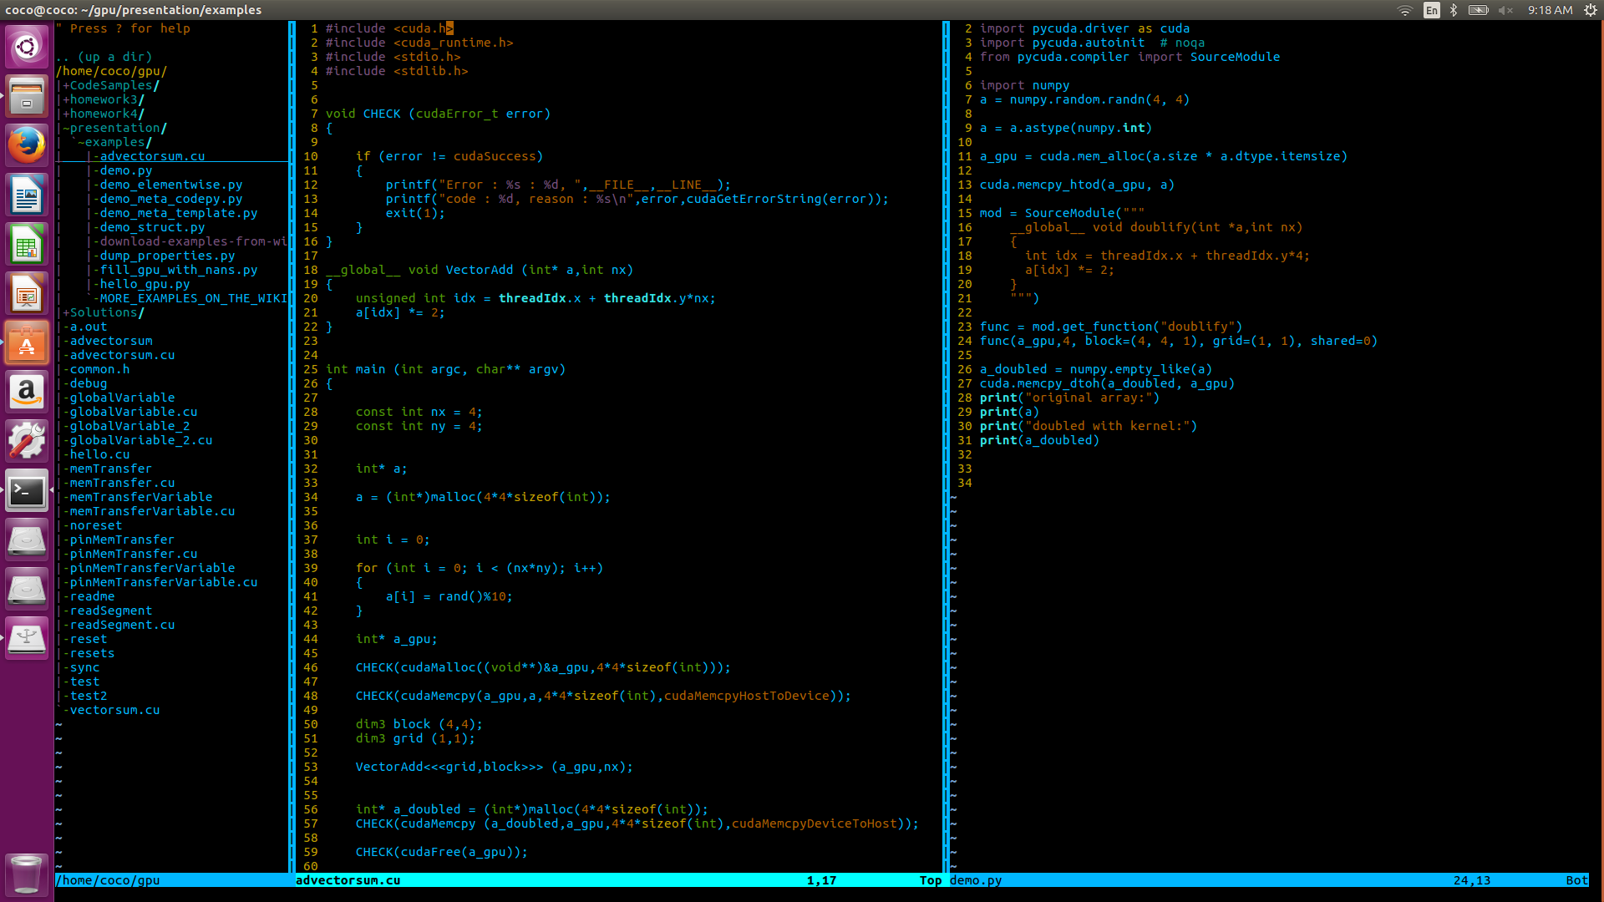
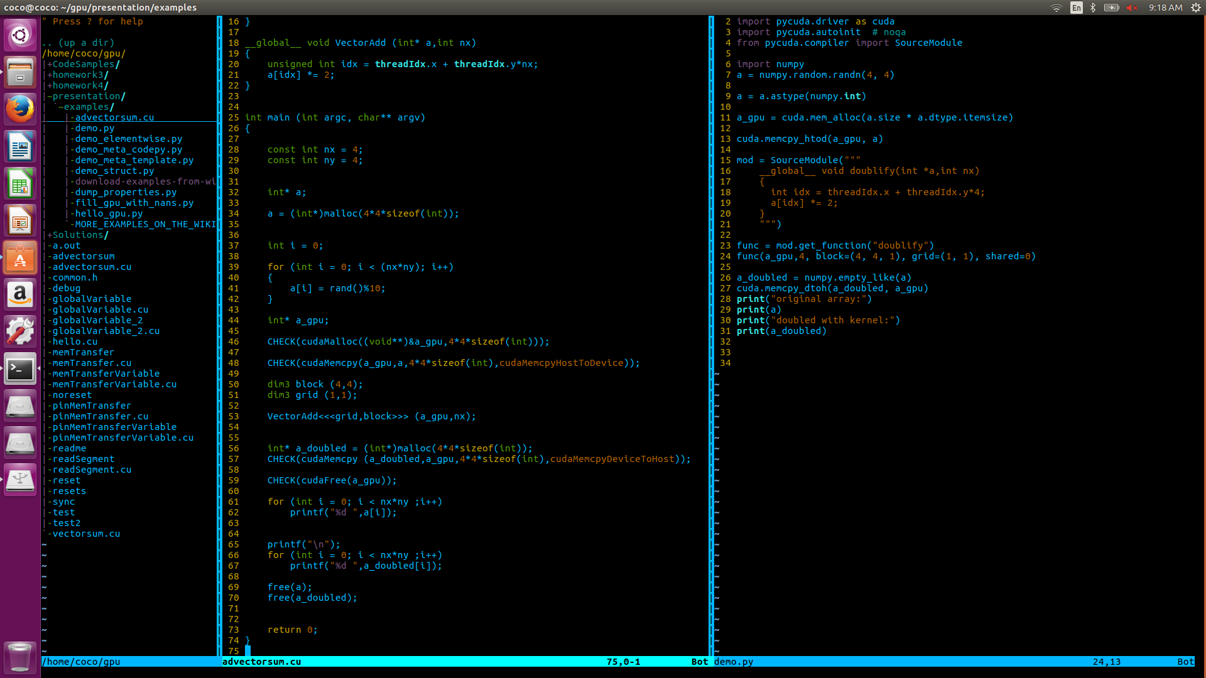
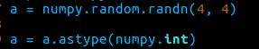
Tutorial
Step 1: import module
Step 2 : initialize data
Notes:
This is tutorial for pycuda.
I just show you simple program that just double the value.
Left one is cuda in c and right one is pycuda.
First you should import module. In c, include header file. In python, import some modules.
second. Initialized data for calculation.
In c, you should malloc array for saving the input data in host and then init them random value.
In python, using numpy, you can allocate random variable to the array. And set the type to integer.

Slide 9
Tutorial
Step 3: allocate device memory & data transfer
Step 4 : define kernel function & launch a kernel
Notes:
and then allocate device memory & and transfer the data from host to device.
In c , using cudaMalloc and cudaMemcpy
In python using mem_alloc, memcpy_htod
and then define kernel function & launch a kernel
In c , you define the kernel using function define. In python you define the kernel using object creation.

Slide 10
Tutorial
Step 5: get a result from the device
Step 6: cuda memory free
Notes:
To get a data from the device. You should transfer the data from device to host.
In c, first allocate a array for saving data. And then using cudamemcpy, you can get a data from the device.
In python, first allocate a array using numpy.empty_like function that create the empty arrary that have same struction in a. and then using memcpy_dtoh, you can get a data from device.
Finally, to free the data, in c you should call the cudaFree function. But in python, you don’t need call the function. Cause python have garabage collection and resource tied to lifetime of object.

Slide 11
Compare pycuda & cuda in c
Running time
running time
array size
Notes:
This is the graph that show the running time comparison pycuda and cuda in c.
As you can see the graph, pycuda is four time slower than cuda in c.
I will tell you the reason in next slide.

Slide 12
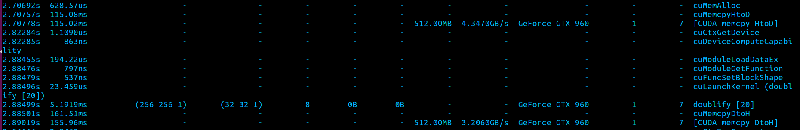
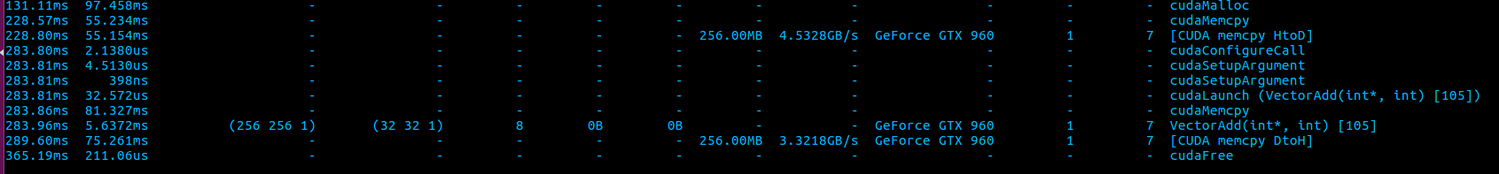
Compare pycuda & cuda in c
1. Initialize step
before cudamalloc, we initialize some data.
2. Data transfer size
Same representation data can have different size in different language
pycuda
Cuda in c
Notes:
First reason point is initialize step.
Before cudamalloc, we initialize some data. And I told you python is slow language. And initialize step is totally depend on the programming language. So pycuda is slower than cuda in c .
Second reason point is data transfer size.
In the below, you can see the nvprof result of both programs. Pycuda have the completeness in the driver. So actually there is no difference about that. You can check this fact in kernel function.
but pycuda have more data to transfer between host and device. Same representation data can have different size in differen language.

Slide 13
Conclusions
Pycuda give you the full power of gpu driver.
But pycuda is just a python, so naturally they are slow.
When you use kernel intensive program, the pycuda is perfect choice.
When you use memory intensive program, the pycuda is poor choice.

Slide 14
Thank you for listening

