Slide 1

Computer System Overview

Slide 2
Basic Elements
Processor
Main Memory
  volatile
  referred to as real memory or primary memory
I/O modules
  secondary memory devices
  communications equipment
  terminals
System bus
  communication among processors, memory, and I/O modules
Hanyang University
Data-Centric Systems Lab.

Slide 3

Processor
Internal registers for data I/O
  Memory address register (MAR)
    Specifies the address for the next read or write
  Memory buffer register (MBR)
    Contains data written into memory or receives data read from memory
  I/O address register
  I/O buffer register
Hanyang University
Data-Centric Systems Lab.

Slide 4
Processor Registers
User-visible registers
  Enable programmer to minimize main-memory references by optimizing register use
Control and status registers
  Used by processor to control operating of the processor
  Used by privileged operating-system routines to control the execution of programs
Hanyang University
Data-Centric Systems Lab.

Slide 5
User-Visible Registers
May be referenced by machine language
Available to all programs - application programs and system programs
Types of registers
  Data
  Address
    Index
    Segment pointer
    Stack pointer
Hanyang University
Data-Centric Systems Lab.

Slide 6

Control and Status Registers
Program Counter (PC)
  Contains the address of an instruction to be fetched
Instruction Register (IR)
  Contains the instruction most recently fetched
Program Status Word (PSW)
  Condition codes
    Bits set by the processor hardware as a result of operations
    Examples
      Positive result
      Negative result
      Zero
      Overflow
  Interrupt enable/disable
  Supervisor/user mode
Hanyang University
Data-Centric Systems Lab.

Slide 7
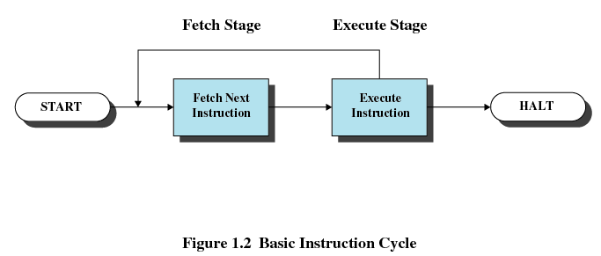
Instruction Execution
Two steps
  Processor reads instructions from memory: Fetch
  Processor executes each instruction
PC register holds address of the instruction to be fetched next
PC register is incremented after each fetch
Hanyang University
Data-Centric Systems Lab.

Slide 8
Instruction Register
Fetched instruction is placed in the instruction register
Instruction categories
  Processor-memory
    Transfer data between processor and memory
  Processor-I/O
    Data transferred to or from a peripheral device
  Data processing
    Arithmetic or logic operation on data
  Control
    Alter sequence of execution
Hanyang University
Data-Centric Systems Lab.

Slide 9
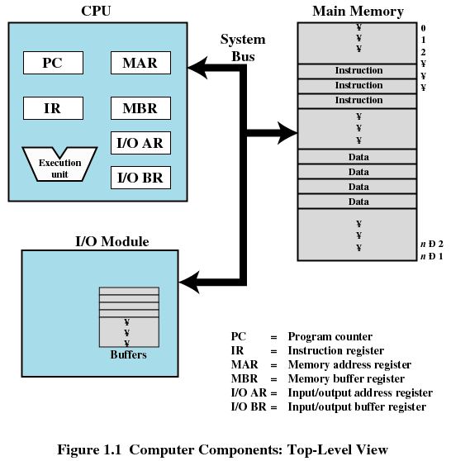
Top-Level Components
Hanyang University
Data-Centric Systems Lab.

Slide 10
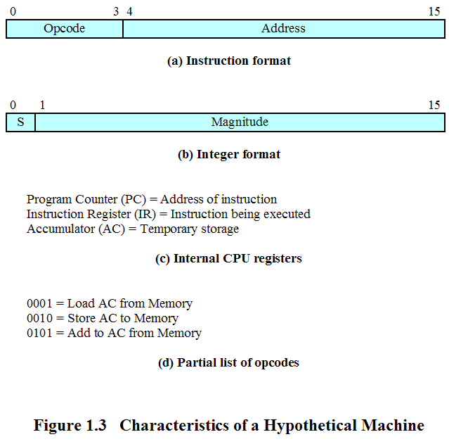
Characteristics of a Hypothetical Machine
Hanyang University
Data-Centric Systems Lab.

Slide 11
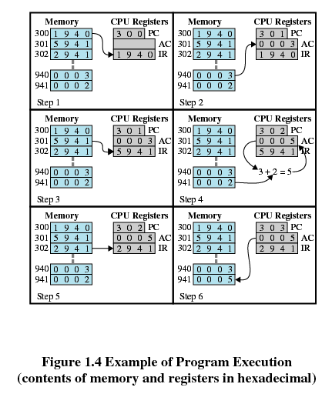
Example of Program Execution
Fetch
Execution
Hanyang University
Data-Centric Systems Lab.

Slide 12
Interrupt & Interrupt handler
Interrupt
  Interrupt the normal sequencing of the processor
  Most I/O devices are slower than the processor
    Processor must pause to wait for device
Interrupt handler
  Program to service a particular I/O device
  Generally part of the operating system
Hanyang University
Data-Centric Systems Lab.

Slide 13
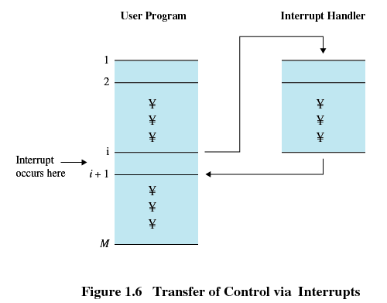
Interrupt
Suspends the normal sequence of execution
Hanyang University
Data-Centric Systems Lab.

Slide 14
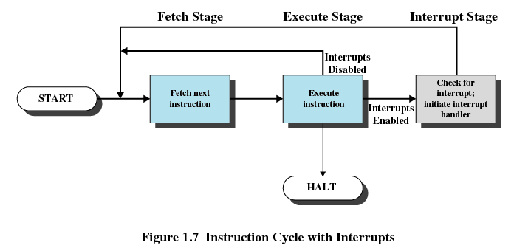
Interrupt Cycle
Hanyang University
Data-Centric Systems Lab.

Slide 15
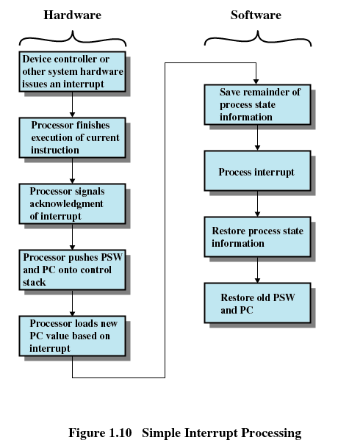
Simple Interrupt Processing
Hanyang University
Data-Centric Systems Lab.

Slide 16
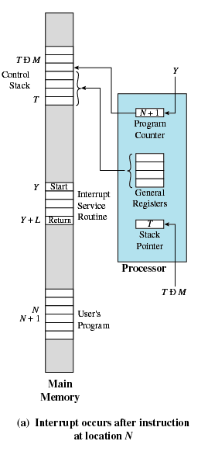
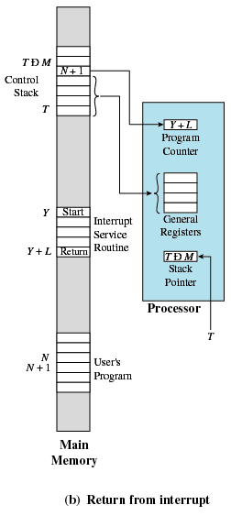
Changes in Memory and Registers for an Interrupt
Hanyang University
Data-Centric Systems Lab.

Slide 17
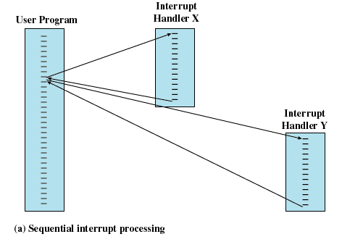
Multiple Interrupts
Disable interrupts while an interrupt is being processed
Hanyang University
Data-Centric Systems Lab.

Slide 18
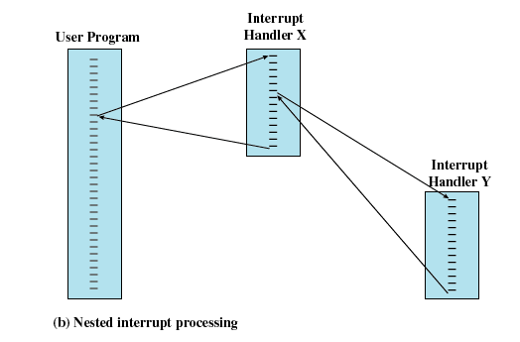
Multiple Interrupts
Define priorities for interrupts
Hanyang University
Data-Centric Systems Lab.

Slide 19
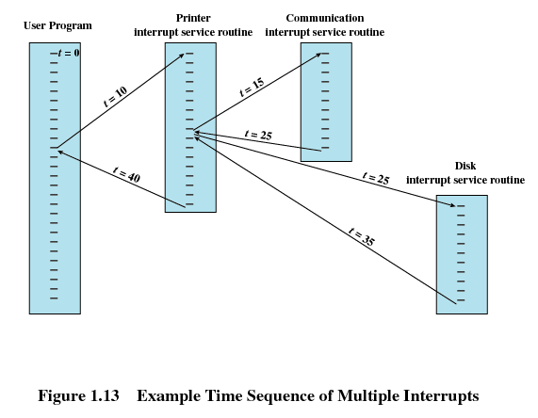
Multiple Interrupts
Hanyang University
Data-Centric Systems Lab.

Slide 20
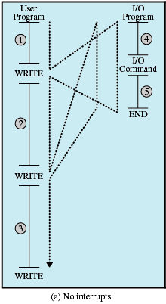
Program Flow of Control Without Interrupts
Hanyang University
Data-Centric Systems Lab.

Slide 21
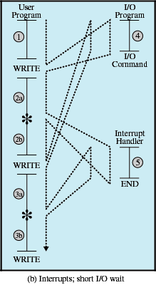
Program Flow of Control with Interrupts: Short I/O Wait
Hanyang University
Data-Centric Systems Lab.

Slide 22
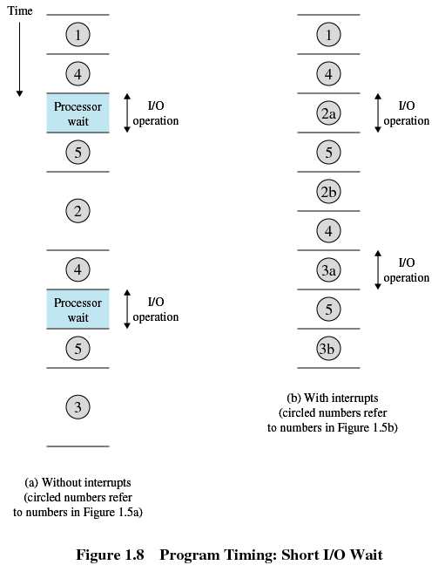
Timing Diagram Based on Short I/O Wait
Hanyang University
Data-Centric Systems Lab.

Slide 23
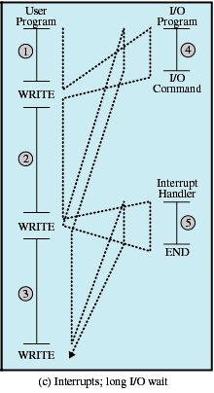
Program Flow of Control With Interrupts; Long I/O Wait
Hanyang University
Data-Centric Systems Lab.

Slide 24
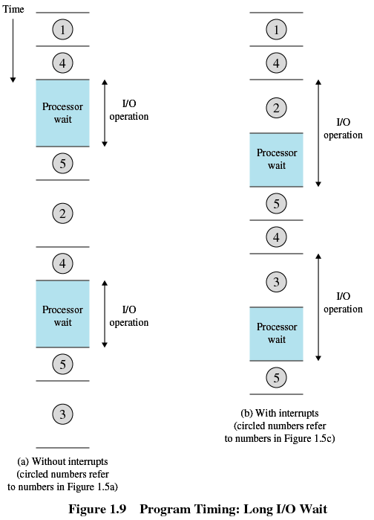
Timing Diagram Based on Long I/O Wait
Hanyang University
Data-Centric Systems Lab.

Slide 25
Multiprogramming
Even using interrupts, processor may not be used efficiently : A solution is multiprogramming
Processor has more than one program to execute
The sequence the programs are executed depends on their relative priority and whether they are waiting for I/O
After an interrupt handler completes, control may not return to the program that was executing at the time of the interrupt
Hanyang University
Data-Centric Systems Lab.

Slide 26
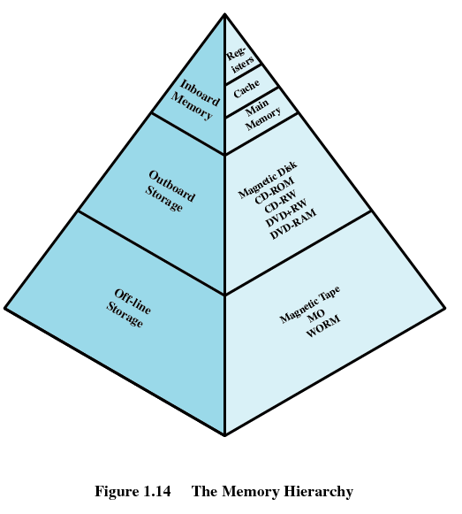
Memory Hierarchy
Going up the hierarchy
  Faster access time
  Decreasing capacity
  Greater cost per bit
Going down the hierarchy
  Decreasing cost per bit
  Increasing capacity
  Increasing access time
  Decreasing frequency of access of the memory by the processor
    Locality of reference
Hanyang University
Data-Centric Systems Lab.

Slide 27
Secondary Memory
Nonvolatile
Auxiliary memory
Used to store program and data files
Hanyang University
Data-Centric Systems Lab.

Slide 28
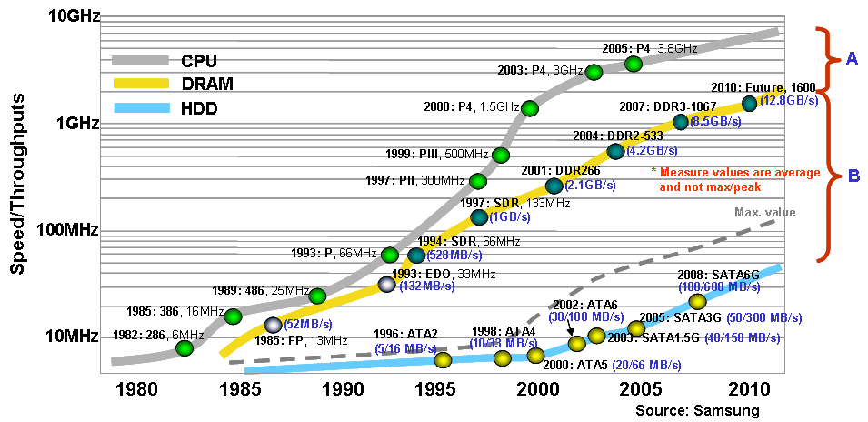
H/W Speed-up Trends
Hanyang University
Data-Centric Systems Lab.

Slide 29
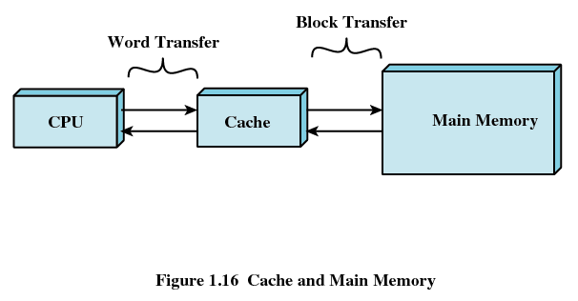
Cache Memory
The rate at which the processor can execute instructions is limited by the memory cycle time:
  The solution is to exploit the principle of locality by providing a small, fast memory between the processor and main memory, namely the cache
Hanyang University
Data-Centric Systems Lab.

Slide 30
Cache Memory
Contains a copy of a portion of main memory
Processor first checks cache
If not found in cache, the block of memory containing the needed information is moved to the cache and delivered to the processor
Hanyang University
Data-Centric Systems Lab.

Slide 31
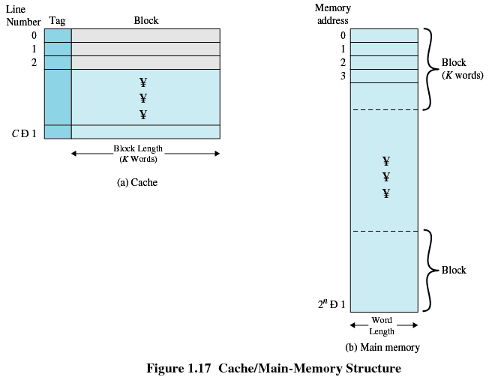
Cache/Main Memory System
Hanyang University
Data-Centric Systems Lab.

Slide 32
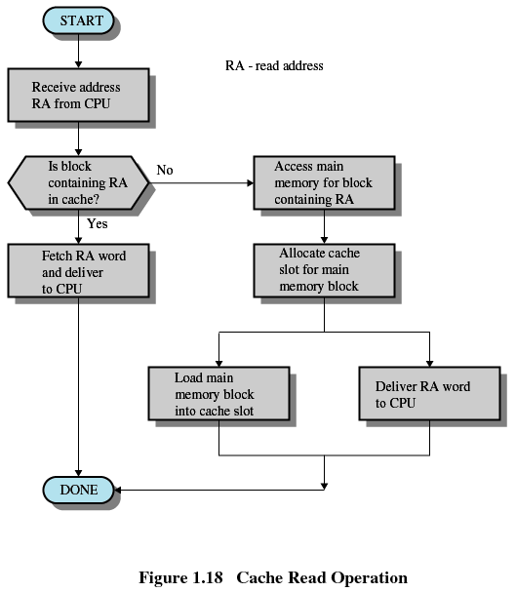
Cache Read Operation
Hanyang University
Data-Centric Systems Lab.

Slide 33
Cache Design
Cache size: Small caches have a significant impact on performance
Block size
  The unit of data exchanged between cache and main memory
  Larger block size increases hit ratio until probability of using newly fetched data becomes less than that of reusing data that have to be moved out of cache
Mapping function: Determines which cache location the block will occupy
Replacement algorithm
  Determines which block to replace
  Least-Recently-Used (LRU) algorithm
Write policy: When the memory write operation takes place
  Can occur every time block is updated
  Can occur only when block is replaced
    Minimizes memory write operations
    Leaves main memory in an obsolete state
    cache coherence problem in multicore or multiprocessor system
Hanyang University
Data-Centric Systems Lab.

Slide 34
Disk Cache
A portion of main memory used as a buffer to temporarily hold data for the disk
Disk writes are clustered
Some data written out may be referenced again. The data are retrieved rapidly from the software cache instead of slowly from disk
Hanyang University
Data-Centric Systems Lab.

Slide 35
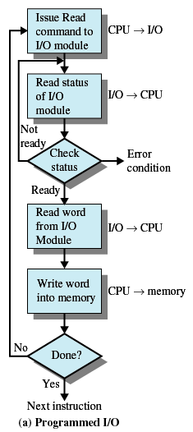
Programmed I/O
I/O module performs the action, not the processor
Sets appropriate bits in the I/O status register
No interrupts occur
Processor checks status until operation is complete
Hanyang University
Data-Centric Systems Lab.

Slide 36
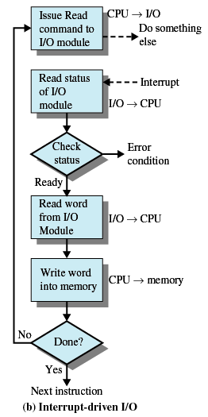
Interrupt-Driven I/O
Processor is interrupted when I/O module ready to exchange data
Processor saves context of program executing and begins executing interrupt-handler
No needless waiting
Still consumes a lot of processor time because every word read or written passes through the processor
Hanyang University
Data-Centric Systems Lab.

Slide 37
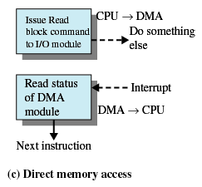
Direct Memory Access
I/O exchanges occur directly with memory
Processor grants I/O module authority to read from or write to memory
Relieves the processor responsibility for the exchange
Transfers a block of data directly to or from memory
An interrupt is sent when the transfer is complete
Processor continues with other work
Hanyang University
Data-Centric Systems Lab.

Slide 38
Computer System Structure
Computer system can be divided into four components
  Hardware – provides basic computing resources
    CPU, memory, I/O devices
  Operating system
    Controls and coordinates use of hardware among various applications and users
  Application programs – define the ways in which the system resources are used to solve the computing problems of the users
    Word processors, compilers, web browsers, database systems, video games
  Users
    People, machines, other computers
Hanyang University
Data-Centric Systems Lab.

Slide 39

Four Components of a Computer System
Hanyang University
Data-Centric Systems Lab.

Slide 40

Computer System Organization
Computer-system operation
  One or more CPUs, device controllers connect through common bus providing access to shared memory
  Concurrent execution of CPUs and devices competing for memory cycles
Hanyang University
Data-Centric Systems Lab.

Slide 41
Computer-System Operation
I/O devices and the CPU can execute concurrently
Each device controller is in charge of a particular device type
Each device controller has a local buffer
CPU moves data from/to main memory to/from local buffers
I/O is from the device to local buffer of controller
Device controller informs CPU that it has finished its operation by causing an interrupt
Hanyang University
Data-Centric Systems Lab.

Slide 42
Computer-System Architecture
Legacy systems use a single general-purpose processor (Smart phones through mainframes)
  Most systems have special-purpose processors as well
Multiprocessors systems growing in use and importance
  Also known as parallel systems, tightly-coupled systems
  Advantages include
    Increased throughput
    Economy of scale
    Increased reliability – graceful degradation or fault tolerance
  Two types
    Asymmetric Multiprocessing
    Symmetric Multiprocessing
Hanyang University
Data-Centric Systems Lab.

Slide 43

Symmetric Multiprocessing Architecture
Hanyang University
Data-Centric Systems Lab.

Slide 44

A Dual-Core Design
Hanyang University
Data-Centric Systems Lab.

Slide 45
Clustered Systems
Like multiprocessor systems, but multiple systems working together
  Usually sharing storage via a storage-area network (SAN)
  Provides a high-availability service which survives failures
    Asymmetric clustering has one machine in hot-standby mode
    Symmetric clustering has multiple nodes running applications, monitoring each other
  Some clusters are for high-performance computing (HPC)
    Applications must be written to use parallelization
Hanyang University
Data-Centric Systems Lab.

Slide 46
Operating System Definition
OS is a resource allocator
  Manages all resources
  Decides between conflicting requests for efficient and fair resource use
OS is a control program
  Controls execution of programs to prevent errors and improper use of the computer
Hanyang University
Data-Centric Systems Lab.

Slide 47
Operating System Definition (Cont)
No universally accepted definition
“Everything a vendor ships when you order an operating system” is good approximation
  But varies wildly
“The one program running at all times on the computer” is the kernel. Everything else is either a system program (ships with the operating system) or an application program
Hanyang University
Data-Centric Systems Lab.

Slide 48
Computer Startup
bootstrap program is loaded at power-up or reboot
  Typically stored in ROM or EPROM, generally known as firmware
  Initializes all aspects of system
  Loads operating system kernel and starts execution
Hanyang University
Data-Centric Systems Lab.

