Slide 1

Memory Management

Slide 2


Background
Program must be brought (from disk) into memory and placed within a process for it to be run
Main memory and registers are only storage CPU can access directly
Register access in one CPU clock (or less)
Main memory can take many cycles
Cache sits between main memory and CPU registers
Protection of memory required to ensure correct operation
Hanyang University
Data-Centric Systems Lab.

Slide 3

Multistep Processing of a User Program
User programs go through several steps before being run on memory.
Hanyang University
Data-Centric Systems Lab.

Slide 4
Binding of Instructions and Data to Memory
Compile time binding
  Absolute address of each symbol must be known at this time
  absolute code containing absolute address is generated
  must recompile code if starting location changes
Load time binding
  Loader assigns absolute address to each symbol
  Compiler generates relocatable code containing relative addresses
Execution time binding
  Used when process moves its in-memory location during execution
  Whenever CPU generates address, binding is required (address mapping table)
  need hardware support (e.g., base and limit registers, MMU).
Hanyang University
Data-Centric Systems Lab.

Slide 5
Address Mapping Table
CPU가 제시한 주소 : 실제 메모리 내 주소
logical physical
Memory
0 번지
500 번지
0
CPU
500:
500 번지
20000 번지
Hanyang University
Data-Centric Systems Lab.

Slide 6

Base and Limit Registers
A pair of base and limit registers define the logical address space
Hanyang University
Data-Centric Systems Lab.

Slide 7
Logical vs. Physical Address Space
The concept of a logical address space that is bound to a separate physical address space is central to proper memory management
  Logical address – generated by the CPU; also referred to as virtual address
  Physical address – address seen by the memory unit
Logical and physical addresses are the same in compile-time and load-time address-binding schemes; logical (virtual) and physical addresses differ in execution-time address-binding scheme
Hanyang University
Data-Centric Systems Lab.

Slide 8
Memory-Management Unit (MMU)
MMU (Memory-Management Unit)
  A Hardware device that maps virtual address to physical address
In MMU scheme
  the value in the relocation register is added to every address generated by a user process at the time it is sent to memory (from CPU)
The user program
  deals with logical addresses
  never sees the real physical addresses
Hanyang University
Data-Centric Systems Lab.

Slide 9

Dynamic Relocation using a Relocation Register
Hanyang University
Data-Centric Systems Lab.

Slide 10
Dynamic Loading and Linking
Dynamic Loading
  Routine is not loaded until it is called
  Better memory-space utilization: unused routine is never loaded
  Useful when large amounts of code are needed to handle infrequently occurring cases
Dynamic Linking
  Linking – Symbolic address v.s. Physical address
  Loader should be able to load program routine to any location in memory
    Linking postponed until execution time
  Operating system needed to check if routine is in another processes’ memory space because
    Processes in memory are protected from one another and
    Processes may reference shared libraries
Hanyang University
Data-Centric Systems Lab.

Slide 11
Swapping
Swapping
  A process can be swapped temporarily out of memory to a backing store and then brought back into memory sometime later
Backing store
  Fast disk large enough to accommodate all memory images for all users
  Must provide direct access to these memory images
Roll out, roll in
  A variant of swapping used for priority-based scheduling algorithms
  lower-priority process is swapped out so that higher-priority process can be loaded and executed.
Major part of swap time is transfer time
  total transfer time is proportional to the amount of memory swapped
Hanyang University
Data-Centric Systems Lab.

Slide 12
Contiguous Allocation
Main memory is usually divided into two partitions:
  Resident operating system, usually
  held in low memory with interrupt vector
  User processes then held in high memory
Single-partition allocation
  To protect user processes from each other, and OS.
    Relocation register
      contains value of smallest physical address
    Limit register
      contains range of logical addresses
      each logical address bounded by limit register
      MMU maps logical address dynamically
OS
user process
Hanyang University
Data-Centric Systems Lab.

Slide 13

Hardware Support for Relocation and Limit Registers
Hanyang University
Data-Centric Systems Lab.

Slide 14
Contiguous Allocation (Cont.)
Multiple-partition allocation
  Several fixed-sized partitions
  Adjacent partitions can be merged
Hole : block of available memory
  Holes of various size are scattered throughout memory
  When a process arrives, it is allocated memory from a hole large enough to accommodate it
  Operating system maintains information about:
  a) allocated partitions b) free partitions (hole)
OS
OS
OS
OS
process 5
process 5
process 5
process 5
partitions
process 9
process 9
process 8
process 10
process 2
process 2
process 2
process 2
Hanyang University
Data-Centric Systems Lab.

Slide 15
Dynamic Storage-Allocation Problem
How to satisfy a request of size n from a list of free holes
First-fit
  Allocate the first hole that is big enough
Best-fit
  Allocate the smallest hole that is big enough
  must search entire list, unless ordered by size
  Produces many small leftover hole
Worst-fit
  Allocate the largest hole
  must also search entire list
  Produces the largest leftover hole
First-fit and best-fit better than worst-fit in terms of speed and storage utilization
Hanyang University
Data-Centric Systems Lab.

Slide 16
Fragmentation
External fragmentation
  Total memory space exists to satisfy a request, but it is not contiguous
Internal fragmentation
  Allocated memory may be slightly larger than requested memory; this size difference is internal fragmentation : memory internal to a partition, but not being used
Reduce external fragmentation by compaction
  Shuffle memory contents to place all free memory together in one large block
  Compaction is possible only if relocation is dynamic, and is done at execution time
Hanyang University
Data-Centric Systems Lab.

Slide 17
Paging
Paging
  is a scheme that permits address space to be noncontiguous
Basic Method
  Divide physical memory into fixed-sized blocks called frames (size is power of 2, between 512 bytes and 8 MB)
  Divide logical memory into blocks of same size called pages
  Keep track of all free frames
  To run a program of size n pages, need to find n free frames and load program
  Set up a page table to translate logical to physical addresses
  Internal fragmentation, but no external fragmentation
Hanyang University
Data-Centric Systems Lab.

Slide 18

Paging
(page) frames
pages
Physical Memory
Process Address Space
Hanyang University
Data-Centric Systems Lab.

Slide 19
Address Translation Scheme
Address generated by CPU is divided into:
  Page number (p) – used as an index into a page table which contains base address of each page in physical memory
  Page offset (d) – combined with base address to define the physical memory address that is sent to the memory unit
  For given logical address space 2^{m} and page size 2^{n}
page number
page offset
p
d
m - n
n
Hanyang University
Data-Centric Systems Lab.

Slide 20
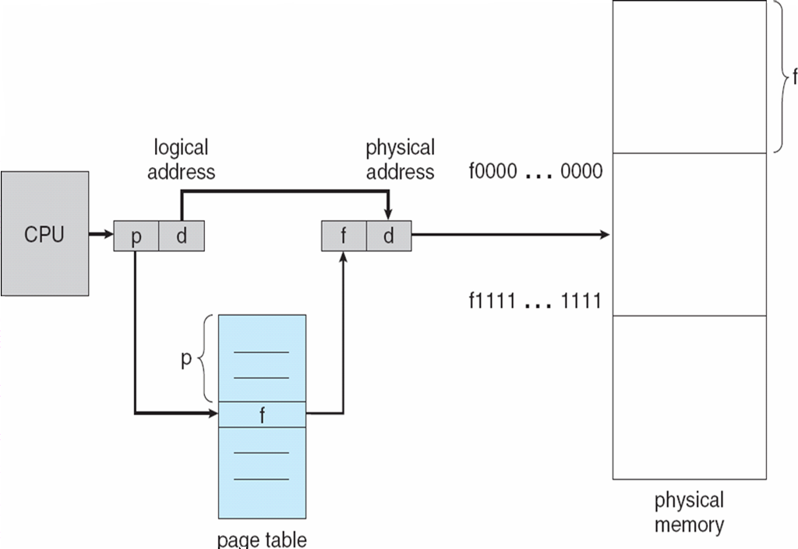
Address Translation Architecture
Hanyang University
Data-Centric Systems Lab.

Slide 21

Paging Model of Logical and Physical Memory
Hanyang University
Data-Centric Systems Lab.

Slide 22

Paging Example
Page Number = 2/4 = 0
Offset = 2%4 = 2
Logical address (m): 4 bits
Page number (m-n): 2 bits
Offset (n): 2 bits
m = 5
32-byte memory and 4-byte pages
n = 2
Hanyang University
Data-Centric Systems Lab.

Slide 23

Free Frames
Before allocation
After allocation
Hanyang University
Data-Centric Systems Lab.

Slide 24
Implementation of Page Table
Page table is kept in main memory
Page-table base register (PTBR) points to the page table
Page-table length register (PTLR) indicates size of the page table
Every memory (data/instruction) access requires two memory accesses
  One for the page table and one for the data/instruction
To speed up, a special fast-lookup hardware cache called Translation Look-aside Buffer (TLB) or Associative memory is used
Some TLBs store address-space identifiers (ASIDs) in each TLB entry – uniquely identifies each process to provide address-space protection for that process
Hanyang University
Data-Centric Systems Lab.

Slide 25
Associative Memory (TLB)
  Two types of memory
    General memory: (ex: DRAM)
      give address -- return record
    Associative memory: (ex: Phone book)
      give field of record -- return record
      Very slow without parallel search (or indexing)
      High cost for implementation
Associative Memory (TLB) – parallel search
  Since only part of page table is in TLB
Address translation (p, d)
  Try portion of page table in associative memory first
  If p is in associative register, get frame # out
  Otherwise, get frame # from page table in main memory
  TLB is flushed (remove old entries) at context switching time
Page #
Frame #
record
Hanyang University
Data-Centric Systems Lab.

Slide 26

Paging Hardware with TLB
Hanyang University
Data-Centric Systems Lab.

Slide 27
Effective Access Time
Associative lookup = α time unit
memory access time = β
Hit ratio = ε
    percentage found in the associative memory
Effective Access Time (EAT)
<hit> <miss>
EAT = (α + β) ε + (α + 2 β)(1 – ε)
= α + (2 - ε) β
Hanyang University
Data-Centric Systems Lab.

Slide 28
Memory Protection
Memory protection implemented by associating protection bit with each frame
Valid-invalid bit - each entry in the page table:
  “valid” indicates the page is legal (a valid page)
    The associated page is in the process’ logical-address space
  “invalid” indicates otherwise (access not allowed)
Hanyang University
Data-Centric Systems Lab.

Slide 29

Valid (v) or Invalid (i) Bit in a Page Table
Page size = 2 KB
Uses only addresses 0 to 10468
6 (=10469/2048) pages are allocated to the process
Only 6 entries are used in the page table
PTLR can be used to test the validity of the address instead of the valid-invalid bit
Hanyang University
Data-Centric Systems Lab.

Slide 30
Shared Pages
Shared code
  One copy of read-only (re-entrant) code shared among processes (eg, text editors, compilers, window systems)
  Shared code must appear in same location in the logical address space of all processes
    To enable self-reference in the shared code
Private code and data
  Each process keeps a separate copy of the data
  The pages for the private code and data can appear anywhere in the logical address space
Hanyang University
Data-Centric Systems Lab.

Slide 31

Shared Pages Example
Editor is shared (Editor consists of 3 pages -- ed1, ed2, ed3)
Hanyang University
Data-Centric Systems Lab.

Slide 32
Structure of the Page Table
Hierarchical Paging
  Break up the logical address space into multiple page tables
Hashed Page Tables
Inverted Page Tables
Hanyang University
Data-Centric Systems Lab.

Slide 33
Two-Level Page-Table Scheme (Hierarchical Paging)
Program has a large address space:
    Use 32 bit address and 4 KB (= 2¹² ) page size (m = 32, n = 12)
    m-n = 20, hence 2²⁰ logical pages
    1 million (2²⁰) page table entries
    4 MB (2²² bytes) page table size (if each entry is 4 Bytes)
    To store 4 MB page table, 1 K (= 2¹⁰) page frames needed per a process
Store entire page table in disk
Page table itself is on-demand loaded in a page unit
  Needs page table for page table
Hanyang University
Data-Centric Systems Lab.

Slide 34

Two-Level Page-Table Scheme
Where is the page table page that stores the physical page number for this logical page?
Where is the physical page for this logical page?
Hanyang University
Data-Centric Systems Lab.

Slide 35
Two-Level Paging Example
A logical address (on 32-bit machine with 4K page size) is divided into:
  a page number consisting of 20 bits
  a page offset consisting of 12 bits
Since the page table is paged, the page number is further divided into:
  a 10-bit page number : for 1 K pages (for page table)
  a 10-bit page offset : for 1 K entries in a page (of page table)
Thus, a logical address is as follows:
where p₁ is an index into the outer page table, and
p₂ is the displacement within the page of the inner page table
page number
page offset
p₁
p₂
d
10
10
12
Hanyang University
Data-Centric Systems Lab.

Slide 36

Address-Translation Scheme
Address-translation scheme for a two-level 32-bit paging architecture
Forward-mapped page table
  Pentium-II uses this architecture
Hanyang University
Data-Centric Systems Lab.

Slide 37
Multilevel Paging and Performance
For even larger address space, the third page is (like B-tree)
not data block, but next level page table
Since each level is stored as a separate table in memory, converting a logical address to a physical one may take three, four memory accesses
Even though time needed for one memory access is quintupled, TLB permits performance to remain reasonable
TLB hit rate of 98 percent with 4-level paging yields:
effective access time = 0.98 x 120 + 0.02 x 520 = 128 nanoseconds,
which is only a 28 percent slowdown in memory access time
(assuming TLB access time = 20 ns, memory access time = 100 ns)
Nevertheless, if address is 64 bits : 6-levels of paging : inappropriate
In current 64-bits OSes, only 48 bits are used for addressing : 4-levels
Hanyang University
Data-Centric Systems Lab.

Slide 38
Hashed Page Tables
For address spaces > 32 bits
The virtual page number is hashed into a page table
  This page table contains a chain of elements hashing to the same location
Virtual page numbers are compared in this chain searching for a match. If a match is found, the corresponding physical frame is extracted.
Hanyang University
Data-Centric Systems Lab.

Slide 39

Hashed Page Table
Hanyang University
Data-Centric Systems Lab.

Slide 40
Inverted Page Table
Problem: why page table so large? → page table size is proportional to the number of pages: one page-table-entry per “logical” page
However, only a small number of pages are needed (memory resident) at a time
Cure: let one page-table-entry per “physical” page frame
each page table entry includes process-id
one system-wide page table :
Required number of entries are the number of page frames
All processes share the page table
Drawback: It is associative search and need to search entire table.
Page sharing is impossible.
Remedy: use hash table to limit the search : one more memory lookup
use associative registers (TLB) for speedup
Hanyang University
Data-Centric Systems Lab.

Slide 41

Inverted Page Table Architecture
Hanyang University
Data-Centric Systems Lab.

Slide 42
Segmentation
Memory management scheme that supports user view of memory
A program is a collection of variable length segments
A segment is a logical unit such as:
main (),
function,
global variables,
stack,
symbol table, arrays
Hanyang University
Data-Centric Systems Lab.

Slide 43

User’s View of a Program
Hanyang University
Data-Centric Systems Lab.

Slide 44
Segmentation Architecture
Logical address structure:
< segment-number, offset >
Segment table
  maps two dimensional logical address into physical addresses
  each table entry has:
    base – contains the starting physical address where the segments reside in memory
    limit – specifies the length of the segment
Segment-table base register (STBR)
  points to the segment table’s location in memory
Segment-table length register (STLR)
  indicates number of segments used by a program;
segment number s is legal if s < STLR
Hanyang University
Data-Centric Systems Lab.

Slide 45

Example of Segmentation
Hanyang University
Data-Centric Systems Lab.

Slide 46

Segmentation Hardware
Hanyang University
Data-Centric Systems Lab.

Slide 47
Segmentation Architecture (Cont.)
Protection
  With each entry in segment table associate:
    validation bit = 0 ⇒ illegal segment
    R/W/X bits
Sharing
  Protection bits associated with segments: code sharing occurs at segment level
  Each process should have the same segment number for the shared segment
    Ex. Self-referencing code segment references itself using segment number and offset
Allocation
  Since segments vary in length, memory allocation is a dynamic storage-allocation problem.
  first fit / best fit
  external fragmentation, but no internal fragmentation
Hanyang University
Data-Centric Systems Lab.

Slide 48

Sharing of Segments
Hanyang University
Data-Centric Systems Lab.

Slide 49
Segmentation with Paging – MULTICS
The MULTICS system solved problems of external fragmentation by paging the segments
Solution differs from pure segmentation in that the segment-table entry contains
  not the base address of the segment
  but rather the base address of a page table for this segment
Hanyang University
Data-Centric Systems Lab.

Slide 50
Segmentation with Paging
Segment
number s
Page
number p
Displacement
d
Virtual address
v = (s, p, d)
Virtual address format in a paged and segmented system
Hanyang University
Data-Centric Systems Lab.

Slide 51

MULTICS Address Translation Scheme
Hanyang University
Data-Centric Systems Lab.

Slide 52
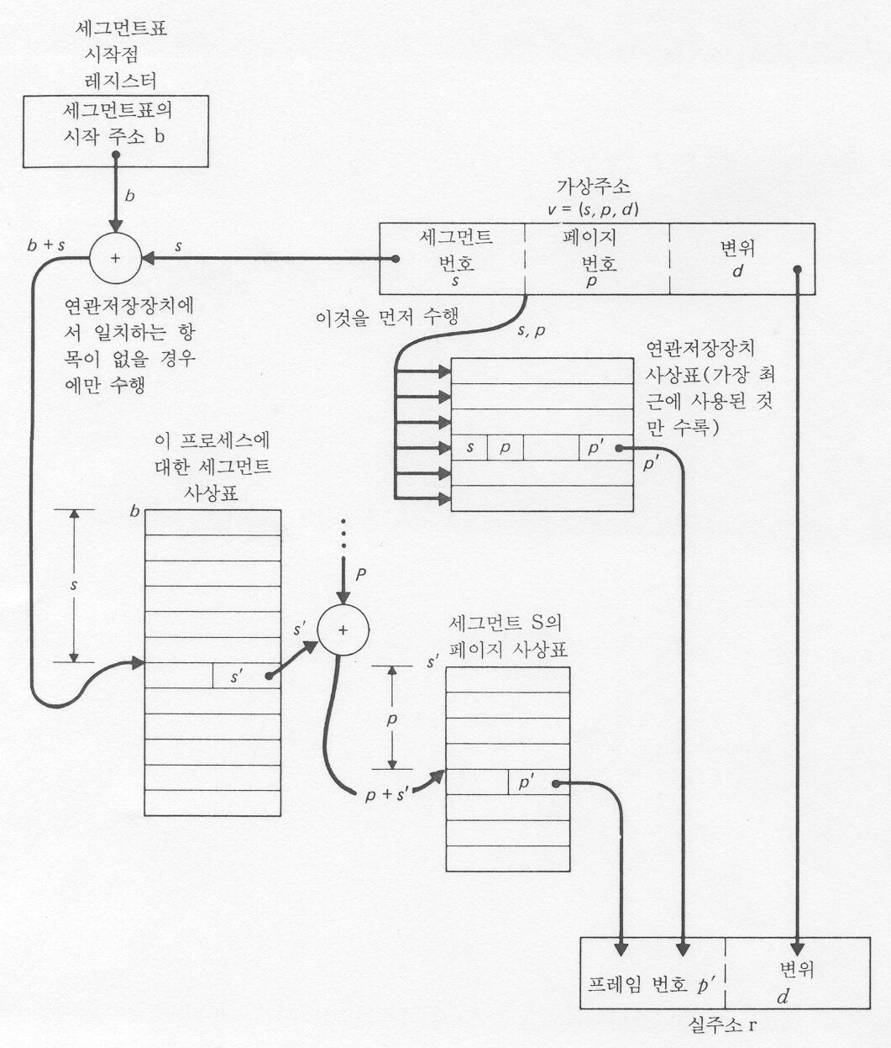
Segmentation with Paging (overall)
Hanyang University
Data-Centric Systems Lab.

Slide 53
Example: The Intel Pentium
Supports both segmentation and segmentation with paging
CPU generates logical address
  Given to segmentation unit which produces linear addresses
  Linear address given to paging unit
    which generates physical address in main memory
    Paging units form equivalent of MMU
Hanyang University
Data-Centric Systems Lab.

Slide 54


Logical to Physical Address Translation in Pentium
Hanyang University
Data-Centric Systems Lab.

Slide 55

Intel Pentium Segmentation
Hanyang University
Data-Centric Systems Lab.

Slide 56

Pentium Paging Architecture
Hanyang University
Data-Centric Systems Lab.

Slide 57

Linear Address in Linux
Broken into four parts:
Hanyang University
Data-Centric Systems Lab.

Slide 58
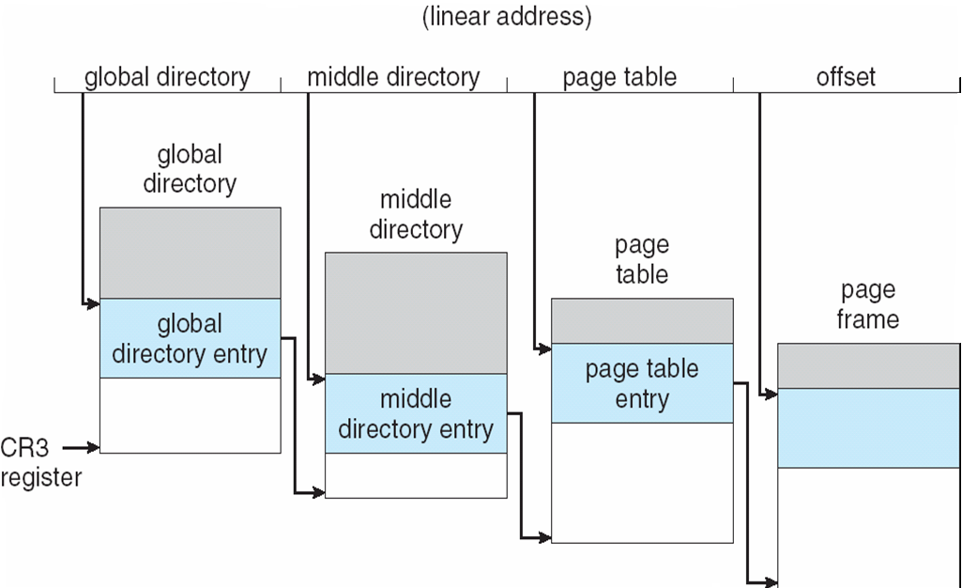
Three-level Paging in Linux
Hanyang University
Data-Centric Systems Lab.

