Slide 1
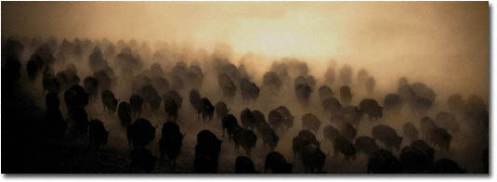
Operating System Overview

Slide 2
What is an Operating System?
A program that acts as an intermediary between a user of a computer and the computer hardware
Operating system goals:
  Execute user programs and make solving user problems easier
  Make the computer system convenient to use
  Use the computer hardware in an efficient manner
Hanyang University
Date-Centric Systems Lab.

Slide 3

Operating System Structure
Multiprogramming needed for efficiency
  Single user cannot keep CPU and I/O devices busy at all times
  Multiprogramming organizes jobs (code and data) so that CPU always has one to execute
  A subset of total jobs in system is kept in memory
  One job selected and run via job scheduling
  When it has to wait (for I/O for example), OS switches to another job
Timesharing (multitasking) is logical extension in which CPU switches jobs so frequently that users can interact with each job while it is running. Creates interactive computing
  Response time should be < 1 second
  Each user has at least one program executing in memory process
  If several jobs ready to run at the same time  CPU scheduling
  If processes don’t fit in memory, swapping moves them in and out to run
  Virtual memory allows execution of processes not completely in memory
Hanyang University
Date-Centric Systems Lab.

Slide 4
Operating-System Operations
Interrupt driven by hardware
Software error or request creates exception or trap
  Division by zero, request for operating system service
Dual-mode operation allows OS to protect itself and other system components
  User mode and kernel mode
  Mode bit provided by hardware
    Provides ability to distinguish when system is running user code or kernel code
    Some instructions designated as privileged, only executable in kernel mode
    System call changes mode to kernel, return from call resets it to user
Hanyang University
Date-Centric Systems Lab.

Slide 5

Transition from User to Kernel Mode
Hanyang University
Date-Centric Systems Lab.

Slide 6
Process Management
A process is a program in execution. It is a unit of work within the system. Program is a passive entity, process is an active entity.
Process needs resources to accomplish its task
  CPU, memory, I/O, files
  Initialization data
Process termination requires reclaim of any reusable resources
Single-threaded process has one program counter specifying location of next instruction to execute
Multi-threaded process has one program counter per thread
Typically system has many processes, some user, some operating system running concurrently on one or more CPUs
  Concurrency by multiplexing the CPUs among the processes / threads
Hanyang University
Date-Centric Systems Lab.

Slide 7
Process Management Activities
The operating system is responsible for the following activities in connection with process management:
Creating and deleting both user and system processes
Suspending and resuming processes
Providing mechanisms for process synchronization
Providing mechanisms for process communication
Providing mechanisms for deadlock handling
Hanyang University
Date-Centric Systems Lab.

Slide 8
Memory Management
All data in memory before and after processing
All instructions in memory in order to execute
Memory management determines what is in memory when
  Optimizing CPU utilization and response time to users
Memory management activities
  Keeping track of which parts of memory are currently being used and by whom
  Deciding which processes (or parts thereof) and data to move into and out of memory
  Allocating and deallocating memory space as needed
Hanyang University
Date-Centric Systems Lab.

Slide 9
Storage Management
OS provides uniform, logical view of information storage
  Abstracts physical properties to logical storage unit - file
  Each medium is controlled by device (i.e., disk drive, tape drive)
    Varying properties include access speed, capacity, data-transfer rate, access method (sequential or random)
File-System management
  Files usually organized into directories
  Access control on most systems to determine who can access what
  OS activities include
    Creating and deleting files and directories
    Primitives to manipulate files and dirs
    Mapping files onto secondary storage
    Backup files onto stable (non-volatile) storage media
Hanyang University
Date-Centric Systems Lab.

Slide 10
Mass-Storage Management
Usually disks used to store data that does not fit in main memory or data that must be kept for a “long” period of time
Proper management is of central importance
Entire speed of computer operation hinges on disk subsystem and its algorithms
OS activities
  Free-space management
  Storage allocation
  Disk scheduling
Some storage need not be fast
  Tertiary storage includes optical storage, magnetic tape
  Still must be managed
  Varies between WORM (write-once, read-many-times) and RW (read-write)
Hanyang University
Date-Centric Systems Lab.

Slide 11

Performance of Various Levels of Storage
< 64 GB
Hanyang University
Date-Centric Systems Lab.

Slide 12

Migration of Integer A from Disk to Register
Multitasking environments must be careful so as to use most recent value, no matter where it is stored in the storage hierarchy
Multiprocessor environment must provide cache coherency in hardware such that all CPUs have the most recent value in their cache
Distributed environment situation even more complex
  Several copies of a datum can exist
Hanyang University
Date-Centric Systems Lab.

Slide 13
I/O Subsystem
One purpose of OS is to hide peculiarities of hardware devices from the user
I/O subsystem responsible for
  Memory management of I/O including buffering (storing data temporarily while it is being transferred), caching (storing parts of data in faster storage for performance), spooling (the overlapping of output of one job with input of other jobs)
  General device-driver interface
  Drivers for specific hardware devices
Hanyang University
Date-Centric Systems Lab.

Slide 14
Protection and Security
Protection – any mechanism for controlling access of processes or users to resources defined by the OS
Security – defense of the system against internal and external attacks
  Huge range, including denial-of-service, worms, viruses, identity theft
Systems generally first distinguish among users, to determine who can do what
  User identities (user IDs, security IDs) include name and associated number, one per user
  User ID then associated with all files, processes of that user to determine access control
  Group identifier (group ID) allows set of users to be defined and controls managed, then also associated with each process, file
  Privilege escalation allows user to change to effective ID with more rights (ex. setuid)
Hanyang University
Date-Centric Systems Lab.

Slide 15
Operating System Services
A set of operating-system services provides functions that are helpful to the user:
  User interface - Almost all operating systems have a user interface (UI)
    Varies between Command-Line Interface(CLI), Graphics User Interface (GUI), Batch Interface
  Program execution - The system must be able to load a program into memory and to run that program, end execution, either normally or abnormally (indicating error)
  I/O operations - A running program may require I/O, which may involve a file or an I/O device
  File-system manipulation - The file system is of particular interest. Obviously, programs need to read and write files and directories, create and delete them, search them, list file Information, permission management.
Hanyang University
Date-Centric Systems Lab.

Slide 16
Operating System Services (Cont)
One set of operating-system services provides functions that are helpful to the user (Cont):
  Communications – Processes may exchange information, on the same computer or between computers over a network
    Communications may be via shared memory or through message passing (packets moved by the OS)
  Error detection – OS needs to be constantly aware of possible errors
    May occur in the CPU and memory hardware, in I/O devices, in user program
    For each type of error, OS should take the appropriate action to ensure correct and consistent computing
    Debugging facilities can greatly enhance the user’s and programmer’ abilities to efficiently use the system
Hanyang University
Date-Centric Systems Lab.

Slide 17
Operating System Services (Cont)
Another set of OS functions exists for ensuring the efficient operation of the system itself via resource sharing
  Resource allocation - When multiple users or multiple jobs running concurrently, resources must be allocated to each of them
  Accounting - To keep track of which users use how much and what kinds of computer resources
  Protection and security - The owners of information stored in a multiuser or networked computer system may want to control use of that information, concurrent processes should not interfere with each other
    Protection involves ensuring that all access to system resources is controlled
    Security of the system from outsiders requires user authentication, extends to defending external I/O devices from invalid access attempts
    If a system is to be protected and secure, precautions must be instituted throughout it. A chain is only as strong as its weakest link.
Hanyang University
Date-Centric Systems Lab.

Slide 18

A View of Operating System Services
Hanyang University
Date-Centric Systems Lab.

Slide 19
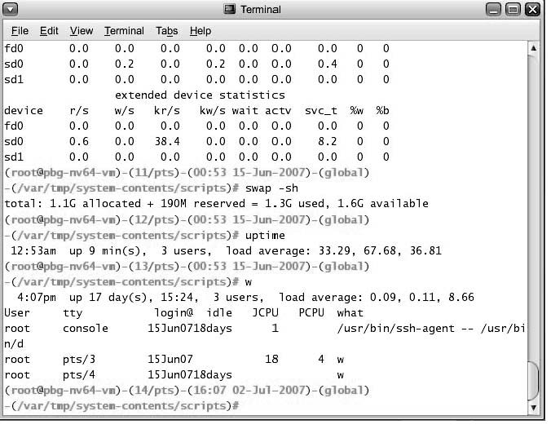
User Operating System Interface - CLI
Command Line Interface (CLI) or command interpreter allows direct command entry
  Sometimes implemented in kernel, sometimes by systems program
  Sometimes multiple flavors implemented – shells
  Primarily fetches a command from user and executes it
Hanyang University
Date-Centric Systems Lab.

Slide 20
User Operating System Interface - GUI
User-friendly desktop metaphor interface
  Usually mouse, keyboard, and monitor
  Icons represent files, programs, actions, etc
  Various mouse buttons over objects in the interface cause various actions (provide information, options, execute function, open directory (known as a folder)
  Invented at Xerox PARC
Many systems now include both CLI and GUI interfaces
  Microsoft Windows is GUI with CLI “command” shell
  Apple Mac OS X as “Aqua” GUI interface with UNIX kernel underneath and shells available
  Solaris is CLI with optional GUI interfaces (Java Desktop, KDE)
Hanyang University
Date-Centric Systems Lab.

Slide 21
System Calls
Programming interface to the services provided by the OS
Typically written in a high-level language (C or C++)
Mostly accessed by programs via a high-level Application Program Interface (API) rather than direct system call use
Three most common APIs are Win32 API for Windows, POSIX API for POSIX-based systems (including virtually all versions of UNIX, Linux, and Mac OS X), and Java API for the Java virtual machine (JVM)
Why use APIs rather than system calls?
  Portability
  Ease of use
Hanyang University
Date-Centric Systems Lab.

Slide 22

Example of System Calls
System call sequence to copy the contents of one file to another file
Hanyang University
Date-Centric Systems Lab.

Slide 23
System Call Implementation
Typically, a number associated with each system call
  System-call interface maintains a table indexed according to these numbers
The system call interface invokes intended system call in OS kernel and returns status of the system call and any return values
The caller need to know nothing about how the system call is implemented
  Just needs to obey API and understand what OS will do as a result
  Most details of OS interface hidden from programmer by API
    Managed by run-time support library (set of functions built into libraries included with compiler)
Hanyang University
Date-Centric Systems Lab.

Slide 24

API – System Call – OS Relationship
Use system call, directly
Hanyang University
Date-Centric Systems Lab.

Slide 25

Standard C Library Example
C program invoking printf() library call, which calls write() system call
Hanyang University
Date-Centric Systems Lab.

Slide 26
System Call Parameter Passing
Often, more information is required than simply identity of desired system call
  Exact type and amount of information vary according to OS and call
Three general methods used to pass parameters to the OS
  Simplest: pass the parameters in registers
    In some cases, may be more parameters than registers
  Parameters stored in a block, or table, in memory, and address of block passed as a parameter in a register
    This approach taken by Linux and Solaris
  Parameters placed, or pushed, onto the stack by the program and popped off the stack by the operating system
  Block and stack methods do not limit the number or length of parameters being passed
Hanyang University
Date-Centric Systems Lab.

Slide 27

Parameter Passing via Table
Hanyang University
Date-Centric Systems Lab.

Slide 28
Types of System Calls
Process control
File management
Device management
Information maintenance
Communications
Protection
Hanyang University
Date-Centric Systems Lab.

Slide 29

Examples of Windows and Unix System Calls
Hanyang University
Date-Centric Systems Lab.

Slide 30
System Programs
System programs provide a convenient environment for program development and execution. They can be divided into:
  File manipulation
  Status information
  File modification
  Programming language support
  Program loading and execution
  Communications
  Application programs
Most users’ view of the operation system is defined by system programs, not the actual system calls
Hanyang University
Date-Centric Systems Lab.

Slide 31
System Programs
Provide a convenient environment for program development and execution
  Some of them are simply user interfaces to system calls; others are considerably more complex
File management - Create, delete, copy, rename, print, dump, list, and generally manipulate files and directories
Status information
  Some ask the system for info - date, time, amount of available memory, disk space, number of users
  Others provide detailed performance, logging, and debugging information
  Typically, these programs format and print the output to the terminal or other output devices
  Some systems implement a registry - used to store and retrieve configuration information
Hanyang University
Date-Centric Systems Lab.

Slide 32
System Programs (cont’d)
File modification
  Text editors to create and modify files
  Special commands to search contents of files or perform transformations of the text
Programming-language support - Compilers, assemblers, debuggers and interpreters sometimes provided
Program loading and execution- Absolute loaders, relocatable loaders, linkage editors, and overlay-loaders, debugging systems for higher-level and machine language
Communications - Provide the mechanism for creating virtual connections among processes, users, and computer systems
  Allow users to send messages to one another’s screens, browse web pages, send electronic-mail messages, log in remotely, transfer files from one machine to another
Hanyang University
Date-Centric Systems Lab.

Slide 33
Operating System Design and Implementation
Design and Implementation of OS is not “solvable”, but some approaches have proven successful
Internal structure of different Operating Systems can vary widely
Start by defining goals and specifications
Affected by choice of hardware, type of system
User goals and System goals
  User goals – operating system should be convenient to use, easy to learn, reliable, safe, and fast
  System goals – operating system should be easy to design, implement, and maintain, as well as flexible, reliable, error-free, and efficient
Hanyang University
Date-Centric Systems Lab.

Slide 34

Layered Approach
The operating system is divided into a number of layers (levels), each built on top of lower layers. The bottom layer (layer 0), is the hardware; the highest (layer N) is the user interface.
With modularity, layers are selected such that each uses functions (operations) and services of only lower-level layers
Hanyang University
Date-Centric Systems Lab.

Slide 35
Microkernel System Structure
Moves as much from the kernel into “user” space
Communication takes place between user modules using message passing
Benefits:
  Easier to extend a microkernel
  Easier to port the operating system to new architectures
  More reliable (less code is running in kernel mode)
  More secure
Detriments:
  Performance overhead of user space to kernel space communication
Hanyang University
Date-Centric Systems Lab.

Slide 36
Modules
Most modern operating systems implement kernel modules
  Uses object-oriented approach
  Each core component is separate
  Each talks to the others over known interfaces
  Each is loadable as needed within the kernel
Overall, similar to layers but with more flexible
Hanyang University
Date-Centric Systems Lab.

Slide 37
Virtual Machines
A virtual machine takes the layered approach to its logical conclusion. It treats hardware and the operating system kernel as though they were all hardware
A virtual machine provides an interface identical to the underlying bare hardware
The operating system host creates the illusion that a process has its own processor and (virtual memory)
Each guest provided with a (virtual) copy of underlying computer
Hanyang University
Date-Centric Systems Lab.

Slide 38
Virtual Machines History and Benefits
First appeared commercially in IBM mainframes in 1972
Fundamentally, multiple execution environments (different operating systems) can share the same hardware
Protect from each other
Some sharing of file can be permitted, controlled
Commutate with each other, other physical systems via networking
Useful for development, testing
Consolidation of many low-resource user systems onto fewer busier systems
Hanyang University
Date-Centric Systems Lab.

Slide 39

Virtual Machines
(a) Nonvirtual machine (b) virtual machine
Hanyang University
Date-Centric Systems Lab.

Slide 40
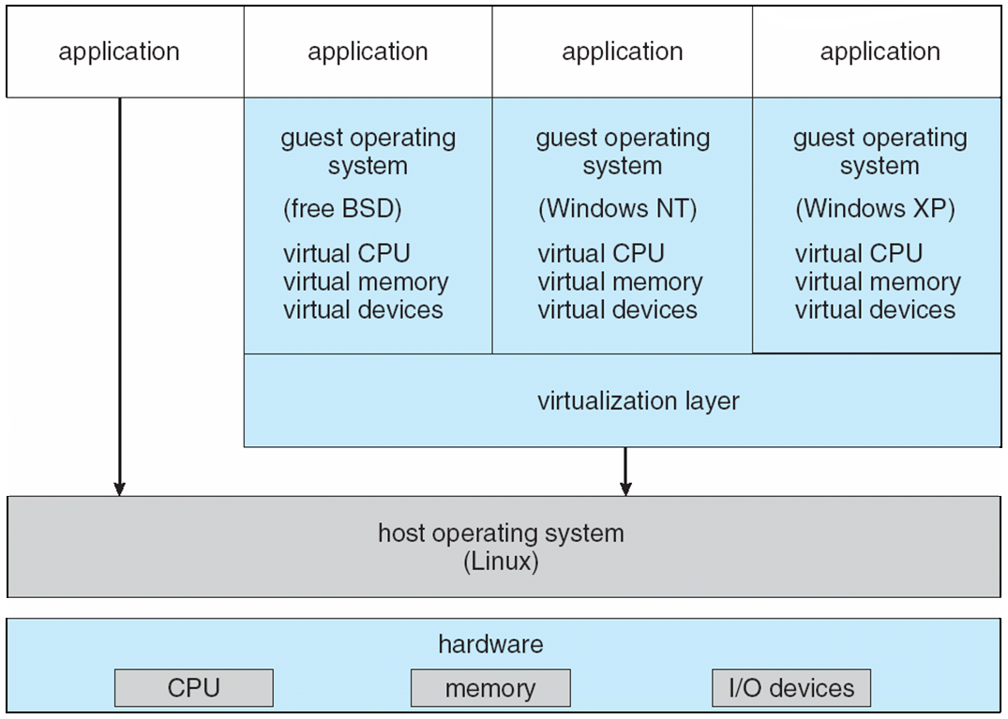
Virtual Machine Example: VMware Architecture
Hanyang University
Date-Centric Systems Lab.

Slide 41
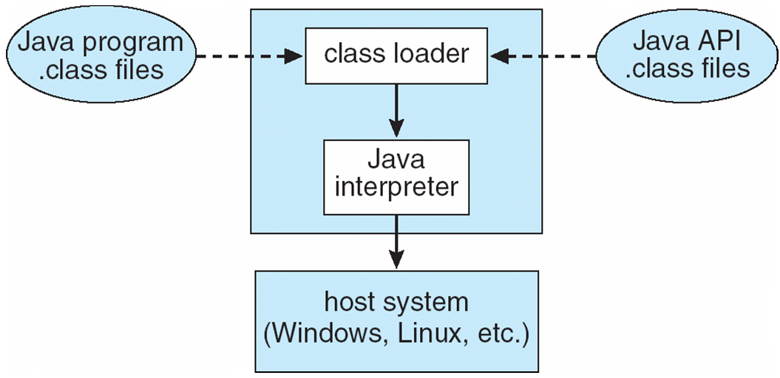

The Java Virtual Machine
“Write (Compile) once, run anywhere”
JVM
Hanyang University
Date-Centric Systems Lab.

