Slide 1
UNIX System Overview
시스템 프로그래밍
Fall 2013
Division of Computer Science & Engineering
Hanyang University

Slide 2
System Programming
Unix System Overview
Unix Standardization and Implementations
File I/O
Files and Directories
Standard I/O Library
System Data Files and Information
Process Environment
Process Control
Process Relationships
Signals
Advanced I/O
Network IPC: Sockets
Notes:
Topics not covered – threads, thread control, IPC, advanced IPC, terminal I/O

Slide 3
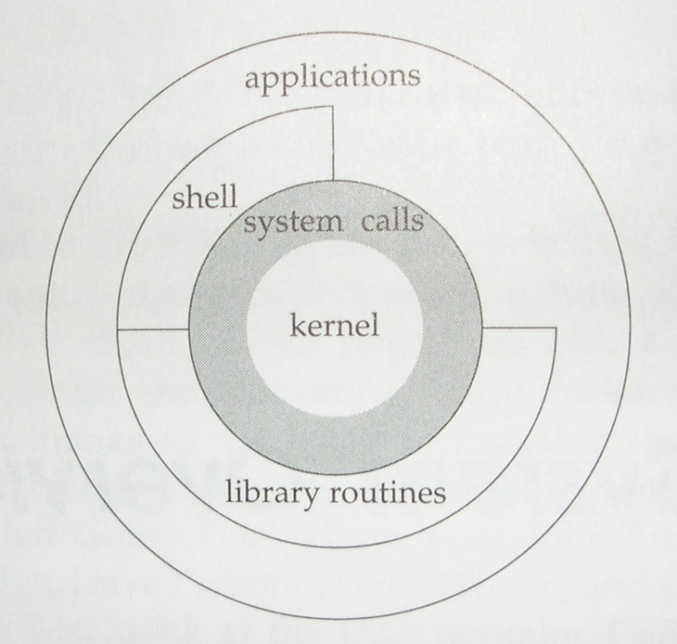
UNIX Architecture
Programming interface to the kernel
System call interfaces and functions in the standard C library

Slide 4
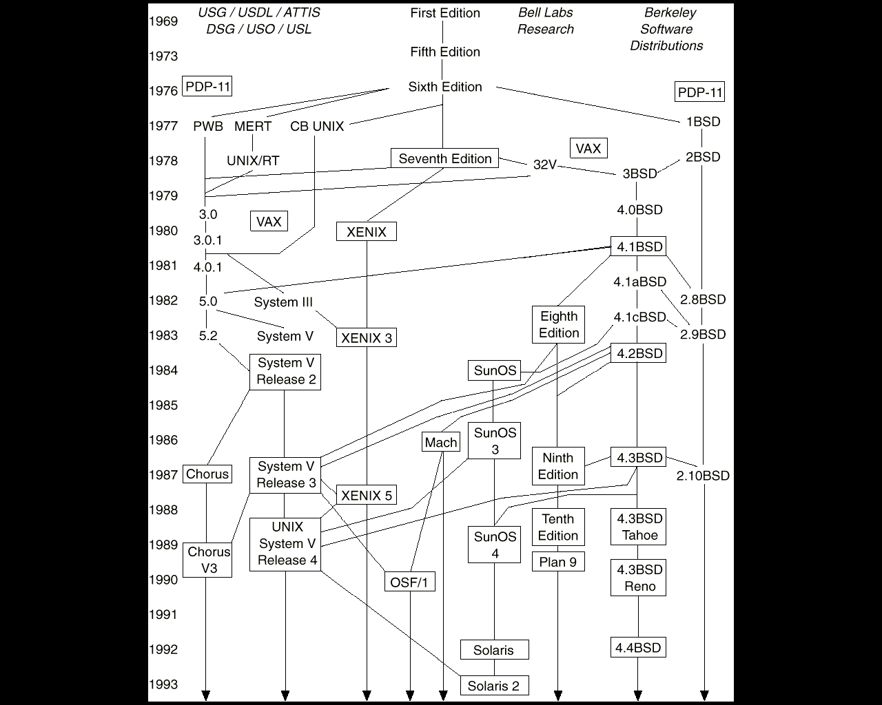
History of UNIX
Adopted from Operating System Concepts
by Abraham Silberschatz et al.
For a full history, refer to http://www.levenez.com/unix

Slide 5
Logging In
/etc/passwd composed of seven colon-separated fields:
chl:x:401:200:Choonhwa Lee:/cise/home/chl:/bin/tcsh
login name:password:user ID:group ID:comment:home directory:shell
/etc/shadow
[sh|csh|tcsh|bash|ksh|zsh]
chl: encrypted passwd
+ passwd aging
/etc/group
hlab::200:chl,helal,…

Slide 6
Files and Directories
UNIX file system: a hierarchical arrangement of directories and files
File
A directory is a file that contains directory entries.
Filename
At least 255 character filenames (Most commercial UNIX)
Special names: “/”, “.”, and “..”
Pathname
A sequence of zero or more file names, separated by slash, and optionally starting with a slash
Absolute pathname vs. relative pathname
Current Working Directory
“.”
pwd

Slide 7
UNIX File System
/
$ pwd
/home/chl
$ ls syst-prog
prog1 prog2 prog3
$ ls ../././chl/syst-prog
prog1 prog2 prog3
$ ls /home/chl/syst-prog
prog1 prog2 prog3
etc
proc
home
usr
lib
include
chl
os
sys
syst-prog
stdio.h
stdlib.h
…
prog1
prog2
prog3
errno.h
types.h
….

Slide 8
Input and Output
File descriptors: small non-negative integers to identify the files
Standard input, output, and error
stdin, stdout, and stderr
Redirections: “<“, “>”, and “>&” in the case of csh
Unbuffered I/O vs. Standard I/O
(open, read, write, …) vs. (fopen, fgetc, printf, …)
Program 1.4 & Program 1.5
(All the examples in http://www.apuebook.com/src.tar.gz)

Slide 9
Program 1.4
#include "apue.h“
#define BUFFSIZE 4096
int main(void)
{
int n;
char buf[BUFFSIZE];
while ((n = read(STDIN_FILENO, buf, BUFFSIZE)) > 0)
if (write(STDOUT_FILENO, buf, n) != n)
err_sys("write error");
if (n < 0)
err_sys("read error");
exit(0);
}

Slide 10
Program 1.5
#include "apue.h“
int main(void)
{
int c;
while ((c = getc(stdin)) != EOF)
if (putc(c, stdout) == EOF)
err_sys("output error");
if (ferror(stdin))
err_sys("input error");
exit(0);
}

Slide 11
Programs and Processes
Program: an executable file residing on disk
Process: an executing instance of a program
Process ID: a nonnegative integer
Process control: fork, exec, and waitpid in Program 1.7
while loop
pid=fork()
waitpid(pid)
start
Pg1.7
“pid>0”
Pg1.7
exit
“pid==0”
exit
Pg1.7
“ls”
execlp(“ls”, …)
Notes:
The term task is used to refer to process by some operating systems.

Slide 12
Program 1.7
#include "apue.h“
#include <sys/wait.h>
int main(void)
{
char buf[MAXLINE]; /* from apue.h */
pid_t pid;
int status;
printf("%% ");
while (fgets(buf, MAXLINE, stdin) != NULL) {
if (buf[strlen(buf) - 1] == '\n')
buf[strlen(buf) - 1] = 0;
if ((pid = fork()) < 0) {
err_sys("fork error");
} else if (pid == 0) { /* child */
execlp(buf, buf, (char *)0);
err_ret("couldn't execute: %s", buf);
exit(127);
}
/* parent */
if ((pid = waitpid(pid, &status, 0)) < 0)
err_sys("waitpid error");
printf("%% ");
}
exit(0);
}

Slide 13
Threads
A thread of control
All the thread within a process share
Address space
File descriptors
Stacks
process-related attributes
Accesses to shared data should be synchronized

Slide 14
Error Handling
In case of an error, a negative value (or a null pointer) is returned, and the errno is set to a value to give additional info.
/usr/include/(sys/)errno.h
extern int errno;
#define EAGAIN 11 /* Resource temporarily unavailable */
#define ENOMEM 12 /* Not enough core */
#define EACCES 13 /* Permission denied */
Never cleared if no error occurs
/usr/include/string.h
char *strerror(int errnum);
/usr/include/stdio.h
void perror(const char *msg);

Slide 15
Signals
A technique to notify a process that some condition has occurred.
On receipt of a signal, a process can
ignore the signal (not recommended.)
let the default action occur.
call your own handler (catch the signal.)
To generate a signal, [Ctrl-C], [Ctrl-backslash], or kill().
Program 1.10

Slide 16
Program 1.10
#include "apue.h"
#include <sys/wait.h>
static void sig_int(int); /* our signal-catching function */
int main(void)
{
char buf[MAXLINE]; /* from apue.h */
pid_t pid;
int status;
if (signal(SIGINT, sig_int) == SIG_ERR)
err_sys("signal error");
printf("%% ");/* print prompt (printf requires %% to print %) */
while (fgets(buf, MAXLINE, stdin) != NULL) {
if (buf[strlen(buf) - 1] == '\n')
buf[strlen(buf) - 1] = 0; /* replace newline with null */

Slide 17
Program 1.10 (cont’d)
if ((pid = fork()) < 0) {
err_sys("fork error");
} else if (pid == 0) {/* child */
execlp(buf, buf, (char *)0);
err_ret("couldn't execute: %s", buf);
exit(127);
}
/* parent */
if ((pid = waitpid(pid, &status, 0)) < 0)
err_sys("waitpid error");
printf("%% ");
}
exit(0);
}
void sig_int(int signo)
{
printf("interrupt\n%% ");
}

Slide 18
UNIX Time Values
Calendar time vs. Process time
Calendar time in the number of seconds since 00:00:00 Jan. 1, 1970, UTC (time_t)
Process time in clock ticks (clock_t)
Clock time (wall clock time), user CPU time, and system CPU time
$ time ls
Notes:
Process time (also called CPU time) – historically 50, 60, or 100 ticks per second

Slide 19
Sys Calls and Library Functions
50 system calls for Unix Version 7, 110 for 4.4BSD, 120 for SVR4, 240-260 for Linux, and 320 for FreeBSD.
System call – manual section 2
Library – manual section 3C, 3m, …
* truss(1) or strace
More elaborate functionality
Atop of sbrk(), malloc() enables better memory allocation management.
Atop of time(), gmtime() provides broken-down time.
Atop of read(), getc() supports buffered I/O.
Application
code
user process
C library
functions
system calls
kernel
Notes:
All operating systems provide service points through which programs request services from the kernel. All implementations of the UNIX system provide a well-defined, limited number of entry points directly into the kernel called
System called.
brk, sbrk – change the amount of space allocated for the calling process’s data segment.
Here we have a clean separation of duties: the system call in the kernel allocates an additional chunk of space on behalf of the process. The malloc library function manages this space from user level.

Slide 20
Unix man pages
Sections
1 – commands, e.g. ls(1)
2 – system calls and error numbers, e.g. read(2)
3 – functions and libraries such as 3C, 3M, etc
4 – file formats, e.g. passwd(4)
5 – miscellany, e.g. environ(5)
6 – games and demos
7 – special files, e.g. hme(7D)
8
9 – device driver interface
/usr/man/* (/usr/local/man/*)
Search path: MANPATH

Slide 21
Unix man pages
$ man man
$ man –s 1 time
$ man –s 2 time
$ man –s 1 intro
$ man –s 3 intro
$ man –s 3c intro
$ man md
$ cat /usr/man/man7/md.7 | nroff –man | more

