Slide 1
Interprocess Communication
시스템 프로그래밍
Fall 2013
Div. Of Computer Science & Engineering
Hanyang University

Slide 2
Introduction
On the same host → 차지하는 메모리공간이 달라서 서로 교신해야함~~.
Pipes, FIFOs, message queues, semaphores, and shared memory(공용 메모리)
On different hosts
Sockets(대중적) and STREAMS-based pipes

Slide 3
Pipes
The oldest form of Unix IPC and provided by all Unix systems.
Half-duplex
Between processes that have a common ancestor (pipe 공유 해야함!!)
Notes:
Half-duplex – data flows in only one direction.
Every time you type a sequence of commands in a pipeline for the shell to execute, the shell creates a separate process for each command and links the standard output of one to the standard input of the next using a pipe.

Slide 4
Pipes
#include <unistd.h>
int pipe(int filedes[2])
filedes[0] is open for reading and filedes[1] for writing
Pipe i-node 존재 X, circular queue 이용
user process
fd[0] fd[1]
pipe
kernel

Slide 5
Pipes
Creating a unidirectional(한쪽 방향) IPC channel bet’n the parent and the child
A pipe from the parent to the child(parent -> child 데이터보내기) – the parent closes the read end of the pipe (fd[0]) and the child closes the write end (fd[1]).
A pipe from the child to the parent – the parent closes fd[1] and the child closes fd[0].
parent
child
fork
fd[0] fd[1]
fd[0] fd[1]
pipe
kernel

Slide 6
Pipes
A pipe from parent to child (Program 15.5)
Parent dup2(fd[1],1) -> stdout을 fd[1]로
Childe dup2(fd[0],0) -> stdin을 fd[0]으로 redirection
“cat file | pager” (Program 15.6)
pipe() → fork() → dup2() → exec(pager)
dup2() - set up the child’s stdin to be the read end of the pipe
parent
child
fd[1]
fd[0]
pipe
kernel

Slide 7
Pipes
#include "apue.h"
int main(void)
{
int n;
int fd[2];
pid_t pid;
char line[MAXLINE];
if (pipe(fd) < 0)
err_sys("pipe error");
if ((pid = fork()) < 0) {
err_sys("fork error");
} else if (pid > 0) { /* parent */
close(fd[0]);
write(fd[1], "hello world\n", 12);
} else { /* child */
close(fd[1]);
n = read(fd[0], line, MAXLINE);
write(STDOUT_FILENO, line, n);
}
exit(0);
}
Figure 15.5

Slide 8
Pipes
} else { /* child */
close(fd[1]); /* close write end */
if (fd[0] != STDIN_FILENO) {
if (dup2(fd[0], STDIN_FILENO) != STDIN_FILENO)
err_sys("dup2 error to stdin");
/* don't need this after dup2 */
close(fd[0]);
}
/* get arguments for execl() */
if ((pager = getenv("PAGER")) == NULL)
pager = DEF_PAGER;
if ((argv0 = strrchr(pager, '/')) != NULL)
argv0++;
else
argv0 = pager;
if (execl(pager, argv0, (char *)0) < 0)
err_sys("execl error for %s", pager);
}
exit(0);
}
#include "apue.h"
#include <sys/wait.h>
#define DEF_PAGER "/bin/more"
int main(int argc, char *argv[])
{
int n;
int fd[2];
pid_t pid;
char *pager, *argv0;
char line[MAXLINE];
FILE *fp;
if (argc != 2)
err_quit("usage: a.out <pathname>");
if ((fp = fopen(argv[1], "r")) == NULL)
err_sys("can't open %s", argv[1]);
if (pipe(fd) < 0)
err_sys("pipe error");
if ((pid = fork()) < 0) {
err_sys("fork error");
} else if (pid > 0) { /* parent */
close(fd[0]); /* close read end */
/* parent copies argv[1] to pipe */
while (fgets(line, MAXLINE, fp)
!= NULL) {
n = strlen(line);
if (write(fd[1], line, n) != n)
err_sys("write error to pipe");
}
if (ferror(fp))
err_sys("fgets error");
/* close write end of pipe for
reader */
close(fd[1]);
if (waitpid(pid, NULL, 0) < 0)
err_sys("waitpid error");
exit(0);
Figure 15.6

Slide 9
Pipes
When one end of a pipe is closed,
Reading an empty pipe with its write end closed returns 0 to indicate EOF. (wirte 끊어짐)
Writing to a pipe with its read end closed causes SIGPIPE signal and sets errno to EPIPE. (read 끊어짐)
PIPE_BUF specifies the kernel’s pipe buffer size.

Slide 10
popen and pclose Functions
#include <stdio.h>
FILE *popen(const char *cmdstring, const char *type);
int pclose(FILE *fp);
Standard I/O functions to handle all the dirty work to create a pipe
The creation of a pipe, the fork of a child, closing the unused ends of the pipe, execing a shell to execute the command, and waiting for the command to terminate.
popen() does a fork and exec to execute the cmdstring, and returns a standard I/O file pointer.
pclose() closes the standard I/O stream, waits for the command to terminate, and returns the termination status of the shell.

Slide 11
popen and pclose Functions
parent
cmdstring (child)
parent
cmdstring (child)
fp
stdout
fp
stdin
fp = popen(command, “r”) fp = popen(command, “w”)
Program 15.11
Implementation of popen and pclose functions (Program 15.12)

Slide 12
popen and pclose Functions
#include "apue.h"
#include <sys/wait.h>
#define PAGER "${PAGER:-more}" /* environment variable, or default */
int main(int argc, char *argv[]) {
char line[MAXLINE];
FILE *fpin, *fpout;
if (argc != 2) err_quit("usage: a.out <pathname>");
if ((fpin = fopen(argv[1], "r")) == NULL) err_sys("can't open %s", argv[1]);
if ((fpout = popen(PAGER, "w")) == NULL) err_sys("popen error");
/* copy argv[1] to pager */
while (fgets(line, MAXLINE, fpin) != NULL) {
if (fputs(line, fpout) == EOF) err_sys("fputs error to pipe");
}
if (ferror(fpin)) err_sys("fgets error");
if (pclose(fpout) == -1) err_sys("pclose error");
exit(0);
}
Figure 15.11

Slide 13
popen and pclose Functions
static pid_t *childpid = NULL; // Pointer to array allocated at run-time.
static int maxfd; // From our open_max(), {Prog openmax}.
FILE *
popen(const char *cmdstring, const char *type) {
int i; int pfd[2]; pid_t pid; FILE *fp;
/* only allow "r" or "w" */
if ((type[0] != 'r' && type[0] != 'w') || type[1] != 0) {
errno = EINVAL; /* required by POSIX */
return(NULL);
}
if (childpid == NULL) { /* first time through */
/* allocate zeroed out array for child pids */
maxfd = open_max();
if ((childpid = calloc(maxfd, sizeof(pid_t))) == NULL)
return(NULL);
}
if (pipe(pfd) < 0)
return(NULL); /* errno set by pipe() */
if ((pid = fork()) < 0) {
return(NULL); /* errno set by fork() */
} else if (pid == 0) { /* child */
if (*type == 'r') {
close(pfd[0]);
if (pfd[1] != STDOUT_FILENO) {
dup2(pfd[1], STDOUT_FILENO);
close(pfd[1]);
}
} else {
close(pfd[1]);
if (pfd[0] != STDIN_FILENO) {
dup2(pfd[0], STDIN_FILENO);
close(pfd[0]);
}
}
/* close all descriptors in childpid[] */
for (i = 0; i < maxfd; i++)
if (childpid[i] > 0)
close(i);
execl("/bin/sh", "sh", "-c", cmdstring, (char *)0);
_exit(127);
}
/* parent continues... */
if (*type == 'r') {
close(pfd[1]);
if ((fp = fdopen(pfd[0], type)) == NULL)
return(NULL);
} else {
close(pfd[0]);
if ((fp = fdopen(pfd[1], type)) == NULL)
return(NULL);
}
childpid[fileno(fp)] = pid; /* remember child pid for this fd */
return(fp);
}
int
pclose(FILE *fp)
{
int fd, stat; pid_t pid;
if (childpid == NULL) {
errno = EINVAL;
return(-1); /* popen() has never been called */
}
fd = fileno(fp);
if ((pid = childpid[fd]) == 0) {
errno = EINVAL;
return(-1); /* fp wasn't opened by popen() */
}
childpid[fd] = 0;
if (fclose(fp) == EOF)
return(-1);
while (waitpid(pid, &stat, 0) < 0)
if (errno != EINTR)
return(-1); /* error other than EINTR from waitpid() */
return(stat); /* return child's termination status */
}
Figure 15.12

Slide 14
FIFOs
Also called named pipes
With FIFOs, unrelated processes can exchange data
Pipes can be used only bet’n related processes
#include <sys/stat.h>
int mkfifo(const char *pathname, mode_t *mode);
Once we have used mkfifo to create a FIFO, we can use the normal file I/O functions.
Two uses for FIFOs
Used to pass data from one shell pipeline to another without creating intermediate temporary files
Used as rendezvous points to pass data between clients and servers
Notes:
Two uses for FIFOs
Used to pass data from one shell pipeline to another without creating intermediate temporary files
Used as rendezvous points to pass data between clients and servers

Slide 15
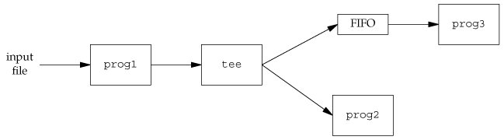
Using FIFOs to Duplicate Output Streams
Procedure that processes a filtered input stream twice
Using a FIFO and tee to send a stream to two processes
$ mkfifo fifo1
$ prog3 < fifo1 &
$ prog1 < infile | tee fifo1 | prog2
prog3
input
file
prog1
prog2
Notes:
The tee program copies its standard input to both its standard output and to the file named on its command line.

Slide 16
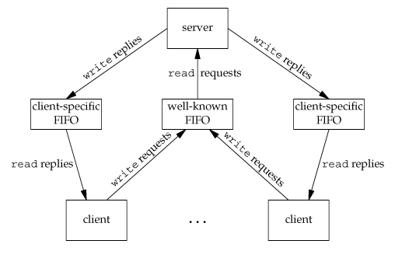
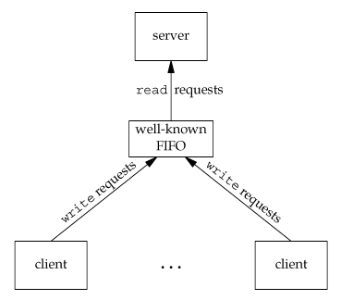
Client-Server Communication Using a FIFO
How to send replies back from the server to each client
A unique FIFO for each client, using a pathname based on the client’s process ID (e.g. /tmp/serv1.{CLIENT_PID})
Notes:
Clients would never know when to read their response

