Slide 1
UNIX Standardization and Implementations
시스템 프로그래밍
Fall 2013
Division of Computer Science & Engineering
Hanyang University

Slide 2
Introduction
Proliferation of versions and differences leading to various standardization efforts
Standardization
ISO C
IEEE POSIX
The Single UNIX Specification
FIPS
Unix Implementations
System V Release 4
4.4BSD
FreeBSD
Linux
Mac OS X
Solaris

Slide 3
ISO C
ANSI Standard X3.159-1989 for the C programming language
ANSI: American National Standards Institute
ISO/IEC 9899:1990
International Organization for Standardization (ISO)
Portability of conforming C programs to a wide variety of operating systems, not just the Unix system
The syntax and semantics of the programming language and a standard library
ISO/IEC 9899:1999

Slide 4
ISO C Standard
<assert.h> verify program assertion
<complex.h> complex arithmetic support
<ctype.h> character types
<errno.h> error codes
<fenv.h> floating-point environment
<float.h> floating-point constants
<inttypes.h> integer type format conversion
<iso646.h> alternate relational operator macros
<limits.h> implementation constants
<locale.h> locale categories
<math.h> mathematical constants
<setjmp.h> nonlocal goto
<signal.h> signals
<stdarg.h> variable argument lists
<stdbool.h> boolean type and values
<stddef.h> standard definitions
<stdint.h> integer types
<stdio.h> standard I/O library
<stdlib.h> utility functions
<string.h> string operations
<tgmath.h> type-generic math macros
<time.h> time and date
<wchar.h> extended multibyte and wide character support
<wctype.h> wide character classification and mapping support

Slide 5
IEEE POSIX
POSIX (Portable Operating System Interface)
“POSIX compliant” – not restricted to Unix and Unix-like systems
No distinction bet’n sys calls and lib functions
POSIX.1
Originally IEEE Std 1003.1-1988
Revision published as IEEE Std 1003.1 – 1990 and ISO/IEC 9945-1:1990 → POSIX.1
IEEE Std 1003.1 – 2001
Several 1003.1 amendments
1003.2 standard
Portions of the Single UNIX Specification (SUS)
ISO/IEC 9899:1999, Programming Languages – C
Required & optional headers in Figure 2.2, 2.3, and 2.4

Slide 6
POSIX.1
<dirent.h> directory entries
<fcntl.h> file control
<fnmatch.h> filename-matching types
<glob.h> pathname pattern-matching types
<grp.h> group file
<netdb.h> network database operations
<pwd.h> password file
<regex.h> regular expressions
<tar.h> tar archive values
<termios.h> terminal I/O
<unistd.h> symbolic constants
<utime.h> file times
<wordexp.h> word-expansion types
<arpa/inet.h> Internet definitions
<net/if.h> socket local interfaces
<netinet/in.h> Internet address family
<netinet/tcp.h> Transmission Control Protocol definitions
<sys/mman.h> memory management declarations
<sys/select.h> select function
<sys/socket.h> sockets interface
<sys/stat.h> file status
<sys/times.h> process time
<sys/types.h> primitive system data types
<sys/un.h> UNIX domain socket definitions
<sys/utsname.h> system name
<sys/wait.h> process control

Slide 7
The Single UNIX Specification
X/Open System Interface (XSI)
A superset of the POSIX.1 standard
Only XSI-conforming implementations can be called UNIX systems.
SUSv1 (a.k.a. Spec 1170) in 1994
SUSv2 in 1997 added support for threads, real-time interfaces, 64-bit processing, large files, and enhanced multibyte character processing.
SUSv3 in 2001
Base Specifications (the same as the IEEE Std 1003.1-2001)
Base Definitions, System Interfaces, Shell and Utilities, and Rationale
X/Open Curses Issue 4, Version 2
SUSv3 2004 Edition
Notes:
The complete set of system interfaces is called the X/Open System Interface.

Slide 8
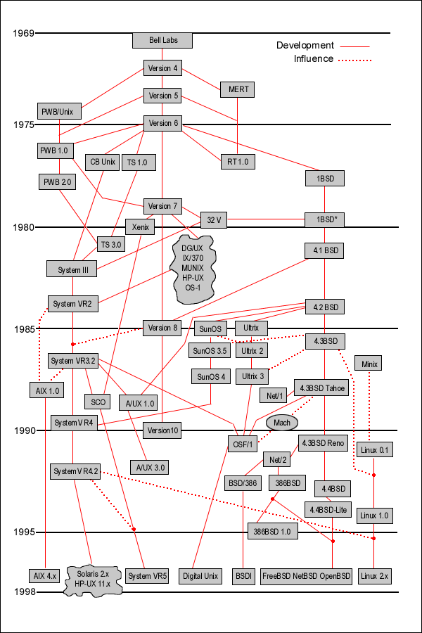
Unix Family Tree
http://www.isk.kth.se/kursinfo/6b2019/for/f1/unixhistory.gif
Notes:
Three branches of the tree evolved.
One at AT&T that led to System III and System V, the so-called commercial versions of the UNIX System
One at the University of California at Berkeley that led to the 4.xBSD implementations
The research version of the UNIX System, developed at the Computing Science Research Center of AT&T Bell Laboratories, that led to the UNIX Time-Sharing System 8th Edition,
9th Edition, and ended with the 10th Edition in 1990.

Slide 9
System V Release 4
1989 by AT&T’s Unix System Laboratories
A merging of SVR3.2, SunOS, 4.3BSD, and Xenix
POSIX 1003.1 and X/OPEN XPG3 compliant
SVID (System V Interface Definition)
Issue 3 defines functionality to qualify as SVR4

Slide 10
4.4BSD
Berkeley Software Distribution
4.2BSD in 1983, 4.3BSD in 1986, 4.3BSD Tahoe in 1988, 4.3Reno in 1990, and 4.4BSD in 1992
BSD Networking Software Release 1.0 in 1989 (from BSD Tahoe) and Release 2.0 in 1991 (from BSD Reno)
4.4BSD-Lite Release 1 in 1994
4.4BSD-Lite Release 2 in 1995

Slide 11
Other Implementations
FreeBSD based on 4.4BSD-Lite
Linux in 1991 as a grass-root effort
Mac OS X
The core OS is called Darwin, which is a FreeBSD/Mach hybrid.
Solaris based on SVR4
AIX (IBM), HP-UX (HP), IRIX (Silicon Graphics), etc.

Slide 12
Limits
To aid the portability of software
Compile-time options and limits (headers)
Does the system support job control?
What’s the largest value of a short integer?
Run-time limits not associated with a file or directory (sysconf function)
Run-time limits associated with a file or directory (pathconf and fpathconf function)
How many characters in a filename?

Slide 13
<limits.h>
ISO C Limits (Figure 2.6)
…
LONG_MAX max value of long 2,147,483,647
LONG_MIN min value of long -2,147,483,647
ULONG_MAX max value of unsigned long 4,294,967,295
…
POSIX limits (Figure 2.8)
…
_POSIX_OPEN_MAX number of open files per process 20
_POSIX_PATH_MAX number of bytes in a pathname 256
…
XSI limits (Figure 2.9)
…
NL_ARGMAX max value of digit in calls to printf/scanf 9
NL_LANGMAX max no. of bytes in LANG environ variable 14
…

Slide 14
Run-time Limits
#include <unistd.h>
long sysconf(int name);
long pathconf(const char *pathname, int name);
long fpathconf(int filedes, int name);
The name argument (Figure 2.10 & 2.11)
…
_SC_ARG_MAX max length of arguments to exec()
_SC_CHILD_MAX max no. of processes per real user ID
_SC_CLK_TCK no. of clock ticks per second
_SC_OPEN_MAX max no. of open files per process
…
_PC_NAME_MAX max no. of bytes in a filename
_PC_PATH_MAX max no. of bytes in a relative pathname
…

Slide 15
Feature Test Macros
Feature test macros – no any implementation-defined limits
_POSIX_C_SOURCE and _XOPEN_SOURCE
cc –D_POSIX_C_SOURCE=200112 file.c
#define _POSIX_C_SOURCE 200112
__STDC__ - automatically defined by an ISO C compiler
#ifdef __STDC__
void *myfunc(const char *, int);
#else
void *myfunc();
#endif

Slide 16
Primitive System Data Type
<sys/types.h> defines some implementation-dependent data types.
caddr_t core address
clock_t counter of clock ticks
comp_t compressed clock ticks
dev_t device numbers (major and minor)
fd_set file descriptors sets
fpos_t file position
gid_t numeric group IDs
ino_t i-node numbers
…
Major and minor device numbers
Historically, 8 bits for both major and minor device no
Solaris: 14 bits for the major and 18 bits for the minor

