Slide 1
File I/O
시스템 프로그래밍
Fall 2007
College of Information & Communications
Hanyang University

Slide 2
Introduction
Unbuffered I/O (part of POSIX.1 and the Single UNIX Specification, but not of ISO C)
open, read, write, lseek, and close
read and write buffer sizes
File sharing among multiple processes
Atomic operation
dup, fcntl, sync, fsync, and ioctl

Slide 3
File Descriptors
A non-negative integer (0 .. OPEN_MAX) returned by open or creat
<unistd.h> in POSIX-compliant systems
0 – STDIN_FILENO
1 – STDOUT_FILENO
2 – STDERR_FILENO
fd 4
System open
file table
v-node table
process table entry

Slide 4
open Function
#include <fcntl.h>
int open(const char *pathname, int oflag, … /* mode_t mode */);
oflag argument
One and only one of the three
O_RDONLY, O_WRONLY, O_RDWR
Optional
O_APPEND, O_CREAT, O_EXCL, O_TRUNC, O_NOCTTY, O_NONBLOCK,
SUS I/O Options: O_DSYNC, O_RSYNC, O_SYNC
The lowest-numbered unused descriptor is returned

Slide 5
creat and close Functions
#include <fcntl.h>
int creat(const char *pathname, mode_t mode);
Equivalent to open(pathname, O_WRONLY | O_CREAT | O_TRUNC, mode);
#include <unistd.h>
int close(int filedes);
When a process terminates, all open files are automatically closed by the kernel.

Slide 6
read and write Functions
#include <unistd.h>
ssize_t read(int filedes, void *buf, size_t nbytes);
The number of bytes read is returned. At EOF, 0 is returned.
Less bytes than the requested are read
EOF, a terminal device (per line reading), a network, a pipe or FIFO, a record-oriented device (e.g. a magnetic tape), and interrupted by a signal
#include <unistd.h>
ssize_t write(int filedes, const void *buf, size_t nbytes);
The number of bytes written is returned

Slide 7
lseek Function
#include <unistd.h>
off_t lseek(int filedes, off_t offset, int whence);
“file offset” in bytes from the beginning
whence:
SEEK_SET: offset from the beginning of the file
SEEK_CUR: current file offset + offset
SEEK_END: file size + offset
To determine the current offset
off_t curpos = lseek(fd, 0, SEEK_CUR);
For a pipe, FIFO or socket, it returns -1 and sets errno to ESPIPE

Slide 8
lseek Function
Program 3.1
$ ./a.out < /etc/motd
seek OK
$ cat < /etc/motd | ./a.out
cannot seek
$ ./a.out < /var/spool/cron/FIFO
cannot seek
Program 3.2 (creating a hole in a file)
$ ./a.out
$ ls –l file.hole
-rw-r--r-- 1 sar 16394 Nov 25 01:01 file.hole
$ od –c file.hole
“abcdefghij\0…\0ABCDEFGHIJ”
$ ls –ls file.hole file.nohole
8 –rw-r--r-- r sar 16394 Nov 25 01:01 file.hole
20 –rw-r--r-- r sar 16394 Nov 25 01:01 file.nohole

Slide 9
Program 3.1
#include "apue.h"
int
main(void)
{
if (lseek(STDIN_FILENO, 0, SEEK_CUR) == -1)
printf("cannot seek\n");
else
printf("seek OK\n");
exit(0);
}

Slide 10
Program 3.2
#include "apue.h"
#include <fcntl.h>
char buf1[] = "abcdefghij";
char buf2[] = "ABCDEFGHIJ";
int
main(void)
{ int fd;
if ((fd = creat("file.hole", FILE_MODE)) < 0)
err_sys("creat error");
if (write(fd, buf1, 10) != 10)
err_sys("buf1 write error");
/* offset now = 10 */
if (lseek(fd, 16384, SEEK_SET) == -1)
err_sys("lseek error");
/* offset now = 16384 */
if (write(fd, buf2, 10) != 10)
err_sys("buf2 write error");
/* offset now = 16394 */
exit(0);
}

Slide 11
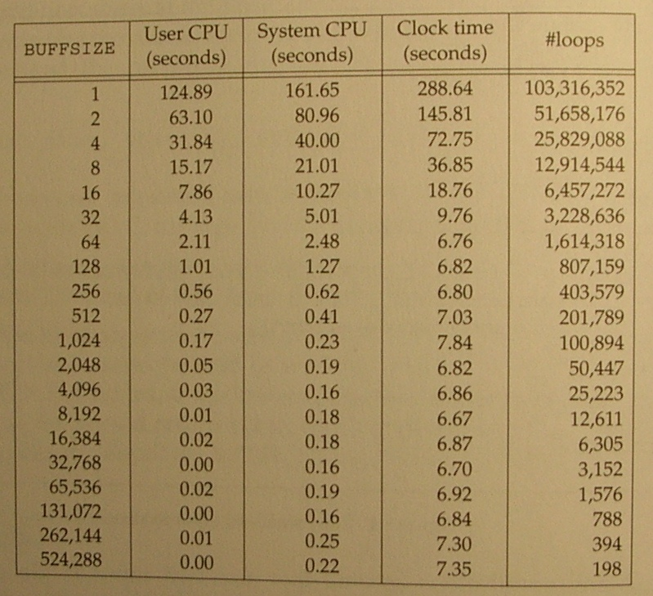
I/O Efficiency
Program 3.4
BUFFSIZE 4096(4k단위로 read ,write하기!)
Reading a 103,316,352-byte file, using 20 different buffer sizes
Tested against the Linux ext2 file system with 4,096-byte blocks

Slide 12
Program 3.4
#include "apue.h“
#define BUFFSIZE 4096
int
main(void)
{ int n;
char buf[BUFFSIZE];
while ((n = read(STDIN_FILENO, buf, BUFFSIZE)) > 0)
if (write(STDOUT_FILENO, buf, n) != n)
err_sys("write error");
if (n < 0)
err_sys("read error");
exit(0);
}

Slide 13
File Sharing
An open file descriptor table within each process table entry
Kernel file table for all open files
v-node table
v-node: filesystem independent portion of the i-node
i-node: file owner, size, dev, ptrs to data blocks, etc
v-node table
file table
v-node
information
process table entry
file status flags
current file offset
i-node
information
fd file
flags pointer
v-node ptr
fd 0:
current file size
fd 1:
fd 2:
…
file status flags
v-node
information
current file offset
v-node ptr
i-node
information
current file size
Notes:
Process table entry – file descriptor flags (close-on-exec)
A file table for all open files
File status flags such as read, write, append, sync, and nonblocking
File offset
A ptr to v-node table entry
A v-node structure that contains information about the type of file and pointers to functions that operate on the file. The i-node contains the owner of the file, the size of the file, pointers to where the actual data blocks for the file are located on disk, and so on.

Slide 14
File Sharing
Each process gets its own current offset.
Each write changes the offset (and the size in the i-node table.)
For each write to a file opened with O_APPEND flag set, the size in the i-node table → the offset
lseek(fd, 0, SEEK_END): the size in i-node table → the offset
dup and fork: More than one file descriptor entry pointing to the same file table entry
process table entry
fd flags ptr
fd 0:
fd 1:
fd 2:
fd 3:
…
file table
file status flags
current file offset
v-node table
v-node ptr
v-node
information
fd flags ptr
fd 0:
i-node
information
fd 1:
fd 2:
file status flags
fd 3:
current file size
fd 4:
…
current file offset
v-node ptr

Slide 15
Atomic Operations
When a process wants to append to the end of a file,
if (lseek(fd, 0L, SEEK_END) < 0)
err_sys(“lseek error”);
if (write(fd, buf, 100) != 100)
err_sys(“write error”);
Assuming process A and B that append to the same file,
A’s lseek sets its offset to 1500.
B’s does the same thing, and calls a write to increase its offset to 1600. Kernel also updates the size in the v-node table entry.
A calls a write, which will overwrite the B’s data.
Any operation that requires more than one function call can not be atomic.
write to a file opened with O_APPEND flag → atomic
Notes:
write to a file opened with O_APPEND flag: atomic since it causes the kernel to position the file to its current EOF before each write.

Slide 16
Atomic Operations
The Single UNIX Specification
#include <unistd.h>
ssize_t pread(int filedes, void *buf, size_t nbytes,
off_t offset);
ssize_t pwrite(int filedes, void *buf, size_t nbytes,
off_t offset);
pread equivalent to calling lseek followed by a call to read
pwrite equivalent to calling lseek followed by a call to write
Notes:
write to a file opened with O_APPEND flag: atomic since it causes the kernel to position the file to its current EOF before each write.

Slide 17
Atomic Operations
open(fd, …|O_CREAT|O_EXCL, modes)
The check for the existence of the file and the creation of the file is performed as an atomic operation.
Otherwise, we might try
if ((fd = open(pathname, O_WRONLY)) < 0){
if (errno == ENOENT) {
if ((fd = creat(pathname, mode)) < 0)
err_sys(“creat error”);
} else
err_sys(“open error”);
}
}
Notes:
In general, the term atomic operation refers to an operation that might be composed of multiple steps. If the operation is performed atomically, either all the steps are performed, or none are performed.
It must not be possible for a subset of the steps to be performed.

Slide 18
dup and dup2 Functions
#include <unistd.h>
int dup(int filedes);
int dup2(int filedes, int filedes2);
dup returns the lowest-numbered available file descriptor.
dup2 makes a copy of filedes into filedes2 (if opened, it first closes filedes2.)
process table entry
v-node table
file table
v-node
information
fd flags ptr
file status flags
fd 0:
current file offset
i-node
information
fd 1:
fd 2:
v-node ptr
fd 3:
…
current file size

Slide 19
sync, fsync, and fdatasync Functions
#include <unistd.h>
int fsync(int filedes);
int fdatasync(int filedes);
void sync(void);
Delayed write via a buffer cache
Data is copied into one of its buffers and queued for writing to disk at some later time.
sync simply queues all the modified block buffers for writing and returns.
fsync waits for disk writes, including file attributes, to complete before returning.
fdatasync affects only the data portions of a file.
Notes:
Delayed write through a buffer cache
- Data is copied into one of its buffers and queued for writing to disk at some later time.

Slide 20
fcntl Function
#include <fcntl.h>
int fcntl(int filedes, int cmd, … /* int arg */);
cmd argument
duplicate an existing descriptor (F_DUPFD)
Its FD_CLOEXEC file descriptor flag is cleared.
get/set file descriptor flags (F_GETFD, F_SETFD)
Currently only one file descriptor flag is defined: FD_CLOEXEC flag
get/set file status flags (F_GETFL, F_SETFL)
the flags used by open
get/set asynchronous I/O ownership (F_GETOWN, F_SETOWN)
get/set record lock (F_GETLK, F_SETLK, F_SETLKW)
Notes:
Fcntl() changes the properties of an open file.

Slide 21
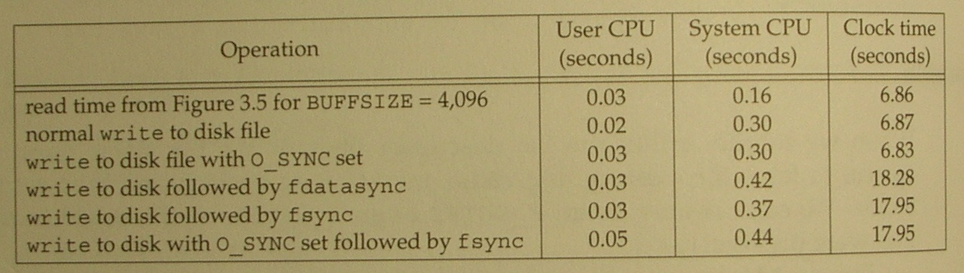
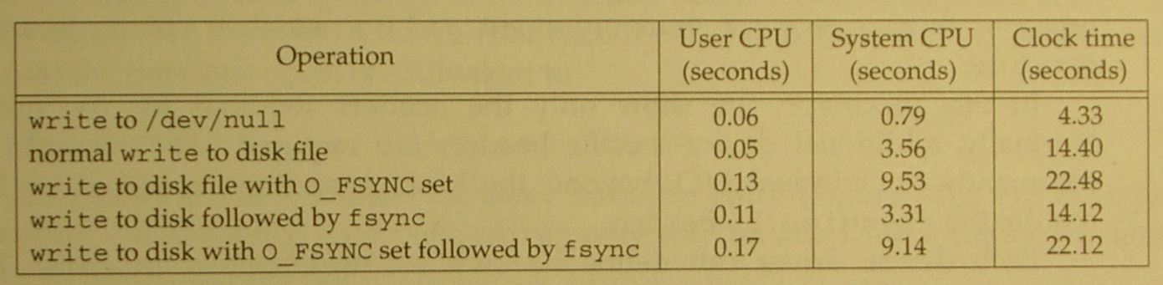
fcntl Function
Program 3.10 – Print file flags for a specified descriptor.
Program 3.11 – Turn on one or more of the file status flags.
Figure 3.12 (Linux ext2 timing results)
Figure 3.13 (Mac OS X timing results)

Slide 22
Program 3.10
#include "apue.h"
#include <fcntl.h>
int main(int argc, char *argv[])
{ int val;
if (argc != 2)
err_quit("usage: a.out <descriptor#>");
if ((val = fcntl(atoi(argv[1]), F_GETFL, 0)) < 0)
err_sys("fcntl error for fd %d", atoi(argv[1]));
switch (val & O_ACCMODE) {
case O_RDONLY:
printf("read only"); break;
case O_WRONLY:
printf("write only"); break;
case O_RDWR:
printf("read write"); break;
default:
err_dump("unknown access mode");
}
if (val & O_APPEND)
printf(", append");
if (val & O_NONBLOCK)
printf(", nonblocking");
#if defined(O_SYNC)
if (val & O_SYNC)
printf(", synchronous writes");
#endif
#if !defined(_POSIX_C_SOURCE) && defined(O_FSYNC)
if (val & O_FSYNC)
printf(", synchronous writes");
#endif
putchar('\n');
exit(0);
}

Slide 23
Program 3.11
#include "apue.h"
#include <fcntl.h>
void
set_fl(int fd, int flags) /* flags are file status flags to turn on */
{
int val;
if ((val = fcntl(fd, F_GETFL, 0)) < 0)
err_sys("fcntl F_GETFL error");
val |= flags;/* turn on flags */
if (fcntl(fd, F_SETFL, val) < 0)
err_sys("fcntl F_SETFL error");
}

Slide 24
ioctl Function
#include <unistd.h> /* SVR4 */
#include <sys/ioctl.h> /* BSD and Linux */
#include <stropts.h> /* XSI STREAMS */
int ioctl(int filedes, int request, …);
The catchall for I/O operations
Each device driver defines its own set of ioctl commands.
FreeBSD ioctl operations
Category | Constant Names | Header | Number of ioctls
disk labels file I/O mag tape I/O socket I/O terminal I/O | DIOxxx FIOxxx MTIOxxx SIOxxx TIOxxx | <sys/disklabel.h> <sys/filio.h> <sys/mtio.h> <sys/sockio.h> <sys/ttycom.h> | 6 9 11 60 44
Notes:
The catchall for I/O operations
- anything that couldn’t be expressed using one of other functions

Slide 25
/dev/fd
Opening /dev/fd/n is equivalent to duplicating descriptor n (assuming the descriptor n is open)
fd = open(“/dev/fd/0”, mode);
fd = dup(0);
The mode could be ignored or must be a subset of the original mode.
Uniformity and cleanliness
filter file2 | cat file1 – file3 | lpr
filter file2 | cat file1 /dev/fd/0 file3 | lpr

