Slide 1
A TestBed for PCE based SDN Orchestration
Jin Seek Choi
jinseek@hanyang.ac.kr
Mir Lab (MiRLab)
http://mir.hanyang.ac.kr
Notes:
26年 11月 8日

Slide 2
Outline
Background
  What is Packet Transport Network (PTN)
  Requirements of the PTN (e.g., GMPLS Vs. PCE vs. SDN)
      What is Software-defined Network (SDN).
    PCE based Orchestration
  A Unified Provisioning Framework &
  Orchestration Framework of OpenFlow Controllers
    Testbed for PCE-based Orchestration
Conclusion
  PCE-based unified Orchestration Framework for Multi-domain SDN
NIA2014
<number>/33
Notes:
26年 11月 8日

Slide 3
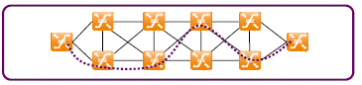
What’s Packet Transport Network
Packet transport Network (PTN) is a network that can support
  e-t-e Transport service on-demand
    E.g., Dynamic provisioning (or restoration) of Connection-oriented transport service via a control & management function
  that commits the QoS, TE requirements, Reliability and manageability equivalent to conventional circuit switched transport technology
    E.g., OAM used in Circuit switched transport will be applicable to packet transport network to support (carrier-grade Reliability)
Needs a Control & Management Frameworks
  for maintaining Stable transport network infrastructure
  Scaling of switching elements for millions of users
NIA2014
<number>/33
Notes:
26年 11月 8日

Slide 4
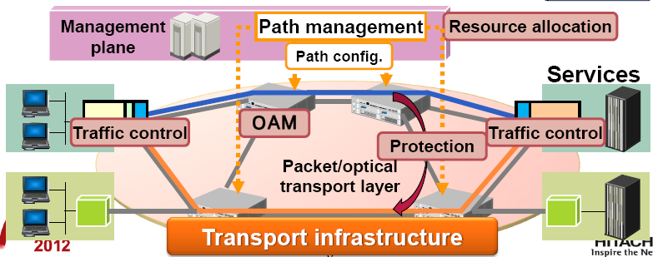
What’re the Requirements of PTN?
Key function is a Control & Management (C&M) Framework
  i.e., topology discovery, provisioning, resource and fault management
Possible solutions
  GMPLS vs. GMPLS-PCE vs. SDN
ref: MPLS2012 (Hitach)
NIA2014
<number>/33
Notes:
26年 11月 8日

Slide 5




GMPLS based Architecture
  IP centric Distributed C&M Framework
  IP centric Distributed Signaling/Routing Protocol (RSVP/OSPF)
  Performing automatic provisioning/routing of LSP at Each node
Call Request
Management
LMP
Connection Request
signaling
CR-LDP
RSVP-TE
PCC
PCC
Control
plane
Call Accept
CC
CC
CC
routing
OSPF-TE
IS-IS-TE
Call Accept
Connection Indication
VC Label
ATM
DLCI Label
Frame Relay
Data
plane
Shim Label
PPP, POS, GE
TDM
Wavelength
Waveband
Fiber
Optical Switching
OXC/OBS/OPS
O
L
S
O
L
S
O
L
S
O
L
S
O
L
S
O
L
S
O
L
S
O
L
S
NIA2014
<number>/33
Notes:
26年 11月 8日

Slide 6
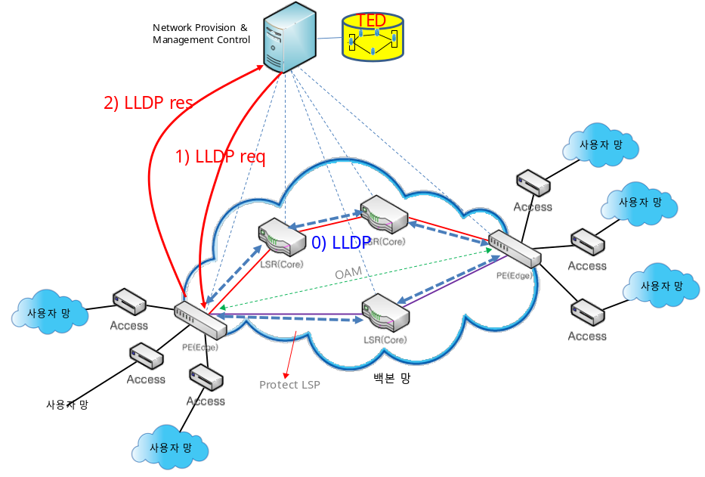

GMPLS-PCE based Architecture
  IP centric C&M Framework except for Centralized PCE
  Still needs IP centric Distributed Signaling/Routing Protocol (RSVP/OSPF)
  & Performing automatic provisioning/routing of LSP at Each node
  excluding Centralized Path Computation (PCE)
Path computation
Management
LMP
Path Request
signaling
CR-LDP
RSVP-TE
Control
plane
Call Request
routing
OSPF-TE
IS-IS-TE
NCC
Connection Request
NCC
Call Accept
CC
CC
CC
Connection Indication
VC Label
ATM
Call Accept
DLCI Label
Frame Relay
Data
plane
Shim Label
PPP, POS, GE
TDM
Wavelength
Waveband
Fiber
Optical Switching
OXC/OBS/OPS
O
L
S
O
L
S
O
L
S
O
L
S
O
L
S
O
L
S
O
L
S
O
L
S
NIA2014
<number>/33
Notes:
26年 11月 8日

Slide 7

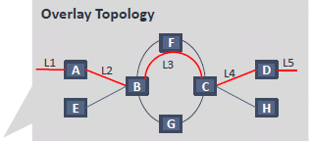
SDN based Architecture
Controller centric C&M Framework
  Enable Clear Separation of control plane and data plane
  Enable flow-based network programmability by using open APIs
Service
& App #1
Service
& App #1
Service
& App #1
SDN controller
OpenFlow
Virtualization
OF
OF
Control
plane
OF agent
OF
VC Label
ATM
OF
DLCI Label
Frame Relay
O
L
S
OF
O
L
S
Data
plane
Shim Label
PPP, POS, GE
O
L
S
O
L
S
TDM
Wavelength
Waveband
Fiber
Optical Switching
OXC/OBS/OPS
O
L
S
O
L
S
O
L
S
O
L
S
OF
OF
NIA2014
<number>/33
Notes:
26年 11月 8日

Slide 8
Why Software-defined Network (SDN)?
SDN concept has been effectively applied to transport networks.
  Clear Separation of control plane from data planes by using a Common network configuration/monitoring interface (e.g., OpenFlow) → (discovery, path computation, resource & fault monitoring) on top of the controller
    Connection/provisioning (instead of RSVP-TE)
    Dissemination of Link/Resource Info. (instead of OSPF-TE)
    Neighbor/Topology Discovery with LLDP (instead of OSPF-TE )
  Carrier preference: Application level API hiding details of the network
    Software-Defined Control Just for flow
    Programmability by using open APIs
NIA2014
<number>/33
Notes:
26年 11月 8日

Slide 9
What is a Unified Control and Management Framework?
Controller provides a unified control and management framework
including Dynamic path provisioning and (Flow and fault) management
Service
& App #1
Service
& App #1
Service
& App #1
Topology discovery
L1-a: 1GE
L1-b: 10GE
SDN controller
Provisioning (e.g., OF)
L2-L3: map vlan200
Fault monitoring
L1-L2: failure
E-t-e connection
O
L
S
O
L
S
O
L
S
O
L
S
O
L
S
O
L
S
O
L
S
O
L
S
NIA2014
<number>/33
Notes:
26年 11月 8日

Slide 10

C&M Framework for SDN controller
Centralized controller
  enable C&M (path computation, topology, provisioning, fault manag.)
  enable these functions via a common interface (OpenFlow)
Unified C&M Framework
OpenFlow
Controller
(Switch-specific
Provisioning,
Discovery, and
managed state)
Path computation
Engine
TED (topology
& TE status)
Path Provisioning
(Injection)
Resource
Dependency
Resource
Management
CSPF
Algorithm
Providers
NMS
integration
Discovery
Configuration
PCEP
Adapter
OpenFlow
Adapter
PCEP Library
OpenFlow
NIA2014
<number>/33
Notes:
26年 11月 8日

Slide 11
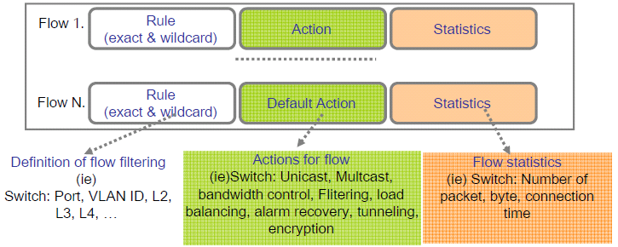
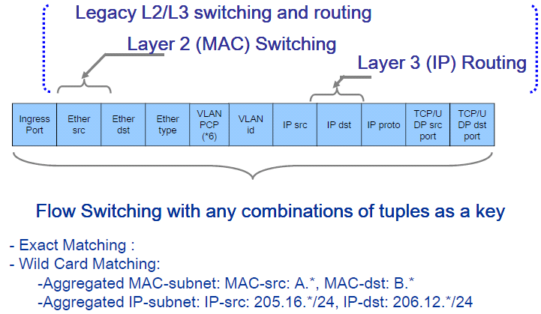
C&M Framework for SDN switches
  Flow programmability over simple switches
  Simplified Flow Switching with minimum OAM & LLDP management
OF agent
API/Driver
OAM
HW
LLDP
Forwarding
Table
NIA2014
<number>/33
Notes:
26年 11月 8日

Slide 12
Unified Control and Management Framework →
PCE-based Orchestration for Multi-domain SDNs
Proposed Framework (in Control & Management Plane)
Unified provisioning
  Topology Discovery, Path Computation, Configuration, and Fault Monitoring
Orchestration of multiple OF-Controllers
Notes:
26年 11月 8日

Slide 13


Our proposal = PCE-based Framework
OF
OF
PCE centric Orchestration &
Provisioning manager
PCE-controller
GUI
NNI
PCE centric Provisioning
OF
OF
OF
NIA2014
<number>/33
Notes:
interworking through extended PCEP protocols
In this paper, we propose a PCE-based federation framework of multi-domain SDN controllers. The proposed architecture provides two novel key features that are not present in previous related work. First, the proposed framework provides support for dynamic topology discovery procedure to cluster without any interruption to the network operation, i.e., dynamic addition and removal of network node. Second, the federation framework is designed to work with all exisiting OpenFlow cotnrollers with minimal or node required changes.
26年 11月 8日

Slide 14
Why PCE-based Framework?
PCE= available in multi-technology/multi-domain network
  Can maintain hierarchical topology and resource status
PCE→ a Hierarchical deployment (iterations of child/parent)
  PCE can cooperate as peers or in a hierarchical model as follows:
  →PCE-controller for inter-domain path computation
  → OF-controller (or Child PCE) for intra-domain path computation
PCE fits with the requirements of multi-domain orchestration.
  Inter-platform signaling mech. (Path computation request/response)
Now Extended into Unified Provisioning Framework
  Integration of (Topology discovery + provisioning+ fault monitoring)
  Orchestration of OpenFlow controllers (small modification)
  (coordination of local provisioning or global provisioning)
NIA2014
<number>/33
Notes:
26年 11月 8日

Slide 15
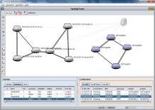

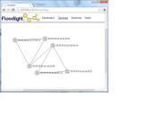
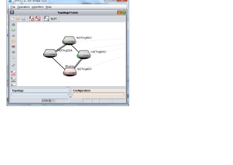

Our goals
PCE-based unified provisioning controller
  PCE/PCEP to compute routes encompassing multiple segements
PCE-based Orchestration of Distributed OpenFlow controllers
  Partition the network in different domains (to reduce traffic processing)
  Each domain is controlled by a centralized controller (to favor simplicity)
PCE
PCE-based
Provisioning
controller
Topology/
provisioning
TED
JSON
interface
SDN Cont.
PCE Cont.
SDN Cont.
OpenFlow
protocol
PCEP
protocol
OpenFlow
protocol
OpenFlow-controlled
domain
GMPLS/PCE-controlled
domain
OpenFlow-controlled
domain
NIA2014
<number>/33
Notes:
26年 11月 8日

Slide 16
Unified Provisioning Issues in SDNs
Legacy Approaches are summarized with
  External Static Provisioning: NMS responsible for configuration and ensuring bi-direction congruency for LSP path establishment
  Dynamic Control Plane: Distributed routing or signaling (GMPLS-ERO, MPLS-RSVP) or Centralized Provisioning Control (SDN)
Provisioning Problems
  Loss of synchronization in between provisioning and computation
  Not scalable to support thousands of switches (a centralized approach)
Issues in SDTNs
  → need a Unified network provisioning architecture for
    Efficient and flexible network resource and fault management
NIA2014
<number>/33
Notes:
Dynamic enforcement of a set of policies
(Uni- and multi-cast) Routing, forwarding, traffic engineering, QoS and security policies
Path management for Efficient and flexible QoS and TE managements
Path computation for Optimization of network resource
Fault management for Reliability
26年 11月 8日

Slide 17
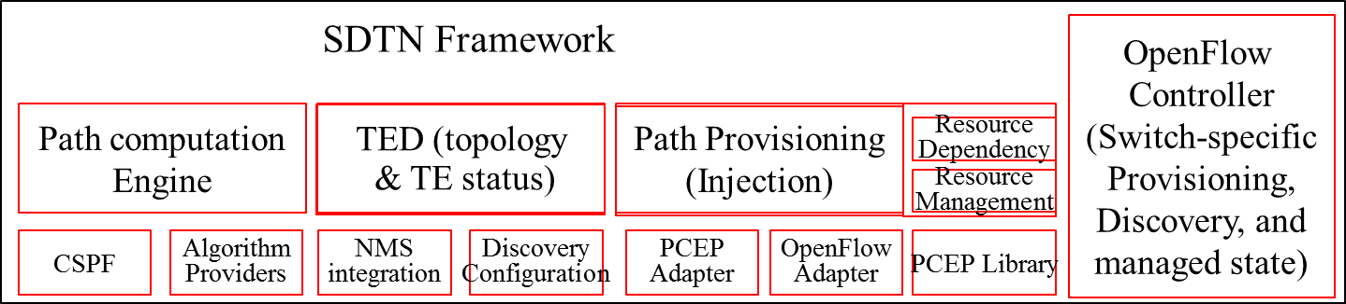
What is a Unified Provisioning Framework in SDN?
Enables Transport Services (bi-directional Paths over PTN)
  that needs QoS-demanding & require traffic isolation.
Enables A separate Provisioning framework with a centralized PCE
  that is a set of operations from service subscription to deployment including
  allocation of network resources & enforcement of a set of OAM parameters
A Unified Provisioning Controller
OpenFlow
Controller
(Switch-specific
Topology discovery
Configuration)
REST int.
OpenFlow
NIA2014
<number>/33
Notes:
26年 11月 8日

Slide 18
Functional Architecture of the PCE-based Unified Provisioning Framework
Integrate all of the provisioning functions into PCE
PCE
GMPLS
GMPLS
/PCE
OF
SDN
/Controller
provisioning
SNMP
SNMP
NOS
PCE
PCE
OP-API
OP-API
monitoring
SNMP
OSPF-TE
SNMP
OSPF-TE
agent
agent
OAM
RSVP
-TE
OAM
RSVP
-TE
OAM
Forwarding engine
Forwarding engine
Forwarding engine
Forwarding engine
NIA2014
<number>/33
Notes:
26年 11月 8日

Slide 19

















PCE-based Topology Discovery
PCE based Node/Topology Discovery
  PCE extension to unified controller for collecting a global view of Node/Topology from OF controllers
PCE
OpenFlow
controller
TED
PCE
OFcontroller
Sw#1
SW#2
LLDP PDU
2) LLDP res
Access Net
LLDP request
LLDP request
1) LLDP
req
Access Net
LLDP response
LLDP
Access Net
LLDP response
Access Net
Topology reg.
사용자
망
Topology Ack.
Access Net
TED
PCE-based Topology Discovery
<number>/33
NIA2014

Slide 20
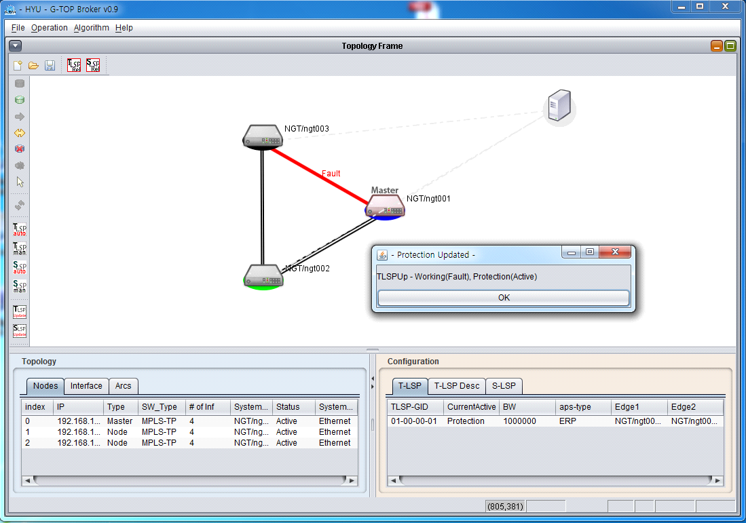
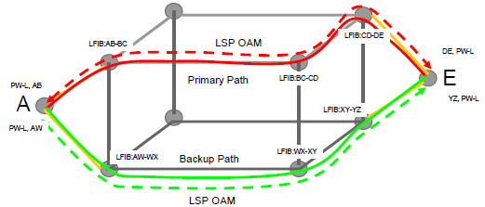

PCE-based Path Computation
  PCE based path computation
  Calculates Multiple Disjoint paths (Working+Protection) with a global view of the network topology
PCE
OpenFlow
controller
TED
Access Net
2) LSP
오류
Access Net
LLDP
Access Net
Access Net
사용자
망
Access Net
Centralized Path Computation with global Topology Information
NIA2014
<number>/33
Notes:
26年 11月 8日

Slide 21




PCE-based Path Provisioning
PCE enables provisioning, in which OF controller directly configures the forwarding table
  PCE extension: to provide Explicit Route or path to the controller for configuring the path over the switches along the path
PCE
OpenFlow
controller
TED
PCE
OpenFlow
Sw agent
controller
Sw agent
(core)
Sw agent
Path computation
(edge)
(edge)
Switch-specific
Configuration
Path set
Access Net
FLOW_MOD
FLOW_MOD
Access Net
FLOW_MOD
Stats Request/reply
Stats reply
LLDP
Access Net
TED update
Access Net
Access Net
Access Net
<number>/33
NIA2014
Notes:
26年 11月 8日

Slide 22
Orchestration Issues in Multi-domain SDNs
The Issue is the Scalability of the SDTN:
  Because the traffic concentration on the centralized controller
  → stress the controller and consequently limit the size of SDTNs
  → even some solutions increase the processing power, not enough
  (parallelism & decrease interactions between switches and controller)
  need a scalable provisioning architecture for the scale out to multiple domain SDTN
  →Towards a distributed control plane, e.g., HyperFlow, DISC etc.
  → hierarchical vs. flat distribution
Our Solution is PCE-based Orchestration
  PCE-based Orchestration
  →Hierarchical Orchestration architecture of multiple OF controllers
  →Scale-out cluster design for multi-domain SDTNs
NIA2014
<number>/33
Notes:
26年 11月 8日

Slide 23
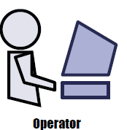
PCE-based Orchestration Architecture
simplify the design and implementation of unified provisioning framework in Multi-domain SDTNs
PCE-based
Provisioning
controller
Orchestration
Software
TED
Open REST interface
SDN Cont.
PCE Cont.
SDN Cont.
OpenFlow
protocol
PCEP
protocol
OpenFlow
protocol
OpenFlow-controlled
domain
GMPLS/PCE-controlled
domain
OpenFlow-controlled
domain
NIA2014
<number>/33
Notes:
26年 11月 8日

Slide 24
Why PCE based Orchestration ?
Orchestration: to build seamless end-to-end transport services
  Discovery of network resources across the multi-domains
  Path computation based on global view of network topology
  Multi-domain/multi-vendor network resource provisioning through different control domains (e.g., OpenFlow, GMPLS, PCE, …)
PCE enables the cooperation with SDN OF-controllers
  OF-controller enables Switch-specific Topology discovery & configuration
  PCE-controller integrates All in one for topology discovery, path computation, provisioning in multi-domain SDTN
PCE enables Open interface for multi-domain/multi-vendor networks including legacy GMPLS/PCE networks
NIA2014
<number>/33
Notes:
26年 11月 8日

Slide 25
What is PCE-based Orchestration?
Decouples provisioning from switch specific configuration
  simplifies provisioning and enables brokered federation.
Provides coordinated operation of network resource control for provisioning in a collective fashion.
  Unified path provisioning control to operators
Provides Open interface for OF-controller including legacy GMPLS/PCE controllers
  Using Extended REST interface for enabling practical policies, on-demand, adaptive, and reliable allocation of networked computing resources from a common pool of OpenFlow Controller.
NIA2014
<number>/33
Notes:
26年 11月 8日

Slide 26
PCE-based Orchestration
  Provides orchestrated Node/Topology Discovery for collecting a global view of Node/Topology
  Provides orchestrated path computation with a global view of Network Topology (e.g., extract Explicit Route or path)
  provides Direct Provisioning (e.g., configure Explicit Routes through multiple OF controllers)
PCE
PCE
OpenFlow
Sw agent
Sw agent
Sw agent
controllers
(edge)
(core)
(edge)
TED
Path computation
Path set
FLOW_MOD
PCE-based
Orchestration
Software
FLOW_MOD
FLOW_MOD
Stats Request/reply
Stats reply
TED update
NIA2014
<number>/33
Notes:
26年 11月 8日

Slide 27
Implementation
Implementation of
PCE-based Provisioning Controller
& OpenWrt based SDTN
Notes:
26年 11月 8日

Slide 28
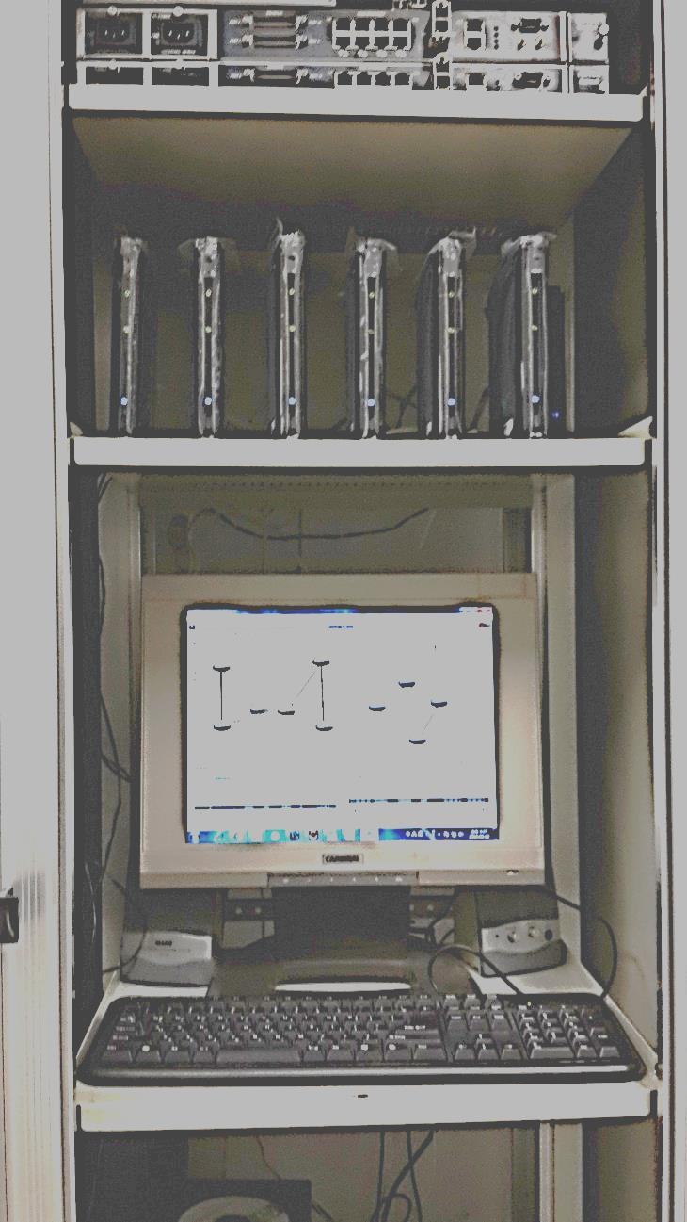
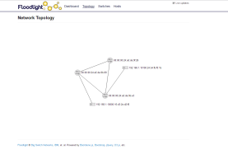


Testbed Architecture
OF-Controller
PCE-controller
TED
Host
OpenVSw
Multi-domain SDTN network
NIA2014
<number>/33
Notes:
26年 11月 8日

Slide 29

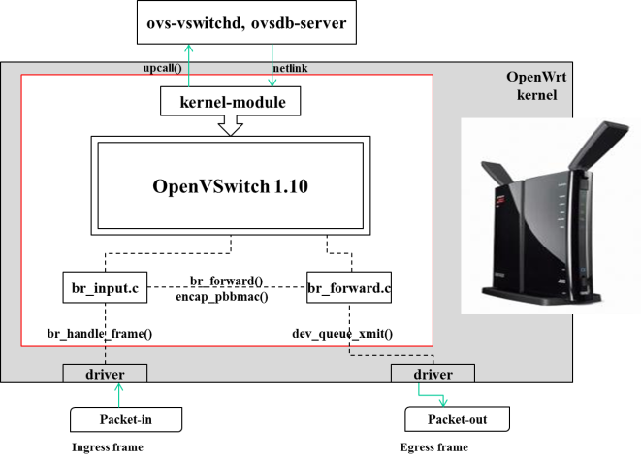
Testbed Implementation
NIA2014
<number>/33
Notes:
26年 11月 8日

Slide 30
PCE-Controller
Provisioning controller
GUI/CLI
Controller Panel
PCE (Algorithms)
Topology
panel
LSP/label
panel
Perfrorm.
panel
Path provisioning
Topology
DataBase
LSP connectivity
Node
Link
Neigbor
Connection (TLSP)
SLSP
Route
Interface
Used Label
Common Data Structure
Communication Server
REST interface
NIA2014
Notes:
26年 11月 8日

Slide 31
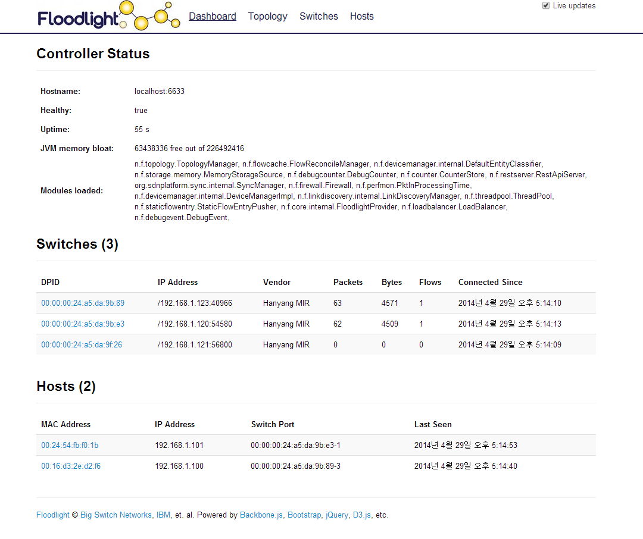
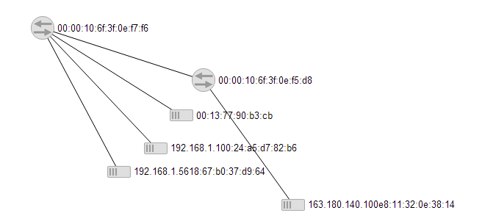
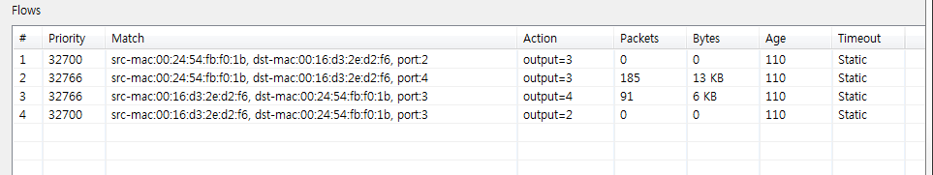
Floodlight OF-Controller
Network Topology
switches
Flow at each switch
NIA2014
<number>/33
Notes:
26年 11月 8日

Slide 32
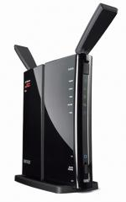
OpenVSwitch based on OpenWrt
OpenFlow
protocol
ovs-vswitchd, ovsdb-server
ovs-vsctl,
ovs-dpctl,
upcall()
netlink
OpenWrt
kernel
kernel-module
OpenVSwitch 1.10
br_input.c
br_forward()
br_forward.c
encap_pbbmac()
br_handle_frame()
dev_queue_xmit()
driver
driver
Packet-in
Packet-out
NIA2014
Egress frame
<number>/33
Ingress frame
Notes:
26年 11月 8日

Slide 33
Conclusion
We show the benefits of introducing programmability into the enterprise Mobility Management System
OpenWrt– lightweight, cheap, and be used to develop network services efficiently
Future Work:
  Bigger testbed with more users, indoors and outdoors
  Further abstractions to support more network apps
  Fault-tolerance, fail-over capabilities, and policy management
NIA2014
<number>/33

Slide 34

Demonstration

