Slide 1
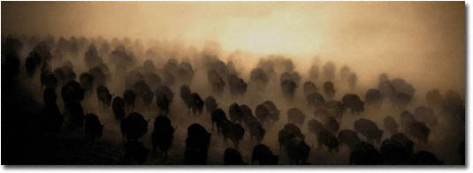
CPU Scheduling

Slide 2

Chapter 6: CPU Scheduling
Basic Concepts
Scheduling Criteria
Scheduling Algorithms
Thread Scheduling
Real-Time Scheduling
Algorithm Evaluation
Hanyang University
Data-Centric Systems Lab.

Slide 3

Alternating sequence of CPU and I/O Bursts
Hanyang University
Data-Centric Systems Lab.

Slide 4

Histogram of CPU-burst Times
I/O bound job
Hyperexponential distribution
CPU bound job
Hanyang University
Data-Centric Systems Lab.

Slide 5
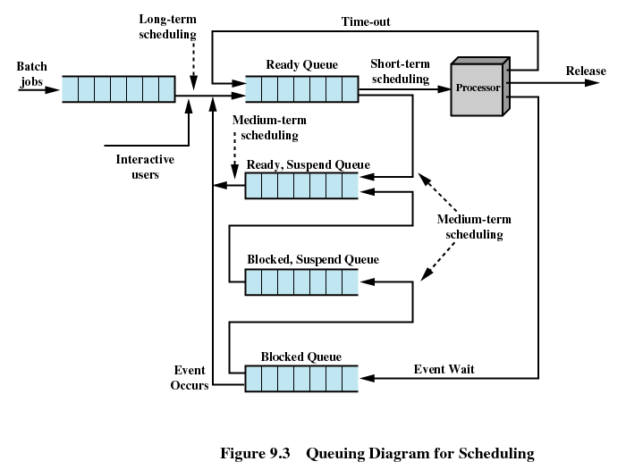
State Diagram - revisited
Hanyang University
Data-Centric Systems Lab.

Slide 6
CPU Scheduler
Multiprogramming environment
CPU Scheduler selects processes in memory
that are ready to execute, and allocates the CPU to one of them
CPU scheduling decisions may take place when a process:
  1. Switches from running to waiting state. (eg I/O request)
  2. Switches from running to ready state. (eg timerunout)
  3. Switches from waiting to ready. (eg I/O finished interrupt)
  4. Terminates
If scheduling takes place only under 1 and 4 :
  The scheduling scheme is nonpreemptive – 실시간성 없음 interrupt 즉각 처리 x
Otherwise, preemptive scheduling scheme – 효율적, interrupt 효율적 처리
Hanyang University
Data-Centric Systems Lab.

Slide 7
Dispatcher
Dispatcher module gives control of the CPU to the process selected by the short-term scheduler; this involves:
  switching context
  switching to user mode
  jumping to the proper location in the user program to restart that program
Dispatch latency
  time it takes for the dispatcher to stop one process and start another running. (대부분 context switch overhead)
Hanyang University
Data-Centric Systems Lab.

Slide 8

Scheduling Criteria (Performance Index)
CPU utilization
  keep the CPU as busy as possible
Throughput
  # of processes that complete their execution per time unit
Turnaround time
  amount of time to complete a particular process
Waiting time
  sum of the periods spent waiting in the ready queue
Response time
  amount of time it takes from when a request was submitted until the first response is produced, not output (for time-sharing environment)
Hanyang University
Data-Centric Systems Lab.

Slide 9
Scheduling Algorithm Optimization Criteria
Max CPU utilization
Max throughput
Min turnaround time
Min waiting time
Min response time
Hanyang University
Data-Centric Systems Lab.

Slide 10
Scheduling Algorithms
FCFS (First-Come First-Served)
SJF (Shortest-Job-First)
SRTF (Shortest-Remaining-Time-First)
Priority Scheduling
RR (Round Robin)
Multilevel Queue
Multilevel Feedback Queue
Hanyang University
Data-Centric Systems Lab.

Slide 11
FCFS Scheduling
Example: Process Burst Time
P₁ 24
P₂ 3
P₃ 3
Suppose that the processes arrive in the order: P₁ , P₂ , P₃
The Gantt Chart for the schedule is (FCFS is nonpreemptive):
Waiting time for P₁ = 0; P₂ = 24; P₃ = 27
Average waiting time: (0 + 24 + 27)/3 = 17
Pair (공정성) 보장
P₁
P₂
P₃
0
24
27
30
Hanyang University
Data-Centric Systems Lab.

Slide 12
FCFS Scheduling (Cont.)
Suppose that the processes arrive in the order
P₂ , P₃ , P₁ .
The Gantt chart for the schedule is:
Waiting time for P₁ = 6; P₂ = 0; P₃ = 3
Average waiting time: (6 + 0 + 3)/3 = 3
Much better than previous case.
Convoy effect : short process behind long process
P₂
P₃
P₁
0
3
6
30
Hanyang University
Data-Centric Systems Lab.

Slide 13
Shortest-Job-First (SJF) Scheduling
Associate with each process the length of its next CPU burst. Use these lengths to schedule the process with the shortest time
Two schemes:
  Nonpreemptive
    once CPU given to the process it cannot be preempted until completes its CPU burst
  Preemptive
    if a new process arrives with CPU burst length less than remaining time of current executing process, preempt
    This scheme is known as the
    Shortest-Remaining-Time-First (SRTF)
SJF is optimal, pair 깨짐
  gives minimum average waiting time for a given set of processes
Hanyang University
Data-Centric Systems Lab.

Slide 14
Example of Non-Preemptive SJF
Process Arrival Time Burst Time
P₁ 0.0 7
P₂ 2.0 4
P₃ 4.0 1
P₄ 5.0 4
SJF (non-preemptive)
Average waiting time = (0 + 6 + 3 + 7)/4 = 4
P₁
P₃
P₂
P₄
0
3
7
8
12
16
Hanyang University
Data-Centric Systems Lab.

Slide 15
Example of Preemptive SJF
Process Arrival Time Burst Time
P₁ 0.0 7
P₂ 2.0 4
P₃ 4.0 1
P₄ 5.0 4
SJF (preemptive) : SRTF
Average waiting time = (9 + 1 + 0 +2)/4 = 3
SJF < SRTF 항상 좋다? – SRTF context switching 많이 발생 (throughput 낮아지고, turnaround time 높아진다.)
P₁
P₂
P₃
P₂
P₄
P₁
0
2
4
5
7
11
16
Hanyang University
Data-Centric Systems Lab.

Slide 16
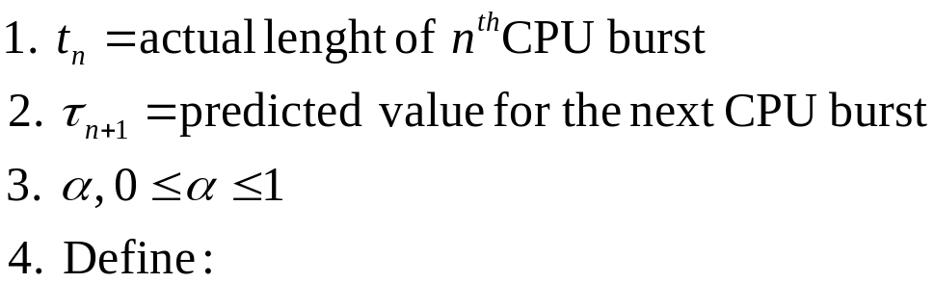

Determining Length of Next CPU Burst
But how do you know the length of next CPU burst?
(input data, branch, user …)
Can only estimate the length.
Can be done by using the length of previous CPU bursts, using exponential averaging.
Hanyang University
Data-Centric Systems Lab.

Slide 17
Examples of Exponential Averaging
α =0
  τ_{n+1} = τ_{n}
  Recent history does not count.
α =1
  τ_{n+1} = t_{n}
  Only the actual last CPU burst counts.
If we expand the formula, we get:
    τ_{n+1} = α t_{n}+(1 - α) α t_{n-1} + …
    +(1 - α )^{j} α t_{n-j} + …
    +(1 - α )^{n+1}τ₀
Since both α and (1 - α) are less than or equal to 1, each successive term has less weight than its predecessor.
Hanyang University
Data-Centric Systems Lab.

Slide 18
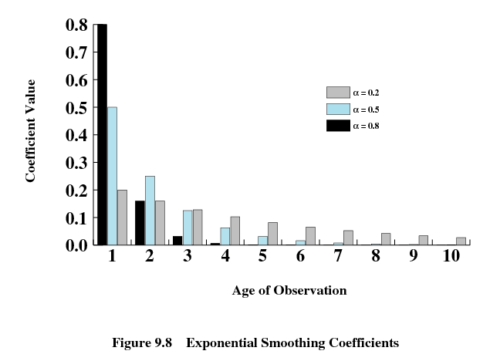
Hanyang University
Data-Centric Systems Lab.

Slide 19
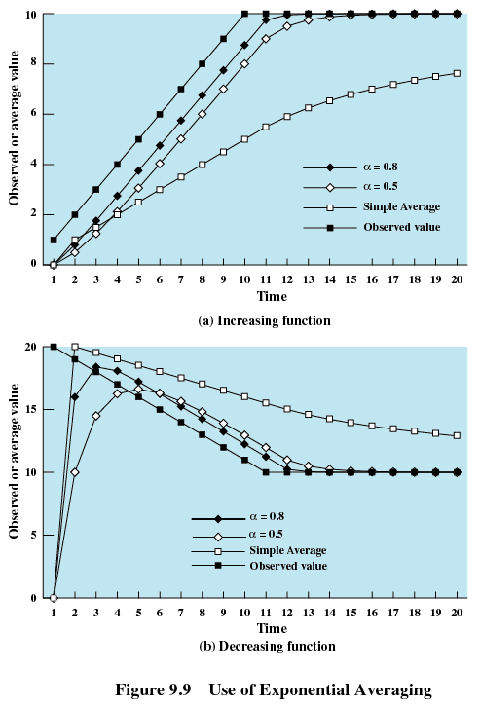
Hanyang University
Data-Centric Systems Lab.

Slide 20
Priority Scheduling
A priority number (integer) is associated with each process
The CPU is allocated to the process with the highest priority (smallest integer ≡ highest priority)
  Preemptive
  nonpreemptive
SJF is a priority scheduling where
priority is the predicted next CPU burst time
Problem
  Starvation: low priority processes may never execute
Solution
  Aging: as time progresses increase the priority of the process
Hanyang University
Data-Centric Systems Lab.

Slide 21
Round Robin (RR)
Each process gets a small unit of CPU time (time quantum),
usually 10-100 milliseconds
  After this time has elapsed, the process is preempted and added to the end of the ready queue
If there are n processes in the ready queue and the time quantum is q sec, then each process gets 1/n of the CPU time in chunks of at most q sec at once
⇒ No process waits more than (n-1)q time units
Performance
  q large ⇒ FIFO
  q small ⇒ q must be large with respect to context switch,
  otherwise overhead is too high
Hanyang University
Data-Centric Systems Lab.

Slide 22
Example: RR with Time Quantum = 20
Process Burst Time
P₁ 53
P₂ 17
P₃ 68
P₄ 24
The Gantt chart is:
Typically, higher average turnaround than SJF, but better response
P₁
P₂
P₃
P₄
P₁
P₃
P₄
P₁
P₃
P₃
0
20
37
57
77
97
117
121
134
154
162
Hanyang University
Data-Centric Systems Lab.

Slide 23

How a Smaller Time Quantum Increases Context Switches
Hanyang University
Data-Centric Systems Lab.

Slide 24

Turnaround Time Varies with the Time Quantum
Hanyang University
Data-Centric Systems Lab.

Slide 25
Multilevel Queue
Ready queue is partitioned into separate queues:
  foreground (interactive)
  background (batch – no human interaction)
Each queue has its own scheduling algorithm
  foreground – RR
  background – FCFS
Scheduling must be done between the queues.
  Fixed priority scheduling
    serve all from foreground then from background.
    Possibility of starvation.
  Time slice
    each queue gets a certain amount of CPU time
    which it can schedule amongst its processes
    Eg., 80% to foreground in RR, 20% to background in FCFS
Hanyang University
Data-Centric Systems Lab.

Slide 26

Multilevel Queue Scheduling
Hanyang University
Data-Centric Systems Lab.

Slide 27
Multilevel Feedback Queue
A process can move between the various queues;
aging can be implemented this way.
Multilevel-feedback-queue scheduler defined by the following parameters:
  number of queues
  scheduling algorithms for each queue
  method used to determine when to upgrade a process
  method used to determine when to demote a process
  method used to determine which queue a process will enter when that process needs service
Hanyang University
Data-Centric Systems Lab.

Slide 28

Example of Multilevel Feedback Queue
Three queues:
  Q₀ – time quantum 8 ms
  Q₁ – time quantum 16 ms
  Q₂ – FCFS
Scheduling
  A new job enters queue Q₀ which is served FCFS
  When it gains CPU, job receives 8 milliseconds
  If it does not finish in 8 milliseconds, job is moved to queue Q₁
  At Q₁ job is again served FCFS and receives 16 additional ms
  If it still does not complete, it is preempted and moved to queue Q₂
Hanyang University
Data-Centric Systems Lab.

Slide 29
Real-Time Scheduling
Hard real-time systems – required to complete a critical task within a guaranteed amount of time
Soft real-time computing – requires that critical processes receive priority over less fortunate ones
Hanyang University
Data-Centric Systems Lab.

