Slide 1

Deadlocks

Slide 2
The Deadlock Problem
A set of blocked processes each holding a resource and waiting to acquire a resource held by another process in the set.
Example
  System has 2 tape drives.
  P₁ and P₂ each hold one tape drive and each needs another one.
Example
  semaphores A and B, initialized to 1
        P₀ P₁
        P (A); P(B)
        P (B); P(A)
Hanyang University
Data-Centric Systems Lab.

Slide 3
Bridge Crossing Example
Traffic only in one direction.
Each section of a bridge can be viewed as a resource.
If a deadlock occurs, it can be resolved if one car backs up (preempt resources and rollback).
Several cars may have to be backed up if a deadlock occurs.
Starvation is possible.
Hanyang University
Data-Centric Systems Lab.

Slide 4
System Model
Resource types R₁, R₂, . . ., R_{m}
    CPU cycles, memory space, I/O devices
Each resource type R_{i} has W_{i} instances.
W₁, W₂, . . ., W_{m}
Each process utilizes a resource as follows:
  request
  use
  release
Hanyang University
Data-Centric Systems Lab.

Slide 5

Deadlock Characterization
Deadlock can arise if 4 conditions hold simultaneously(necessary condition)
Mutual exclusion: only one process at a time can use a resource
No preemption: a resource can be released only voluntarily by the process holding it, after that process has completed its task
Hold and wait: a process holding at least one resource is waiting to acquire additional resources held by other processes.
Circular wait: there exists a set {P₀, P₁, …, P₀} of waiting processes such that P₀ is waiting for a resource that is held by P₁,
P₁ is waiting for a resource that is held by P₂, …,
P_{n–1} is waiting for a resource that is held by P_{n}, and
P_{n} is waiting for a resource that is held by P₀.
Hanyang University
Data-Centric Systems Lab.

Slide 6

Traffic Deadlock
Hanyang University
Data-Centric Systems Lab.

Slide 7
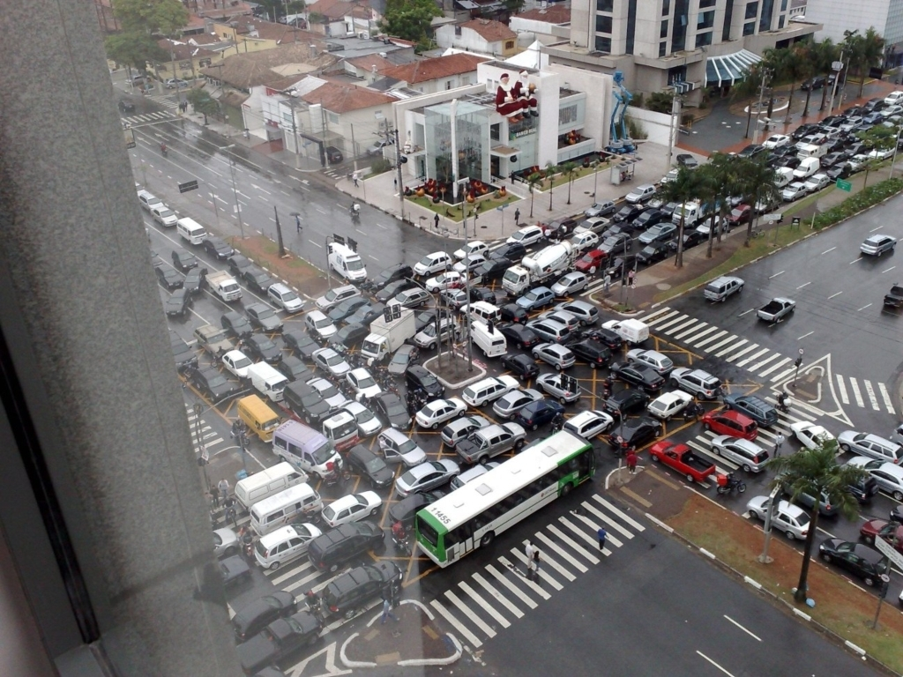
Real World Traffic Deadlock
Hanyang University
Data-Centric Systems Lab.

Slide 8
Resource-Allocation Graph
A set of vertices V and a set of edges E.
V is partitioned into two types:
  P = {P₁, P₂, …, P_{n}}, the set consisting of all the processes in the system.
  R = {R₁, R₂, …, R_{m}}, the set consisting of all resource types in the system.
request edge – directed edge P₁ → R_{j}
assignment edge – directed edge R_{j} → P_{i}
Hanyang University
Data-Centric Systems Lab.

Slide 9
Resource-Allocation Graph
Process
Resource Type with 4 instances
P_{i} requests an instance of R_{j}
P_{i} is holding an instance of R_{j}
P_{i}
R_{j}
P_{i}
R_{j}
Hanyang University
Data-Centric Systems Lab.

Slide 10

Example of a Resource Allocation Graph
Hanyang University
Data-Centric Systems Lab.

Slide 11
Basic Facts
If graph contains no cycles ⇒ no deadlock.
If graph contains a cycle ⇒
  if only one instance per resource type, then deadlock.
  if several instances per resource type, possibility of deadlock.
Hanyang University
Data-Centric Systems Lab.

Slide 12

Resource Allocation Graph with a Deadlock
Hanyang University
Data-Centric Systems Lab.

Slide 13

Resource Allocation Graph with a Cycle But No Deadlock
Hanyang University
Data-Centric Systems Lab.

Slide 14
Methods for Handling Deadlocks
Ensure that the system will never enter a deadlock state.
(prevent, avoid)
Allow the system to enter a deadlock state and then recover.
(after detection)
Ignore the problem and pretend that deadlocks never occur in the system; used by most operating systems, including UNIX.
Hanyang University
Data-Centric Systems Lab.

Slide 15
Deadlock Prevention
Restrain the ways request can be made.
Mutual Exclusion – not required for sharable resources;
must hold for non-sharable resources (enforcement impossible for intrinsically non-sharable resources).
Hold and Wait – must guarantee that whenever a process requests a resource, it does not hold any other resources.
  Require process to request and be allocated all its resources before it begins execution, or allow process to request resources only when the process has none. (all or nothing)
  Low resource utilization; starvation possible.
Hanyang University
Data-Centric Systems Lab.

Slide 16
Deadlock Prevention (Cont.)
No Preemption
  If a process that is holding some resources requests another resource that cannot be immediately allocated to it, then all resources currently being held are released.
  Preempted resources are added to the list of resources for which the process is waiting.
  Process will be restarted only when it can regain its old resources, as well as the new ones that it is requesting.
Circular Wait
  impose a total ordering of all resource types, and require that each process requests resources in an increasing order of enumeration.
-----------------------------
** Low resource utilizations and reduced system throughput
Hanyang University
Data-Centric Systems Lab.

Slide 17
Deadlock Avoidance
Requires that the system has some additional a priori information
available.
Simplest and most useful model requires that each process declare the maximum number of resources of each type that it may need
The deadlock-avoidance algorithm dynamically examines the resource-allocation state to ensure that there can never be a circular-wait condition
Resource-allocation state is defined by the number of available and allocated resources, and the maximum demands of the processes
Hanyang University
Data-Centric Systems Lab.

Slide 18
Safe State
When a process requests an available resource, system must decide if immediate allocation leaves the system in a safe state.
Sequence <P₁, P₂, …, P_{n}> is safe if for each P_{i}, the resources that P_{i} can still request can be satisfied by currently available resources + resources held by all the P_{j}, with j<i.
  If P_{i} resource needs are not immediately available, then P_{i} can wait until all P_{j} have finished.
  When P_{j} is finished, P_{i} can obtain needed resources, execute, return allocated resources, and terminate.
  When P_{i} terminates, P_{i+1} can obtain its needed resources, and so on.
System is in safe state if there exists a safe sequence of all processes.
Hanyang University
Data-Centric Systems Lab.

Slide 19
Basic Facts
If a system is in safe state ⇒ no deadlocks.
If a system is in unsafe state ⇒ possibility of deadlock.
  When all processes request maximum amount of resources of all types
Avoidance ⇒ ensure that a system will never enter an unsafe state.
“grant the request if it results in a safe state,
do not grant it otherwise”
Hanyang University
Data-Centric Systems Lab.

Slide 20

Safe, unsafe , deadlock state spaces
Hanyang University
Data-Centric Systems Lab.

Slide 21
Avoidance algorithms
Single instance of a resource type
  Use a resource-allocation graph
Multiple instances of a resource type
  Use the banker’s algorithm
Hanyang University
Data-Centric Systems Lab.

Slide 22
Case A: One instance per resource types :
Resource Allocation Graph Algorithm
claim edge
P_{i} → R_{j} indicated that process P_{i} may request resource R_{j};
represented by a dashed line.
request edge
Claim edge converts to request edge when a process
requests a resource.
assignment edge
Request edge converts to assignment edge when the
resource is allocated to the process.
When a resource is released by a process,
assignment edge reconverts to a claim edge.
Resources must be claimed a priori in the system.
Hanyang University
Data-Centric Systems Lab.

Slide 23
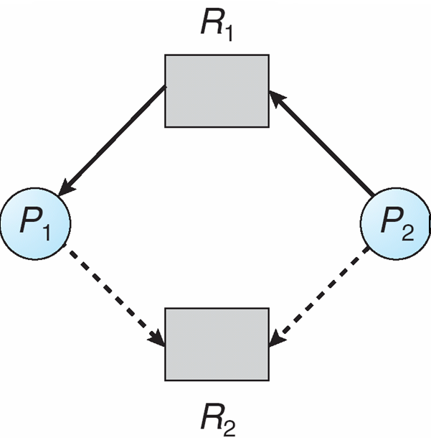
Resource-Allocation Graph For Deadlock Avoidance
P2 requests R2
If we grant it,
A cycle is formed
(unsafe)
Hanyang University
Data-Centric Systems Lab.

Slide 24
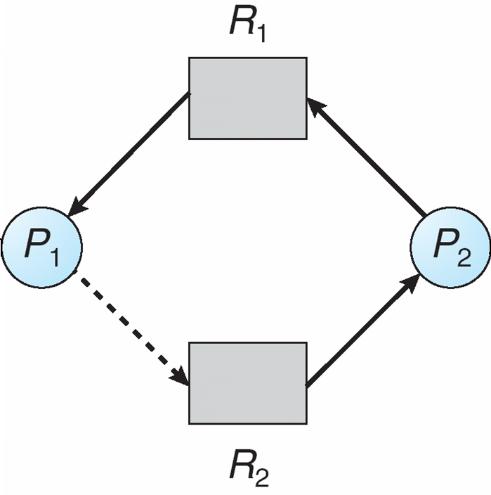
Unsafe State In A Resource-Allocation Graph
No cycle ➔ safe ➔ grant
Cycle ➔ unsafe ➔ deny
Hanyang University
Data-Centric Systems Lab.

Slide 25
Resource-Allocation Graph Algorithm
Suppose that process P_{i} requests a resource R_{j}
The request can be granted only if converting the request edge to an assignment edge does not result in the formation of a cycle in the resource allocation graph
Hanyang University
Data-Centric Systems Lab.

Slide 26
Case B: Multiple instances per resource types : Banker’s Algorithm
Each process must a priori claim maximum use
When a process requests a resource it may have to wait
When a process gets all its resources it must return them in a finite amount of time
Hanyang University
Data-Centric Systems Lab.

Slide 27
Data Structures for the Banker’s Algorithm
Let n = number of processes, and m = number of resources types.
vector
Available:
Available[j] = k : k instances of resource type R_{j} are available.
Max: Max [i,j] = k : P_{i} may request at most k instances of R_{j}.
Allocation:
Allocation[i,j] = k : P_{i} is currently allocated k instances of R_{j.}
Need: If Need[i,j] = k : P_{i} may need k more instances of R_{j.}
    Need [i,j] = Max[i,j] – Allocation [i,j].
n x m
matrix
Hanyang University
Data-Centric Systems Lab.

Slide 28
Safety Algorithm
1. Let Work and Finish be vectors of length m and n, respectively. Initialize:
      Work := Available
      Finish [i] = false for i = 1,2, …, n.
2. Find an i such that both:
  (a) Finish [i] = false
  (b) Need_{i} ≤ Work
  If no such i exists, go to step 4.
3. Work := Work + Allocation_{i}
Finish[i] := true
go to step 2.
4. If Finish [i] = true for all i, then the system is in a safe state.
Hanyang University
Data-Centric Systems Lab.

Slide 29
Resource-Request Algorithm for Process P_{i}
Request_{i} = request vector for process P_{i}.
If Request_{i} [j] = k then process P_{i} wants k instances of resource type R_{j.}
  1. If Request_{i} ≤ Need_{i} go to step 2. Otherwise, raise error condition, since process has exceeded its maximum claim.
  2. If Request_{i} ≤ Available, go to step 3. Otherwise P_{i} must wait, since resources are not available.
  3. Pretend to allocate requested resources to P_{i} by modifying the state as follows:
      Available := Available - Request_{i};
      Allocation_{i} := Allocation_{i} + Request_{i};
      Need_{i} := Need_{i} – Request_{i;;}
    If safe ⇒ the resources are allocated to P_{i}.
    If unsafe ⇒ P_{i} must wait, and the old resource-allocation state is restored
Hanyang University
Data-Centric Systems Lab.

Slide 30
Example of Banker’s Algorithm
5 processes P₀ through P₄;
3 resource types A (10), B (5), and C (7) instances. 10 5 7
Snapshot at time T₀:
Allocation Max Available Need
A B C A B C A B C A B C
P₀ 0 1 0 7 5 3 3 3 2 7 4 3
P₁ 2 0 0 3 2 2 1 2 2
P₂ 3 0 2 9 0 2 6 0 0
P₃ 2 1 1 2 2 2 0 1 1
P₄ 0 0 2 4 3 3 4 3 1
The system is in a safe state since the sequence < P₁, P₃, P₄, P₂, P₀> satisfies safety criteria.
Hanyang University
Data-Centric Systems Lab.

Slide 31
Example (Cont.): P₁ request (1,0,2)
Check that Request ≤ Available (that is, (1,0,2) ≤ (3,3,2) ⇒ true)
Allocation Need Available
A B C A B C A B C
P₀ 0 1 0 7 4 3 2 3 0
P₁ 3 0 2 0 2 0
P₂ 3 0 2 6 0 0
P₃ 2 1 1 0 1 1
P₄ 0 0 2 4 3 1
Executing safety algorithm shows that sequence <P₁, P₃, P₄, P₀, P₂> satisfies safety requirement.
Can request for (3,3,0) by P₄ be granted?
Can request for (0,2,0) by P₀ be granted?
Hanyang University
Data-Centric Systems Lab.

Slide 32
Deadlock Detection
Allow system to enter deadlock state
Detection algorithm
Recovery scheme
2 cases
  A: single instance per resource type: cycle → deadlock
  B: multiple instance per resource type: ?
Hanyang University
Data-Centric Systems Lab.

Slide 33
Single Instance of Each Resource Type
Maintain wait-for graph
  Nodes are processes.
  P_{k} → P_{j} if P_{k} is waiting for P_{j}.
Invoke an algorithm that searches for a cycle.
An algorithm to detect a cycle in a graph requires an order of n² operations, where n is the number of vertices in the graph.
Hanyang University
Data-Centric Systems Lab.

Slide 34
Reduction of Resource Graph
Assume each process is in dormant state
Let each process (if it is not blocked) do:
  Acquire resource
  Complete execution
  Release all resources
If irreducible → deadlock
Reduction order is not important
Perform reduction in each time a resource is allocated
“Dormant” state: no more resource request
Comparison:
detection - processes show most favorable attitude
banker’s algorithm – processes show the worst behavior
Hanyang University
Data-Centric Systems Lab.

Slide 35
Reduction of Resource Graph
R₁
P₂
P₃
R₂
P₁
Reduction by P₃ → P₂ → P₁ sequence
→ Completely reducible
→ No deadlock!
Hanyang University
Data-Centric Systems Lab.

Slide 36

Resource-Allocation Graph and Wait-for Graph
Reduction by P₅ only
→ Not completely reducible
→ deadlock! (cycle)
Resource-Allocation Graph
Corresponding wait-for graph
Hanyang University
Data-Centric Systems Lab.

Slide 37
Several Instances of a Resource Type
Use Deadlock Detection Algorithm
Data structures
  Available: vector of length m indicates the number of available resources of each type
  Allocation: n x m matrix defines the number of resources of each type currently allocated to each process
  Request: n x m matrix indicates the current request of each process. If request[i,j]=k, then process P_{i} is requesting k more instances of resource type R_{j}
Hanyang University
Data-Centric Systems Lab.

Slide 38
Detection Algorithm
1. Let Work and Finish be vectors of length m and n, respectively. Initialize
Work := Available
For i = 1,2, …, n
Finish[i] = false, if Allocation_{j} is not 0
Finish[i] = true, otherwise
2. Find an index i such that both:
  (a) Finish [i] = false
  (b) Request_{i} ≤ Work
  If no such i exists, go to step 4.
3. Work := Work + Allocation_{i}
Finish[i] := true
go to step 2.
4. If Finish [i] = false for some i, 1 ≤ i < n, then the system is in a deadlock state. Moreover, if Finish[I] = false, then process P_{i} is deadlocked.
Hanyang University
Data-Centric Systems Lab.

Slide 39
Example of Detection Algorithm
Five processes P₀ through P₄; three resource types
A (7 instances), B (2 instances), and C (6 instances)
Snapshot at time T₀:
Allocation Request Available
A B C A B C A B C
P₀ 0 1 0 0 0 0 0 0 0
P₁ 2 0 0 2 0 2
P₂ 3 0 3 0 0 0
P₃ 2 1 1 1 0 0
P₄ 0 0 2 0 0 2
Sequence <P₀, P₂, P₃, P₁, P₄> will result in Finish[i] = true for all i
Hanyang University
Data-Centric Systems Lab.

Slide 40
Detection Algorithm (Cont.)
Algorithm requires O(m x n²) operations to detect whether the system is in deadlocked state.
m: resource types
n: processes
If m=n, algorithm requires O(n³) operations
-----------------
Problem: How frequently the detection algorithm will be invoked?
every request?(large overhead)
every request not allocated immediately?
periodically? (if deadlock probability is low)
Hanyang University
Data-Centric Systems Lab.

Slide 41
Recovery from Deadlock: Process Termination
Abort all deadlocked processes.
Abort one process at a time until the deadlock cycle is eliminated.
In which order should we choose to abort?
  Priority of the process.
  How long process has computed, and how much longer to completion.
  Resources the process has used.
  Resources process needs to complete.
  How many processes will need to be terminated.
  Is process interactive or batch?
Hanyang University
Data-Centric Systems Lab.

Slide 42
Recovery from Deadlock: Resource Preemption
Selecting a victim : minimize cost
Rollback
  return to some safe state,
  restart process from that state.
Starvation
  same process picked as victim repeatedly,
  include number of rollback in cost factor.
Hanyang University
Data-Centric Systems Lab.

Slide 43
Avoidance v.s. Detection
Differences of two algorithms
Avoidance: we assumed that processes behave the worst
  Worst case assumption: every process claims maximum resources all at the same time
  Assign resources only if there is a safe sequence assuming the worst case!
  May waste resources
Detection: we assume every process is dormant
  Best case assumption: no process will request resources furthermore
  Detects cycle based on the current state (best case assumption)
  cycle in wait-for graph ➔ deadlock
Hanyang University
Data-Centric Systems Lab.

