Slide 1
This Lecture
Chapter 5: Synchronous Sequential Logic

Slide 2
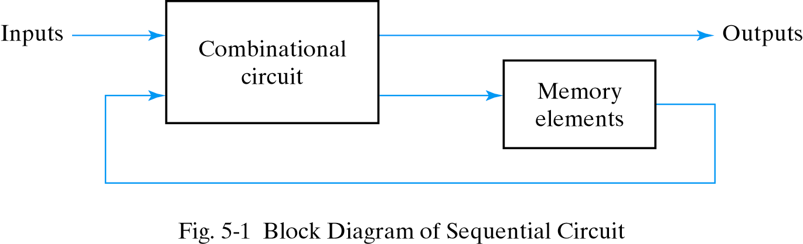
Sequential Circuits
There are two types of sequential circuits: Synchronous and Asynchronous

Slide 3
Types of Sequential Circuits
Two major types: depending on timing of their signals
Asynchronous sequential circuits (see Chapter 9)
The transition happens at any instant of time
Do not use clock pulses. Change of internal state occurs when there is a change in input variables
Instability problem: may become unstable at times
Storage elements work as time-delay device
May be regarded as a combinational circuit with feedback
Synchronous sequential circuits
The transition happens at discrete instants of time
The circuit responds only to pulses on particular inputs
Storage elements are affected only with the arrival of each pulse

Slide 4
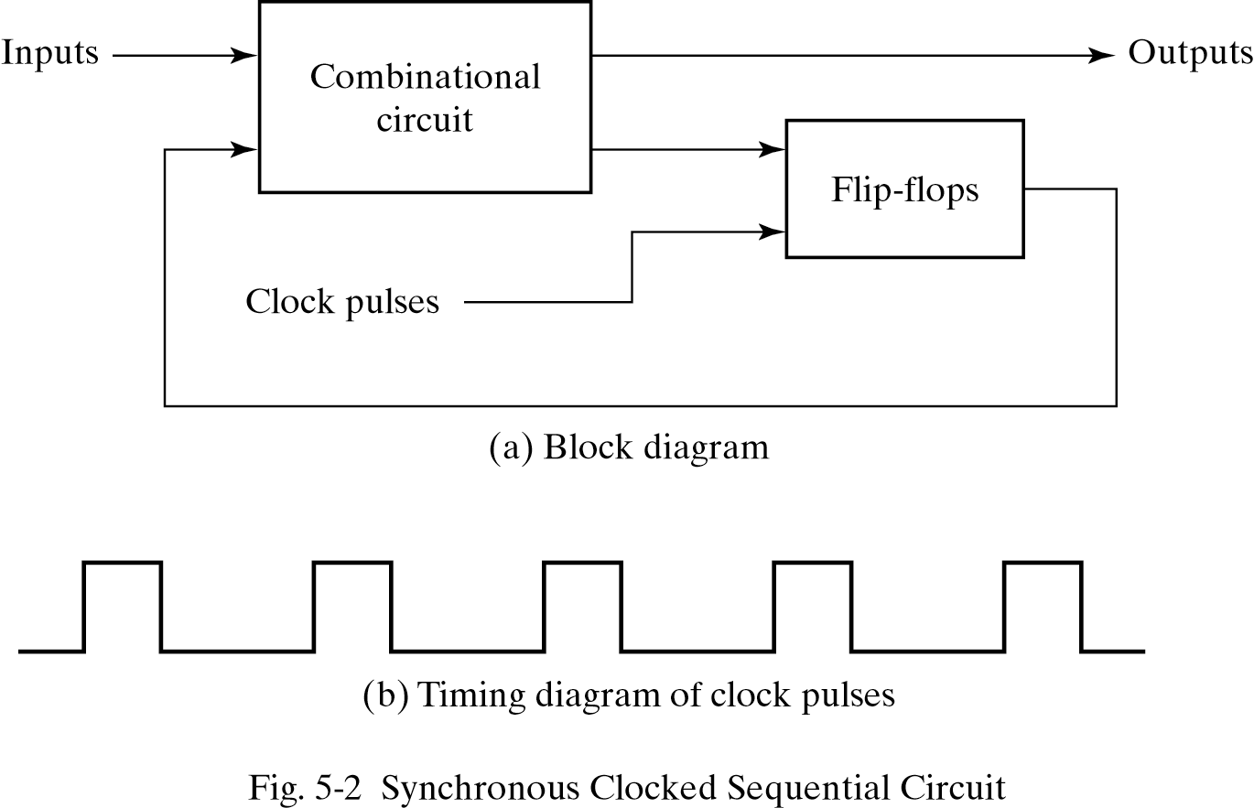
Synchronous Sequential Circuits
The outputs can come either from the combinational circuit or from the flip-flops or both The flip-flops receive their inputs from the combinational circuit and also from a clock signal with pulse that occurs at fixed intervals of time
The flip-flop outputs cannot change and the feedback loop is broken when a clock pulse is not active

Slide 5
Flip-Flops
Sequential Circuits use flip-flops as storage elements
Flip-Flop is a binary storage device that saves one bit of information
The outputs can come from flip-flops or combinational logic
Flip-flop inputs come from combinational logic or clock generators

Slide 6
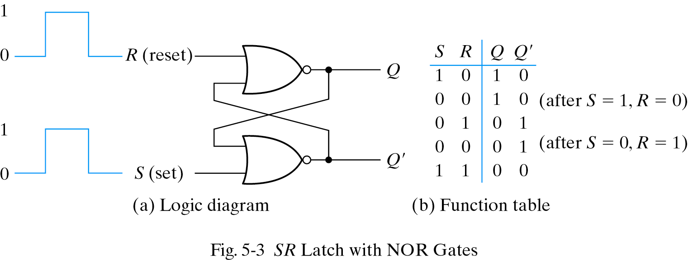
Latches
Different flip-flops are different based on the number of inputs
and how the inputs affect the binary state.
Basic types of flip-flops operate with signal levels and are called latches.
Example: SR latch
Two states: Set and Reset states
an asynchronous sequential circuit with two cross-coupled NOR gates

Slide 7
SR Latches
Two inputs labeled S for set and R for reset
(S,R)=(1,0): set (Q=1, the set state)
(S,R)=(0,1): reset (Q=0, the reset/clear state)
(S,R)=(0,0): normal condition
no operation, in either the set or the reset state
depending on which input was most recently at 1
(S,R)=(1,1): indeterminate state (Q=Q'=0)
consider (S,R) = (1,1) ⇒ (0,0)
unpredictable next state when both inputs return to 0
(depend on which input returns to 0 first)

Slide 8
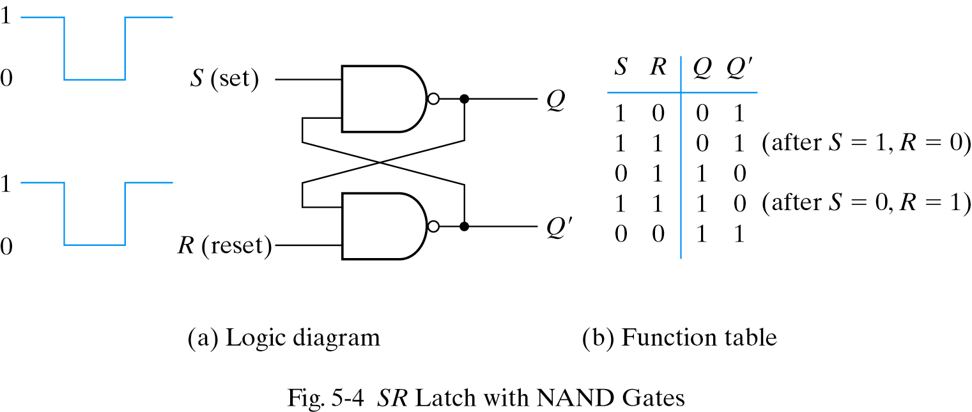
SR Latches with NAND Gates(S’-R’ Latch)
SR latch with two cross-coupled NAND gates
0 signal to change its state
(S,R)=(0,1): set (Q=1, the set state)
(S,R)=(1,0): reset (Q=0, the reset/clear state) (S,R)=(1,1): normal condition
(S,R)=(0,0): indeterminate state (Q=Q’=1)
unpredictable next state

Slide 9
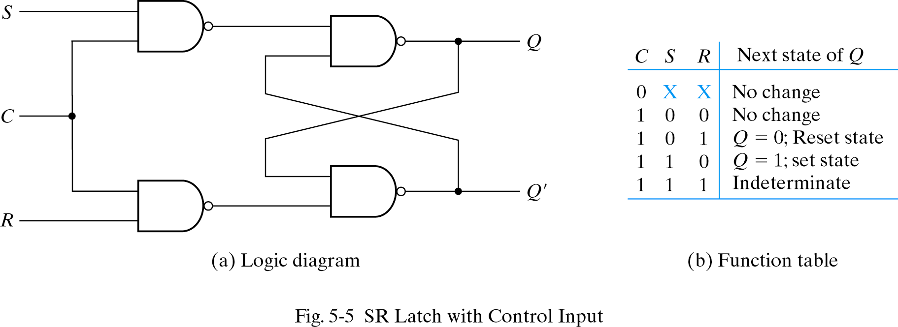
SR Latches with Control input
Determines when the state of the latch can be changed
C=0 ⇒ quiescent condition, no change
C=1 ⇒ S or R is allowed to affect the SR latch (1 signal to change its state)

Slide 10
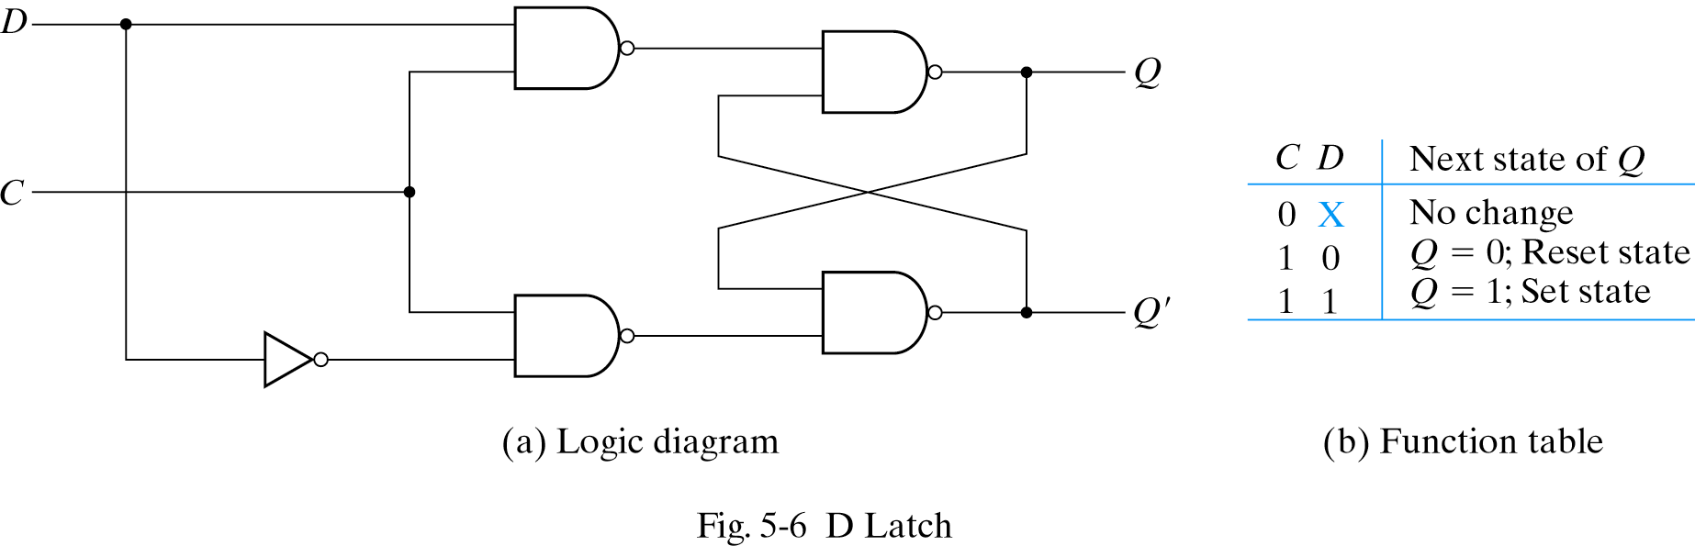
D Latch
S=D and R=D’
Ensure S and R are never equal to 1 at the same time
Eliminate the undesirable conditions of the indeterminate state in the SR latch
One output Q and two inputs: D (data) and C (control)
Q = D when C=1
Q = no change when C=0.
1
0
1
1
1
1
1
0
1
0
Also called a transparent latch

Slide 11
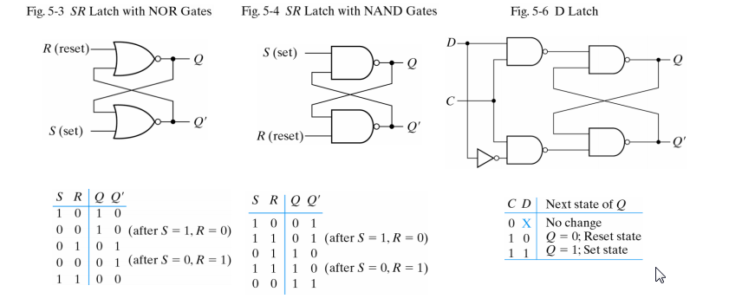
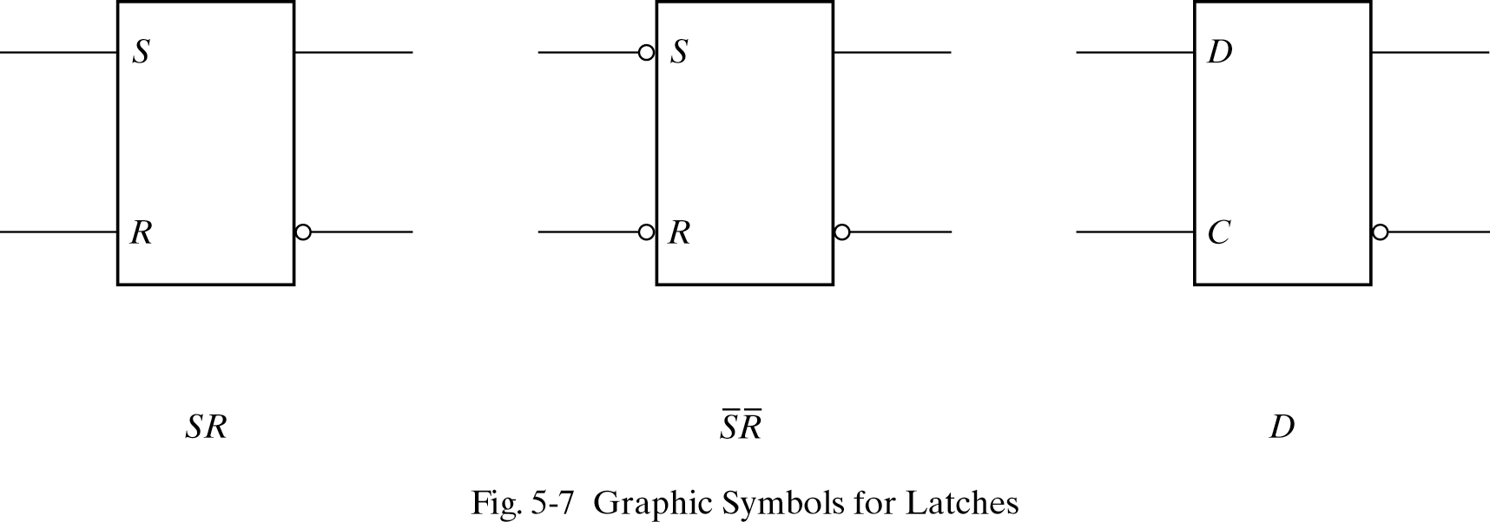
Diagrams, Function Tables, and Graphic Symbols for Latches

Slide 12
Flip-Flips
A trigger: the momentary change to switch the state of a latch or flip-flop
The transition it causes is said to trigger the flip-flop
Types of triggers
Level triggered – latches
D latch is triggered every time the pulse stays at logic 1 level.
Be used as a temporary storage between a unit and its environment
Edge triggered – flip-flops
If level-triggered flip-flops are used, the feedback path may cause instability problem as long as the clock pulse stays in the active level
triggered only during a signal transition (0⇒1 or 1⇒0)

Slide 13
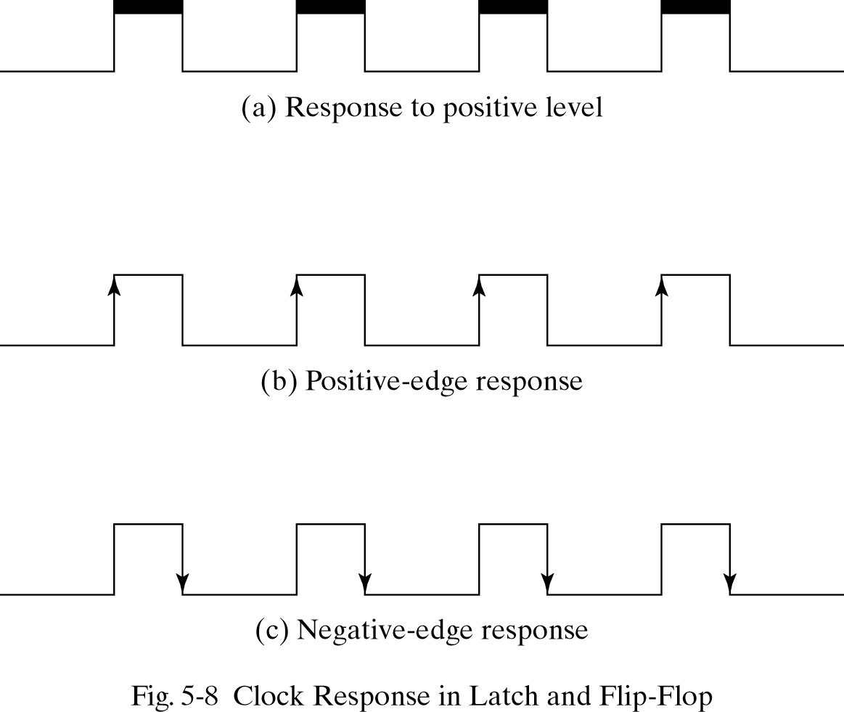
Flip-Flips
Many flip-flops are edge triggered:
They respond to the input only during transition from 0 to 1 or from 1 to 0.

Slide 14
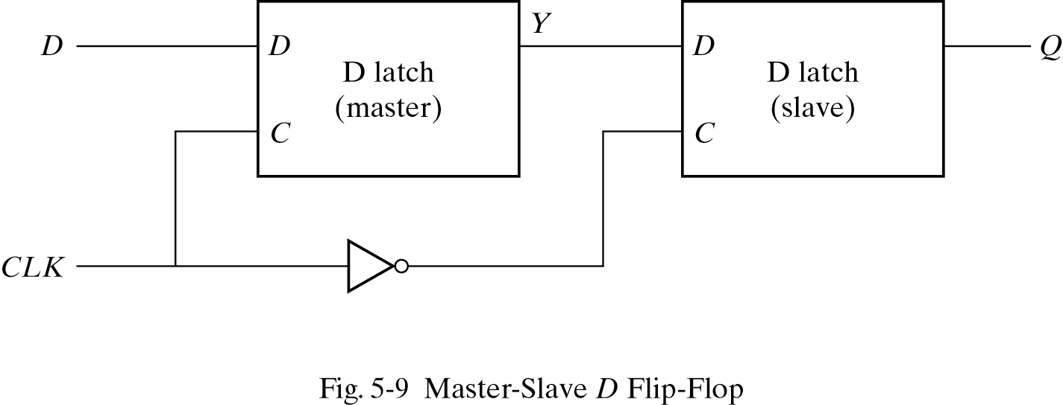
Edge-Triggered D Flip-Flop
Store binary info during transition
Master-slave D flip-flop
two separate latch
a master latch (positive-level triggered)
a slave latch (negative-level triggered)
change only during negative edge of clock (1->0)
longer propagation delay
Data blocked here while CLK =1
1
1
1
0

Slide 15
Edge-Triggered D Flip-Flop
The output can change only when clock goes from 1 to 0.
Data passes here while CLK =0
1
1
1
0
1

Slide 16
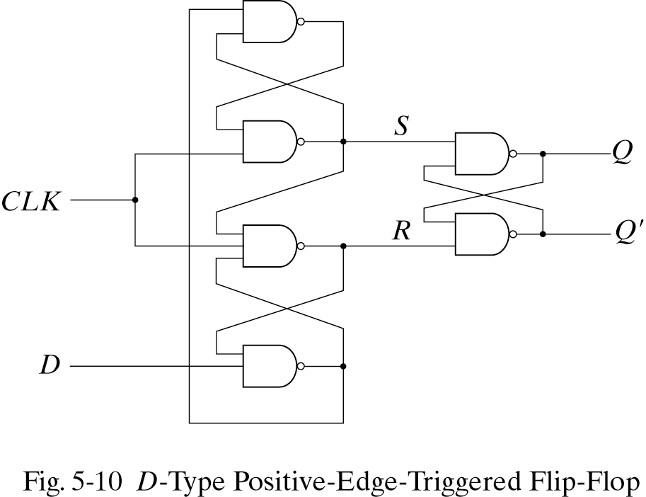
Positive Edge-Triggered D Flip-Flop
How is this a positive edge triggered? Lets look at all possible scenarios:
a) CLK = 0, then S=R=1 which causes the output to stay unchanged.
1
0
1

Slide 17
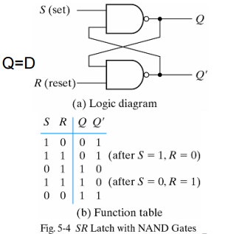
Positive Edge-Triggered D Flip-Flop
How is this a positive edge triggered? Lets look at all possible scenarios:
a) CLK = 0, then S=R=1 which causes the output to stay unchanged.
1
Q=R ⇒
0
1

Slide 18
Positive Edge-Triggered D Flip-Flop
What if CLK goes from 0 to 1? (↑ : Positive-edge) Q=D (state changes once)
a) D = 0, when CLK becomes 1, R changes 1 to 0. Flip-Flop goes to reset state. Q=0.
If D changes while CLK = 1, R remains 1. Q does not change.
1
S used to be 1 when CLK was 0
1
1
1
0
1
1
0
Since one input is 0 changes in D can’t change Q
0
1

Slide 19
Positive Edge-Triggered D Flip-Flop
What if CLK goes from 0 to 1? (Positive-edge)
b) D = 1, when CLK becomes 1, S changes to 0. Flip-Flop goes to set state. Q=1.
If D changes while CLK = 1, R remains 0. Q does not change.
0
1
S and R used to be 1 when CLK was 0
1
1
0
1
1
1
0
1
1
0
Since one input is 0 changes in D can’t change Q
1
1
0

Slide 20
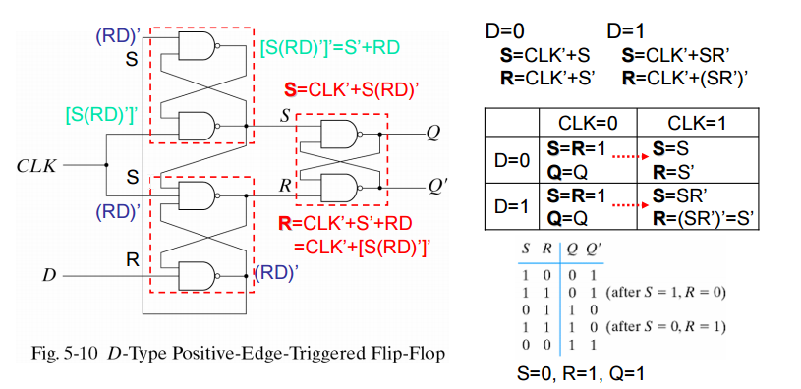
Positive Edge-Triggered D Flip-Flop

Slide 21
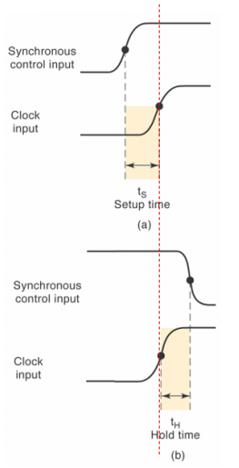
Setup Time and Hold Time
Setup time
a minimum time for which the D input must be maintained at a constant value (or be ready) prior to the occurrence of the clock transition
data to the internal latch
Hold time
a minimum time for which the D input must not changes after the application of the positive transition of the clock
clock to the internal latch

Slide 22
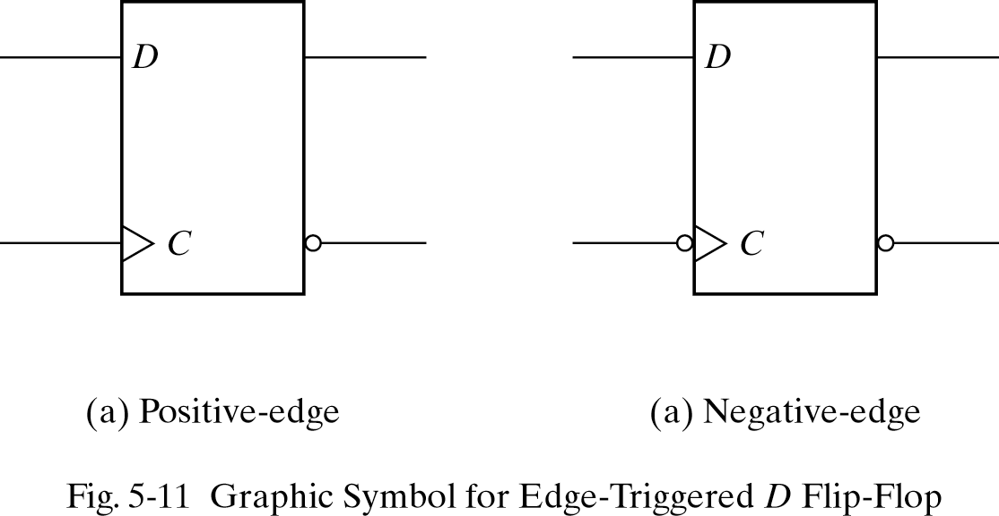
Graphic Symbols

Slide 23
Other Flip-Flops
Each flip-flop is made of interconnection of gates.
The edge-triggered D flip-flop is the most efficient flip-flop since it requires the least number of gates.
Other flip-flops are made using the D flip-flop and extra logic.
Two flip-flops widely used are the JK and T flip-flop.

Slide 24
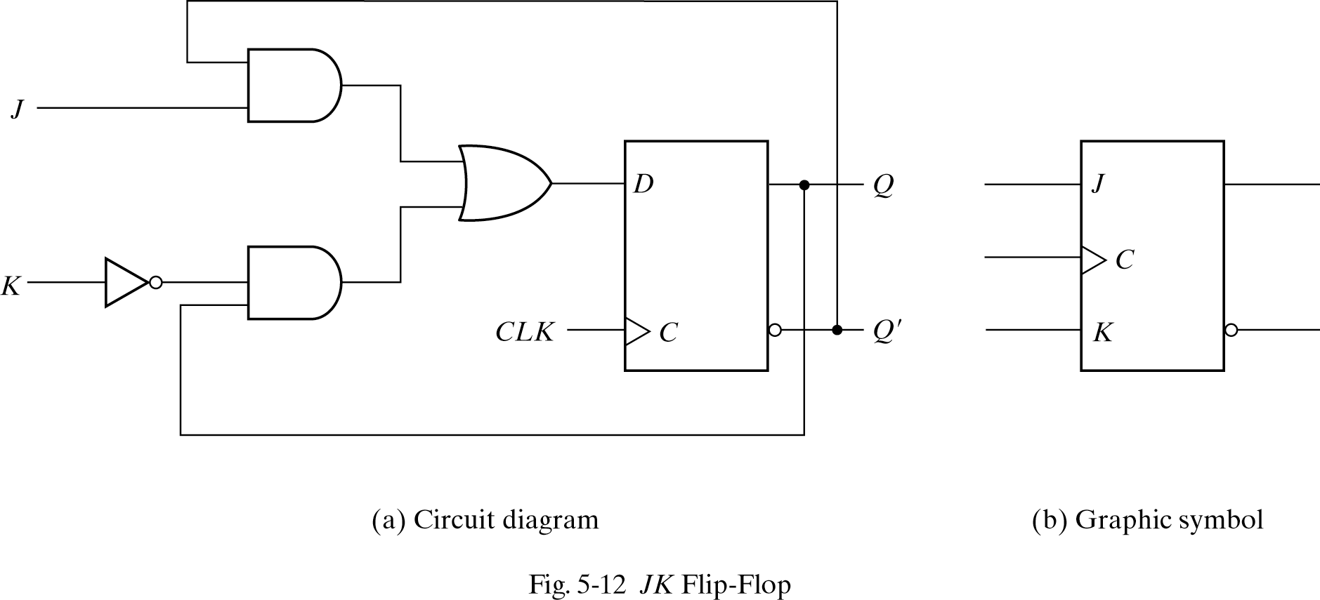
JK Flip-Flop
Three flip-flop operations: Set, Reset, Complement output.
JK performs all three

Slide 25
JK Flip-Flop
JK Flip-Flop: D=JQ'+K'Q
J=0, K=0: D=Q ⇒ Q no change
J=0, K=1: D=0 ⇒ Q =0 reset to 0
J=1, K=0: D=1 ⇒ Q =1 set to 1
J=1, K=1: D=Q’ ⇒ Q =Q’ complement output

Slide 26
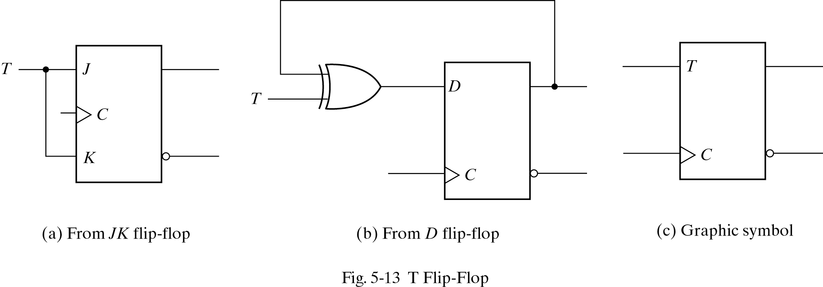
T Flip-Flop
T (Toggle) flip-flop is a complementing one.
T flip-flop is obtained from a JK when inputs J and K are tied together.

Slide 27
T Flip-Flop
If T=0 ( J=K=0) D=Q, output does not change.
If T=1 ( J=K=1) D=Q’ output is complemented.
A T flip-flop can also be made of D flip-flop and a XOR.
D = T ⊕ Q = TQ’ + T’Q

Slide 28
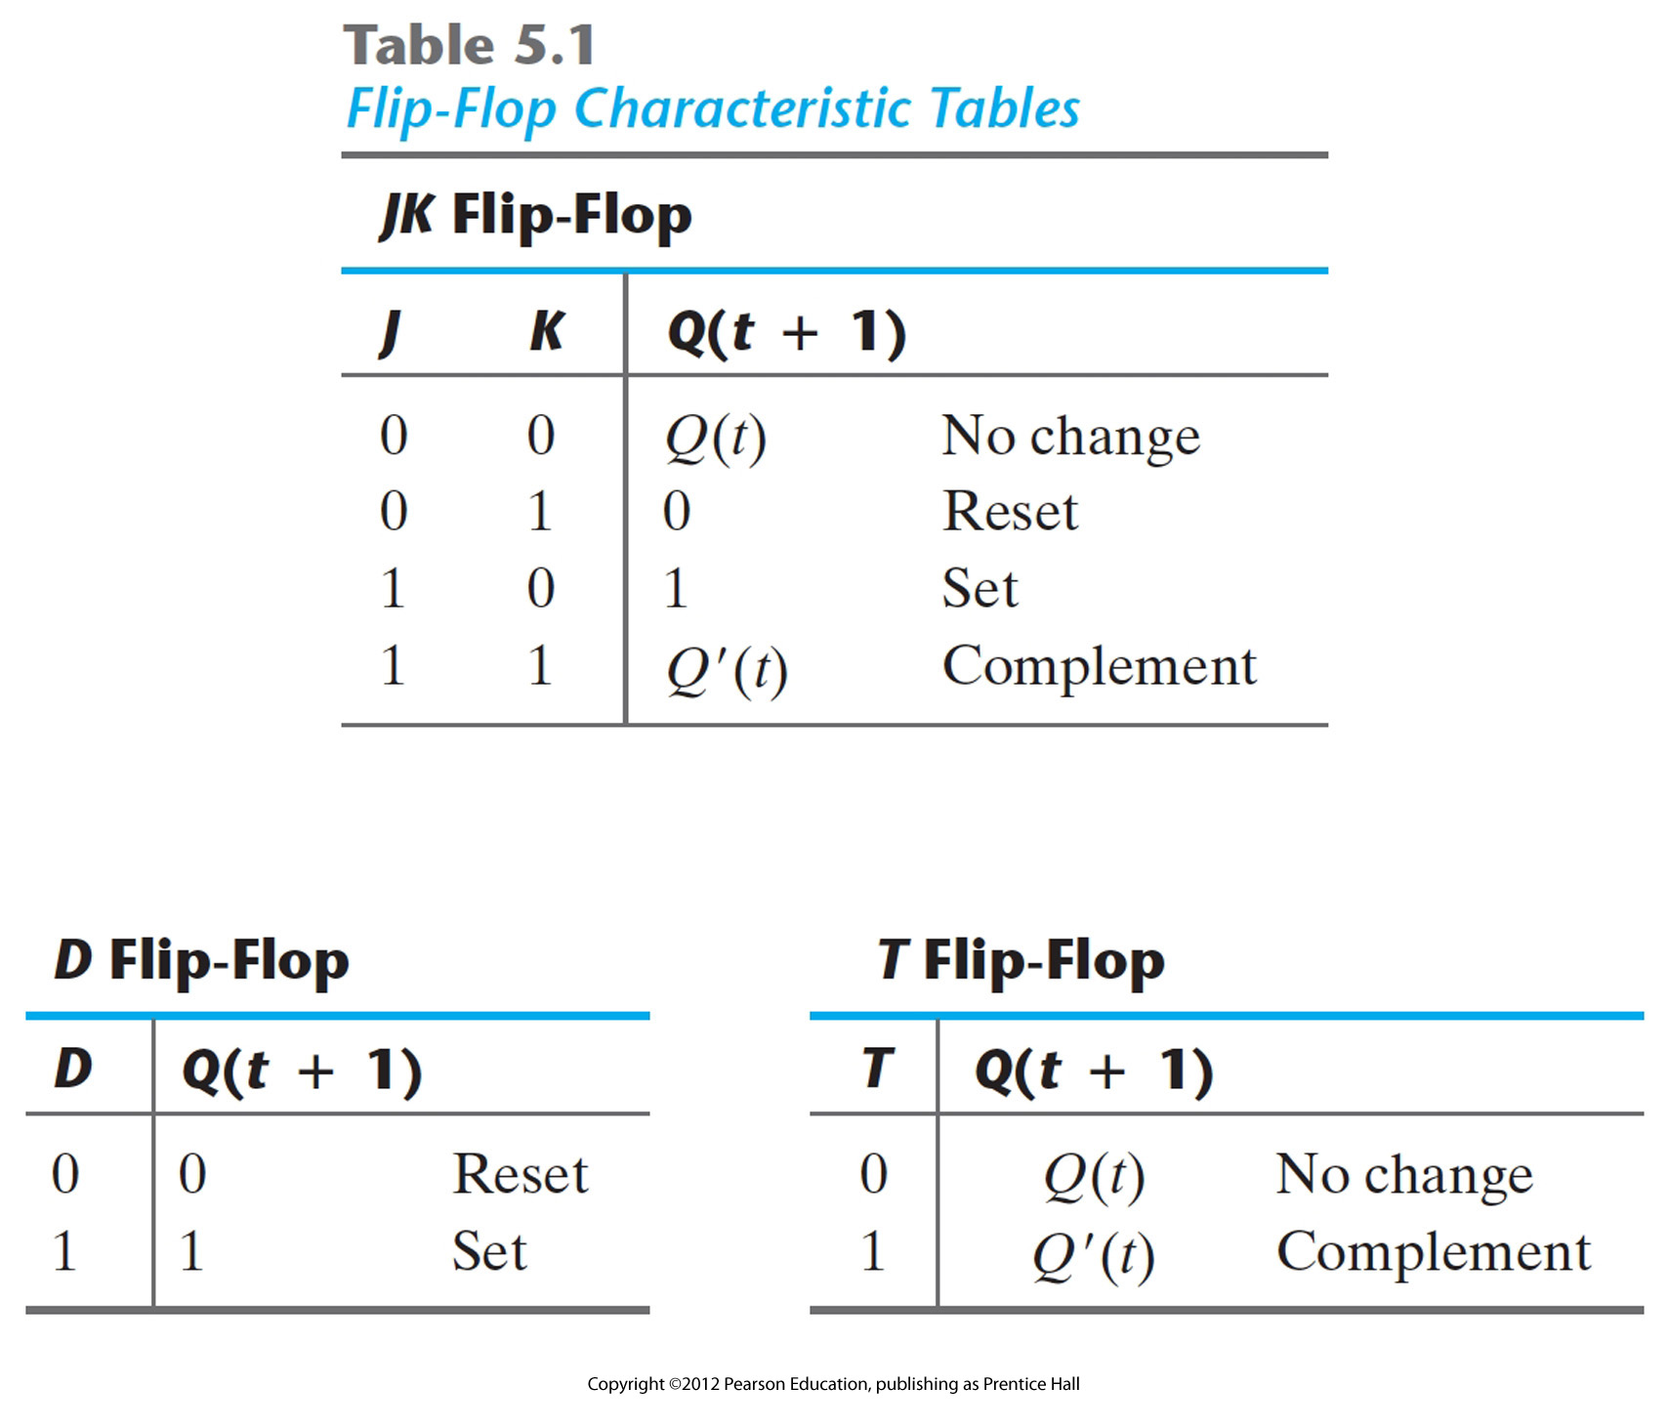
Characteristic Tables
Characteristic equations
D flip-flop Q(t+1) = D
JK flip-flop Q(t+1) = JQ’+K’Q
T flop-flop Q(t+1) = T ⊕Q = TQ’ + T’Q

Slide 29
Direct Inputs
Some flip-flops have asynchronous inputs to force the flip-flop to a particular state.
Examples: Direct Set, Direct Reset.
The input that sets the flip-flop to 1 is called preset or direct set.
The input that clears the flip-flop to 0 is called clear or direct reset.
Works independent of clock.

Slide 30
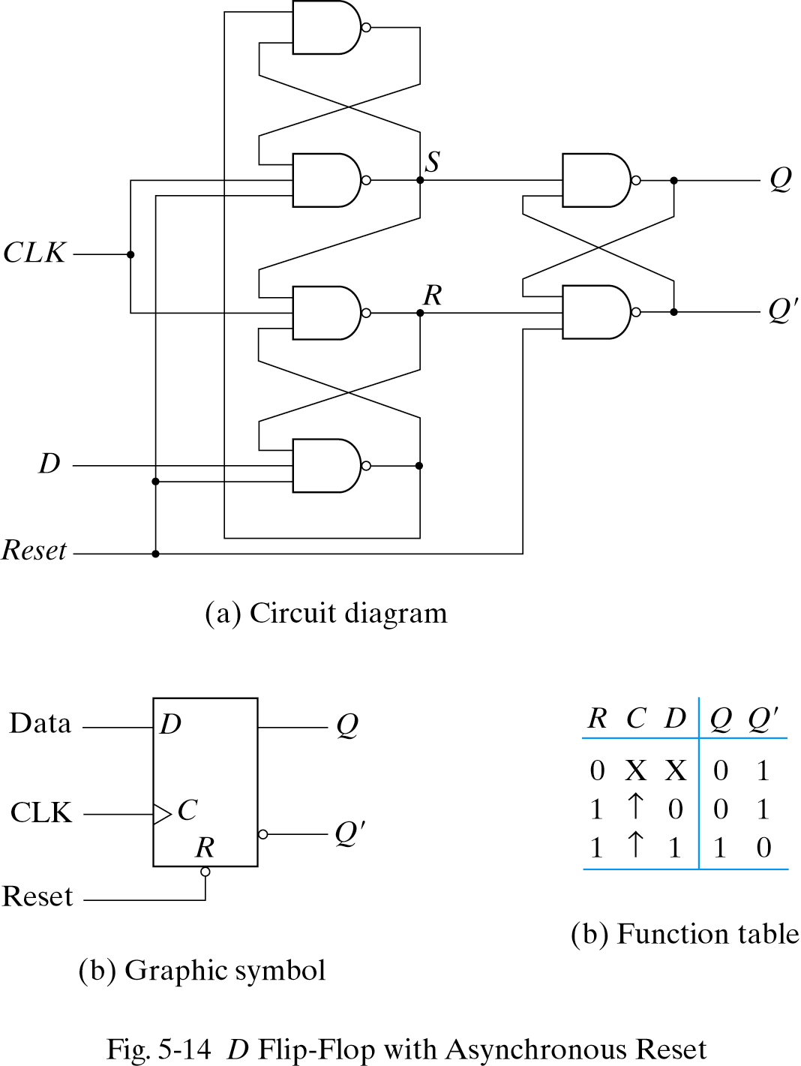
Direct Inputs: Asynchronous Reset
Note reset signal for D flip flop
If R = 0, the output Q is cleared
This event can occur at any time, regardless of the value of the CLK

Slide 31
Analysis of Clocked Sequential Circuits
Analysis: Obtaining a table/diagram for the time sequence of inputs/outputs/internal states.
Examples: State Equations, State Table, State Diagram

Slide 32
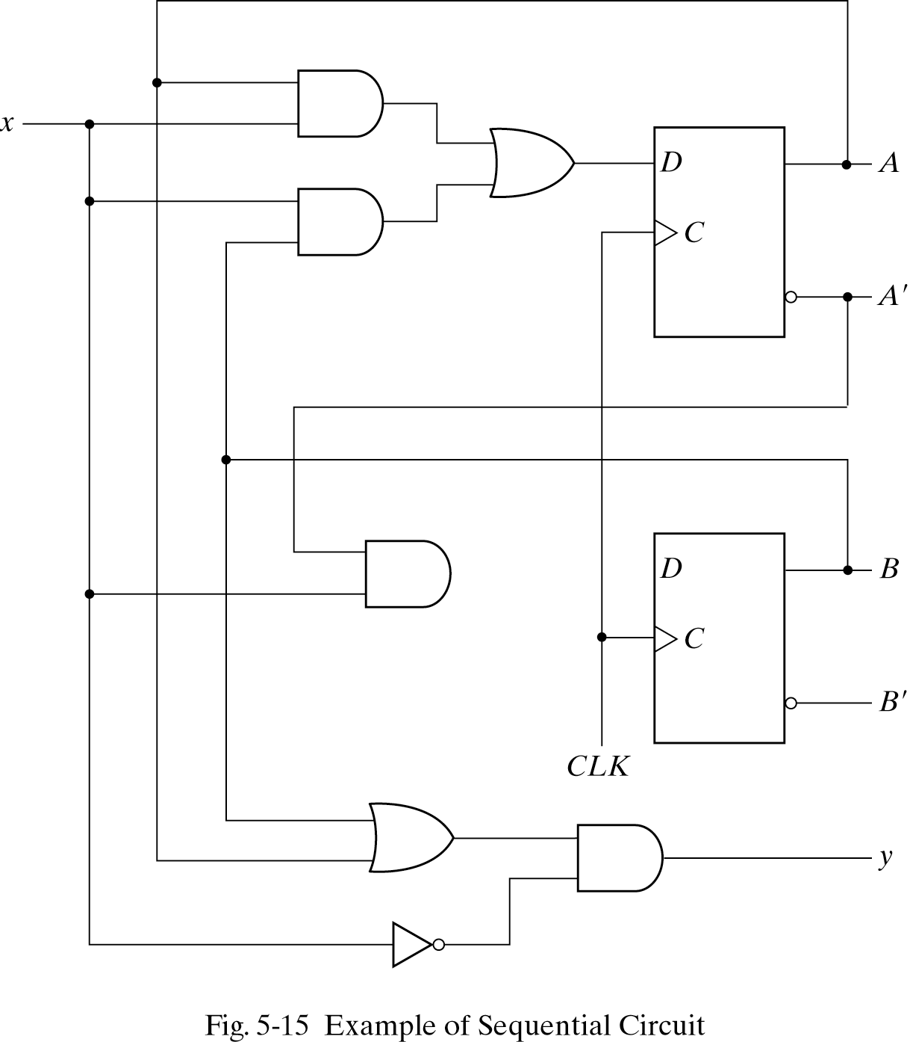
Analysis of Clocked Sequential Circuits
Example of state equation:
A(t+1) = A(t)x(t) + B(t)x(t)
B(t+1) = A’(t)x(t)
A(t+1)=Ax+Bx
B(t+1)=A’x
y(t)=(A(t)+B(t)).x’(t)
= (A+B)x’

Slide 33
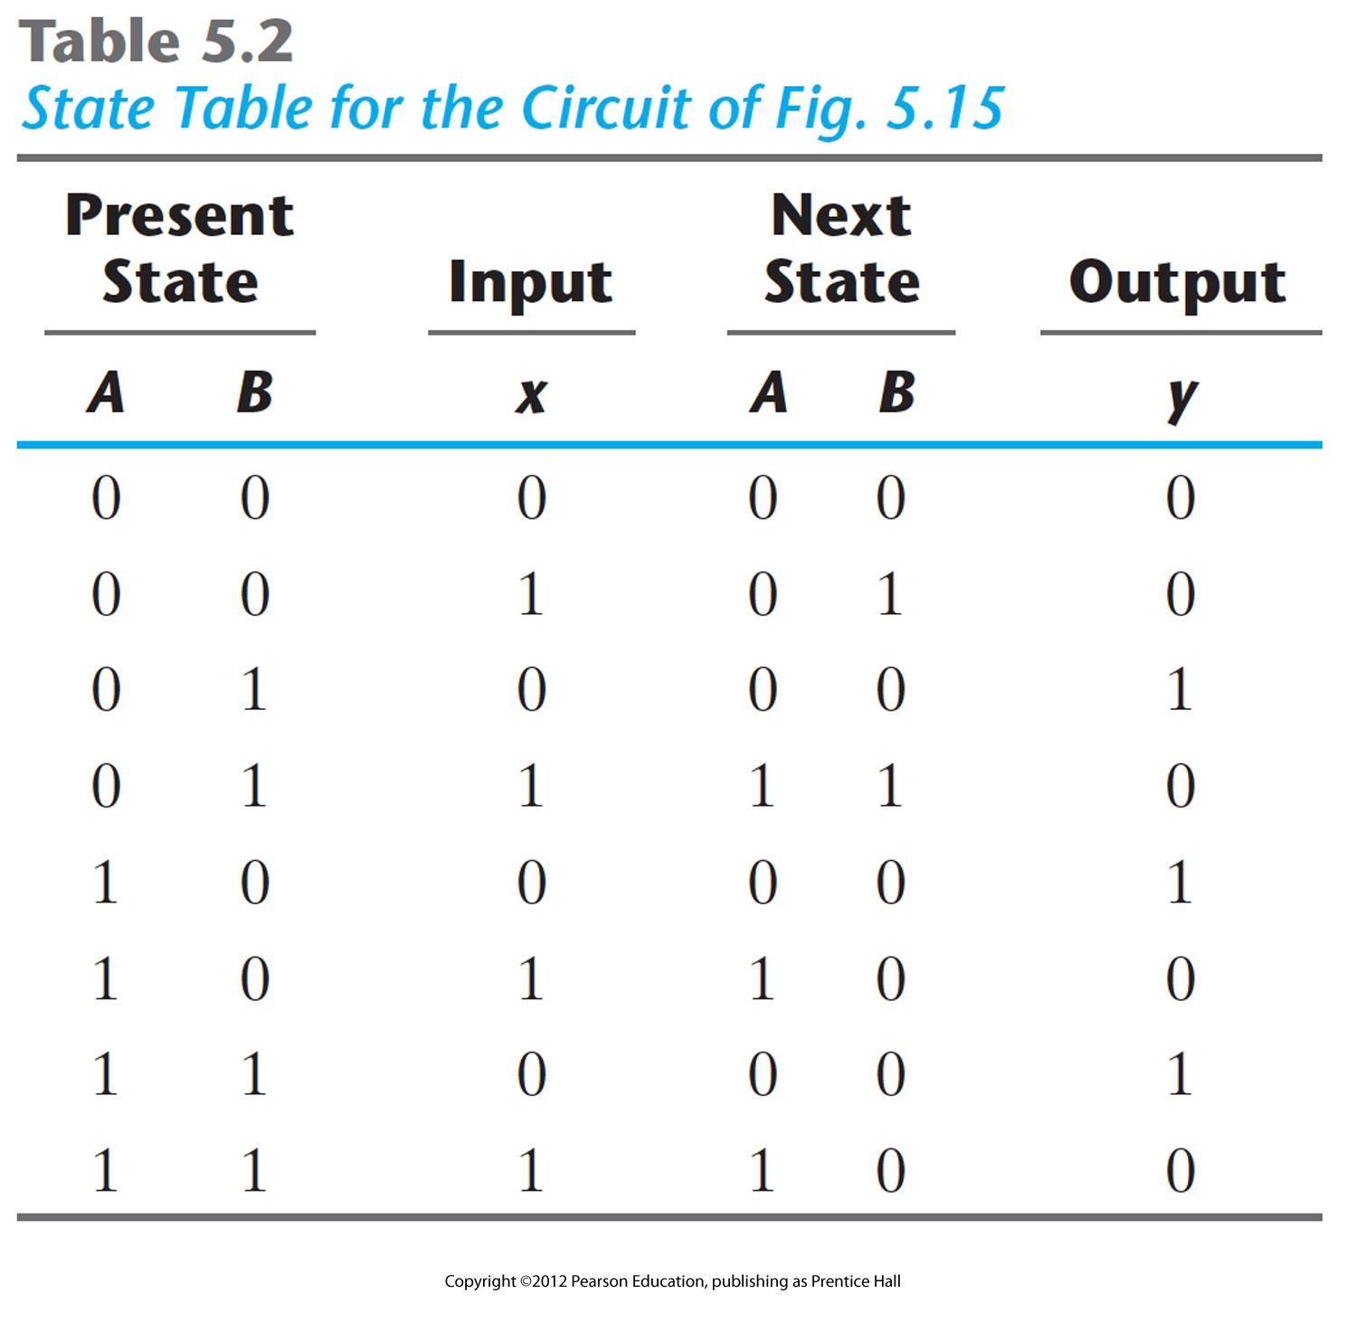
Example of state tables
Sequence of outputs, inputs, and flip flop states enumerated in state table
Present state indicates current value of flip flops
Next state indicates state after next rising clock edge
Output is output value on current clock edge
State equation:
A(t+1) = A(t)x(t) + B(t)x(t)
B(t+1) = A’(t)x(t) y(t)=(A(t)+B(t)).x’(t)

Slide 34
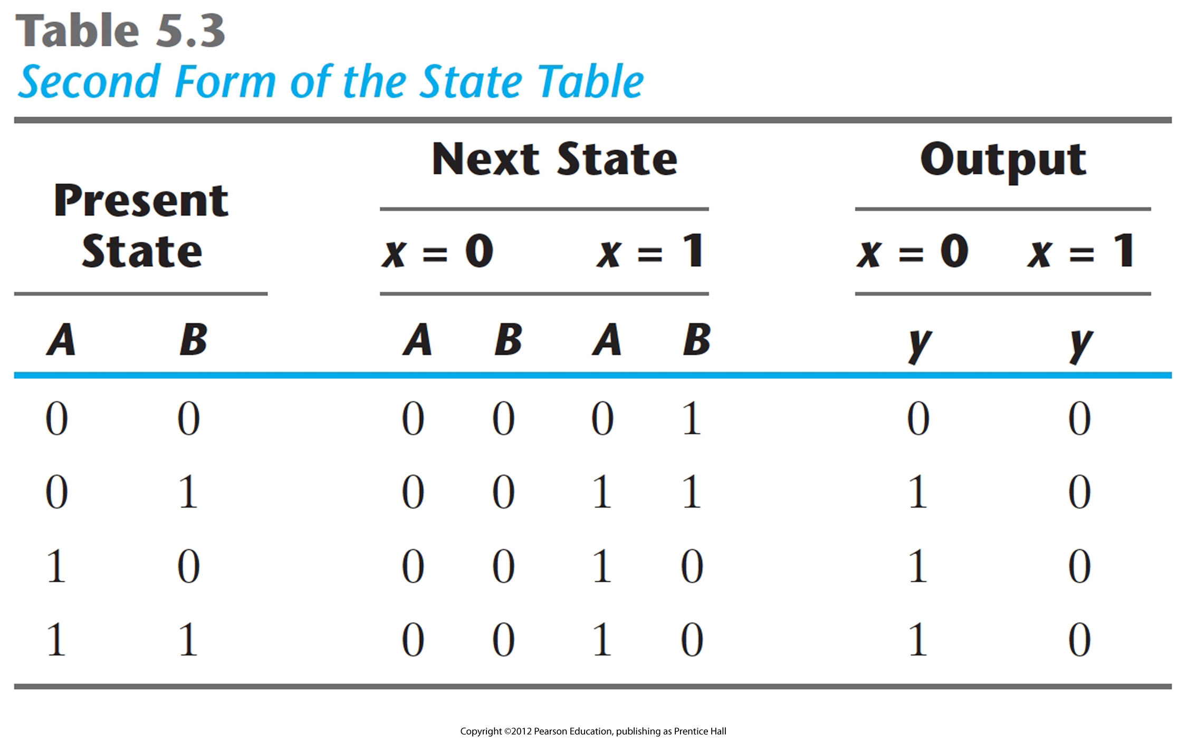
Example of state tables-2nd form
All possible input combinations enumerated
All possible state combinations enumerated
Separate columns for each output value.
Sometimes easier to designate a symbol for each state.

Slide 35
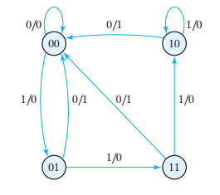
Example of state diagram
Present state Next State Output
x=0 x=1 x=0 x=1
AB AB AB y y
00 00 01 0 0
01 00 11 1 0
10 00 10 1 0
11 00 10 1 0
Circles indicate current state
Arrows point to next state
For x/y, x is input and y is output
FIGURE 5.16 State diagram of the circuit of Fig. 5.15

Slide 36
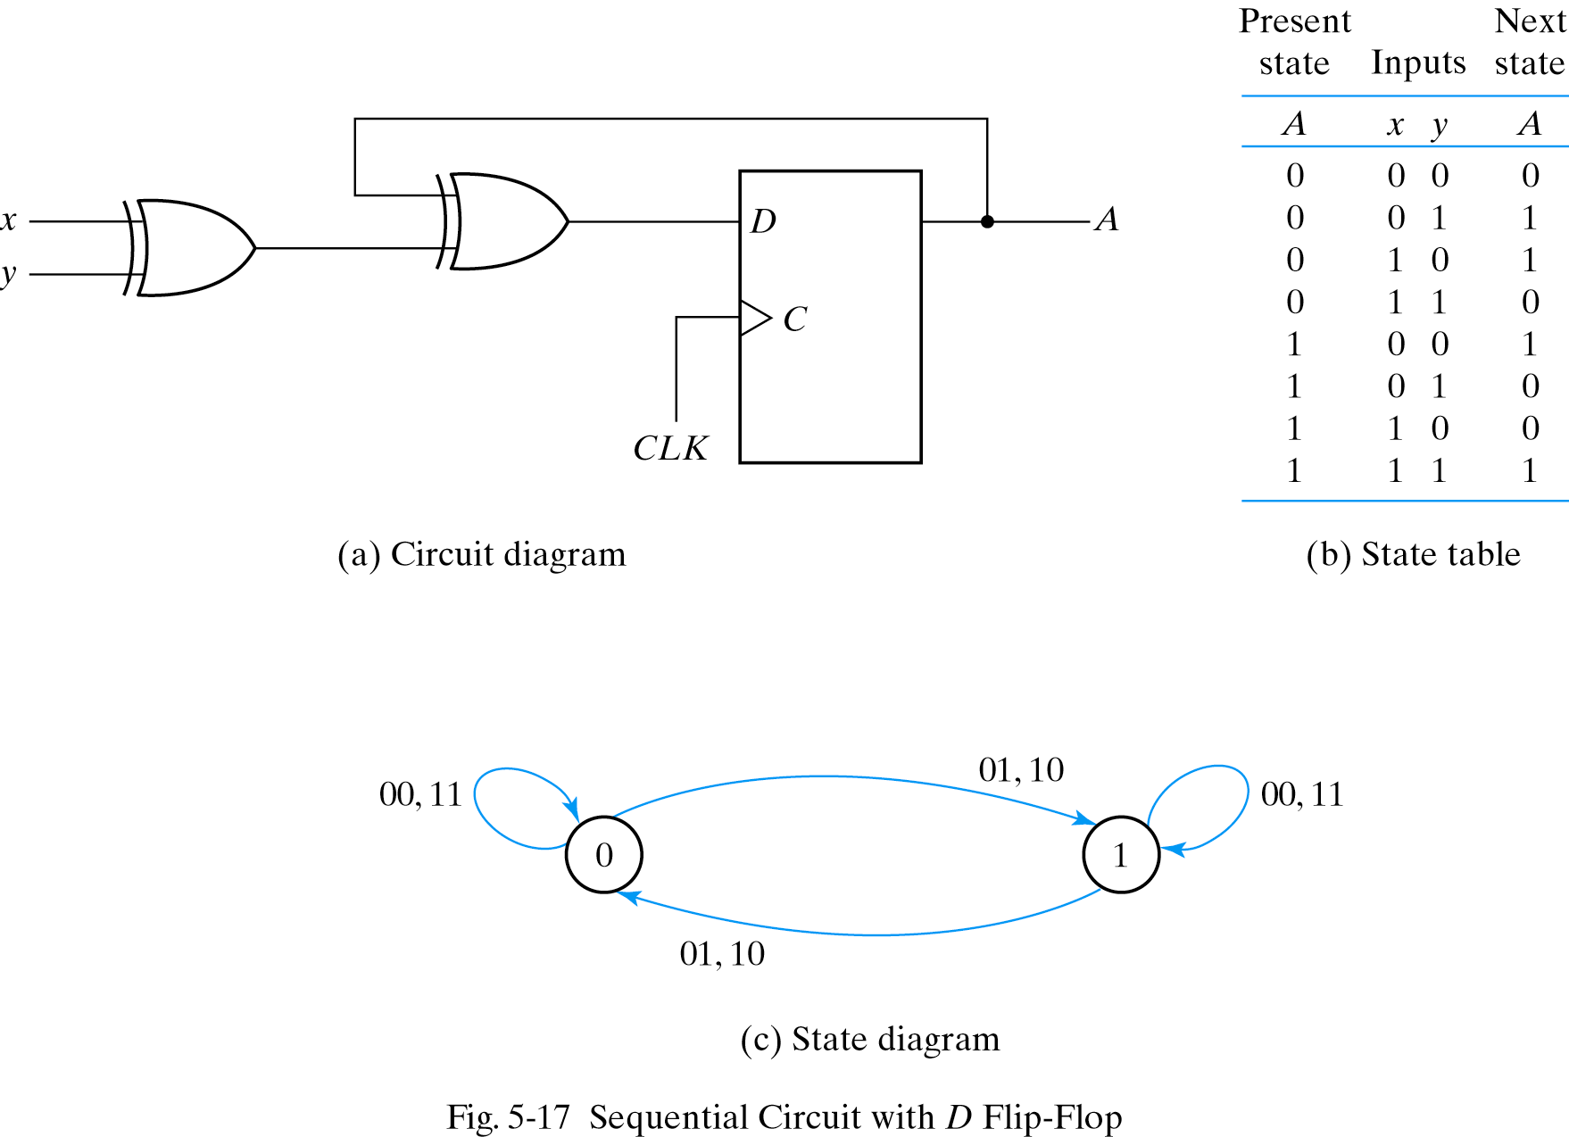
Analysis- D flip-flop
Note: this example
has no output

Slide 37
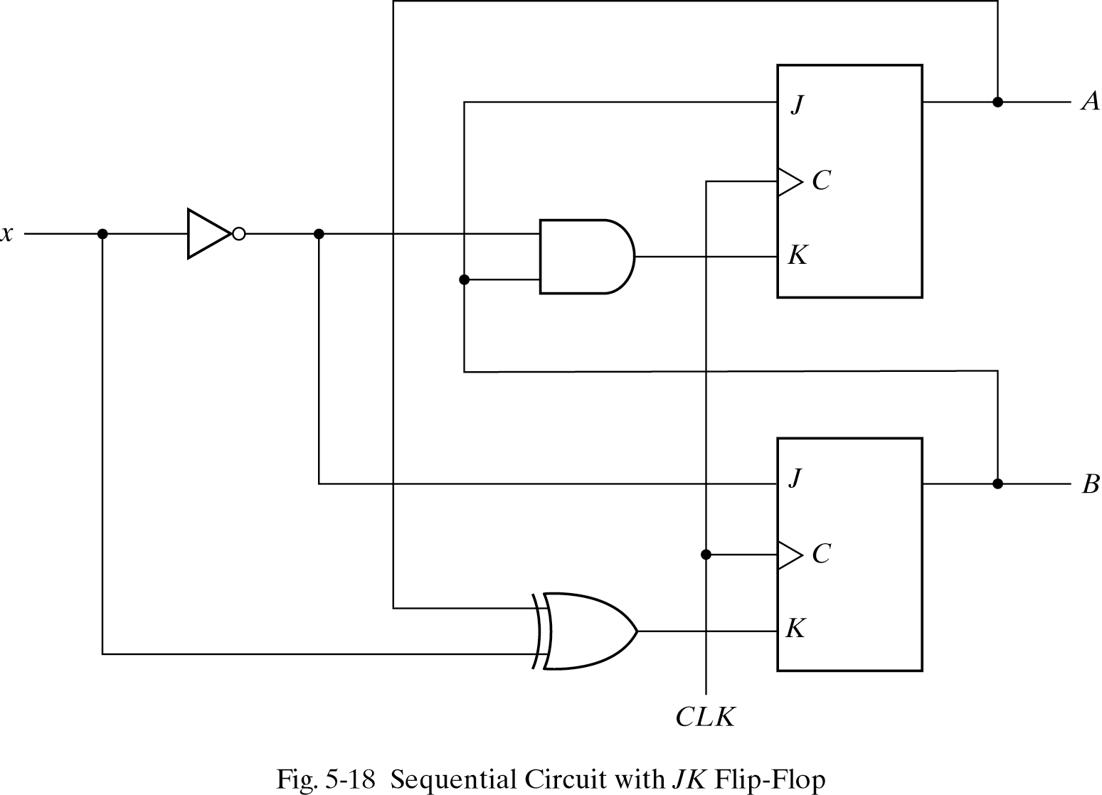
Analysis: JK flip-flop
J_{A}=B
K_{A}=Bx’
J _{B}=x’
K_{B}=A’x+Ax’

Slide 38
Analysis: JK flip-flop
A(t+1)=JA’+K’A
B(t+1)=JB’+K’B
A(t+1)=BA’+(Bx’)’A=A’B+AB’+Ax
B(t+1)=x’B’+(A XOR x’)B
=B’x’+ABx+A’Bx’

Slide 39
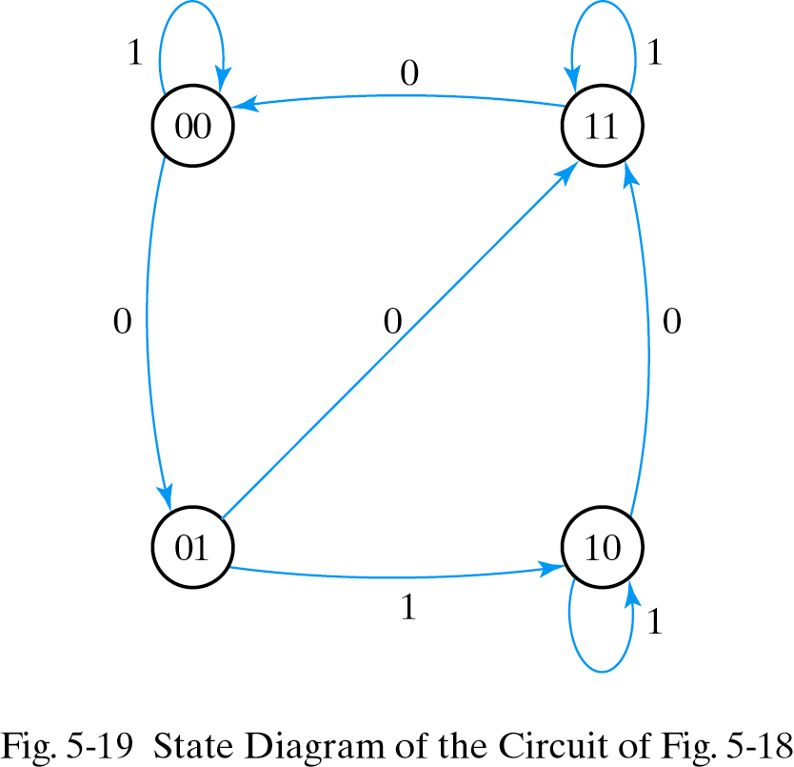
Analysis: JK flip-flop
Present state input Next State
A B x A B
0 0 0 0 1
0 0 1 0 0
0 1 0 1 1
0 1 1 1 0
1 0 0 1 1
1 0 1 1 0
1 1 0 0 0
1 1 1 1 1

Slide 40
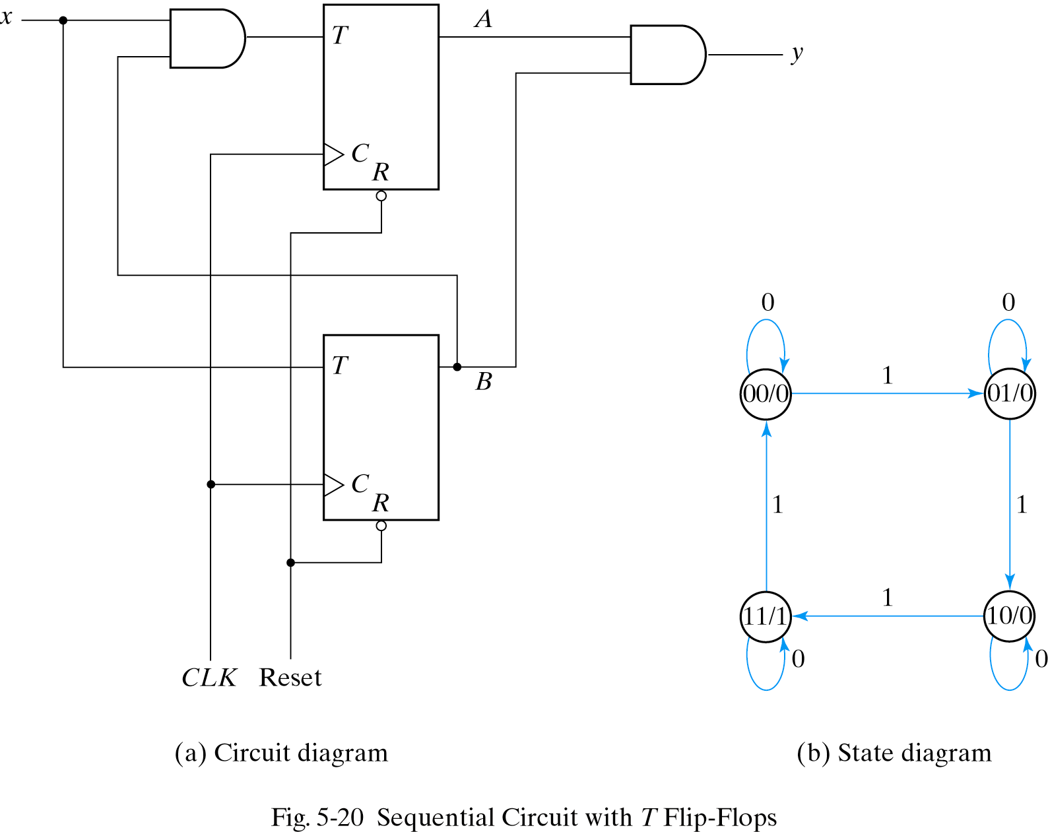
Analysis: T flip-flop
Q(t+1)=T’Q+TQ’
T_{A}=Bx
T_{B}=x
y=AB
A(t+1)=(Bx)’A+(Bx)A’
=AB’+Ax’+A’Bx
B(t+1)=x XOR B

Slide 41
Mealy Machine
Output based on state and present input
Asynchronous signals
Comb.
Logic
Comb.
Logic
Q(t+1)
Flip
Flops
next
state
Q(t)
X(t)
present
state
Y(t)
present
input
clk

Slide 42
Moore Machine
Output based on state only
Outputs change synchronously with state changes
Comb.
Logic
Comb.
Logic
Q(t+1)
Y(t)
Flip
Flops
next
state
Q(t)
X(t)
present
state
present
input
clk

Slide 43
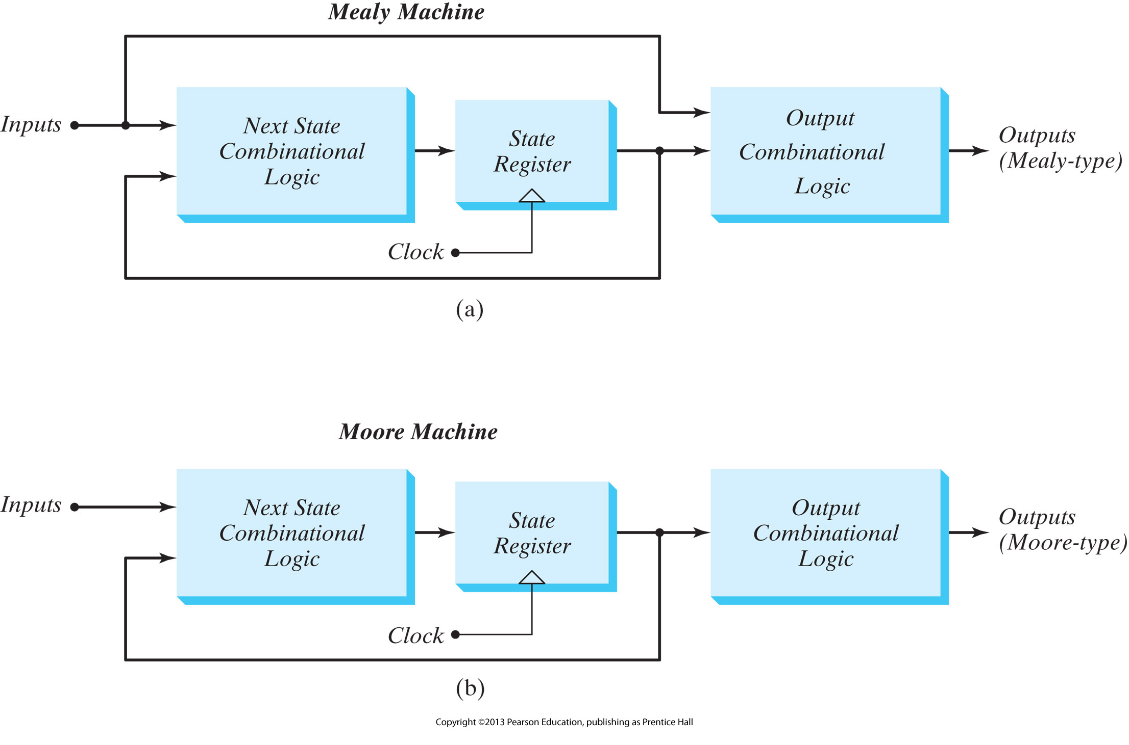
Mealy versus Moore

Slide 44
State Diagram with One Input & One Mealy Output
Mano text focuses on Mealy machines
State transitions are shown as a function of inputs and current outputs.
e.g. 1
0/0
Input(s)/Output(s) shown in transition
1/1
S1
1/0
S4
0/0
S2
0/0
0/0
1/0
S3
1/0

Slide 45
State Diagram with One Input & a Moore Output
Moore machine: outputs only depend on the current state
Outputs cannot change during a clock pulse if the input variables change
Moore Machines usually have more states.
No direct path from inputs to outputs
Can be more reliable

Slide 46
Designing Finite State Machines
Six Step Process
1. Understand the statement of the Specification
2. Obtain an abstract specification of the FSM
(state table or state diagram)
3. Perform a state minimization
4. Perform state assignment
5. Choose FF types to implement FSM state register
and build excitation table
6. Combinational circuit minimization

Slide 47
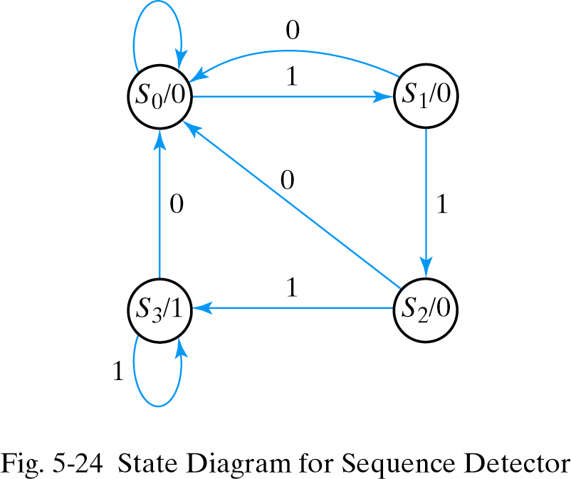
Example: Detect 3 Consecutive 1 inputs
0
State S₀ : zero 1s detected
State S₁ : one 1 detected
State S₂ : two 1s detected
State S₃ : three 1s detected
Note that each state has 2 output arrows
Two bits needed to encode state

Slide 48
State Table for Sequence Detector
Present
State
Next
State
Sequence of outputs, inputs, and flip flop states enumerated in state table
Present state indicates current value of flip flops
Next state indicates state after next rising clock edge
Output is output value on current clock edge
Input
Output
A B x A B y
0 0 0 0 0 0
0 0 1 0 1 0
0 1 0 0 0 0
0 1 1 1 0 0
1 0 0 0 0 0
1 0 1 1 1 0
1 1 0 0 0 1
1 1 1 1 1 1
S₀ = 00
S₁ = 01
S₂ = 10
S₃ = 11

Slide 49
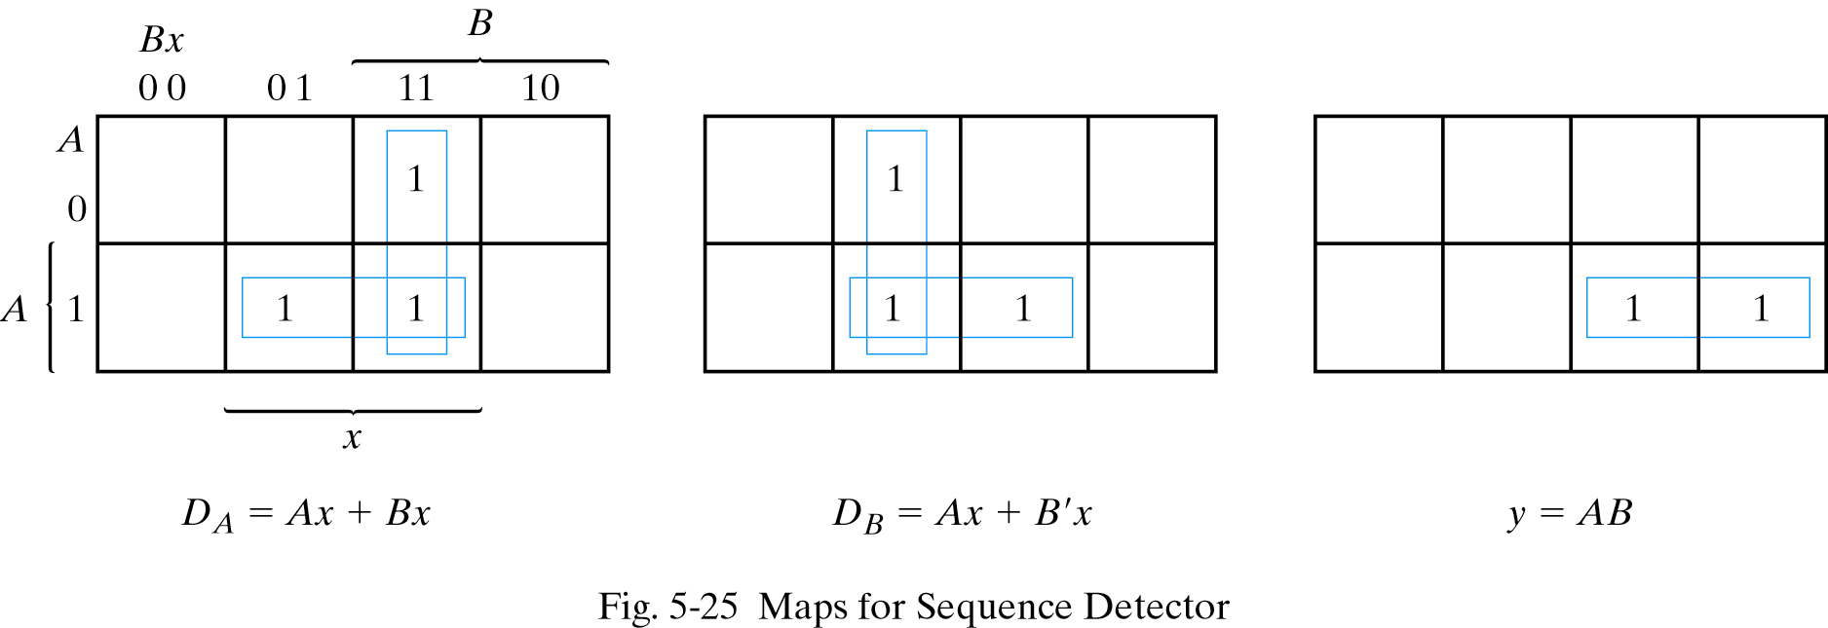
Finding Expressions for Next State and Output Value
Create K-map directly from state table (3 columns = 3 K-maps)
Minimize K-maps to find SOP representations
Separate circuit for each next state and output value

Slide 50
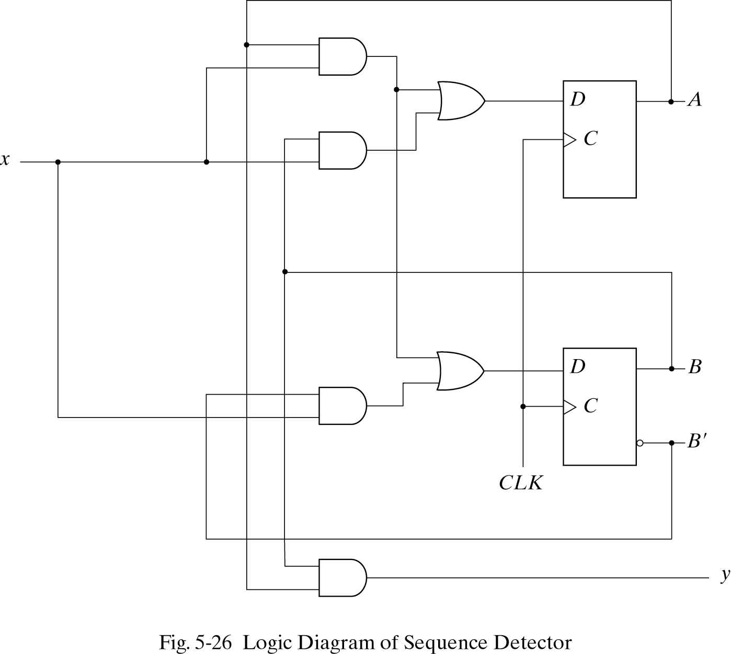
Circuit for Consecutive 1s Detector
Note location of state flip flops
Output value (y) is function of state
This is a Moore machine.

Slide 51
Concept of the State Machine
Example: Odd Parity Checker
Assert output whenever input bit stream has odd # of 1's
Symbolic State Transition Table
State
Diagram
Encoded State Transition Table
Note: Present state and output are the same value
Moore machine

Slide 52
Concept of the State Machine
Example: Odd Parity Checker
Next State/Output Functions
NS = PS xor PI; OUT = PS
D FF Implementation
Timing Behavior: Input 1 0 0 1 1 0 1 0 1 1 1 0

Slide 53
Mealy and Moore Machines
Solution 1: (Mealy)
Solution 2: (Moore)
0/0
0
Reset
Even
Even
Input
Output
[0]
1/1
O/P is dependent
on current state and
input in Mealy
1/0
1
1
Input
Output
Transition
Arc
Odd
Odd
[1]
Output is
dependent only
on current state
0
0/1
Mealy Machine: Output is associated with the state transition
- Appears before the state transition is completed (by the next clock pulse).
Moore Machine: Output is associated
with the state
Appears after the state transition
takes place.

Slide 54
Vending Machine FSM
Step 1. Specify the problem
Deliver package of gum after 15 cents deposited
Single coin slot for dimes, nickels
No change
Design the FSM using combinational logic and flip flops

Slide 55
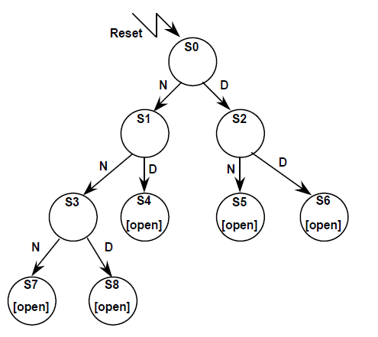
Vending Machine FSM
Step 2. Map into more suitable abstract representation
Tabulate typical input sequences:
three nickels
nickel, dime
dime, nickel
two dimes
two nickels, dime
Draw state diagram:
Inputs: N, D, reset
Output: open

Slide 56
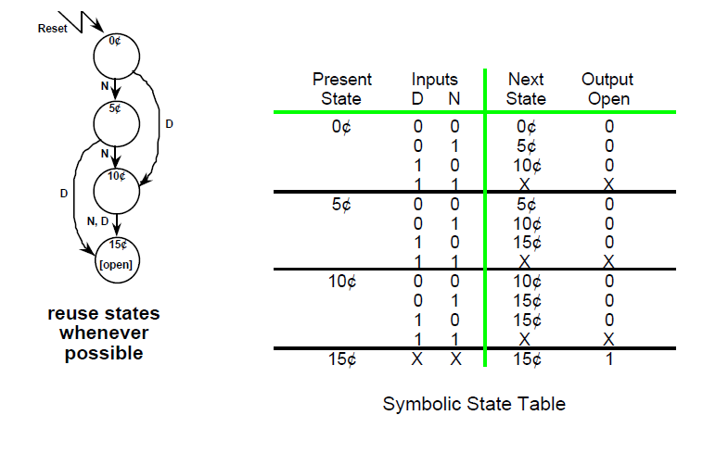
Vending Machine FSM
Step 3: State Minimization

Slide 57
Vending Machine FSM
Step 4. State Encoding
How many flip-flops are needed?

Slide 58
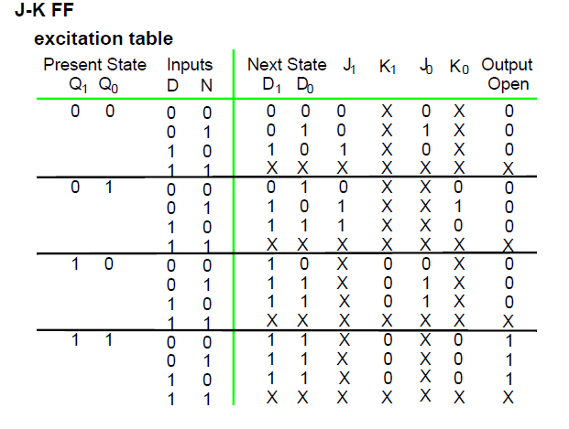
Vending Machine FSM
Step 5. Chose FF type for implementation

Slide 59
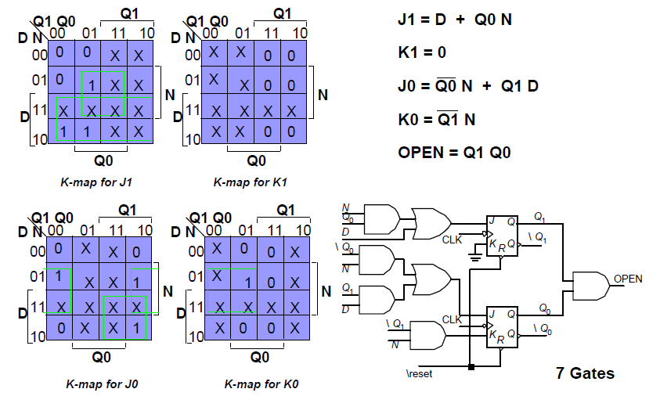
Vending Machine FSM
Step 6. Combinational circuit minimization(JK FF )

Slide 60
Vending Machine FSM
Step 6. Combinational circuit minimization(D FF easiest to use)
Q1 Q0
Q1
Q1 Q0
Q1
Q1 Q0
Q1
D N
D N
D N
N
N
N
D
D
D
Q0
Q0
Q0
K-map for D1
K-map for D0
K-map for Open

Slide 61
Minimized Implementation
Q₁
D
D₁
Q₁
D Q
Q₀
CLK
R
Q
N
Reset
OPEN
N
Q₀
D₀
Q₀
D Q
Q₁
CLK
Q
R
N
Reset
Q₁
D
Vending machine FSM implementation based on D flip-flops(Moore).

Slide 62
Summary
Finite state machines form the basis of many digital systems
Designs often start from clear specifications
Develop state diagram and state table
Optimize using combinational design techniques
Mealy or Moore implementations possible
Can model approach using HDL.
Notes:
credential:
bring a computer
die photo
wafer
:
This can be an hidden slide. I just want to use this to do my own planning.
I have rearranged Culler’s lecture slides slightly and add more slides. This covers everything he covers in his first lecture (and more) but may
We will save the fun part, “ Levels of Organization,” at the end (so student can stay awake): I will show the internal stricture of the SS10/20.
Notes to Patterson: You may want to edit the slides in your section or add extra slides to taylor your needs.

