Slide 1
4.12 HDL for Combinational Circuits

Slide 2
Lecture Outline
HDL for Combinational Logic
Gate Level Modeling
  Vectors
Modular design
Tri-state gates
Dataflow modelling
Behavioural Modelling

Slide 3
HDL for Combinational Logic
Verilog allows the designer to describe a module in one of three ways:
  Gate-level (using primitive and built-in and UDPs)
  Dataflow modeling (using keyword assign)
  Behavioral modeling (using keyword always)

Slide 4
Gate Level Modeling
There are 8 standard gates
  and, or, nand, nor, not, buf, xor, xnor
There are 4 tri-state primitives

Slide 5
Vectors
Often we want multi-bit quantities in digital circuits – bytes, samples, codes, etc.
Instead of specifying one wire for each bit we can specify the complete quantity as a vector
e.g.
      output [0:3]D;
      wire [7:0]SUM;

Slide 6
Vectors
The MSB of the vector is first, LSB last.
Can address individual bits of a vector
  e.g. D[2]
Can address parts of a vector e.g. SUM[5:3];

Slide 7
Gate Level Modeling
Two valued logic (“0” or “1”)
We use 4 valued logic
  – 0 or false
  – 1 or true
  – x or unknown
  – z or high impedance
An output is unknown when not yet assigned (hopefully)

Slide 8
4-valued logic
There are a few rules about this 4-valued logic that make a lot of sense. Some of them are:
  – Only tri-state gates can output high impedance
  – High impedance behaves like an unknown input to
  an ordinary gate
  – If an input to an AND gate is zero the output is zero
  – If an input to an OR gate is one the output is one similarly for other gates

Slide 9
2 to 4 line Decoder Example
module decoder_gl (A,B,E,D);
input A,B,E;
output [0:3]D;
wire Anot,Bnot;
not
n1 (Anot,A),
n2 (Bnot,B),
and
n4 (D[0],Anot,Bnot,E),
n5 (D[1],Anot,B,E),
n6 (D[2],A,Bnot,E),
n7 (D[3],A,B,E);
endmodule

Slide 10
Nested Modules
A module can instantiate other modules
Instantiation means allocation of needed hardware

Slide 11
Half Adder
module halfadder (S,C,x,y);
input x,y;
output S,C;
//Instantiate primitive gates
xor (S,x,y);
and (C,x,y);
endmodule

Slide 12
Full Adder
module fulladder (S,C,x,y,z);
input x,y,z;
output S,C;
wire S1,D1,D2; //Outputs of first XOR and two AND gates
//Instantiate the halfadder
halfadder HA1 (S1,D1,x,y),
HA2 (S,D2,S1,z);
or g1(C,D2,D1);
endmodule

Slide 13
4 bit Adder
module _4bit_adder (S,C4,A,B,C0);
input [3:0] A,B;
input C0;
output [3:0] S;
output C4;
wire C1,C2,C3; //Intermediate carries
//Instantiate the fulladder
fulladder FA0 (S[0],C1,A[0],B[0],C0),
FA1 (S[1],C2,A[1],B[1],C1),
FA2 (S[2],C3,A[2],B[2],C2),
FA3 (S[3],C4,A[3],B[3],C3);
endmodule

Slide 14
Three-state gates
Binary gates have two states: 0 or 1.
Sometimes it is useful to have a third state: “undefined”
In practice undefined is a high-impedance (or open circuit) state where the output has no effect on connected circuits.
This is useful for allowing multiple outputs to be connected together (e.g. to a bus)

Slide 15

Tri-state Gates in HDL
High-impedance state is z
Non-inverting gate is
  bufif1(output, input, control)
bufif1(Y, A, C)
if C=1, Y=A
else Y=z

Slide 16
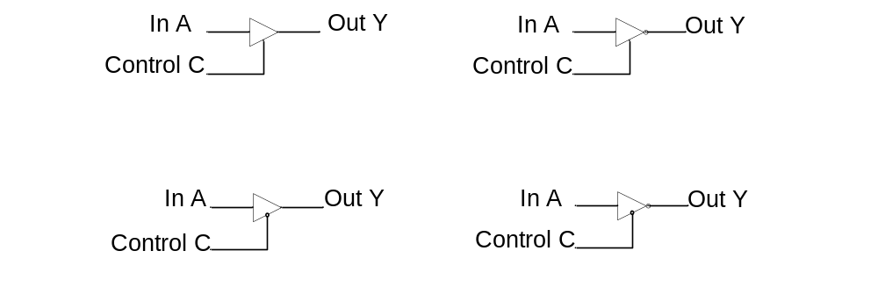
Tri-state Gates
bufif1(Y,A,C)
notif1(Y,A,C)
bufif0(Y,A,C)
notif0(Y,A,C)

Slide 17
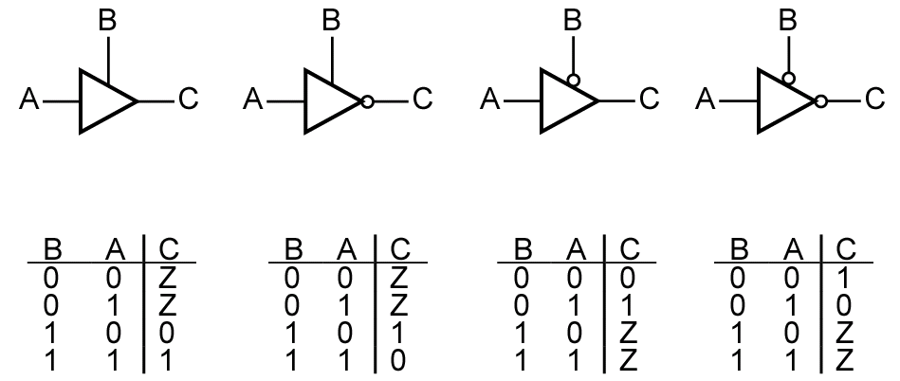
Three-State Buffers
Four kinds of three-state buffers
Can not operate: Output = Z
Unclear output: Output = X
(a)
(b)
(c)
(d)

Slide 18
Three-state Naming
The name bufif1 means that the thing is a buffer if the control input is 1.
The notif0 means that the thing is an inverter if the control input is 0

Slide 19
Net: Class of Types
Data types like tri are called net
Other net types are:
  – wire
  – wor (wired-or)
  – wand (wired-and)
  – supply1 (power supply or logic-1)
  – supply0 (ground or logic-0)

Slide 20
Multiplexor
Multiplexor is a combinational circuit where an input is chosen by a select signal.
  Two input mux
  output =A if select =1
  output= B if select =0
A
x
B
s

Slide 21
Two Input Multiplexor
A two-input mux is actually a three input device.
s | A | B | x
0 | 0 | 0 | 0
0 | 0 | 1 | 1
0 | 1 | 0 | 0
0 | 1 | 1 | 1
1 | 0 | 0 | 0
1 | 0 | 1 | 0
1 | 1 | 0 | 1
1 | 1 | 1 | 1
A
x
B
s
x = A.s + B.s

Slide 22
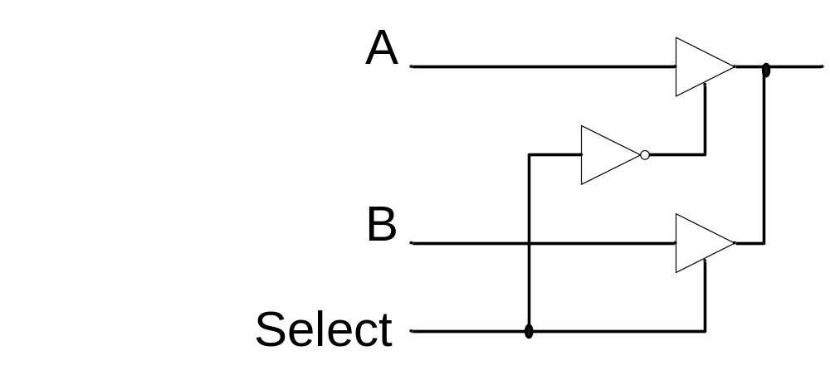
Tri-state 2-Input Mux

Slide 23
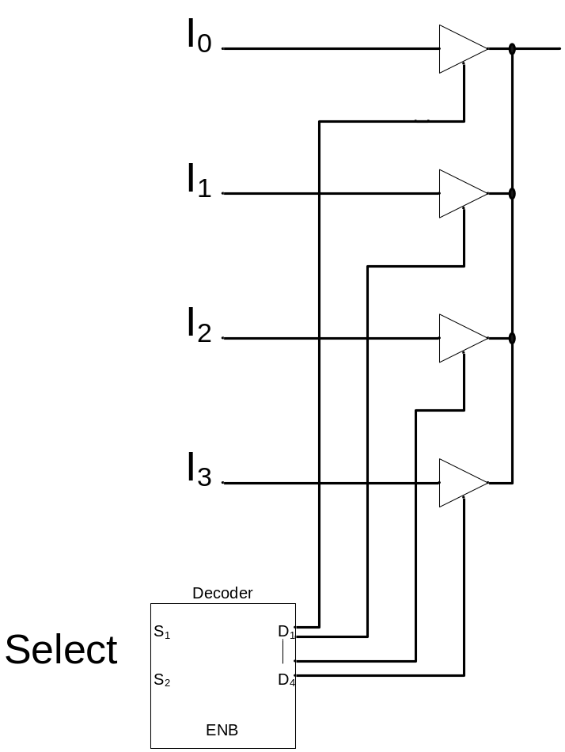
Tri-state 4-Input Mux

Slide 24
2-Input Tri-state Mux
module muxtri (A,B,select,OUT);
input A,B,select;
output OUT;
//use tri data type for output
tri OUT;
bufif1 (OUT,A,select);
bufif0 (OUT,B,select);
endmodule

Slide 25
Dataflow modelling
Another level of abstraction is to model dataflow.
  Uses a variety of operators to describe functionality, not structure
In dataflow models, signals are continuously assigned values using the assign keyword.
assign can be used with Boolean expressions.
  Verilog uses & (and), | (or), ^ (xor) and ~ (not)
Logic expressions and binary arithmetic are also possible.

Slide 26
Dataflow description of 2 to 4 line Decoder
module decoder_df (A,B,E,D);
input A,B,E;
output [0:3] D;
assign D[0] = ~A & ~B & E,
D[1] = ~A & B & E,
D[2] = A & ~B & E,
D[3] = A & B & E;
endmodule

Slide 27
Dataflow description of 4 bit Adder
module binary_adder (A,B,Cin,SUM,Cout);
input [3:0] A,B;
input Cin;
output [3:0] SUM;
output Cout;
assign {Cout,SUM} = A + B + Cin;
endmodule

Slide 28
Dataflow description of 2-input MUX
Conditional operator ?:takes three operands:
  condition? true_expression : false_expression
module mux2x1_df (A,B,select,OUT);
input A,B,select;
output OUT;
assign OUT = select ? A : B;
endmodule

Slide 29
Behavioural Modelling
Represents circuits at functional and algorithmic level.
Use procedural statements similar in concept to procedural programming languages (e.g. C, Java)
Behavioural modelling is mostly used to represent sequential circuits.

Slide 30
Behavioural Modelling
Behavioural models place proceedural statements in a block after the always keyword.
The always keyword takes a list of variables. The block of statements is executed whenever one of the variables changes.
The target variables are of type reg. This type retains its value until a new value is assigned.

Slide 31
Things to notice
The always is followed by an @-list
The always is “executed” immediately after one of the items in the @-list changes. The or separates the items in the list.
There is an if-(then)-else statement
The reg has memory; if not assigned anything it remembers.
The assignment is blocking

Slide 32
Things to notice
The assignment is “ blocking” , which means it is similar to the C assignment
The output is also declared as reg since it is on the LHS(Left-hand sid) of a procedural assignment.

Slide 33
Procedural Assignments
Blocking
  LHS = RHS ;
Non-Blocking
  LHS <= RHS ;
LHS has to be of type reg
  Common compilation error is to declare LHS as net.
  LHS value is held until driven again
RHS rules : Same as in continuous assignment
  can be an expression using all the previous operators.

Slide 34
Race Condition
What is Race Condition?
  When two expressions are scheduled to execute at same time, and if the order of the execution is not determined, then race condition occurs.
  Avoids race-condition
    same identifier assigned different values in different process

Slide 35
Blocking and Non-Blocking
EXAMPLE:
always @(posedge clk)
a = 1;
always @(posedge clk)
b = a;
always @(posedge clk)
a <= 1;
always @(posedge clk)
b <= a;
There is a race condition. Two
blocking assignments in different
always are executed sequentially
depending on the simulator
Implementation
Read-Write race
Race condition is eliminated.
At the rising edge of clock,
RHS value of nonblocking
assignments are “read” and
the expressions evaluated.
During write operation, the
stored values are used

Slide 36
Behavioral description of 2-input mux
module mux2x1_bh(A,B,select,OUT);
input A,B,select;
output OUT;
reg OUT;
always @ (select or A or B)
if (select == 1) OUT = A;
else OUT = B;
endmodule

Slide 37
Behavioral description of 4-input mux
module mux4x1_bh (i0,i1,i2,i3,select,y);
input i0,i1,i2,i3;
input [1:0] select;
output y;
reg y;
always @ (i0 or i1 or i2 or i3 or select)
case (select)
2'b00: y = i0;
2'b01: y = i1;
2'b10: y = i2;
2'b11: y = i3;
endcase
endmodule
The case is kind-of-similar to C
There are no break statements!

Slide 38
Test Benches
A test bench is a sequence of artificial stimuli for our circuit.
The keyword for this is initial
An extremely useful construct is the #-delay
One can also use repeats, for-loops, forever,etc

Slide 39
Useful command inside..
There are many system tasks that help “ see”
inside the hardware
– $display
– $write (no newline)
– $monitor (when there is change)
– $time (returns the simulation time)
– $finish

Slide 40
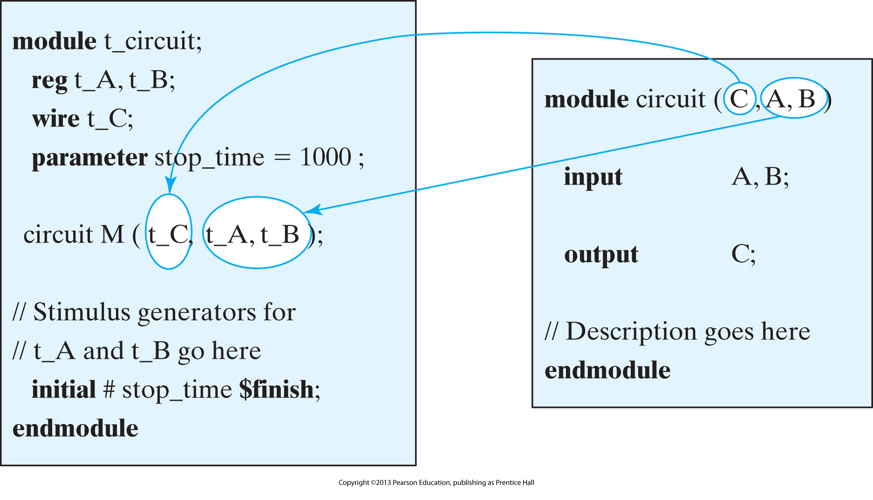
Interaction between stimulus and design module

Slide 41
Value Change Dump (VCD) File
VCD (Value Change Dump) is an ASCII file that contains information about simulation time, scope, signal definition, signal value changes while simulator runs
Realted System Tasks : $dumpfile, $dumpvars, $dumpall,$dumpon, $dumpoff
  $dumpfile : Assign the Name of VCD file
  $dumpvars : selects module instances or signals to dump
  $dumpon / $dumpoff : start and stop dump process
  $dumpall : generate check points

Slide 42
Usage of $dump
// specify the name of dump file. Otherwise default name is assigned
initial $dumpfile (“dump.out”);
// Dump signals in a module
initial $dumpvars ; // dump all arguments
initial $dumpvars(1,top) ; // dump variables in module instance top
// number 1 indicates the level of hierarchy (1 level below top)
// signals in top module, but signals in the modules instantiated by top)
initial $dumpvars (2, top.m1) ; // dump upto 2 levels below top.m1
initial $dumpvars (0, top.m1); // 0 means entire hierarchy below top.m1
initial begin
$dumpon ; // begin dump process
#10000 $dumpoff; // stop dump process after 10000 time units
end
// create checkpoints. Dump all current value of all VCD variable
initial $dumpall;

Slide 43
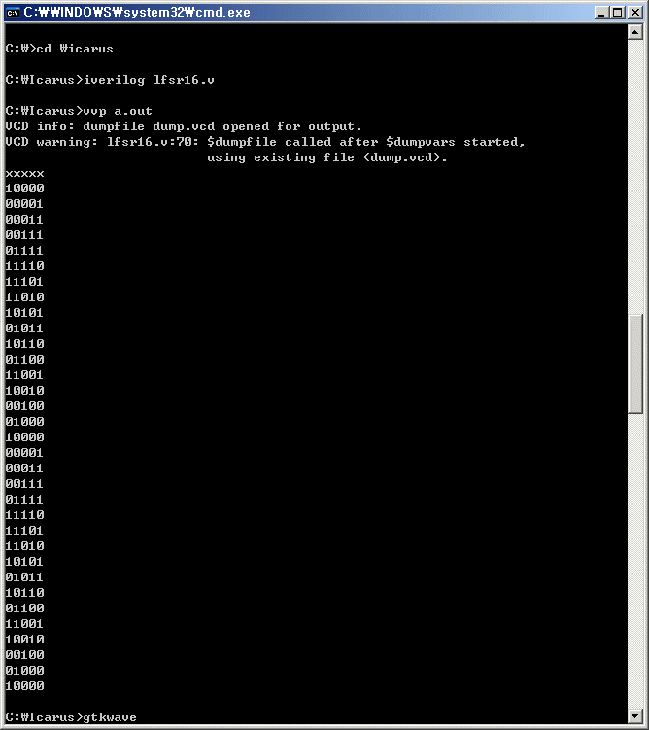
Verilog Simulator – Icarus
iverilog lfsr16.v <enter>
vvp a.out <enter>
gtkwave <enter>

Slide 44
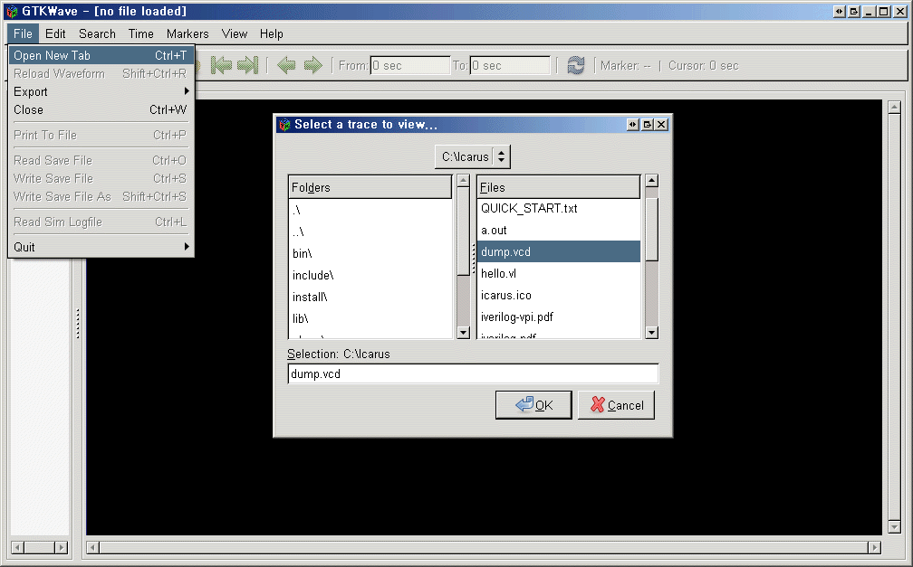
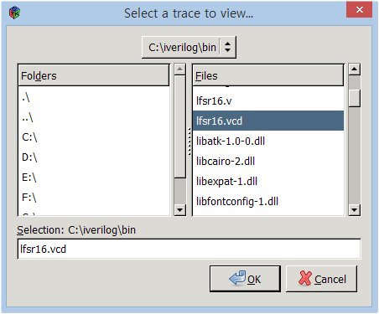
Verilog Simulator – Icarus

Slide 45
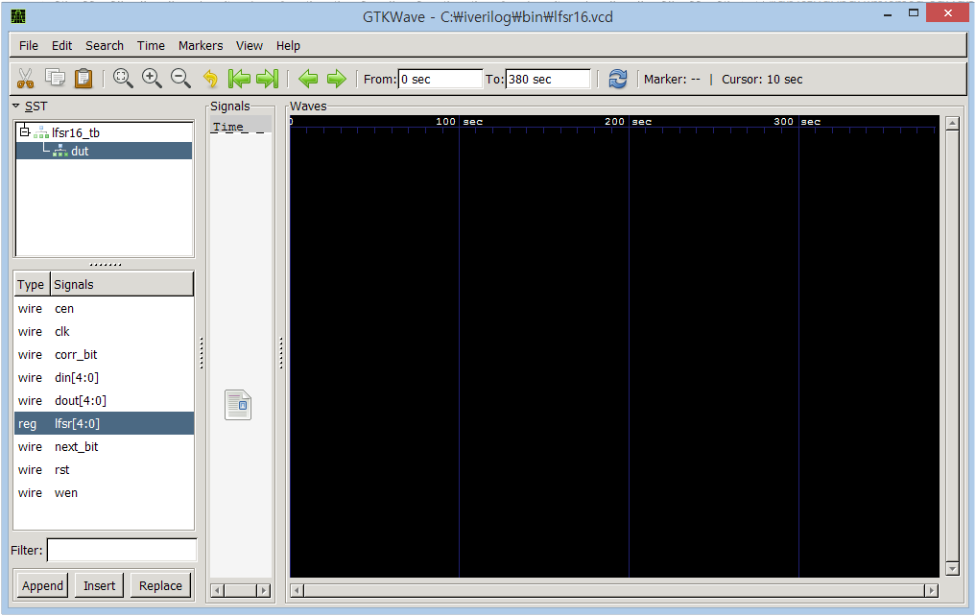
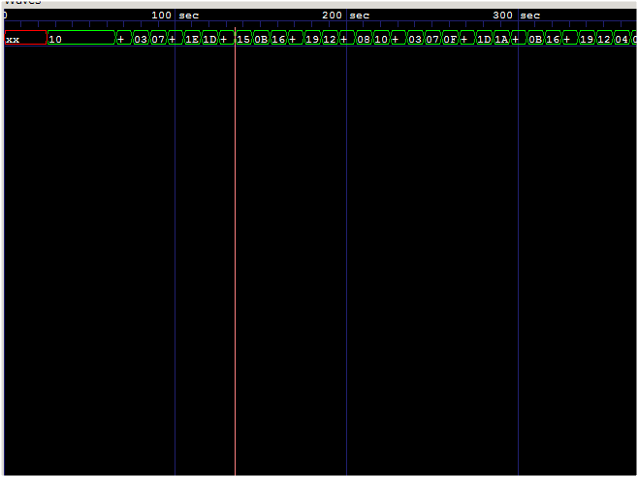
Verilog Simulator – Icarus

Slide 46
Verilog Simulator – Icarus
Example
module simple(A, B);
input [3:0] A;
output [3:0] B;
// mix up the input bits
assign B = { A[0], A[2], A[1], A[3] };
endmodule
`include "simple.v"
module simple_tb;
reg [3:0] A = 4'b1010;
wire [3:0] B;
initial
begin
$dumpfile("simple.vcd");
$dumpvars(0, s);
$monitor("A is %b, B is %b.", A, B);
#50 A = 4'b1100;
#50 $finish;
end
simple s(A, B);
endmodule
simple.v
simple_tb.v

Slide 47
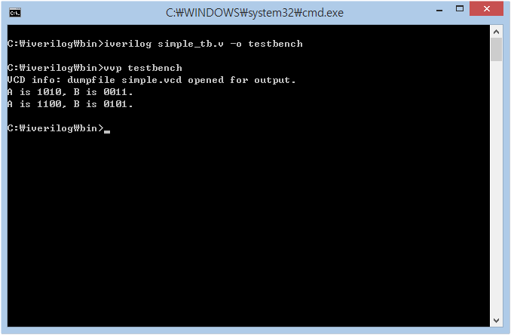
Verilog Simulator – Icarus
Example

Slide 48
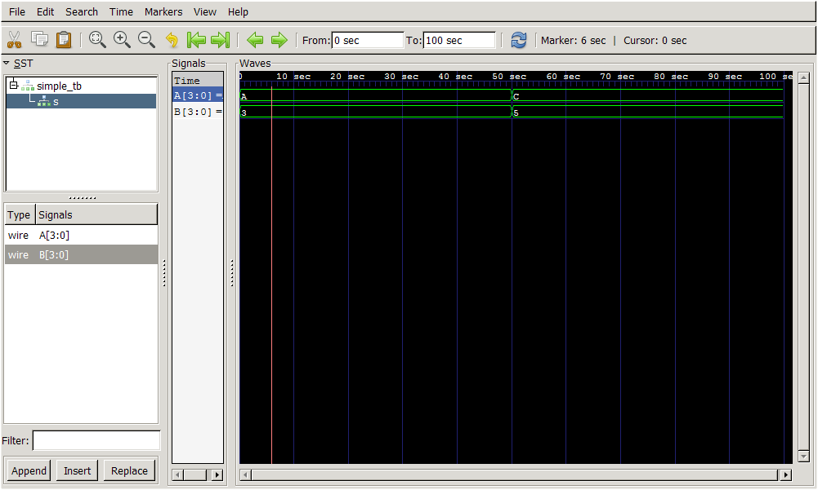
Verilog Simulator – Icarus
Example

