Slide 1
Leakage reduction in instruction cache
Kim, Jinkwon
Embedded Computing Lab.
KAIST
Notes:
Hi, my name is kim jin kwon, I am going to tell you leakage reduction in instruction cache

Slide 2
Outline
Motivation
Approach
Observation
Implementation
Experimental methodology
Experimental results
Conclusion
Notes:
This is outline about my presentation, first I will tell you motivation,terminology,methodology,observation,implemenation

Slide 3
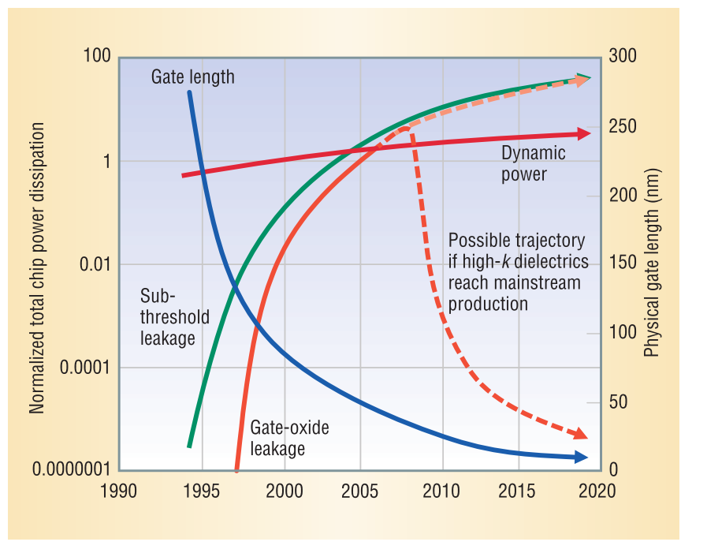
Motivation
Leakage power is Critical in chip power [1]
[1] Kim, Nam Sung, et al. "Leakage current: Moore's law meets static power." computer 36.12 (2003): 68-75.
Notes:
This is my motivation.
the graph show the trend of the chip power consumption.
As you can see, leakage power is critical in chip power over time.

Slide 4
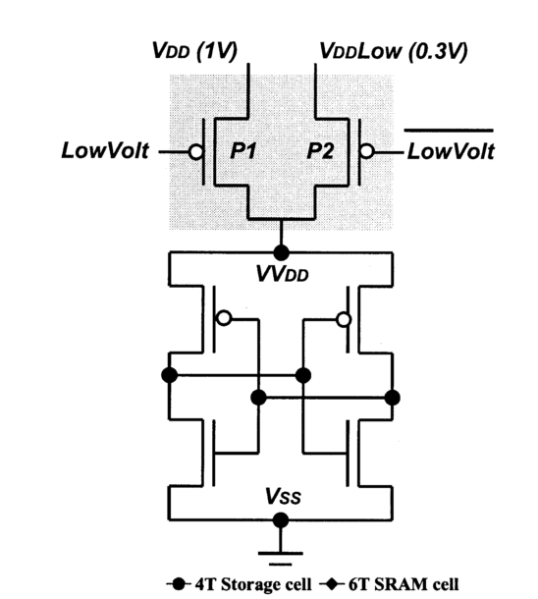
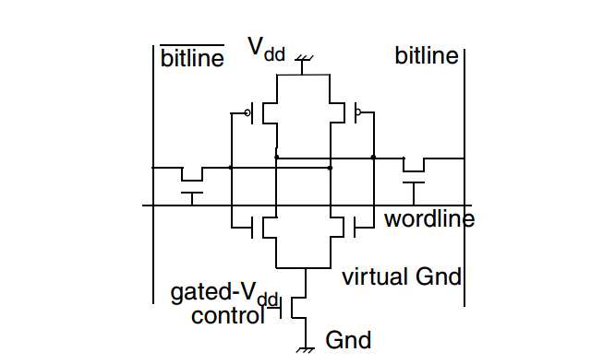
Approach
Subthreshold power leakage reduction
Gated-vdd : destroy the state, leakage reduction high, increase read time [1]
Drowsy cache : state-preserving, leakage reduction low, need wake-up time [2]
Gated-vdd
Drowsy cache
[1] Powell, Michael, et al. "Gated-V dd: a circuit technique to reduce leakage in deep-submicron cache memories." Proceedings of the 2000 international symposium on Low power electronics and design. ACM, 2000.
[2] Kim, Nam Sung, et al. "Circuit and microarchitectural techniques for reducing cache leakage power." IEEE Transactions on Very Large Scale Integration (VLSI) Systems 12.2 (2004): 167-184.
Notes:
Subthreshold power can be reduced by several methods. I tell you two famous method, one is gated-vdd , the other is drowsy cache.
Gated vdd can reduce the leakge reduction very high, but it destroy the state and increase read time and drowsy cache can preserve state, but leakage reduction is low.
I will choose the gated-vdd.

Slide 5
Observation
Redundant instruction in the cache.
Index
0
1
2
3
4
cmp r3,#0 | mov r7, #4 | mov r3,r0 | push {r4, lr}
ldr lr, [r3, #60] | cmp r3,#0 | sub r1, r1, #1 | mov r7, #4
pop {r4, pc} | mov r7, #4 | cmp r3,#0 | tst r2, #8
mov lr, #10 | mov r3,r1 | andeq r8, fp, r4, asr #19 | cmp r3,#0
Notes:
This is my observation.
I think there are some redundant instruction in the cache.
The picture show the simple direct instruction cache.
The red one and blue one show the redundant. red one repeat four times, blue one repeat three times.

Slide 6
Observation
1. add small buffer that have original instruction
2. change from the redundant instruction to pointer that point the address in the buffer
3. cut the remain bit using gate-vdd
Index
0
1
2
3
4
cmp r3,#0 pointer 0 | mov r7, #4 pointer 1 | mov r3,r0 | push {r4, lr}
ldr lr, [r3, #60] | cmp r3,#0 pointer 0 | sub r1, r1, #1 | mov r7, #4 pointer 1
pop {r4, pc} | mov r7, #4 pointer 1 | cmp r3,#0 pointer 0 | tst r2, #8
mov lr, #10 | mov r3,r1 | andeq r8, fp, r4, asr #19 | cmp r3,#0 pointer 0
Redundant memory
cmp r3,#0
mov r7,#4
Notes:
My idea is that add small buffer that have original instruction.
And change from the redundant instruction to pointer that point the buffer address.
And then cut the reamin bit using gate-vdd

Slide 7
Implementation
Select redundant instruction algorithm
Step 1. Extract the text section from the file
Step 2. read all instruction in the text section.
Step 3. sort them by the frequency.
Step 4. choose the instruction based on the higher frequency
Before run the program, the redundant memory should be filled with the chosen instruction.
Notes:
My idea is that add small buffer that have original instruction.
And change from the redundant instruction to pointer that point the buffer address.
And then cut the reamin bit using gate-vdd

Slide 8
Implementation
Static result
size | Avg rate(%)
128 | 23.4947464
256 | 29.36233409
512 | 36.21439912
1024 | 43.92585357
2048 | 52.46381816
Notes:
My idea is that add small buffer that have original instruction.
And change from the redundant instruction to pointer that point the buffer address.
And then cut the reamin bit using gate-vdd

Slide 9
Implementation
Cache hit
CPU
redundant memory
create 1 latency
with multiport
request
Index 0
Plain read
hit
L1 instruction cache
Index
0
cmp r3,#0 pointer 0 | mov r7, #4 pointer 1 | mov r3,r0 | push {r4, lr}
Notes:
My idea is that add small buffer that have original instruction.
And change from the redundant instruction to pointer that point the buffer address.
And then cut the reamin bit using gate-vdd

Slide 10
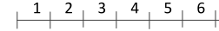
Implementation
Redundant memory can be pipelined easily
Instruction cache latency : 1 cycle
cycle
L1 cache
Redundant memory
Fetch 1
L1 cache
Redundant memory
Fetch 2
L1 cache
Fetch 3
L1 cache
Redundant memory
Fetch 4
Notes:
My idea is that add small buffer that have original instruction.
And change from the redundant instruction to pointer that point the buffer address.
And then cut the reamin bit using gate-vdd

Slide 11
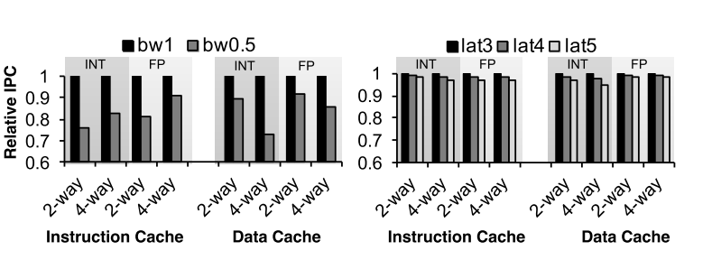
Implementation
Hit latency tolerance
[1] Hong, Seokin, and Soontae Kim. "AVICA: An access-time variation insensitive L1 cache architecture." Design, Automation & Test in Europe Conference & Exhibition (DATE), 2013. IEEE, 2013.[2] Kim, Nam Sung, et al. "Circuit and
Notes:
My idea is that add small buffer that have original instruction.
And change from the redundant instruction to pointer that point the buffer address.
And then cut the reamin bit using gate-vdd

Slide 12
Implementation
Cache miss
CPU
request
miss
L1 instruction cache
Associative
Search
redundant memory
No latency
request
hit
L2 unified cache
Notes:
My idea is that add small buffer that have original instruction.
And change from the redundant instruction to pointer that point the buffer address.
And then cut the reamin bit using gate-vdd

Slide 13
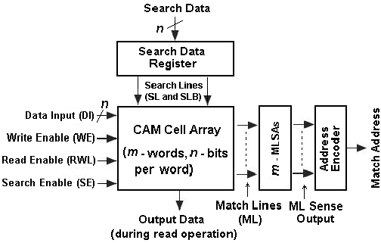
Experimental methodology
cacti
Redundant memory area & access time & power consumption
Subthreshold leakage in cache cell
cache area
Block diagram of content addressable memory (CAM) system.
[1] Dwivedi, Amit Krishna, and Aminul Islam. "Nonvolatile and robust design of content addressable memory cell using magnetic tunnel junction at nanoscale regime." IEEE Transactions on Magnetics 51.12 (2015): 1-13.[2] Kim, Nam Sung, et
Notes:
You may ask me the question what is the leakage?
Leakage power is static power that consume your energy every second.
There are two major leakage in chip, first subthreshold leakage and gate leakage. in the picture, you can see that

Slide 14
Experimental methodology
cacti
Redundant memory configuration
Instruction cache configuration
parameters | Value
tech | 22nm
Device type | LSTP
temperature | 340K
Machine bits | 32bits
Voltage | 0.6V
pure_cam | O
data width | 32
output width | 32
bank | 1
rw_port | 1
search_port | 1
se_rdport | 3
parameters | Value
tech | 22nm
Device type | LO
temperature | 340K
Machine bits | 32bits
Voltage | 0.6V
Cache size | 64kb
Cache line | 32byte
associative | 4
bank | 1
rw_port | 1
Notes:
You may ask me the question what is the leakage?
Leakage power is static power that consume your energy every second.
There are two major leakage in chip, first subthreshold leakage and gate leakage. in the picture, you can see that

Slide 15
Experimental methodology
Gem5
Fast forward 10billion instruction & perform 200 million instruction
1. get a redundant instruction number in the instruction cache
2. Get a redundant memory access number (ram mode)
3. Support pipelined instruction cache.
4. Support redundant memory latency.
Notes:
You may ask me the question what is the leakage?
Leakage power is static power that consume your energy every second.
There are two major leakage in chip, first subthreshold leakage and gate leakage. in the picture, you can see that

Slide 16
Experimental methodology
gem5
cache configuration
parameters | Value
L1 I-cache | 64kb,4way,32B line, 1 cycle (2cycle for redundant memory)
L1 Dcache | 64kb,2way,32B line, 2 cycle
Unified L2 cache | 2MB/8way/32B line, 12 cycle
Clock rate | 2Ghz
Notes:
You may ask me the question what is the leakage?
Leakage power is static power that consume your energy every second.
There are two major leakage in chip, first subthreshold leakage and gate leakage. in the picture, you can see that

Slide 17
Experimental results
Cacti : redundant memory 256 entry
type | value
Area (mm^2) | 0.00706478
Read energy (j) | 3.99E-13
Associative energy (j) | 4.61E-12
Leakage (W) | 6.79E-07
Access time (s) | 4.86E-10
Cycle time (s) | 2.94E-10
Notes:
You may ask me the question what is the leakage?
Leakage power is static power that consume your energy every second.
There are two major leakage in chip, first subthreshold leakage and gate leakage. in the picture, you can see that

Slide 18
Experimental results
Energy reduction
Area overhead
Latency overhead
Normalized energy = active ratio + redundant ram mode energy overhead : data cell leakage energy[1]
+ redundant cam mode energy overhead : data cell leakage energy
+ redundant memory leakage energy : data cell leakage energy
Normalized area = (conventional cache area + data cell area increase (5%) )/conventional cache
Normalized latency = (execution time with redundant memory )/conventional execution time
[1] Kaxiras, Stefanos, Zhigang Hu, and Margaret Martonosi. "Cache decay: exploiting generational behavior to reduce cache leakage power." ACM SIGARCH Computer Architecture News 29.2 (2001): 240-251.
Notes:
You may ask me the question what is the leakage?
Leakage power is static power that consume your energy every second.
There are two major leakage in chip, first subthreshold leakage and gate leakage. in the picture, you can see that

Slide 19
Experimental results
Energy reduction
AVG :75% energy reduction
Notes:
You may ask me the question what is the leakage?
Leakage power is static power that consume your energy every second.
There are two major leakage in chip, first subthreshold leakage and gate leakage. in the picture, you can see that

Slide 20
Experimental results
EDA
AVG :84% EDA reduction
Notes:
You may ask me the question what is the leakage?
Leakage power is static power that consume your energy every second.
There are two major leakage in chip, first subthreshold leakage and gate leakage. in the picture, you can see that

Slide 21
Conclusion
As feature size shrink, the leakage power reduction will be more important.
Portability : My idea can be applied to drowsy cache, DRI cache.
My idea can be optimized with compiler support, cache victim algorithm.
Notes:
You may ask me the question what is the leakage?
Leakage power is static power that consume your energy every second.
There are two major leakage in chip, first subthreshold leakage and gate leakage. in the picture, you can see that

Slide 22
Any Questions?

Slide 23

Reference
[1] Kim, Nam Sung, et al. "Leakage current: Moore's law meets static power." computer 36.12 (2003): 68-75
Li, Sheng, et al. "CACTI-P: Architecture-level modeling for SRAM-based structures with advanced leakage reduction techniques." Computer-Aided Design (ICCAD), 2011 IEEE/ACM International Conference on. IEEE, 2011.
Powell, Michael, et al. "Gated-V dd: a circuit technique to reduce leakage in deep-submicron cache memories." Proceedings of the 2000 international symposium on Low power electronics and design. ACM, 2000.
Kim, Nam Sung, et al. "Circuit and microarchitectural techniques for reducing cache leakage power." IEEE Transactions on Very Large Scale Integration (VLSI) Systems 12.2 (2004): 167-184.
Kaxiras, Stefanos, Zhigang Hu, and Margaret Martonosi. "Cache decay: exploiting generational behavior to reduce cache leakage power." ACM SIGARCH Computer Architecture News 29.2 (2001): 240-251.
Ye, Yibin, Shekhar Borkar, and Vivek De. "A new technique for standby leakage reduction in high-performance circuits." VLSI Circuits, 1998. Digest of Technical Papers. 1998 Symposium on. IEEE, 1998.
Yang, S., et al. "An integrated circuit/architecture approach to reducing leakage in deep-submicron high-performance I-caches." High-Performance Computer Architecture, 2001. HPCA. The Seventh International Symposium on. IEEE, 2001.
Hong, Seokin, and Soontae Kim. "AVICA: An access-time variation insensitive L1 cache architecture." Design, Automation & Test in Europe Conference & Exhibition (DATE), 2013. IEEE, 2013.[2] Kim, Nam Sung, et al. "Circuit and

