Slide 1
Hot-Air Recirculation in a Cooling-Tower Array
A steady RANS parametric study and a physics-informed field surrogate
Computational Fluid Dynamics | Physics-Informed Machine Learning

Slide 2
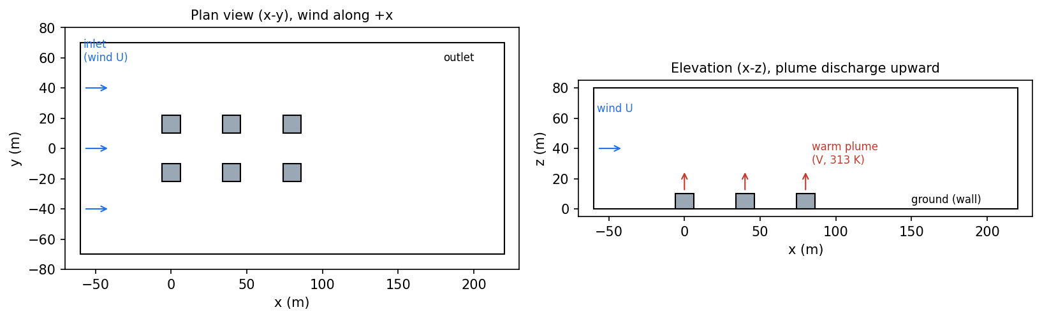
The problem: hot-air recirculation
When plumes bend back onto neighbouring intakes, the whole plant loses cooling capacity
Cooling towers reject heat by discharging warm air upward.
In a tight array, wind can bend one unit’s plume down onto the intakes of the next.
Ingested exhaust raises intake temperature and cuts thermal capacity.
The outcome is a tug-of-war: buoyancy lifts the plume, wind bends it over.
Plan and elevation of the six-unit array in a crosswind

Slide 3
Approach: from solver to a fast field model
1
2
3
CFD sweep
→
Field data
→
Physics-informed surrogate
Seven steady RANS cases in ANSYS Fluent over wind speed and discharge velocity, with buoyancy.
Full 3D velocity and temperature extracted per case, plus per-tower recirculation.
A network maps operating point to the full field, constrained to conserve mass.
One fixed geometry across the sweep, so the surrogate sees a single consistent domain.

Slide 4
The case and the mesh
6
105,676
600
<0.1%
cooling-tower cells
tetrahedral cells
iterations per case
energy balance error
Domain 280 x 140 x 80 m atmospheric block, wind along +x.
Towers 12 x 12 m footprint, 10 m tall, three columns by two rows.
Physics realizable k-epsilon, incompressible-ideal-gas density under gravity.
Discharge 313 K warm air into a 298 K ambient.

Slide 5
Parametric sweep
Seven operating points spanning the wind and discharge design space
Case | Wind U | Discharge V | V / U | Mean RC | Worst RC
c1 | 3.0 | 6.0 | 2.0 | 0.61% | 2.41%
c2 | 1.5 | 6.0 | 4.0 | 0.24% | 0.83%
c3 | 6.0 | 6.0 | 1.0 | 1.22% | 1.62%
c4 | 3.0 | 3.0 | 1.0 | 0.59% | 1.38%
c5 | 3.0 | 9.0 | 3.0 | 0.14% | 0.55%
c6 | 1.5 | 3.0 | 2.0 | 0.27% | 1.33%
c7 | 6.0 | 9.0 | 1.5 | 0.89% | 1.88%
Key variable
V / U
the plume bend-over ratio
Low V/U wind bends plumes onto intakes.
High V/U plumes rise clear.
Units: m/s. RC is the intake temperature rise as a fraction of the discharge excess.

Slide 6
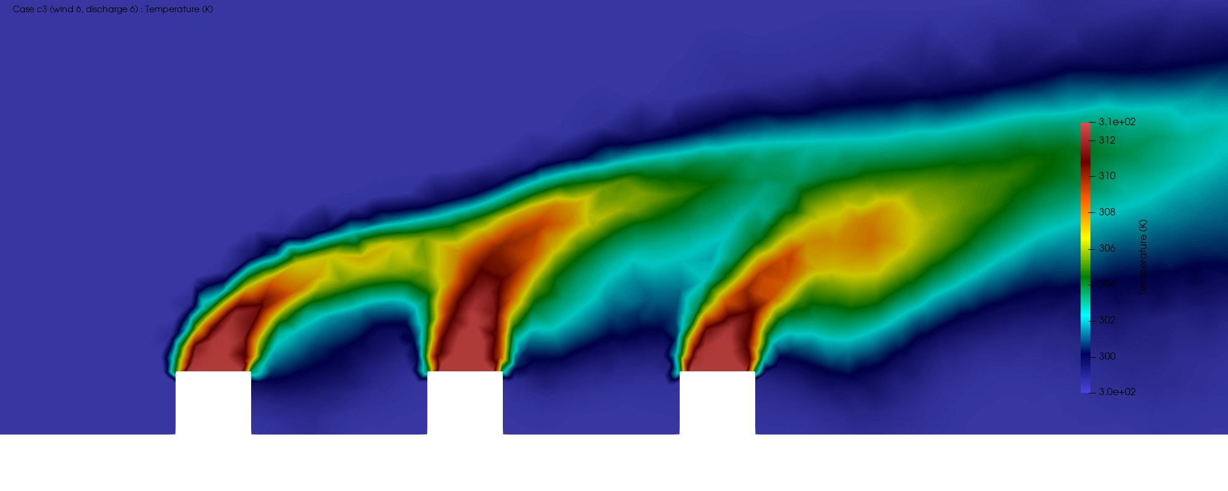
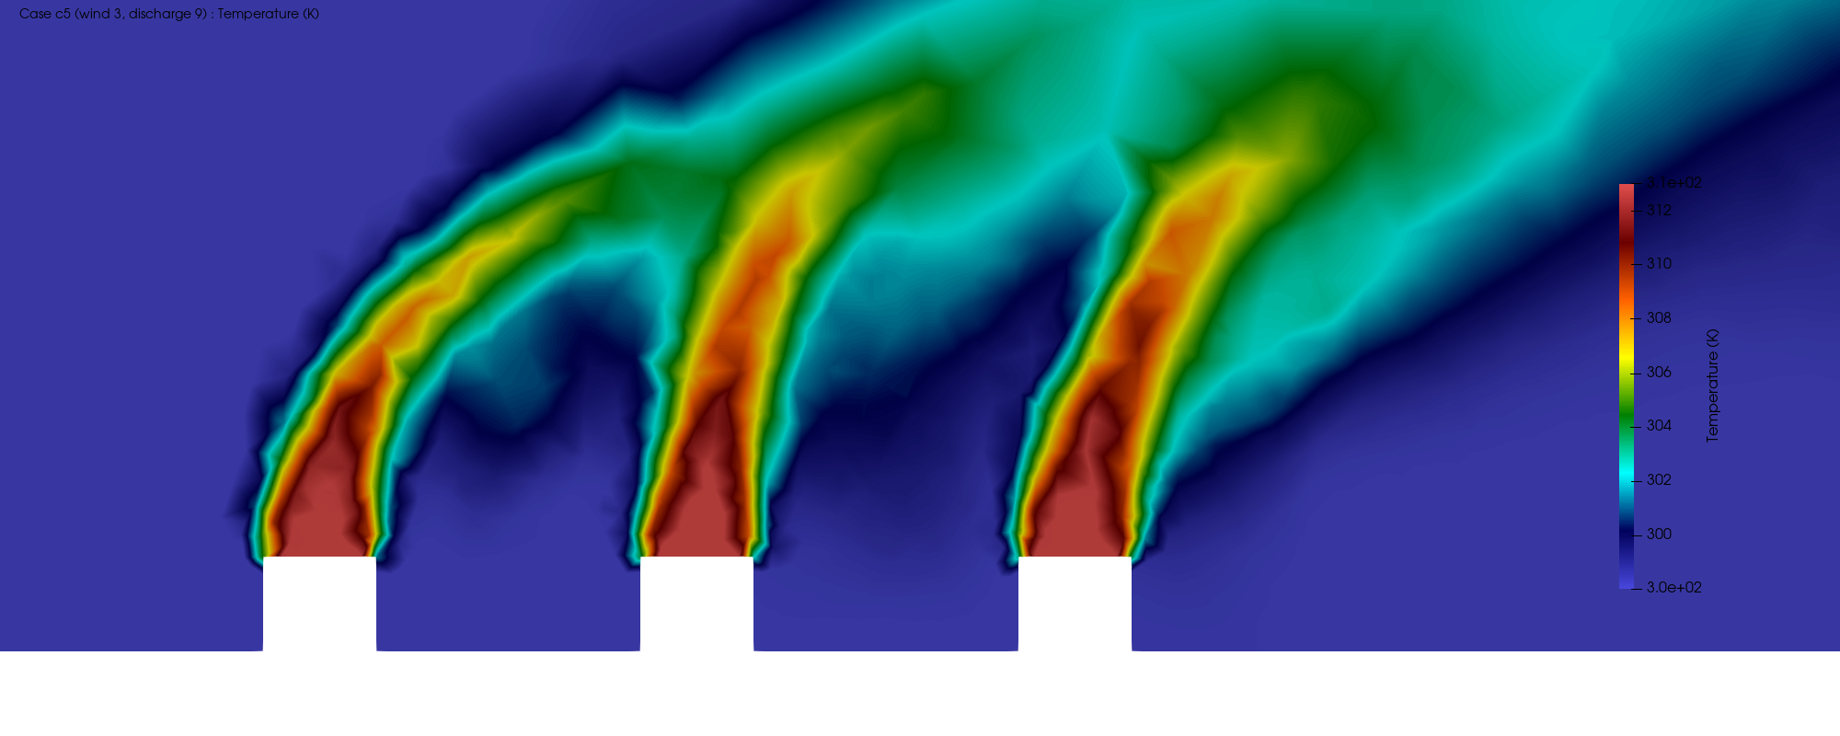
Temperature fields: the regime change
Wind-dominated (c3): plumes bend over and warm the downwind wake
Buoyancy-dominated (c5): plumes rise steeply, intakes stay cool
Same geometry, opposite outcome: the wind-to-plume balance decides whether exhaust is re-ingested.

Slide 7
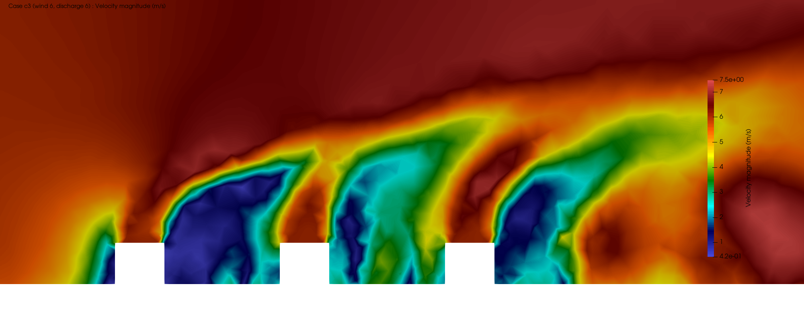
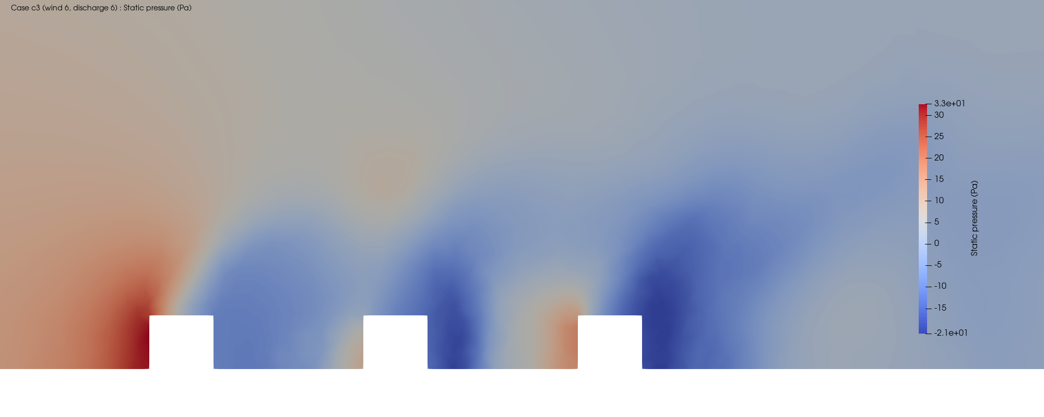
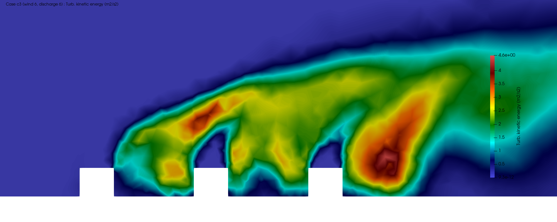
Flow diagnostics (wind-dominated case)
Velocity magnitude
Wakes low-speed recirculation forms right behind each tower.
Pressure stagnation high on the windward face, suction lows in the wakes.
Turbulence concentrates in the plume shear layers, where entrainment is strongest.
Static pressure
Turbulent kinetic energy

Slide 8
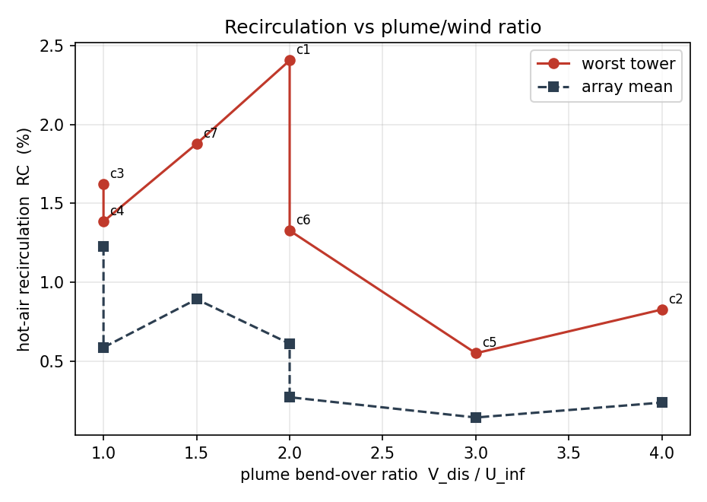
Recirculation follows the bend-over ratio
1.62%
worst-tower recirculation (strong wind, c3)
0.14%
array mean, strong plume in light wind (c5)
Modest magnitudes for a well-spaced generic array, but the ordering is unambiguous and physical.

Slide 9
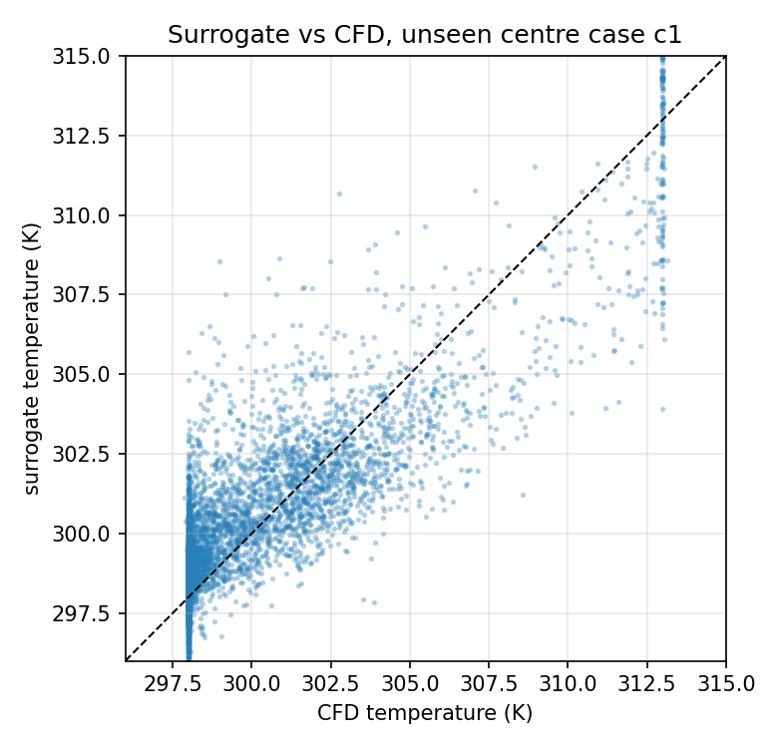
Physics-informed surrogate
Predict an unseen operating point’s full field in milliseconds
Maps (x, y, z, wind, discharge) to the velocity and temperature field.
Fourier features let a small network capture sharp plume gradients.
A mass-conservation (divergence-free) term is built into the loss.
Trained on six cases; the centre case was held out entirely.
1.62 K
temperature RMSE, unseen case
ms
inference vs a solver run
R² = 0.76 on temperature for an operating point the model never saw.

Slide 10
Takeaways
Recirculation tracks the wind-to-plume balance: worst near 1.6%, best under 0.2%.
A converged 7-case CFD sweep, mass and energy balanced to better than 0.1%.
A physics-constrained surrogate reproduces an unseen field to 1.6 K in milliseconds.
The full pipeline, CFD to constrained learning, on a data-centre-adjacent thermal problem.
Limitations: coarse mesh with wall functions, steady RANS time-averaging, and a divergence constraint that is only part of the governing physics. Magnitudes are indicative; the trends and the workflow are the result.

